Slide 1
SeeingGreen
A sustainability walking tour of downtown Raleigh.

Slide 2

Sustainability, y’all
Downtown Raleigh has lots of cool, sustainably built features. You can see them on a walking tour.
A mobile app to guide people on the tour would make it more accessible and increase awareness about it
Our initial idea was to use Layar, but it had lots of problems

Slide 3
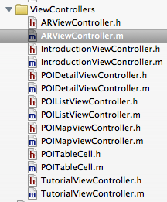
Our solution
Code our own AR system for iOS
Create exactly the features we need
Tailor functionality to fit the downtown sustainability tour

Slide 4
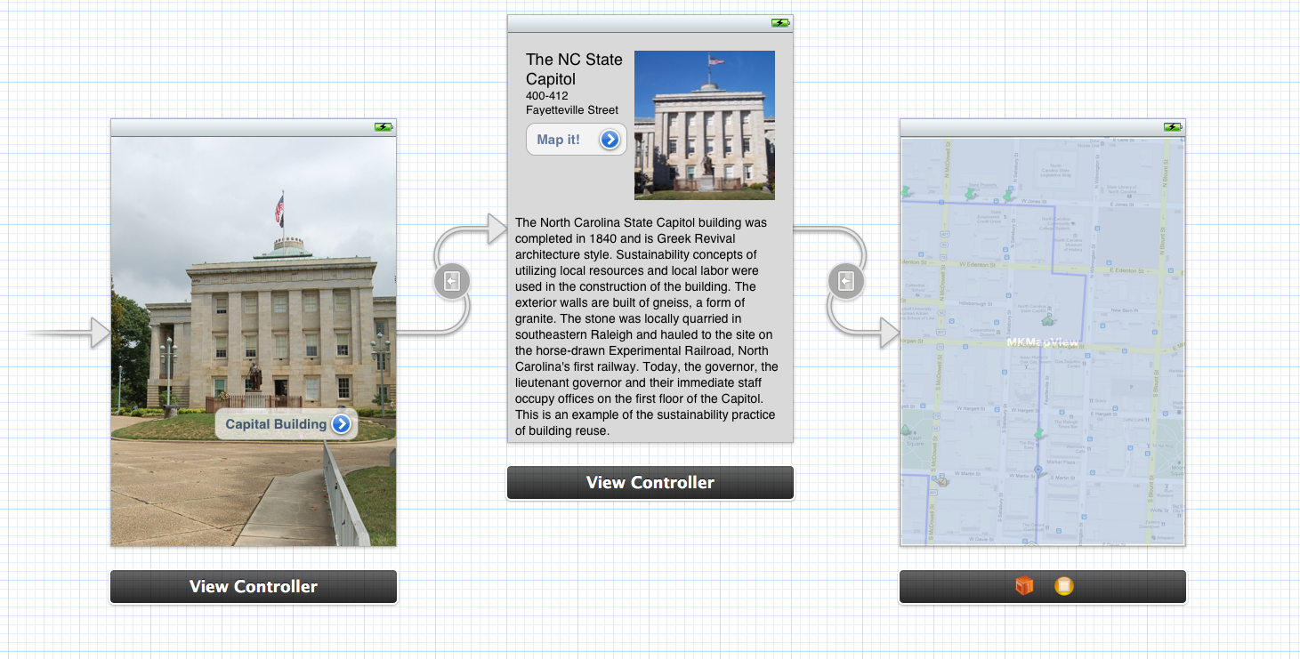
Interface Storyboards: Then

Slide 5
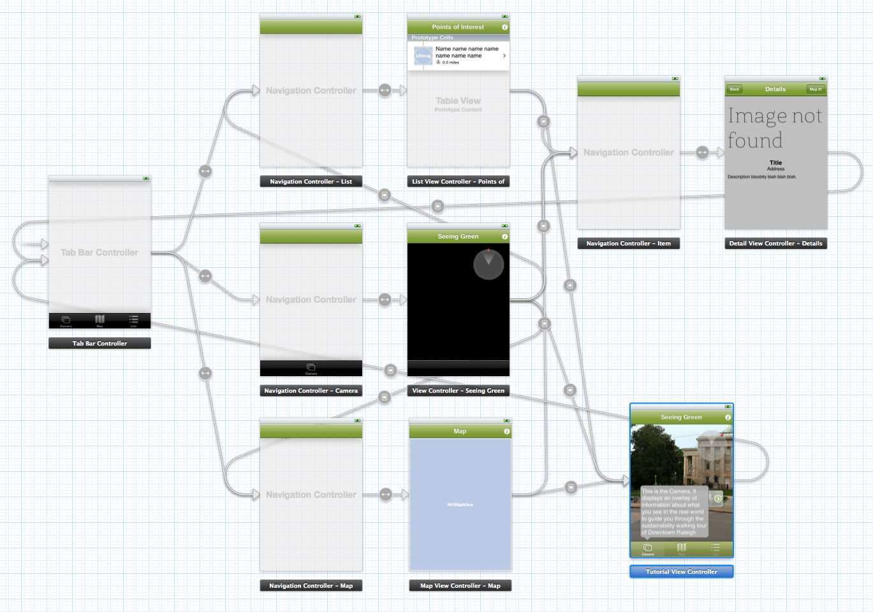
Interface Storyboards: Now

Slide 6
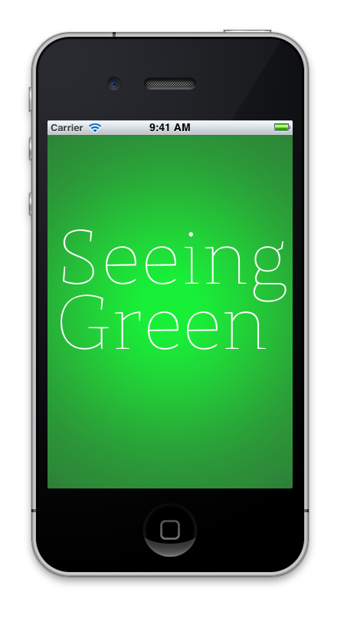
Using Seeing Green

Slide 7
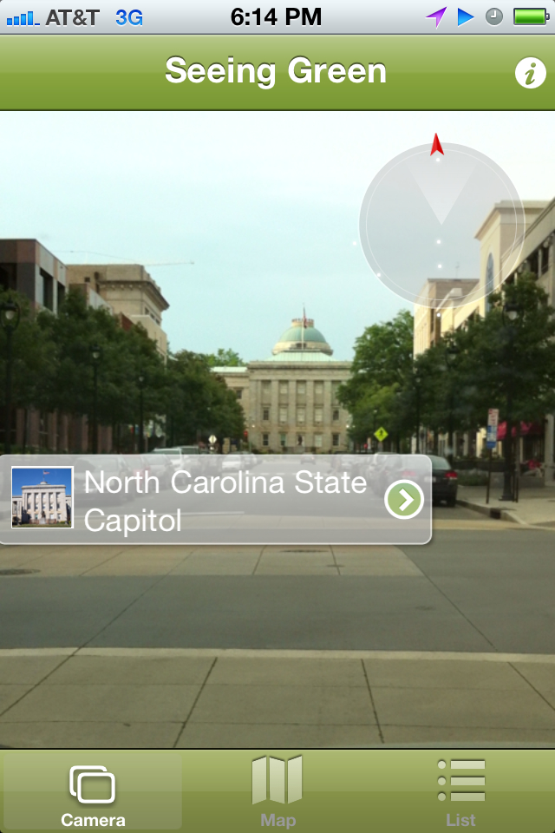
Augmented Reality
Points on the walking tour have information displayed in front of them
The user moves their device around to discover stops on the tour
Tapping the overlay loads POI details

Slide 8
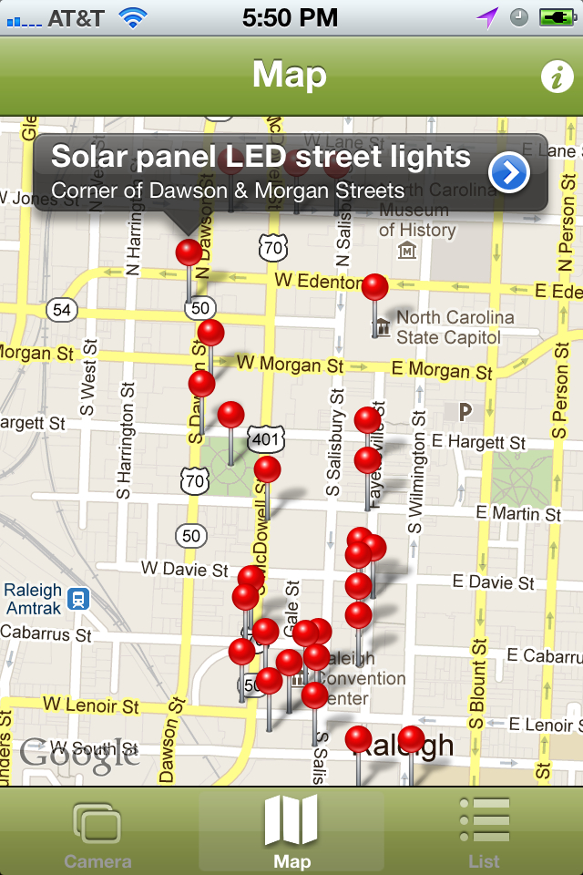
Maps
A map is shown with all the stops on the tour and the user’s location
Tapping the callout panel loads the detailed view
From the detailed view, users can pull up walking directions to the stop

Slide 9
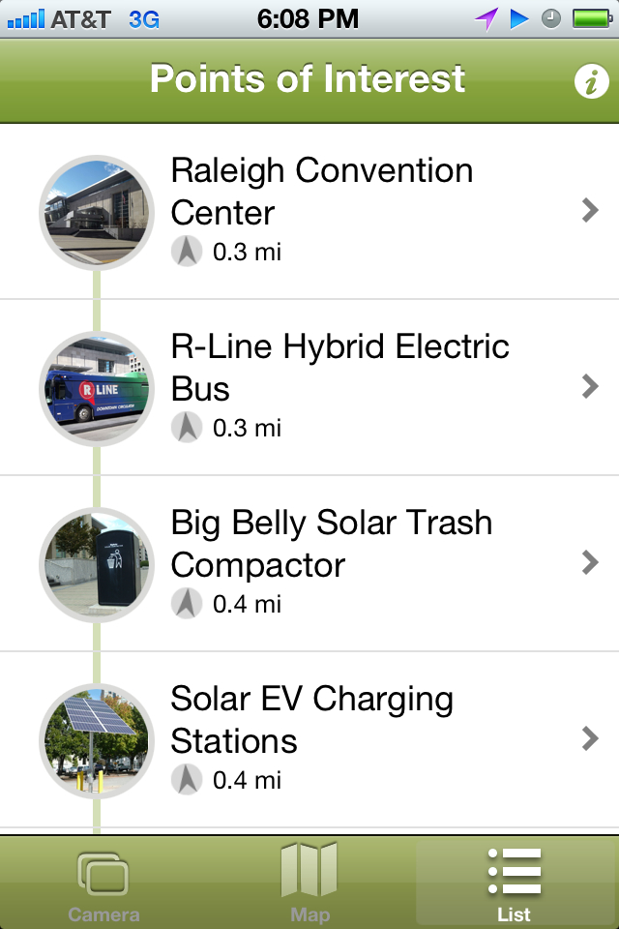
The List
Users can see a list of the stops on the tour in order
The distance and direction to the stops are shown under their names
Tapping an entry in the list brings up the detail view

Slide 10
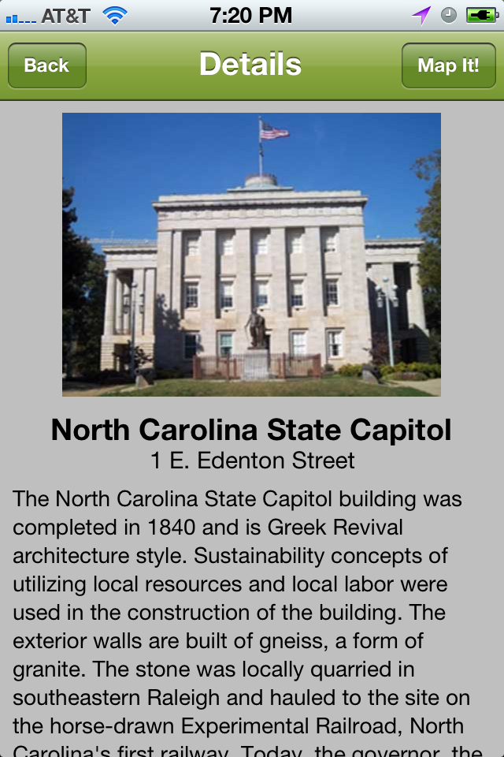
Details
The detail view displays all of the information about a stop on the tour
The “Map It!” button loads walking directions into the Maps app
We can’t display directions in our app because that would violate Google’s TOS

Slide 11
Live Demo

