Slide 1

Notes:
Introduce group members:
Adam
Prairie Rose
Mark

Slide 2
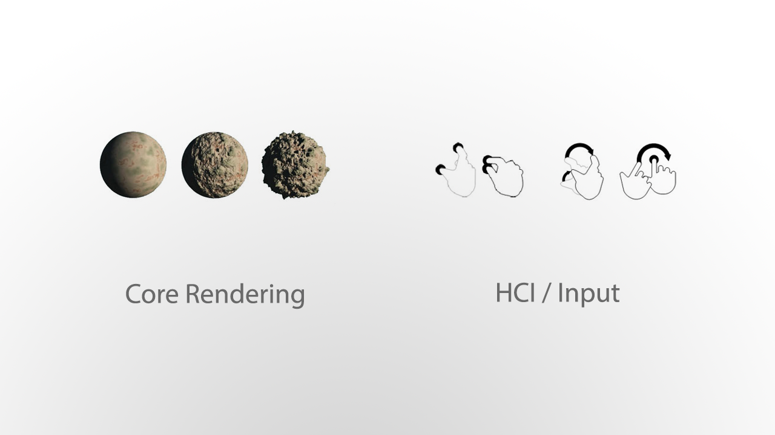
Notes:
Our project is broken down into two major components

Slide 3
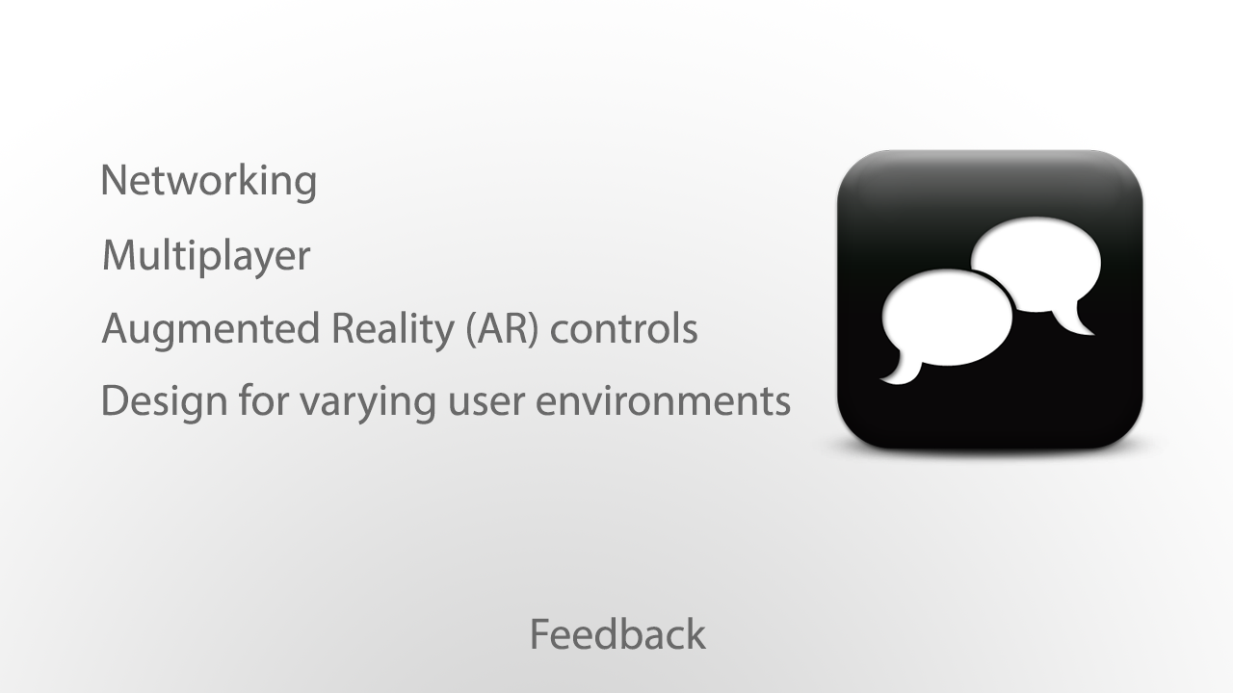
Notes:
We aren’t doing networking
Multiplayer isn’t a priority because our focus is on graphics / user input
We thought the class provide great suggestions for input, including AR, and PR will talk about this a bit later.

Slide 4
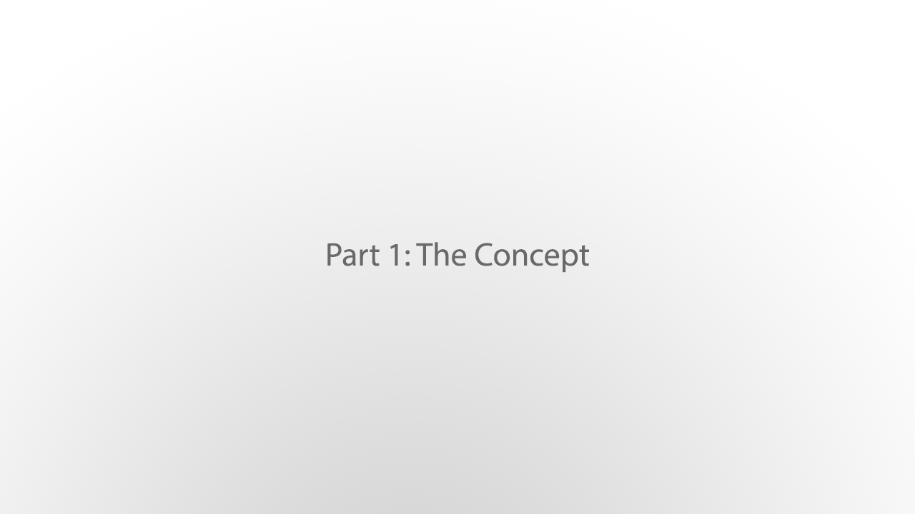
Notes:
Before we could build our game world, we had to decide on what it was going to be.

Slide 5


Slide 6
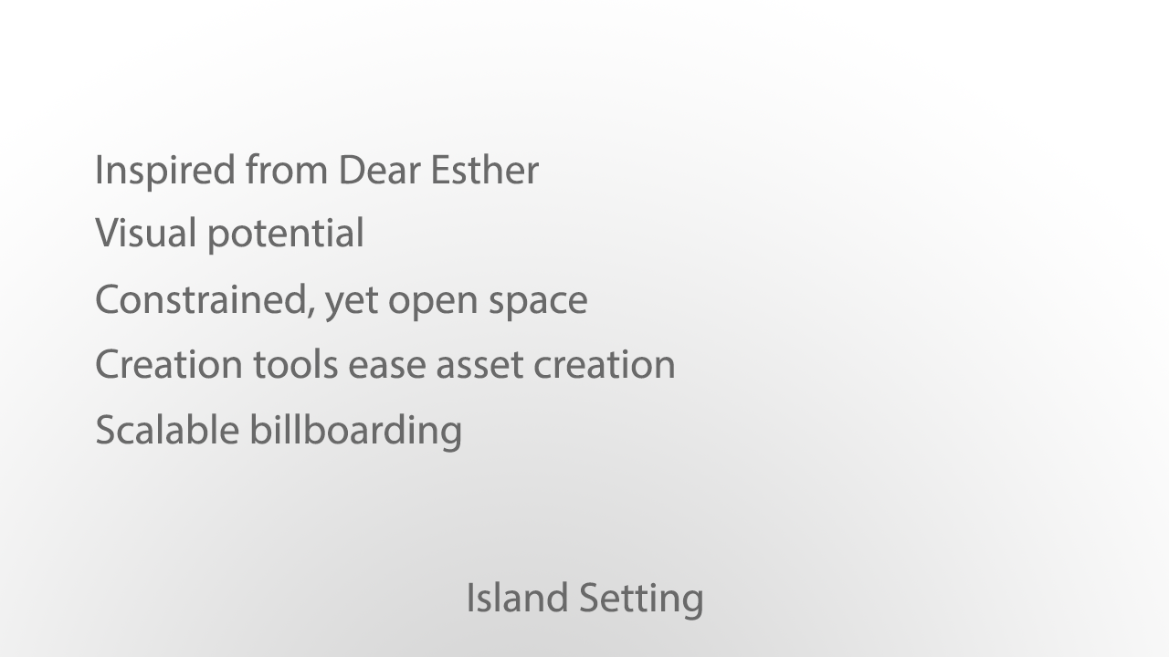

Slide 7
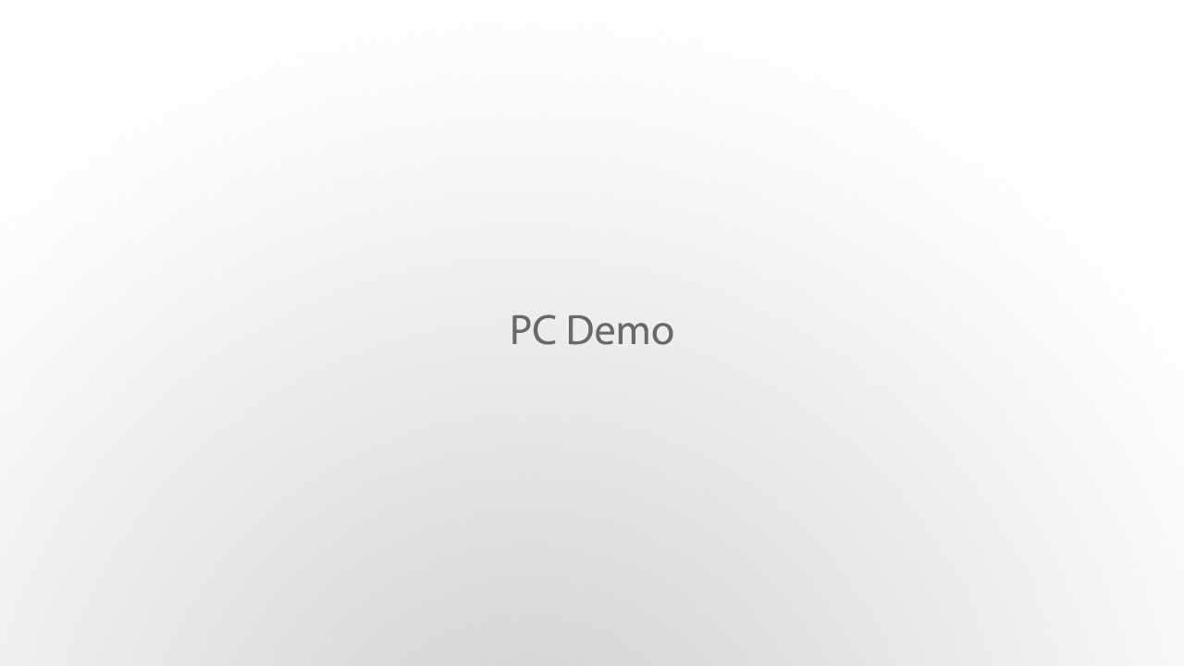

Slide 9
