Slide 1


Exploring the Surrounding Digital Footprint
TEAM TRACES
Andrew DeLissio
Tyrone Jenkins
Monis Masood Khan
Phillip Bailey
Vikas Piddempally

Slide 2

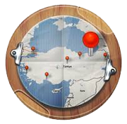
What Traces Does For You
Search
Discover
Explore
Notes:
Discover what’s been tweeted around you
Search tweets around any location in the world
Explore tweets either on map, or see list of most popular tweets

Slide 3


Slide 4
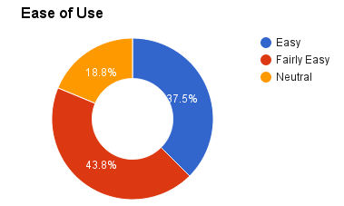
Usability Tests Results
“No units of measurement for the radius.”
“Had to use trial and error to figure out the dates.”

Slide 5
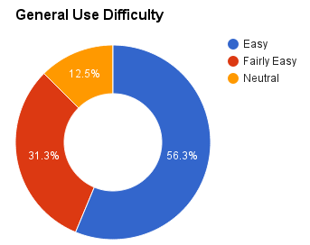
User Evaluation Results
“Not intuitive to swipe up to get advanced search or from the left to see a list without instructions.”
“It would have been nice to have a quick demo.”

Slide 6
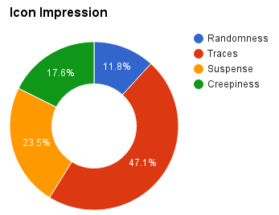
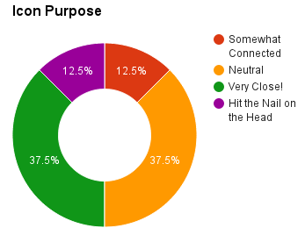
User Evaluation Results

Slide 7
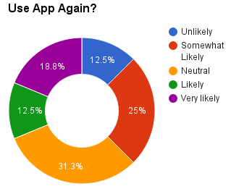
User Evaluation Results
“Overall it's pretty cool to see what others around me are tweeting.”
“An excellent app. I was impressed by the icons and features.”

Slide 8
Future Development Goals
Allow user to save tweets of interest
Provide ability to share tweets via social media applications
Sentiment analysis on tweets
“Stream” mode for continuously searching via current map locations

Slide 9
Future Development Goals
Implement a Webview within Listview
Cluster nearby tweets together
Unified UI Design

Slide 10
Download from the Google Play Store!
http://bit.do/traces
Project Site
https://github.com/enj/traces

Slide 11


Slide 12




Technical Progress
Comprehensive & Fully Functional Backend
Google Maps Integration
Swipe UI Slider Views
Custom Markers & CustomInfo Window
Advanced & Instant Search options
JSON parsing using GSON.
Location Fetch & Geocoding API
BitMap Scaling & Optimization
Async UI Tasks for content management
Color Indicators based on Popularity
Error Handling
Custom Recycler List View using ViewHolder
Android Graphics for Custom Animations
Notes:
Discover what’s been tweeted around you
Search tweets around any location in the world
Explore tweets either on map, or see list of most popular tweets

Slide 13
Required Goals
Backend API returns data using coordinates or address
Android app’s user input forms
Basic android app / backend API communication
Return data using date range and radius
Display results in a listview
Google Maps API integration show current location
Google Maps markers for data points
Lightweight evaluation (interactive prototype)
Long press on map to do search for current point

Slide 14
Extra Credit Goals
Backend ranks tweets via favorites and retweet count
Color code markers on map by importance
Customized icons for map markers

