Slide 1
RECOGNIZE
Mason Lesser, Dani Chiavegatto, Julian Patterson, Arjun Sharma and Vasil Uhnyuck

Slide 2
What is Recognize?
A picture matching Android application
Limited by time, slowly revealed picture
Customizable albums
Different ways to play

Slide 3
Problem Statement
Pixelation/picture hiding algorithm
Custom album creation functionality
Different difficulty levels
Cloud server migration of existing albums

Slide 4
Challenges
Communication due to distance and time conflicts
Large code base at start
Problems with emulation/lack of numerous physical devices
Lack of documentation

Slide 5
Our Scope
Developing client API for managing application content on Google app engine.
Establishing link between between the App Engine and application
Moving images from local storage to server

Slide 6
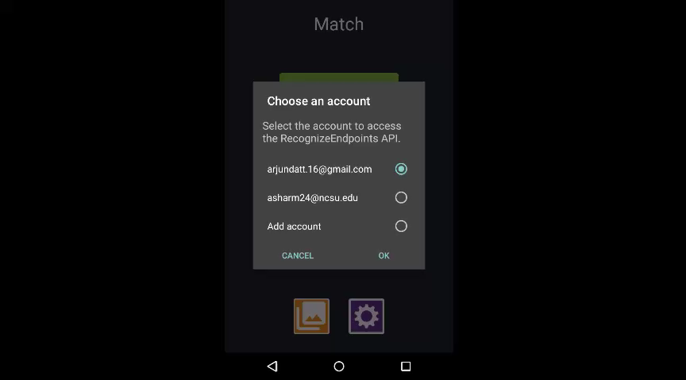
Video

Slide 7
Live Demo

Slide 8
Questions?

