Slide 1
Approachable analytics for
SAS users
Charuroopa Varadarajan
Kenny Yarboro
Mayur Bindal
Pongobinath Sivashanmugam
Shubaa Jhanani Ayengar Devanathan

Slide 2
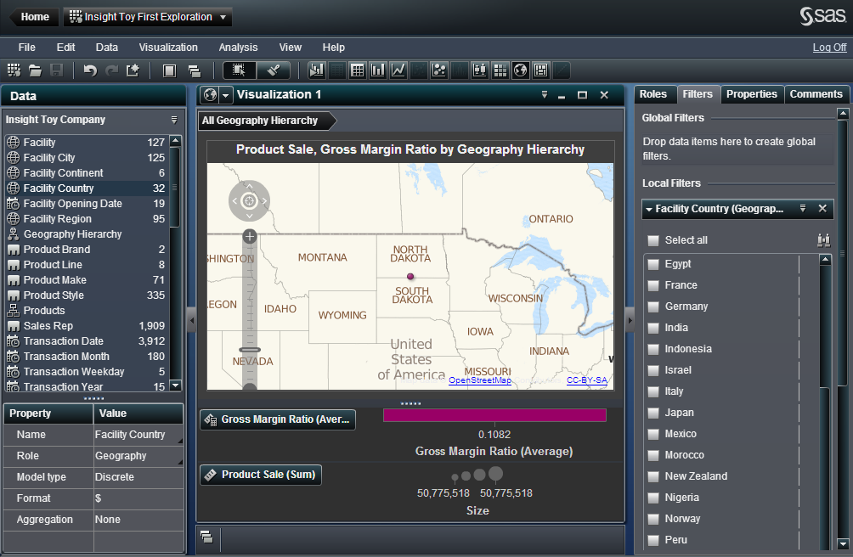
SAS Visual Analytics Explorer

Slide 3
SAS Visual Analytics Explorer
Previous Feedback from Dr. Watson
  Consistency to Improve Approachability
  Use More Non-Computer-Science Participants
  Interface is Overwhelming
    Expert View vs Basic View
  Consider Scaffolding
  Consider Adjusting Color Schemes

Slide 4
SAS Visual Analytics Explorer
Previous Feedback from SAS
  Cover the Basics of the Exploration Process
    Primary
      Find & Select Data
      Build Visualizations
    Secondary
      Filtering Data
      Looking for Patterns or Specific Answers
      Exporting as PDF or Report
  Covering Previous Tasks Not Required
  Consider PowerPoint

Slide 5
File Options
Chart Type
Data Select
Set Filters
Export
SELECT A CHART TYPE
Reset
Welcome to SAS VA!
SAS VA

Slide 6
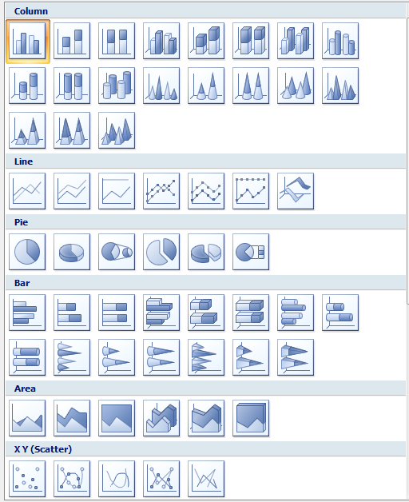


File Options
Chart Type
Data Select
Set Filters
Export
Map
Confirm
Cancel
Reset
SAS VA

Slide 7

File Options
Chart Type
Data Select
Set Filters
Export
SELECT DATASETS
Reset
Geography Chart selected.
SAS VA

Slide 8

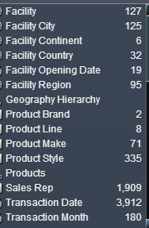
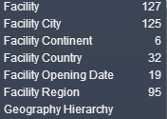
File Options
Chart Type
Data Select
Set Filters
Export
Search for Dataset:
+
Search for Dataset:
Selected Datasets:
+
+
-
-
Confirm
Cancel
Reset
SAS VA

Slide 9
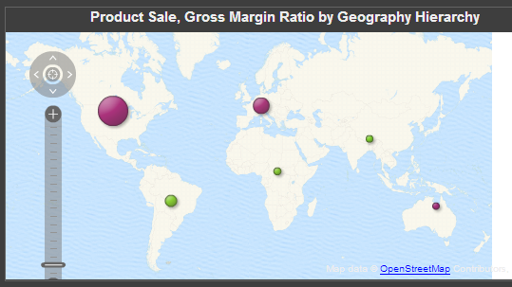
File Options
Chart Type
Data Select
Set Filters
Export
SELECT DATASETS
Reset
Datasets selected.
SAS VA

Slide 10
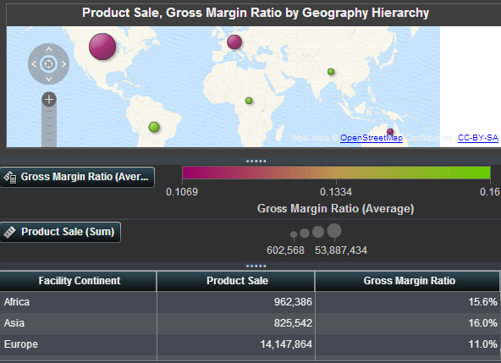
File Options
Chart Type
Data Select
Set Filters
Export
SELECT DATASETS
Reset
Table View enabled.
SAS VA

Slide 11

File Options
Chart Type
Data Select
Set Filters
Export
Select Dataset:
Select Condition:
Apply Filter
Set Value(s):
Clear
Enter text
Filters:
-
+
Confirm
Cancel
Reset
SAS VA

Slide 12
File Options
Chart Type
Data Select
Set Filters
Export
SELECT DATASETS
Reset
Filters applied.
SAS VA

Slide 13
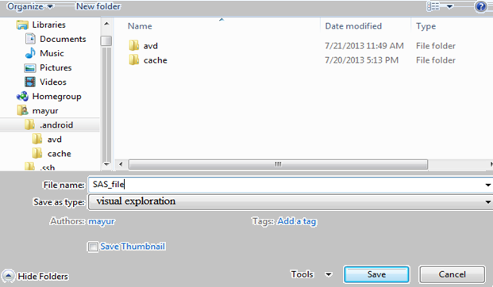
File Options
Chart Type
Data Select
Set Filters
Export
Reset
SAS VA

Slide 14
File Options
Chart Type
Data Select
Set Filters
Export
SELECT DATASETS
Reset
Visualization saved as MyFile.ext.
SAS VA

Slide 15
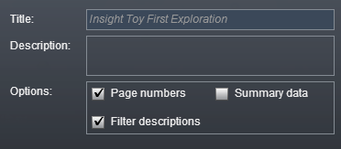
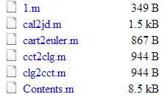
File Options
Chart Type
Data Select
Set Filters
Export
Browse
Export
Cancel
Reset
SAS VA

Slide 16
File Options
Chart Type
Data Select
Set Filters
Export
SELECT DATASETS
Reset
Visualization exported to PDF – MyFile.pdf.
SAS VA

Slide 17
Chart Type
Data Select
Set Filters
Export
File Options
Chart Type
SELECT A CHART TYPE
Reset
Visualization has been reset.
SAS VA

Slide 18
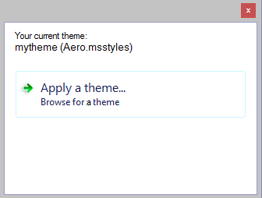
Data Select
Set Filters
Export
File Options
Chart Type
Data Select
Reset
SAS VA

Slide 19
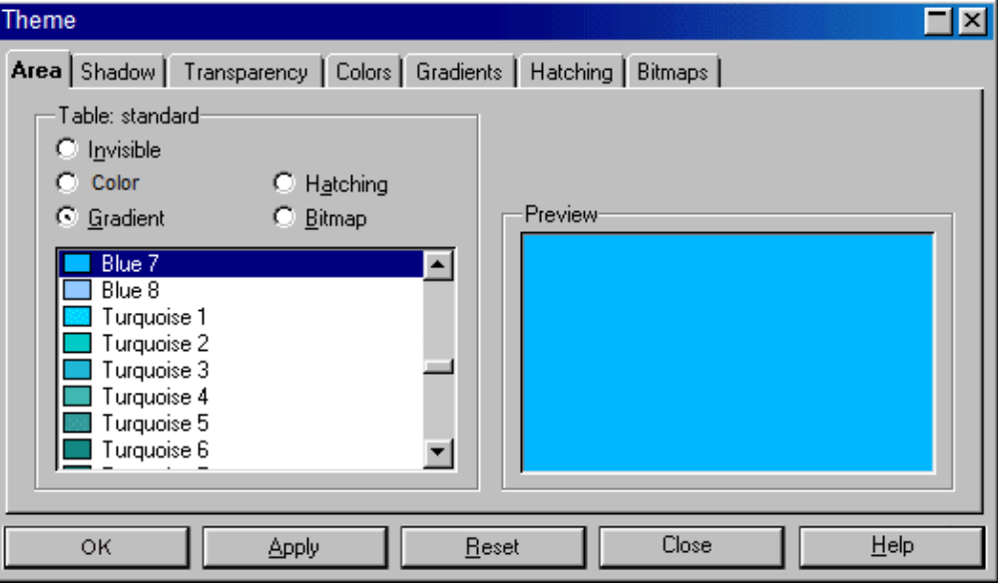
File Options
Chart Type
Data Select
Set Filters
Export
SELECT DATASETS
Reset
SAS VA

Slide 20
File Options
Chart Type
Data Select
Set Filters
Export
SELECT A CHART TYPE
Reset
New theme applied
SAS VA

Slide 21

Participants for our survey
Total Participants Surveyed: 20
  5 Business Professionals
  13 Students who have decent computer knowledge
  2 Students who don’t have much exposure to software tools
10 new participants
10 Participants (who took the survey last time)
Questions to users about their view on new UI prototype when compared to the older one

Slide 22
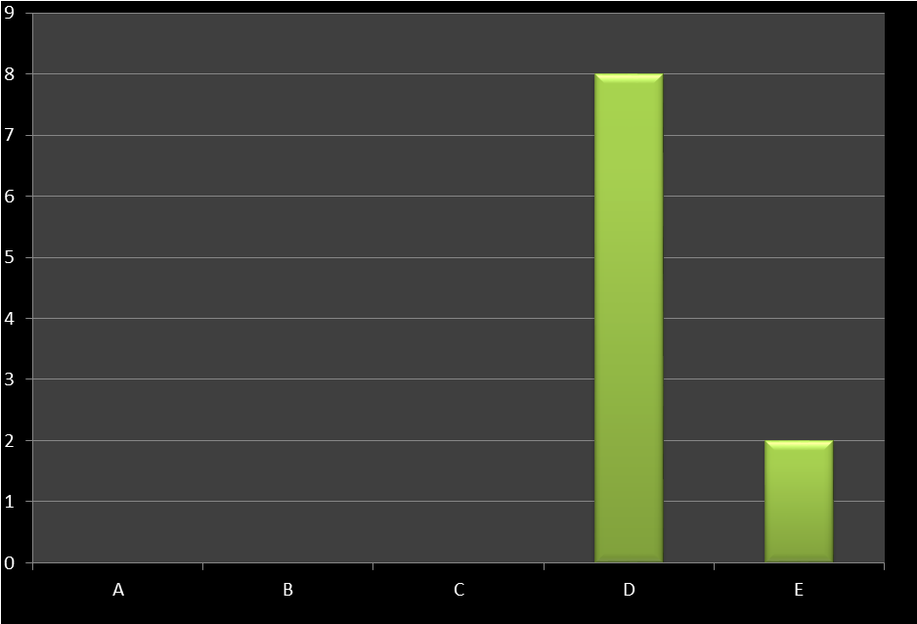
Did you like the new layout when compared to old one?
LEGEND:
A No, old layout looks good
B I don’t see difference
C Both are equally appealing
D Yes, new prototype layout looks good
E Cant tell now, without seeing implementation
Key Inference: 80% of participants liked the new prototype

Slide 23
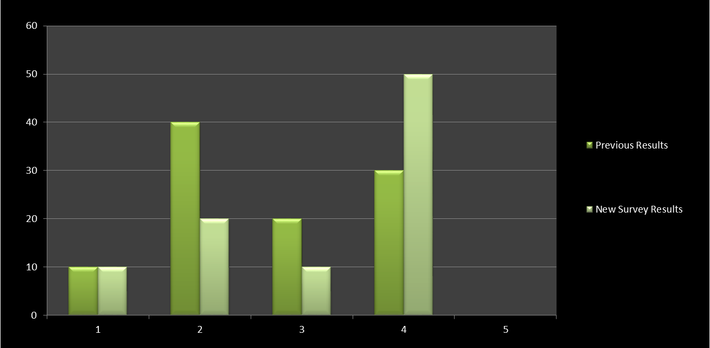
Rate Expected Difficulty(1-5 Scale)
Chart Histogram of Rate Expected Difficulty (Before actual Evaluation)
Legend : X Axis :
1 --> Extremely Difficult 3 --> Neutral 2 --> Somewhat Difficult 4 --> Somewhat Easy 5 --> Extremely Easy
Y Axis: Denotes the Percentage of count

Slide 24
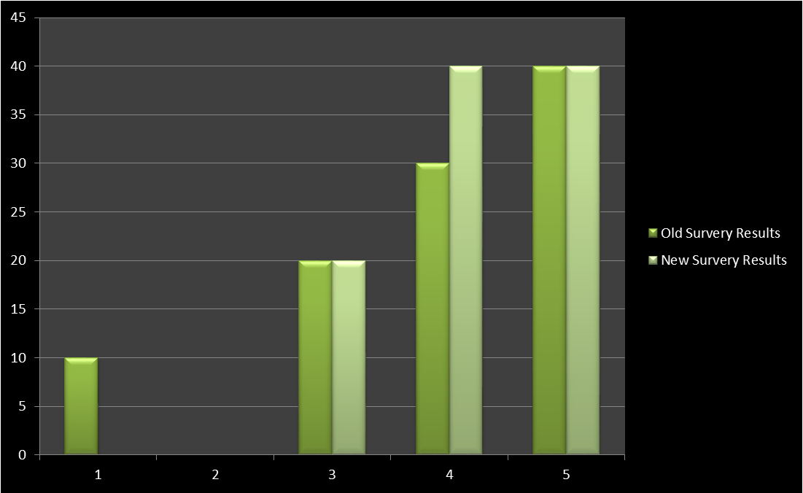
Rate Expected Percentage of Tasks Completed Successfully ( Scale 1-5 )
X Axis Legend
1: 20% or less
2: Between 20% and 40%
3: Between 40% and 60%
4: Between 60% and 80%
5: More than 80%
Key Inference:
With the new layout, people expect lesser difficulties. (Due to separation of contents / modular approach)

Slide 25
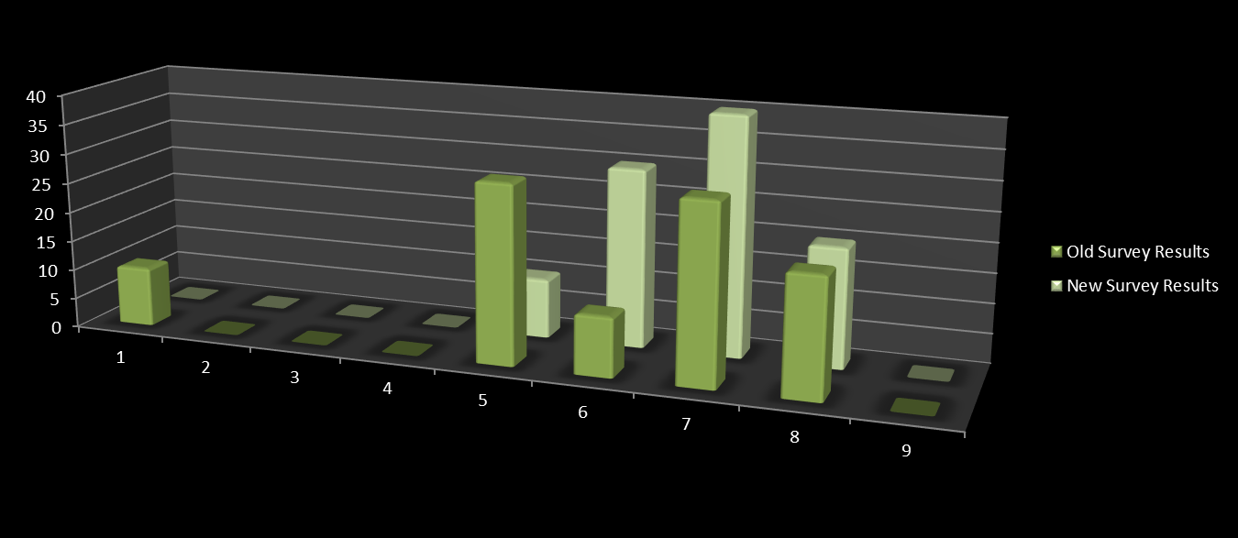
Please rate your current level of emotions based on the following scale: sad – happy(1-9 Scale) (Before Evaluation)
Key Inference: Overall participants seem to be happy with the new prototype

Slide 26
Tell us about the new prototype when compared to your experiences with old layout:
the new one looks better with the current color background
I'm not sure cant tell much without actual implementation maybe by look n field and by first look the new prototype seem to do well
The new layout is good. New layout looks much more lively. The old one was a bit stereotypical.

Slide 27
Do you think working with new prototype will increase approachability? If yes why?
Yes, Seems to be modular and has good separation of contents
Oh yea, I feel new one more user friendly and serving its purpose
I dont see much of difference functionality-wise
I feel it may be helpful to achieve some task with ease as it follows step by step visibility

Slide 28
What do you think are possible improvements that can be made on the new Prototype?
Exit button is too gaudy. A different approach could be better
Hard to say without seeing the actual implementation, I would love to evaluate when it is actually implemented
The overall app can be driven with functional flow, like the new one with multiple tabs. More tabs can be added like frequently used queries.

Slide 29
SAS Visual Analytics Explorer
Future work
  Analyze Evaluation results on new prototype
  Prioritize implementation
    Re Evaluation
  Enhancements
    Frequently applied filters can appear on top of the list
    Provide scaffolds for filtering operations
    Suggest chart types, visualizations based on the dataset
    Add more dimensions to the visualization results
    Query text parsing

Slide 30
Thank you!
SAS - for their valuable suggestion and time
Professor – for giving this wonderful learning experience

