Slide 1


Slide 2
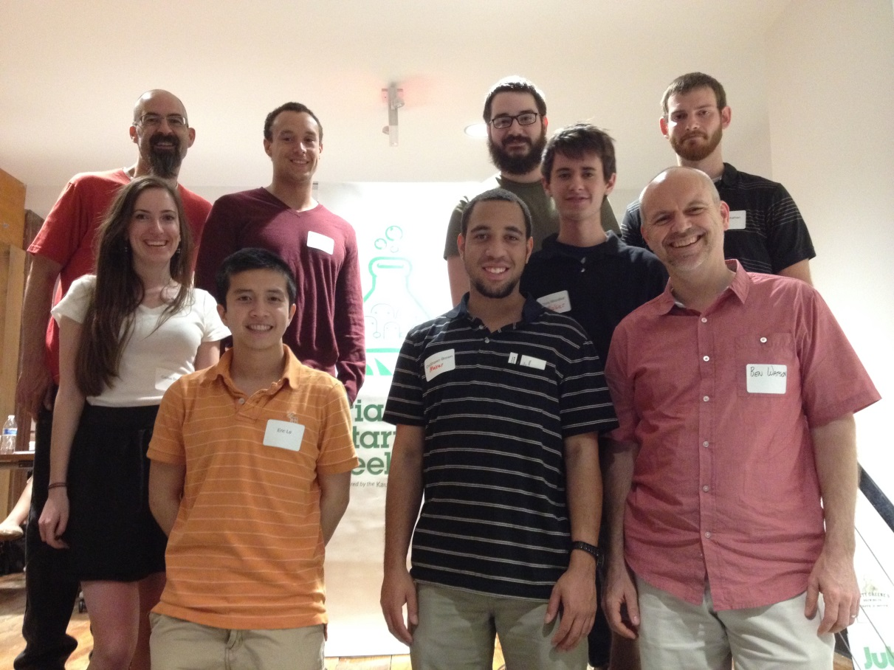

Triangle Startup Weekend
David Ball, Matthew Thomas, Chris McDaniels, Dalton Shehan, Cailee Storrs, Eric Le, DeShawn Brown, and Chris WoodLief with Dr. Watson at TSW Maker Weekend.

Slide 3




The Event Sponsors

Slide 4
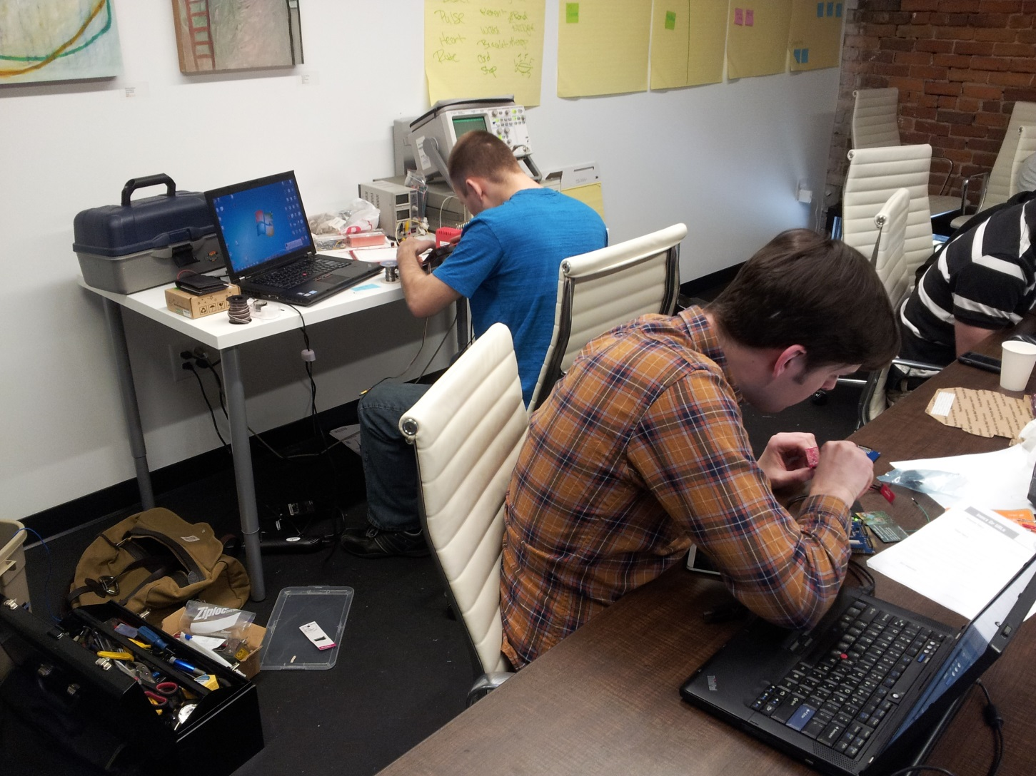
The Hardware Guys
Kevin Wolf
Matthias Welsh

Slide 5
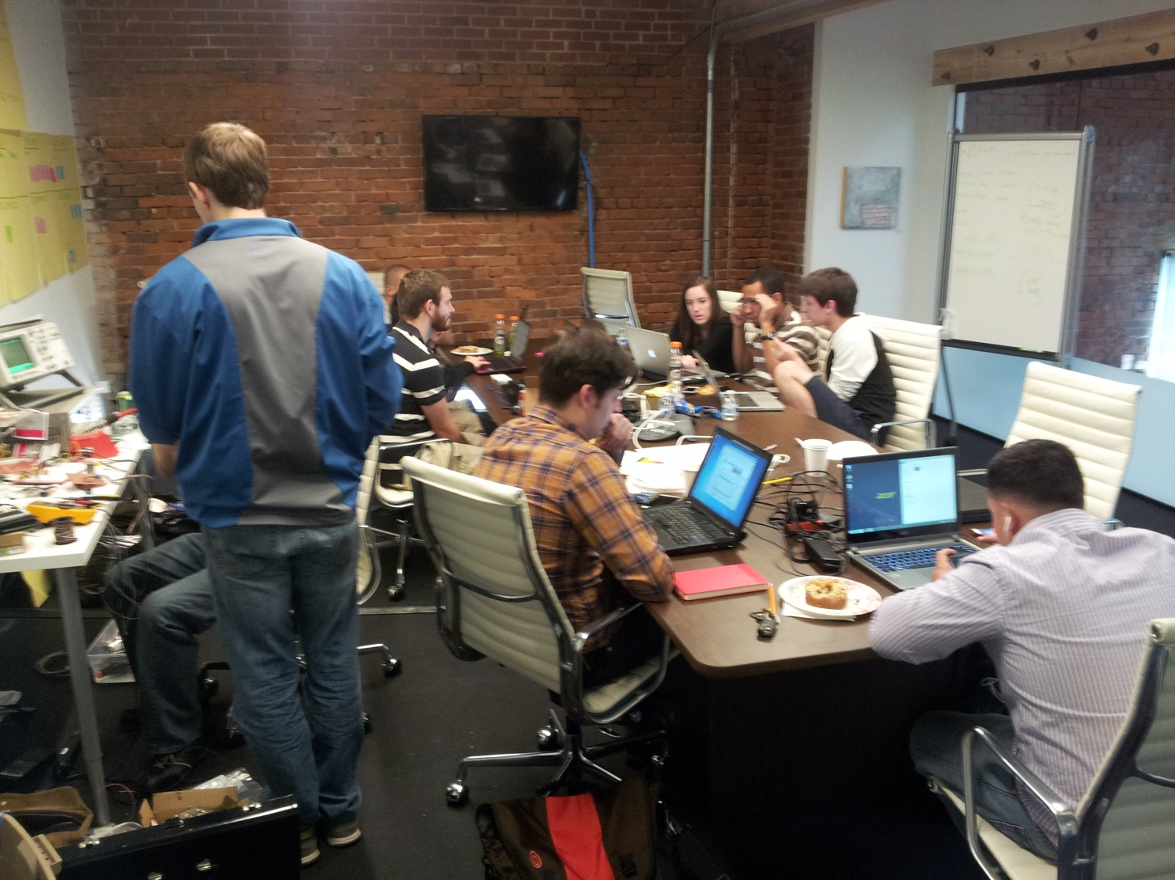
Late Saturday Night

Slide 6
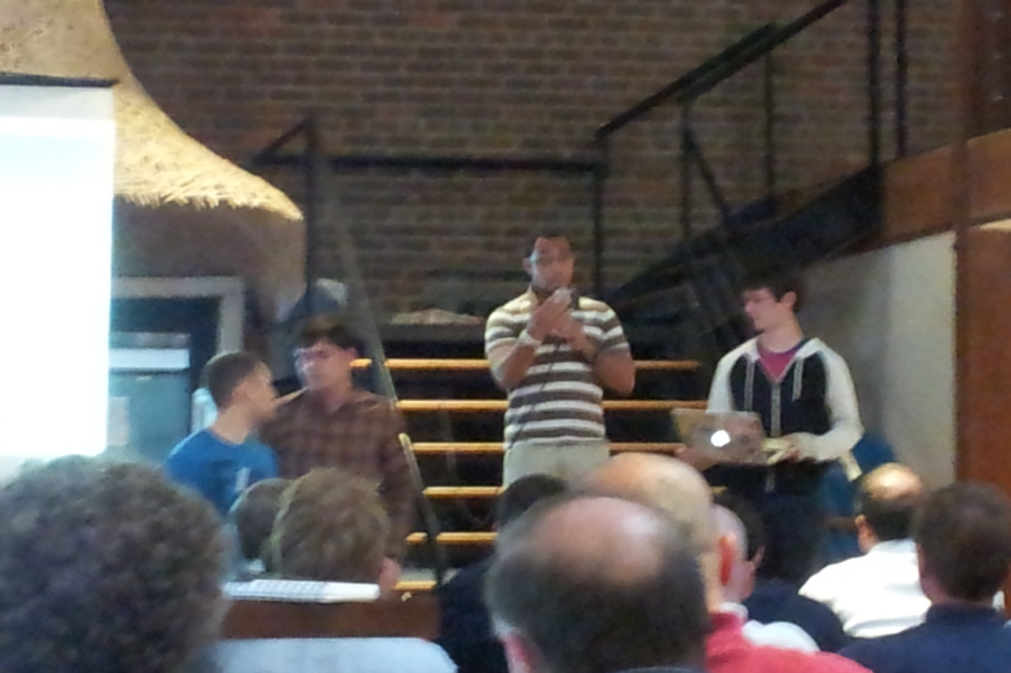
Sunday Evening – Presentation

Slide 7
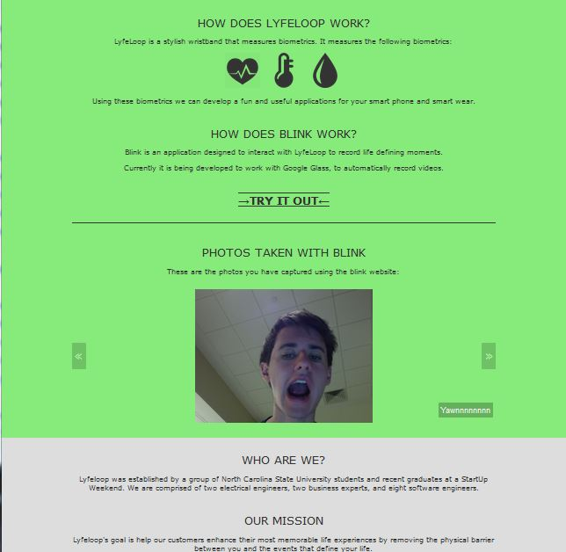
Desktop version is Great

Slide 8
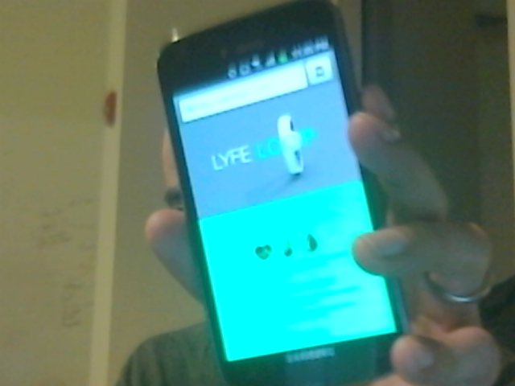
Mobile version… Even Better

Slide 9



Current Browser Support

Slide 10
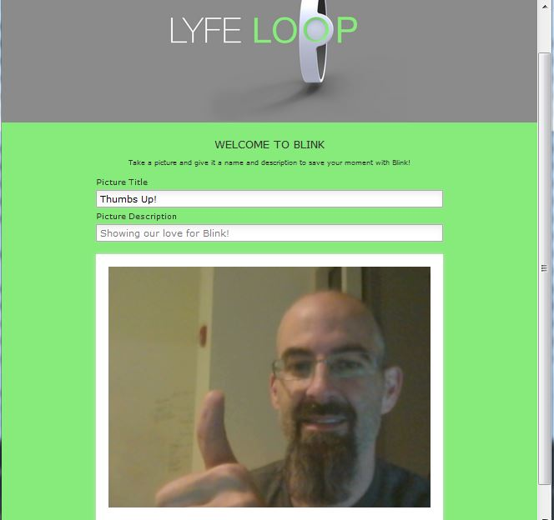
The Capture Screen

Slide 11




Technologies Implemented

Slide 12

Thank you
Contact Us – lyfeloop@gmail.com

