Slide 1


Slide 2
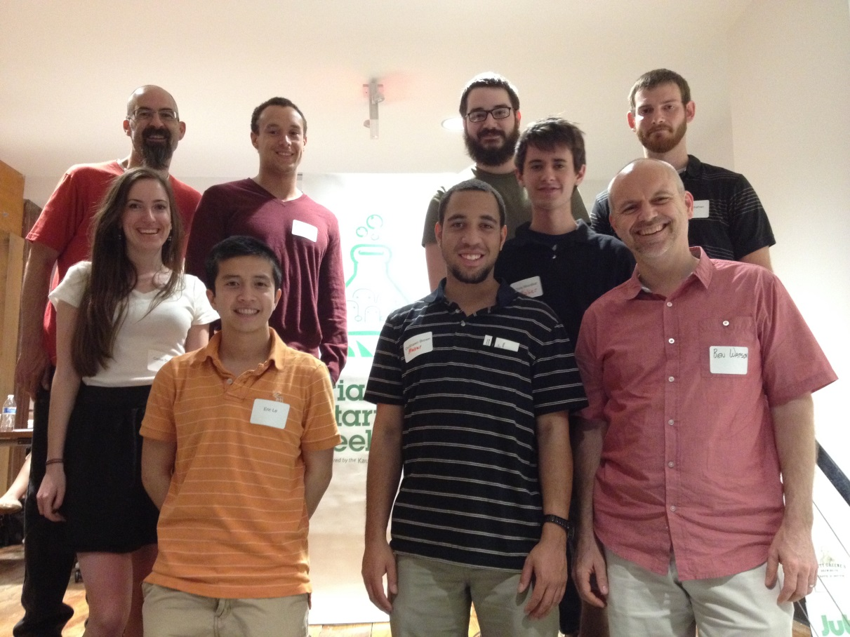

Triangle Startup Weekend
David Ball, Matthew Thomas, Chris McDaniels, Dalton Shehan, Cailee Storrs, Eric Le, DeShawn Brown, and Chris WoodLief with Dr. Watson at TSW Maker Weekend.

Slide 3




The Event

Slide 4
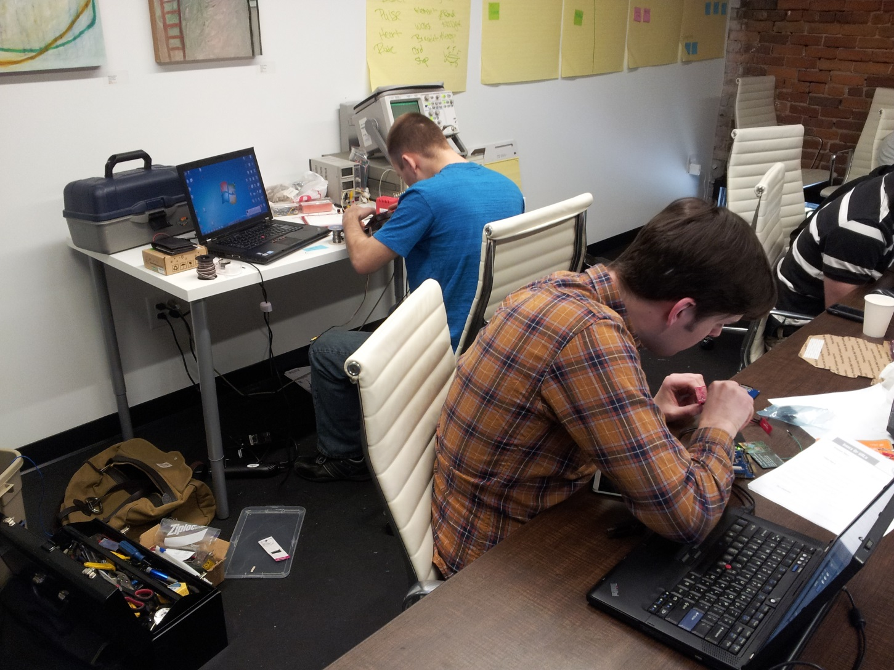
The Hardware Guys
Kevin Wolf
Matthias Welsh

Slide 5
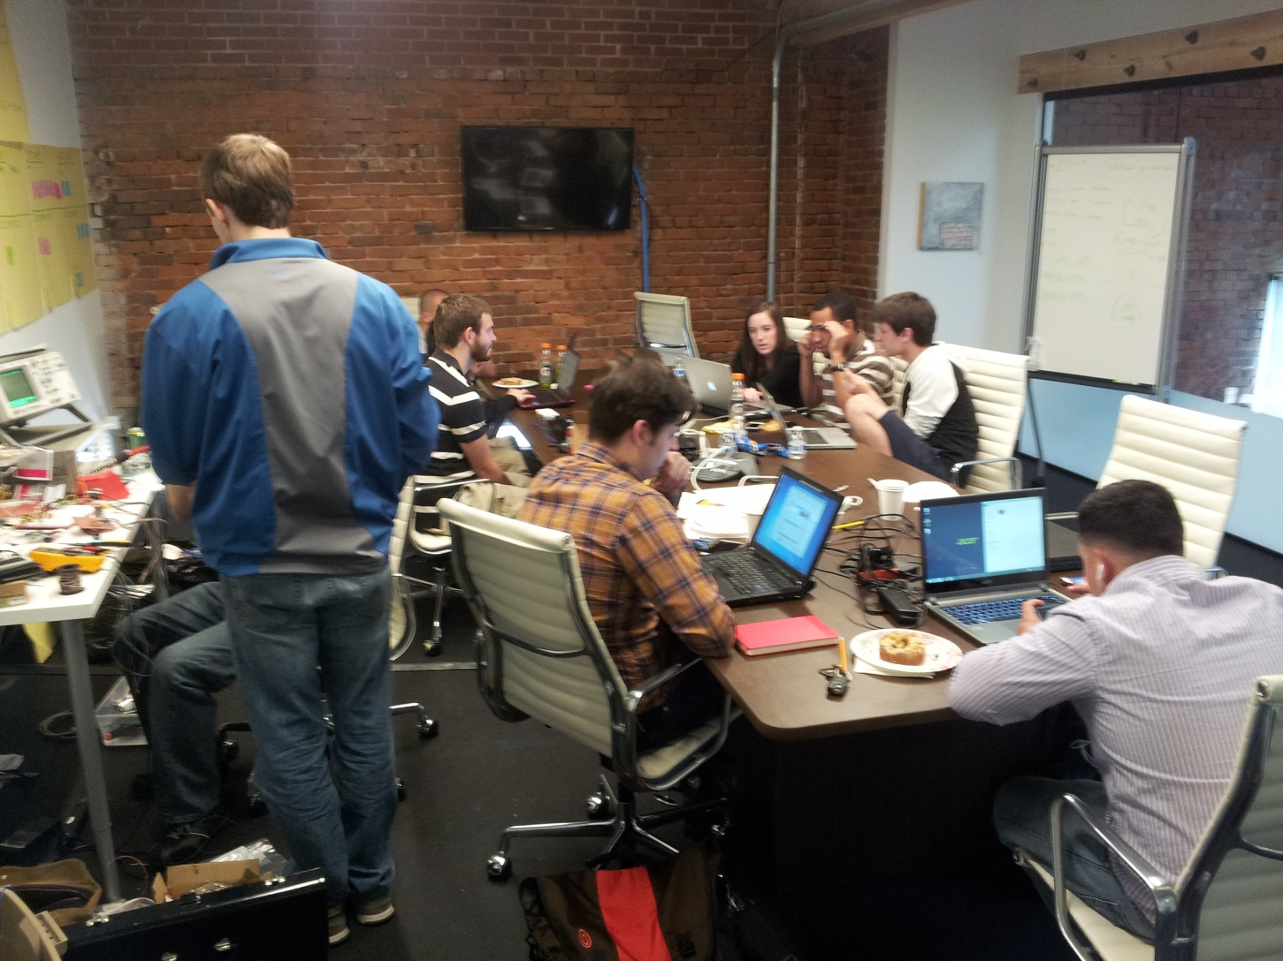
Late Saturday Night

Slide 6
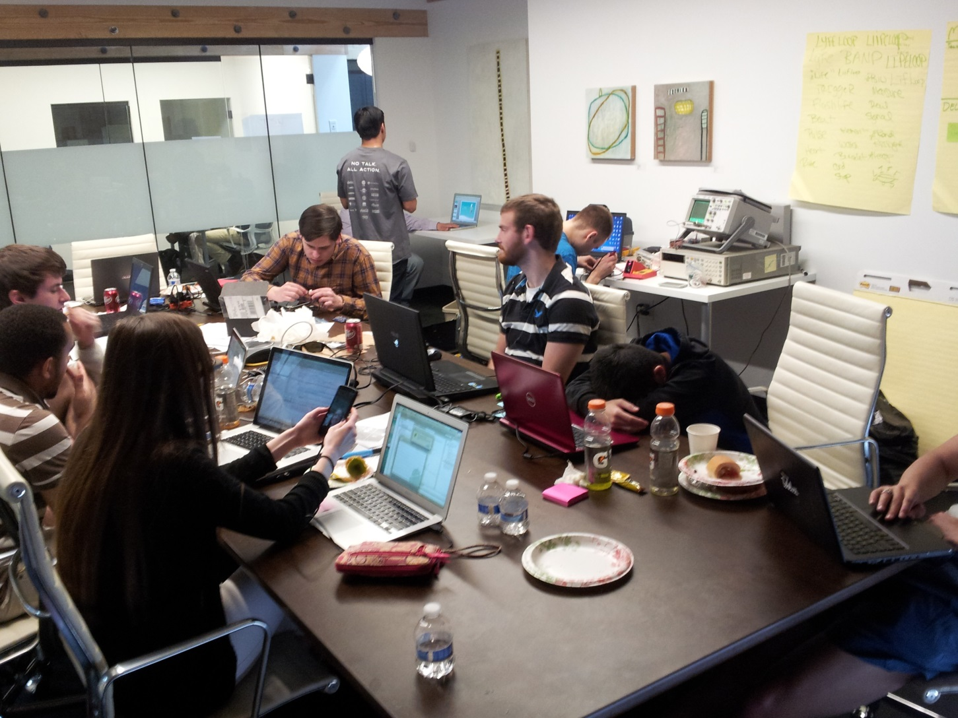
Later Saturday Night…

Slide 7
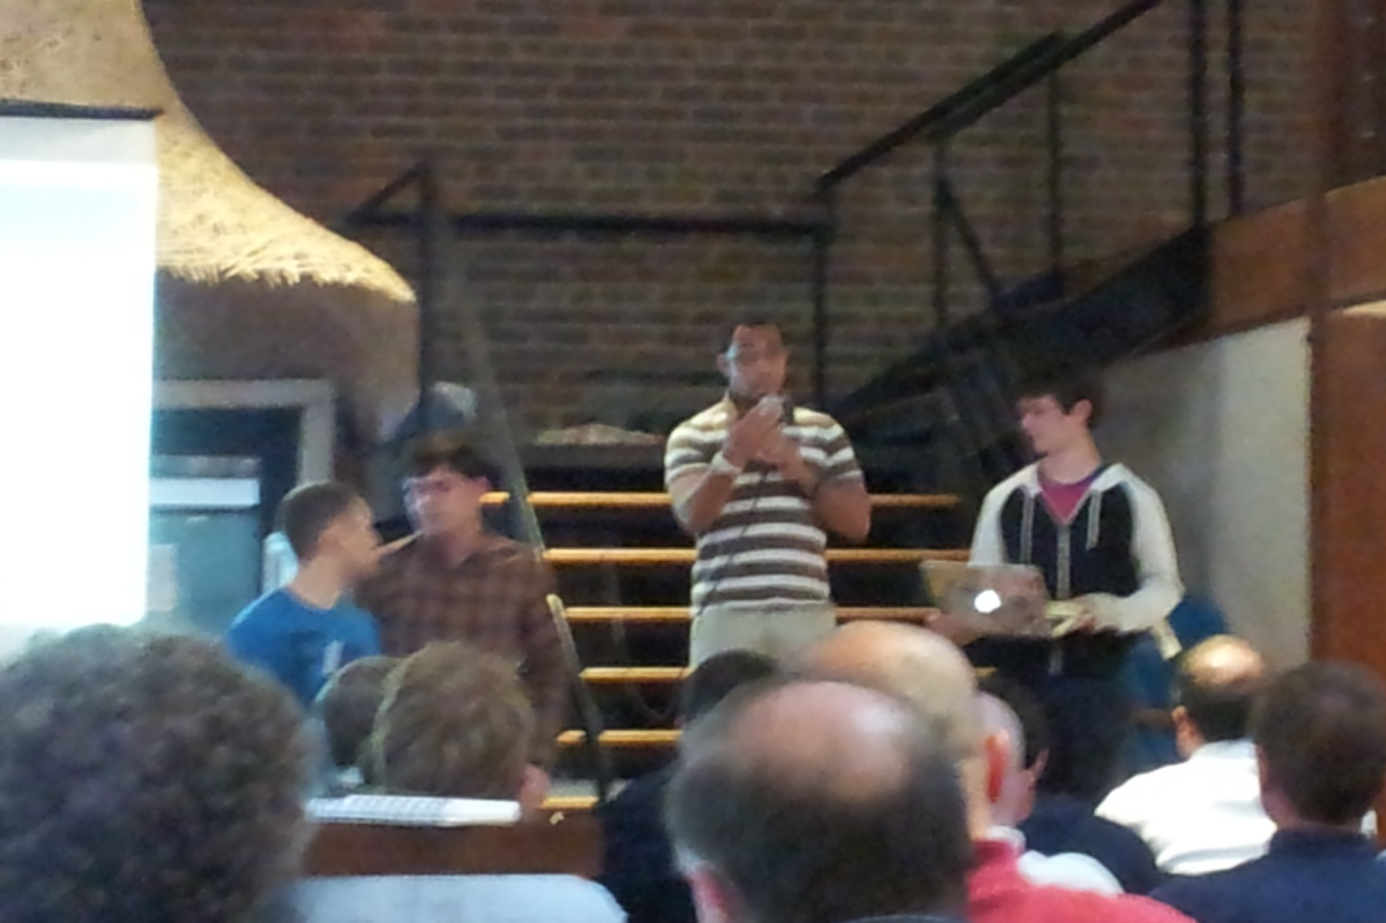
Sunday Evening – Presentation

Slide 8
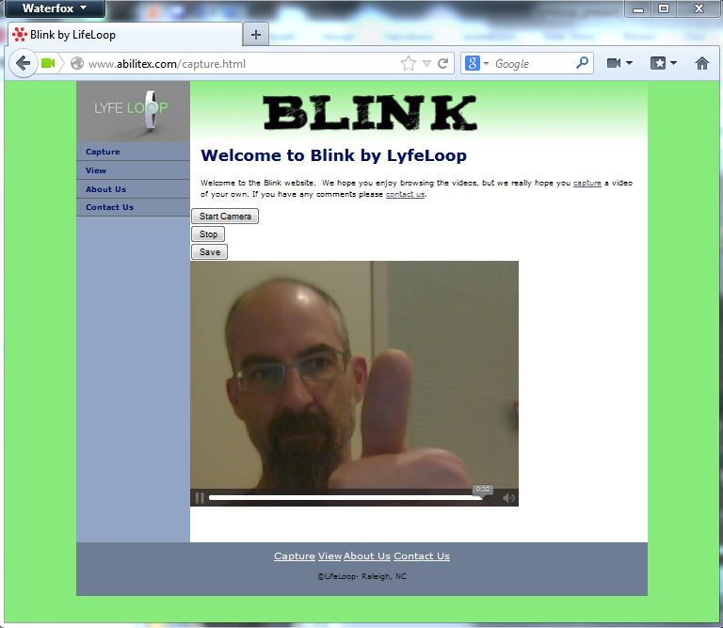
The Desktop Website

Slide 9




Current Browser Support
Safari

Slide 10
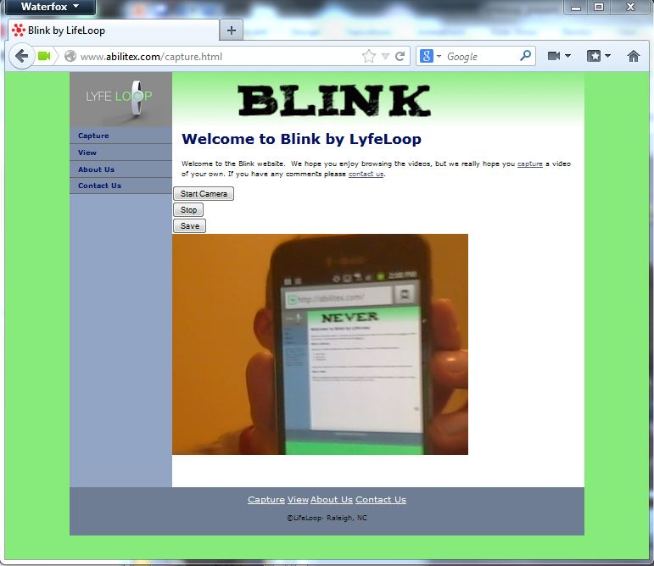
The Mobile Version… in progress

Slide 11



Technologies Implemented

Slide 12
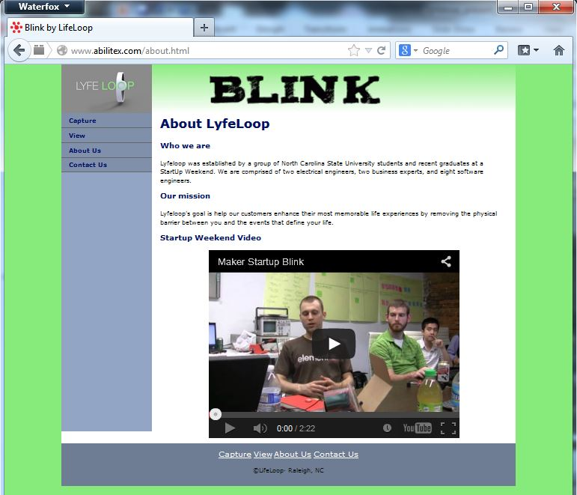
Video Interview at TSW

Slide 13
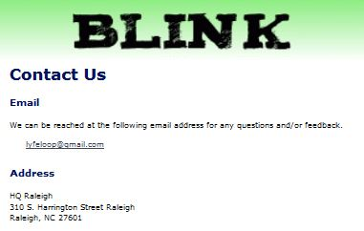
Contact Us – lyfeloop@gmail.com

