Slide 1
Walk [your city]
Erik Minges, Gavin Nicol, Travis Pomfrey, Corey Glasson, Justin Toniazzo, Haizhou Wu

Slide 2
Walk your city
Discover the Most Popular Points of Interest Near You…
The Mobile Walking App!

Slide 3
Locations of interest
Google Places API
Public Parks Clothing Store
Bars Department Store
Food Florist
Amusement Parks Furniture Store
Aquariums Gym
Art Gallery Library
Bowling Alleys Liquor Store
Café Movie Theatre
Casino Museum
Night Club Restaurant
Shoe Stores Shopping Mall
Spa Stadium
Zoo University

Slide 4
Sorting Location types
Sort by rating: Yelp API
- Pass similar location types to Yelp
- Return 2 highest rated

Slide 5
Sort locations by distance
Google Places API
sort by distance from YOUR current location

Slide 6
Return information
Google Maps image location
Location
Name Phone Number
Address Images
Operation Hours Yelp Rating
Website Customer Reviews
Get Walking Directions

Slide 7
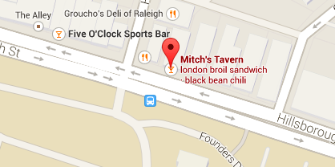
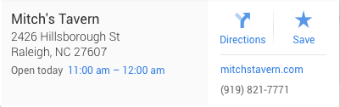
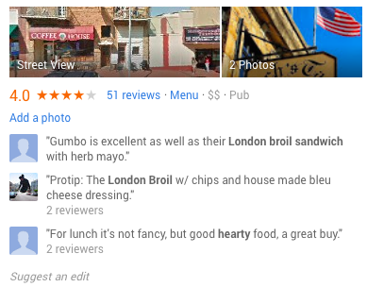
Locations Near You
Within 3 minutes……………….. Mitch’s Tavern
The Keg
Global Village
Jimmy Johns
Pullen Park
Within 7 minutes………………
Applebees
Nara Lounge
Within 10 minutes……………
Sugar Magnolia
The Alley

Slide 8
milestones
Milestones:
- Meet with project coordinator and develop project proposal………….. 10%
- Research API’s that could be used…………..……………………………….. 10%
- Front end markups………………………………………………………………… 10%
- Design the website………………………………………………………………... 25%
- Implement API to find places of interest near the user……………………. 20%
- Implement API to sort same location types by rating…………….............. 20%
- Usability testing………………………………………………………..................... 5%
- Visual appeal (Extra Credit).......................................................................... 20%

Slide 9
References
Google Places API
https://developers.google.com/places.documentation/supported_types
Yelp API
http://www.yelp.com/developers

