Slide 1
Charger Active Defense - Adversarial Attack Tool Defense
Noah Sickels, Adam Brannon, William Lochte
MENTOR: Dr. David Coe
CPE 488: Cybersecurity Engineering Capstone I
Electrical and Computer Engineering The University of Alabama in Huntsville
email: ncs0016@uah.edu, ajb0093@uah.edu, wpl0001@uah.edu

Slide 2
Some Important Terms
Active Defense: Defending a system by directly interacting with the adversary while an attack is in progress.
Attacking Application: The program the adversary is using to attack your system.
Active Defense Response: The response that the victim computer gives the attacking application; often sent as a network packet.
Fuzz Testing: Software testing methodology that injects invalid input data into a software to test for crashes or hangs.
Note:
Attacking applications often exploit vulnerabilities within a program on the victim’s system.
What would happen if we instead exploited vulnerabilities in the attacking application?

Slide 3
Stalling Attacker’s Tools
Modern attack tools are highly efficient, while the cybersecurity industry lacks active defense capabilities.
Current passive defenses primarily focus on mitigating threats by disabling ports or services, which can disrupt business operations. Other methods, such as blocking source IP addresses, may prove ineffective, as adversaries can spoof IP addresses through proxies or VPNs.
With the rapid advancement of artificial intelligence and prompt engineering, attackers can instantly generate various attack tools to target organizations.

Slide 4
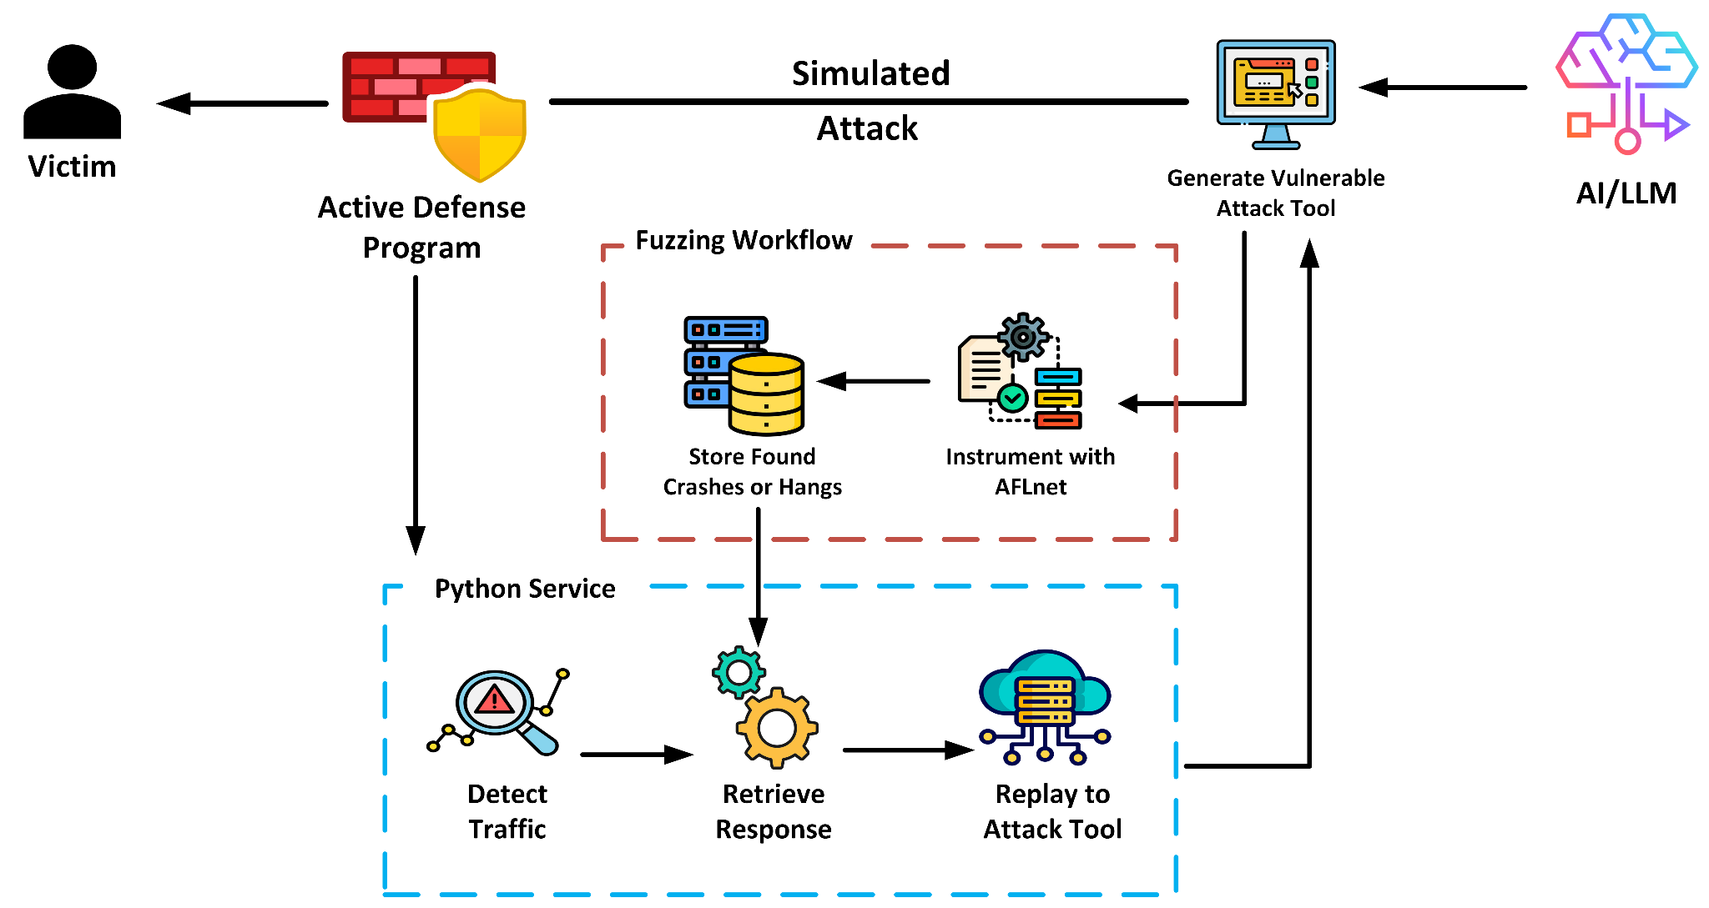
Charger Active Defense Overview

Slide 5
Survey: Patents
Continuous Active Defense for Digital Services [1]
Created a secure client-server session using challenge-response pairs. Collected behavior patterns on the client’s server to detect threats.
This method enables dynamic countermeasures based on real-time behavior analysis. Countermeasures are initiated by the client device for proactive defense. Various countermeasures include screen blackening, challenge responses, and session logout. It uses databases to store affected sessions, countermeasures, and rules for their application.
Cyber Threat Defense System and Method [2]
A cyber threat defense system utilizes machine learning and artificial intelligence to analyze network data and detect threats. It integrates multiple machine learning modules to assess overall data, identify metrics, and evaluate breach likelihood. An autonomous response module can transmit reports and initiate mitigation actions upon detecting a breach. The system continuously trains its AI classifier to enhance threat identification.
[1] Casas, Jose Carlos. Continuous Active Defense for Digital Services. 18 Jan. 2024, patents.google.com/patent/US20240022581A1/en?oq=20240022581.
[2] Humphrey, Dickon Murray. Cyber Threat Defense System and Method. 20 Aug. 2024, patents.google.com/patent/US20210273960A1/en.

Slide 6
Survey: Patents
Fuzz Testing of Asynchronous Program Code [3]
Developed a fuzz testing methodology for asynchronous event processing applications by introducing event processors between sources and sinks to modify event streams. The application starts with asynchronous behavior, managing sources and sinks by transforming and supplying modified events. Key components include event abstraction, event processor, source and sink interfaces, statistical distributions, and test storage.
A uniform interface connects event processing to sources, enabling abstracted event-related code. Event processors can modify or create events between the source and sink, affecting application behavior. The statistical distribution component stores seeds for generating specific test runs, aiding in defect reproduction and test storage.
[3] Meijer, Erik. Fuzz Testing of Asynchronous Program Code. 21 Apr. 2015, patents.google.com/patent/US20120089868A1/en?oq=20120089868.

Slide 7
Survey: Products
Defensics, BlackDuck (AppSec) [4] – ~13k/server + license
Features: Comprehensive and flexible fuzzing tool that provides over 300 pre-built testing suites for various protocols, file formats, and interfaces. It also offers vulnerability mapping to industry standards like CWE and injection types.
beSTORM, BeyondSecurity [5] – $50,000/one-time
Features: A black-box dynamic application security testing and fuzzing suite designed to test millions of attack combinations. Able to perform test cases without access to the source code of the targeted application. Offers 250+ pre-built modules and protocols with the ability to implement custom protocols.
Burp Suite Professional, PortSwigger [6] – $449/year
Features: A complete suite of web-based application testing tools capable of intercepting and manipulating network requests before repeating them back. Allows you to capture, filter, and query automated attack results.
[4 ]BlackDuck, AppSec. “Defensics Fuzz Testing Tools & Services | Black Duck.” Blackduck.com, 2023, www.blackduck.com/fuzz-testing.html. Accessed 10 Jan. 2025.
[5] Security, Beyond. “Dynamic Application Security Testing Tool (DAST) | BeSTORM.” Vulnerability Security Testing & DAST | beyond Security, 2019, www.beyondsecurity.com
[6] PortSwigger. “Burp Suite Professional.” Portswigger.net, 2020, portswigger.net/burp/pro

Slide 8
Survey: Projects
SnapFuzz [7]
Offers a robust architecture that transforms slow asynchronous network communication into fast synchronous communications.
Snapshots the target at the latest point, speeds up all file operations by redirecting them to a custom in-memory filesystem, and removes the need for many fragile modifications, such as configuring time delays or writing clean-up scripts.
Integrates directly with AFLnet to improve overall performance and speed of protocol fuzzing.
HonggFuzz [8]
Security-oriented software fuzzer that supports feedback-driven fuzzing based on code coverage for software and hardware fuzz testing.
It is multi-process and multi-threaded, making it incredibly efficient. File corpus is automatically shared and improved between all fuzzed processes.
It provides a corpus minimization mode, enabling it to optimize input data to improve fuzzing results.
[7]srg-imperial. “GitHub - Srg-Imperial/SnapFuzz.” GitHub, 2022, github.com/srg-imperial/SnapFuzz.
[8] honggfuzz, Google. “Honggfuzz.” GitHub, 25 Jan. 2022, github.com/google/honggfuzz.

Slide 9
Survey: Projects
SGANFuzz [9]
Uses Generative Adversarial Networks (GANs) to generate realistic MQTT message sequences.
Supports multiple message types and parameters, allowing users to configure message sequence lengths and batch sizes.
It provides visualization tools to help users analyze generated message sequences.
[9] Peter Wei Just. “GitHub - PeterWeiJust/SGANFuzz.” GitHub, 2023, github.com/PeterWeiJust/SGANFuzz.

Slide 10
Marketing Requirements
# | Description
M1 | The ChAD fuzzing workflow must conduct network-based fuzzing to identify network responses, also known as Active Defense Responses, that can crash or hang adversarial attack tools.
M2 | The existing vulnerabilities of six well-known attack tools must be documented.
M3 | Down select to a single well-known attack tool for testing.
M4 | Must use two different AI/LLM models to generate additional attack tools.
M5 | Use each AI/LLM to generate three attack tools for fuzz testing.
M6 | Software fuzzing tools capable of testing the attack tools must be identified.

Slide 11
Marketing Requirements
# | Description
M7 | Demonstrate a fuzz testing workflow for Masscan and AI-generated attack tools.
M8 | The ChAD program must monitor incoming network traffic to the host machine.
M9 | All transaction history of incoming and outgoing response packets must be logged and recorded.
M10 | The ChAD program must provide an active defense response.
M11 | Evaluate the effectiveness of any active defense responses found.
M12 | Findings must be documented in an IEEE/ACM-style paper.

Slide 12
Engineering Requirements
Marketing Requirements | Engineering Requirements
M3 | E1: LDRA static analysis and Valgrind memory leak analysis must be used on both selected attack tools for present vulnerabilities or more favorable testing targets.
M6 | E2: Develop a fuzzing workflow using three fuzzing tools and approaches and rank them based on the probability of success with selected well-known attack tools.
M4, M5 | E3: Must use GitHub Copilot and Phind models to generate three types of attack tools each - a banner-grabber, password brute-force, and a simplistic multi-threaded banner-grabber.
M7 | E4: Must demonstrate fuzzing workflow on selected/generated attack tools
M1, M7, M10 | E5: The workflow must be capable of finding vulnerabilities (crashes or hangs) within attack tools, if any exist.

Slide 13
Engineering Requirements
Marketing Requirements | Engineering Requirements
M11 | E6: We must document whether each network response crashes or hangs the attacking application and calculate and record the average hang time if it hangs the application.
M12 | E7: The rationale must be compiled for the selection of existing attack tools, fuzzing tools, compatibility results, and analysis for testing into an IEEE conference paper using proper formatting with font type, size, headers, and two columns per page.
M1, M2 | E8: Search MITRE CVE and Exploit-DB databases and compile known vulnerabilities for all six possible attack tools.
M8, M10 | E9: The ChAD service must send active defense responses within one minute of detection of an incoming attack.

Slide 14
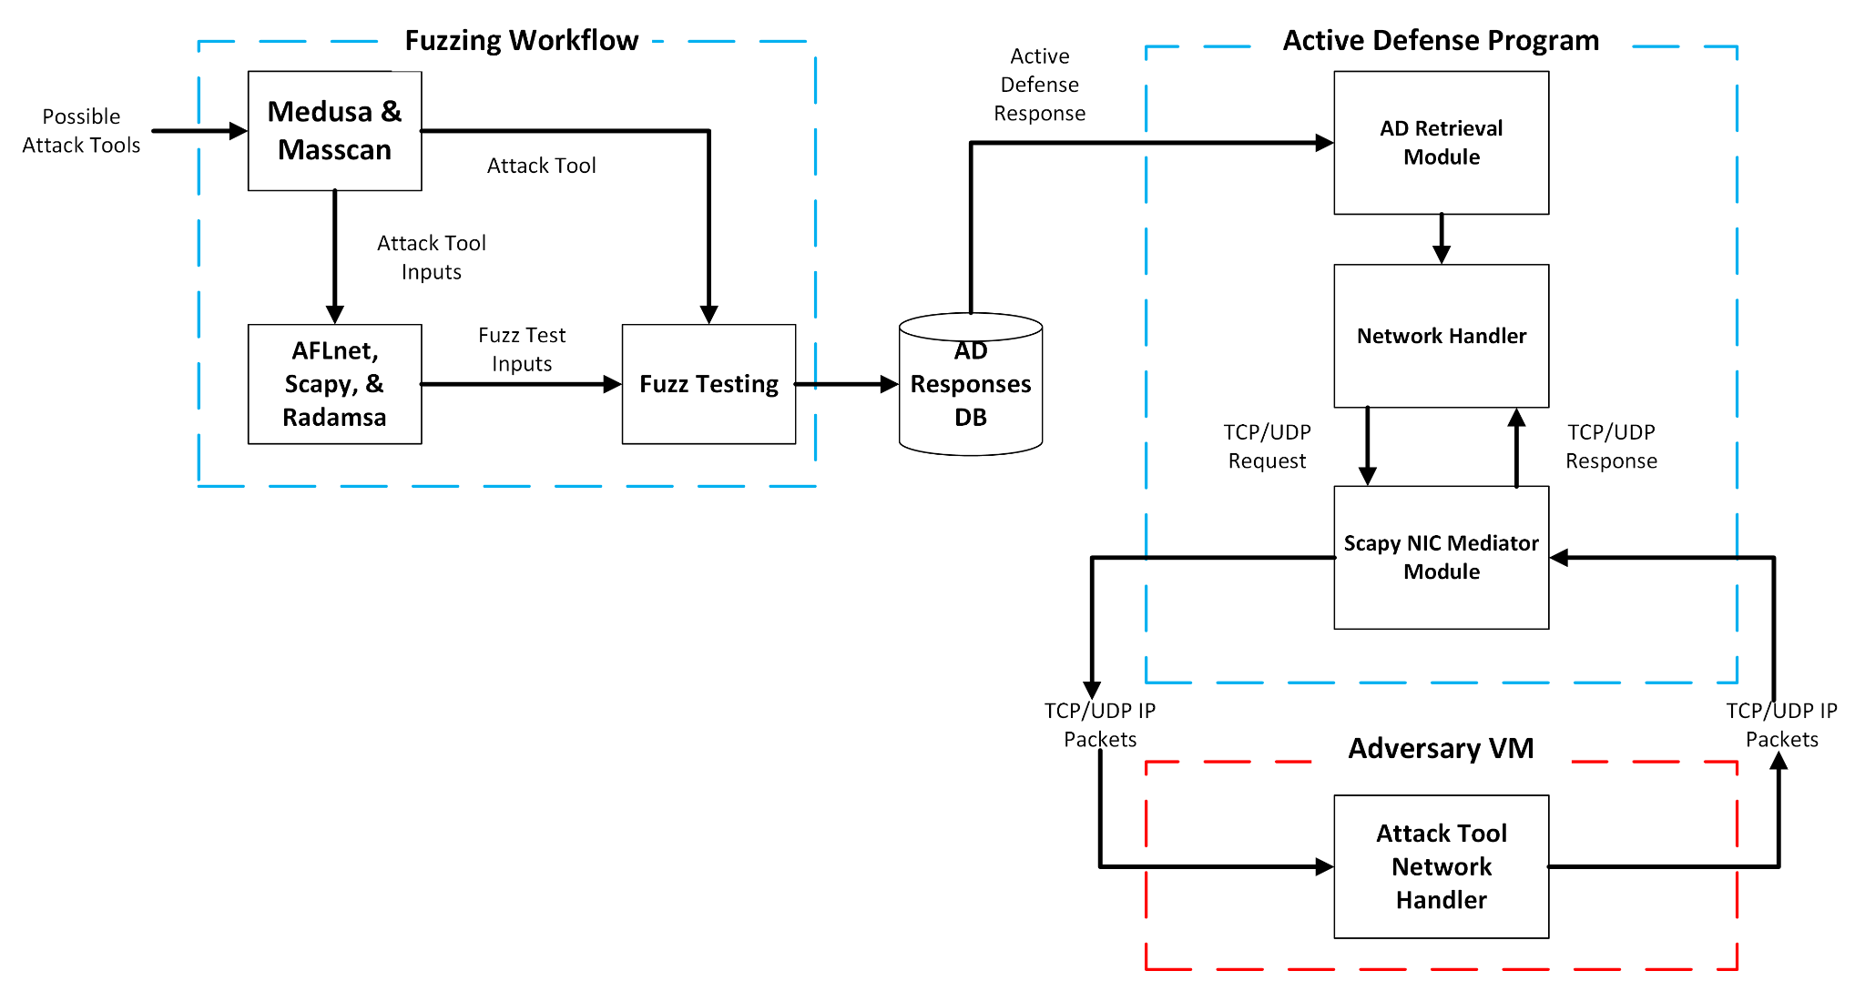
System Components Overview

Slide 15
Proposed Solution
Our proposed solution included:
Performing network-based fuzz testing with AFLnet, with Radamsa as a backup.
Modifying the fuzzing workflow to include a ThreadSanitizer hook to determine if we were able to crash threads in multi-threaded attack tools like Masscan.
Utilizing two AI models - GitHub Copilot and Phind - to generate three different types of attack tools from each model:
A banner-grabber
A password brute-forcer
And a multi-threaded banner-grabber
Applying the full fuzzing-workflow to each Gen-AI attack tool
This includes performing static and dynamic analysis with LDRA, Flawfinder, and Valgrind, and instrumenting them with AFLnet
Notes:
Using the appropriate design representation format present the details of your design. At the highest-level of abstraction start with the overall organization of main components and their interactions. Then present each important element of your design. As you present this material make sure to highlight the important trade-offs and design decisions that had to be made as the design progressed and what motivated these decisions.

Slide 16
Proposed Solution
Additionally, we planned to:
Develop a Python replay service to act as a man-in-the-middle device between the attacker and victim virtual machines
This application would actively monitor network traffic on a provided IP address and service port.
Once traffic is detected from that protocol, it automatically sends the active defense response back to the attacking virtual machine.
For each Gen-AI attack tool, compare the functionality, code structure (libraries, data structures used, etc.), and results between the two models.
Compile all results from LDRA, Valgrind, Flawfinder, Gen-AI code comparison, and fuzz testing reports into an IEEE-style conference paper
Notes:
Using the appropriate design representation format present the details of your design. At the highest-level of abstraction start with the overall organization of main components and their interactions. Then present each important element of your design. As you present this material make sure to highlight the important trade-offs and design decisions that had to be made as the design progressed and what motivated these decisions.

Slide 17
Alternative Solutions / Tradeoffs
Modifying Existing Tools: Refactoring Masscan and Medusa to remove multi-threading is impractical due to complexity and time constraints of the semester.
Introducing Vulnerabilities in AI-Generated Attack Tools: Manually adding vulnerabilities could allow us to test the feasibility of our active defense mechanisms against applications that have vulnerabilities, as AI-generated tools typically will not include them.
Fuzzed PCAP File Generation: Scriptable method for generating random data packets; easy to set up but requires manual regeneration for new test cases. Real-time protocol fuzzing is more challenging but yields more accurate results compared to static fuzzed files.

Slide 18
Current Functionality
Developed fuzzing workflow to comprehensively fuzz test network-based attack tools.
Successfully generated a banner-grabber, password brute-forcer, and multi-threaded banner-grabber attack tools from GitHub Copilot and Phind.
Performed static and dynamic analysis and applied our fuzzing workflow on each generated attack tool.
Including LDRA, Flawfinder, Valgrind, and instrumenting and compiling with AFLnet.
Written comparison report for code structure for each tool between each model and analysis of results from testing.
Remaining tasks before the end of the semester:
Compile results into IEEE conference paper.
Publish GitHub repository and review Dependabot alerts from the Python replay service.

Slide 19
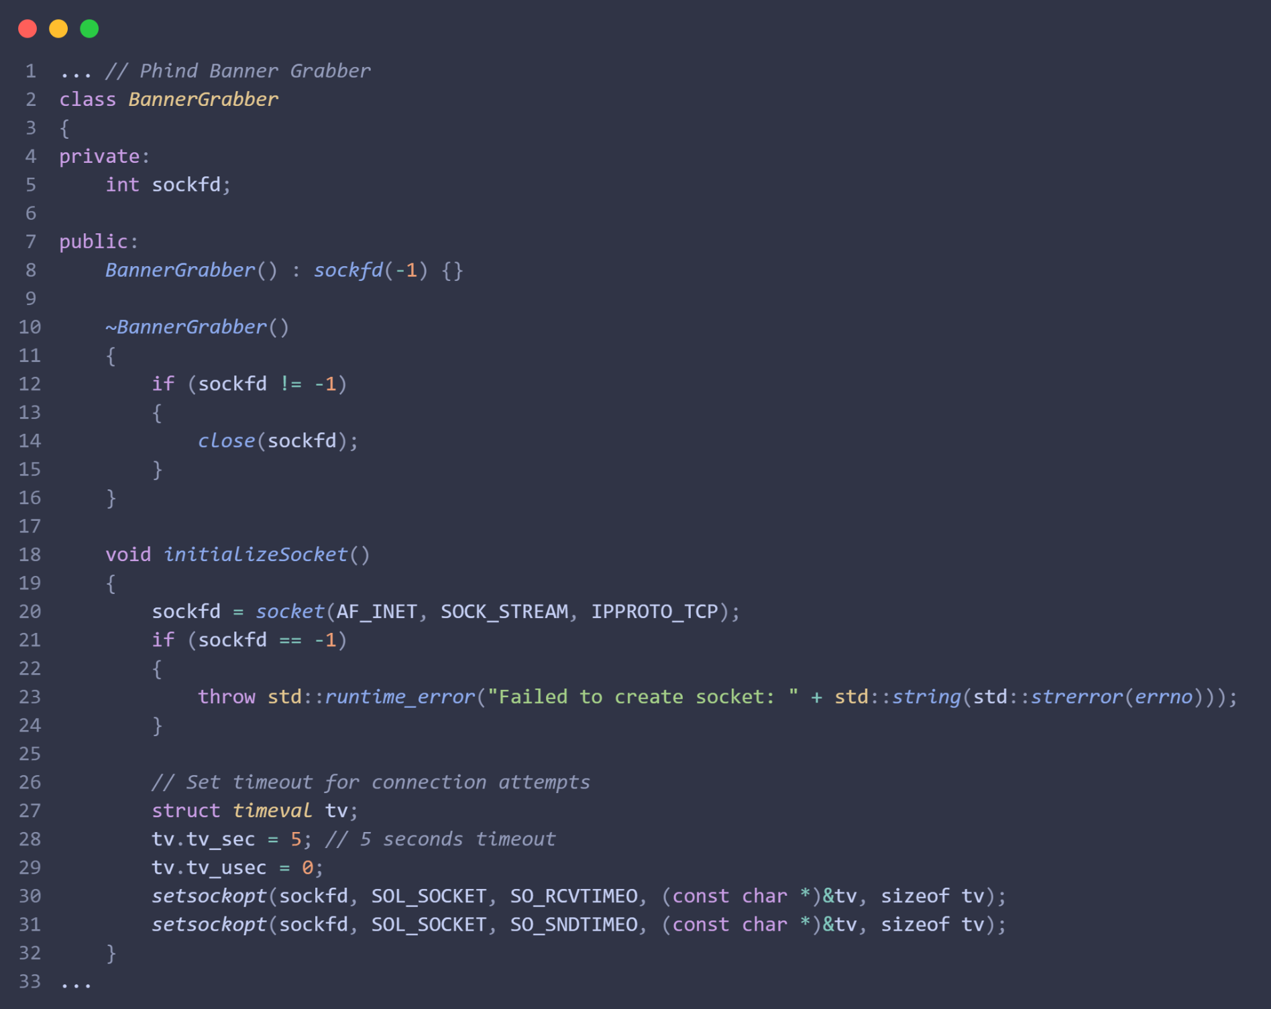
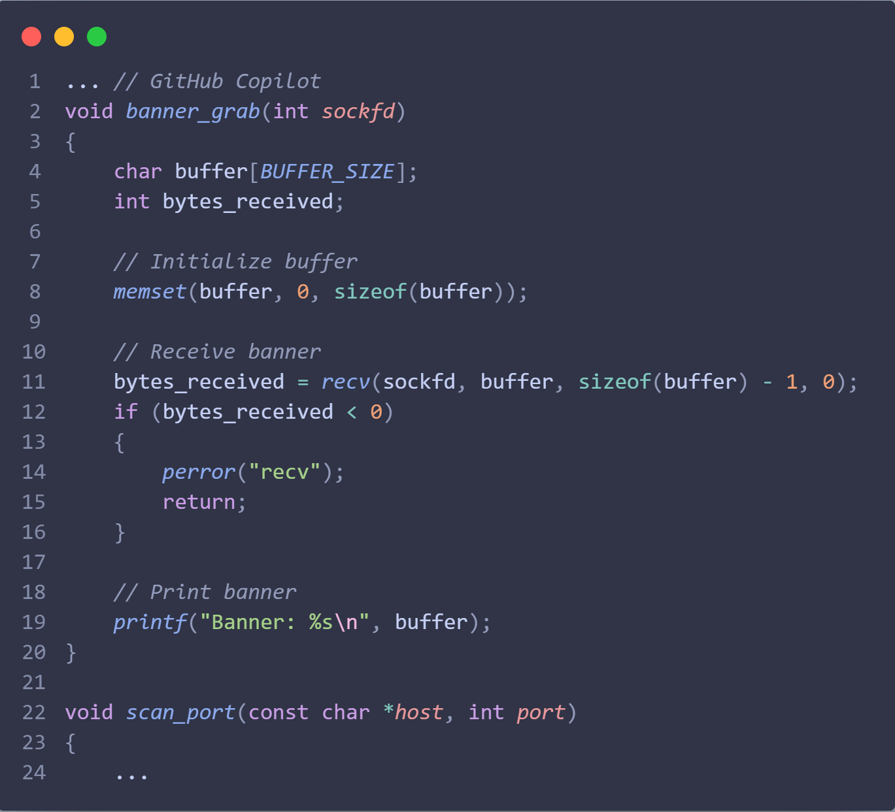
Major Project Accomplishments
Generated three different attack tools from GitHub Copilot and Phind AI models.
Notes:
What is the current state of the project?
What are the major accomplishments at the time of the presentation?
Analyze proposed and actual timeline and milestones.
Do you have critical latencies on the project?
Will you be able to complete the project as expected by the end of the semester?

Slide 20
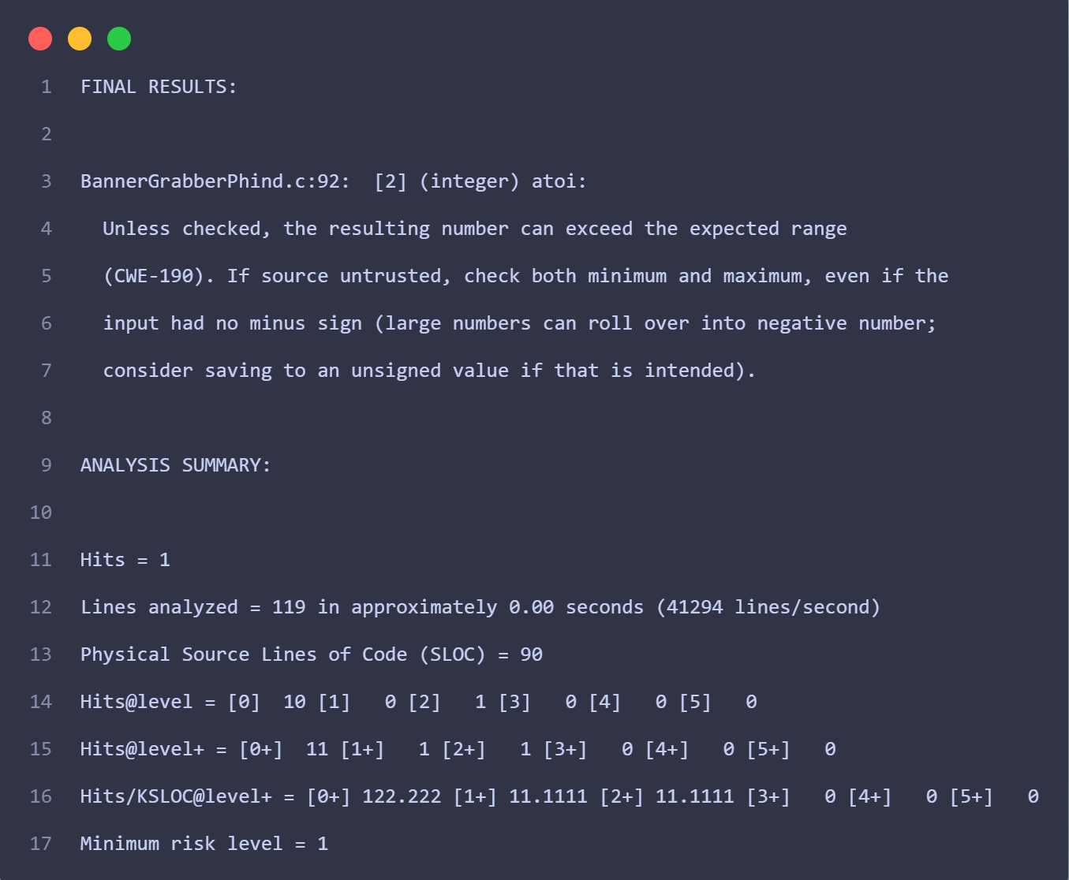
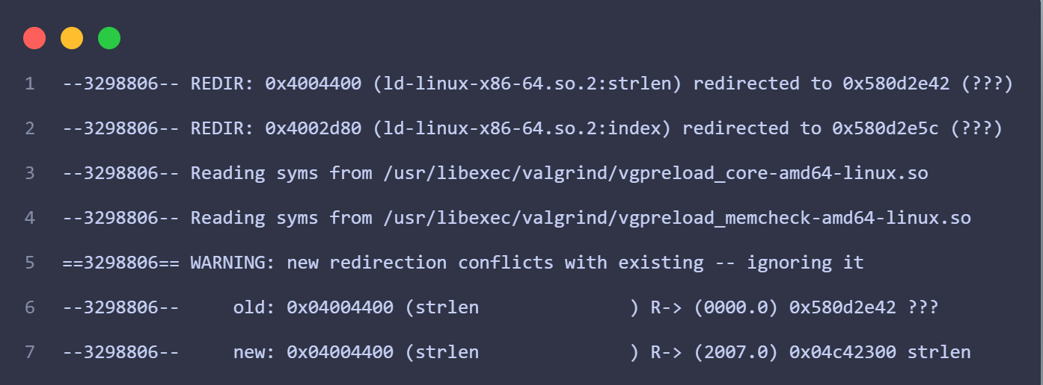
Major Project Accomplishments
For Phind & Copilot attack tools:
Performed static analysis with LDRA and FlawFinder.
Performed dynamic analysis with Valgrind.

Slide 21


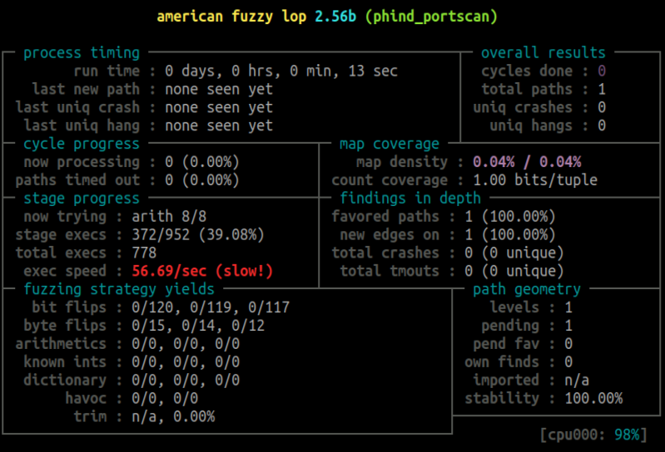
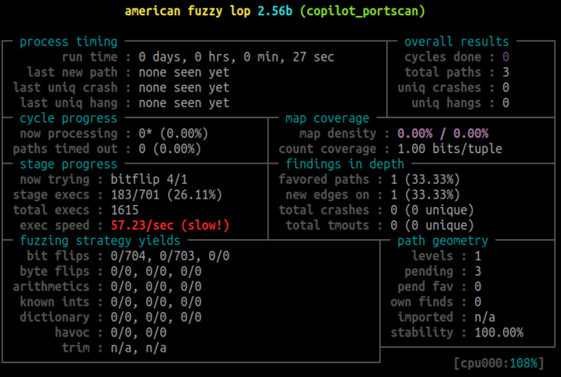
Major Project Accomplishments
Applied fuzzing workflow to all Gen-AI attack tools.

Slide 22
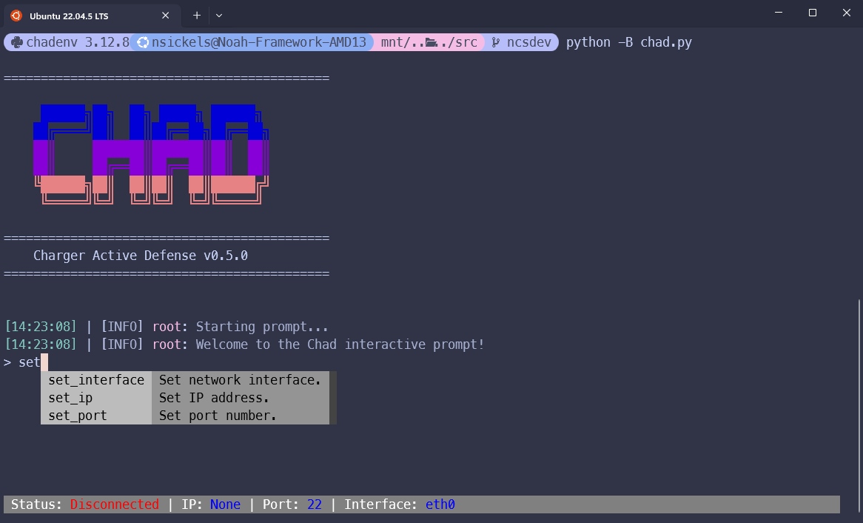
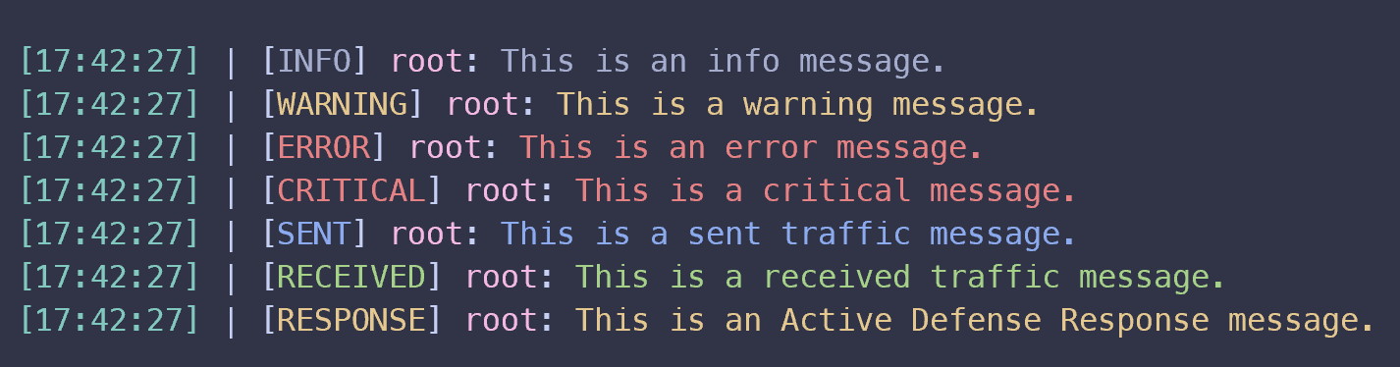
Major Project Accomplishments
Python service user-interface complete
Functional interactive CLI or command-line arguments option
Custom colorized logger with unique messages for sent/received traffic & active defense responses

Slide 23
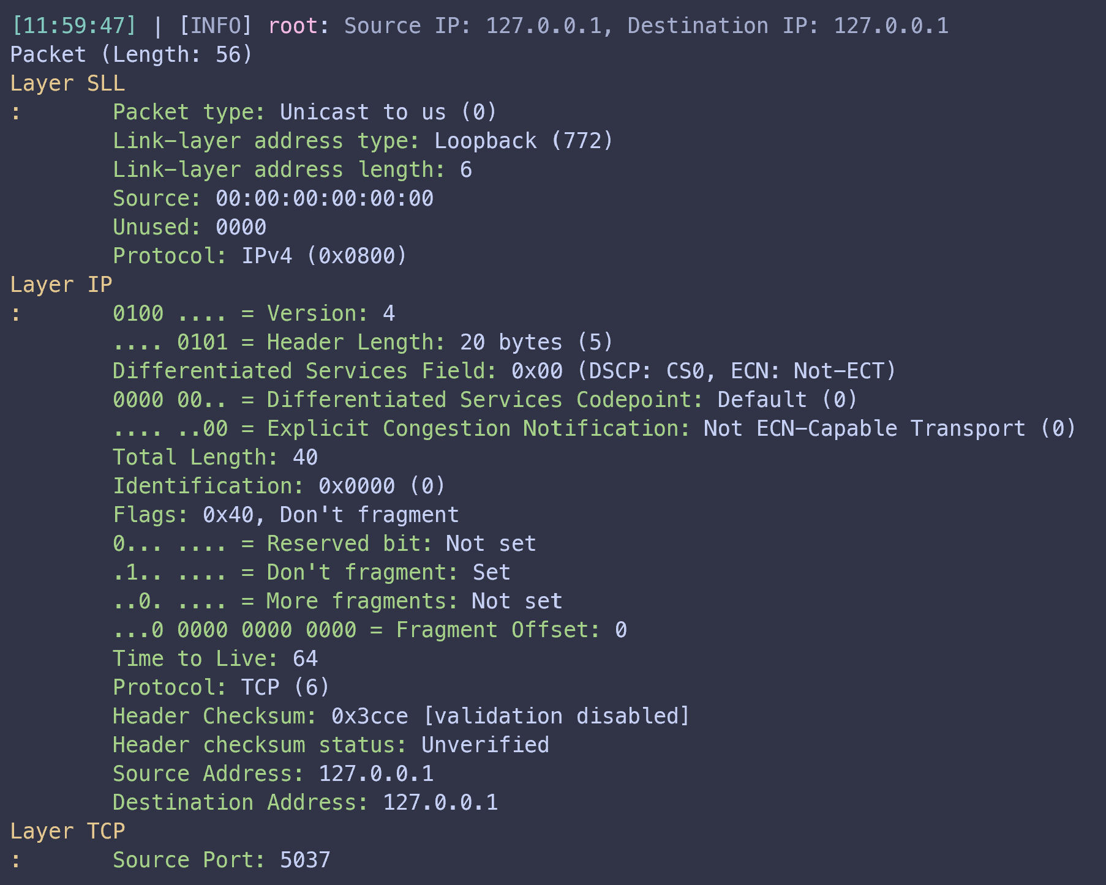
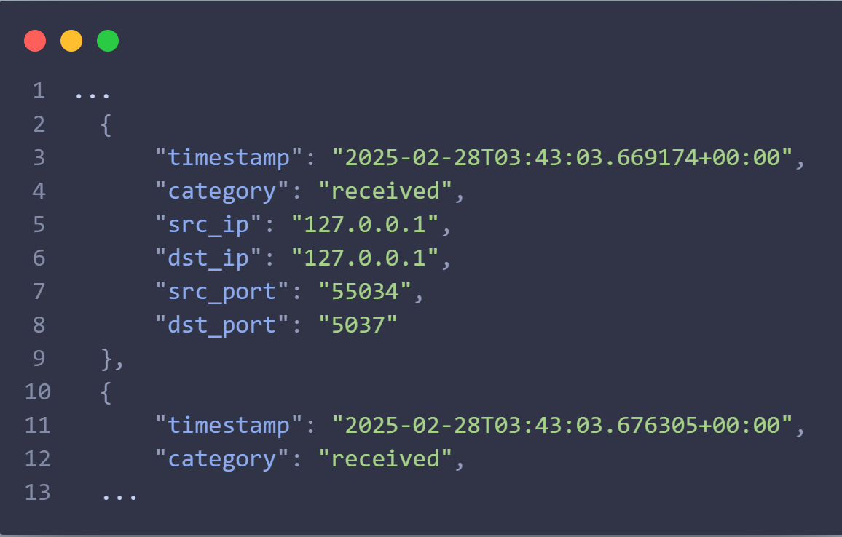
Major Project Accomplishments
Live network capture capabilities on the provided network interface
Traffic history logged in JSON format

Slide 24
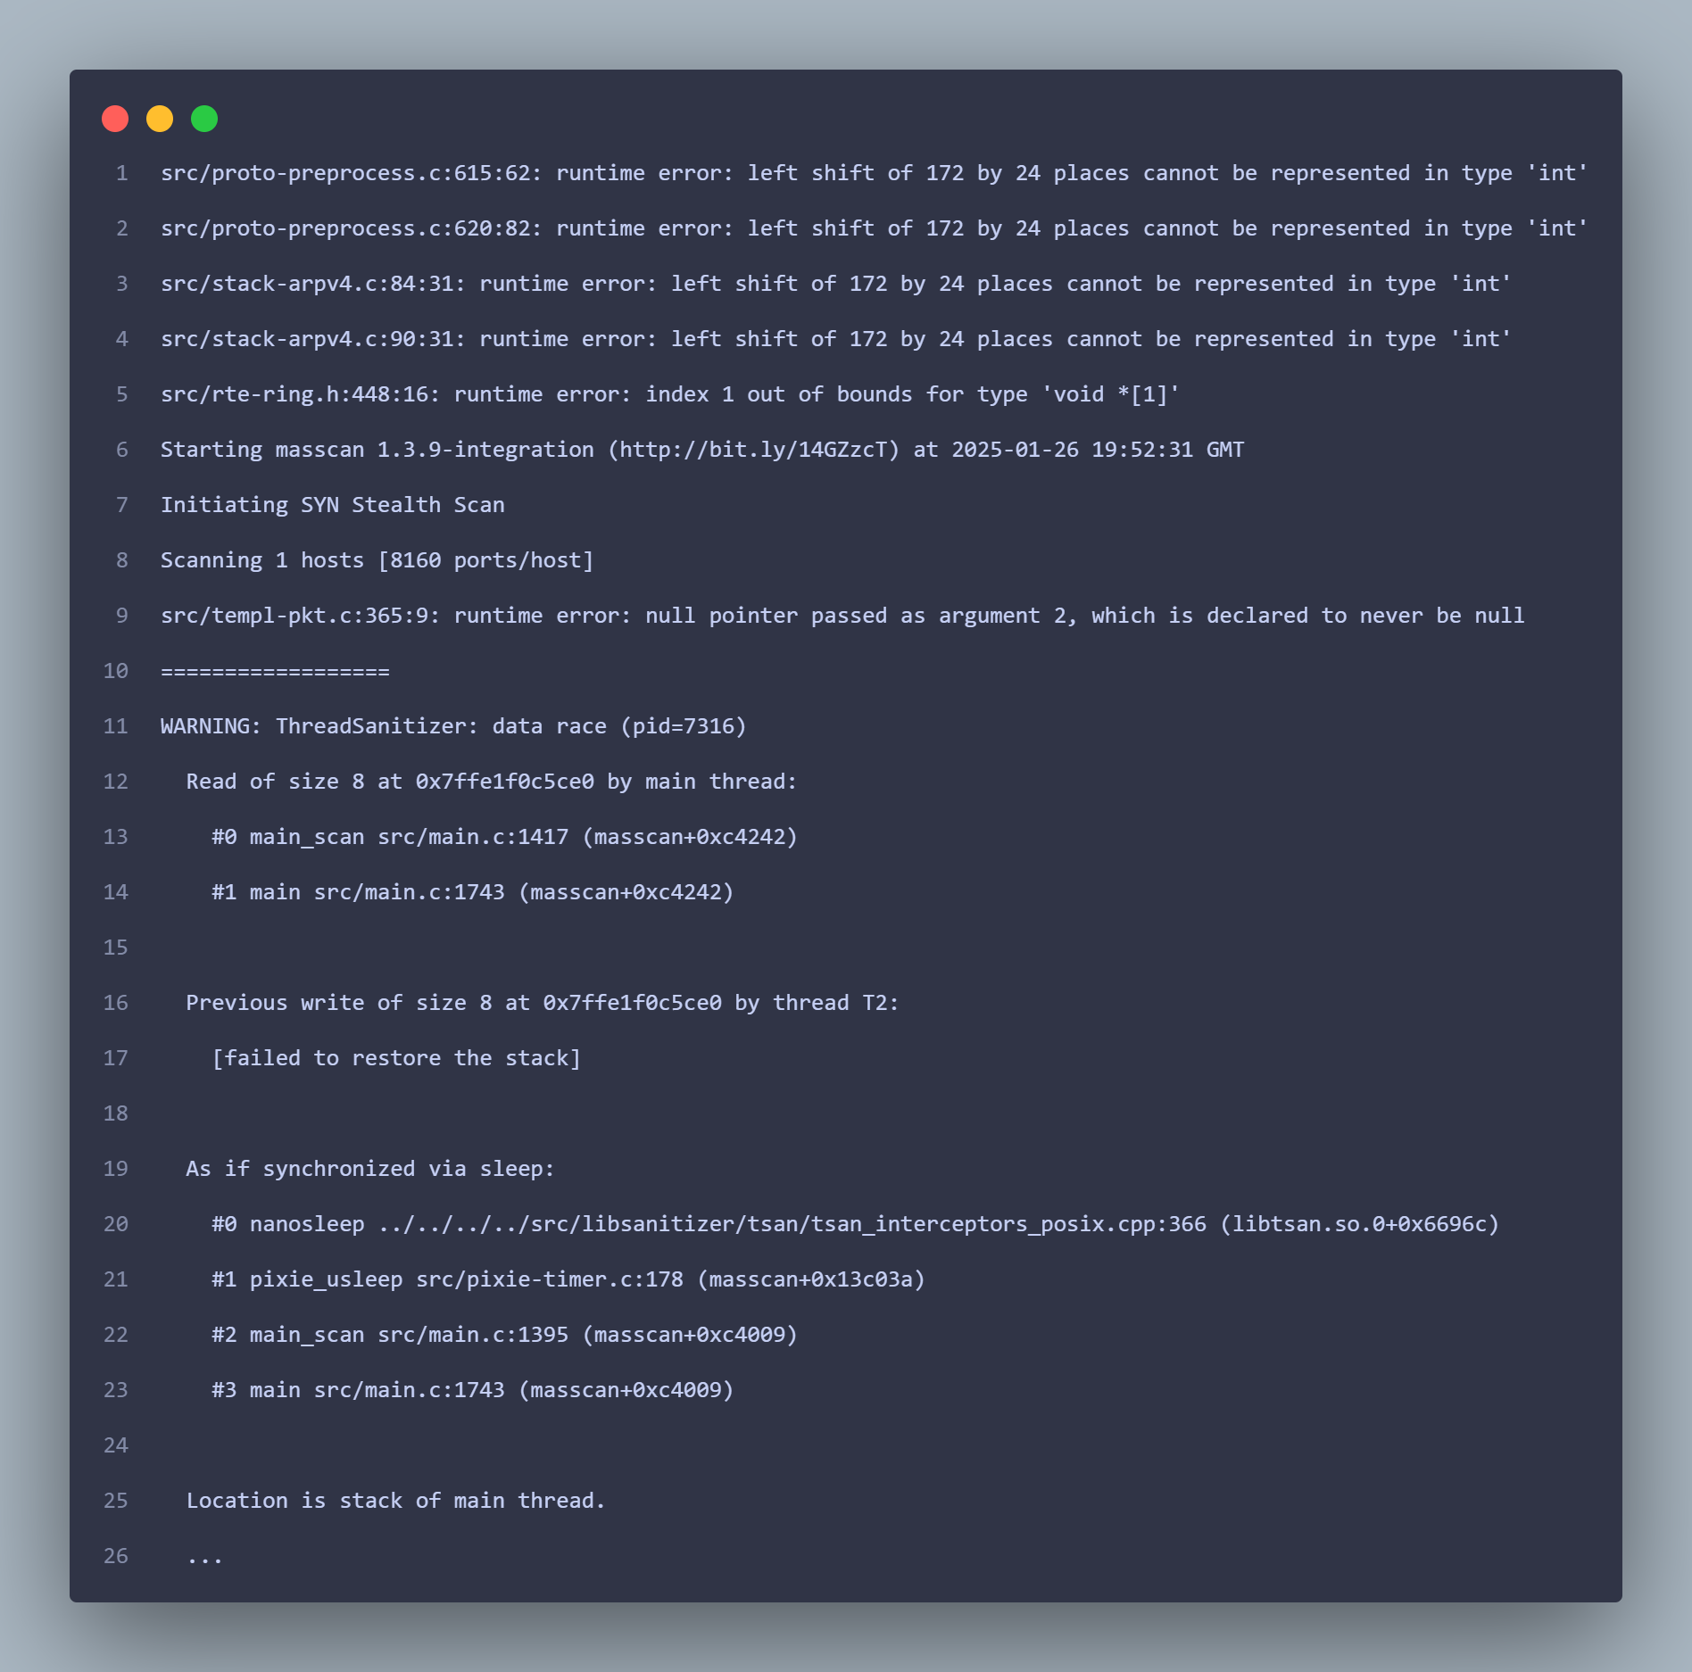
Major Project Accomplishments
Updated fuzzing workflow with ThreadSanitizer integration, including Masscan’s Makefile and our fuzzing workflow automation script

Slide 25
Demo Video

Slide 26
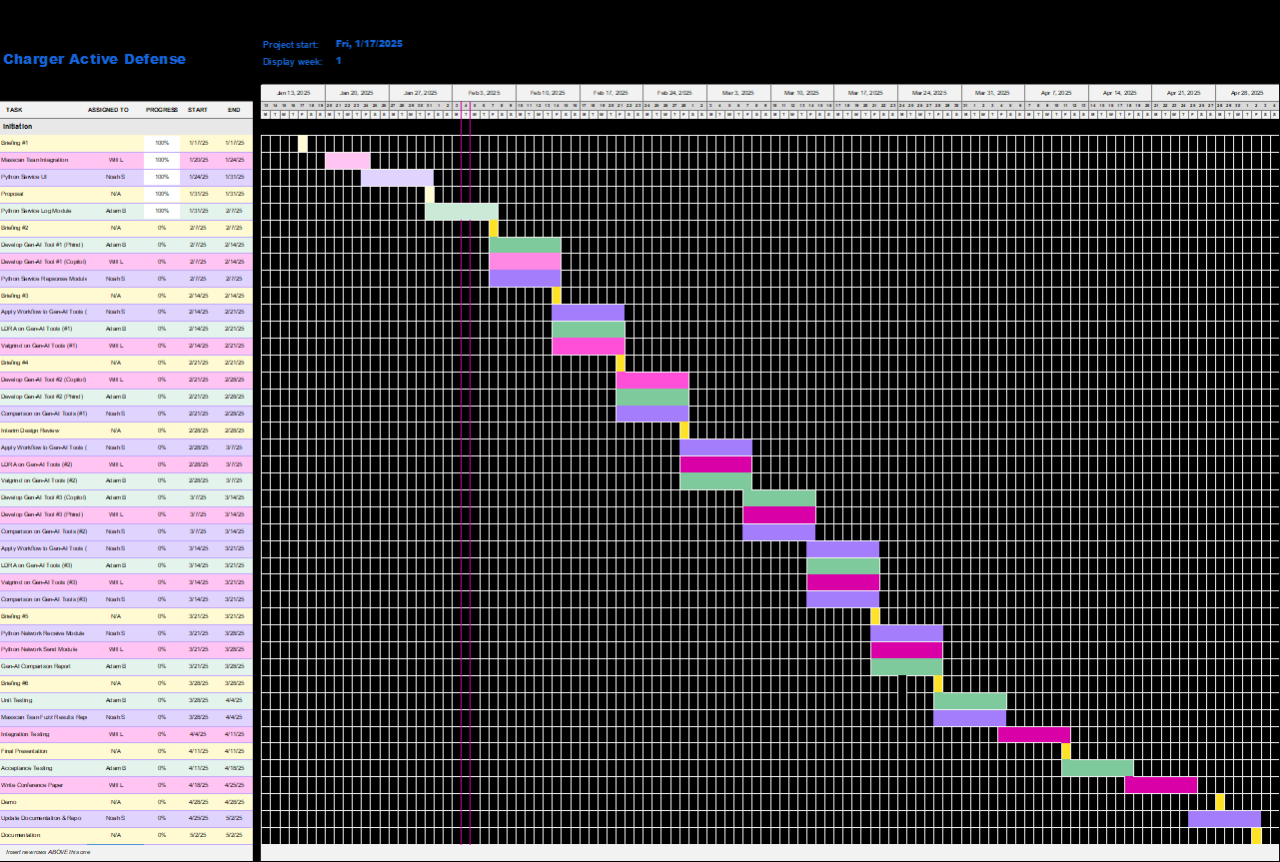
Proposed Timeline

Slide 27
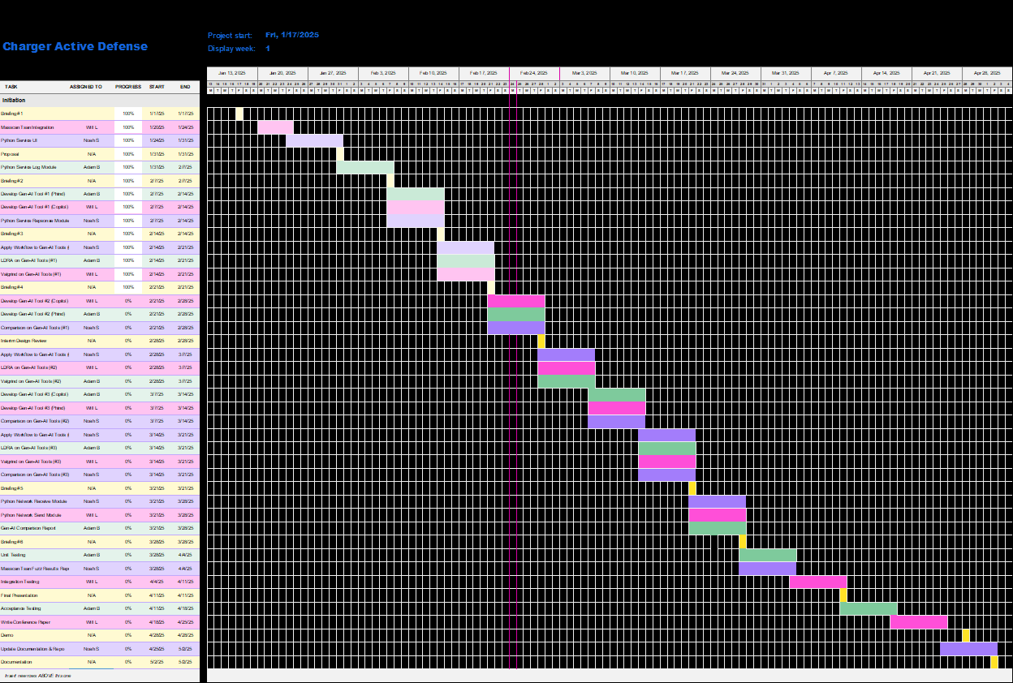
Actual Timeline
Complete

Slide 28
Proposed Milestones
Milestone | End Date
Masscan ThreadSanitizer Integration for AFLnet Fuzzing | 1/31
Python Service User Interface Complete | 2/3
Python Relay Error and Traffic Logging Module | 2/7
Gen-AI Banner-Grabbing Attack Tool | 2/14
Python Relay Network Handling Module | 2/14
LDRA Static Analysis on Gen-AI Banner-Grabber Tools | 2/21
Gen-AI Brute-Force Attack Tool | 2/28
Comparison of Results of Analysis & Fuzzing on Gen-AI Banner-Grabber Attack Tools Complete | 2/28
Static Analysis Performed on Gen-AI Brute Force Attack Tools | 3/7
Gen-AI Multi-Threaded Banner-Grabbing Attack Tool | 3/14

Slide 29
Proposed Milestones
Milestone | End Date
Compare Gen-AI Brute-Force Attack Tool Performance Between Models | 3/14
Static Analysis Performed on Gen-AI Multi-Threaded Banner-Grabber Attack Tools | 3/21
Comparison of Results of Analysis & Fuzzing on Gen-AI Brute Force Attack Tools Complete | 3/21
Python Service Network Receiver Module Developed | 3/28
Python Service Network Sender Module Developed | 3/28
Gen-AI Attack Tool Comparison Report Finished | 3/28
Unit Testing Complete | 4/4
Review of Masscan ThreadSanitizer Results | 4/4
Integration Testing Complete | 4/11
Acceptance Testing Complete | 4/18

Slide 30
Actual Milestones
Yellow = New
Milestone | Proj. End Date | Act. End Date | Status
Masscan with ThreadSanitizer Integrated into Fuzzing Workflow | 1/31 | 1/31 | ✔
Python Service User Interface Complete | 2/3 | 2/3 | ✔
Python Service Error & Traffic Logging Module Complete | 2/7 | 2/7 | ✔
Gen-AI Banner-Grabber Attack Tools Generated | 2/14 | 2/14 | ✔
Python Service Response Handling Module Complete | 2/14 | 2/14 | ✔
Fuzzing Workflow Applied to Gen-AI Banner-Grabber Attack Tools | 2/21 | 2/21 | ✔
Static Analysis Performed on Gen-AI Banner-Grabber Attack Tools | 2/21 | 2/21 | ✔
Gen-AI Brute Force Attack Tools Generated | 2/28 | 2/24 | ✔
Comparison of Results of Analysis & Fuzzing on Gen-AI Banner-Grabber Attack Tools Complete | 2/28 | 2/28 | ✔

Slide 31
Actual Milestones
Yellow = New
Milestone | Proj. End Date | Act. End Date | Status
Fuzzing Workflow Applied to Gen-AI Brute Force Attack Tools | 3/7 | 3/7 | ✔
Static Analysis Performed on Gen-AI Brute Force Attack Tools | 3/7 | 3/2 | ✔
Gen-AI Multi-threaded Banner-Grabber Attack Tools Generated | 3/14 | 3/10 | ✔
Comparison of Results of Analysis & Fuzzing on Gen-AI Multi-Threaded Banner-Grabber Attack Tools Complete | 3/14 | 3/14 | ✔
Fuzzing Workflow Applied to Multi-Threaded Banner-Grabber Gen-AI Attack Tools | 3/21 | 3/21 | ✔
Static Analysis Performed on Gen-AI Multi-Threaded Banner-Grabber Attack Tools | 3/21 | 3/15 | ✔
Comparison of Results of Analysis & Fuzzing on Gen-AI Brute Force Attack Tools Complete | 3/21 | 3/21 | ✔
Python Service Network Receiver Module Developed | 3/28 | 3/4 | ✔

Slide 32
Actual Milestones
Yellow = New
Milestone | Proj. End Date | Act. End Date | Status
Python Service Network Sender Module Developed | 3/28 | 3/1 | ✔
Gen-AI Attack Tool Comparison Report Finished | 4/4 | 4/4 | ✔
Unit Testing Complete | 4/4 | 4/4 | ✔
Masscan ThreadSanitizer Fuzzing Results Analyzed | 4/4 | 4/11 | ✔
Integration Testing Complete | 4/11 | 4/11 | ✔
Acceptance Testing Complete | 4/18 | - | ✘
IEEE Conference Paper Written | 4/25 | - | ✘
Documentation & GitHub Repository Updated | 5/2 | - | ✘
GitHub Repository & Research Published | 5/2 | - | ✘

Slide 33
Milestone Analysis
Missed Milestones | Proj. End Date | Act. End Date | Reason
Masscan ThreadSanitizer Fuzzing Results Analyzed | 4/4 | 4/11 | Server running AFLnet testing crashed, had to be re-imaged from backups.
Missing this milestone did not set us back much, as the unit testing for the fuzzing workflow with Masscan was set later in the week.

Slide 34
Milestone Analysis
Early Milestones | Proj. End Date | Act. End Date | Reason
Gen-AI Brute Force Attack Tools Generated | 2/28 | 2/24 | Overestimated duration of prompting before getting functional program that correctly compiled.
Static Analysis Performed on Gen-AI Brute Force Attack Tools | 3/7 | 3/2 | Generated tool earlier than originally estimated.
Gen-AI Multi-threaded Banner-Grabber Attack Tools Generated | 3/14 | 3/10 | Overestimated duration of prompting before getting functional program that compiled.

Slide 35
Milestone Analysis
Early Milestones | Proj. End Date | Act. End Date | Reason
Static Analysis Performed on Gen-AI Multi-Threaded Banner-Grabber Attack Tools | 3/21 | 3/15 | Generated tool earlier than originally estimated.
Python Service Network Receiver Module Developed | 3/28 | 3/4 | Completed at the same time as the implementation of the initial traffic sniffing.
Python Service Network Sender Module Developed | 3/28 | 3/1 | Completed at the same time as the implementation of the initial traffic sniffing.

Slide 36
Project Timing & Analysis
Level of completion for project
Masscan integrated with ThreadSanitizer. ✓
Generated 3 out of 3 attack tools: 100%
Performed Static Analysis on 3 out of 3 attack tools: 100%
Python service complete: 100%
User interface ✓
Live traffic monitoring ✓
traffic and error logging ✓
Active defense response handling ✓
Notes:
What is the level of completion of your project according to the revised plan submitted at the beginning of the semester?

Slide 37
Individual Contributions
Member | Overview of Contributions
Noah | Maintaining GitHub repository - organization, structure, general upkeep. Python replay service development - UI, logging and network handling. Application of fuzzing workflow on Gen-AI tools.
Adam | Generating the three attack tools from the Phind model. Performing Valgrind and Flawfinder analysis on all generated attack tools.
Will | Generating the three attack tools from the GitHub Copilot model. Performing LDRA static analysis on all generated attack tools.
Full individual contribution breakdown for each reporting period is available in appendix.

Slide 38
Level of Effort
Member | Brief 1 | Brief 2 | Brief 3 | Brief 4 | Brief 5 | Brief 6 | Total
Noah | 15 | 28 | 23 | 30 | 64 | 7 | 167
Adam | 5 | 18 | 8 | 8 | 24 | 2 | 65
Will | 7 | 20 | 5 | 3 | 20 | 3 | 58
Total | 29 | 66 | 36 | 41 | 108 | 12 | 290
Total work hours for each semester = 193 + 290 = 483. Original estimated effort ~= 450 hours.

Slide 39
Future Work
Some goals we would set if given more time to work on the current project include:
Extend the fuzzing workflow to include other network-based fuzzing and attack tools
While our first semester’s efforts focused on testing several fuzzing tools to use for the fuzzing workflow, there are still many available on the market we did not have time to assess.
Time/effort required would depend on the scope of additional tools, but could vary from a few weeks or an entirely new project.
Explore other AI’s to use for generating attack tools
Time/effort required would likely be similar to this semester - two AI models for three different attack tools.
Implement attack tool traffic identification to the Python replay service
Time/effort required would most likely warrant an entire design project - two semesters. This was originally planned, but dropped by recommendation of the sponsor.

Slide 40
Lessons Learned
Multi-threaded applications are often resistant to crashing and hanging, making fuzz-testing difficult
GitHub copilot educational licenses have a several day approval process
We were able start a one-month trial for Pro while we waited
ThreadSanitizer output does not display when using AFLnet
Fixed by piping the output to a file
The Phind AI raises ethical and legal concerns when generating password brute forcing tools

Slide 41
Analysis of Modifications from Original Plan
Key Changes
Incoming traffic between attacker and victim VMs are assumed to be the attacking tool.
Removed attack tool traffic identification requirement at recommendation of the sponsor due to added complexity and feasibility.
Added AI-generated attack tools to scope of fuzz testing targets.
Originally, the sponsor wished for us to use AI to generate active defense responses, but he allowed us to instead use it to generate AI attack tools.

Slide 42
Conclusion
Attackers today use tools that are extremely efficient, often capable of sending hundreds if not thousands of requests per minute
Our solution is to have an active defense mechanism that targets attackers directly by sending data packets that hang or crash the attacker's application
This is different from the standard solution of blacklisting the attacker’s IP address.
This is innovative since it focuses on exploiting vulnerabilities in the attacker's code instead of patching our own.
We hope that our project will pave the way for further research into the feasibility of active defense.
Notes:
Describe the problem and the solution
What is innovative in your project?
What has been accomplished?
What is expected impact of your project?

Slide 43
Questions

