Slide 1
Software Fuzzing Workflow & Tool for Slowing Adversarial Attack Tools
Adam Brannon, Noah Sickels, William Lochte
MENTOR: Dr. David Coe
CPE495 COMPUTER ENGINEERING DESIGN I CPE 488: CYBERSECURITY ENGINEERING CAPSTONE I
ELECTRICAL AND COMPUTER ENGINEERING UNIVERSITY OF ALABAMA IN HUNTSVILLE
email: ajb0093@uah.edu, ncs0016@uah.edu, wpl0001@uah.edu

Slide 2
Stalling Attacker’s Tools
Attackers today use tools that are extremely efficient, often capable of sending hundreds if not thousands of requests per minute or send packets infrequently over multiple days to avoid detection.
Therefore, it is important to slow down or stop attackers. An active defense mechanism can do this by neutralizing an attacking application, wasting an attacker’s time and resources.
Useful for all businesses with information to protect.
It will also be helpful to perform a counterattack using binary exploitation to install malware on the attacker’s computer in cases where it is legal to do so.
Could be useful in a nation-state scenario.

Slide 3
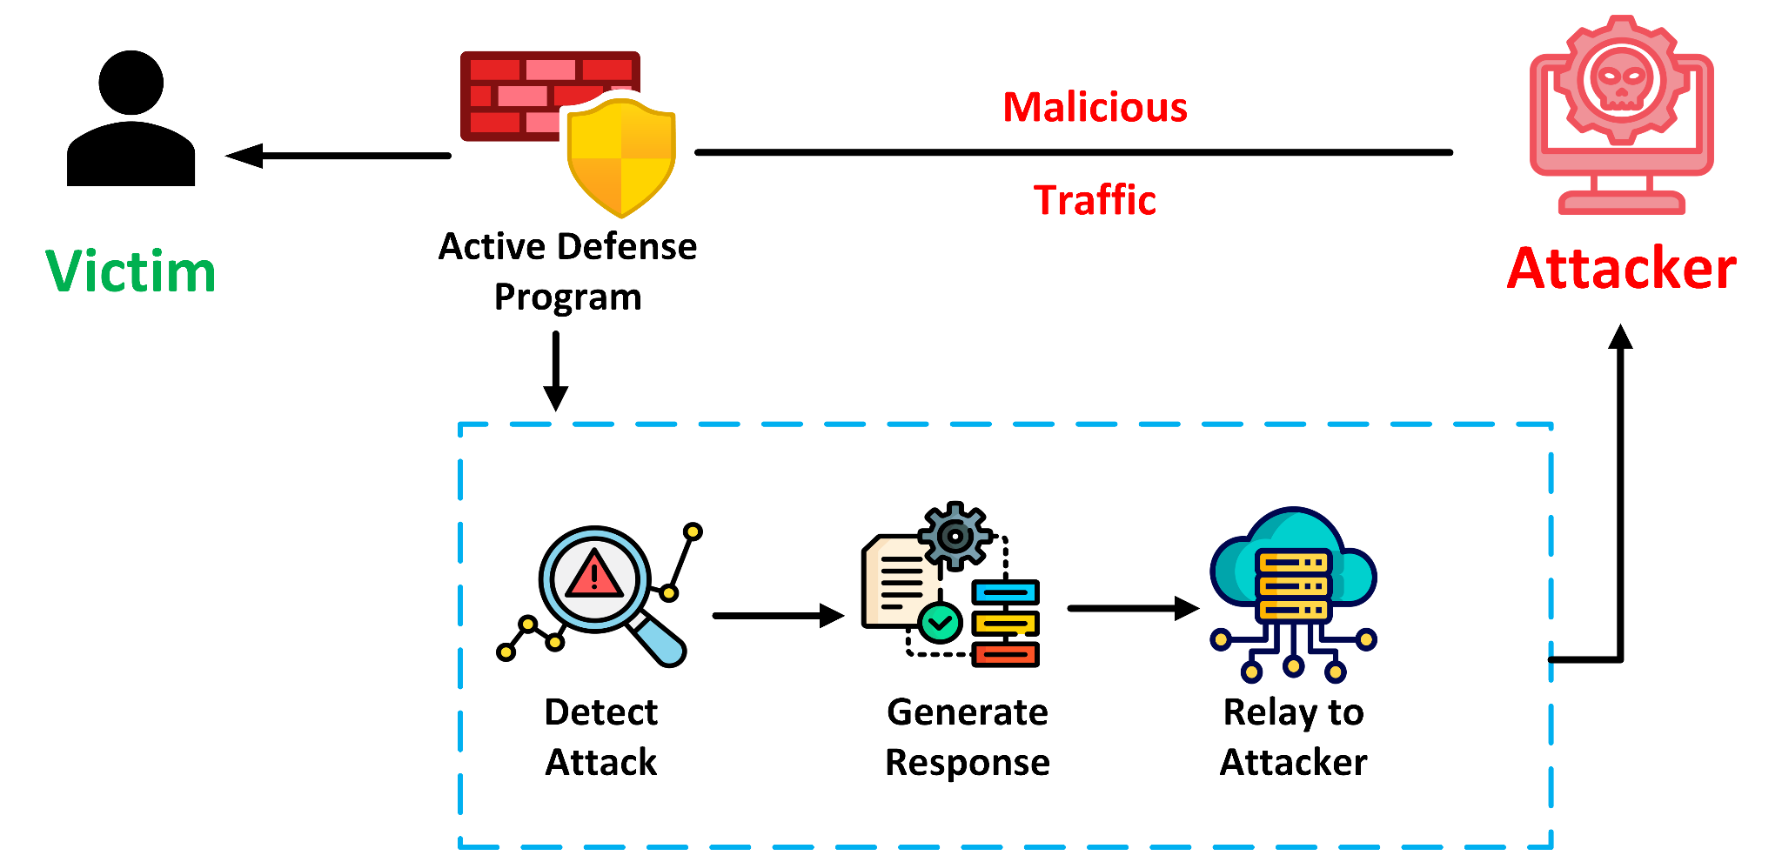
Charger Active Defense Overview

Slide 4
Innovation
Push the industry forward by finding a new exploitable vulnerability for a cyber attack tool.
Fuzzing is a well documented technique for finding vulnerabilities in software but it is not usually placed on the attack tools themselves to find exploitable vulnerabilities as an active defence mechanism.
Implementation of an adaptive real-time defense strategy, focused on proactive defense instead of reactive.

Slide 5
Marketing Requirements
Workflow should prioritize attack tools that are more likely to have vulnerabilities
Workflow should fuzz test attack tools for vulnerabilities
Proof of concept program should mitigate or slow an attacking tool
Proof of concept program should provide an active defense response
Proof of concept should show that the workflow functions
Proof of concept should use AI/LLM to generate responses capable of neutralizing or slowing the attacking application
Findings should be placed into a IEEE/ACM style paper

Slide 6
Engineering Requirements
Marketing Requirements | Engineering Requirements | Justification
1 | Workflow should prioritize tools that are at least 25% C/C++ or have memory errors during static analysis | C/C++ are memory unsafe languages, which mean they are more likely to have memory vulnerabilities. We allow static analysis as an alternative to support other languages
1,2 | Workflow should choose a static analysis tool | Static analysis will help with prioritizing attack tools
2,4,5 | Workflow should find at least 1 exploitable vulnerability within attacking application | To be able to stop or slow the attacking application
3,4,6 | Proof of concept should be able to crash or hang the attacking application for at least 1 second | A 1 second hang will greatly reduce the efficiency of the attacking application
See Appendix A for full list

Slide 7
Market & Competition
Market and competition primarily consists of two main categories:
IDS/IPS Solutions
Snort3, Cisco
Efficient, Robust, Free/Open-Source
Suricata, OISF
Easy to use, Customizable, Direct rule feeds, Partially Free/Open-Source
EDR Solutions
CrowdStrike Falcon, CrowdStrike
Broad OS support, 24/7 Support Service, $99-$185/Device per month
SentinelOne Singularity Complete, SentinelOne
Real-time monitoring, reactive threat isolation, $36/VM per month

Slide 8
Comparative Advantages over Market Competitors
Snort3, Cisco
Can be easily misconfigured.
Generates more false positives and false negatives.
Designed to prevent traffic on specific ports; does not affect adversary’s attack tool.
Suricata, OISF
Rule feeds for specific attacks and attack tools are paywalled.
Does not affect adversary’s attack tool.
CrowdStrike Falcon, CrowdStrike
Can be expensive; lose all access when license expires.
Generates high false negatives.
Cloud dependency.
Complex integration process.
SentinelOne Singularity Complete, SentinelOne
Can be expensive; lose all access when license expires.
Generates high false negatives.
Vendor lock-in.

Slide 9
Existing Projects
EkHunter:
Automatically detects presence of web-based exploit vulnerabilities, and derives test cases to compromise integrity of exploit kit and even kit operator.
AutoFuzz:
Framework for automatically testing and fuzzing network protocols for implementation flaws.
LSSM:
AI/ML to actively resist deductive attacks from network traffic analysis.
Eshete, Birhanu, et al. "EKHunter: A Counter-Offensive Toolkit for Exploit Kit Infiltration." NDSS. 2015. http://dx.doi.org/10.14722/ndss.2015.23237.
Gorbunov, Serge, and Arnold Rosenbloom. "AutoFuzz: Automated Network Protocol Fuzzing Framework." IJCSNS 10.8 (2010): 239.
Z. Zhou, X. Kuang, L. Sun, L. Zhong and C. Xu, "Endogenous Security Defense against Deductive Attack: When Artificial Intelligence Meets Active Defense for Online Service," in IEEE Communications Magazine, vol. 58, no. 6, pp. 58-64, June 2020, doi: 10.1109/MCOM.001.1900367.

Slide 10
Existing Patents
IMMIX-Intrusion Detection & Prevention Systems, Cylance Inc.
Endpoint detection and response utilizing machine learning.
“Detection of Anomalies, Threat Indicators, & Threats to Network Security”, Splunk
Methodology for detecting anomalies in activity on a computer network by processing, using a plurality of machine-learning anomaly models to identify, generate, and process anomaly data.
Automated Analysis using Sandbox & Machine Learning Classification Veracode Inc.
Methodology for automated behavioral and static analysis using a sandboxed environment and machine learning detection.
IMMIX, Rahul C. Kashyap, Vadmin D. Kotov, Samuel J. Oswald, 2018, ID: EP3568792B1
Splunk Security Platform, Sudhakar Muddu, Christos Tryfonas, 2019, ID: US20190342311A1
Veracode Automated Analysis Methodology, Theodora H. Titonis, Nelson R. Manohar-Alers, Christopher J. Wysopal, 2017, ID: EP2610776B1

Slide 11
Possible Approaches
Smart Fuzzing
Uses built-in intelligence
Achieves higher code coverage
More efficient in terms of computation and time
Dumb Fuzzing
Generates completely random input
May uncover bugs more readily
Time and computationally intensive
Comparison
Smart fuzzers focus on specific areas of code
Smart fuzzers are generally more favorable due to efficiency
Dumb fuzzers explore broader possibilities

Slide 12
Possible Fuzzing Targets
Masscan, asynchronous port scanner - 99.8% C
Aircrack-ng, WiFi security auditing suite - 71.9% C
Medusa, login brute-forcer - 69.8% C
Reaver, WPS brute-forcer - 99.4% C
Yersinia, framework for layer-2 attacks - 95.9% C
Tool | Est. Importance | Est. Likelihood of Vulnerability | Priority
Aircrack-ng | 5 | 3 | 15
Reaver | 3 | 4 | 12
Yersinia | 1 | 4 | 4
Masscan | 3 | 3 | 9
Medusa | 2 | 5 | 10
Scale of 0-5 where 0 is least important/likely and 5 is most important/likely

Slide 13
Risks for the Fuzzing Workflow
Attack Tool Identification
Likelihood: Medium-High
Impact: High
Mitigation: Extensively test each of the various attack tool candidates with several analysis tools to ensure attack tool is sufficient
Vulnerability Discovery Capability
Likelihood: High
Impact: Critical
Mitigation: Employ multiple fuzzing techniques, integrate with static analysis tools.
Fuzz Testing Workflow
Likelihood: Medium
Impact: Moderate
Active Defense Response Generation
Likelihood: High
Impact: Critical
Mitigation: Develop multiple response types, implement thorough testing procedures
Scalable Framework Implementation
Likelihood: Medium
Impact: Moderate
Overall Risk Exposure: High-Moderate

Slide 14
Summary
The need for this project is to find an exploitable vulnerability for a cyber attack tool that a victim computer or organization can exploit as an active defense mechanism
We plan to accomplish this by using a fuzz testing software to find bugs to exploit in an attacking tool
The vulnerability should slow down the attack or prevent the attacker from using that specific tool
We plan on developing a workflow that streamlines this process to make it easier for others to accomplish the same thing
We plan to write an IEEE/ACM style paper to document the workflow of fuzz testing the cyber attacking tool

Slide 15
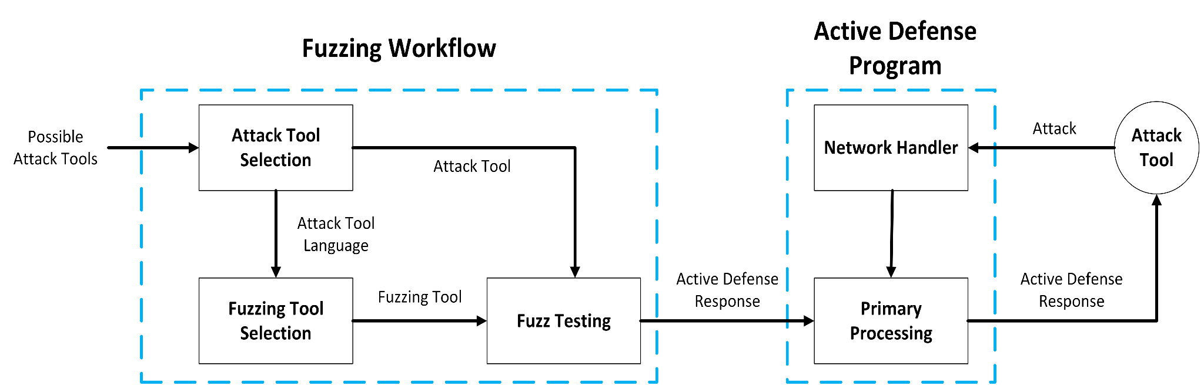
Functional Decomposition

Slide 16
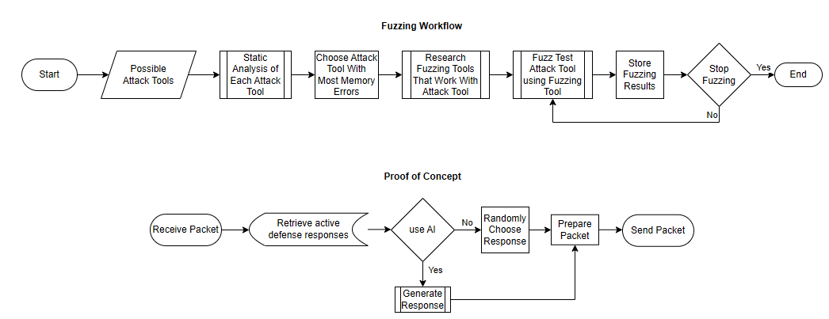
Behavioral Decomposition

Slide 17
Testing Plan
Unit Tests
Valid fuzzing test response(s) acquisition
Network traffic acquisition
Attack tool network traffic identification
Integration Tests
Analyzing captured network traffic
Sending generated response back to adversary
Script sends proper response based on identified traffic
Acceptance Tests
Workflow adequately finds and generates counter-attack responses to adversarial applications
Appropriate response generated
Attack tool network traffic correctly identified

Slide 18
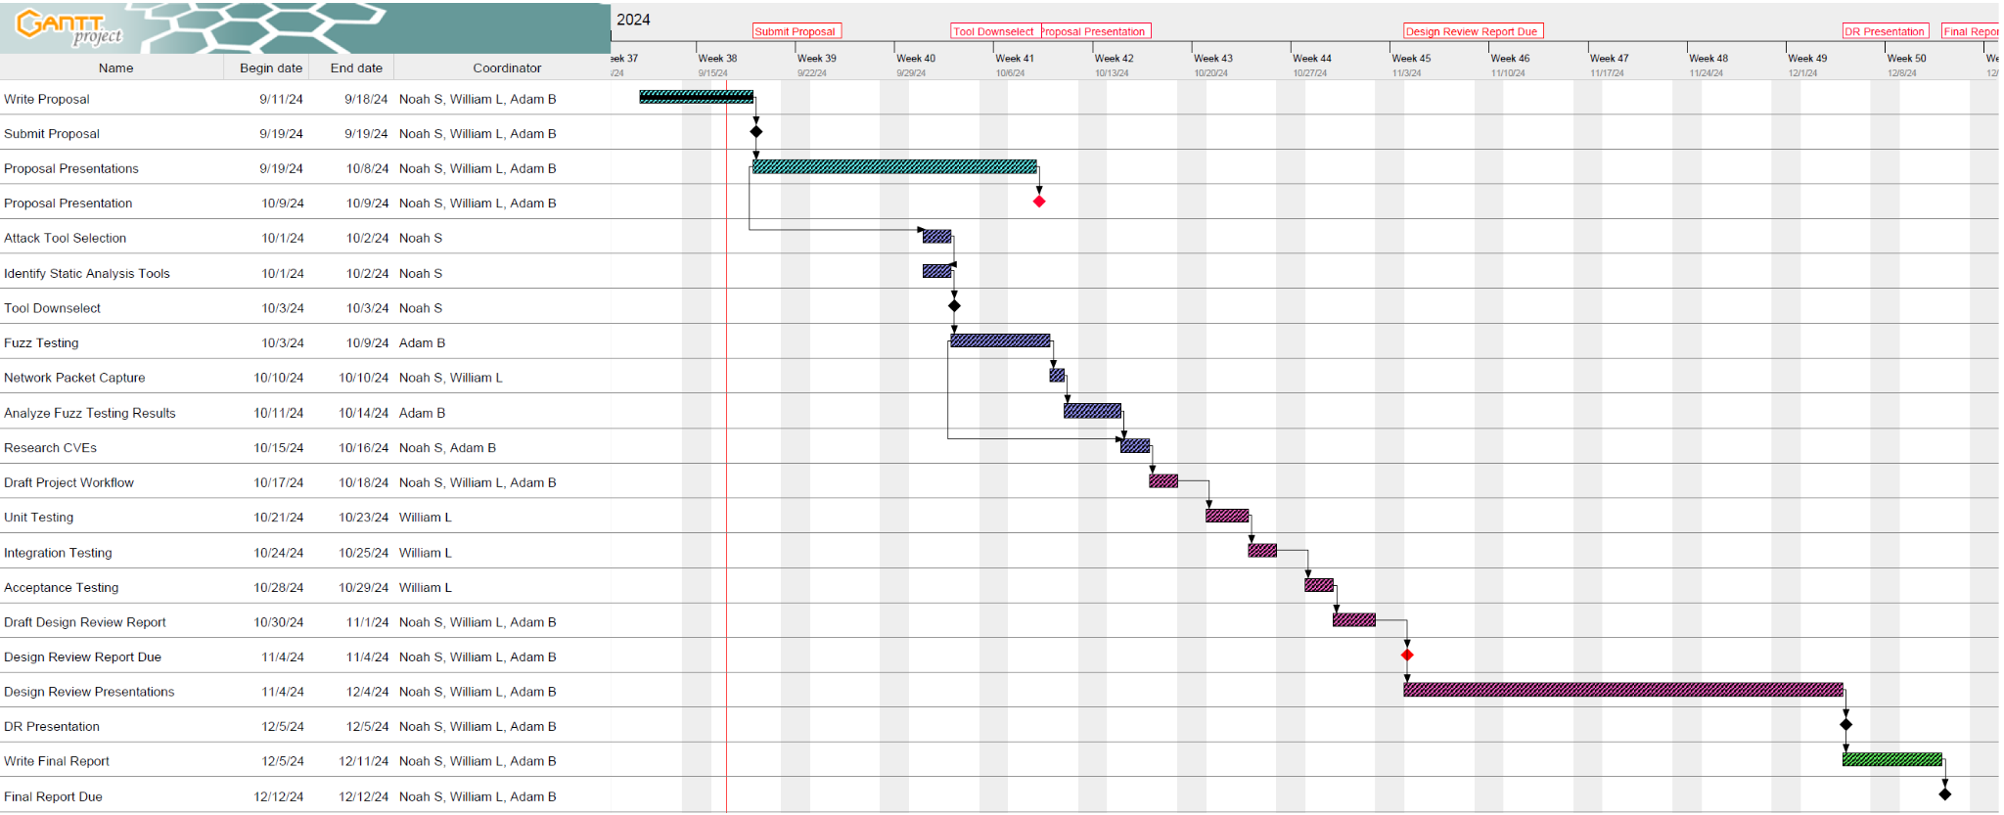
Project Timeline
Critical path duration: ~85 days

Slide 19
Individual Responsibility
Adam Brannon:
Primary: Fuzzer
Secondary: Primary processing
Noah Sickels:
Primary: Attack tool selection
Secondary: Fuzz tool selection
William Lochte:
Primary: Packet Capture
Secondary: Testing (Unit, Integration, Acceptance)

Slide 20
Cost Estimation
Estimated Cost: $300.00
Expected Software:
AFL (including forks)
Cost: $0.00
LDRA
Cost: $0.00
Licensed to UAH
Premium Chat GPT
Cost: $20.00/person per month
Labor Cost: 150 hours/person, 450 hours total

Slide 21
CPE 495/496 Expected Deliverables
ID | Activity | Description | Deliverables / Checkpoints | Duration (Days) | People | Resources | Prede- cessors
1 | Tool(s) Selection
1.1 | Attack Tools Selection | Choose attack tools to analyze | Identify two potential tools for testing | 1 | Noah
1.2 | Fuzzing Tool(s) Selection | Choose tools to analyze with | Identify all fuzzing tools for workflow | 1 | Noah
1.3 | Pre-screening Tools | (opt) Prescreen attack tools for candidate | Identify two potential tools for testing | 1 | Adam
2 | Tool Analysis
2.1 | AFL/AFL++ Fuzzing | Perform testing on attack tool with AFL/AFL++ | Confirmed crashes/hangs | 3 | Adam | AFL tools Attack tools Test bench | 1.1, 1.2
2.2 | LDRA Static Analysis | Perform testing on attack tool with LDRA | Confirmed memory leaks | 3 | Will (1) Adam (2) | LDRA TestBed LDRA TBRun Test bench | 1.1, 1.2

Slide 22
CPE 495/496 Expected Deliverables
ID | Activity | Description | Deliverables / Checkpoints | Duration (Days) | People | Resources | Prede- cessors
3 | Networking Traffic
3.1 | Attack tool network traffic | Capture traffic using Wireshark while running attack tool | Captured network traffic .PCAP file | 1 | Noah | Attack tool Wireshark Metasploitable VM Test bench | 1.1
4 | Test Data Analysis
4.1 | Review attack tool network traffic | Review captured network traffic from attack tool. | Identify attack tool traffic behavior and interaction | 1 | Adam | Captured network traffic .PCAP file Wireshark Test bench | 1.1, 3.1
4.2 | Review Found Memory Leaks | Review discovered memory leaks from fuzzing & analysis test | Identify actionable memory leaks | 1-2 | Will (1) Adam (2) | AFL/AFL++ test results LDRA test results | 1.1, 1.2, 2.2
4.3 | Research Attack Tool
4.3.1 | Find relevant CVEs | Search for CVEs relevant to attack tool | Relevant CVE ID(s) | 1-2 | Adam (1) Noah (2) | CVE database Exploit-DB | 1.1, 2.1, 2.2, 3.1

Slide 23
CPE 495/496 Expected Deliverables
ID | Activity | Description | Deliverables / Checkpoints | Duration (Days) | People | Resources | Prede- cessors
5 | Project Workflow
5.1 | Draft fuzzing workflow | Begin fuzzing workflow design and report | Complete fuzzing workflow | 3 | All | Fuzz test results LDRA testing results CVE entries | 1.2, 4.1
6 | Testing Plan
6.1 | Unit Tests | Unit testing of individual components | Workflow components verification | 1-2 | Will (1) Noah (2) | Verified fuzz testing workflow Test bench | 5.1
6.2 | Integration Tests | Integration tests of components together |  | 1-2 | Will (1) Noah (2) | Verified components from prior tests Test bench | 5.1, 6.1
6.3 | Acceptance Tests | Customer acceptance of workflow | Meet with customer Customer acceptance of fuzzing workflow | 1-2 | Will (1) Adam (2) | Successful unit/integration tests | 5.1, 6.1, 6.2
6.4 | Revise Test Plans | Revise testing plans as needed based on feedback | Finalized, verified testing workflow | 1-2 | Adam (1) Will (2) |  | 6.1, 6.2, 6.3

Slide 24
CPE 495/496 Expected Deliverables
ID | Activity | Description | Deliverables / Checkpoints | Duration (Days) | People | Resources | Prede- cessors
7 | Design Review
7.1 | Draft Design Review report | Begin writing Design Review report | Design Review report | 3 | All | Completed fuzzing workflow | 5.1, 6.1, 6.2, 6.3
7.2 | Design Review due | Design Review submission | Design Review report | 1 | All | Completed DR report | 7.1
7.3 | Design Review Presentation | Class group presentation for Design Review | Design Review report | 1 | All | Completed DR report | 7.1, 7.2
8 | Final Report
8.1 | Draft Final Report | Begin writing final project report | Final project report | 5 | All | Comments from Design Review | 7.3
8.2 | Final Report due | Final Report submission | Final project report | 1 | All | Completed Final project report | 7.3, 8.1

Slide 25
Questions

Slide 26
Appendix A:
Full Engineering Requirements

Slide 27
Appendix A: Engineering Requirements
Marketing Requirements | Engineering Requirements | Justification
1 | Workflow should prioritize tools that are at least 25% C/C++ or have memory errors during static analysis | C/C++ are memory unsafe languages, which mean they are more likely to have memory vulnerabilities. We allow static analysis as an alternative to support other languages
1,2 | Workflow should choose a static analysis tool | Static analysis will help with prioritizing attack tools
1,2 | Workflow should choose a fuzzing tool | Choice of fuzzing tool will depend on scenario
2,4,5 | Workflow should find at least 1 exploitable vulnerability within attacking application | To be able to stop or slow the attacking application
3,4,6 | Proof of concept should be able to crash or hang the attacking application for at least 1 second | A 1 second hang will greatly reduce the efficiency of the attacking application

Slide 28
Appendix A: Engineering Requirements
Marketing Requirements | Engineering Requirements | Justification
7 | Report should include keywords at the start | IEEE report standard
7 | Report should include abstract at the start | IEEE report standard
7 | Report should include byline at start | IEEE report standard
7 | Figures, tables and equations should be at the top or bottom of the page not the middle | IEEE report standard
7 | Report body should use 10 pt Times New Roman font | IEEE report standard
7 | Report body should be formatted as two columns per page | IEEE report standard
7 | Report should use IEEE style headers | IEEE report standard

Slide 29
Abstract
Modern attack tools are efficient, allowing them to attack quickly. To mitigate this risk, it is important to have a way to slow or stop them. Our solution plans to accomplish this by finding network responses that cause attack tools to crash or hang, and then providing those network responses whenever the attack tool makes a request. We expect that our project will lead to a workflow for countering attack tools using fuzz testing.

