Slide 1
Unscented Kalman Filter-Based Bayesian Filtering of RC Circuit
Authors: Ranu Sharma, Rahul Bansal
Group Members
312513010 賴宥齊
312513007 林芷妘

Slide 2
Outline
Introduction & Background
Method
Unscented Kalman Filter
Model of RC Circuit
State space representation of RC LPF Circuit
Stochastic Based Model of RC LPF Circuit
Simulation
Data preparation
Simulation Results
Ablation study

Slide 3
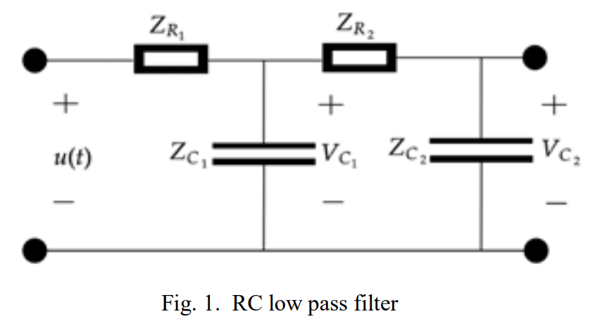
Introduction & Background
Goal: Estimate output voltage of second order RC LPF circuit using the unscented Kalman filter (UKF).
Stochastic modeling is a method that used to describe the complex system along with some uncertainties.

Slide 4

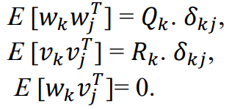
Unscented Kalman Filter
The nonlinear discrete-time system is represented as:
Kalman can only solve the linear system. Therefore…
Extended Kalman Filter
Unscented Kalman Filter

Slide 5
Unscented Kalman Filter
Unscented Kalman Filter & non-linear function
By using 2L+1 symmetrically-Sigma sampling.
2L+1 symmetrically-Sigma sampling.
Sigma points are chosen and weight of all sigma points is calculated such that their additive weight should be equal to one.

Slide 6
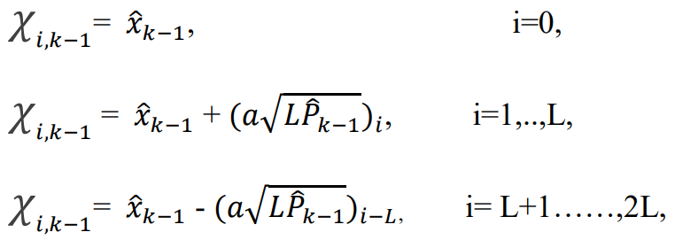


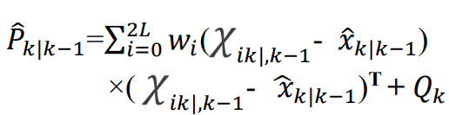
Unscented Kalman Filter
Step 1: n-dimensional RV are represented as:
Step 2: Prediction step:
Each sigma point is passed through nonlinear model to obtain new samples
Notes:
a(a set of small positive values) is a real number determining the spread of sigma point around the RV mean, i in the following term denotes the column of the matrix square root.

Slide 7
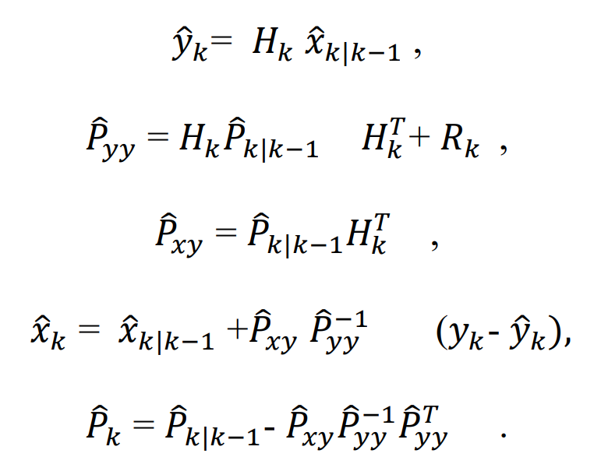
Unscented Kalman Filter
Step 3: Update Step:
Using the Kalman filter equations, measurement updates are performed:
Notes:
It is clearly evident that UKF does not require calculating Jacobian.

Slide 8
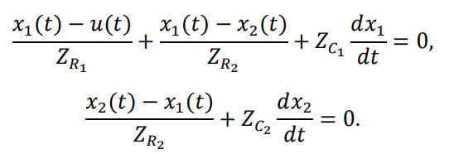
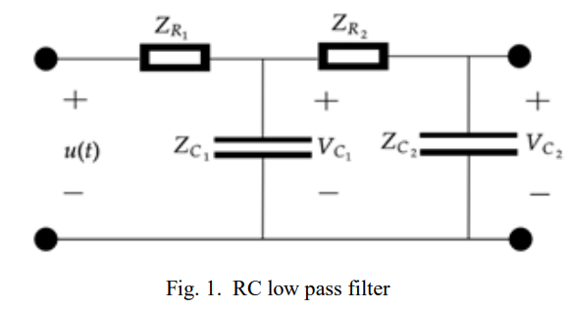






State Space representation of RC LPF Circuit
Consider the state variables and applying KCL to the circuit
Therefore, we can formulate the ODE as:

Slide 9


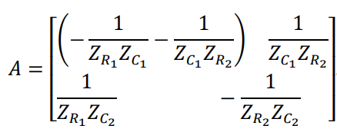

State Space representation of RC LPF Circuit
The ODEs can be expressed using state-space representation as:

Slide 10
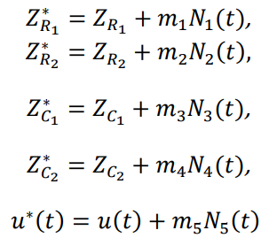


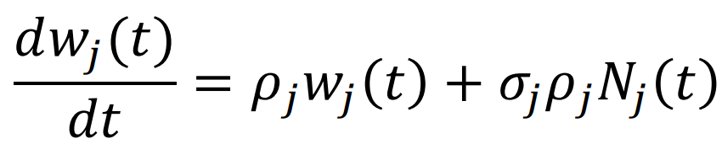
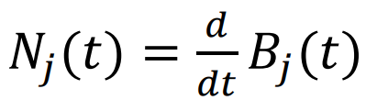
Stochastic Based Model of RC Circuit
We can obtain SDE by introducing white Gaussian process to the input voltage and circuit components in ODE (deterministic model).

Slide 11
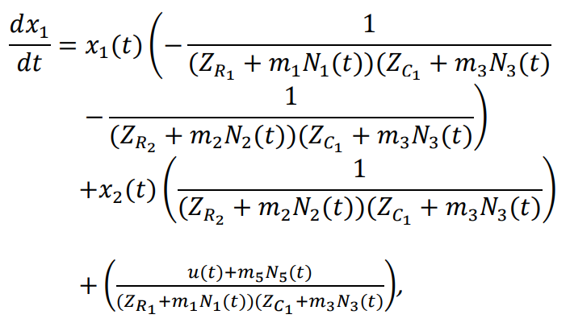
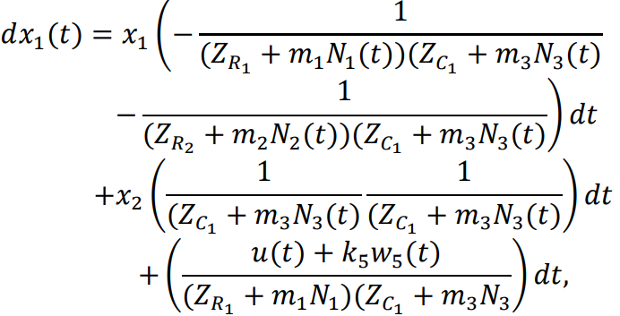
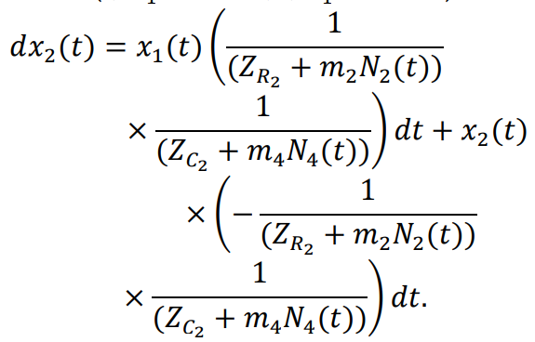
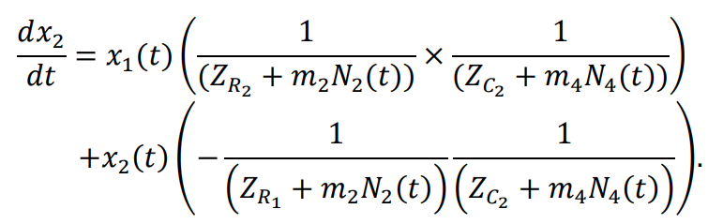
Stochastic Based Model of RC Circuit
So we have:

Slide 12



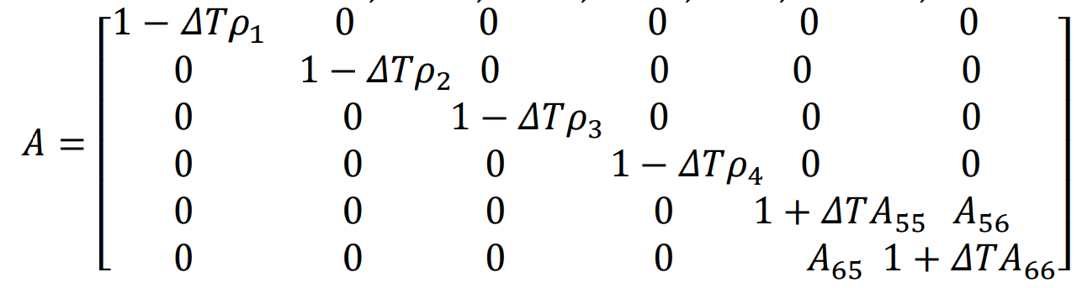
Stochastic Based Model of RC Circuit
With Euler-Maruyama method, we can get the DT system model:

Slide 13
Stochastic Based Model of RC Circuit
Let’s look into physical meaning of the stochastic based model
The new state of RC Circuit is determined by:
Previous state
Input source
Noise of each components
X: the new state of the RC Circuit
AnXn: the impact of the previous state.
Zn: the impact of the input source.
KnBn: the impact of the noise.

Slide 14
Simulation
Data preparation:
Actual value: LTspice simulation results are considered as actual values.
Estimated value: UKF in MATLAB.
Configuration
ZR1 = 1MΩ, ZR2 = 1MΩ, ZC1 = 1uF, ZC2 = 1uF, σj=1, ρj=1.
Q = eye(6) [uncorrelated]
R = [1]
a = 1.5

Slide 15
Simulation
Root Mean Square Error
 | RMS in paper | RMS of our simulation
m1=m2=m3=m4=m5=1 | No given | 0.2550
m1=m2=m3=m4=m5=0 | No given | 0.2897
m1=1, m2=m3=m4=m5=0 | 0.14 | 0.2555
m2=1, m1=m3=m4=m5=0 | 0.13 | 0.2553
m3=1, m1=m2=m4=m5=0 | 0.15 | 0.3165
m4=1, m1=m2=m3=m5=0 | 0.12 | 0.2548
m5=1, m1=m2=m3=m4=0 | 0.09 | 0.2553

Slide 16
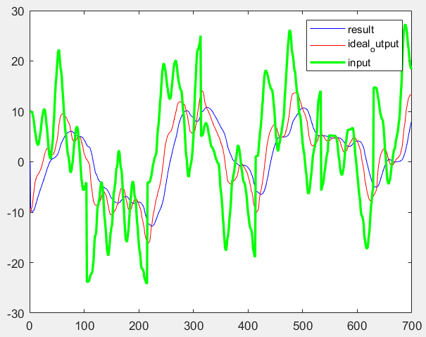
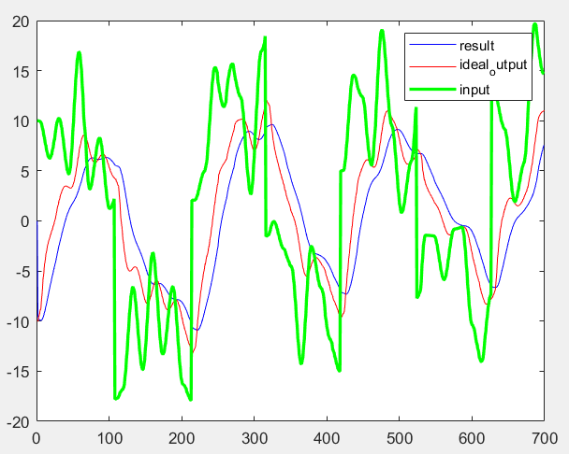
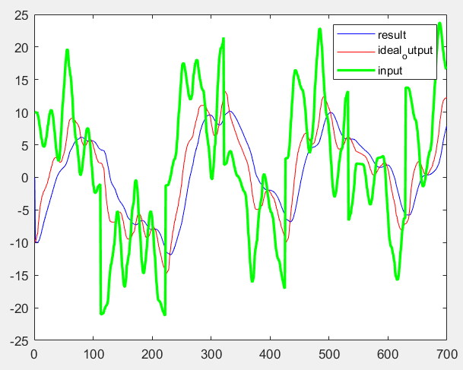
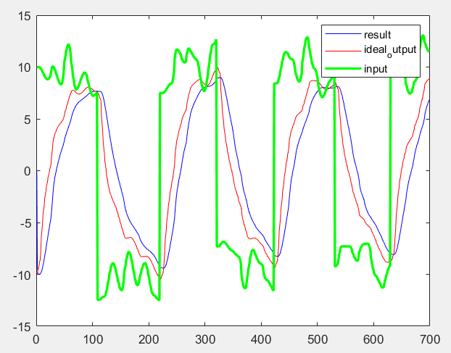
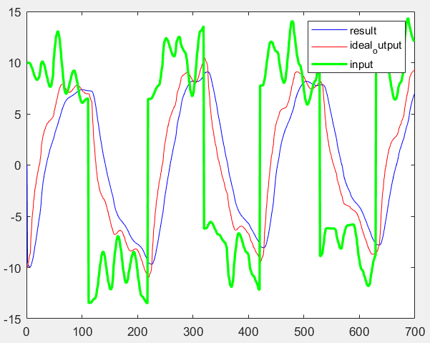
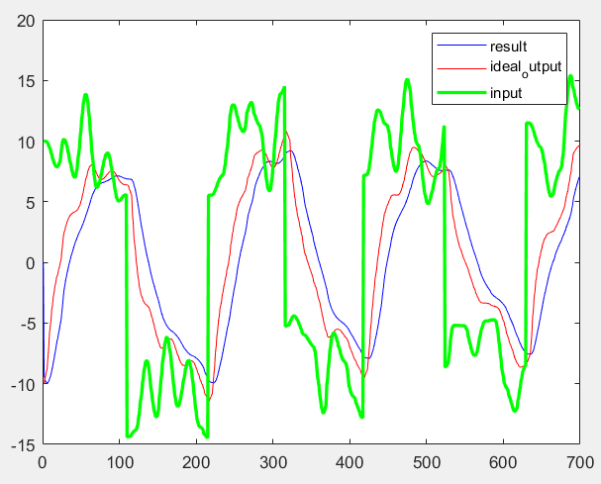
Simulation
We test the UKF under different SNR to seek into the robustness.
SNR=-5
SNR=0
SNR=3
SNR=5
SNR=7
SNR=10
Notes:
六張圖的ideal output看起來有點不一樣的原因是因為取樣的點數不一樣，但實際上是一樣的東西。

Slide 17
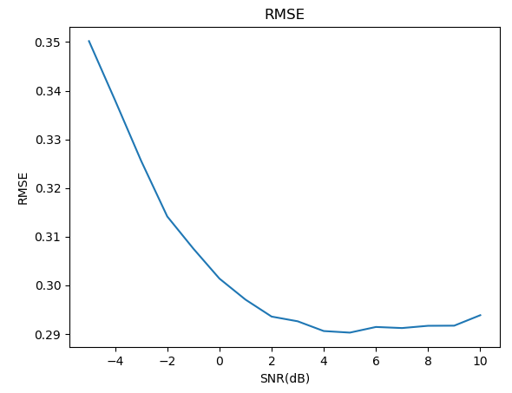
Simulation
RMSE under different SNR
We test RMSE when SNR = [-5, 10]
Input source is square wave with amplitude=20.
Noise is white noise simulated in LTSpice.
Result shows that…
RMSE is smaller when SNR increases.
Although the RMSE become larger when noise increases, we think the performance is still acceptable.
UKF can still work when the environment has bad SNR.

Slide 18
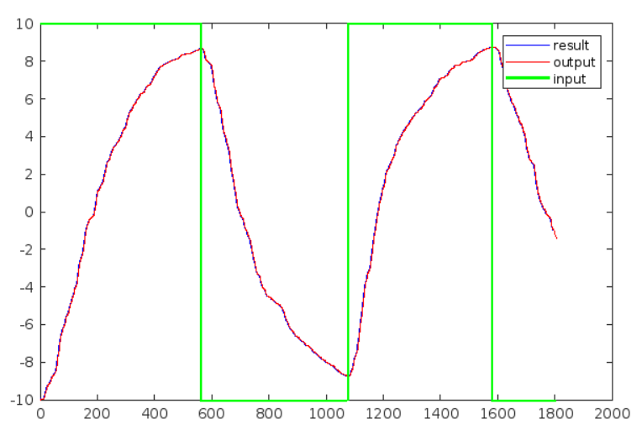
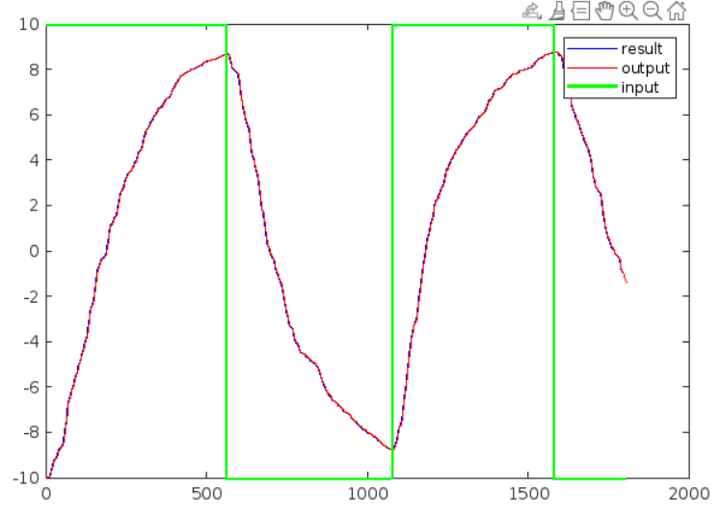
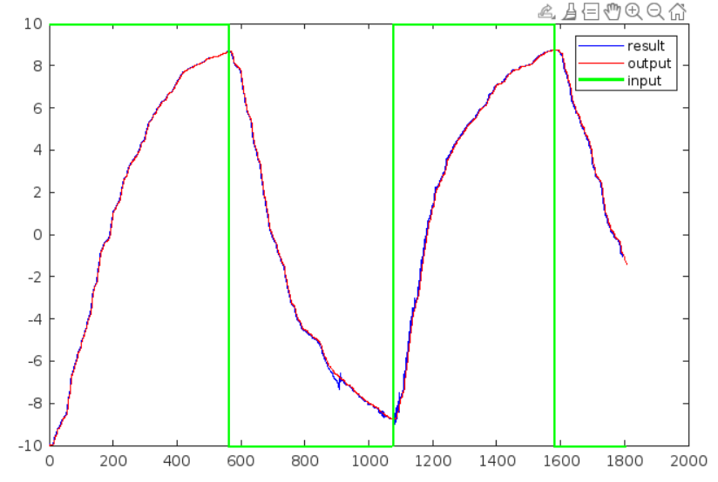
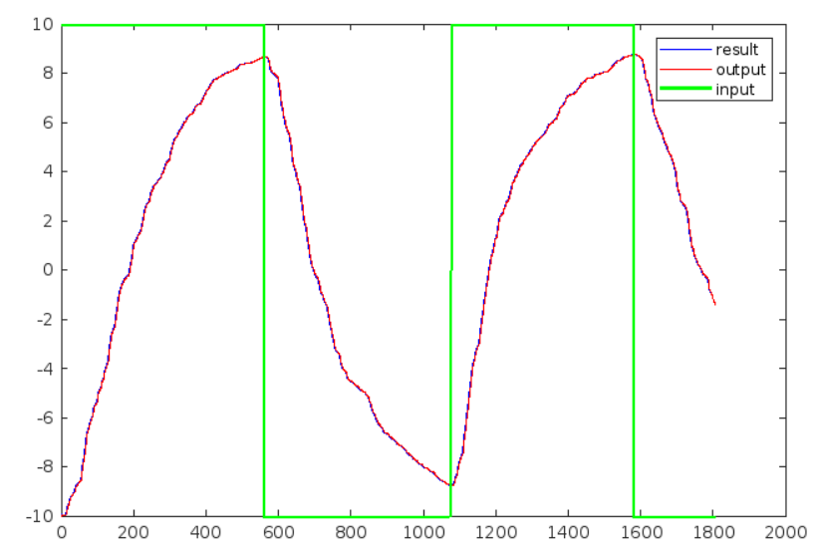
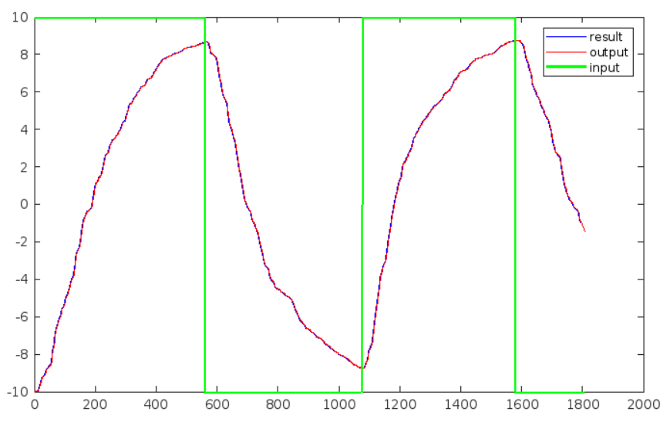
Simulation

Slide 19
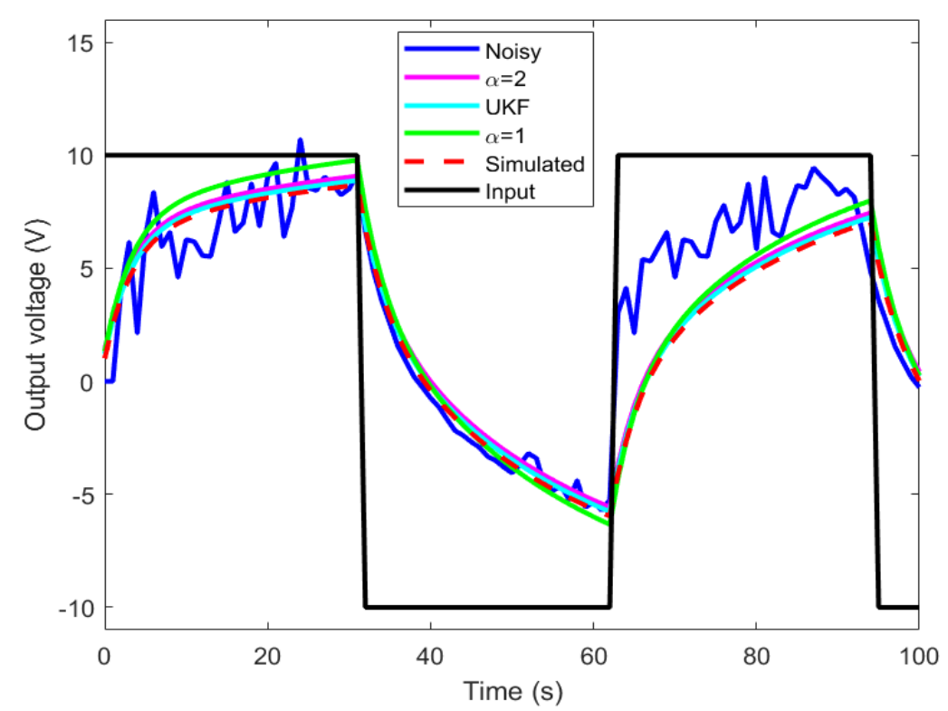
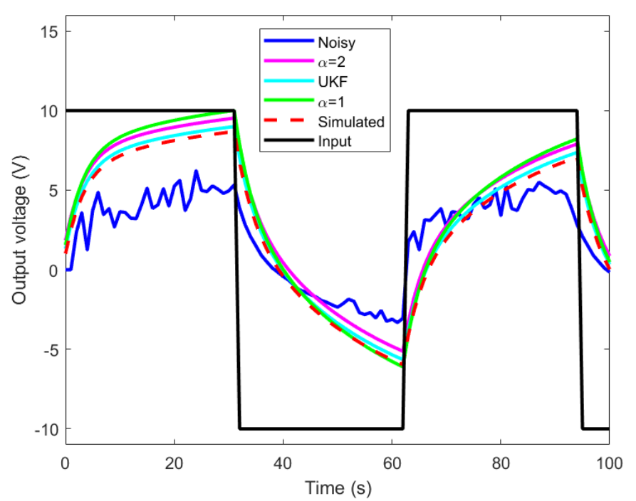
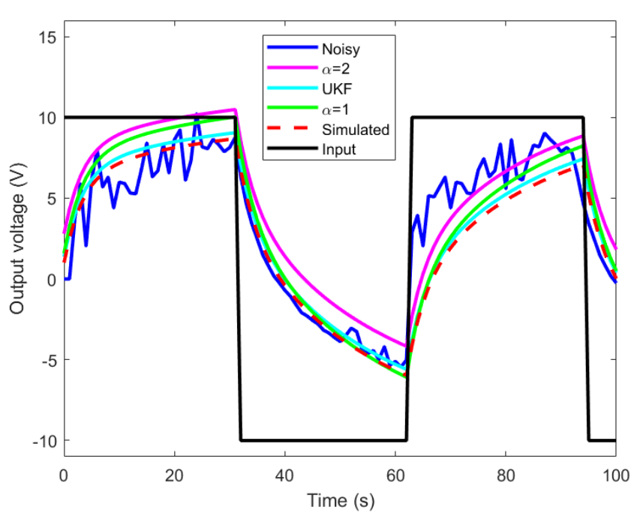
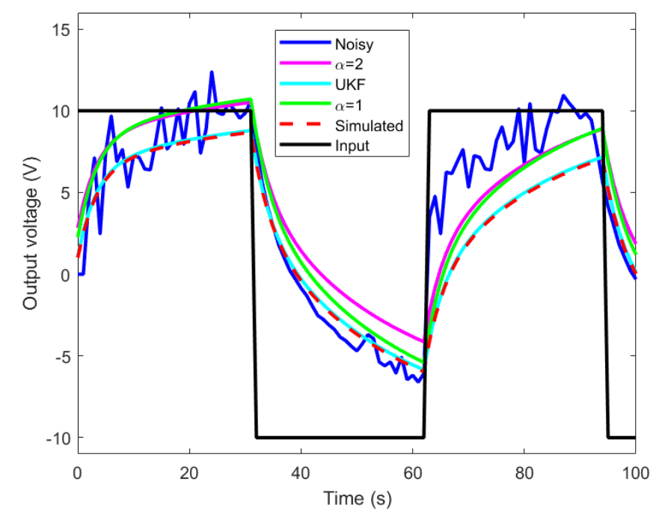
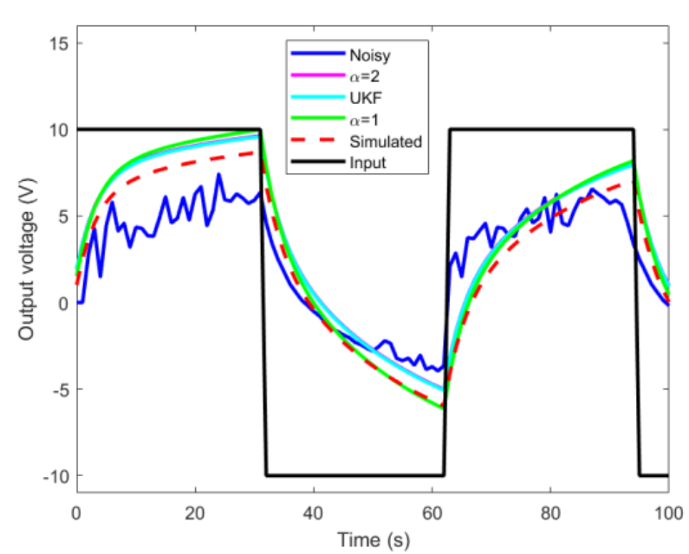
Simulation

