Slide 1
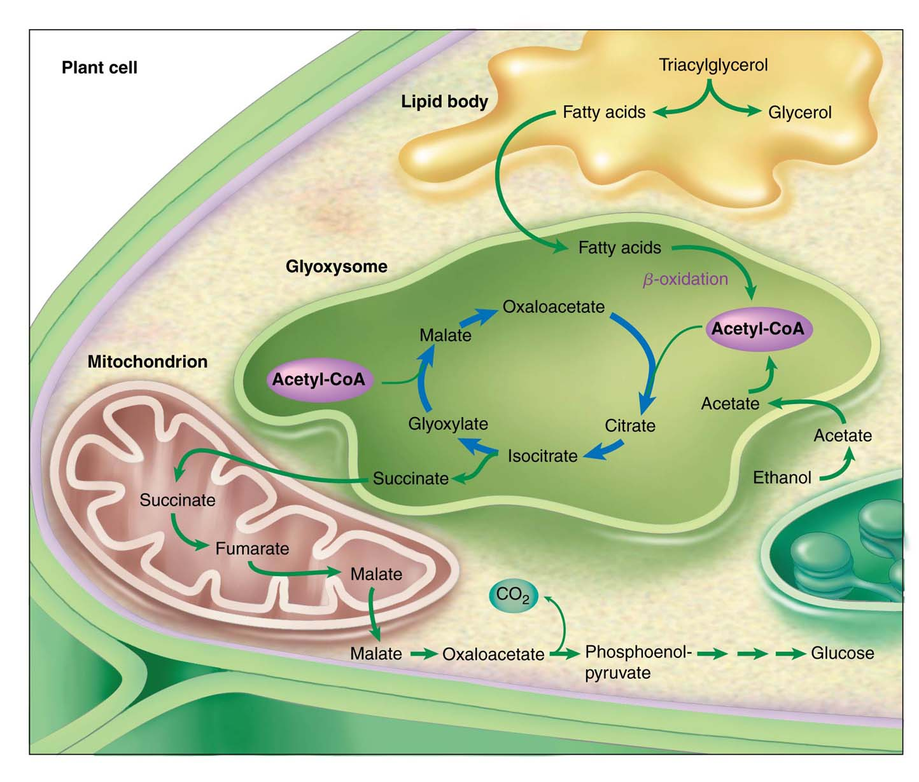
FIGURE Role of the Glyoxylate Cycle in Gluconeogenesis
乙醛酸循環中的酵素存在於乙醛酸體glyoxysomes中（ 植物的種子中的特殊胞器），但產物被轉移到粒線體基質及細胞質中。

Slide 2
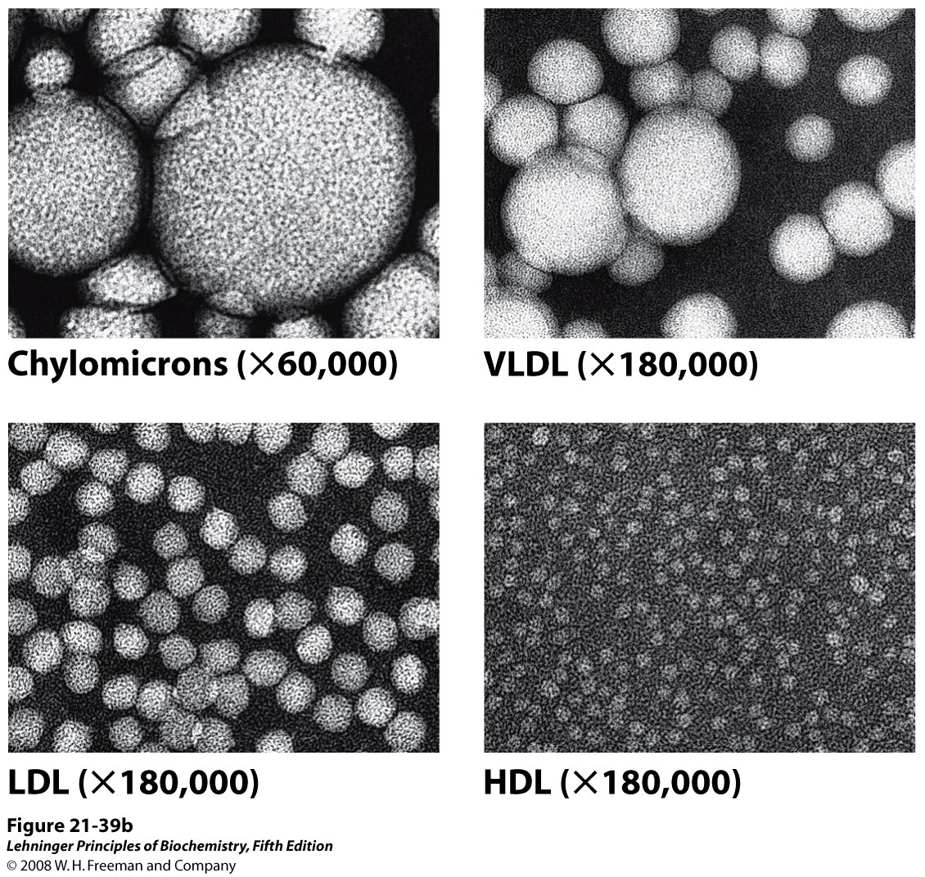
FIGURE 21–39 Lipoproteins. Structure of a low-density lipoprotein LDL
50-200 nm 28-70 nm
20-25 nm 8-11 nm

Slide 3
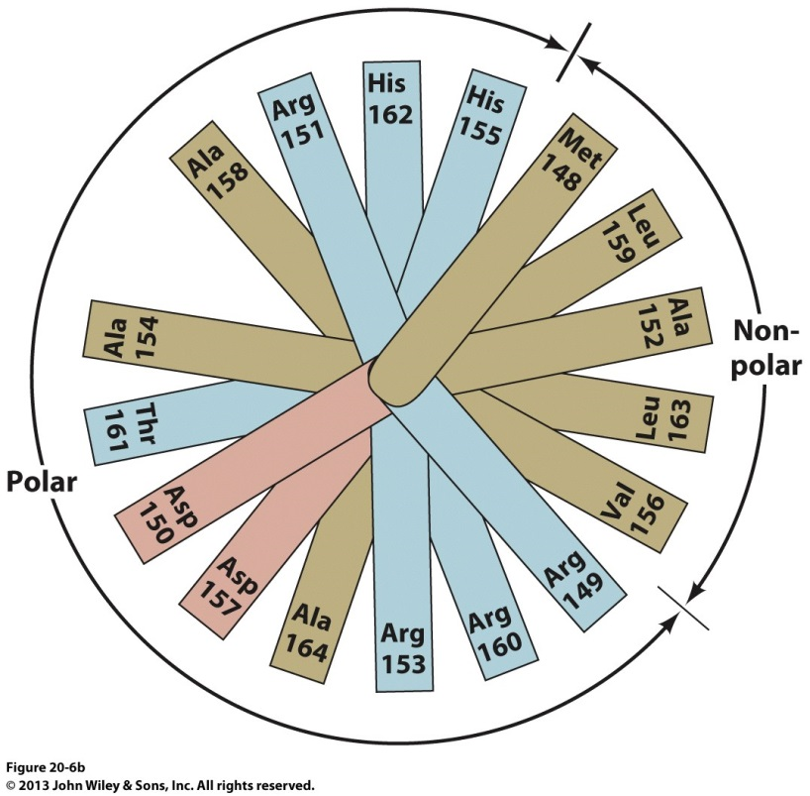
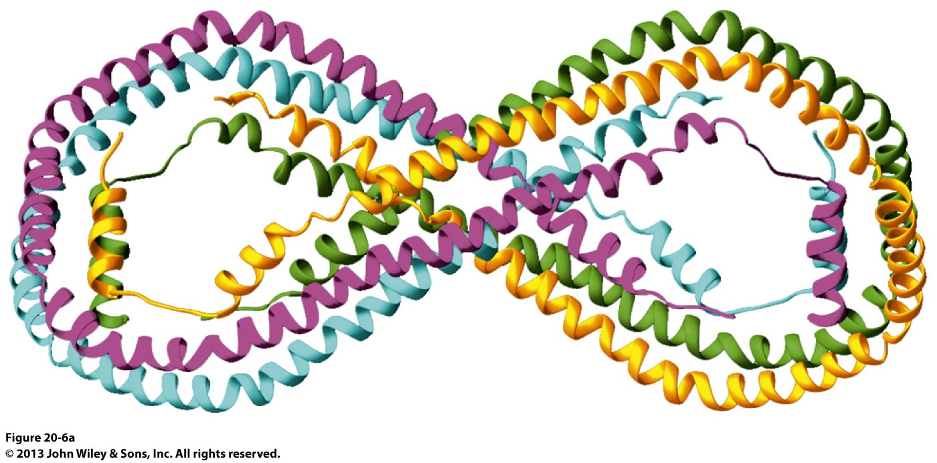
Unlike apoB-100, the other apolipoproteins are water soluble and associate rather weakly with lipoproteins.
These apolipoproteins also have a high helix content, which increases when they are incorporated into lipoproteins.
The helices in apolipoproteins have hydrophilic and hydrophobic side chains on opposite sides of the helical cylinder, suggesting that lipoprotein helices are amphipathic and float on phospholipid surfaces, much like logs on water.
a helical wheel
FIG. 20-6 structure of human Apolipoprotein A-I.
homotetramer

