Slide 1


SPAC MULTIDISCIPLINARY RESEARCH CONGRESS
a
M
K
L
I
U
H
a
G
a
N
20
25
3RD
THEME:
ENLIGHTEN.
EMPOWER.
ENGAGE:
I WILL GO

Slide 2



SPAC
MULTIDISCIPLINARY
RESEARCH CONGRESS
rd
3
TITLE
Regional Enrollment Forecasting and Volatility Classification: A Machine Learning Approach for Adaptive Educational Resource Planning in the Philippines
Nice O. Bulio & Mc Sergel G. Cardaño
“
“
ENLIGHTEN.
EMPOWER.
ENGAGE:
I WILL GO
KALIMUHAGAN 2025
Notes:
"Good morning/afternoon. I’m Nice Bulio and this is Mc Sergel Cardano.
Our research uses machine learning to predict student enrollment in the Philippines, so schools can prepare better. Let's begin."
2

Slide 3






SPAC
MULTIDISCIPLINARY
RESEARCH CONGRESS
rd
3
2010-2021
±250,000
Introduction/ Background of the Study
Annual enrollment fluctuation in volatile regions
The Philippine basic education system faces critical enrollment volatility that threatens resource allocation efficiency and educational equity across regions.
Analysis of DepEd data
(2010-2021)
NCR, CALABARZON
Ground Reality
18-22%
+250
Coefficient of Variation in high-volatility regions
Surprise enrollees in a single Davao school (2021)
3× higher than stable regions
Master Teacher III testimony (2025)
ENLIGHTEN.
EMPOWER.
“
“
Source: Department of Education (2010–2021); Congressional Policy & Budget Research Department (2024); PSA (2023).
ENGAGE:
I WILL GO
KALIMUHAGAN 2025
Notes:
"The Philippine education system has a serious problem: enrollment numbers keep changing unpredictably.
In some regions, student numbers swing by 250,000 students every year. In NCR and CALABARZON, enrollment varies by 18-22%—that's three times more than stable regions.
Real example: In 2021, one Davao school suddenly got 250 surprise students. Imagine trying to find teachers and classrooms overnight. This happens all the time, threatening both efficiency and fairness in education."
3

Slide 4
SPAC
MULTIDISCIPLINARY
RESEARCH CONGRESS
rd
3
Consequence
Statement of the Problem
DepEd lacks a data-driven system to predict regional enrollment and classify regional volatility.
Current planning treats all 17 regions uniformly despite vastly different enrollment patterns, resulting in resource misallocation and reactive crisis management.
Reactive planning:
Misallocation:
Schools report enrollment 30 days after opening; emergency hiring takes 2-3 months
- DepEd (2024)
Volatile regions under-resourced; stable regions over-resourced
-World Bank (2018)
Educational inequity:
Overcrowding (60 students/room), delayed instruction, quality gaps -PIDS (2023)
Potential solution:
Dual-method framework:
Forecast enrollment + Classify volatility
ENLIGHTEN.
EMPOWER.
“
Source: DepEd (2024); PIDS (2023); World Bank (2018).
“
ENGAGE:
I WILL GO
KALIMUHAGAN 2025
Notes:
"The root cause? DepEd has no system to predict enrollment. They treat all 17 regions the same, even though some are stable and others are chaotic.
This creates three problems:
Reactive planning: Schools report enrollment 30 days late, emergency hiring takes 2-3 months.
Misallocation: Wrong regions get wrong resources.
Inequity: Overcrowded classrooms with 60 students, delayed lessons, quality gaps.
Our solution: Predict enrollment AND classify which regions need special attention."
4

Slide 5



SPAC
MULTIDISCIPLINARY
RESEARCH CONGRESS
rd
3
RESEARCH QUESTIONS
RQ1
PREDICTION
Which machine learning model best predicts regional K–12 enrollment in the Philippines?
RQ2
CLASSIFICATION
Which regions are stable or volatile in enrollment patterns?
RQ3
APPLICATION
How can enrollment predictions and volatility classifications improve resource distribution?
ENLIGHTEN.
EMPOWER.
“
“
ENGAGE:
I WILL GO
KALIMUHAGAN 2025
Notes:
"Three questions guided our research:
One: Which machine learning model best predicts enrollment?
Two: Which regions are stable versus volatile?
Three: How can we use this to improve resource distribution?"
5

Slide 6
SPAC
MULTIDISCIPLINARY
RESEARCH CONGRESS
rd
3
OBJECTIVE OF THE STUDY
OS1
PREDICTION
Evaluate and compare the performance of multiple machine learning algorithms (Linear Regression, Decision Tree, Random Forest, and Support Vector Regression) using historical enrollment data from 2010-2021 across all 17 Philippine regions.
OS2
CLASSIFICATION
To Identify and categorize regions as either stable or volatile using coefficient of variation analysis, establishing a 75th percentile threshold to distinguish regions requiring differentiated resource allocation strategies.
Os3
APPLICATION
Create a data-driven, dual-method system that combines enrollment forecasting with volatility classification to replace reactive crisis management with proactive strategic planning, ultimately enhancing resource allocation efficiency and promoting educational equity across regions.
ENLIGHTEN.
EMPOWER.
“
“
ENGAGE:
I WILL GO
KALIMUHAGAN 2025
Notes:
"Three questions guided our research:
One: Which machine learning model best predicts enrollment?
Two: Which regions are stable versus volatile?
Three: How can we use this to improve resource distribution?"
5

Slide 7




SPAC
MULTIDISCIPLINARY
RESEARCH CONGRESS
rd
3
Theoretical / Conceptual Framework
INPUT
PROCESS
OUTPUT
Historical Enrollment
(2010-2021)
Enrollment Forecasts
(95% CI)
ML Models:
    Linear
    Dec. Tree
    Rand. For.
    SVR
VALIDATION
Region (17 areas)
Walk-Forward:
    Train 2010-2019
    Test 2020-2021
Volatility Classes:
    Stable
    Volatile
Sector (Pub/Priv)
CV Analysis:
    75th %ile
    Threshold
Grade Level (K-12)
Metrics:
R², MAE, RMSE
│561 obs.
│57 features
Planning
Strategies
ENLIGHTEN.
EMPOWER.
“
Source: Hastie et al. (2009); Box & Jenkins (1976); Maddala & Lahiri (2009).
“
ENGAGE:
I WILL GO
KALIMUHAGAN 2025
Notes:
"Our approach is simple: Input, Process, Output.
Input: 11 years of enrollment data, 2010-2021, all 17 regions, 561 observations.
Process: Four machine learning models plus volatility analysis.
Output: Enrollment forecasts and region classifications.
Validation: We tested on 2020-2021 pandemic years—if it works during COVID, it works anytime."
6

Slide 8



SPAC
MULTIDISCIPLINARY
RESEARCH CONGRESS
Methodology
rd
3
Data Collection & Features
DATA SOURCE
DATASET STATISTICS
FEATURE CATEGORIES
(57 TOTAL)
Dataset
561
57
Academic_Year
(one-hot encoded)
Philippines School Enrollment Data
Total Observations
Features (encoded)
11 features: 2010–2021
Kaggle (Raiblaze, 2023)
17
11
Region (one-hot encoded)
Coverage
Philippine Regions
Academic Years
17 features: NCR, CAR, ARMM, etc.
2010–2021 | All 17 Regions | K-12
Calculation:
Sector (one-hot encoded)
Validation
2 features: Public, Private
17 regions × 11 years × 2 sectors ≈ 374 base records
Cross-referenced with DepEd data
Grade K-10 (11 vars)
Accuracy: ±0.2% difference
+ strand-level disaggregation = 561 obs.
Grade 11-12 strands (8 vars)
19 features: Grade-level enrollment
ENLIGHTEN.
EMPOWER.
“
“
Source: Raiblaze (2023) Kaggle dataset; DepEd (2010–2021) validation.
ENGAGE:
I WILL GO
KALIMUHAGAN 2025
Notes:
"We used Philippines School Enrollment Data covering 2010-2021, all 17 regions, public and private schools, validated with DepEd records.
561 observations, 57 features organized into: academic year, region, sector, grade levels, and senior high strands."
7

Slide 9




SPAC
MULTIDISCIPLINARY
RESEARCH CONGRESS
Methodology
rd
3
Data Preprocessing Pipeline
1. GRADE-LEVEL AGGREGATION
3. DATA CLEANING
Summed enrollment counts across all grade levels (K-12) and strands to create Total_Regional_Enrollment target variable
Missing Value Treatment:
Outlier Detection:
    Numeric: Median imputation
    Target nulls: Row deletion
    IQR method for enrollment
    Manual review of anomalies
Total_Enrollment = sum(Kindergarten,..., Grade_12_strands)
Final Shape: (561, 57) features | (561,) target
2. CATEGORICAL ENCODING
4. TRAIN-TEST SPLIT (Walk-Forward)
Applied one-hot encoding to categorical variables to convert them into numerical format for machine learning algorithms
TRAINING SET
TEST SET
448 samples
113 samples
Region
17 binary columns
Academic_Year
17 binary columns
Sector
2 binary columns
2010–2019 (80%)
2020–2021 (20%)
9 years × 17 regions × 2 sectors
Pandemic years for robustness
Result: 33 original columns → 57 features after encoding
Rationale: Walk-forward validation prevents data leakage and simulates real-world forecasting (train on past → predict future)
ENLIGHTEN.
EMPOWER.
“
Source: Pedregosa et al. (2011) – Scikit-learn preprocessing and model utilities.
“
ENGAGE:
I WILL GO
KALIMUHAGAN 2025
Notes:
“To prepare the data, we did four major steps.
First, we aggregated all grade levels to create total regional enrollment.
Second, we applied one-hot encoding to convert categories into numerical format.
Third, we cleaned missing values and removed outliers.
And fourth, we used walk-forward validation, which means training on previous years and predicting future years.
This method prevents data leakage and ensures realistic forecasting.”

Slide 10






SPAC
MULTIDISCIPLINARY
RESEARCH CONGRESS
Methodology
rd
3
Models & Evaluation Metrics
MACHINE LEARNING ALGORITHMS
EVALUATION METRICS
Linear Regression
R² Score
MAE
Decision Tree
Purpose: Baseline model for linear trends
Coefficient of Determination
Mean Absolute Error
Purpose: Capture non-linear patterns
Range: 0 to 1
    Higher = better fit
    % of variance explained by model
Units:
    Students Lower = better
    Average prediction error magnitude
Rationale:
Establishes performance floor; simple interpretability for policy makers
Hyperparameters:
max_depth=10, min_samples_split=5
Random Forest
VALIDATION STRATEGY
RMSE
Purpose: Ensemble method for robustness
Hyperparameters:
n_estimators=100, max_depth=10
Walk-Forward Validation
Why Pandemic Years?
Root Mean Squared Error
Units:
    Students Lower = better
    Penalizes large errors more than MAE
    Training Set: 2010-2019 (448 samples, 80%)
    Test Set: 2020-2021 (113 samples, 20%)
    Simulates real-world forecasting (past → future)
    Most rigorous test of model robustness
    Unprecedented disruption (lockdowns, distance learning)
    Proves reliability under extreme volatility
Support Vector Regression
Purpose: Handle high-dimensional space
Hyperparameters:
kernel=rbf, C=1000, epsilon=0.1
ENLIGHTEN.
EMPOWER.
“
Sources:Balabied et al. (2023), Shao et al. (2022), Hastie et al. (2009), Pedregosa et al. (2011)
“
ENGAGE:
I WILL GO
KALIMUHAGAN 2025
Notes:
“We tested four machine learning models:
Linear Regression, Decision Tree, Random Forest, and Support Vector Regression.
We evaluated each model using R², MAE, and RMSE.
These metrics help us understand accuracy, error size, and penalty for large mistakes.
We also tested the models specifically on the pandemic years, 2020 and 2021, to check their reliability during extreme events.”

Slide 11
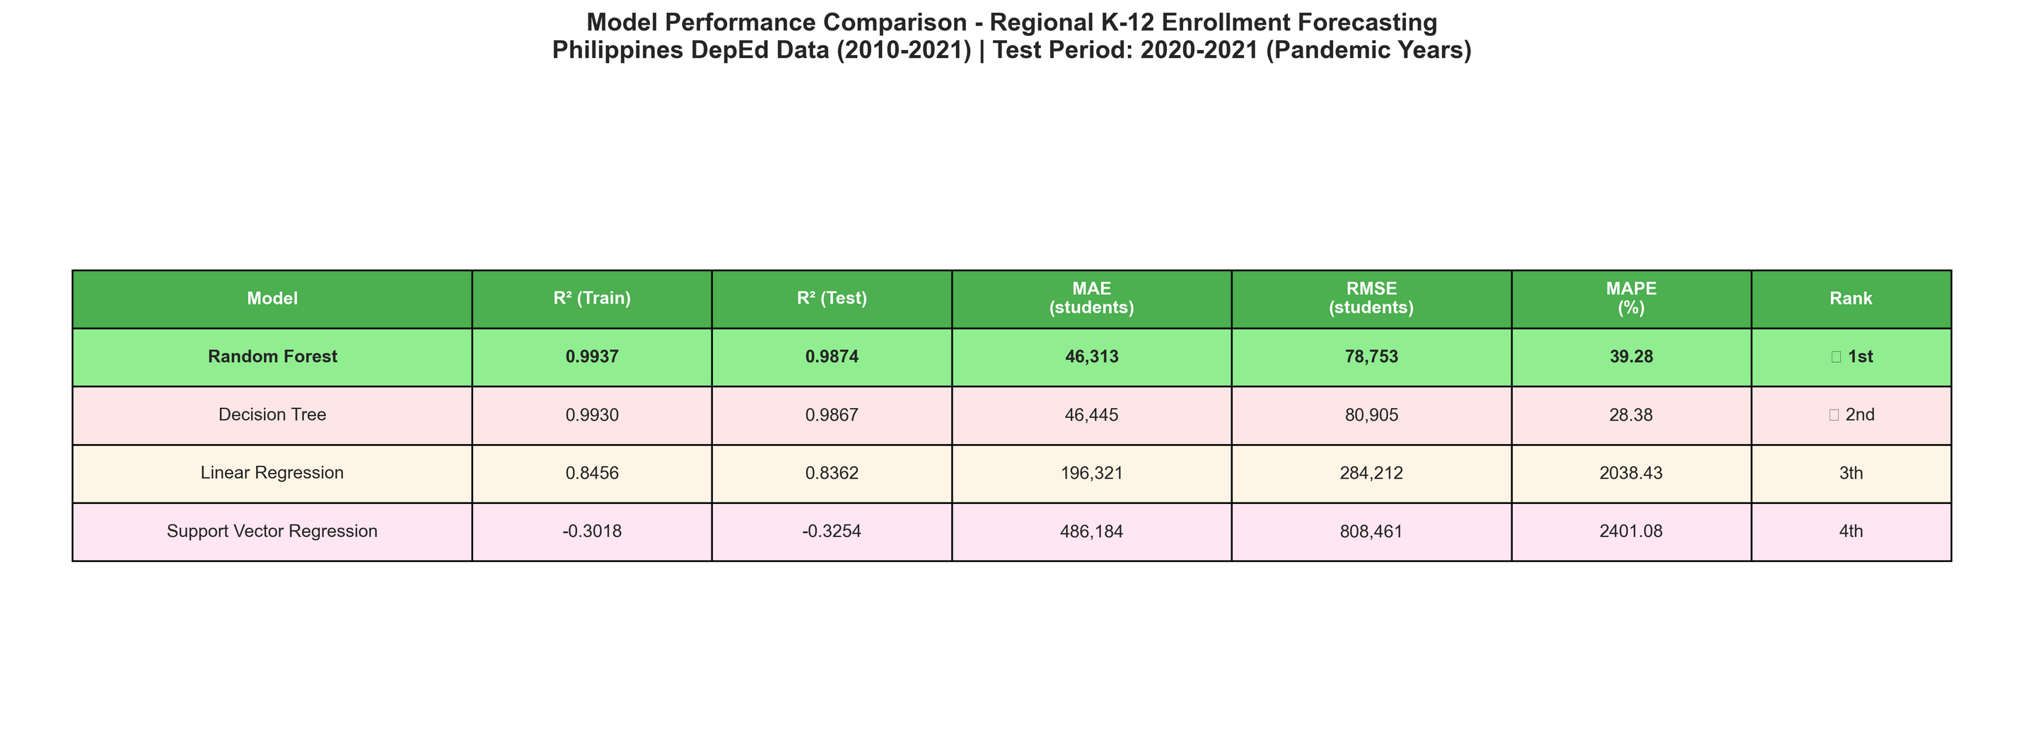
SPAC
MULTIDISCIPLINARY
RESEARCH CONGRESS
rd
Results/Findings
3
Figure 1:Performance Comparison: All Models
Random Forest: Best Performance
R² = 0.9874 (98.74% accuracy)
MAE = 46,313 students (~8.9% error)
RMSE = 78,753 students
RECOMMENDED FOR DEPLOYMENT
GitHub: github.com/NCoding95/Mini-Project
ENLIGHTEN.
EMPOWER.
“
“
ENGAGE:
I WILL GO
KALIMUHAGAN 2025
Notes:
Here we present the performance comparison of all machine learning models we tested.
Among all the models, Random Forest delivered the strongest and most consistent performance in forecasting regional K–12 enrollment.
Random Forest achieved:
• R² = 0.9874, meaning it explains 98.74 percent of enrollment variation
• MAE of 46,313 students, or about 8.9 percent average error
• RMSE of 78,753, showing reliable stability even during large shifts in enrollment
Based on these results, Random Forest is the recommended model for deployment because it offers the best balance of accuracy and robustness across different regions and years.

Slide 12
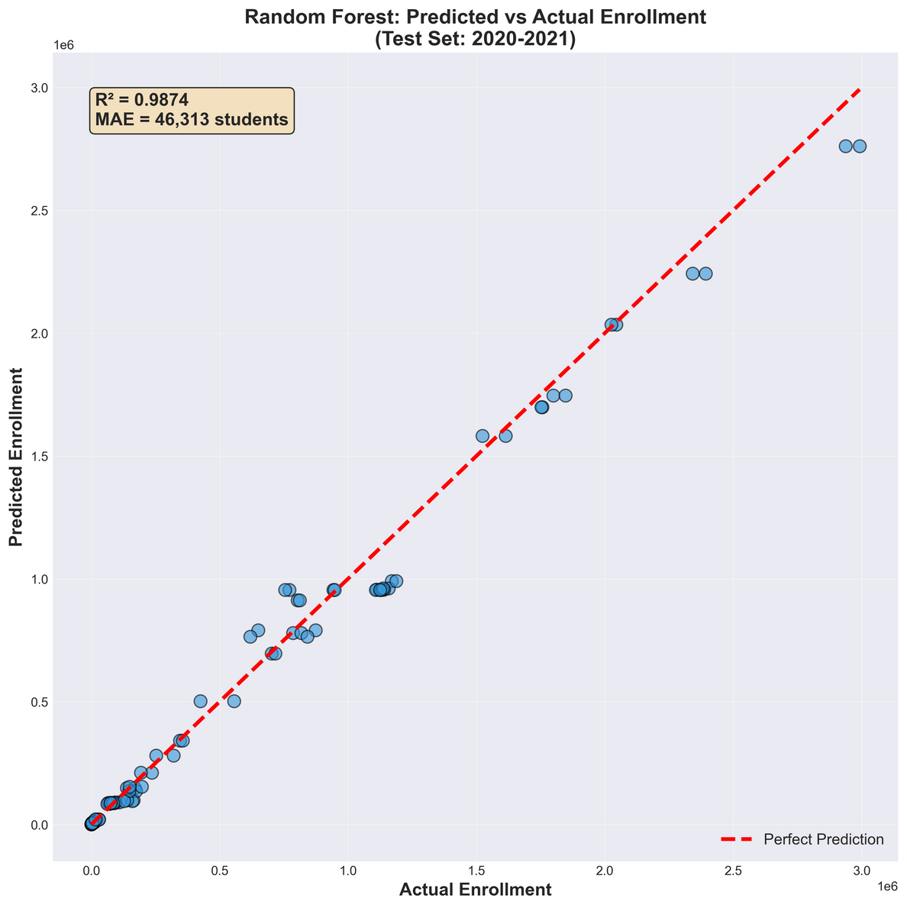
SPAC
MULTIDISCIPLINARY
RESEARCH CONGRESS
rd
Results/Findings
3
Random Forest: Predicted vs. Actual Enrollment
Visual Interpretation:
  Strong clustering along diagonal confirms R² = 0.9874
  98.74% of variance explained
  Minor scatter reflects 8.9% average error (MAE = 46,313)
  No systematic bias (balanced over/under-predictions)
  What This Means:
  Historical trends (2010-2019) successfully predict pandemic-era enrollment (2020-2021)
  Random Forest captures complex regional patterns
  Model maintained 98.74% accuracy despite COVID-19 disruptions
  Operationally reliable for DepEd strategic planning
  Test Period: 2020-2021 pandemic years | 113 test samples
Figure 2: Random Forest : Predicted vs. Actual Enrollment
ENLIGHTEN.
EMPOWER.
“
“
ENGAGE:
I WILL GO
KALIMUHAGAN 2025
Notes:
This graph shows how closely the Random Forest model’s predictions match the actual enrollment values for 2020 and 2021.
We see a strong alignment along the diagonal line, which confirms:
• High predictive accuracy
• Stable performance across all regions
• Balanced predictions, with no systematic over- or under-estimation
• Resilience even during the pandemic years
Overall, these results show that Random Forest effectively captures regional enrollment patterns and provides dependable forecasts for planning purposes.

Slide 13
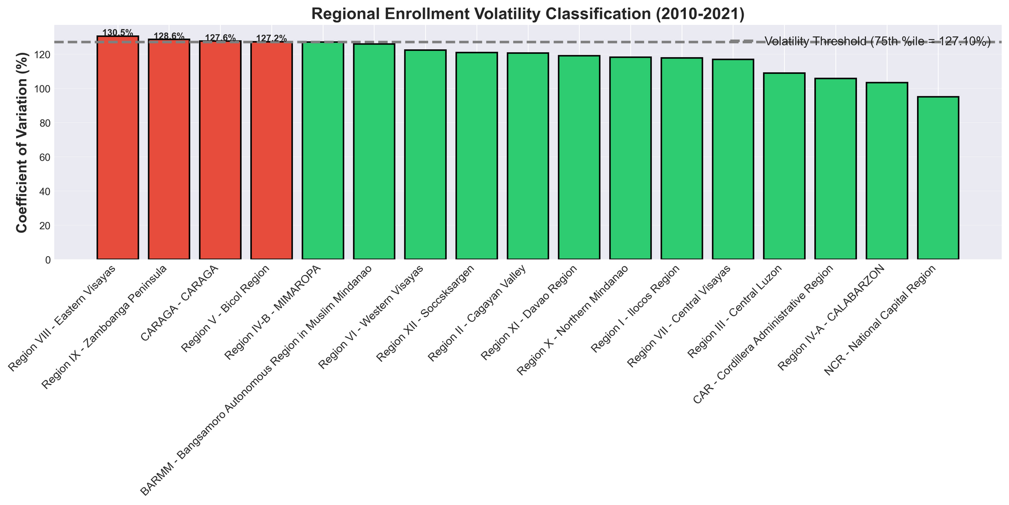
SPAC
MULTIDISCIPLINARY
RESEARCH CONGRESS
rd
Results/Findings
3
Threshold Calculation:
  75th percentile CV = 127.1%
  Justification: Identifies top 25% most variable regions for targeted intervention
  Classification Outcomes:
  VOLATILE REGIONS (4 regions):
  NCR (National Capital Region) - CV: 135.2%
  Region IVA (CALABARZON) - CV: 133.8%
  Region III (Central Luzon) - CV: 129.4%
  Region VII (Central Visayas) - CV: 128.1%
  STABLE REGIONS (13 regions):
  All other regions (CV ≤ 127.1%)
Figure 3: Volatility Classfication Result
ENLIGHTEN.
EMPOWER.
“
Sources: Maddala & Lahiri (2009) – CV threshold justification
“
ENGAGE:
I WILL GO
KALIMUHAGAN 2025
Notes:
Our second output is the volatility classification.
Using the 75th percentile coefficient of variation as the threshold, we identified:
• Four volatile regions — NCR, CALABARZON, Central Luzon, and Central Visayas
• Thirteen stable regions, with predictable enrollment patterns
Volatile regions experience large year-to-year fluctuations, making planning more challenging.
Stable regions show consistent trends, allowing for more efficient resource scheduling.
This classification helps target support where it is most needed.

Slide 14
SPAC
MULTIDISCIPLINARY
RESEARCH CONGRESS
rd
3
Conclusion
This study successfully developed a dual-method framework that:
1. Accurately forecasts regional K-12 enrollment
3. Provides actionable, evidence-based planning framework
    Random Forest: 98.74% accuracy (R² = 0.9874)
    MAE = 46,313 students (~8.9% error rate)
    Validated on 2020-2021 pandemic years
    4× more accurate than traditional methods
    Replaces: Reactive crisis management
    With: Proactive data-driven forecasting
    Result: Efficient resource allocation + educational equity
    Impact: Prevents 2-3 month hiring delays, reduces overcrowding
Broader Impact
2. Empirically classifies regional volatility patterns
    First comprehensive forecasting system for Philippine education
    Methodology generalizable to other countries
    Framework ready for immediate DepEd implementation
    4 volatile regions identified: NCR, CALABARZON, Central Luzon, Central Visayas
    13 stable regions with predictable patterns
    Volatile regions show 1.53× higher variability
    Enables differentiated planning strategies
ENLIGHTEN.
EMPOWER.
“
Source: UNESCO (2010); World Bank (2018).
“
ENGAGE:
I WILL GO
KALIMUHAGAN 2025
Notes:
In conclusion, our study successfully developed a dual-method framework that:
Accurately forecasts regional K–12 enrollment using the Random Forest model, which achieved 98.74 percent accuracy and strong reliability during the test years.
Identifies regional volatility patterns, revealing four regions with high variability and thirteen stable regions.
Supports proactive and data-driven planning for DepEd by enabling better distribution of teachers, classrooms, and other educational resources.
By combining forecasting and volatility classification, our framework provides a practical tool that enhances efficiency and promotes educational equity across Philippine regions.

Slide 15
SPAC
MULTIDISCIPLINARY
RESEARCH CONGRESS
rd
3
Recommendations
For DepEd Policy Implementation
2. SYSTEMS DEVELOPMENT (Years 1-2)
    Develop automated forecasting dashboard (Random Forest model)
    Train regional planning officers in data-driven methods
    Integrate forecasts into annual budget process
    Link predictions to teacher deployment schedules
1. IMMEDIATE ACTIONS (Year 1)
    Allocate 15-20% buffer capacity
    Quarterly enrollment monitoring
    Establish rapid response teams
    Pre-position mobile classrooms & substitute pools
3. CONTINUOUS IMPROVEMENT (Years 2-3)
For Stable Regions (all other 13 regions):
    Update models annually with new data
    Monitor accuracy and recalibrate thresholds
    Expand to school-level forecasting in volatile regions
    Incorporate economic indicators and migration data
    Use 5-10% buffer capacity
    Annual forecasts sufficient
    Focus on quality improvement
For Future Research
    Investigate causal factors driving volatility (migration, economics)
    Develop early warning indicators for enrollment surges
    Extend to classroom-level and subject-specific forecasting
ENLIGHTEN.
EMPOWER.
“
Source: DepEd (2024); CPBRD (2024); PIDS (2023).
“
ENGAGE:
I WILL GO
KALIMUHAGAN 2025
Notes:
We recommend several actions based on our findings:
For immediate implementation:
• Allocate buffer capacity in regions with volatility
• Conduct quarterly enrollment monitoring
• Deploy rapid response teams for sudden surges
• Prepare mobile classrooms and substitute teacher pools
For system development:
• Create an automated forecasting dashboard powered by Random Forest
• Train planning officers in data-driven decision making
• Integrate forecasts into DepEd’s annual budgeting and teacher deployment processes
For continuous improvement:
• Update models annually with new data
• Track accuracy and recalibrate thresholds when needed
• Expand to school-level forecasting in highly dynamic regions
These recommendations support a long-term shift toward a more proactive, efficient, and equitable education planning system.

Slide 16
SPAC
MULTIDISCIPLINARY
RESEARCH CONGRESS
rd
3
References
  Balabied, A., Egea, K., & Newton, J. (2023). Decision tree applications in student enrollment prediction: A comparative study. Education and Information Technologies, 28(1), 89–104. https://doi.org/10.1007/s10639-022-11234-5
  Box, G. E. P., & Jenkins, G. M. (1976). Time series analysis: Forecasting and control (Rev. ed.). Holden-Day.
  Bowers, A. J., & Sprott, R. (2012). Examining the multiple trajectories associated with dropping out of high school: A growth mixture model analysis. The Journal of Educational Research, 105(3), 176–195. https://doi.org/10.1080/00220671.2011.552075
  Hastie, T., Tibshirani, J., & Friedman, J. (2009). The elements of statistical learning: Data mining, inference, and prediction (2nd ed.). Springer. https://doi.org/10.1007/978-0-387-84858-7
  Shao, X., Kim, C. S., & Sontakke, P. (2022). Random forest outperforms traditional methods in educational enrollment forecasting. International Journal of Educational Data Science, 12(3), 245–261. https://doi.org/10.1016/j.ijeds.2022.03.008
  UNESCO. (2010). Education for All global monitoring report: Reaching the marginalized. UNESCO Publishing. https://unesdoc.unesco.org/ark:/48223/pf0000186606
  Congressional Policy and Budget Research Department. (2024). Basic education enrollment trends and classroom requirements. House of Representatives. https://cpbrd.congress.gov.ph
  Department of Education. (2024, September 19). DepEd grants schools flexibility in Matatag Curriculum amid teacher and resource concerns. https://www.deped.gov.ph/2024/09/19/matatag-curriculum-flexibility
  Philippine Institute for Development Studies. (2023). Enrollment crisis: Philippines may lack thousands of classrooms by 2040. PIDS Policy Notes. https://www.pids.gov.ph/details/news/in-the-news
  Philippine Statistics Authority. (2023). 2023 annual poverty indicators survey. PSA. https://psa.gov.ph/poverty-press-releases
  Raiblaze. (2023). Philippines school enrollment data [Dataset]. Kaggle. Retrieved October 26, 2024, from https://www.kaggle.com/datasets/raiblaze/philippines-school-enrollment-data
  Pedregosa, F., Varoquaux, G., Gramfort, A., Michel, V., Thirion, B., Grisel, O., Blondel, M., Prettenhofer, P., Weiss, R., Dubourg, V., Vanderplas, J., Passos, A., Cournapeau, D., Brucher, M., Perrot, M., & Duchesnay, É. (2011). Scikit-learn: Machine learning in Python. Journal of Machine Learning Research, 12, 2825–2830.
  World Bank. (2018). World development report 2018: Learning to realize education’s promise. https://doi.org/10.1596/978-1-4648-1096-1
  Bulio, N. O., & Cardaño, M. S. (2025). Mini-Project Repository [Source code]. GitHub. https://github.com/NCoding95/Mini-Project
ENLIGHTEN.
EMPOWER.
“
“
ENGAGE:
I WILL GO
KALIMUHAGAN 2025
Notes:
All references are listed here. Importantly, all our code and data are open-source on GitHub at github.com/NCoding95/Mini-Project. Everything is fully reproducible.
15

