Slide 1

Introduction to Docker
Nuno Correia

Slide 2
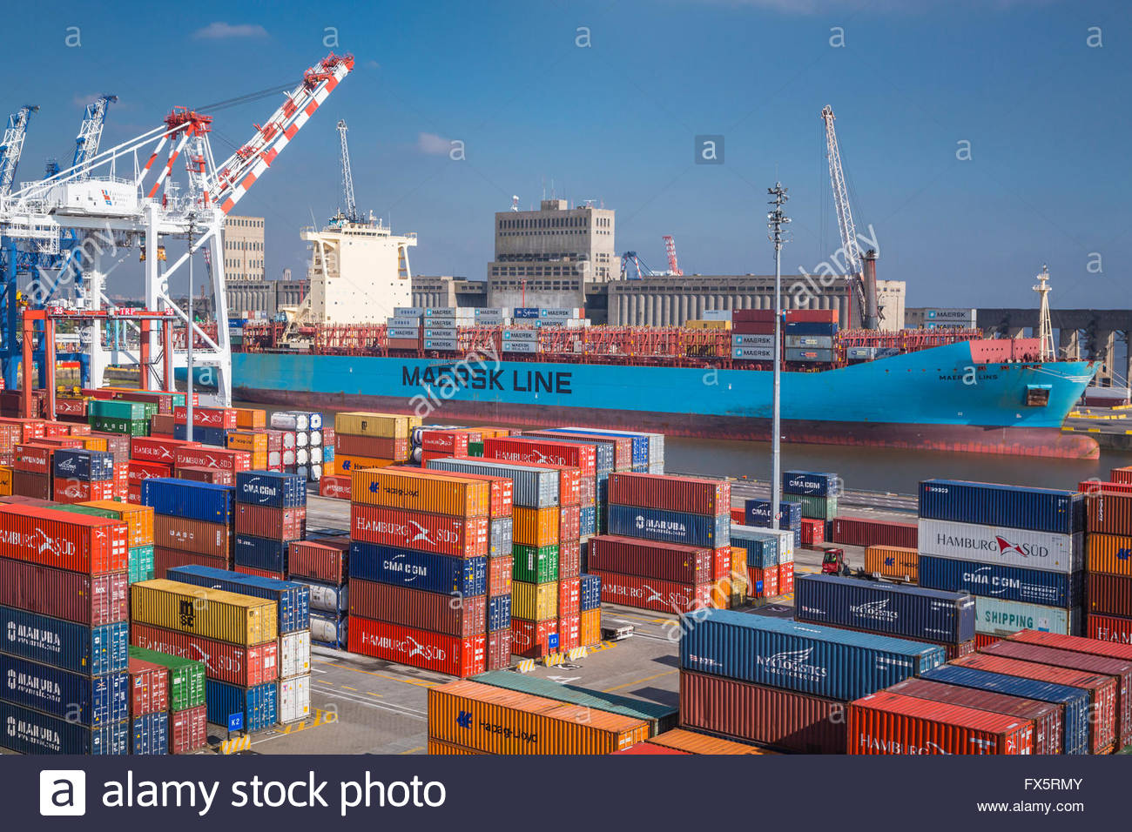
What is Docker?

Slide 3
What is Docker?
R: A service that creates virtualizations that have their own OS and operate in an isolated environment (sand box). These virtualizations are known as containers as they have the purpose of housing and protecting a server or servers.
Some of the benefits:
Added Security
Easy to replicate
Same behavior in any host OS
Promotes separation of concerns
Automated processes (e.g. at startup)
Build containers in layers (thus using resources efficiently)
Perfect testing environment (due to isolation and replication)
Promotes version control
Portability (stored in a repos alike GitHub)
Fast to deploy (since OS state is store as an image)

Slide 4
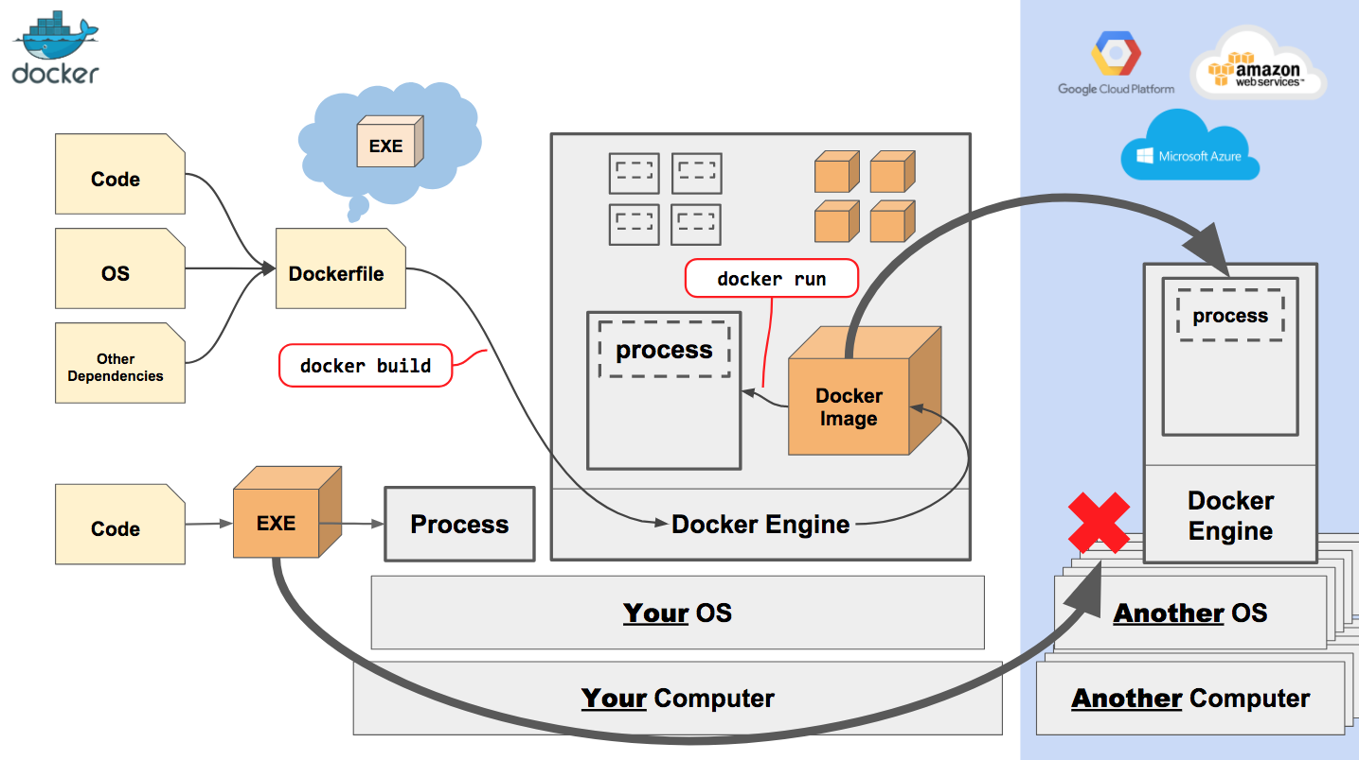
Nginx

Slide 5
Let’s brake it down first…
…Before we bring it home

Slide 6
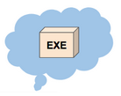
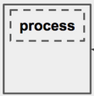


Docker Concepts:
Image:
Abstract representation of a virtual instance
Container:
Physical environment that holds the virtual OS
Dockerfile:
File containing a set of instructions for creating an image
Dockerhub:
Online storage of images into repos

Slide 7


Docker Concepts:
4. Push image to DockerHub
12. Pull image from DockerHub
9. Pull image from DockerHub
6. Pull image from DockerHub
2. Build image
1. Create conf
7. Run image
3. Run image to test container
10. Run image
13. Run image
Scale up & profit!!!!

Slide 8
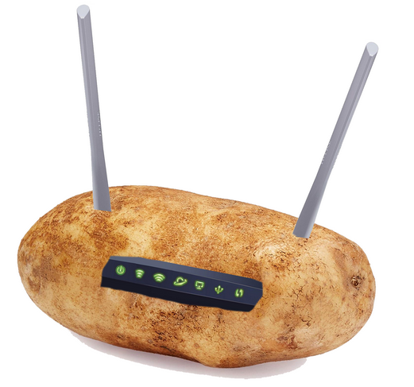
Sorry for the long presentation, here’s a potato router:

