Slide 1
NodeJS

Slide 2
What is NodeJS?
Node.js is a cross-platform runtime environment and library for running JavaScript applications outside the browser. It is used for creating server-side and networking web applications. It is open source and free to use. It can be downloaded from this link https://nodejs.org/en/
Many of the basic modules of Node.js are written in JavaScript. Node.js is mostly used to run real-time server applications.
Node.js is a platform built on Chrome's JavaScript runtime for easily building fast and scalable network applications. Node.js uses an event-driven, non-blocking I/O model that makes it lightweight and efficient, perfect for data-intensive real-time applications that run across distributed devices.
Node.js also provides a rich library of various JavaScript modules to simplify the development of web applications.

Slide 3
Features of NodeJS
Extremely fast: Node.js is built on Google Chrome's V8 JavaScript Engine, so its library is very fast in code execution.
I/O is Asynchronous and Event Driven: All APIs of Node.js library are asynchronous i.e. non-blocking. So a Node.js based server never waits for an API to return data. The server moves to the next API after calling it and a notification mechanism of Events of Node.js helps the server to get a response from the previous API call. It is also a reason that it is very fast.
Single threaded: Node.js follows a single threaded model with event looping.
Highly Scalable: Node.js is highly scalable because event mechanism helps the server to respond in a non-blocking way.
No buffering: Node.js cuts down the overall processing time while uploading audio and video files. Node.js applications never buffer any data. These applications simply output the data in chunks.
Open source: Node.js has an open source community which has produced many excellent modules to add additional capabilities to Node.js applications.
License: Node.js is released under the MIT license.

Slide 4
Install Node.js on Windows
To install and setup an environment for Node.js, you need the following two softwares available on your computer:
Text Editor. (Visual Studio Code)
Node.js Binary installable
How to download Node.js:
You can download the latest version of Node.js installable archive file from https://nodejs.org/en/

Slide 5
Install Node.js on Linux/Ubuntu
We can easily install Node.js on linux/ubuntu/etc. To install Node.js on Linux (Ubuntu) operating system, follow these instructions:
1) Open Ubuntu Terminal (You can use shortcut keys (Ctrl+Alt+T).
2) Type command sudo apt-get install python-software-properties
3) Press Enter (If you have set a password for your system then it will ask for the password)
4) Type the password and press enter
5) Type command sudo apt-add-repository ppa:chris-lea/node.js
6) Press Enter
7) Again Press Enter to continue
8) Type command sudo apt-get update ( Wait for sometime)
9) Type command sudo apt-get install nodejs npm
10) Type command sudo apt-get install nodejs
Installation completed. Now you can check the version of Node by node --version

Slide 6
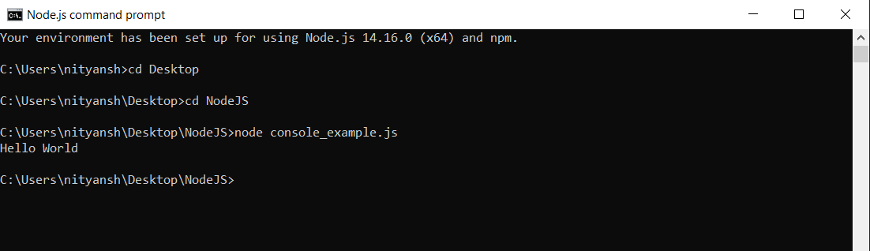
Node.js First Example
There can be console-based and web-based node.js applications.
Node.js console-based Example
console.log("Hello World");
Open Node.js command prompt and run the following code:
node console_example.js

Slide 7
Node.js web-based Example
A node.js web application contains the following three parts:
Import required modules: The "require" directive is used to load a Node.js module.
Create server: You have to establish a server which will listen to client's request similar to Apache HTTP Server.
Read request and return response: Server created in the second step will read HTTP request made by client which can be a browser or console and return the response.

Slide 8
How to create node.js web applications
Import required module: The first step is to use require directive to load http module and store returned HTTP instance into http variable. For example:
Create server: In the second step, you have to use created http instance and call http.createServer() method to create server instance and then bind it at port 8081 using listen method associated with server instance. Pass it a function with request and response parameters and write the sample implementation to return "Hello World".
Combine step1 and step2 together

Slide 9
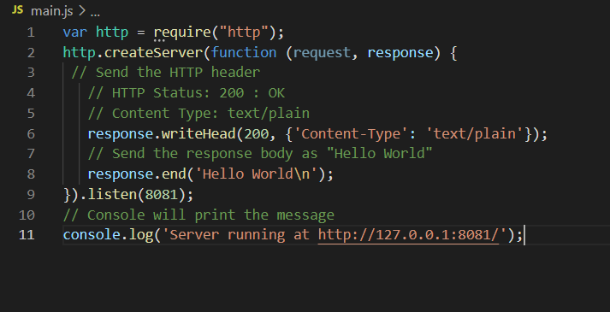
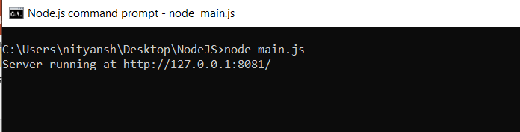
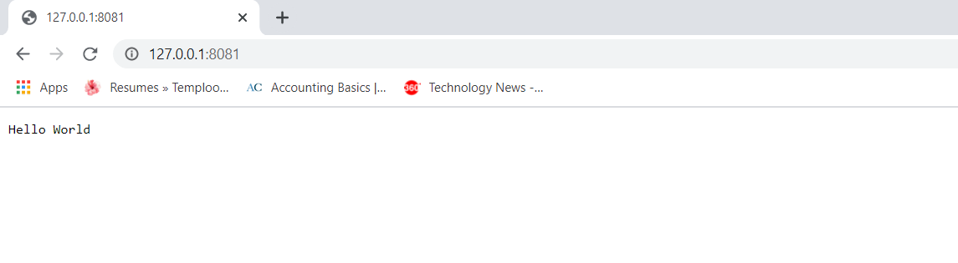

Slide 10
Node.js Console
The Node.js console module provides a simple debugging console similar to JavaScript console mechanism provided by web browsers.
There are three console methods that are used to write any node.js stream:
console.log()
console.error()
console.warn()
Node.js console.log()
The console.log() function is used to display simple message on console. Prints to stdout with newline.
console.log('Hello World');
var name="Nityansh"
console.log('Hello %s', name);

Slide 11
Node.js console.error()
The console.error() function is used to render error message on console.
Prints to stderr with newline.
console.error('Invalid input.');
Node.js console.warn()
The console.warn() function is used to display warning message on console.
It is an alias for console.error().
age=55;
console.warn(`My age is ${age}`);

Slide 12
Node.js REPL
The term REPL stands for Read Eval Print and Loop. It specifies a computer environment like a window console or a Unix/Linux shell where you can enter the commands and the system responds with an output in an interactive mode.
REPL Environment
The Node.js or node come bundled with REPL environment. Each part of the REPL environment has a specific work.
Read: It reads user's input; parse the input into JavaScript data-structure and stores in memory.
Eval: It takes and evaluates the data structure.
Print: It prints the result.
Loop: It loops the above command until user press ctrl-c twice.

Slide 13
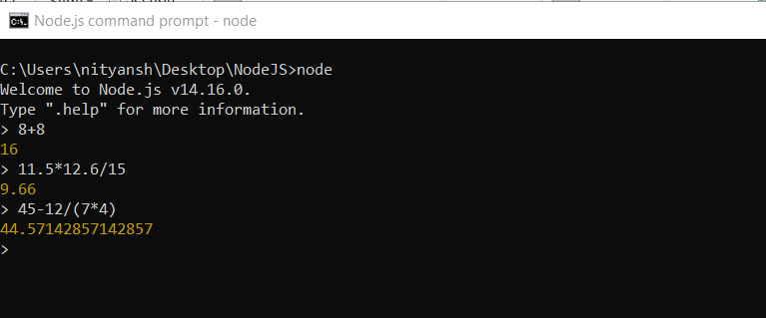
You can start REPL by simply running "node" on the command prompt.
You can execute various mathematical operations on REPL Node.js command prompt:
Node.js Simple expressions

Slide 14
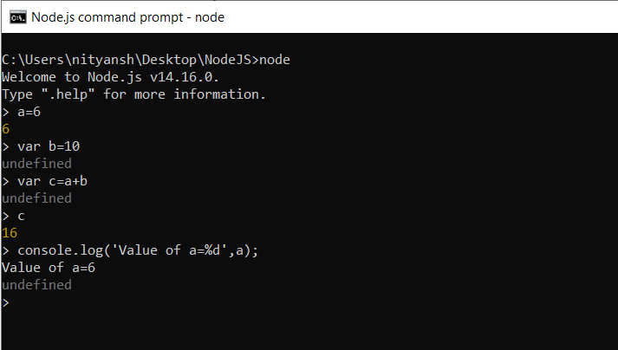
Using variable
Variables are used to store values and print later. If you don't use var keyword then value is stored in the variable and printed whereas if var keyword is used then value is stored but not printed. You can print variables using console.log()

Slide 15
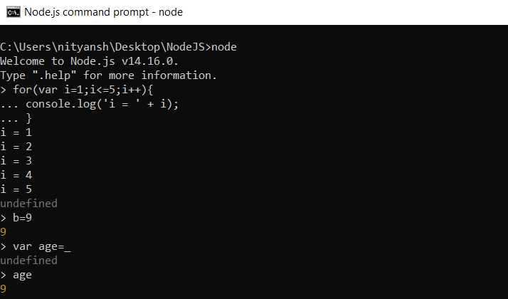
Node.js Multiline expressions and Underscore Variable
Node REPL supports multiline expressions.
We can use underscore _ to get the last result.

Slide 16
Node.js REPL Commands
Commands | Description
ctrl + c | It is used to terminate the current command.
ctrl + c twice | It terminates the node repl.
ctrl + d | It terminates the node repl.
up/down keys | It is used to see command history and modify previous commands.
tab keys | It specifies the list of current command.
.help | It specifies the list of all commands.
.break | It is used to exit from multi-line expressions.
.clear | It is used to exit from multi-line expressions.
.save filename | It saves current node repl session to a file.
.load filename | It is used to load file content in current node repl session.

Slide 17
Node.js Modules
What is a Module in Node.js?
Consider modules to be the same as JavaScript libraries.
A set of functions you want to include in your application.
Include Modules
To include a module, use the require() function with the name of the module:
var http = require("http");
Now your application has access to the HTTP module

Slide 18
Create Your Own Modules
You can create your own modules, and easily include them in your applications.
The following example creates a module that returns a date and time object:
var os = require('os’)
exports.system = function () {
return os.type();
};
We make use of the exports keyword to make properties and methods available outside the module file.

Slide 19
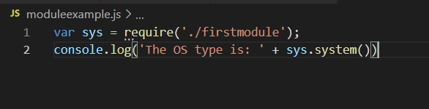
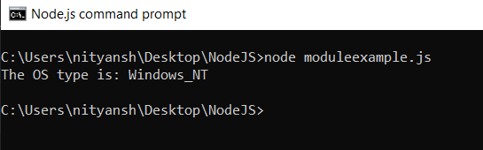
Include Your Own Module
Now you can include and use the module in any of your Node.js files.

Slide 20
Node.js Package Manager
Node Package Manager provides two main functionalities:
It provides online repositories for node.js packages/modules which are searchable on search.nodejs.org
It also provides command line utility to install Node.js packages, do version management and dependency management of Node.js packages.
The npm comes bundled with Node.js installables in versions after that v0.6.3. You can check the version by opening Node.js command prompt and typing the following command:
npm version

Slide 21
Installing Modules using npm
Following is the syntax to install any Node.js module:
npm install <Module Name>
Let's install a famous Node.js web framework called express:
Open the Node.js command prompt and execute the following command:
npm install express

