Slide 1


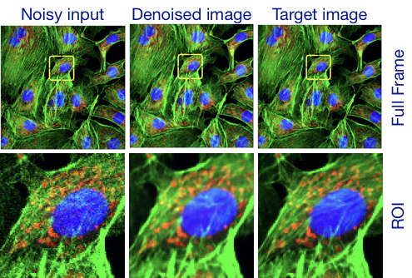
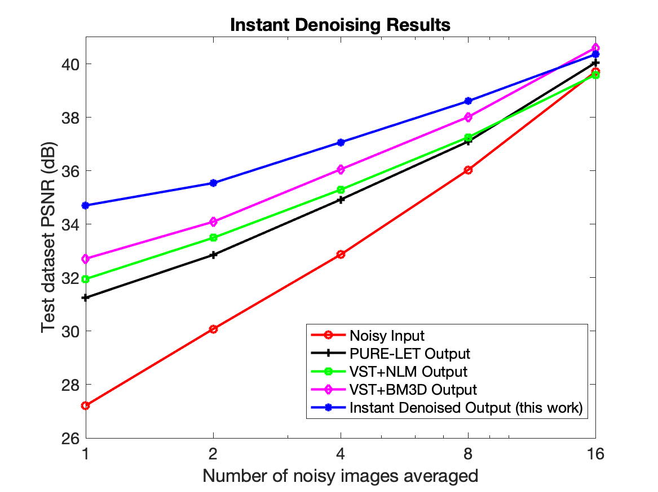
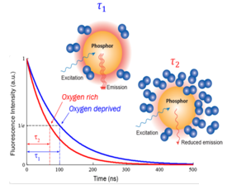
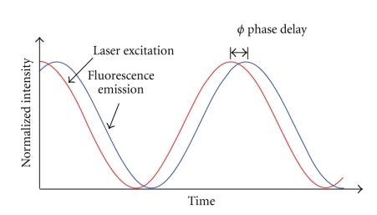
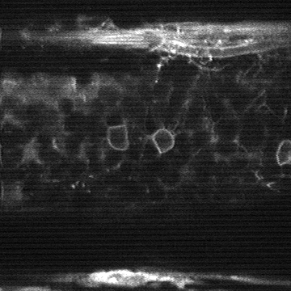
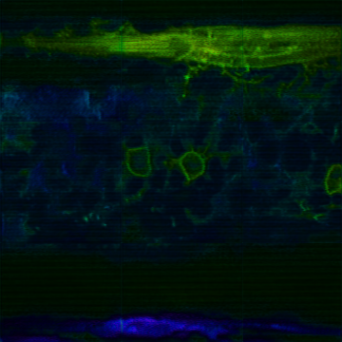
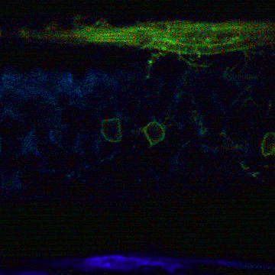


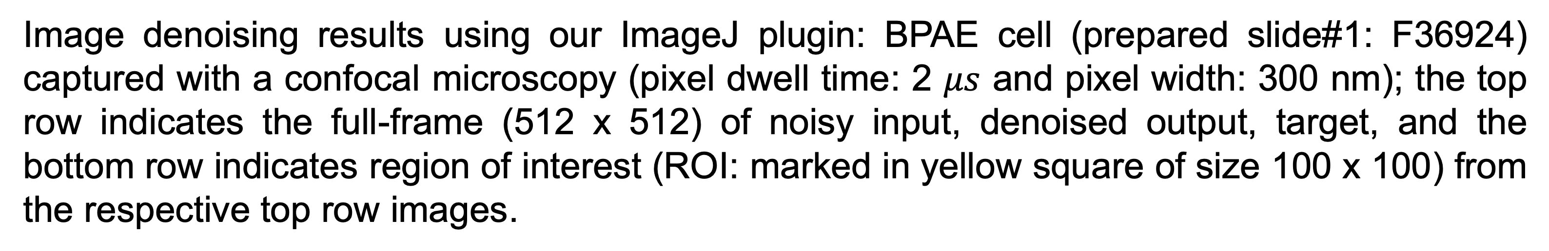
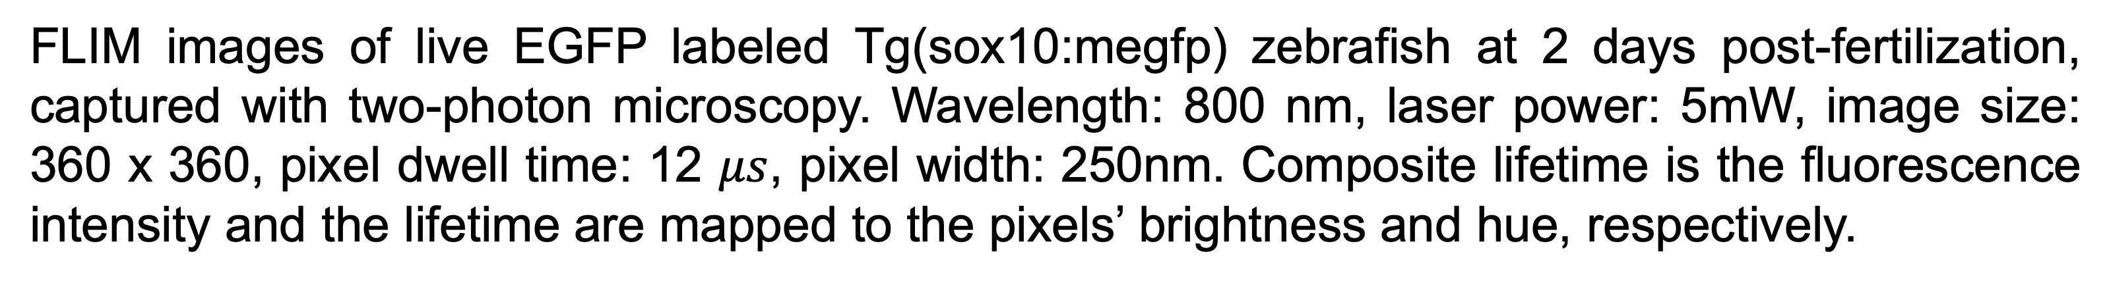
Enhancements on Fluorescence Images using Machine Learning
Varun Mannam*, Yide Zhang, Xiaotong Yuan, and Scott Howard
Department of Electrical Engineering | University of Notre Dame, IN 46556, USA
*vmannam@nd.edu
Introduction
Intensity denoising using our ImageJ plugin
Results
FLIM: Fluorescence lifetime imaging microscopy (FLIM) is a powerful tool in biology and chemistry by measuring the fluorescence decay lifetime of excited fluorophores in optical microscopy. The fluorescence lifetime can be utilized as an indicator of ion or dissolved oxygen concentration, thus enabling FLIM to measure the microenvironment in biology [1-2].
Test-mix dataset average PSNR [3]
Our ImageJ plugin denoising technique allows imaging 8 times faster than the fundamental speed limit
The PSNR of the denoised image is 5.2 dB more than the PSNR of input image
FLIM techniques are slow compared to conventional microscopy due to the extra data acquisition and processing steps required to acquire fluorescence lifetime information
FLIM images suffer from their low SNR because the photon efficiency in measuring fluorescence lifetimes is low; this problem is more dominant in deep tissue imaging, where useful ballistic photons are scarce
Image denoising results using our ImageJ plugin: BPAE cell (prepared slide#1: F36924) captured with a confocal microscopy (pixel dwell time: 2 $μs$ and pixel width: 300 nm); the top row indicates the full-frame (512 x 512) of noisy input, denoised output, target, and the bottom row indicates region of interest (ROI: marked in yellow square of size 100 x 100) from the respective top row images.
Estimation of the lifetime from intensity:
The structural similarity index (SSIM) of the estimated composite lifetime compared to the target composite lifetime is 0.9023. Therefore, we can estimate the lifetime from the intensity. The estimated composite lifetime is less noisy when compared to the target composite lifetime.
Network Configuration: U-Net architecture with an input of 256x256, encoded to the latent space of 8 x 8 and reconstructed back to an image of 256 x 256 (Noise2Noise model [3]).
Motivation
Fluorescence Lifetime from Intensity
Denoise the intensity image which has the combination of Poisson and Gaussian noise
Estimate the lifetime from intensity to reduce the processing time and make it suitable for real-time processing
Conclusions
The denoised intensity image average PSNR is improved by 7.5 dB and computation time is less than 80 ms using our ImageJ plugin
A similar U-Net architecture gives the composite lifetime information from the intensity information
Acknowledgements & references
This work was supported by the National Science Foundation under Grant No. CBT-1554516 (SSH). We would like to acknowledge the Notre Dame Integrated Imaging Facility (NDIIF) for the use of the Nikon A1RMP confocal microscope and Nikon Eclipse 90i wide-field microscope in NDIIF’s Optical Microscopy Core and the Center for Research Computing (CRC) for the use of GPU’s to train our machine learning models.
[1] Y. Zhang, A. A. Khan, G.D. Vigil and S. S. Howard, Opt. Express, vol, 24, no.18, pp. 20662-20667, 2016
[2] Y. Zhang, S. S. Howard, In Multiphoton Microscopy in the Biomedical Sciences XIX, vol. 10882, p. 108822H. International Society for Optics and Photonics, 2019,
[3] Y. Zhang, Yinhao Zhu, S. S. Howard, In Proceedings of the IEEE Conference on Computer Vision and Pattern Recognition, pp. 11710-11718. 2019
Intensity image
Estimated composite lifetime
Target
composite lifetime
Future Work
FLIM images of live EGFP labeled Tg(sox10:megfp) zebrafish at 2 days post-fertilization, captured with two-photon microscopy. Wavelength: 800 nm, laser power: 5mW, image size: 360 x 360, pixel dwell time: 12 $μs$, pixel width: 250nm. Composite lifetime is the fluorescence intensity and the lifetime are mapped to the pixels’ brightness and hue, respectively.
Create a large dataset for accurate estimation of fluorescence lifetime from its intensity
Create a machine learning model to denoise the lifetime using this dataset.
Use this trained model to enhance the other aspects of lifetime (ex: segmentation, super-resolution.)
Network Configuration: A similar U-Net architecture with an input of 128 x 128, encoded to the latent space of 8 x 8 and reconstructed back to an image of 3 x 128 x 128 (composite image) and batch-norm enabled between the layers.

