Slide 1


One Health: from environment to individuals
Thesis Title - Investigating The Structure-Function Changes Due to Variations In Redox Regulating Glutathione Peroxidases.
Presented By : Nayanika Das
PhD Student
Computational Biochemistry and Biophysics Lab (http://mon.uvic.cat/cbbl)
Bioinformatics and Bioimaging (BI-SQUARED)
Department of Biosciences
Faculty of Sciences,Technology and Engineering
Universitat de Vic
Universitat Central de Catalunya
Director of the Thesis : Dr. Jordi Villà i Freixa Co-Supervisor : Dr. Vijay Baladhye
<number>
nayanikasekhar.das@uvic.cat

Slide 2
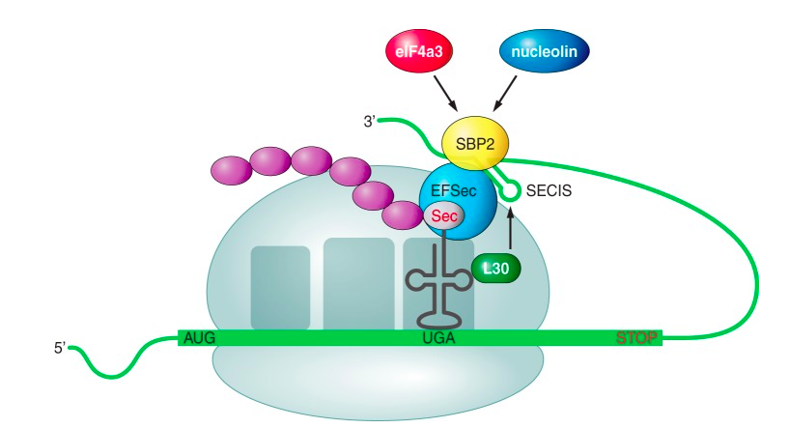
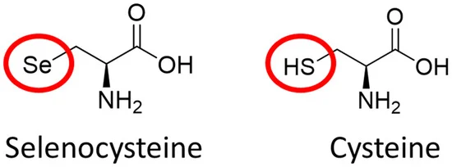
Background
What are Selenoproteins
SECIS element (selenocysteine insertion sequence)
UGA stop codon
RNA stem-loop structure
Evolutionary adaptation to enable a more efficient synthesis of selenoproteins
Selenoprotein includes a selenocysteine amino acid residue.
Fig 1: Chemical structure of selenocysteine and cysteine.
Fig 2: Selenoprotein Biosynthesis
The Image has been obtained from https://bioinformaticaupf.crg.eu/20172018/projectes1718/10/intro.html#1
<number>

Slide 3
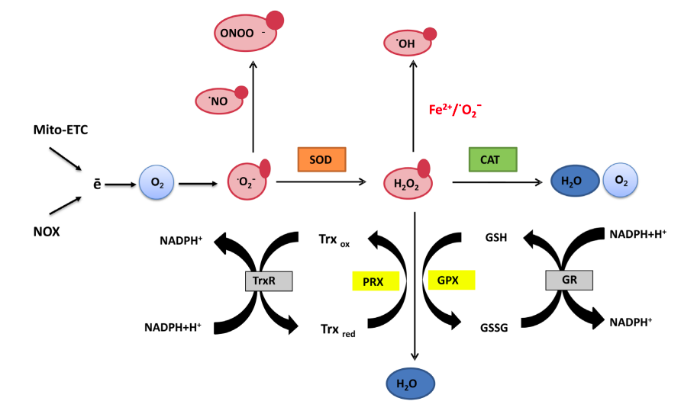
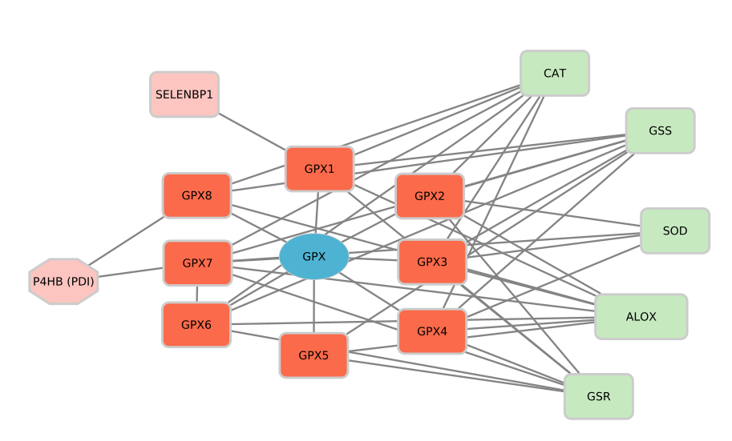
Background
Function of glutathione peroxidase
Protein-Protein Interaction of Mammalian GPX Isoforms
ROS : reactive oxygen species generation
Fig 3: Generation and scavenging of reactive oxygen species
Fig 4: PPI network of GPX
The image has been obtained from
Sznarkowska A, Kostecka A, Meller K, Bielawski KP. Inhibition of cancer antioxidant defense by natural compounds. Oncotarget. 2017 Feb 28;8(9):15996-16016. doi: 10.18632/oncotarget.13723.
The image has been made using Cytoscape
<number>

Slide 4
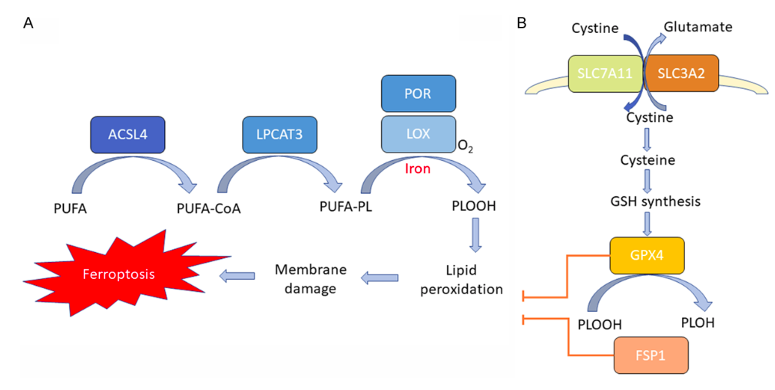
Background
Role of GPX4 in Ferroptosis Pathway
GPX4 uses GSH as a substrate and reduces the membrane phospholipid hydroperoxide to harmless lipid alcohols.
Fig 5 A: Lipid peroxidation pathway.
Fig 5 B: Antioxidant pathway.
Polymorphisms Associated Disease
GPX1 (P75R, A192T) Probable association with Cancer
GPX1: rs1050450 Breast, Lung, Colorectal Cancer
GPX4: rs713041 Colorectal Cancer
GPX3: rs3763013, rs8177412, Gastric Cancer, Thyroid Cancer
rs3805435, rs3828599,
rs2070593
The image has been obtained from https://www.ncbi.nlm.nih.gov/pmc/articles/PMC8727800/pdf/ajcr0011-5856.pdf
<number>

Slide 5
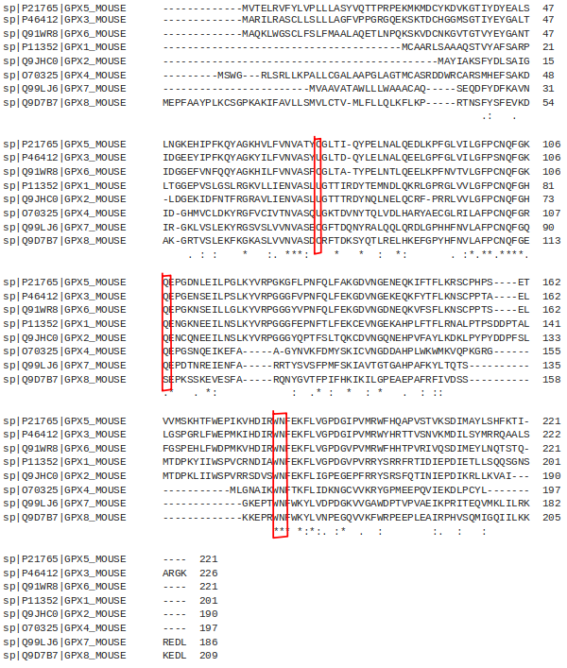
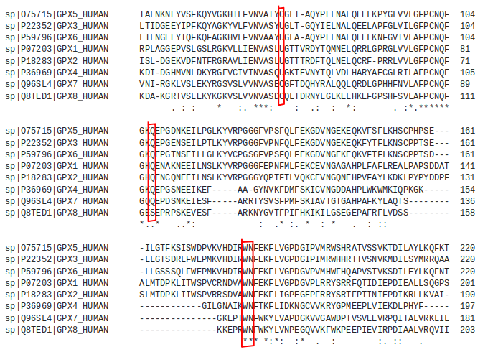
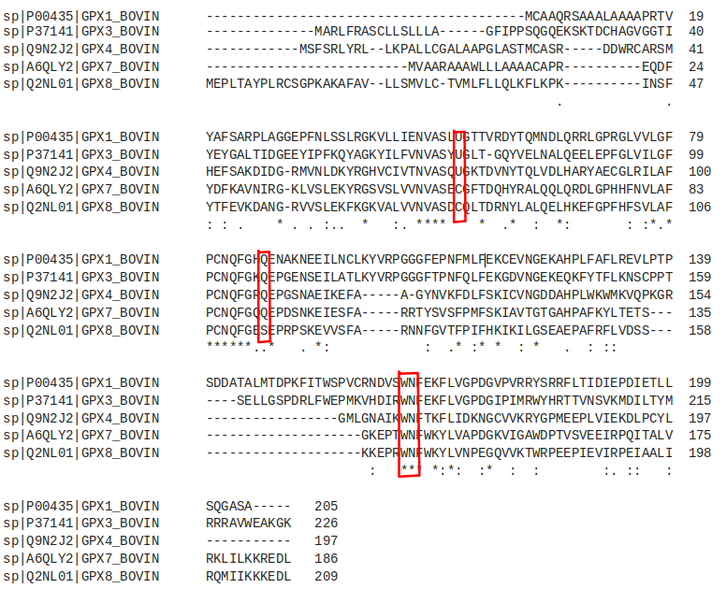
Background
Multiple sequence alignment of GPX isoforms
Mouse
Active site
Human
Active site
Bovine
Active site
<number>

Slide 6
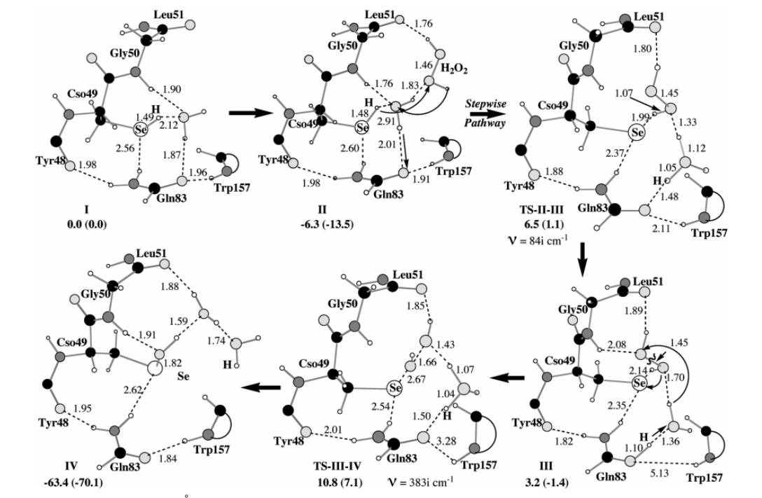
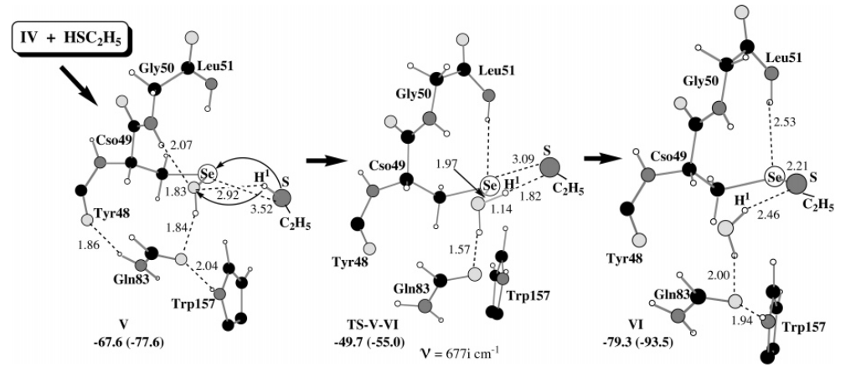
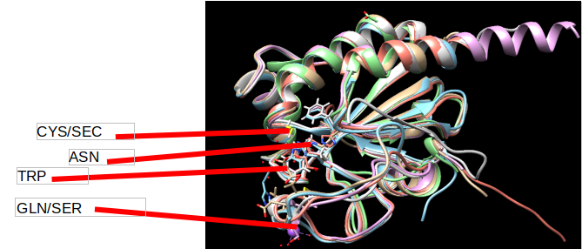
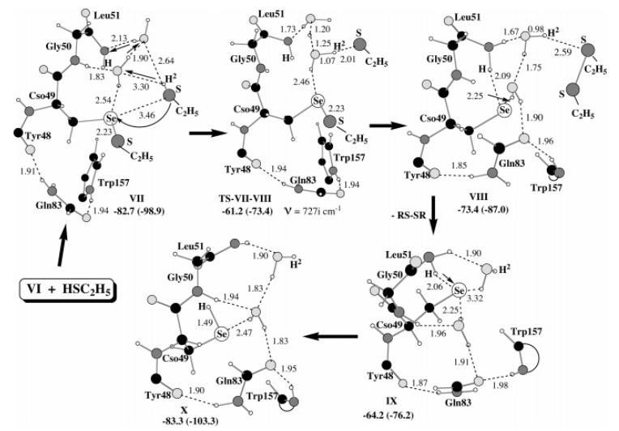
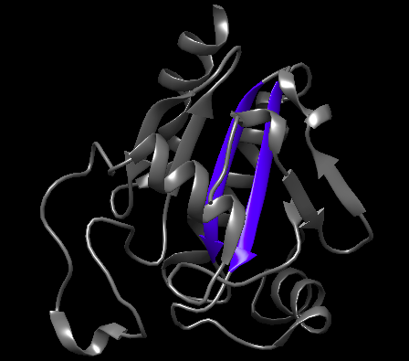
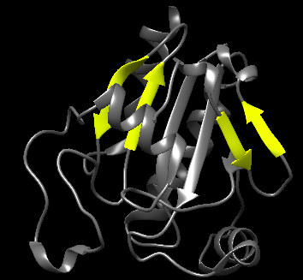
Background
Mechanism of GPX
Structural homology in mammalian GPX isoforms
STEP 1
STEP 2
STEP 3
Fig 6: Structure of GPX
Fig 7: Stepwise mechanism of Bovine GPX
The image has been obtained from
Prabhakar R, Vreven T, Morokuma K, Musaev DG. Elucidation of the mechanism of selenoprotein glutathione peroxidase (GPx)-catalyzed hydrogen
peroxide reduction by two glutathione molecules: a density functional study. Biochemistry. 2005 Sep 6;44(35):11864-71. doi: 10.1021/bi050815q. PMID:
16128588.
Step 1 - RSeH + H₂O₂ → RSeOH + H₂O
Step 2 - RSeOH + GSH → GS-SeR + H₂O
Step 3 - GS-SeR + GSH → GS-SG + RSeH
<number>

Slide 7
Questions
1. How do the presence of variants in this protein affect its dynamics?
2. How is the enzymatic activity affected by variations?
Objectives
1. Explore the mode of interaction between GPX6 and the glutathione in ancestral to modern GPX6
2. Unraveling the effect of the variants in the dynamics of the protein structures.
3. Free energy calculations for reactivity
4. To understand the enzymatic mechanism of GPX
Hypothesis
It is possible to attain knowledge about alterations in structure, reaction kinetics and biochemical networks due to mutations, with free energy calculations and protein-protein interaction network studies.
<number>

Slide 8
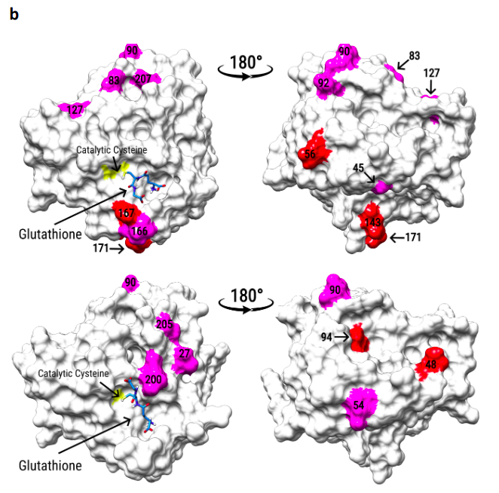
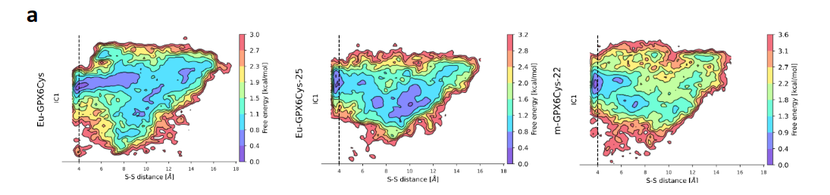
Results: Objective 1
The binding of GSH have not been
adversely affected by the involvement of Cys, but lost the peroxidase activity when Se is replaced by S
Figure 8a : Free energy profiles for the docking
Figure 8b : The catalytic cysteine (yellow) is shown with the glutathione best binding energy conformation.
Ref : Ancient loss of catalytic selenocysteine spurred convergent adaptation in a mammalian oxidoreductase. Rees JSarangi GCheng QFloor MAndrés AMiguelBVillà-Freixa JSj Arnér ECastellano S. Doi: 10.1101/2023.01.03.522577
Question
Has loosing of peroxidase activity in GPX6 seen due to substitution of Se by S in the active site or the accompanying of mutations play a crucial role in this process ?
<number>

Slide 9
Protocol for next steps
Glutathione Peroxidase Isoforms
Sequence and Structure (MD for conformational analysis)
QM and QM/MM (reaction mechanism)
Free energy calculations for reactivity
OpenMM molecular dynamic simulations.
MDTraj and Markov state models
EVB simulations on the different mutants by Q6 program OpenMM and AMBER ff
QM (GAMESS) and QM/MM (pDynamo) methods
<number>

Slide 10
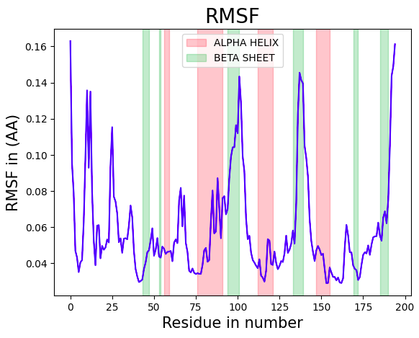
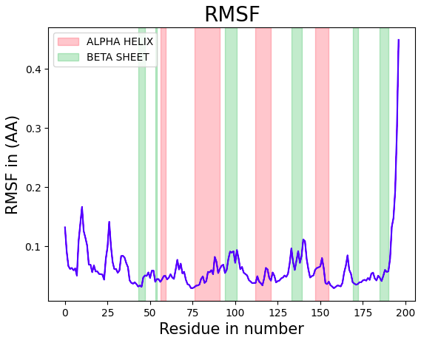
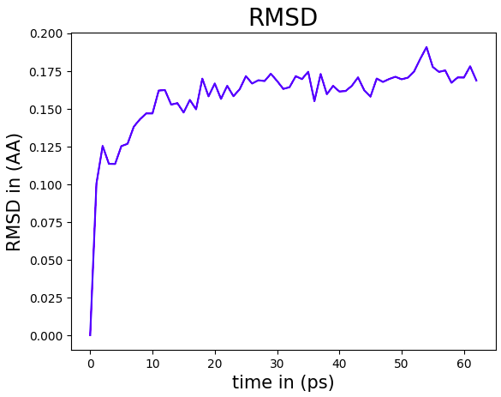
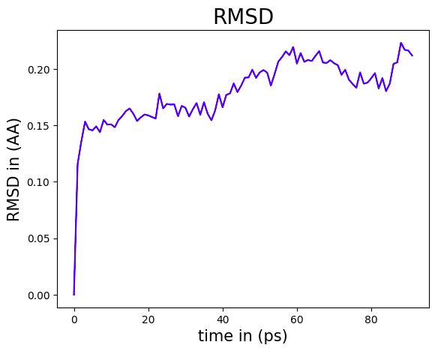
Preliminary Results
Fig 9: RMSF calculated from MD simulation of GPX6 mouse
Fig 10: RMSF calculated from MD simulation of GPX6 human
Fig 11: RMSD calculated from MD simulation of GPX6 mouse
Fig 12: RMSD calculated from MD simulation of GPX6 human
<number>

Slide 11
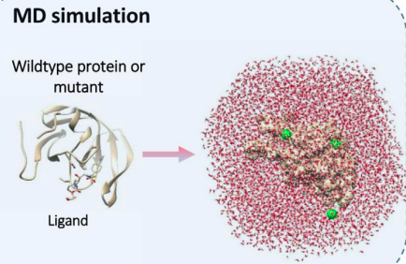
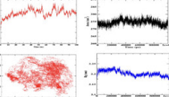
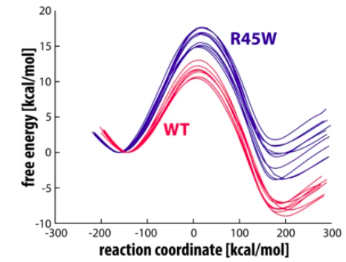
Next Steps :
1. Running Molecular Dynamics Simulations on different structures of GPX
2. Running EVB simulations on the different mutants
Analysis
The image has been obatined from https://doi.org/10.1016/j.csbj.2020.02.007
The image has been obatined from Prah, A., Pregeljc, D., Stare, J. et al. Brunner syndrome caused by point mutation explained by multiscale simulation of enzyme reaction. Sci Rep 12, 21889 (2022). https://doi.org/10.1038/s41598-022-26296-7
<number>

Slide 12
Thank You
Questions
<number>

