Slide 1
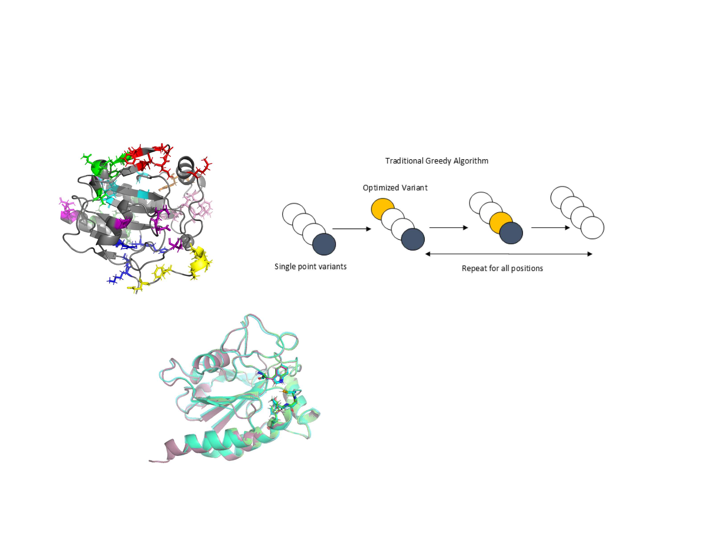
Possible sites for mutagenesis
Superimposed Structures

