Slide 1
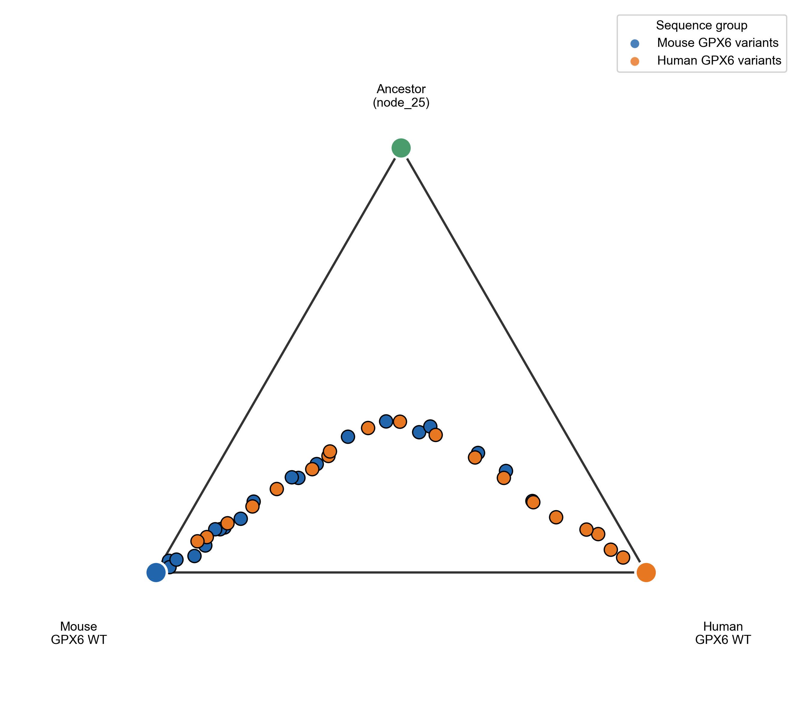
TS
ΔG‡
ANCESTOR
Free Energy
RS
EVB simulations
PS
MOUSE
HUMAN
Reaction Coordinate

