Slide 1
Computational and Experimental characterization of the catalytic activity of
artificial enzymes based on the LmrR scaffold
Introduction
EVB/FEP
Alanine Scanning
Results

Slide 2
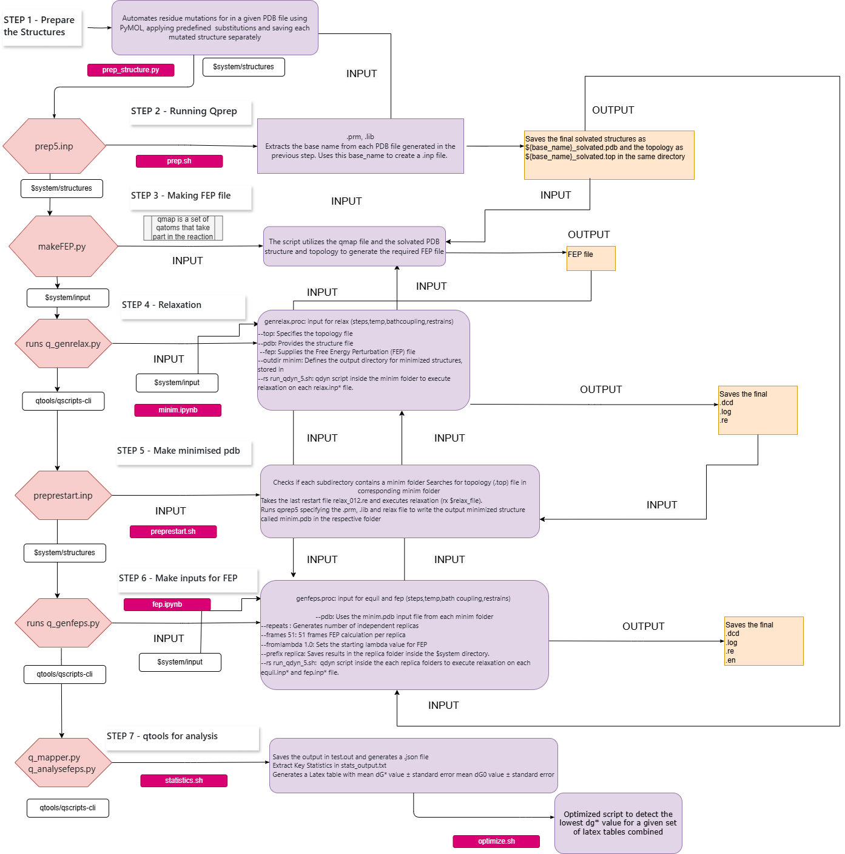
Workflow
Detailed Workflow to run EVB on several mutations
https://github.com/ND7996/GPX6

Slide 3
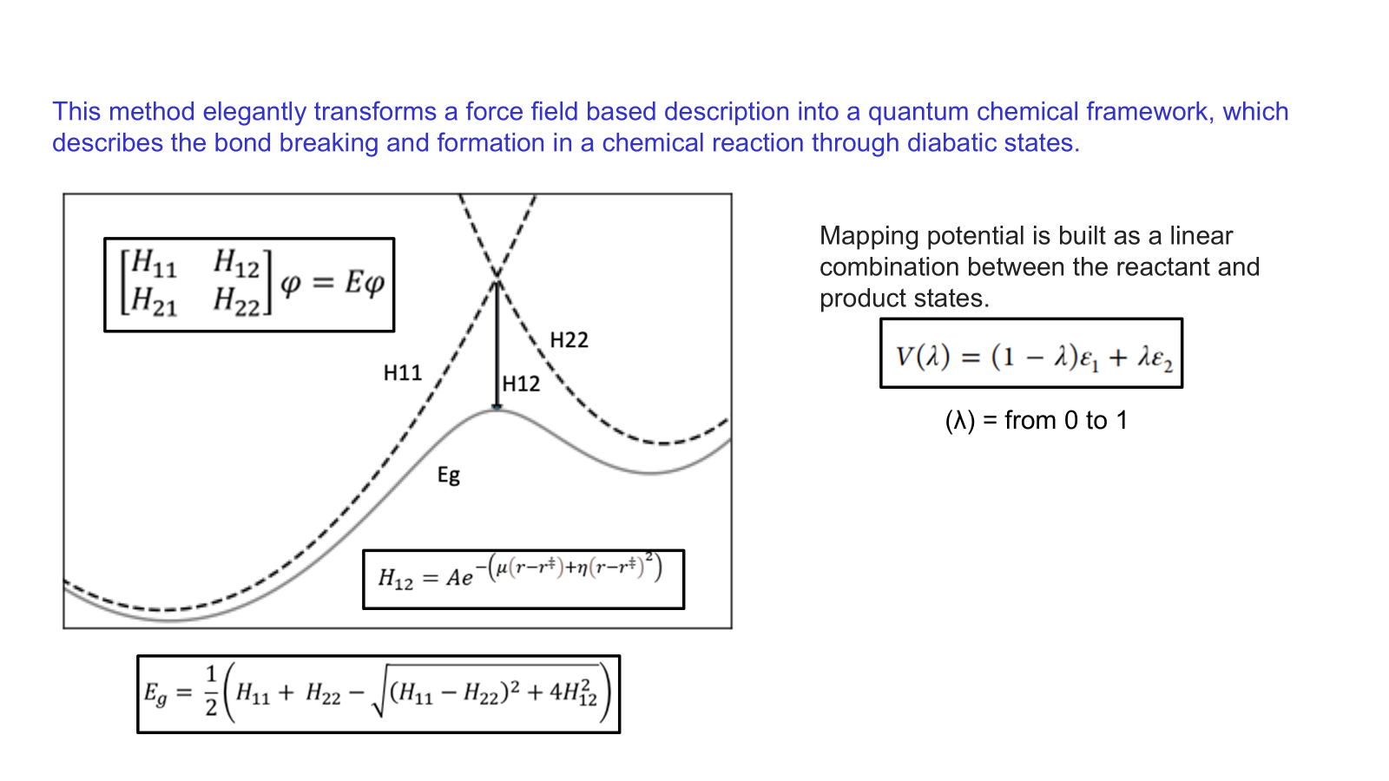
FEP calculations
PREPARE
ANALYSE
SIMULATE
Qprep
Qfep
Qdyn

Slide 4
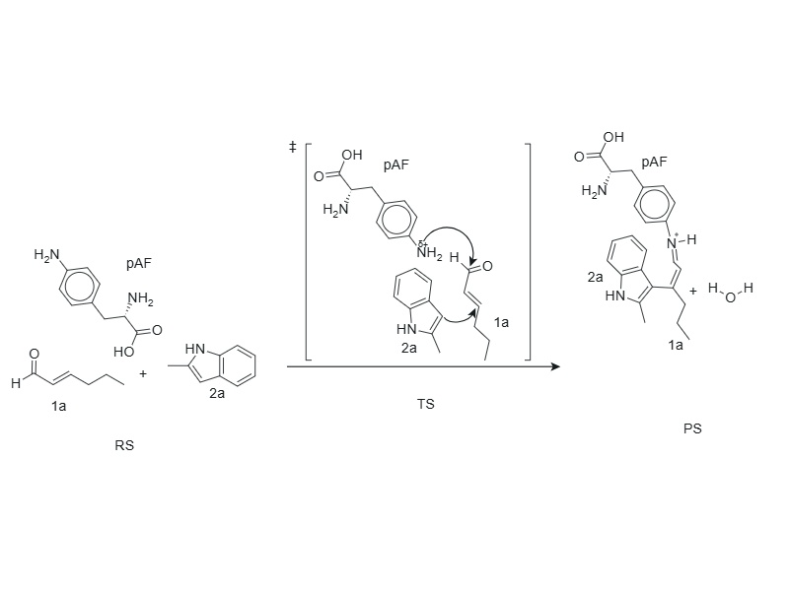
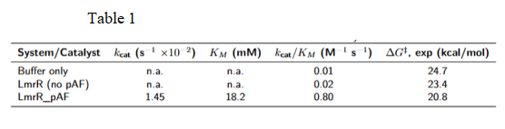
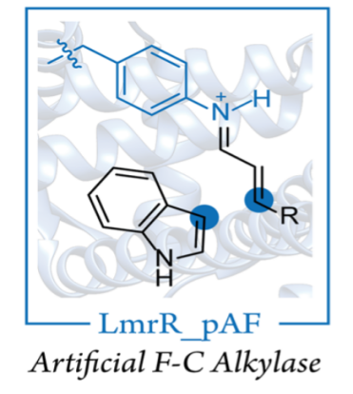
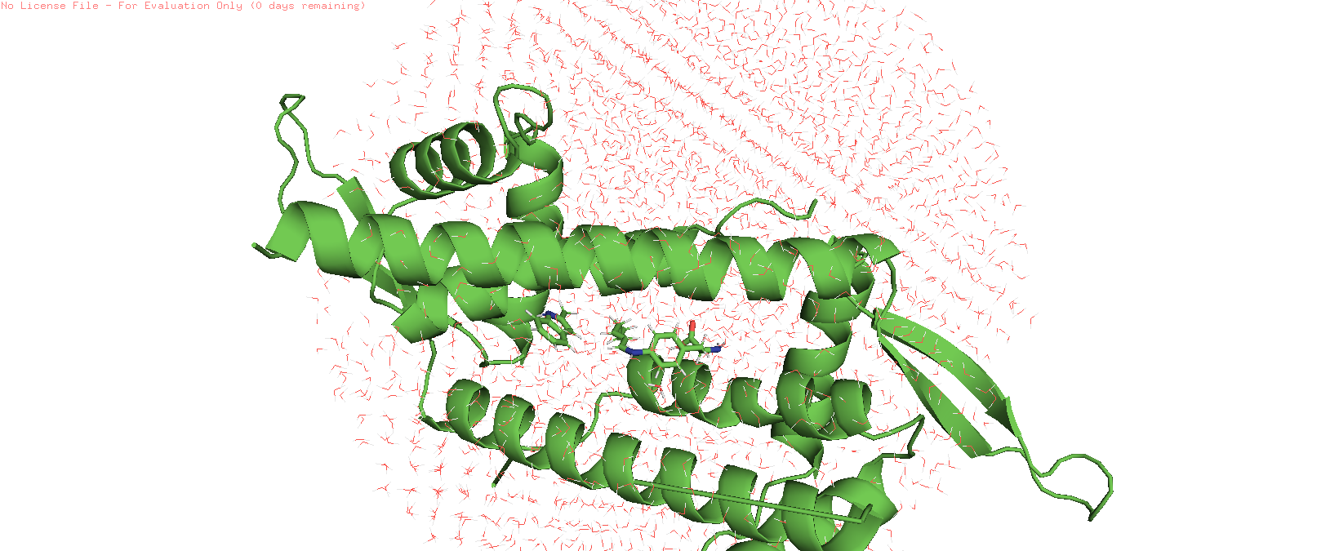
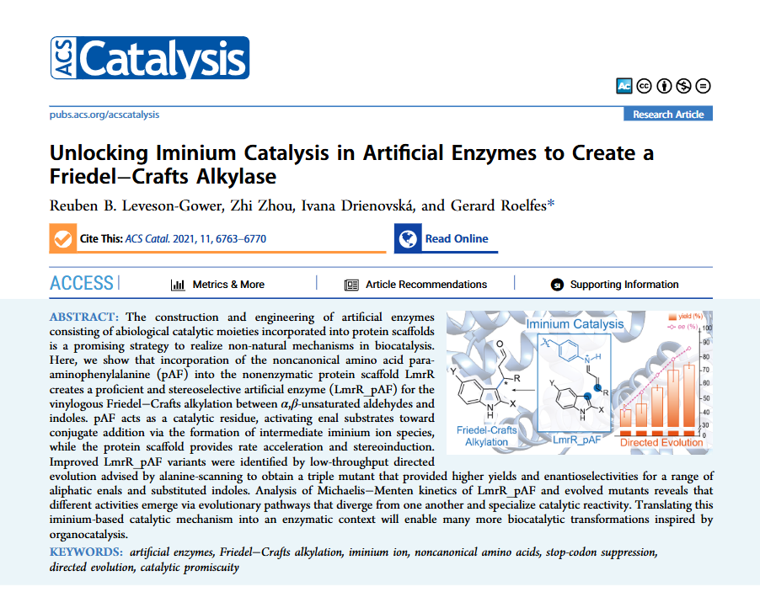
Alanine Scanning: A Synergistic Computational and Experimental Approach
EVB

Slide 5
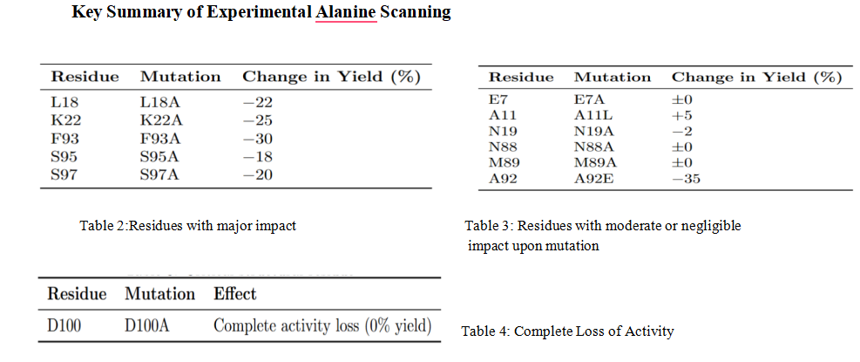
Results

