Slide 1
Identification Of Novel Inhibitors Against NRAS Target In Melanoma Using In Silico Approach.
Under Guidance Of
Dr. Vijay B. Baladhye (Guide)
Dr. Rohan J. Meshram (Co-guide)
Presented By
Nayanika Das
BIM_2017_07

Slide 2
Contents
Introduction to Melanoma & Statistics
Melanoma Pathway & MAPK pathway
NRAS & NRAS as a Target
Workflow of Methodologies
Wild Type NRAS
Mutant NRAS Structure
Validation of Mutant NRAS Structure
Compounds obtained for screening
Filtration of Compounds
Results Of Screening
Interaction analysis
Conclusion
Future work
Acknowledgements

Slide 3
Introduction To Melanoma
Melanoma, is a type of skin cancer which , develops in the cells (melanocytes) that produce melanin (the pigment) that gives skin its colour.The major types are Superficial spreading melanoma, Lentigo maligna, Acral lentiginous melanoma and Nodular melanoma.
Causes :
One of the causes is UV radiations.
Symptoms :
Most melanomas are detected by moles at early stages. These moles are of 4 types -
No symmetricity in shape, rough edges, dark coloured, changes it’s size and shape.
The other ways of detecting melanoma are :
No healing of sores or moles, redness, pigments, itchiness, pain, blurred vision.

Slide 4
Melanoma Statistics
There are few reports in the literature on cutaneous malignant melanoma (CMM) in the Asian population.
In 2017, the National Institute of Health (NIH) had estimated that there will be 87,110 new cases of melanoma and 9,730 deaths.(https://www.nih.gov/)
World’s highest melanoma risk is accounted in Australia and New Zealand followed by North America.
Melanoma is the third most frequent cancer among women age 20-39 and in men age 20-39. 10% of all people with melanoma have a genetic trait

Slide 5
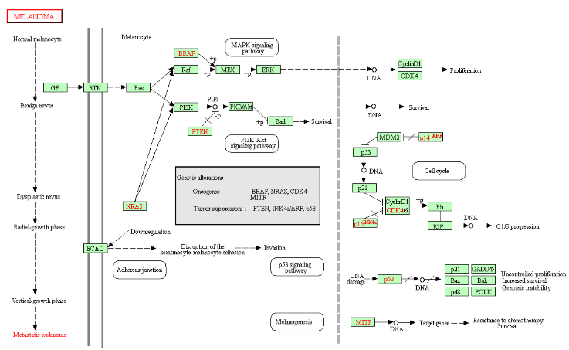
Melanoma Pathway in Homo sapiens.
Oncogenic NRAS mutations activate both pathways Raf-MEK-ERK and PI3K-Akt
Image has been borrowed from https://www.kegg.jp/kegg-bin/highlight_pathway?scale=1.0&map=hsa05218&keyword=melanoma

Slide 6
Important Pathways Involved In Melanoma
Table I. The contents of this table has been borrowed from Shtivelman E, Davies MQ, Hwu P, et al. Pathways and therapeutic targets in melanoma. Oncotarget. 2014;5(7):1701-52.

Slide 7
MAPK pathway
Dysregulation of MAPK pathway is very common in many cancers due to mutations in RAS genes (Inamdar GS, Madhunapantula SV, Robertson GP 2010)
About 28% of the mutations are seen in NRAS of this pathway(Wellbrock C, Arozarena I 2016)
It harbors BRAF,NRAS,ERK and MEK as MAPK pathway components.
Studying this pathway for quite sometime MEK inhibitors were designed to target BRAF and NRAS, but it did not show 100% inhibitory activity towards both.
The crosstalks with MAPK and the other pathways is very important for further targeting NRAS in future.

Slide 8
NRAS (Neuroblastoma RAS viral oncogene )
The Ras family includes mainly 3 types of genes,HRAS,KRAS and NRAS.
The N-Ras protein is a GTPase, which means it converts a molecule called GTP into another molecule called GDP.
The N-Ras protein acts like a switch and it is turned on by attachment to the GTP molecule and turned off when GTP gets converted to GDP.

Slide 9
NRAS As A Target
Targeted cancer therapies have shown some progress in treating BRAF-mutant melanoma, but not against NRAS-mutant.
The oncogenic mutation in 20– 25% of melanomas are due to affects of NRAS gene.
Because of aggressive nature and the complex changes in molecular signalling, NRAS becomes the second most significant target after BRAF.
MEK inhibitor Binimetinib, particularly focuses on NRAS mutant melanoma at 61 residue.

Slide 10
Materials And Methods

Slide 11
Workflow Of Methodologies
Building the mutant structure of NRAS in SPDBV and it’s validation using ProSA and PROCHECK
Obtaining data from Zinc DB natural products
Filtration of the compounds using FAFdrugs4 (ADME/Tox tool)
Screening of Natural compounds using PyRx Virtual Screening tool
Selecting the best compounds after docking based on the binding free energy scores

Slide 12
Workflow Of Methodologies Continued..
Generation of ligplot to check for the conserved residues and stability using Ligplot Plus
Selecting the compounds highly stable for further analysis based on the molecular docking results
Conclusion as to why these compounds were chosen as inhibitors for further analysis

Slide 13
RESULTS & DISCUSSION

Slide 14
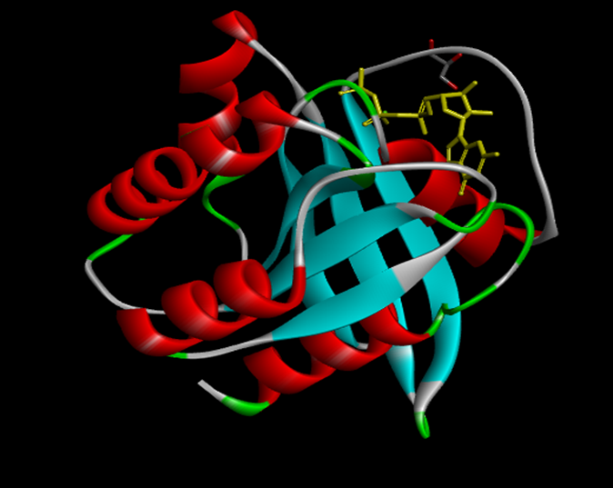
Wild Type NRAS
ACTIVE SITE
This is the first crystal structure of NRAS solved at 1.67Å resolution. The ligand bound to it is phosphoaminophosphonic acid-guanylate ester (Johnson CW, Reid D, Parker JA, et al. 2017).
Fig 1.Wild Type Structure of NRAS [PDB ID-5UHV]

Slide 15
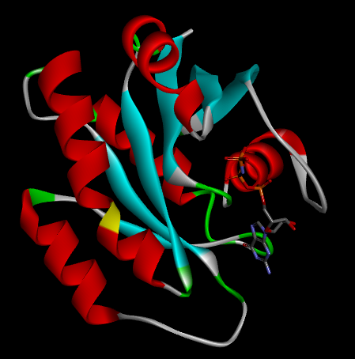
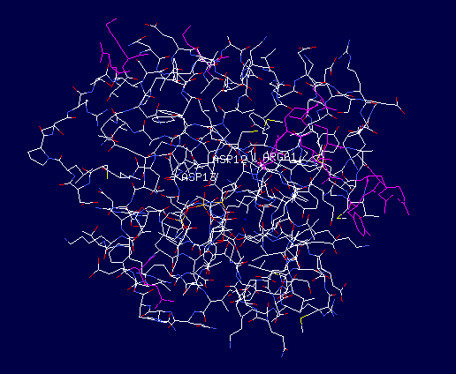
Mutant NRAS
Fig 2.Visualization of Mutant NRAS in Discovery studio
Fig 3.Building Of Mutant NRAS in SPDBV
NRAS is most frequently mutated at 12 and 13 and 61 positions
G-D = 12 (Glycine-Aspartic Acid)
G-D = 13 (Glycine-Aspartic Acid)
Q-R = 61 (Glutamine-Arginine)

Slide 16
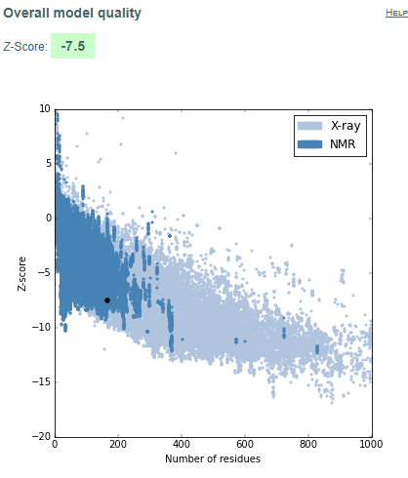
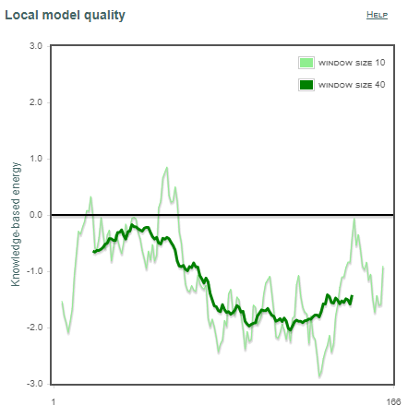
Mutant NRAS Structure Validation Using ProSA
Fig 4.ProSA analysis of Mutant NRAS

Slide 17
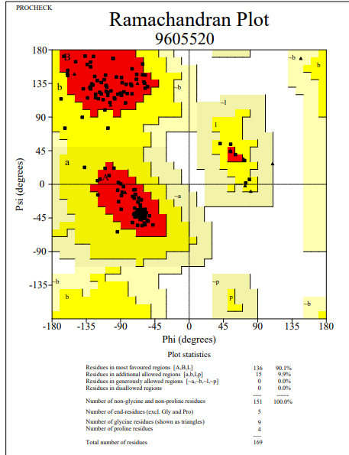
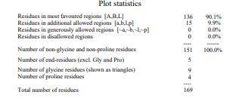
Mutant NRAS structure Validation Using PROCHECK
Fig.5 PROCHECK analysis of Mutant NRAS

Slide 18
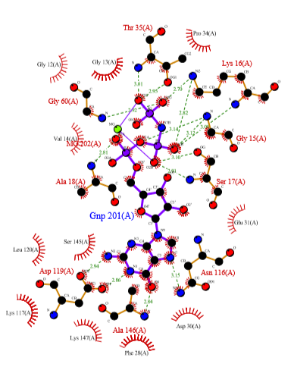
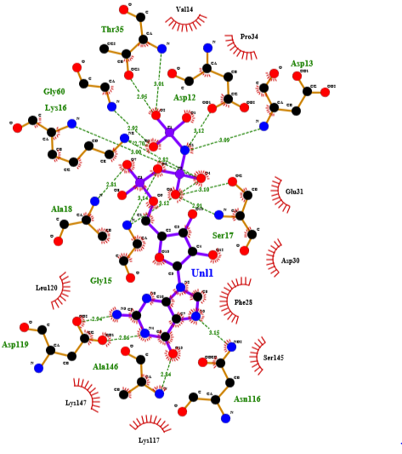
A Comparison Of Molecular Interactions Between Wild Type NRAS and Mutant NRAS
Molecular Docking
Hydrogen Bonding Pairs
Asp-12::Unl1=3.12 Å
Asp-13::Unl1=3.09 Å
Fig.6 Wild Type NRAS with Hydrophobic Interactions of Gly-12,Gly-13
Fig.7 Mutant NRAS Molecular Interactions

Slide 19
Data Collection For Docking
The natural compounds that were to be screened were obtained from Zinc Database natural product library.
These databases are provided under collaborative agreements with each respective catalog owner. Most of it is for sale.
The total compounds were 1,12,170 which after filtering using FAFdrugs4, were 5322 compounds.
The filters used were LEAD-LIKE and PAINS.

Slide 20
Why These Filters ?
PAINS moieties, standing for Pan Assay Interference Compounds, are compounds that are frequently occurring(promiscuous compounds) in many biochemical high throughput screens.
Pan-assay interference compounds (PAINS) are chemical compounds that often give false positive results in high-throughput screens.
LEAD-LIKE filter has a goal to have a relatively small log P and thus molecules that could be selected further to increase affinity

Slide 21
Screening Results
These compounds were selected on the basis of binding free energy scores.
Ligand | Target | Binding free energy (kcal/mol)
ZINC02107288_19972 | promutation | -10.62
ZINC02096813_6040 | promutation | -10.61
ZINC02096815_6057 | promutation | -10.33
ZINC02114326_14245 | promutation | -10.23
ZINC01020381_6354 | promutation | -10.16
ZINC06167356_6831 | promutation | -10.16
ZINC02120343_9364 | promutation | -10.14
ZINC02102162_14892 | promutation | -10.14
ZINC02114643_7056 | promutation | -10.1
ZINC00518885_18475 | promutation | -10.06
ZINC03882094_17080 | promutation | -10.04
Table II. Top eleven compounds after docking

Slide 22
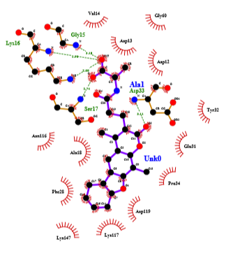
Molecular Interactions
Zinc ID-ZINC02107288
Hydrogen Bonding Pairs
Lys-16(N):: Unk0(C)^{OXT}
Lys-16(NZ):: Unk0(C)^{OXT}
Gly-15(N):: Unk0(C)^{OXT}
Ser-17(N)::Unk0(C)^{O}
Asp-33(N)::Unk0(C₁₁)^{O}₃
Hydrophobic Interactions
Val-14,Asp-13,
Gly-60,Asp-12,
Tyr-32,Glu-31,Ala-18,
Asn-116,Lys-117,
Asp-119,Lys-147,
Phe-28,Pro-34
Fig.8 Molecular Docking Interaction of ZINC02107288

Slide 23
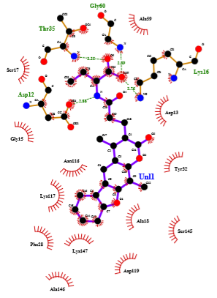
Zinc ID-ZINC02096813
Hydrogen Bonding Pairs
Thr-35(N):: Unl1(C₂₃)^{O}₅
Asp-12(OD1):: Unl1(N) Distance = 2.88 Å
Gly-60(N):: Unl1(OXT)
Lys-16(NZ):: Unl1(OXT)
Hydrophobic Interactions
Ser-17,Gly-15,
Asn-116,Lys-117,
Phe-28,Lys-147,
Ala-146,Asp-119,
Ser-145,Ala-18,Tyr-32,
Asp-13
Fig.9 Molecular Docking Interaction of ZINC02096813

Slide 24
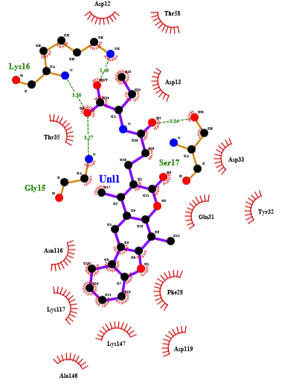
Zinc ID-ZINC02096815
Hydrogen Bonding Pairs
Lys-16(N):: Unl1(C₂₃)^{O}₅
Lys-16(NZ):: Unl1(C₂₃)OXT
Gly15(N):: Unl1(C₂₃)^{O}₅
Ser17(OG):: Unl1(C20)^{O4}
Hydrophobic Interactions
Asp-12,Thr-58,
Asp-13,Asp-33,Try-32,
Glu-31,Phe-28,Lys-147,
Asp-119,Ala-146,
Lys-117,Asn-116,Thr-35
Fig.10 Molecular Docking Interaction of ZINC02096815

Slide 25
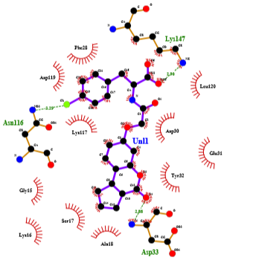
Zinc ID-ZINC02114326
Hydrogen Bonding Pairs
Asn-116(ND2):: Unl1(CL)
Lys-147(NZ):: Unl1(OXT)
Asp-33(N):: Unl1 (C₁₂)^{O}₄
Hydrophobic Interactions
Phe-28,Asp-119,
Leu-120,Gly-15,
Lys-117,Asp-30,
Lys-16,Ser-17,
Ala-18,Tyr-32,Glu-31
Fig.11 Molecular Docking Interaction of ZINC02114326

Slide 26
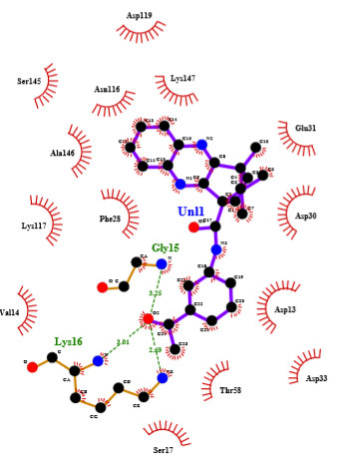
Zinc ID-ZINC01020381
Hydrogen Bonding Pairs
Gly-15(N):: Unl1(C₂₄)^{O}₂
Lys-16(N):: Unl1(C₂₄)^{O}₂
Lys-16(NZ):: Unl1(C₂₄)^{O}₂
Hydrophobic Interactions
Asp-119,Lys-147,
Asn-116,Ala-146,
Ser-145,Glu-31,
Phe-28,Asp-30,Asp-13,
Thr-58,Asp-33
Fig.12 Molecular Docking Interaction of ZINC01020381

Slide 27
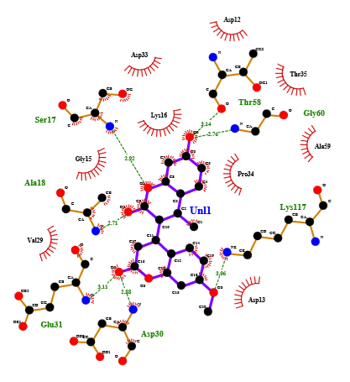
Zinc ID-ZINC06167356
Hydrogen Bonding Pairs
Thr-58(O)::Unl1(C₆)^{O}₆
Gly-60(N):: Unl1(C₆)^{O}₆
Lys-117(NZ):: Unl1(C₁₈)^{O}₅
Asp-30(N):: Unl1(C₁₆)^{O}₄
Glu-31(N):: Unl1(C₁₆)^{O}₄
Ala-18(N):: Unl1(C₉)^{O}₂
Ser-17(N):: Unl1(O1)
Hydrophobic Interactions
Asp-33,Asp-12,
Lys-16,Thr-35,
Gly-15,Pro-34,
Ala-59,Asp-13,Val-29
Fig.13 Molecular Docking Interaction of ZINC06167356

Slide 28
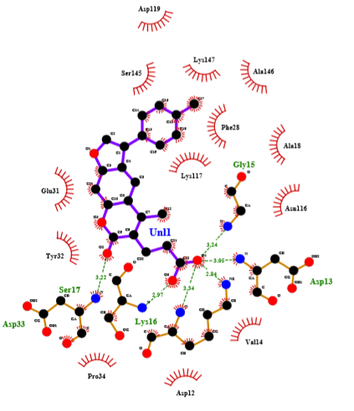
Zinc ID-ZINC02120343
Hydrogen Bonding Pairs
Asp-33(N):: Unl1(C₉)^{O}₂
Ser-17(N):: Unl1(C₂₂)^{O}₅
Lys-16(N):: Unl1(C₂₂)^{O}₄
Lys-16(NZ):: Unl1(C₂₂)^{O}₄
Asp-13(N):: Unl1(C₂₂)^{O}₄ Distance ₌ 3.05 Å
Gly-15(N):: Unl1(C₂₂)^{O}₄
Hydrophobic Interactions
Asp-119,Ser-145,
Lys-147,Ala-146,
Phe-28,Ala-18,Asn-116,
Lys-117,Glu-31,Tyr-32,
Pro-34,Asp-12,Val-14
Fig.14 Molecular Docking Interaction of ZINC02120343

Slide 29
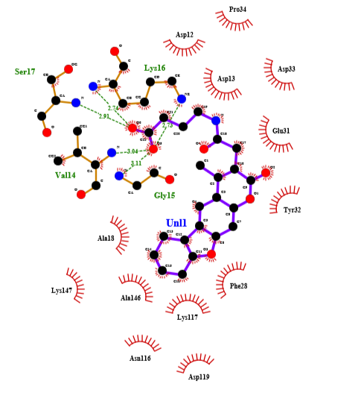
Zinc ID-ZINC02102162
Hydrogen Bonding Pairs
Lys-16(N):: Unl1(C₂₂)^{O}₆
Lys-16(N)::Unl1(C₂₂)^{O}₅
Val-14(N):: Unl1(C₂₂)^{O}₅
Gly-15(N):: Unl1(C₂₂)^{O}₅
Ser-17(N):: Unl1(C₂₂)^{O}₆
Hydrophobic Interactions
Pro-34,Asp-12,
Asp-13,Asp-33,
Glu-31,Tyr-32,
Phe-28,Lys-117,
Asn-116,Ala-18,
Ala-146,Lys-147,
Asp-119
Fig.15 Molecular Docking Interaction of ZINC02102162

Slide 30
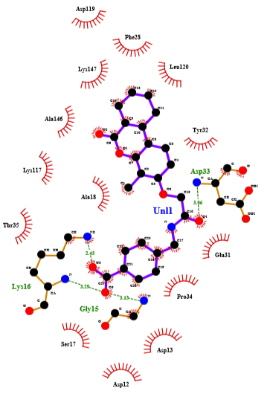
Zinc ID-ZINC02114643
Hydrogen Bonding Pairs
Asp-33(N)::Unl1(C₁₆)^{O}₄
Lys-16(N)::Unl1(C₂₄)^{O}₅
Lys-16(NZ)::Unl1(C₂₄)^{O}₆
Gly-15(N)::Unl1(C₂₄)^{O}₅
Hydrophobic Interactions
Asp-19,Phe-28,
Lys-147,Lys-147,
Leu-120,Tyr-32,
Ala-18,Ala-146,
Lys-117,Thr-35,
Glu-31,Pro-34,Asp-13
Fig.15 Molecular Docking Interaction of ZINC02114643

Slide 31
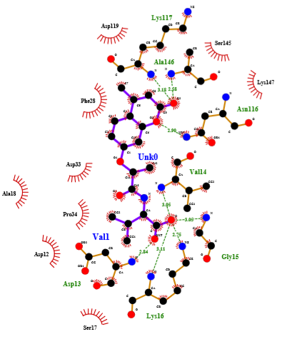
Zinc ID-ZINC00518885
Hydrogen Bonding Pairs
Lys-117(N):: Unk0(C₉)^{O}₂
Ala-146(N):: Unk0(C₉)^{O}₂
Asn-116(ND2)::Unk0(O3)
Asp-13(N):: Unk0(OXT) Distance = 2.84 Å
Lys-16(N)::Unk0(O)
Lys-16(NZ)::Unk0(O)
Gly-15(N)::Unk0(O)
Val-14(N)::Unk0(O)
Hydrophobic Interactions
Asp-119,Phe-28,
Asp-33,Pro-34,Asp-12,
Ala-18,Ser-17,Lys-147,
Ser-145
Fig.16 Molecular Docking Interaction of ZINC00518885

Slide 32
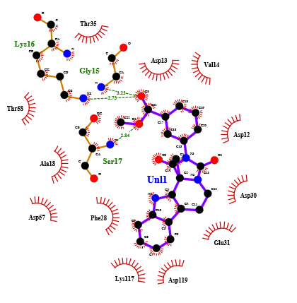
Zinc ID-ZINC03882094
Hydrogen Bonding Pairs
Lys-16(NZ)::Unl1(C₂₁)^{O}₃
Gly-15(N):: Unl1(C₂₁)^{O}₃
Ser-17(N)::Unl1(C₂₂)^{O}₄
Hydrophobic Interaction
Thr-35,Asp-13,
Val-14,Asp-12,
Asp-30,Glu-13,
Asp-119,Lys-117,
Phe-28,Asp-57,
Ala-18,Thr-58
Fig.17 Molecular Docking Interaction of ZINC03882094

Slide 33
Role of conserved residues in inhibition of NRAS
Thr-35
This residue shows hydrophobic interactions which are responsible for the stability of the structure. Thr-35 residues are important for Mg2 coordination and interactions.( Johnson CW, Reid D, Parker JA, et al. 2017)
In complex 2 with Zinc ID ZINC02096813 Thr-35 forms a hydrogen bond between N of Thr-35 and O⁵ of Unl1(ligand) at a distance of 3.25 Å .
In complex nine and eleven with Zinc IDs- ZINC02114643 and ZINC03882094 respectively it shows hydrophobic interactions.

Slide 34
Role of conserved residues in inhibition of NRAS
Phe-28
Phe-28 is a residue showing hydrophobic interactions in complex one, two, three, four, five, seven, eight, nine, ten, eleven.
Phe-28, helps to stabilize nucleotide binding(Johnson CW, Reid D, Parker JA, et al. 2017).

Slide 35
Role of conserved residues in inhibition of NRAS
Asp-119
Asp-119 makes nucleotide-specific interactions with the guanine base and is critical for nucleotide binding. (Johnson CW, Reid D, Parker JA, et al. 2017).
It does not show hydrophobic interactions or Van der Waals contact in complex six and nine with Zinc IDs- ZINC06167356, ZINC02114643 respectively and found to be showing stability in rest of the nine complexes.

Slide 36
Results Of Molecular Interactions
Zinc ID- ZINC02096813,the glycine residue at position 12 in wild type NRAS being mutated to Asp-12 in mutant NRAS shows formation of hydrogen bond with the ligand at a distance of 2.88 Å and , and Asp-13 forms hydrophobic interaction
Zinc ID- ZINC02120343 and ZINC00518885 respectively Asp-13 which is also a mutated residue of Gly in mutant NRAS shows formation of hydrogen bond at a distance of 3.05 Å and 2.84 Å respectively and Asp-12 forms hydrophobic interaction around the compound.
Phe-28 and Asp-119 which are critical stabilizers are also present in all the three compounds showing hydrophobic interactions.

Slide 37
Conclusion
Based on molecular docking studies, these three compounds with Zinc ID-ZINC02096813, ZINC02120343 and ZINC00518885 can act as a potential inhibitors of mutant NRAS.

Slide 38
Future Work
The inhibitory activity shown by some specific compounds after screening and further analysis, can be computationally validated by molecular dynamics simulations.
This is to check for the stability of the system during its inhibition and validate by experimental techniques on the selected compounds so as to further justify the action of the inhibitors and prove them as potent drugs against the activity of NRAS in melanoma.

Slide 39
References
1.Johnson CW, Reid D, Parker JA, et al. The small GTPases K-Ras, N-Ras, and H-Ras have distinct biochemical properties determined by allosteric effects. J Biol Chem. 2017;292(31):12981–12993. doi:10.1074/jbc.M117.778886
Inamdar GS, Madhunapantula SV, Robertson GP. Targeting the MAPK pathway in melanoma: why some approaches succeed and other fail. Biochem Pharmacol. 2010;80(5):624–637. doi:10.1016/j.bcp.2010.04.029
Shtivelman E, Davies MQ, Hwu P, et al. Pathways and therapeutic targets in melanoma. Oncotarget. ;5(7):1701–1752. doi:10.18632/oncotarget.1892
Wellbrock C, Arozarena I. The Complexity of the ERK/MAP-Kinase Pathway and the Treatment of Melanoma Skin Cancer. Front Cell Dev Biol. 2016;4:33. Published 2016 Apr 27. doi:10.3389/fcell.2016.00033

Slide 40
Acknowledgements
The Director of Bioinformatics Centre, Dr. Sangeeta Sawant and the Bioinformatics Centre, SPPU.
Guide Dr. Vijay B. Baladhye and Co-guide Dr. Rohan Meshram, Assistant Professors, SPPU.
Ms. Kamini Bagul , Research Associate, SPPU.
And My Classmates.

Slide 41
THANK YOU !

