Slide 1
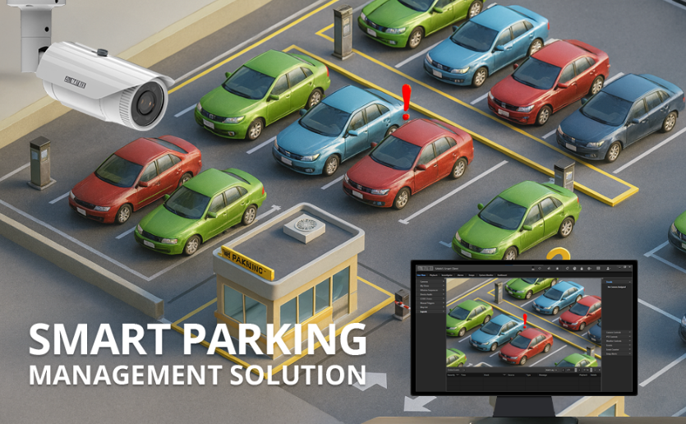
ParkaSmart
Automated Vehicle Identification, Parking Space & Billing System

Slide 2
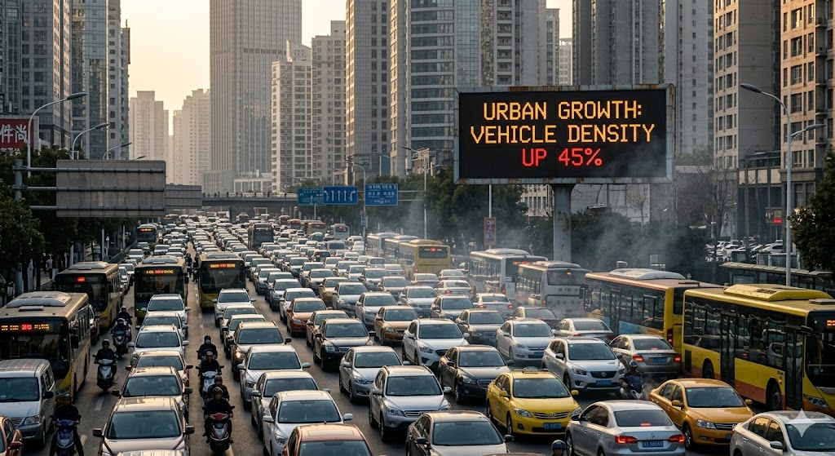
Introduction
Urbanization has increased vehicle numbers in Rwanda to 60,000 cars additional in 2024.(RURA Report)
Manual parking systems are inefficient and error-prone
Need for automation in parking management

Slide 3
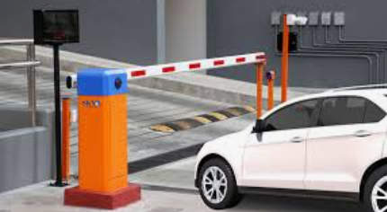
Problem Statement
In Rwanda;
Vehicle fleet grew 18% (2021–2023)
Annual growth averages 11% yearly
Manual parking systems cause delays, congestion, and human errors
This slows down entry and exit processes.
Globally, studies estimate losses of 20–40% (estimated delays and billing errors)

Slide 4
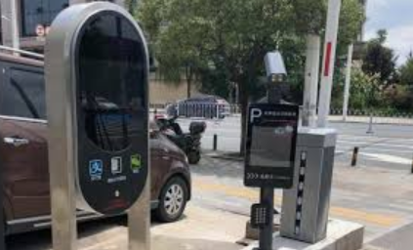
ParkaSmart
ParkaSmart Technologies is a smart parking system that address challenges in urban parking management. It:
Automates vehicle identification
Tracks parking space and time
Ensures accurate billing to improve efficiency and reduce congestion.

Slide 5
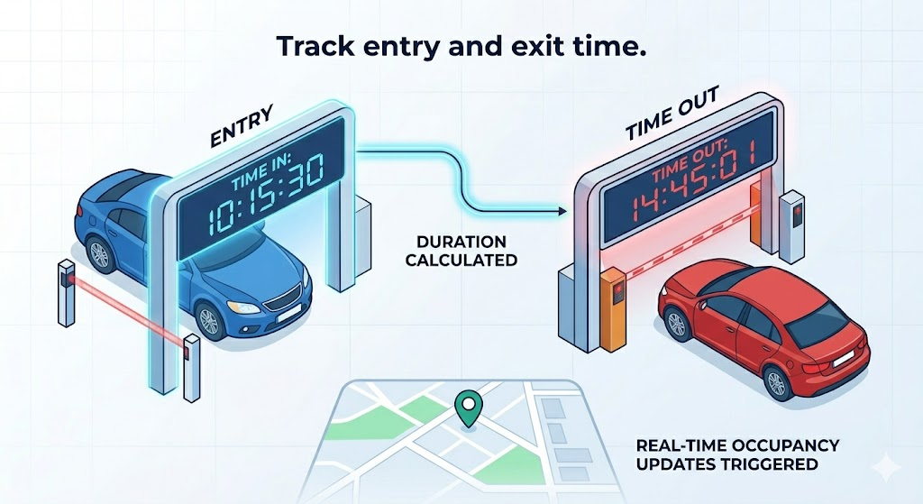
Project Objectives
Automate vehicle identification
Track entry and exit time
Calculate parking fees automatically
Improve efficiency and reduce human intervention

Slide 6
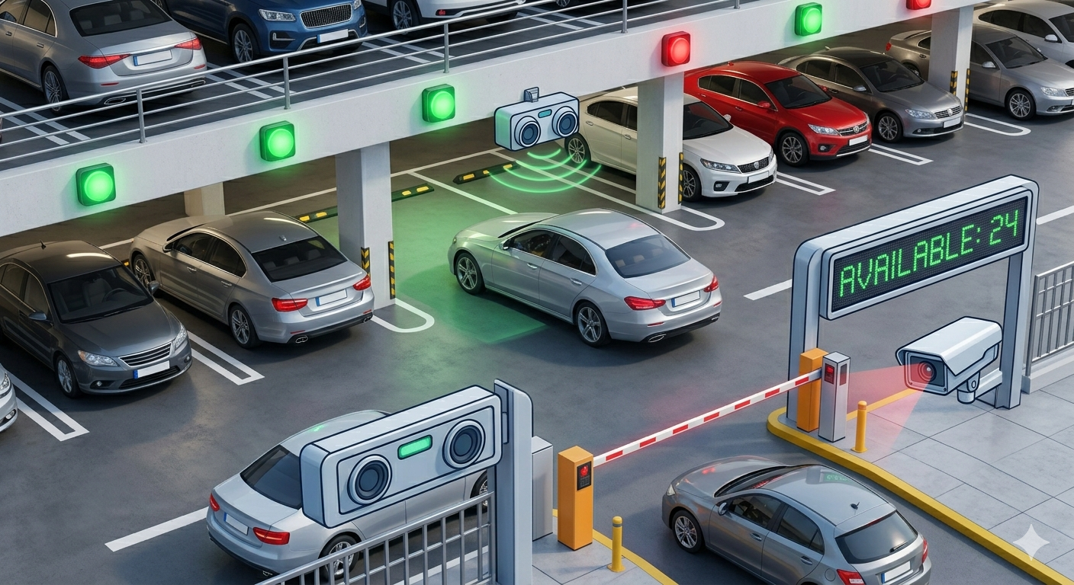
Proposed Solution
Smart parking system using sensors, camera, and microcontroller
Automates entire parking process from entry to exit

Slide 7
System Methodology
Entry
Vehicle detected using ultrasonic sensor
Camera captures plate number
OCR extracts plate number
Entry time stored using RTC
Exit
Vehicle detected at exit
Plate number re-captured
System retrieves entry time
Calculates parking duration and fee

Slide 8
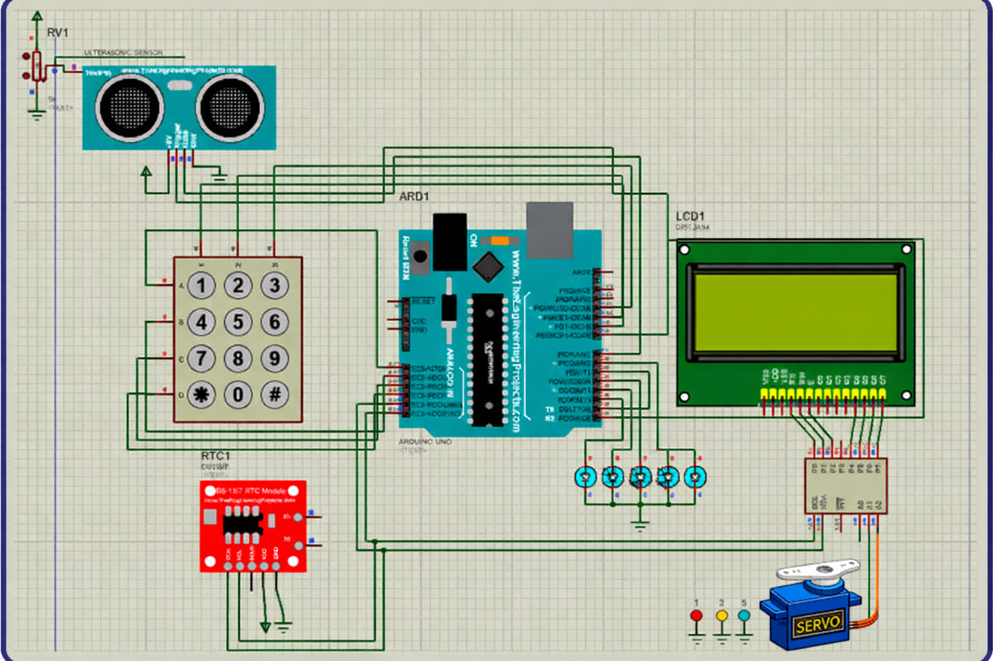
System Architecture

Slide 9
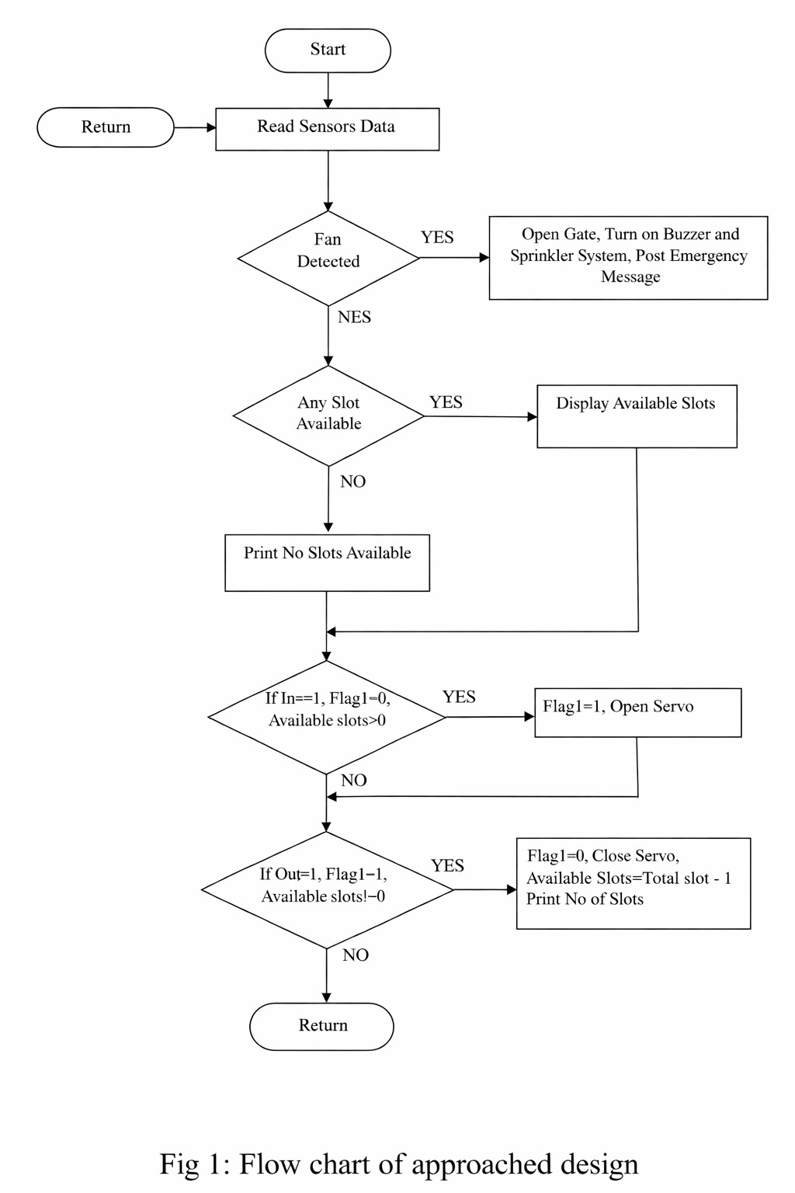
System Flowchart

Slide 10
Results Discussion
Advantages
Future Improvements
Minimizes human error
Enhances transparency
Saves time
Scalable for smart cities
Mobile payment integration
Cloud database
Real-time parking availability

Slide 11
Conclusion & Recommendation
Smart parking improves efficiency and reliability.
Supports smart city development.
Reduces congestion and enhances user experience.

Slide 12
Reference
ParkaSmart Technologies, “ParkaSmart: Automated Vehicle Identification, Parking Space & Billing System,” unpublished technical report, Apr. 2026.

Slide 13
Thanks !
Questions & Discussion

