Slide 1
NDCLab Resources
NDCLab | August 18, 2021

Slide 2

Wiki https://ndclab.github.io/wiki/
Onboarding information
Expectations in the lab
Process etiquette for projects
Technical how-tos
Information on how to contribute
A living, collaborative project! Please make it better by:
adding pages, correcting mistakes, keeping information updated

Slide 3
LAB PROCESS DIAGRAM
interested individual > lab member
lab member > upskilled lab member
new idea > project
tool plan > public release
research plan > data, publications
Like everything else, a work in progress!

Slide 4

SLACK
browse channels
avoid noise by only joining those you need to follow
#general, #random, #tech, #from-george
be responsive but not a workaholic
prioritize channels over DMs
use status messages to communicate extended unavailabilities (but also tell Jess to put those on the lab calendar)
lab meeting agenda, notes, and video (last complete and upcoming pinned to #general)

Slide 5

zoom
where we face-to-face across the distances
each of the live studies also has its own account for running participants

Slide 6
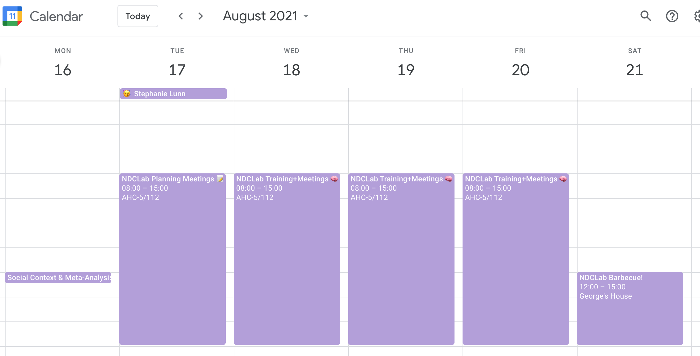
LAB CALENDAR
displays lab meetings, events, and birthdays
you can sit in any event, even if you aren’t part of that working group

Slide 7

Google Drive
please ignore the current clutter
will be repository for things that don’t work well on GitHub
grab “blanks” to use and let Jess know if they need re-seeding
please don’t create fresh documents within the lab Drive space
please don’t create documents within your own Drive space

Slide 8

fiu hpc
when you need the power!
study storage
get excited for this week’s training session with Farukh!

Slide 9

redcap
foundation for data collection
must be on the associated IRB to have access to the project
houses study-specific passwords
new lab members will receive access once onboarded to the CCF

Slide 10
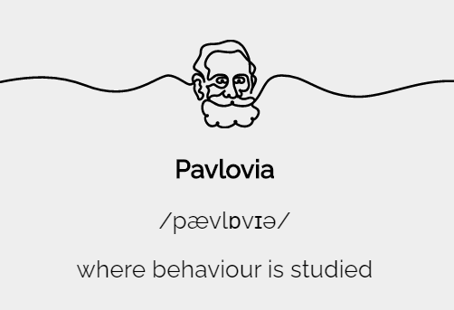
pavlovia
platform that hosts our PsychoPy experiments (flanker, dccs, nback, multi-ef, read-aloud)
must be on the associated IRB to have access
new lab members will receive access once onboarded to the CCF

Slide 11

Github and zenhub
primary place where great things will happen
get excited for this week’s GitHub and ZenHub training sessions!

