Slide 1
Zoom setup
“Read at your normal volume and speed...”
passage text
comprehension
question
optional break
(60 seconds)

Slide 2
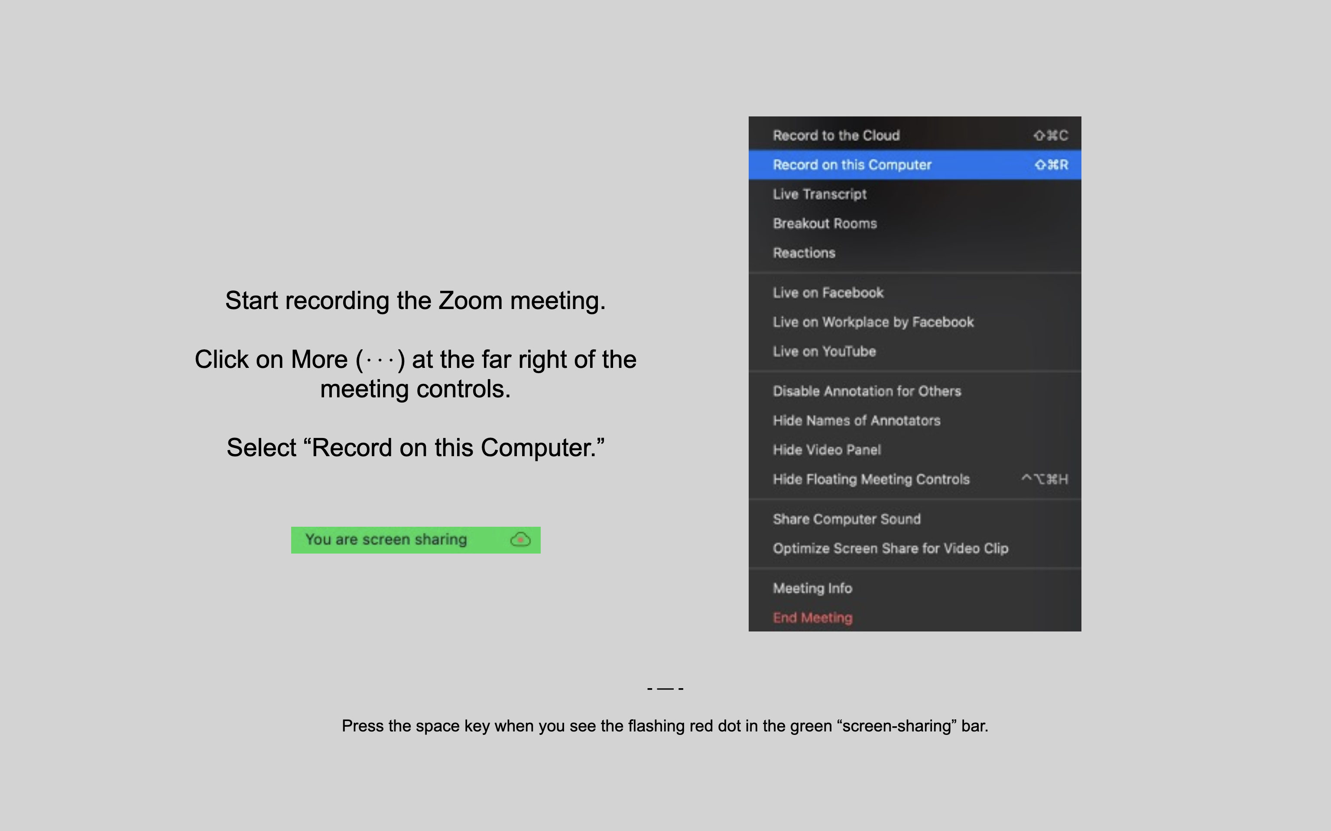
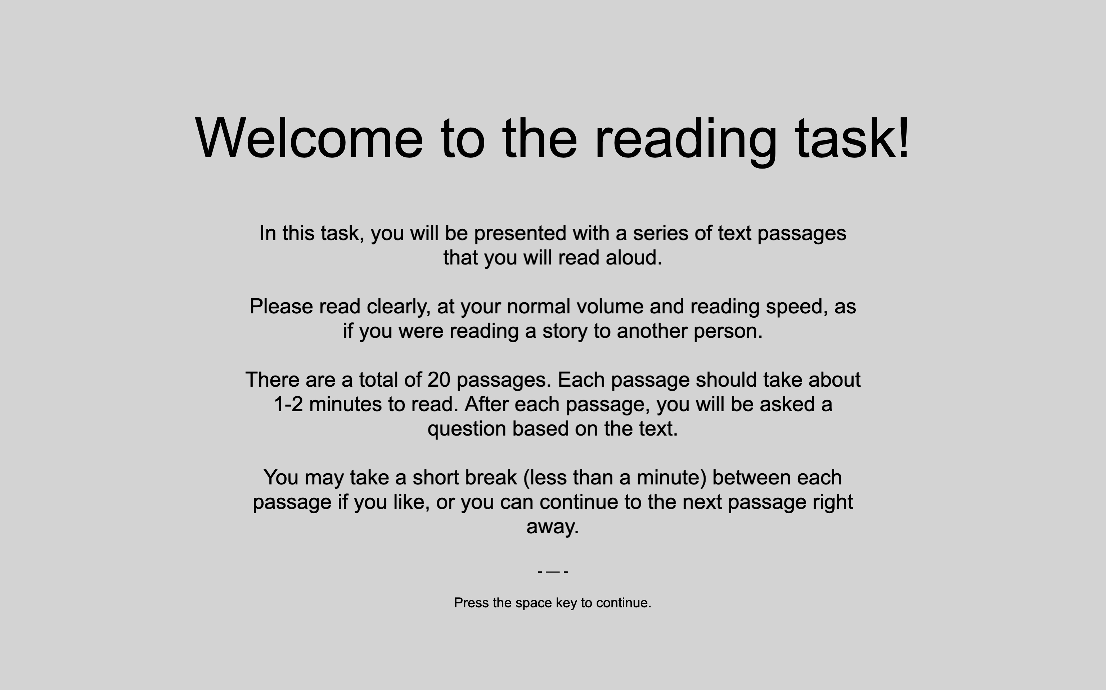
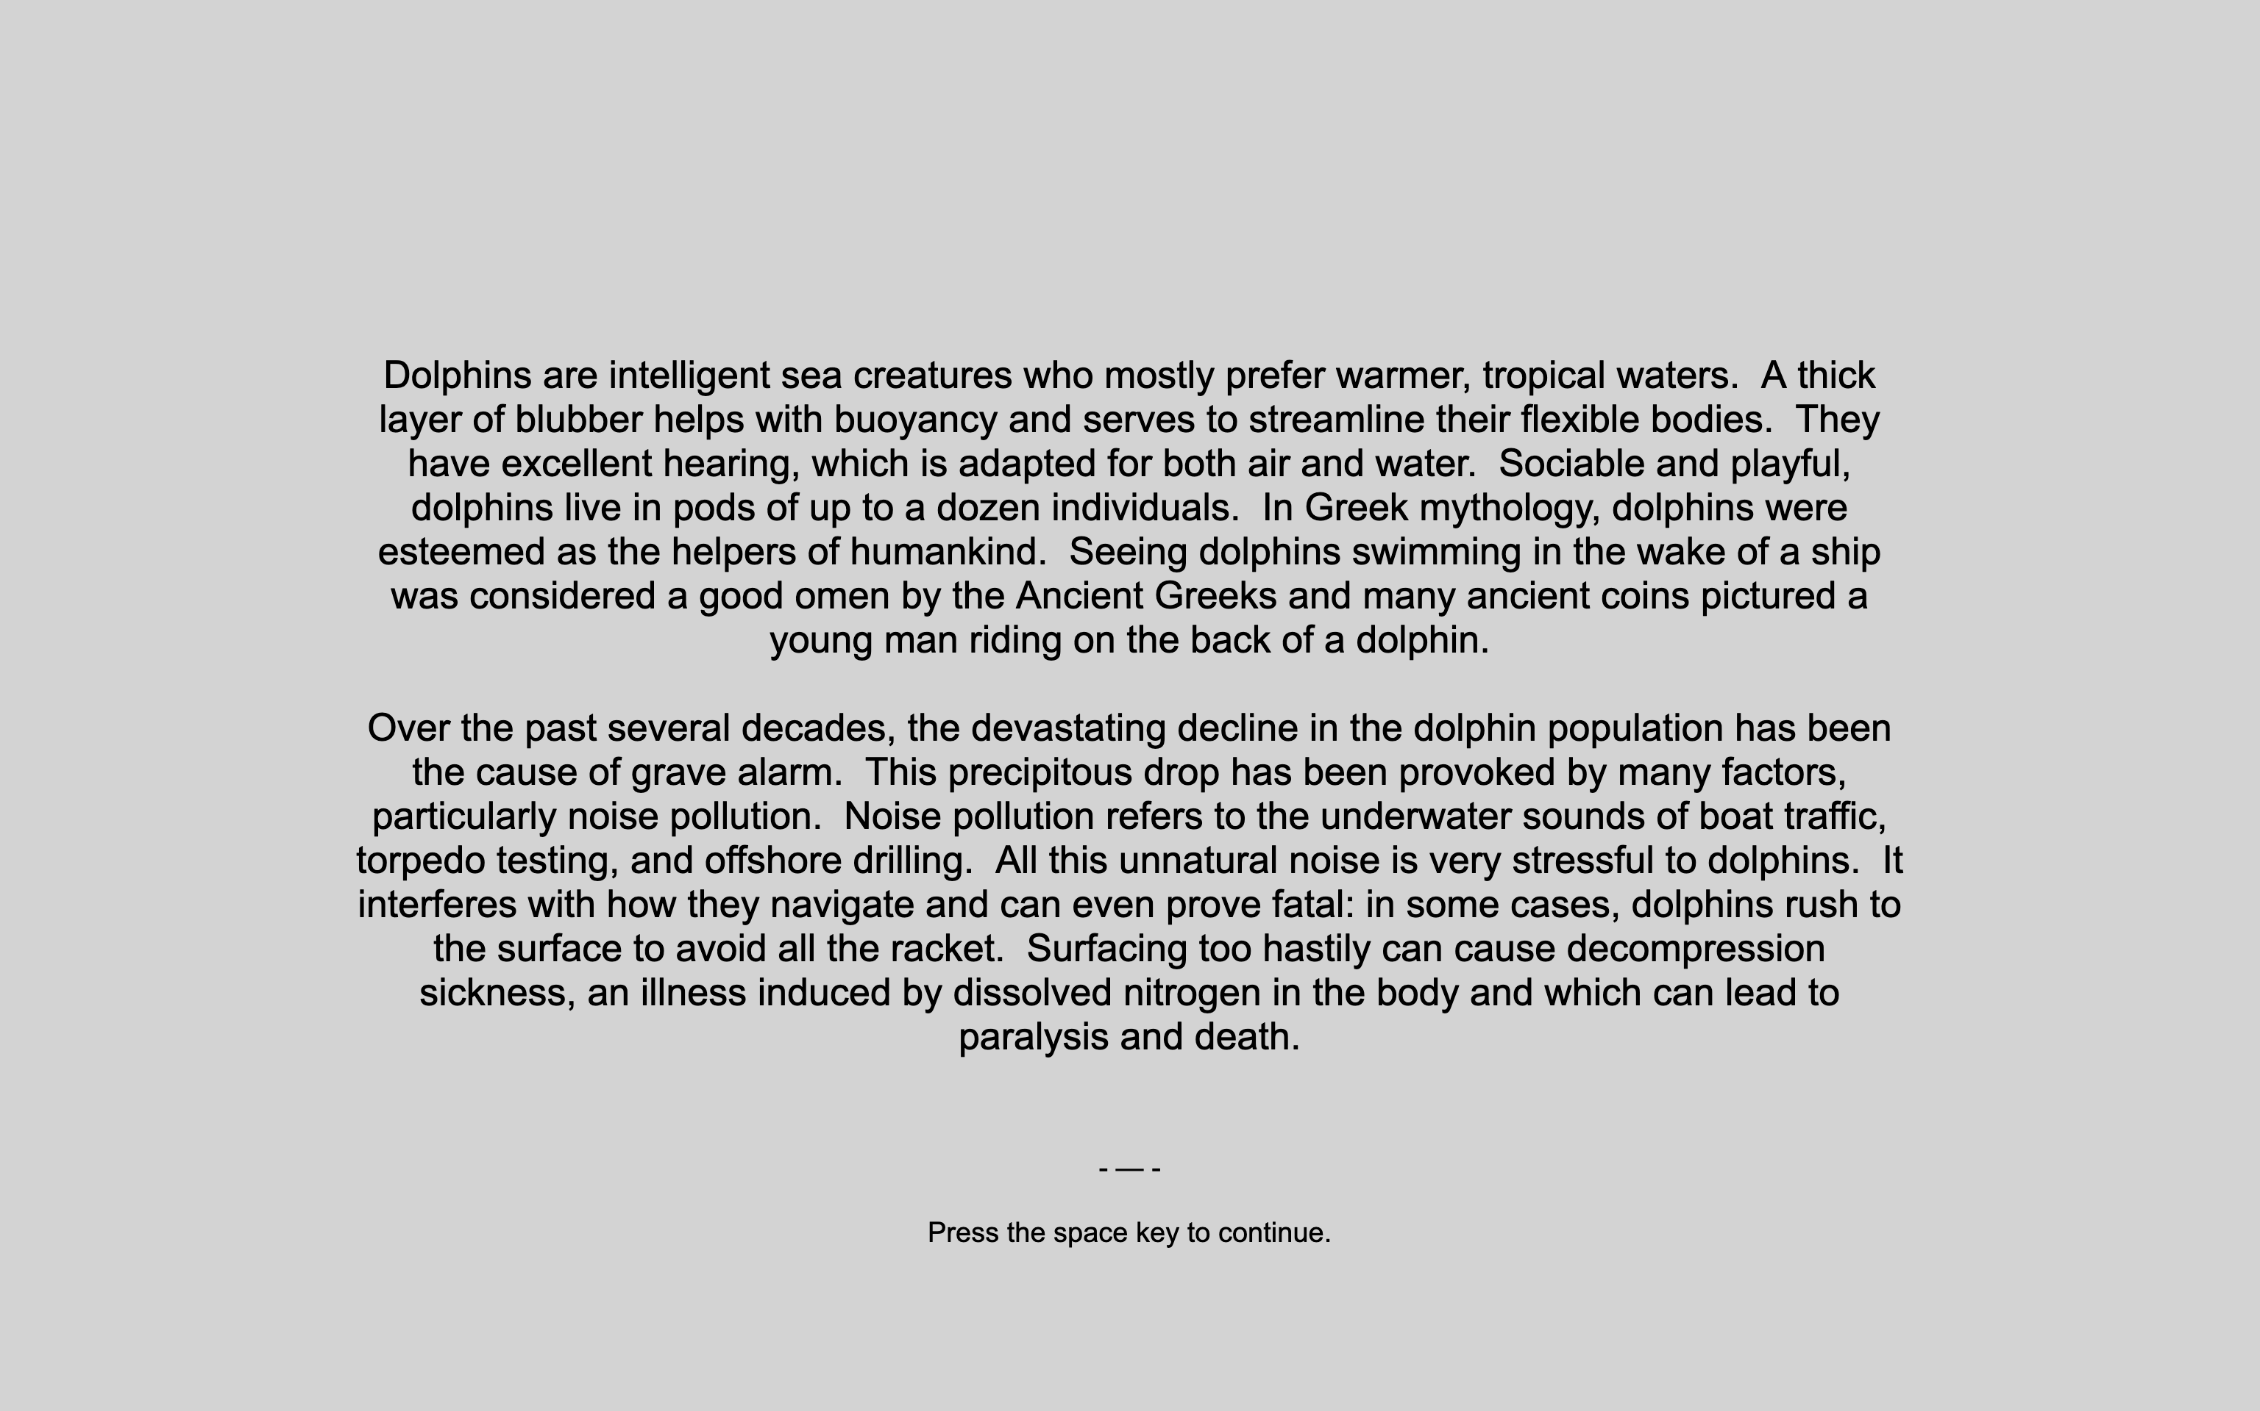
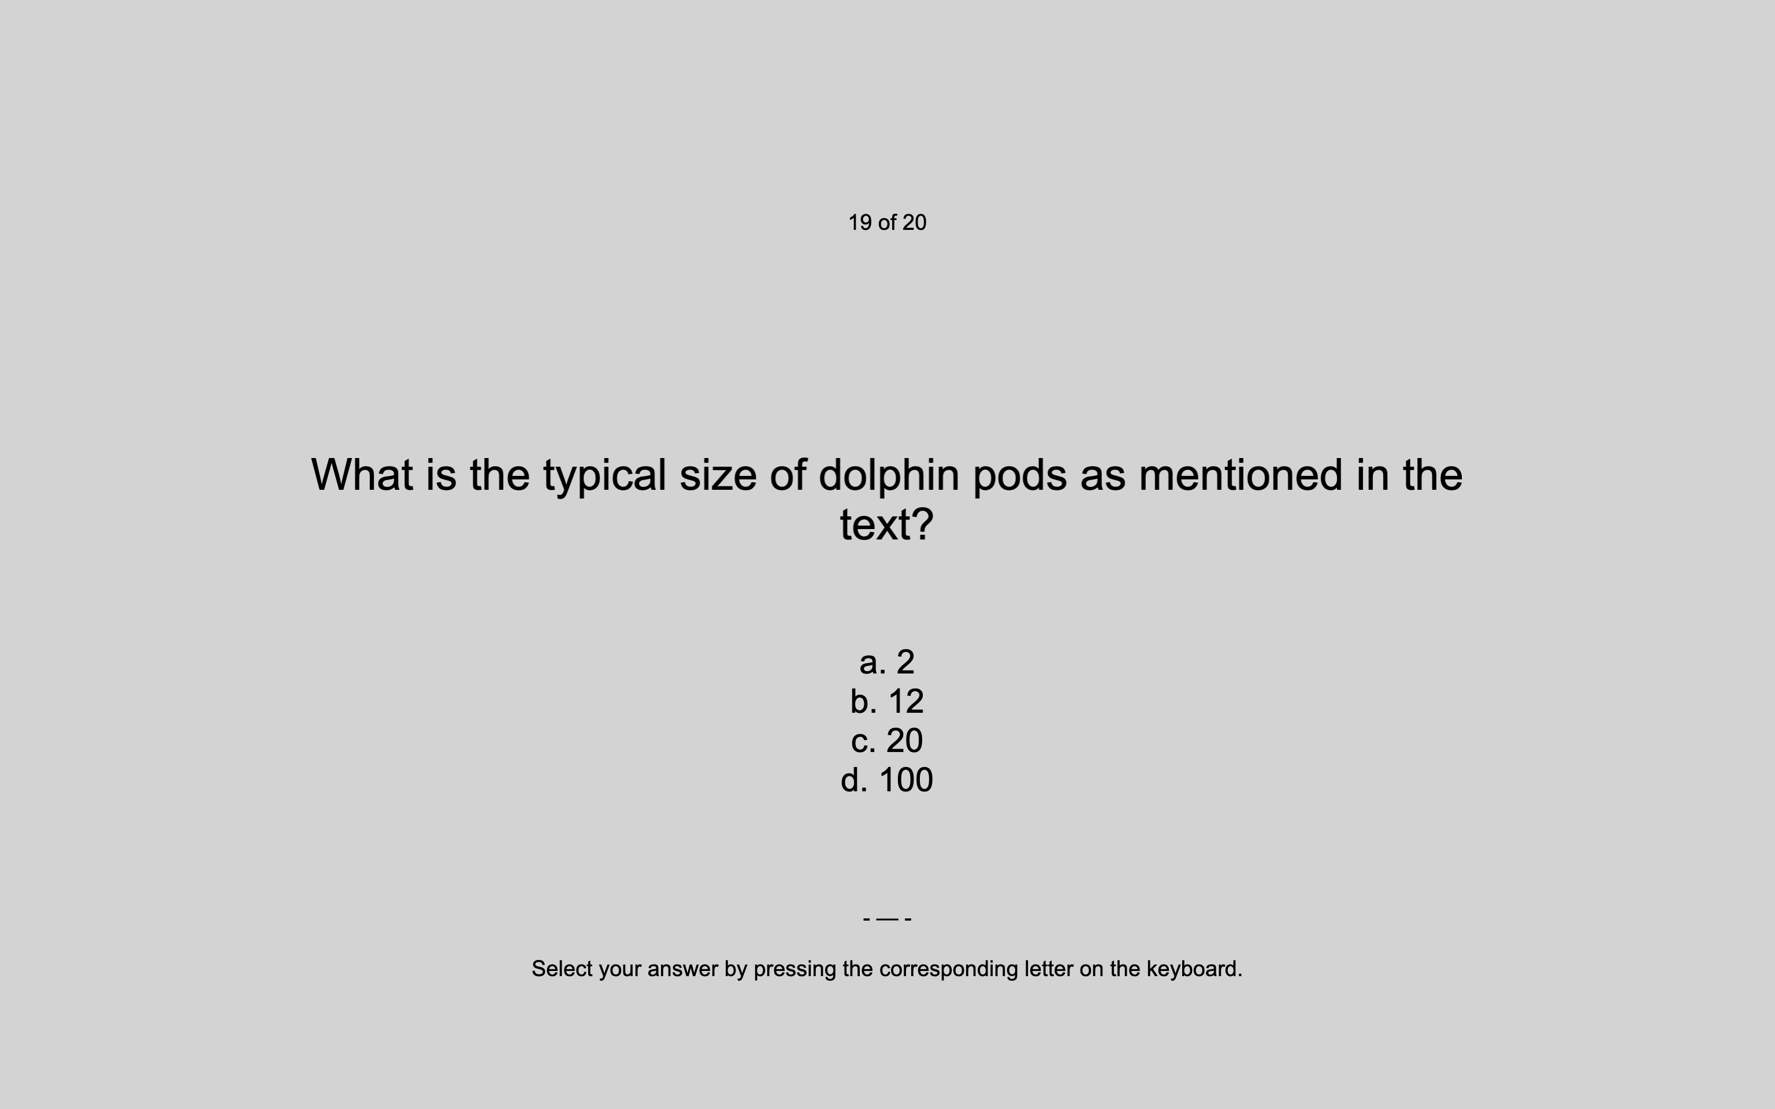

Zoom setup
Instructions
Passage text
Comprehension
question
Optional break

