Slide 1
DEVOPS FINAL CAPSTONE
GameSense
A Steam-style game discovery app with a content-based recommender,
shipped through CI/CD, Terraform on AWS EKS, GitOps, and observability.
Nishant Dasgupta
16 October 2026 · github.com/NDGCodes/GameSense

Slide 2
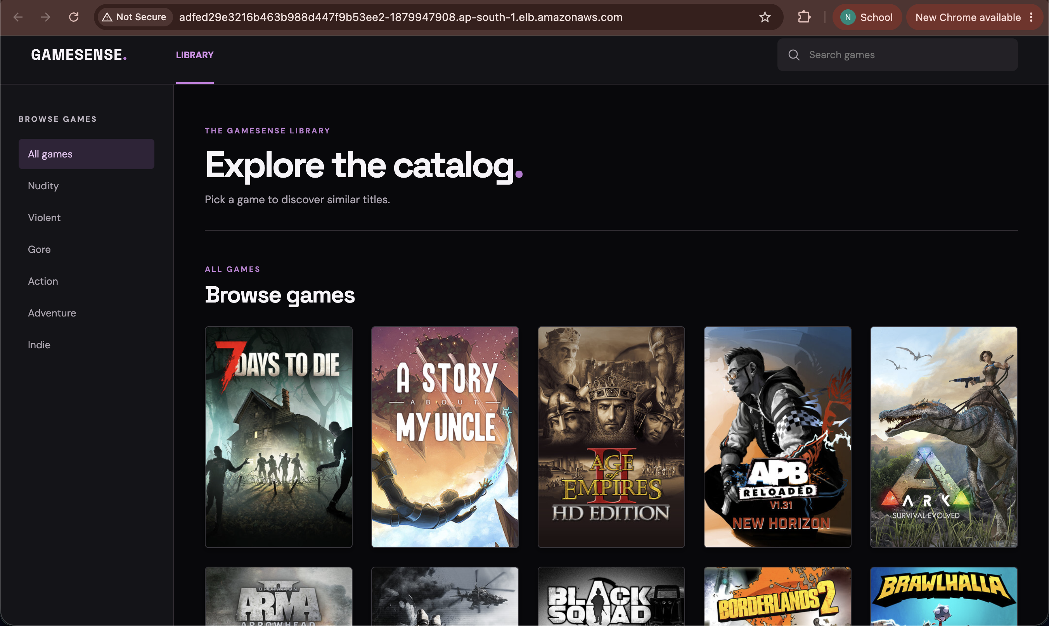
OVERVIEW
What I built
Game discovery web app
Browse and search a Steam catalog, filter by genre, open a game, and get similar-game recommendations with artwork.
Content-based recommender
TF-IDF over tags, genres, and descriptions, fitted on the Kaggle Steam Store Games dataset (27,075 games locally; a 100-game subset on EKS).
Production-style delivery
Tested, scanned, containerised, and deployed to AWS EKS by GitOps, with Prometheus and Grafana monitoring.
Live on EKS through the Traefik load balancer

Slide 3
LANGUAGES, TOOLS, PLATFORMS
Tech stack
Application
ML
Quality & security
Python 3.11 · FastAPI · SQLAlchemy · Alembic
React 19 · Vite 8 · Nginx
PostgreSQL 16 (pg8000)
TF-IDF + tag similarity in pure Python
Kaggle Steam Store Games (2019)
Fitted in a Kaggle notebook
pytest · npm build
Trivy (HIGH/CRITICAL gate)
helm lint · terraform validate
Delivery
Infrastructure
Observability
Docker · Docker Compose
GitHub Actions · GHCR
Argo CD (GitOps)
Terraform · AWS VPC · EKS 1.35
Helm · Traefik ingress
kubectl
prometheus_client · Prometheus
Grafana dashboards

Slide 4
END-TO-END FLOW
Architecture
Developer
git push main
GitHub Actions
test · build · Trivy
GHCR
images :<sha>
values-eks.yaml
CI bumps image tag
Argo CD
auto-sync · self-heal
Frontend ×2
React · Nginx
Prometheus → Grafana
pod discovery
Users
browser
Traefik Ingress
AWS load balancer
Backend ×2
FastAPI · /metrics
PostgreSQL
Alembic migrations
AWS ap-south-1 · Terraform: VPC (2 public + 2 private subnets, NAT) → EKS 1.35 → managed node group (2 × t3.medium)
Namespaces: gamesense · gamesense-ingress · argocd

Slide 5
FRONTEND · BACKEND · DATABASE
Application (M1)
Frontend: React + Vite
Catalog grid, search, genre filters, detail view with similar games. Served by Nginx, which proxies /api to the backend.
Backend: FastAPI
Health and readiness checks, catalog, recommendations, and a saved-games list persisted in PostgreSQL.
Database: PostgreSQL + Alembic
Three migrations: demo catalog, canonical catalog tables, saved-game list.
REST API
GET /health · /ready · /metrics
GET /api/games
POST /api/recommendations
GET /api/saved-games
PUT /api/saved-games/{slug}
DELETE /api/saved-games/{slug}

Slide 6
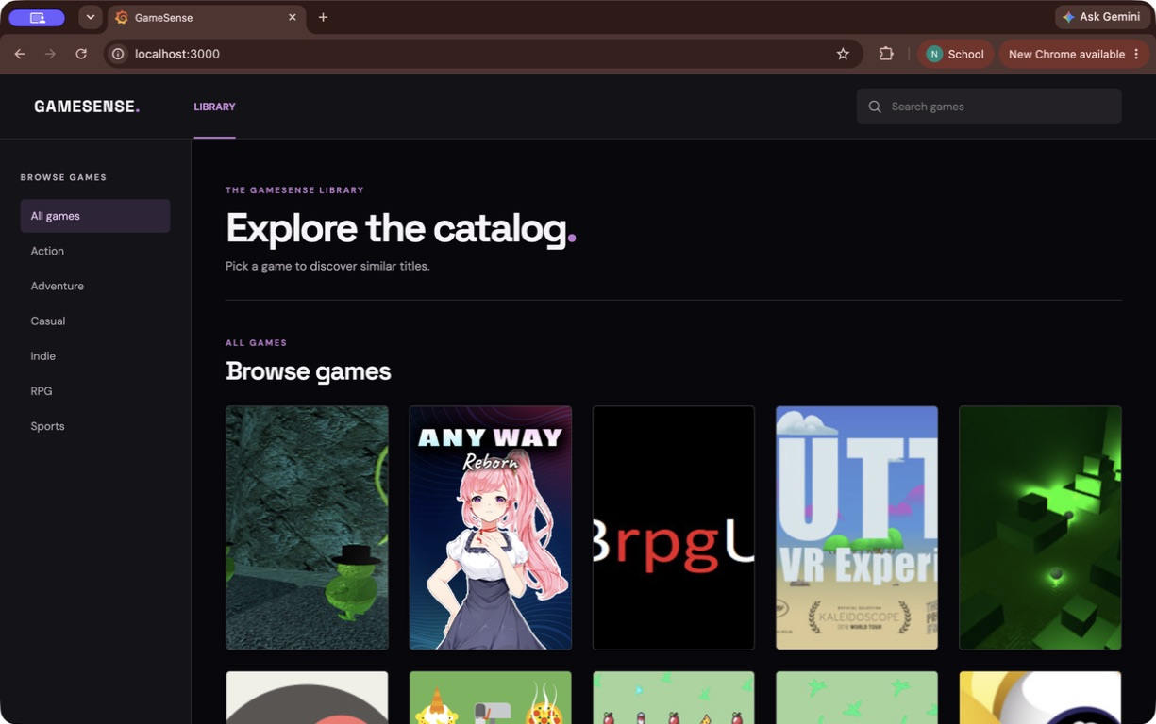
EVIDENCE
App running locally (M1 · M4)
React UI at http://localhost:3000 via docker compose, calling the FastAPI backend

Slide 7
QUALITY GATES
Testing, Git & containers (M2 · M3 · M4)
pytest: 59 tests passing
API, Alembic migrations, catalog schemas, recommender, ML data pipeline, and artwork. API tests run against a fresh temporary SQLite database built by the Alembic migrations, never the production database.
Git workflow
Feature branches and pull requests into main, meaningful commits, and a .gitignore covering secrets, state, data, and build output.
Docker
Backend runs as a non-root user (UID 999). Frontend is a multi-stage Node build into an unprivileged Nginx image (UID 101) on port 8080.
Docker Compose
PostgreSQL, backend, frontend, Prometheus, and Grafana, with health checks and a named database volume. App on :3000, Grafana on :3001.

Slide 8
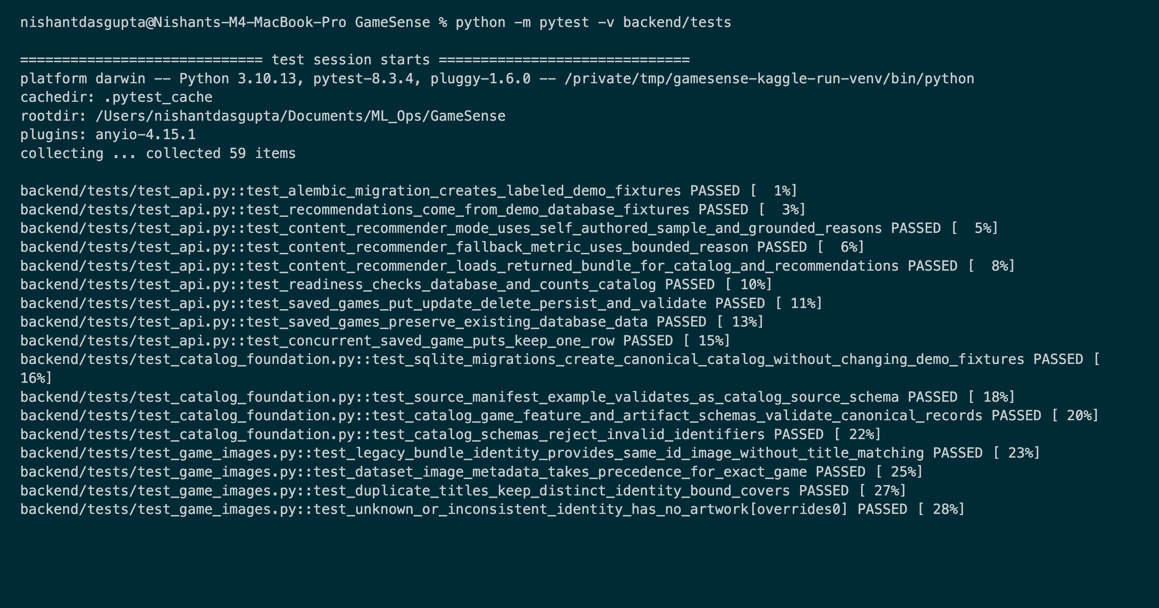
EVIDENCE
pytest: all tests pass (M2) (1/2)
pytest -v: API, migration, and catalog tests

Slide 9
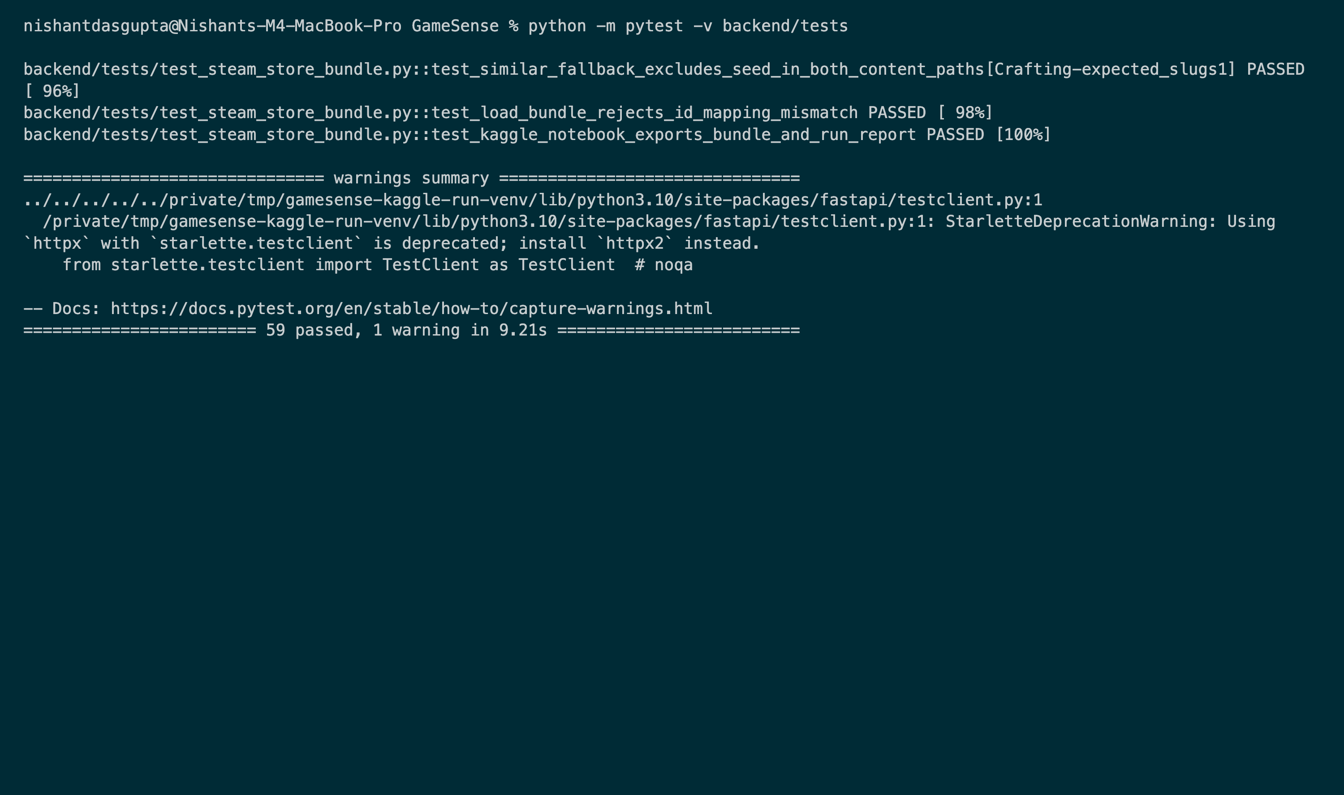
EVIDENCE
pytest: all tests pass (M2) (2/2)
Suite result: 59 passed

Slide 10
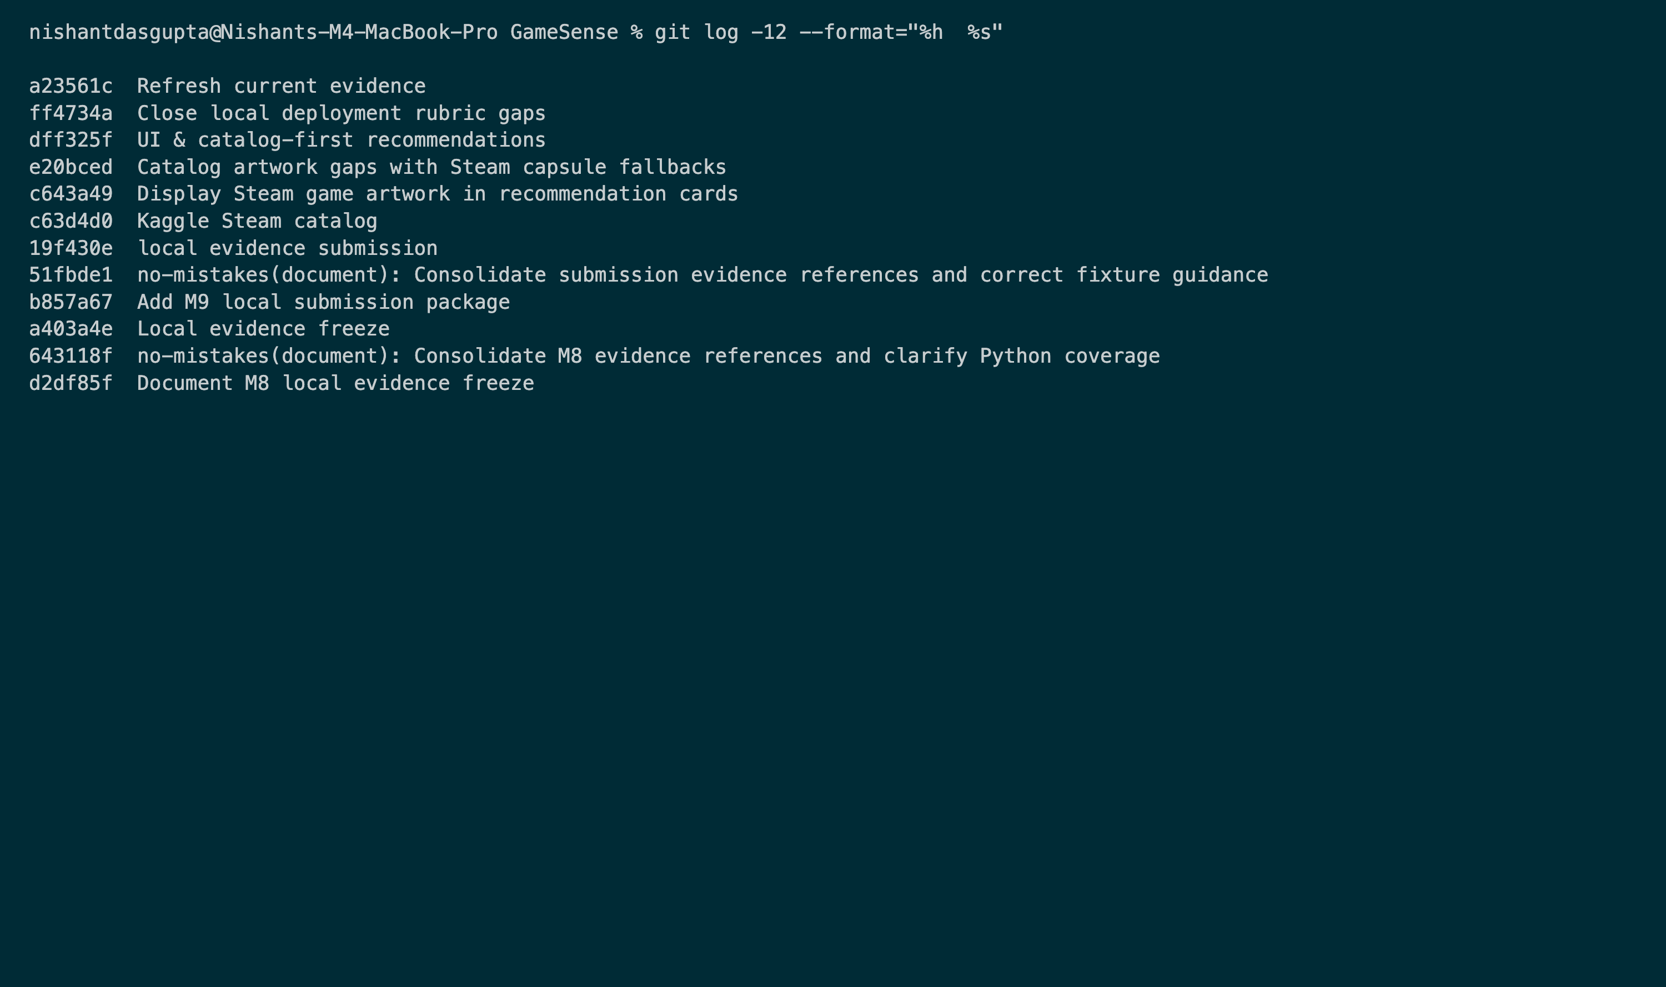
EVIDENCE
Commit history (M3)
Meaningful commit messages on main

Slide 11
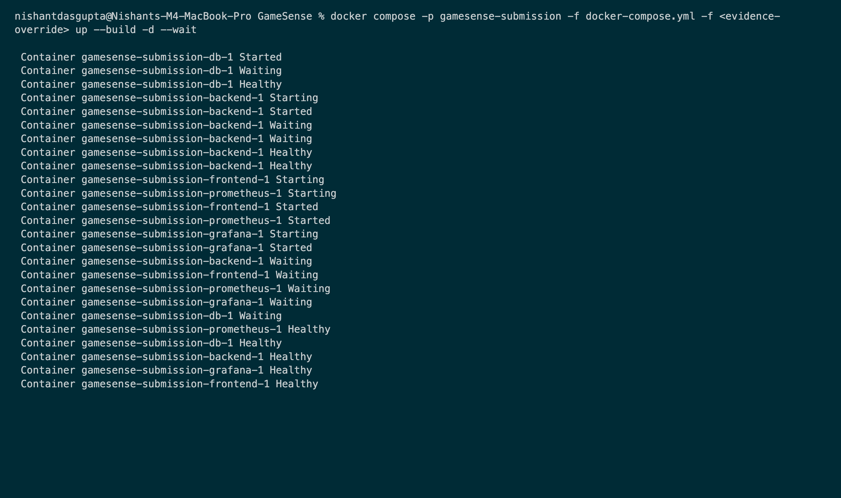
EVIDENCE
docker compose up --build (M4) (1/2)
All services start and report healthy

Slide 12
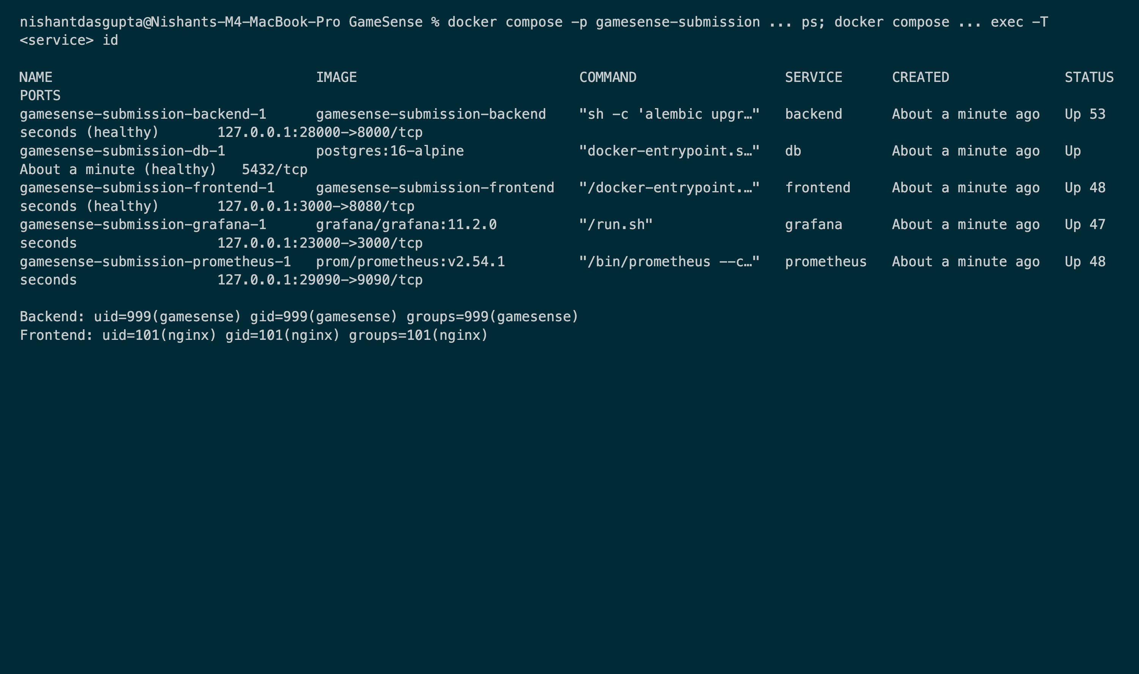
EVIDENCE
docker compose up --build (M4) (2/2)
Containers run as non-root (backend UID 999, frontend UID 101)

Slide 13
GITHUB ACTIONS
CI/CD pipeline (M5 · M6)
validate-foundation
pytest · npm build
helm lint · terraform validate
container-security
docker build ×2
Trivy: fail on HIGH/CRITICAL
publish-images
push to GHCR
tag = commit SHA
update-gitops
commit SHA to
values-eks.yaml
• Runs on every push and pull request. Images are published and deployed only from main.
• Trivy scans both images for OS and library CVEs; any fixable HIGH or CRITICAL finding fails the build before anything is pushed.
• The final job commits the new tag to Git as github-actions[bot]. Argo CD sees that commit and deploys it, so no deployment is run by hand.

Slide 14
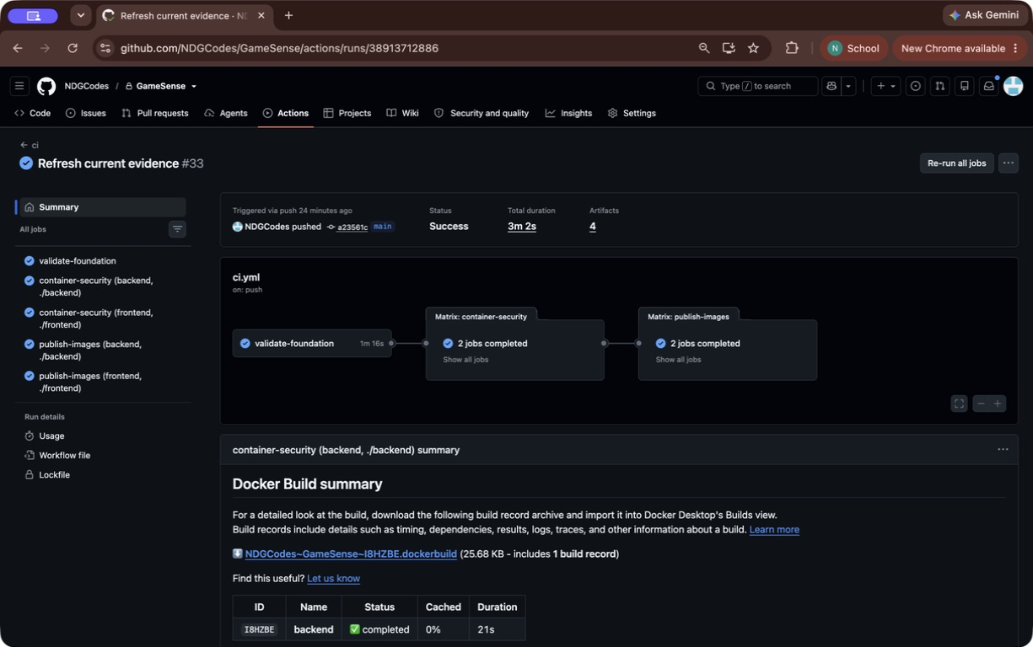
EVIDENCE
GitHub Actions: green pipeline (M5)
Push to main: validate → container-security → publish-images, all green

Slide 15
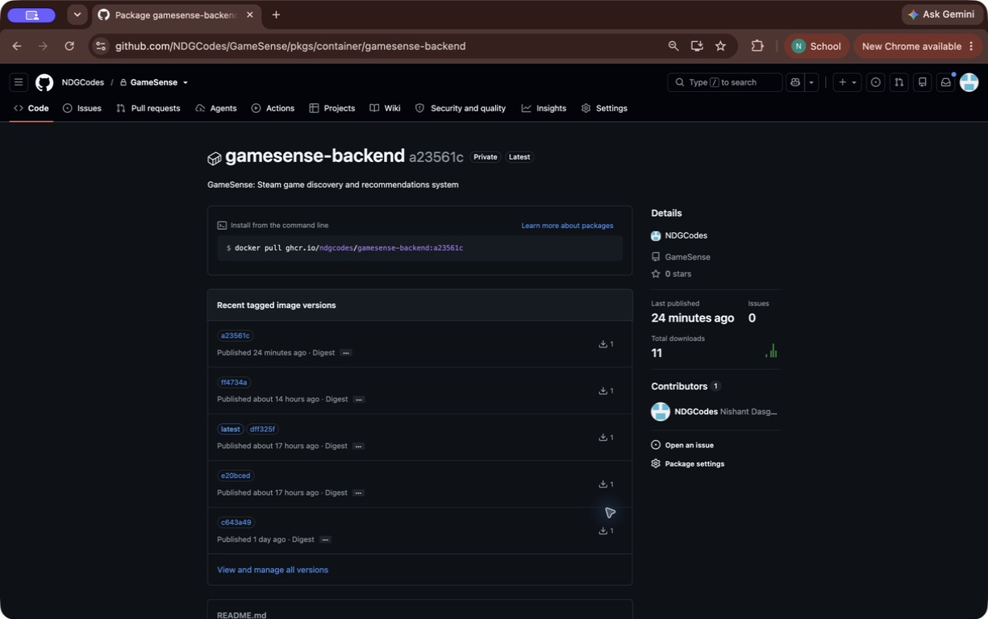
EVIDENCE
GHCR images tagged with the commit SHA (M5) (1/2)
ghcr.io/ndgcodes/gamesense-backend

Slide 16

EVIDENCE
GHCR images tagged with the commit SHA (M5) (2/2)
ghcr.io/ndgcodes/gamesense-frontend

Slide 17
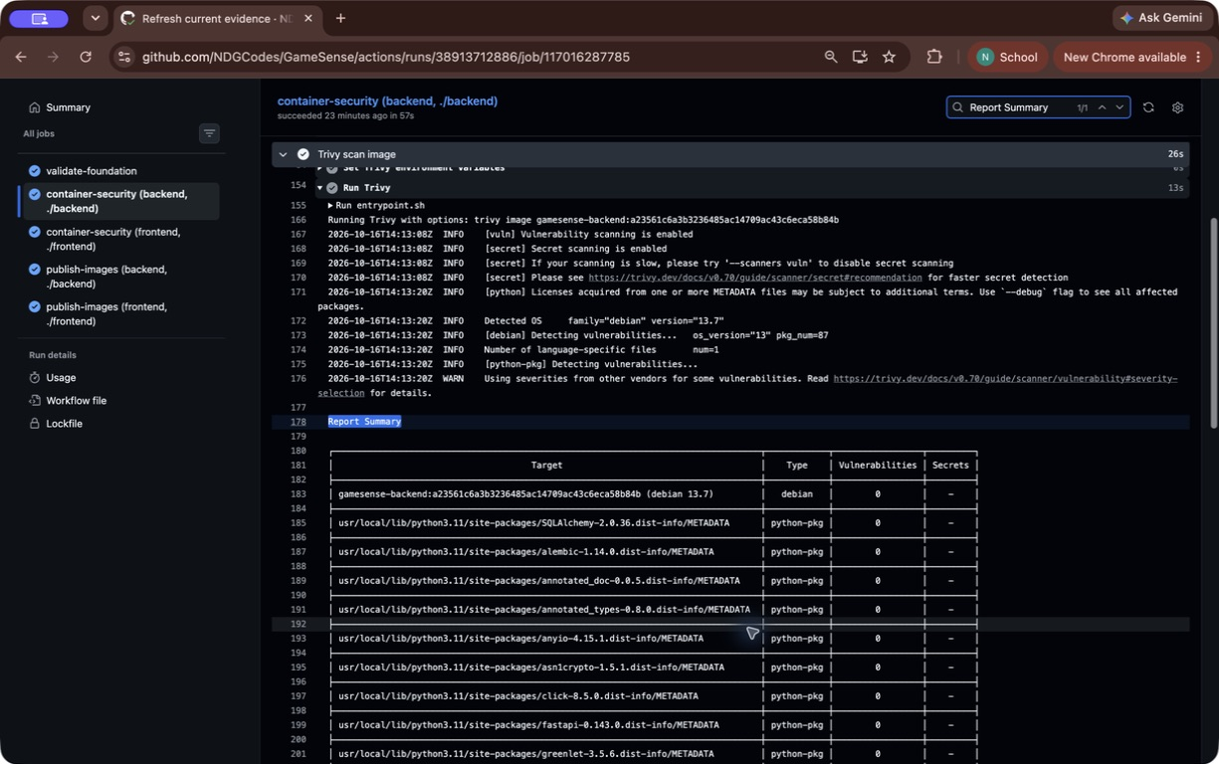
EVIDENCE
Trivy scan in CI (M6)
Backend image: 0 HIGH/CRITICAL vulnerabilities (gate passes; the build fails if any are found)

Slide 18
TERRAFORM ON AWS
Infrastructure as code (M7)
Network
VPC 10.42.0.0/16 across two AZs in ap-south-1 (Mumbai): 2 public and 2 private subnets, one NAT gateway, and the subnet tags EKS uses for load balancers.
Cluster
EKS 1.35 with a managed node group of 2 × t3.medium (AL2023). The cluster creator gets admin access.
Safety
allowed_account_ids guards against the wrong account. State and plans stay out of Git. Optional ECR repos are force-deleted on destroy.
Lifecycle
terraform init
terraform fmt -check · validate
terraform plan -out=<saved plan>
terraform apply <saved plan>
terraform destroy (after the demo)

Slide 19
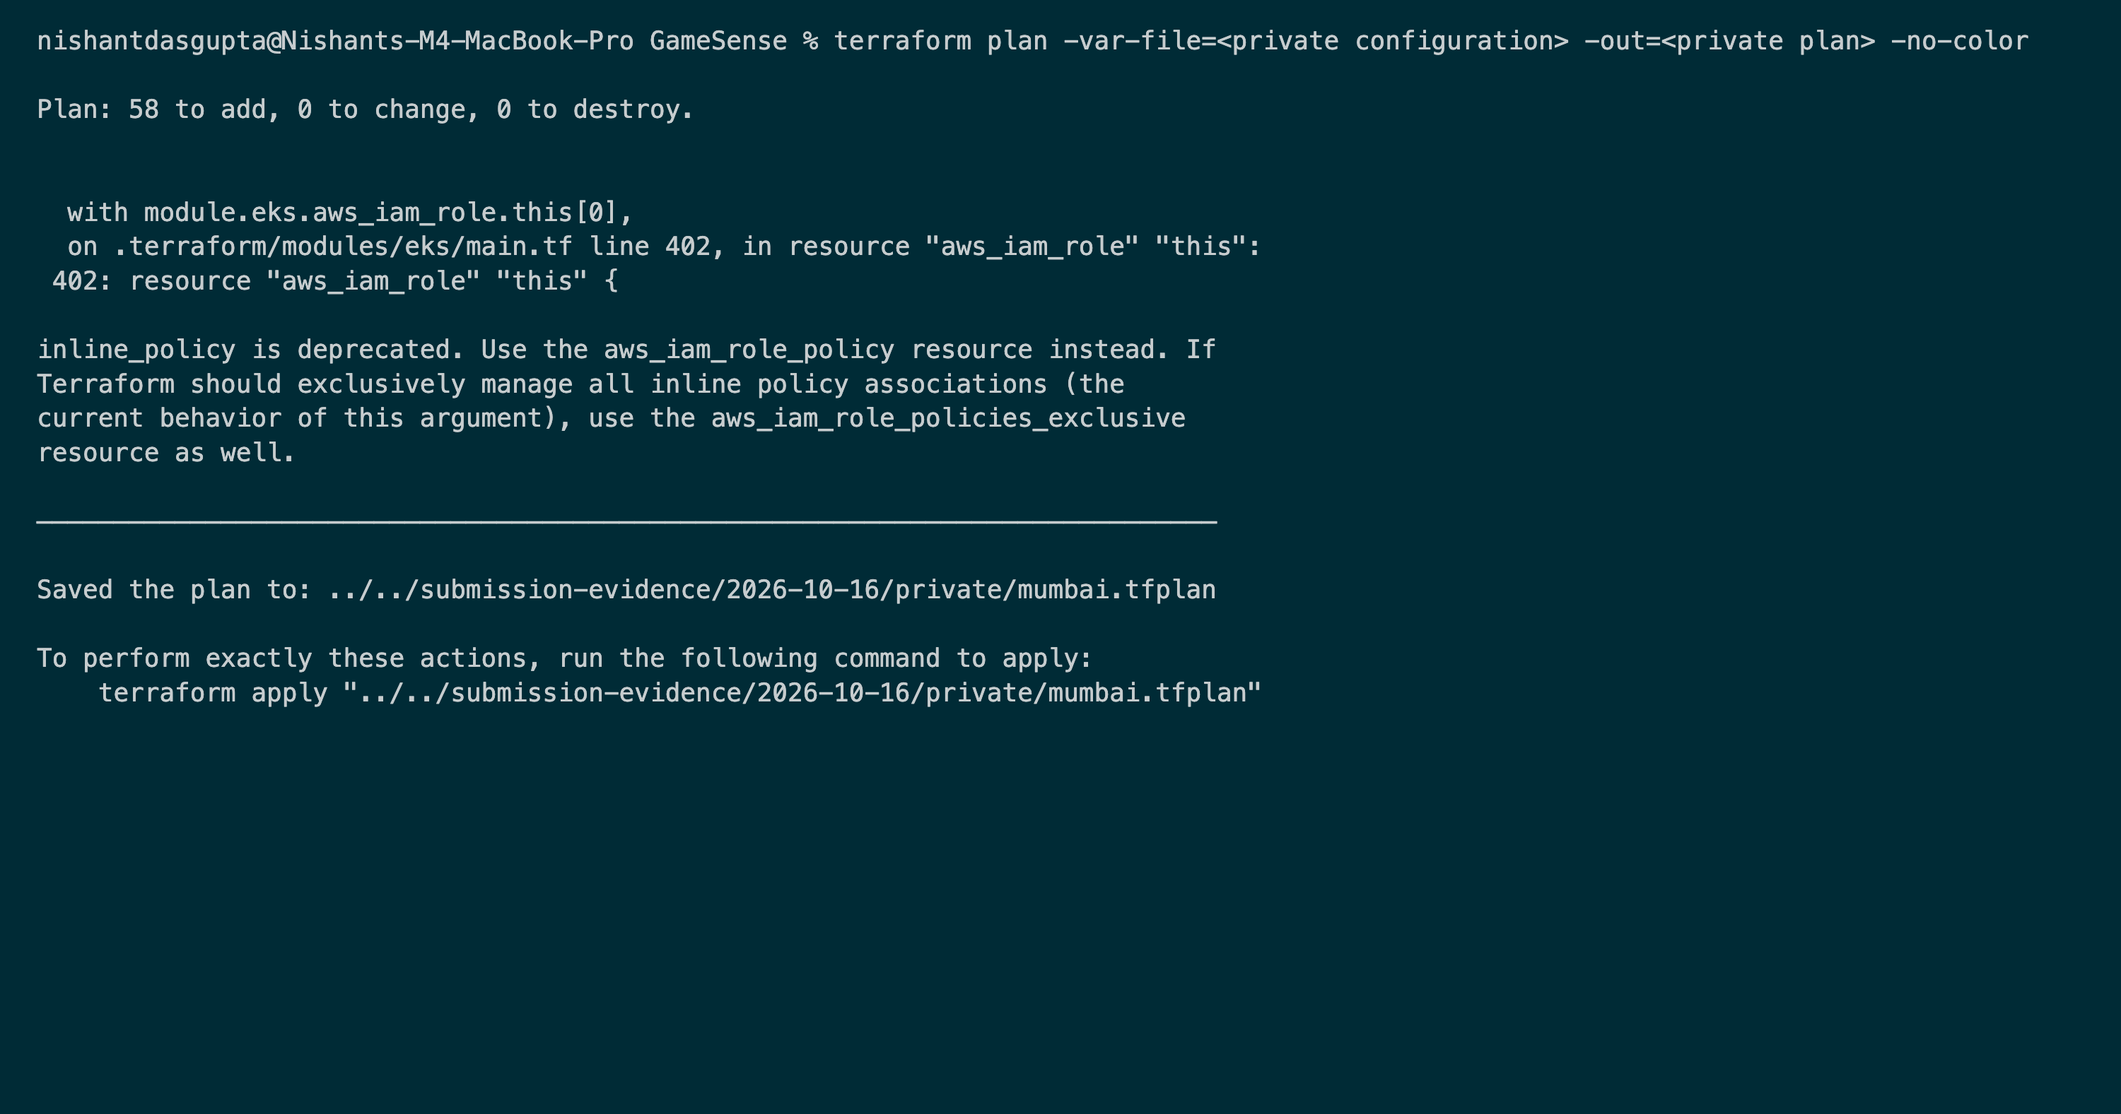
EVIDENCE
terraform plan (M7)
Plan: 58 to add, 0 to change, 0 to destroy

Slide 20
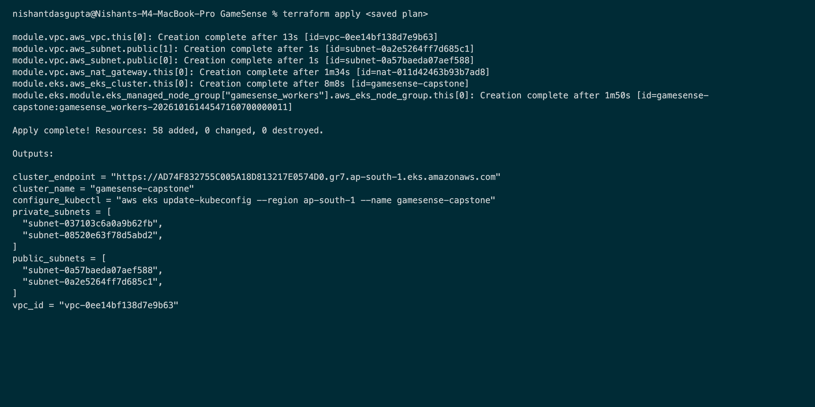
EVIDENCE
terraform apply (M7)
VPC, 2 public subnets, NAT, EKS cluster, and node group created: 58 resources

Slide 21
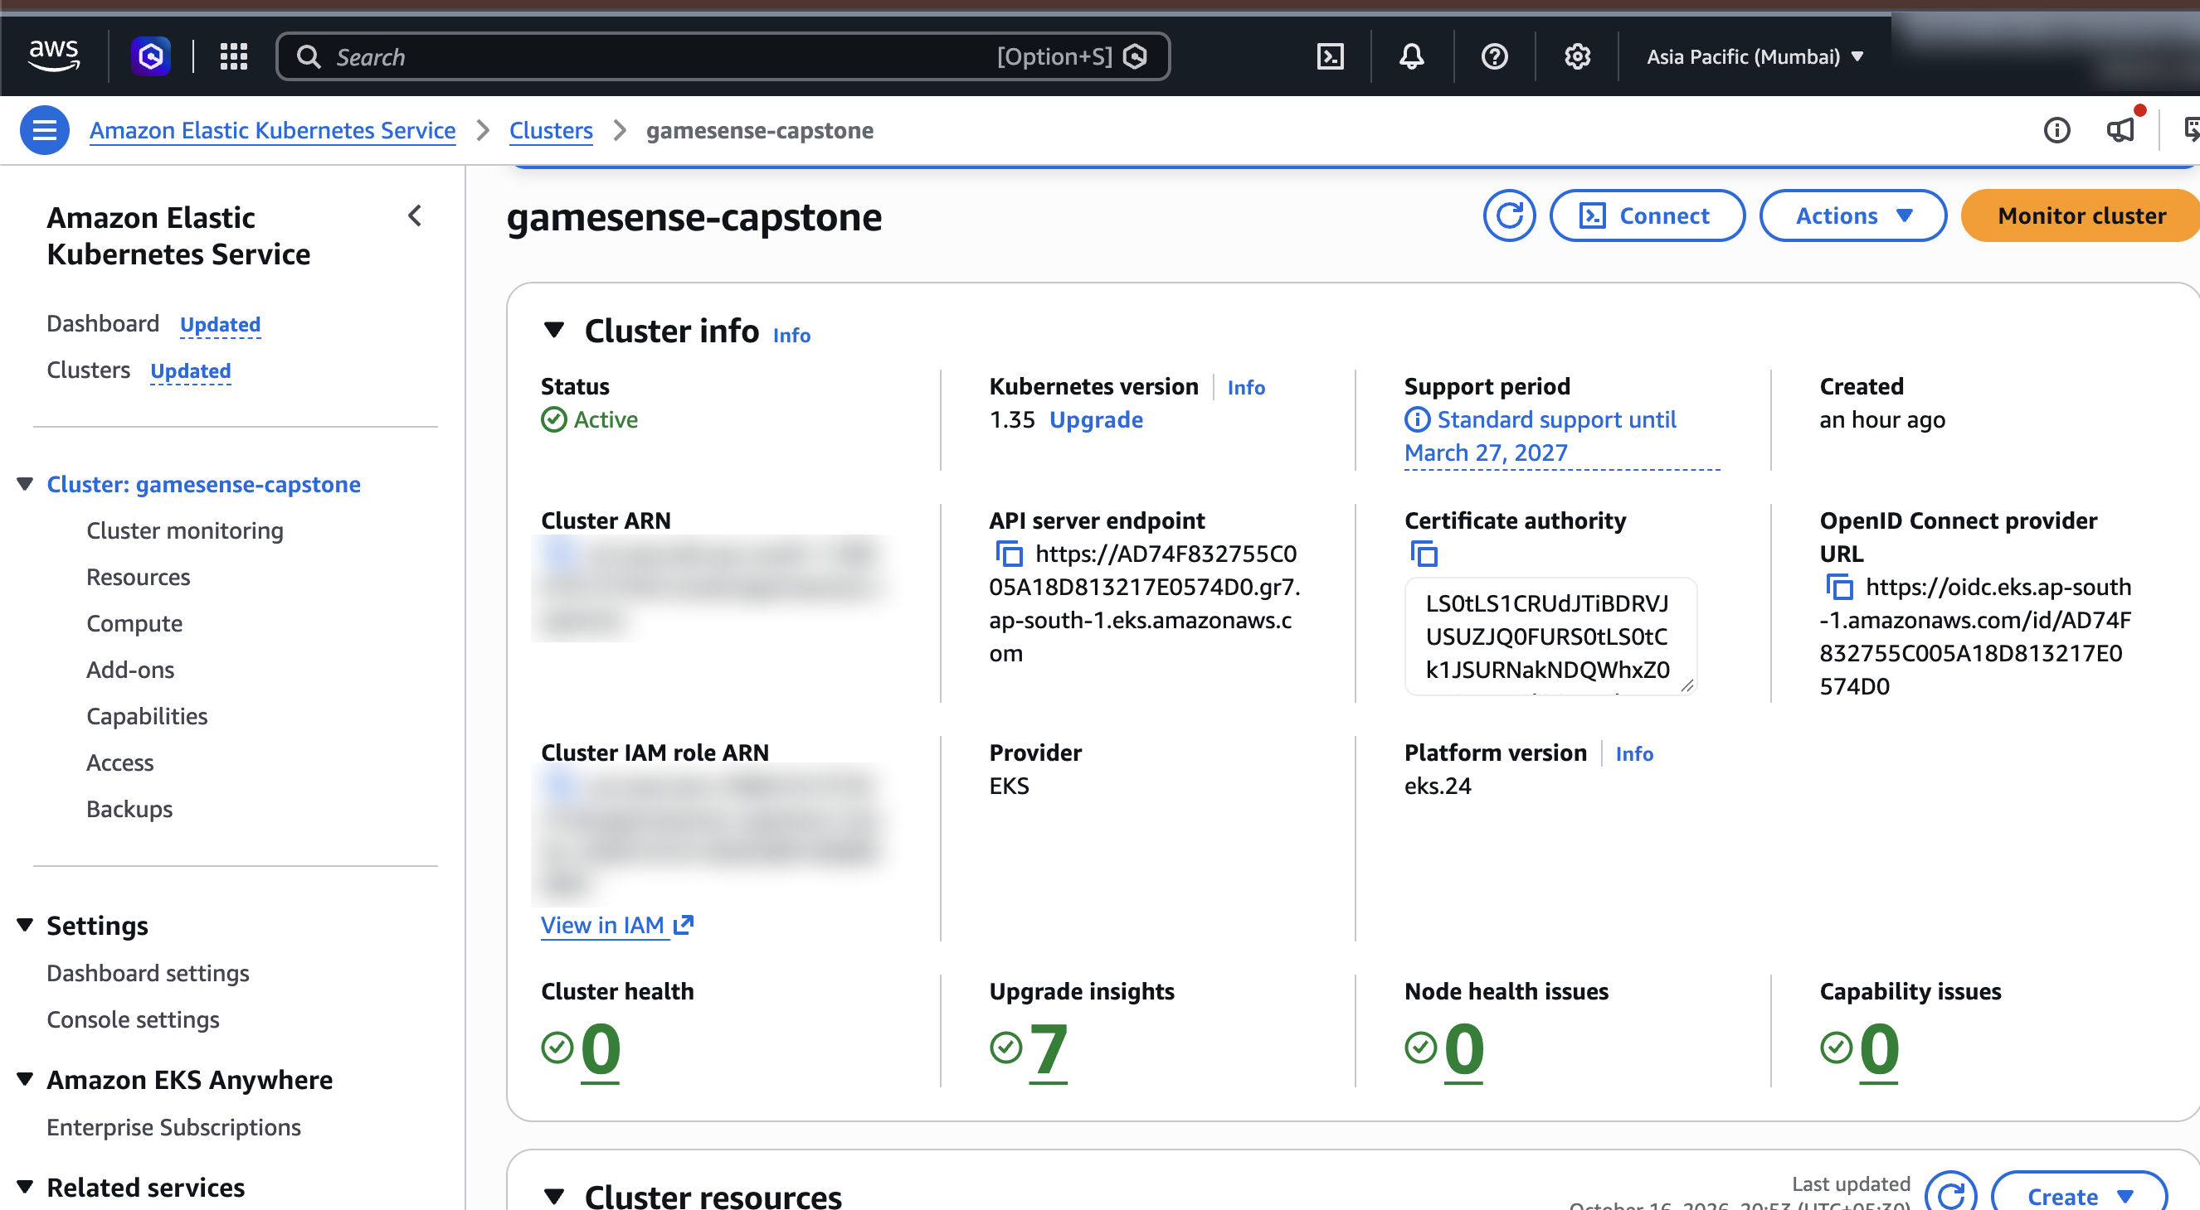
EVIDENCE
AWS Console: EKS + VPC in ap-south-1 (M7) (1/2)
EKS cluster gamesense-capstone: Active, Kubernetes 1.35

Slide 22
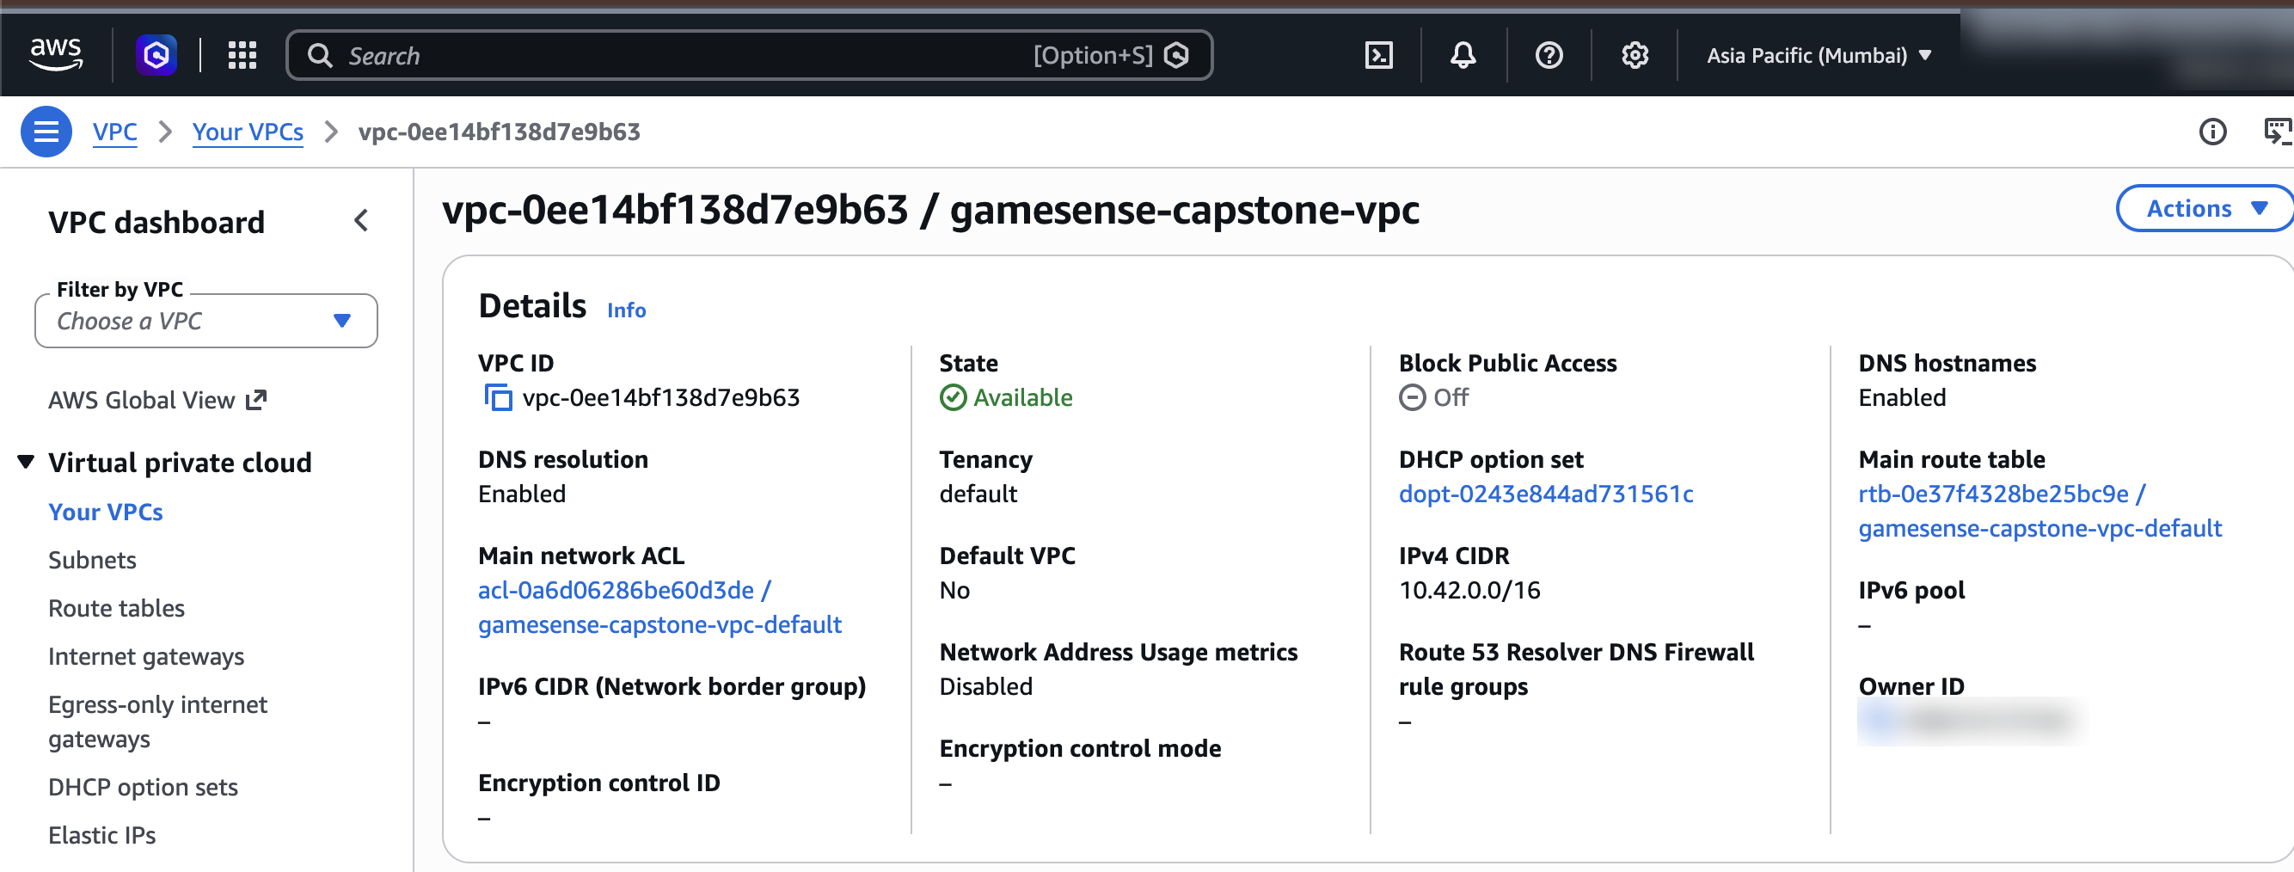
EVIDENCE
AWS Console: EKS + VPC in ap-south-1 (M7) (2/2)
gamesense-capstone-vpc: Available, 10.42.0.0/16

Slide 23
DEPLOYMENT
Kubernetes, Helm & GitOps (M8)
Helm chart
Frontend and backend Deployments with 2 replicas each, readiness and liveness probes, ClusterIP Services, and one Ingress (/ → frontend, /api → backend).
Ingress
Traefik publishes the Ingress through an AWS load balancer, so no DNS purchase is needed for the demo.
Secrets & data
Database URL and passwords live in Kubernetes Secrets created outside Git. The catalog bundle is mounted from a ConfigMap.
Argo CD
Watches main and renders helm/ with values-eks.yaml layered on top. Auto-sync, prune, and self-heal are on.
Push to deploy
A push to main makes CI publish images and commit the new tag; Argo CD syncs and rolls the pods. No kubectl or helm is run by hand.
One owner
Helm installed the release once. Argo CD now owns ongoing changes, so two controllers never fight over it.

Slide 24
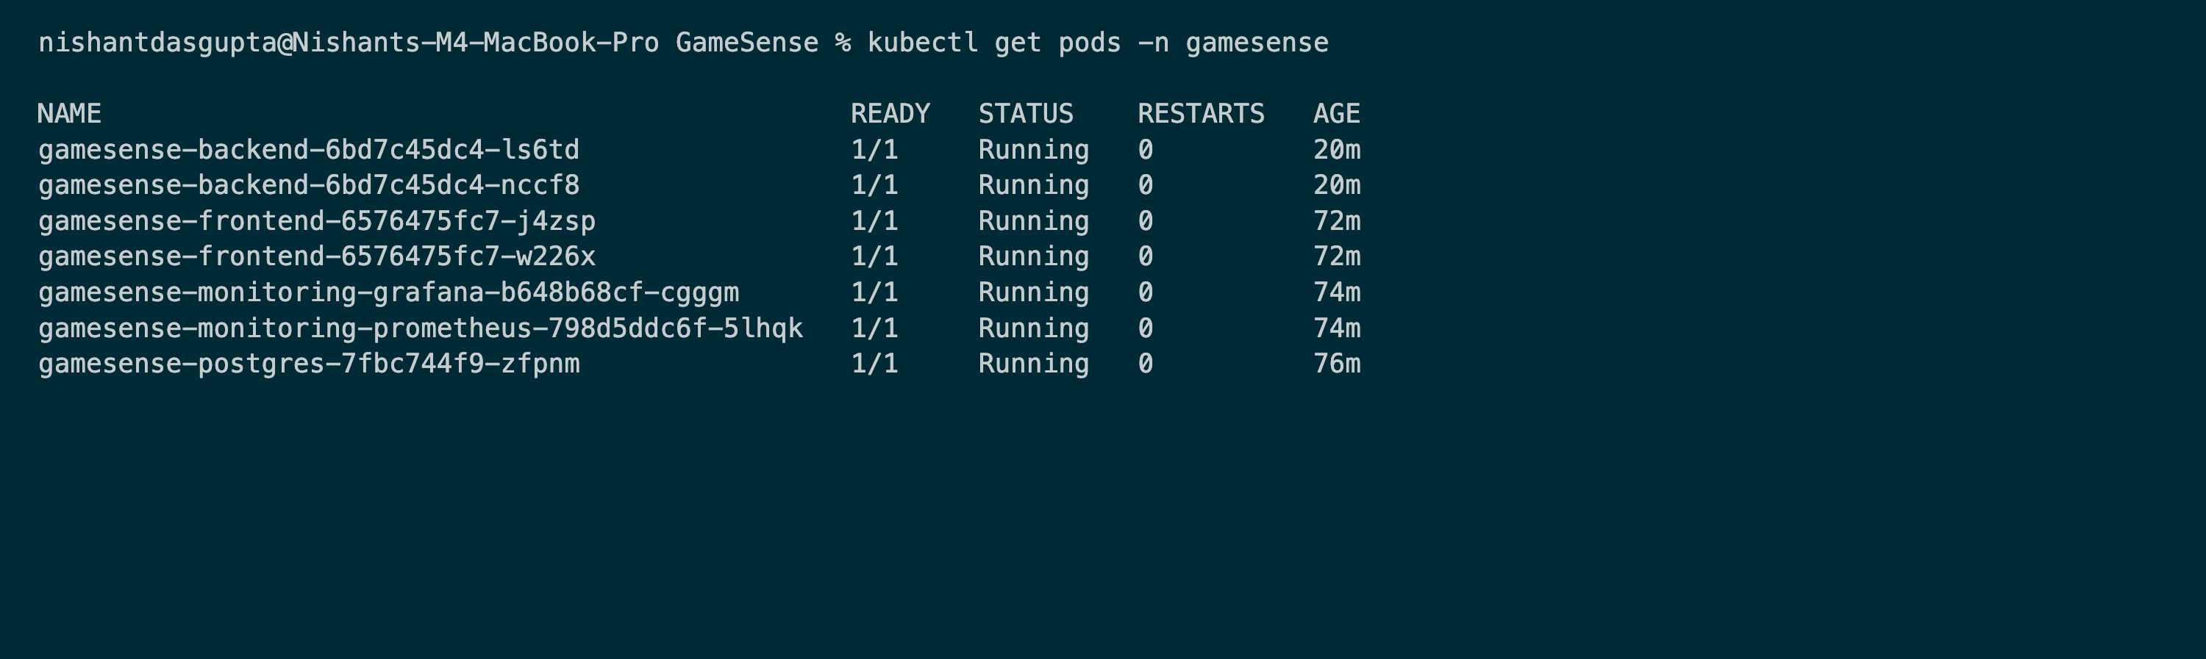
EVIDENCE
kubectl get pods (M8)
All pods Running: 2 backend and 2 frontend replicas, plus PostgreSQL, Prometheus, and Grafana

Slide 25
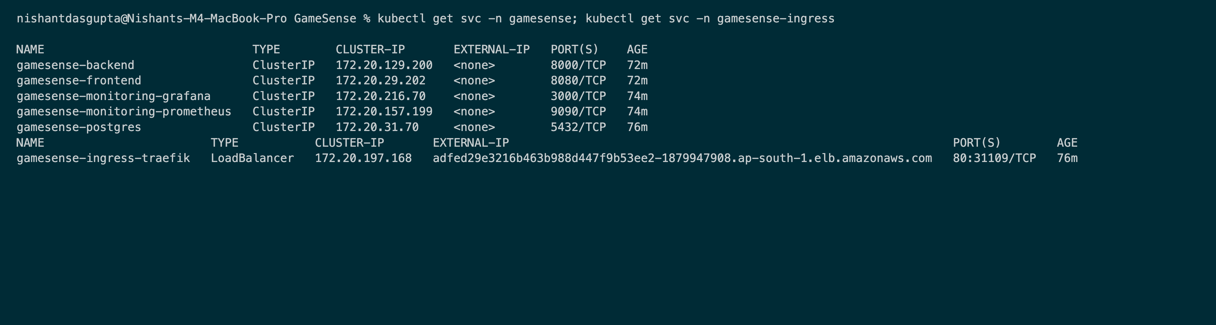
EVIDENCE
kubectl get svc (M8)
ClusterIP Services for the app, and the Traefik LoadBalancer

Slide 26
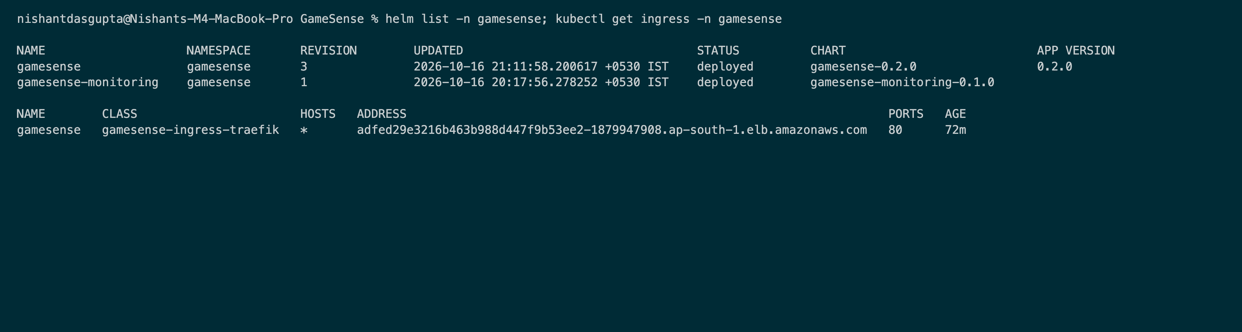
EVIDENCE
helm list + Ingress (M8)
Helm releases deployed; the Ingress routes / and /api through the load balancer

Slide 27
EVIDENCE
App live through the Ingress (M8)
GameSense on EKS at the AWS load balancer hostname

Slide 28
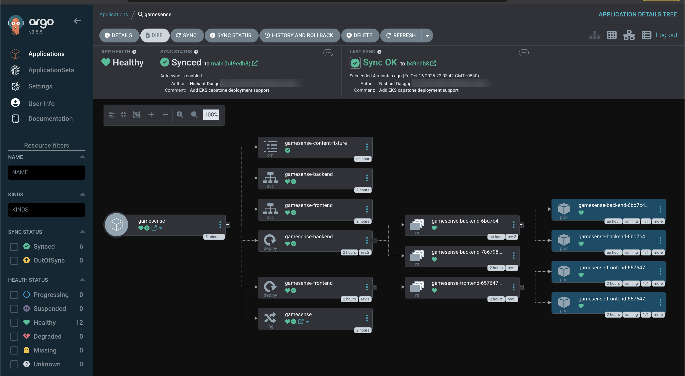
EVIDENCE
Argo CD: synced and healthy (GitOps)
Tracks main; auto-sync and self-heal on; full resource tree healthy

Slide 29
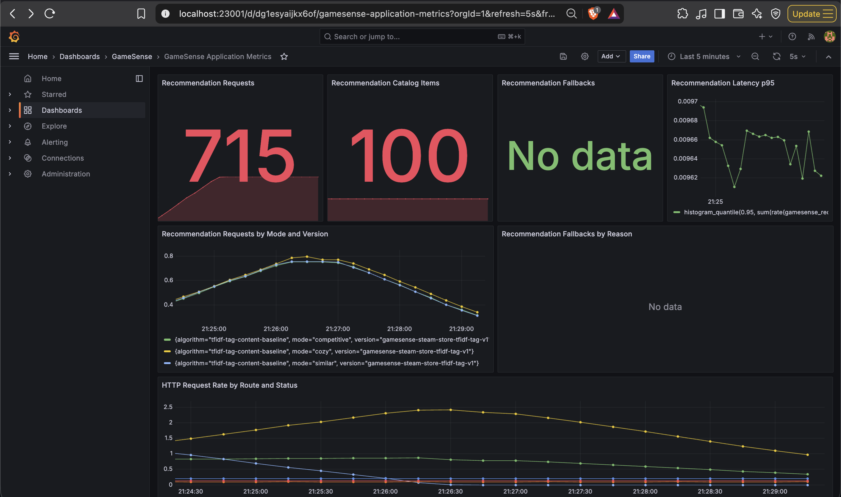
PROMETHEUS · GRAFANA
Observability (M9)
Instrumented API
/metrics exposes request counts, latency histograms, and recommender metrics labelled by mode, algorithm, version, and data snapshot.
Prometheus
Discovers backend pods by annotation, scoped to the app namespace. Both replicas show as UP.
Grafana
Provisioned datasource and dashboard: requests, catalog size, fallbacks, p95 latency, and HTTP rate by route.
Grafana on EKS: 715 recommendation requests, 100-game catalog

Slide 30
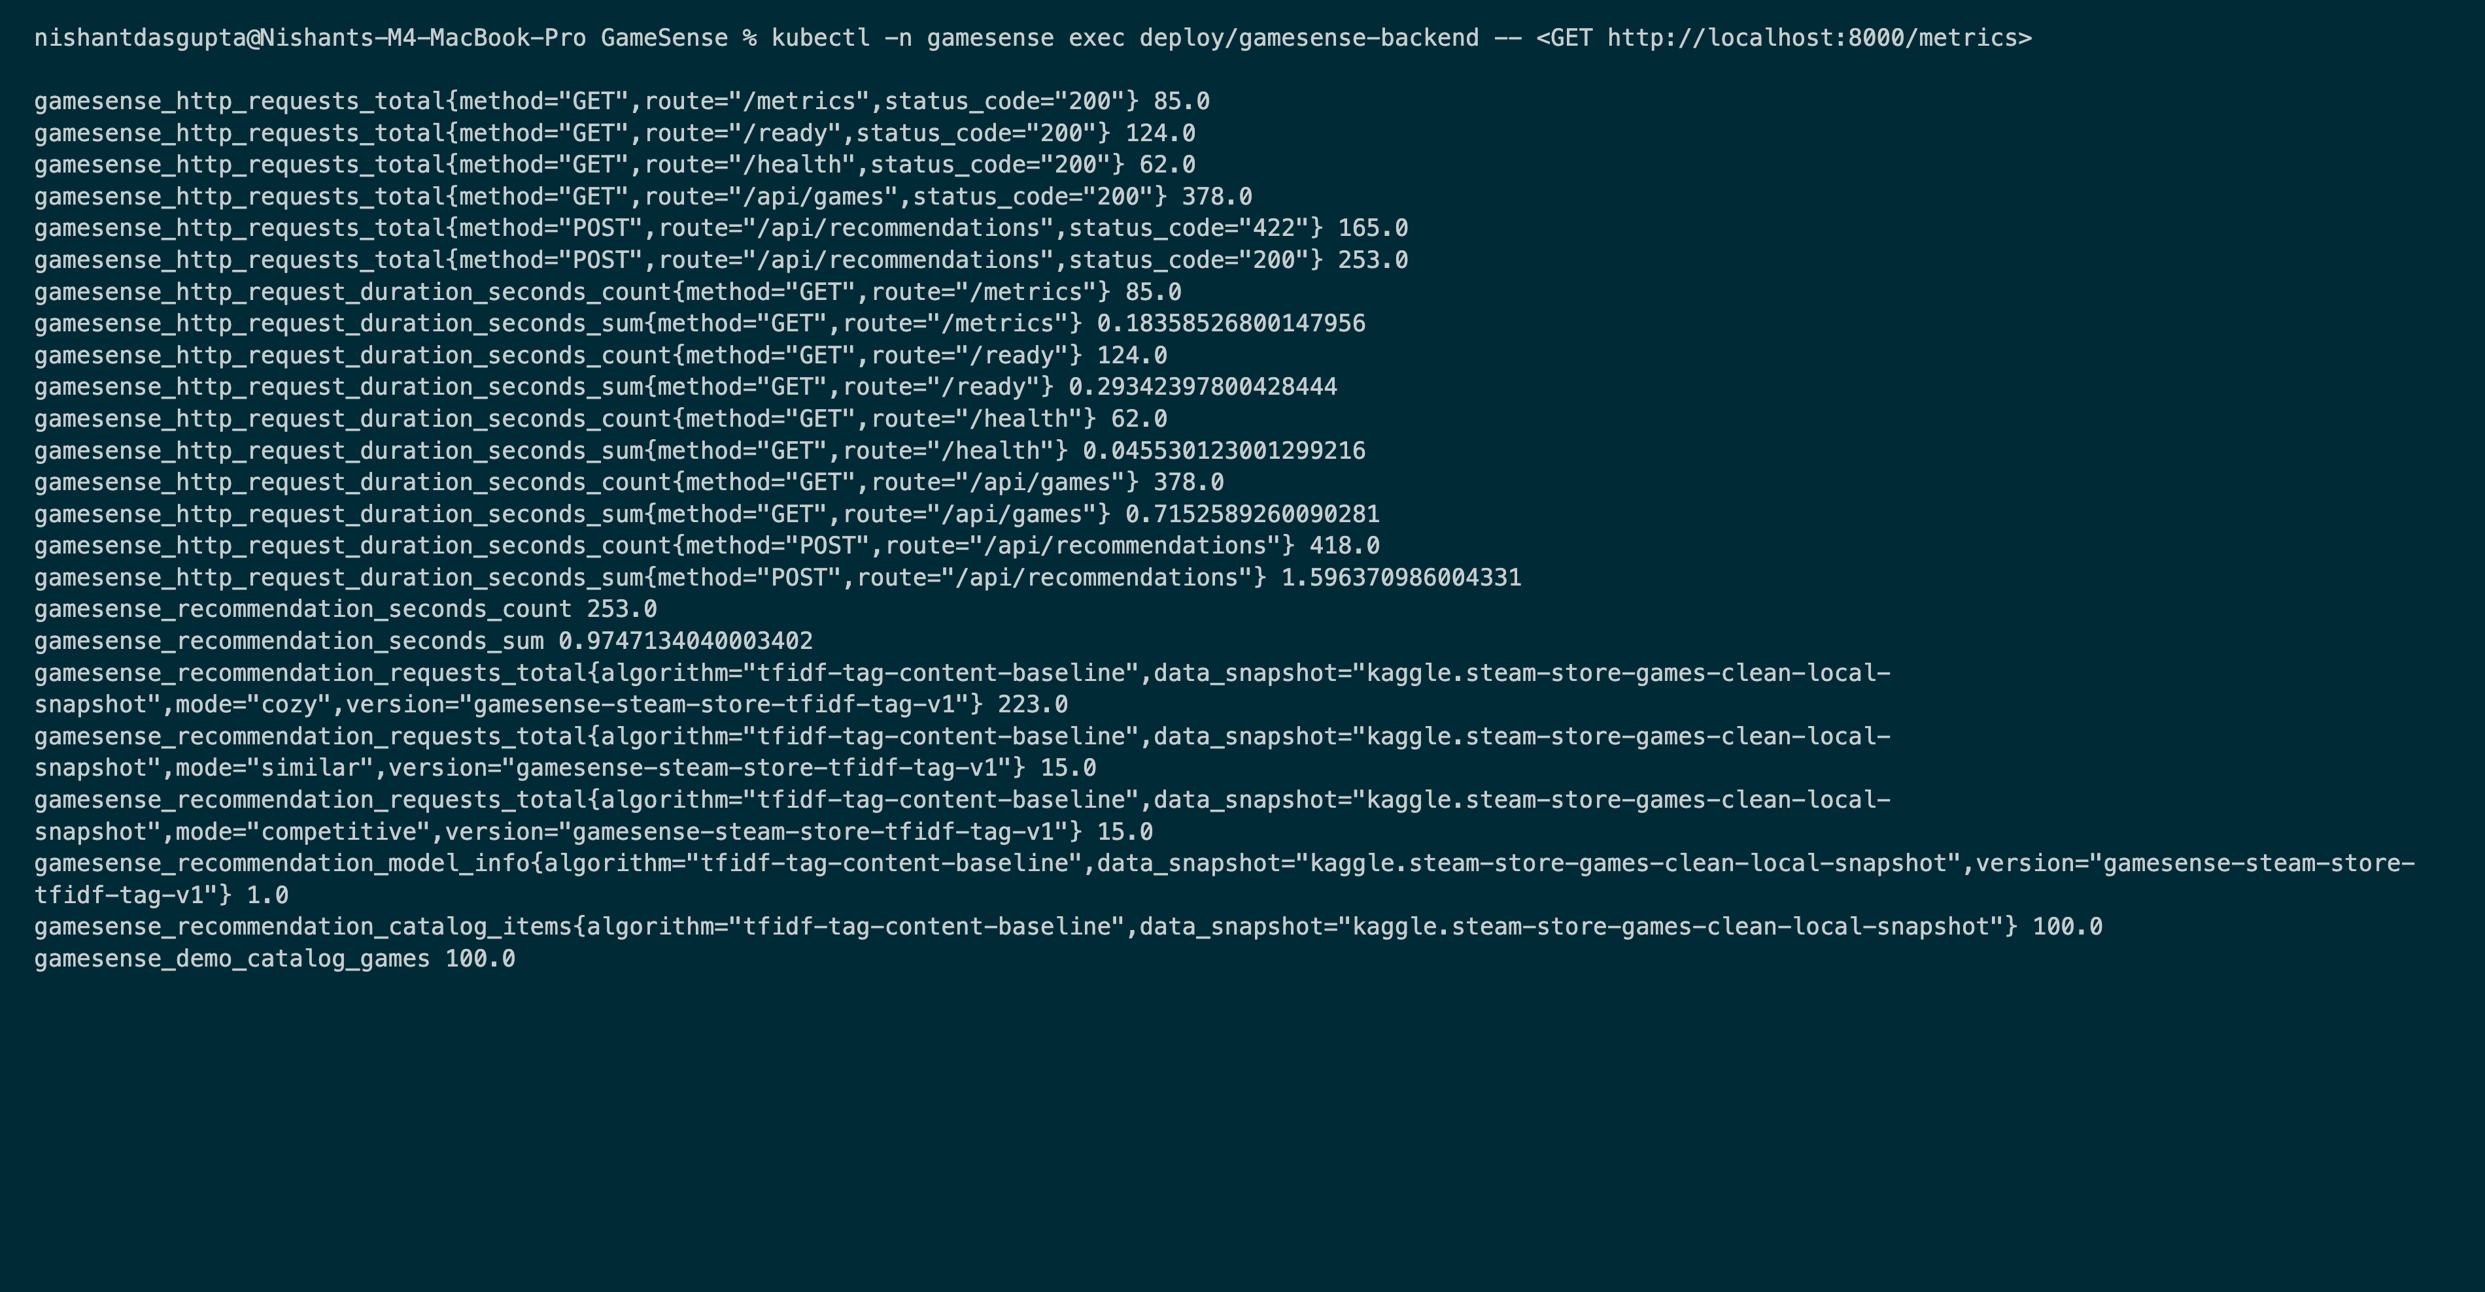
EVIDENCE
Backend /metrics (M9)
Prometheus-format metrics from a backend pod on EKS

Slide 31
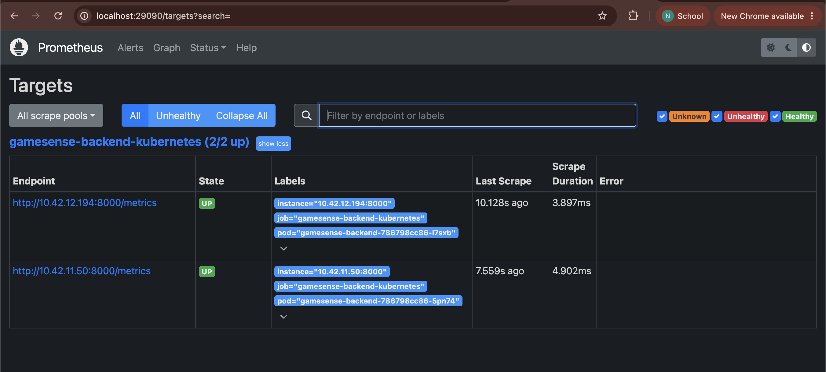
EVIDENCE
Prometheus targets UP (M9)
gamesense-backend-kubernetes: 2/2 targets UP

Slide 32
EVIDENCE
Grafana dashboard (M9)
Live recommendation requests, catalog size, latency, and HTTP rate by route

Slide 33
WHY IT IS BUILT THIS WAY
Design decisions & trade-offs
Traefik instead of the AWS ALB controller
Fewer IAM moving parts for a short-lived demo. The chart still supports ALB via ingress.className.
Disposable PostgreSQL (emptyDir)
Good enough for a demo; production would use RDS or a persistent volume.
GitOps image tags
CI writes the deployed tag to Git, so every deployment is a reviewable commit.
Data licensing
Raw Kaggle data and model bundles are never committed. The cloud demo serves only a 100-game subset.
Secrets out of Git
Tokens and passwords live in Kubernetes Secrets. Trivy secret scan and history checks are clean.
Cost control
Short-lived cluster, one NAT gateway, two small nodes, and terraform destroy straight after the demo.

Slide 34
WHAT I WOULD KEEP AND CHANGE
Key learnings
Small configuration details break deployments
The Ingress returned 404 until its class matched the name Traefik actually registered. Check the cluster's real resource names, not the defaults.
GitOps needs one source of truth
Deployed image tags had to move into Git, written by CI, before Argo CD could be the only deployer.
Helm merges maps
An empty annotations map does not remove a default annotation; it takes an explicit null.
Security gates belong before publish
Trivy runs before anything reaches GHCR, so a vulnerable image never becomes deployable.
Data has licences too
The dataset's terms shaped what could be committed or shipped to the cloud.
Next steps
TLS and DNS, RDS instead of emptyDir, an ALB controller with IRSA, and alerting rules in Prometheus.

Slide 35
WHAT THE DEMO SHOWS
Live walkthrough
1
Codebase tour: folder structure and key files
2
Push a visible change → GitHub Actions runs end-to-end
3
Terraform plan / apply output + AWS Console (VPC, EKS)
4
Argo CD picks up the tag commit and syncs
5
kubectl get pods, svc, ingress in the cluster
6
The updated app live through the load balancer
7
Prometheus Targets UP · Grafana live dashboard

Slide 36
Thank you
github.com/NDGCodes/GameSense
Rubric evidence: screenshots and logs submitted with this deck.

