Slide 1
Plenty

Slide 2
TABLE OF CONTENTS
01
03
02
04
Our team
Applications used
Assignment
Demonstration

Slide 3
01
Our team

Slide 4
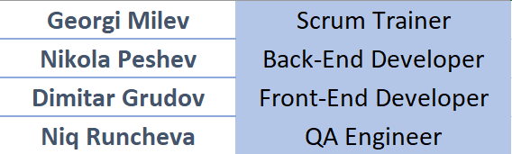
Our team

Slide 5
02
Assignment

Slide 6
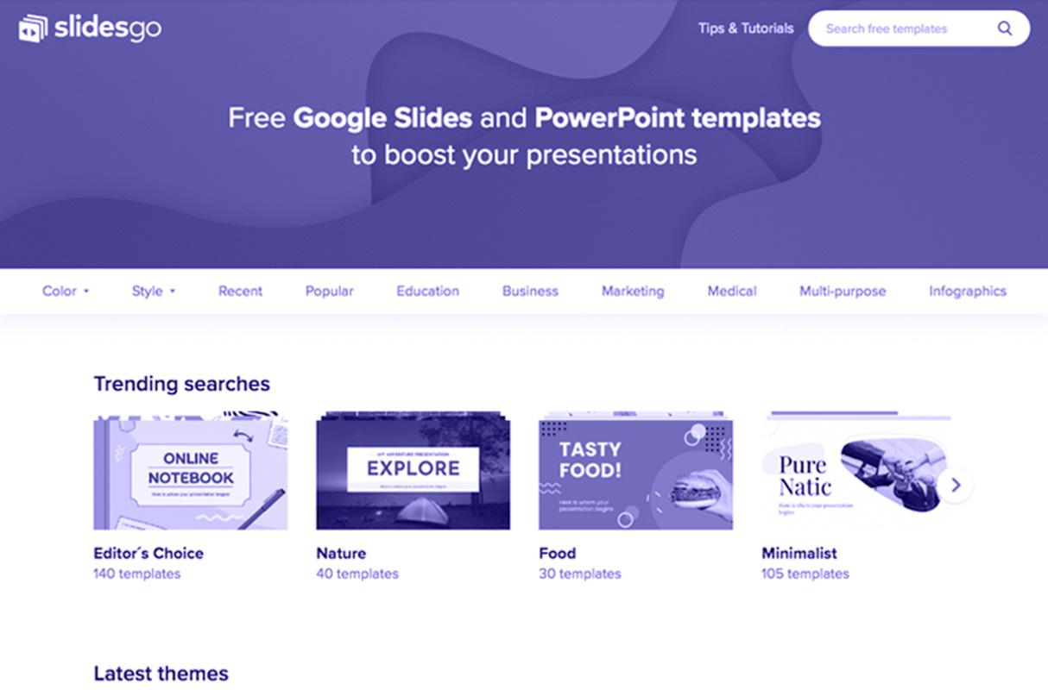
Assignment
We had school assignment to develop history event application. We had to make functionality that the user can add, delete and see all events.

Slide 7
03
Applications used

Slide 8





Applications used

Slide 9
04
Demonstration

