Slide 1
Spam-Classifier
ARTIFICIAL Intelligence – MAy2021

Slide 2
in1
W1
rW1+B + rW2+B
act
out
W2
in2
B

Slide 3
Visualised
B1
in1
W11
rW11+B + rW12+B
act
out
W12
in2
Matrix Form
W_Matrix
in_Vector
B_Vector
out_Vector
act

Slide 4
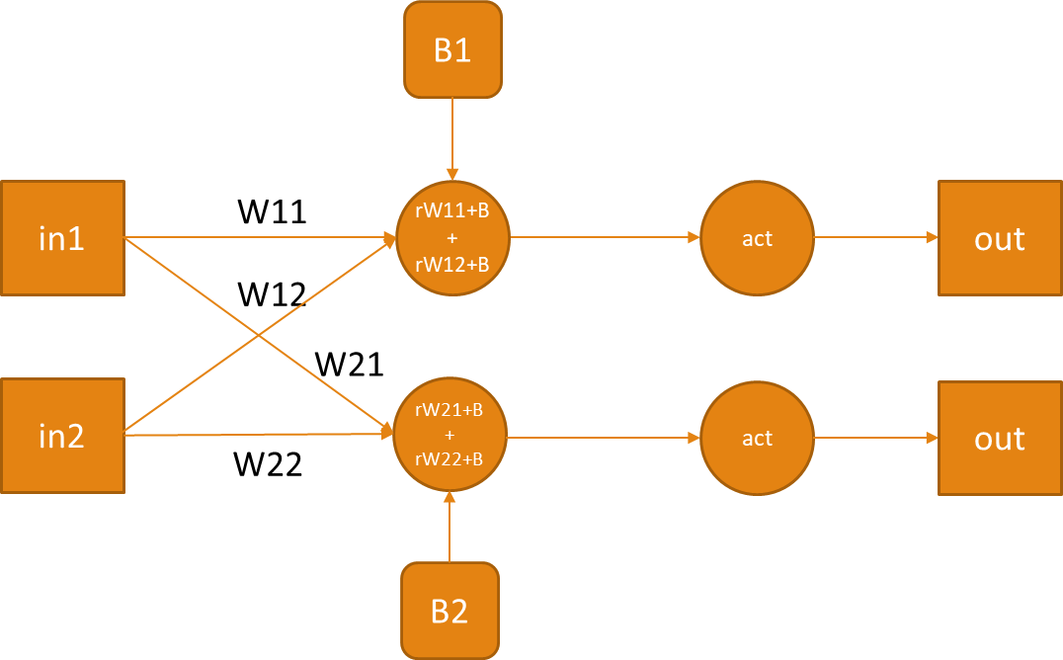
Classifier
B
in1
W11
rW11+B + rW12+B
act
out
Expected
W12
in2
Calculate the loss
Layer1
Layer0

Slide 5
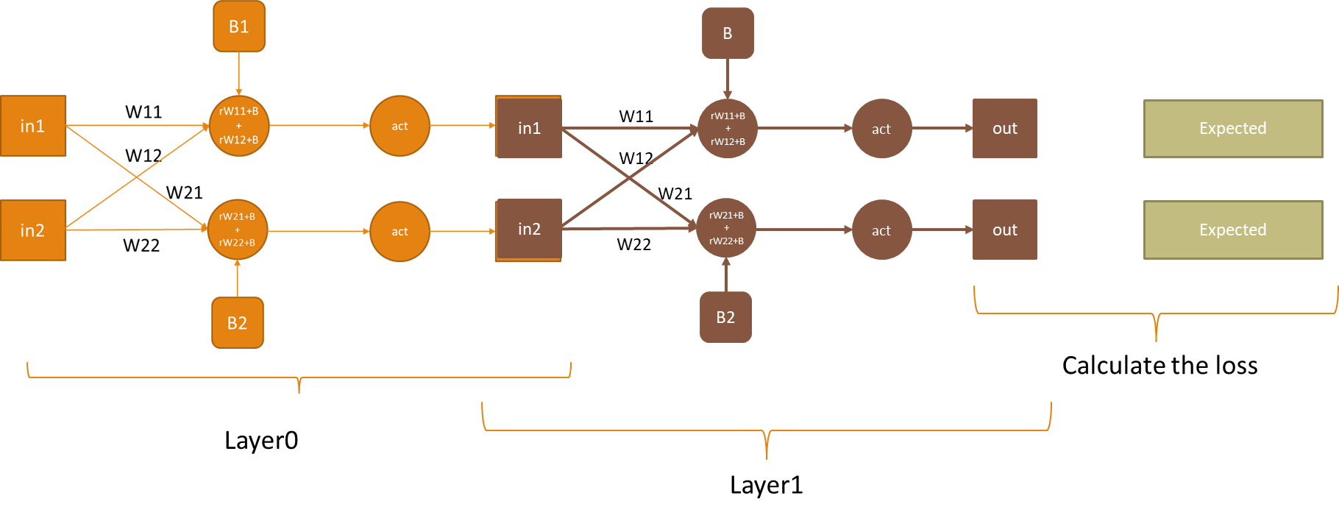
Classifier

Slide 6
Froward
Layer0 activation is ReLU
Layer1 activation is sigmoid
in1
W11
rW21+B + rW22+B
act
out
> 0.5
W12
in2
B
Layer0 activation is ReLU
Layer1
activation is Sigmoid
Gradient Descent
Backprop

Slide 7
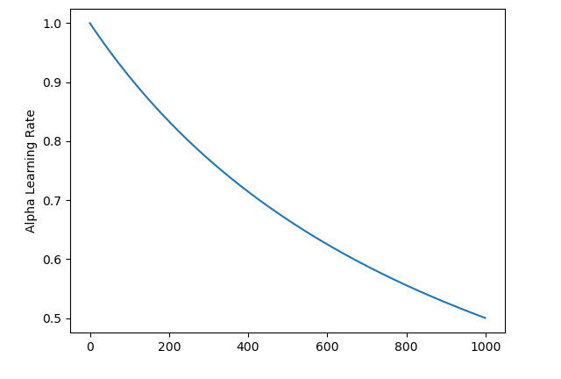

Slide 8
Training data (n=1000)
Flag | w1 | w1 | w2 | … | w51 | w52 | w54
0 | 0 | 1 | 1 |  | 0 | 0 | 0
1 | 0 | 0 | 0 |  | 1 | 1 | 0
Train
Test
Test data (n=500)
Flag | w1 | w1 | w2 | … | w51 | w52 | w54
0 | 0 | 1 | 1 |  | 0 | 0 | 0
1 | 0 | 0 | 0 |  | 1 | 1 | 0

Slide 9
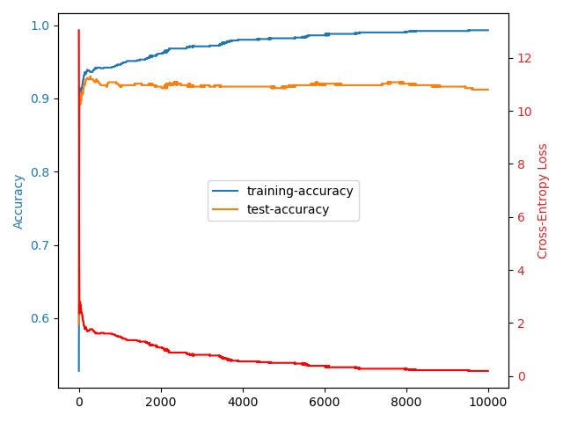
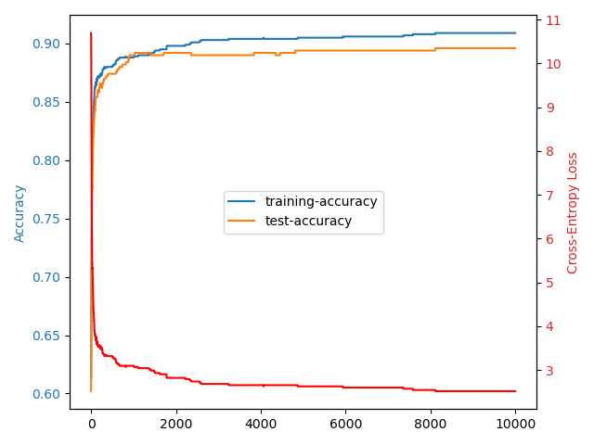
Expected Behaviour
Target
Accuracy
train
Fixed Learning Rate
test
Overfit
Epochs
Decay Learning Rate

Slide 10
Weight
Epochs

Slide 11
Weights
Weights

Slide 12
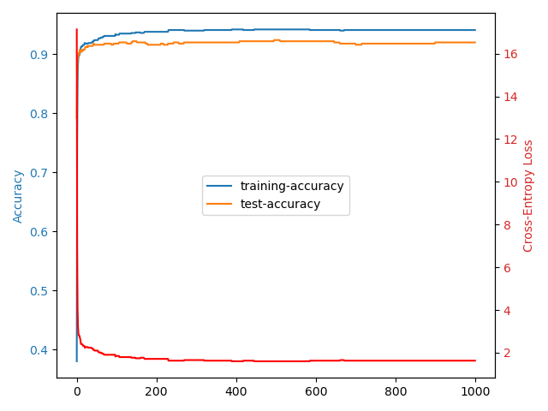
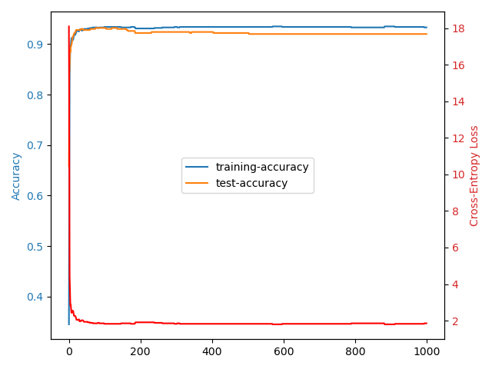
Epochs
Epochs
(NewronLayer(1, receptors, output=True))
(NewronLayer(2, receptors, output=True))

Slide 13
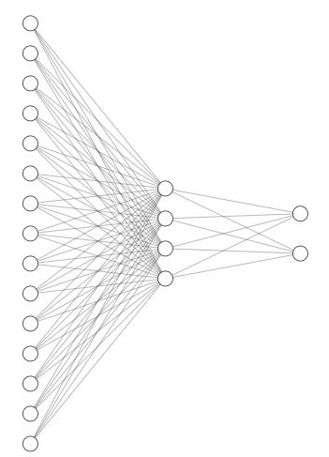

Slide 19
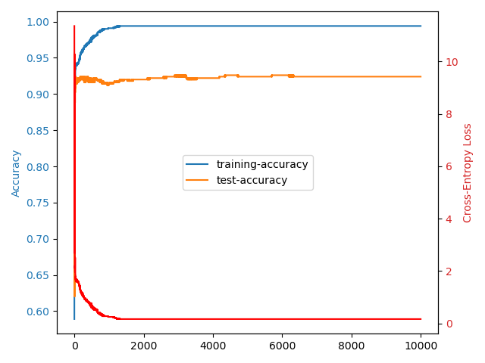
Final Choice
Final submission is the weights at epoch 6000 since:
Both training and test accuracies seem to reach a max
Max is reached while cross-entropy is low
The NN seems stable
92+% Accuracy on Test Data
layer0_nodes = 54 * 2
NN_stucture.append(NewronLayer(layer0_nodes, receptors)) # first hidden
NN_stucture.append(NewronLayer(1, layer1_nodes, output=True)) # output

Slide 20
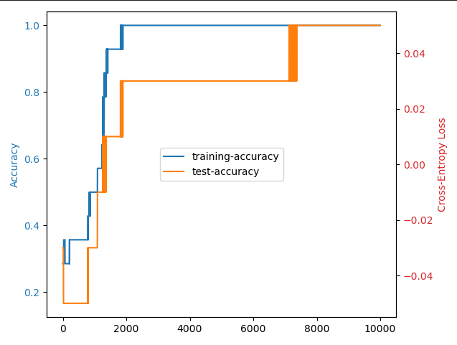
Fun Bonus Experiment
Sum
A
B
0 | 0 | 0
1 | 0 | 1
1 | 1 | 0
2 | 1 | 1
2 | 0 | 2
2 | 2 | 0
3 | 1 | 2
3 | 2 | 1
3 | 0 | 3
3 | 3 | 0
4 | 3 | 1
4 | 1 | 3
4 | 2 | 2
4 | 4 | 0
1 | 0 | 1
3 | 1 | 2
2 | 1 | 1
3 | 2 | 1
4 | 2 | 2
4 | 0 | 4

