Slide 1

podft: On Accelerating Dynamic Taint Analysis with Precise Path Optimization
Zhiyou Tian
Xidian University
21151213645@stu.xidian.edu.cn
Cong Sun
Xidian University
suncong@xidian.edu.cn
Dongrui Zeng
Palo Alto Networks dzeng@paloaltonetworks.com
Gang Tan
Pennsylvania State University
gtan@psu.edu
BAR 2023
Notes:
My name is … and our first author could no come in person due to a visa issue.
The title of our paper is podft: On Accelerating Dynamic Taint Analysis with Precise Path Optimization.
In this work and our future work, our goal is to use static analysis and deep-learning to improve the efficiency of dynamic taint analysis.

Slide 2



Background and Motivations
Dynamic taint analysis (DTA)
What is it?
Useful for security
Binary-level dynamic data-flow tracking (DFT)
Dynamic binary instrumentation (DBI)
Virtual machine manager (VMM)
Emulator
Notes:
First, I would like to introduce the background and motivations of our research.
Dynamic taint analysis (DTA), also known as dynamic data-flow tracking (DFT), is a technique for precisely tracking the flow of selected data throughout the execution of software, widely used in vulnerability detection, program protection, etc.
Binary-level dynamic data-flow tracking (DFT) uses runtime techniques, e.g., dynamic binary instrumentation (DBI), virtual machine manager (VMM), or emulator, to propagate sensitive taints across program contexts. Knowledge of taint propagation is collected directly over the target binary.

Slide 3
Background and Motivations
DBI-based DTA
Focus on explicit flows
Hold the tainting states within tagging memory
Challenge of DTA —— significant performance penalty
High Cost !
Notes:
Dynamic binary instrumentation (DBI) is promising in tracking the runtime taint propagation across a process’s memory space.
Such approaches hold the tainting status of suspicious data within tagging memory and virtual registers and check at particular program execution points to decide if specific runtime policies are enforced or violated.
（摁下空格）
But DBI-based DTA has a significant performance penalty. Its taint tracking is conducted per binary instruction, and the complex taint tracking takes much longer to execute the instrumented program than the original program.

Slide 4
Background and Motivations
Existing works
Lift (MICOR 2006)
static fast path
Libdft (VEE 2012)
on Pin
DBI inline routines
TaintRabbit (ASIA CCS 2020)
on DynamoRIO
dynamic fast path
SELECTIVETAINT (USENIX 2021)
static binary rewriting
bloat the attack surface
value-set analysis
cannot work on library code
podft advantages
more efficient
not bloat the attack surface
consider library code
flexible scalability
Our work —— podft defines and enforces various fast paths
Notes:
There are many DTA works trying to reduce performance penalties.
For example, Lift distinguishes safe data and unsafe data. And for code chunks that only touch safe data, Lift optimizes them to skip taint tracking computations; such optimization is called static fast path.
LibDFT is developed with Intel’s Pin, using well-constructed routines to exploit the DBI inline optimization, thereby reducing overhead.
Taint Rabbit is developed on DynamoRIO. Compared with the static fast paths, Taint Rabbit generates the fast paths just-in-time even when the taints are presented at in- and out-states of basic blocks. The efficiency of their approach assumes the executions of a basic block are frequently over the same taint state.
The most recent work, SELECTIVETAINT uses value-set analysis to ensure a must-not-tainted instruction set and taints only the instructions outside this set with static binary rewriting. Although SELECTIVETAINT is very effective in eliding uninvolved instructions, their static binary rewriting technique may bloat the attack surface of binaries and confront more scalability issues than DBI. And the VSA-based analysis cannot work on library code.
In our work, （摁下空格） podft defines and enforces different fast paths. It is more efficient than the other DTA tools. It does not bloat the attack surface of binaries. It uses function-level fast paths to optimize library code. Based on the experimental results, podft is scalable over real-world programs.

Slide 5
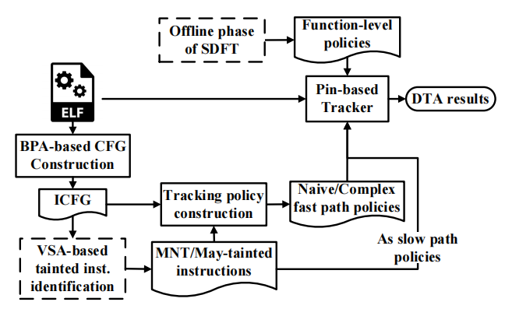
Design of podft
podft overview
BPA-based CFG Construction
VSA-based tainted inst identification
Tracking policy construction
PDG-based function abstract(from SDFT)
Pin-based Tracker
Fig1. Framework of podft (dashed block = usage of existing tools)
Next —— give a toy example to demonstrate
Notes:
Secondly, I would like to introduce the design of the podft.
podft is a hybrid taint tracking framework, as presented in Fig1. Its static analysis uses the results of several existing analyses to build the tracking policies for the later runtime taint tracking.
With the tracking policies, the Pin-based tracker takes fast paths on demand to track the taints’ propagation at runtime.
In all, podft consists of the following modules:
BPA-based CFG Construction,
VSA-based tainted instruction identification,
tracking policy construction,
PDG-based function abstract,
and Pin-based Tracker.
（摁下空格） Next, we will give a simple toy example to explain how these modules work.

Slide 6
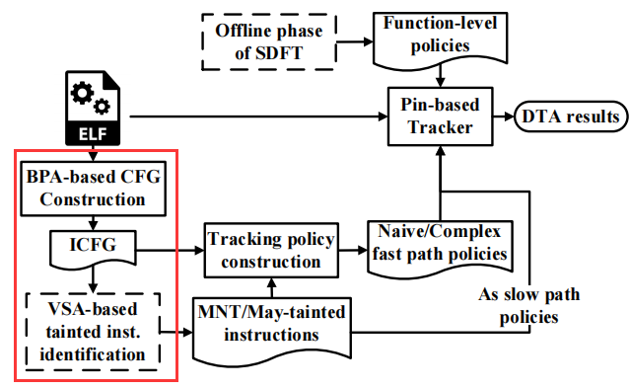
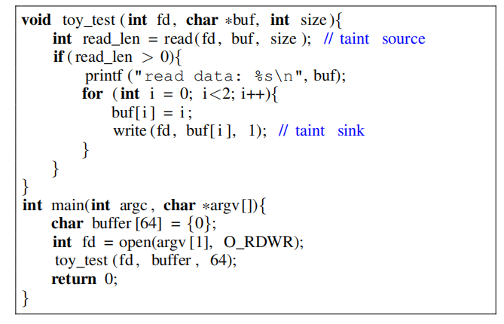
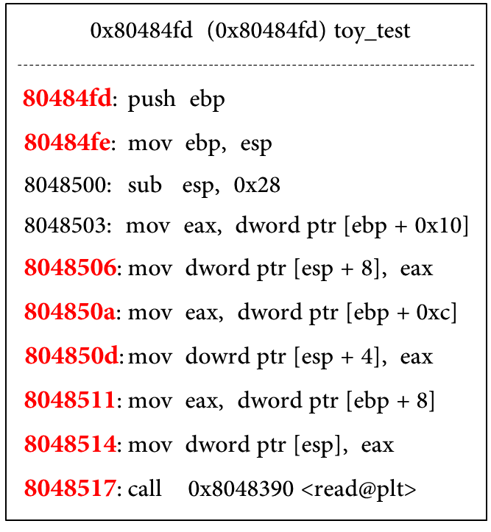
Example demonstration
BPA-based CFG Construction
VSA-based tainted inst identification
basic block B (bbl-b)
basic block C (bbl-c)
…etc
Fig.2 toy example
basic block A (bbl-a)
Notes:
First, podft uses BPA to derive the indirect call targets for the binary-level CFG; we call it ICFG.
Then, the ICFG is delivered to a value-set analysis to derive the must-not-tainted instruction set.
In this procedure, from input, we know what values are considered as tainted. So, if a tainted value appears in the value set of an instruction operand, we know this operand is potentially tainted. If a source operand is potentially tainted, the destination operand’s value set is removed from the must-not-tainted value set.
If value sets of all the operands of one instruction are MNT value sets, the instruction is labeled as a must-not-tainted instruction, and the MNT value set gets enlarged if the destination is concrete.
In this toy program, for example, read is a taint source that reads file FD’s input as taints to buf. The function toy_test prints buf, modifies the tainted buf[0] and buf[1] with constants in the for-loop, and delivers the untainted buf[0] and buf[1] to the taint sink write to modify the file.
One basic block of the example binary is presented in Fig.bbl-a. The red code locations in Fig. bbl-a stand for the potentially-tainted instructions; the rest are the MNT instructions identified by the VSA-based analysis.

Slide 7
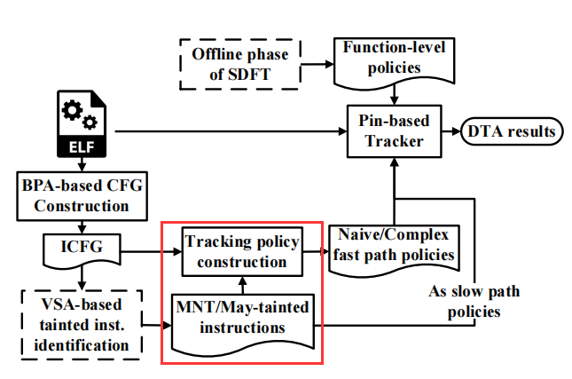
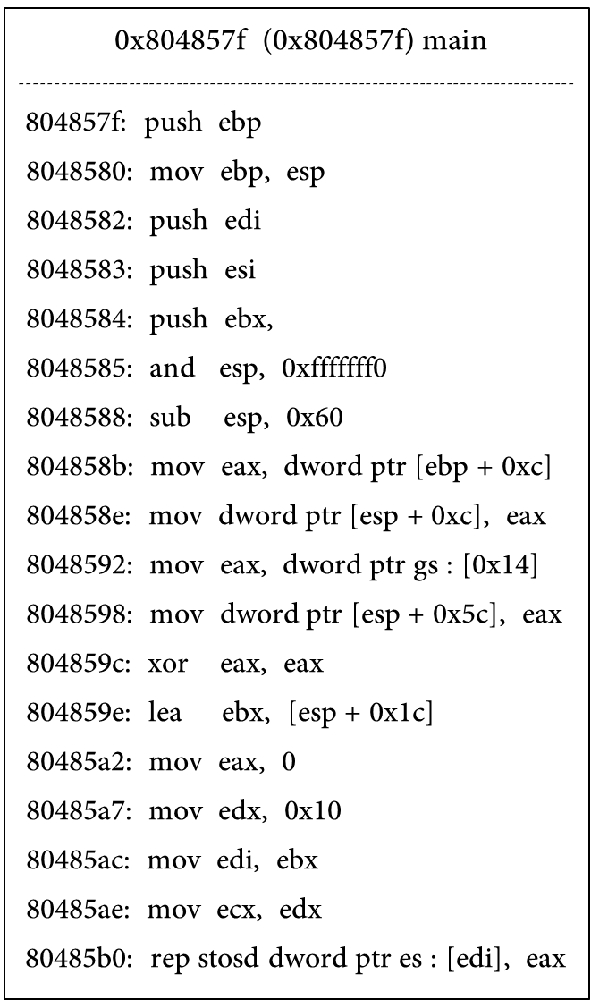
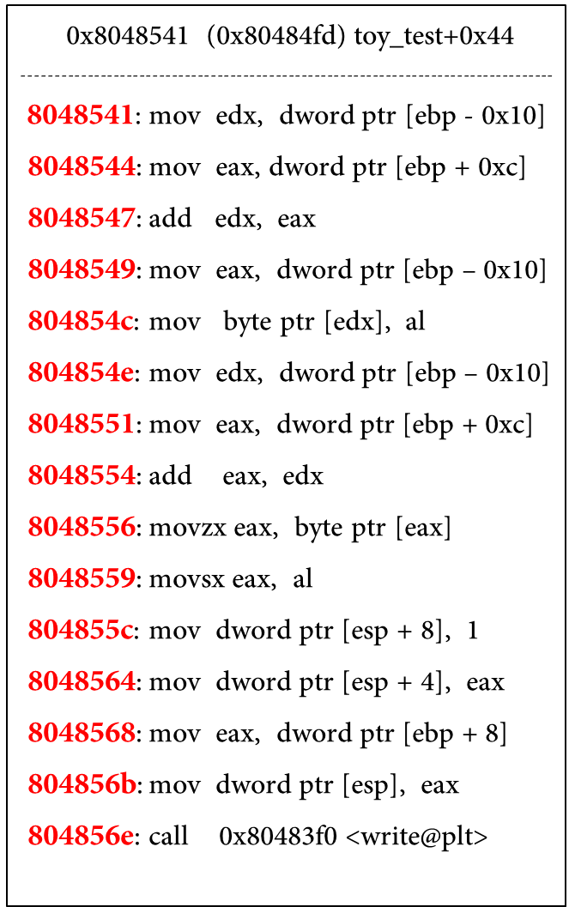
Example demonstration
Tracking policy construction
naive fast path → main(bbl-c)
complex fast path → toy_test+0x44(bbl-b)
slow path →toy_test(bbl-a)
function fast path →printf etc..
Why?
basic block A (bbl-a)
basic block B (bbl-b)
basic block C (bbl-c)
Notes:
Then, podft’s tracking policy construction module traverses the basic blocks of the ICFG to build the tracking policies for the runtime Pin-based taint tracker.
In total, we have different tracking policies for four kinds of paths, including naive fast path, complex fast path, slow path, and function fast path. In general, we build basic block-level fast path policy for the naive and complex fast paths, and use a instruction-level policy for slow paths and function-level fast paths.
Next, we will show our definitions of the four kinds of paths and the situations in which they apply.

Slide 8
Example demonstration
Tracking policy construction
naive fast path → main(bbl-c)
Not contain potentially tainted instructions
because
basic block C (bbl-c)
Notes:
For naive fast paths, basic blocks should not contain any potentially tainted instructions, just like bbl-c.
For basic blocks that execute the naive fast path, we ignore instrumenting tag operations on all its instructions.

Slide 9
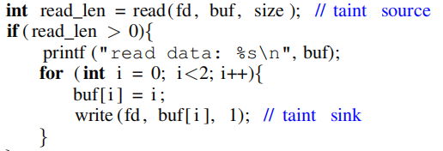
Example demonstration
Tracking policy construction
complex fast path → toy_test+0x44(bbl-b)
Contain potentially tainted instructions
Hot BBL (be executed multiple times)
TaintedMem(bbl) ∩ MergedDep(bbl) =∅.
because
basic block B (bbl-b)
The data delivered to the sink are irrelevant to the tainted data from the source.
Notes:
For complex fast paths, basic blocks are required to satisfy three conditions.
First, it contains potentially tainted instructions.
Second, it is a hot basic block that is executed multiple times, which is determined by profiling the binaries.
Third, its runtime merge check result is empty.
Specifically, for a basic block bbl, we identify the entry-state memory and registers of bbl that are data-depended by the memory or registers of bbl, i.e., MergedDep(bbl). Such entry-state memory and registers should not intersect with the tainted memory and registers at bbl’s entry state, i.e., TaintedMem(entry(bbl)). Such as bbl-b, the memory involved in the basic block 0x8048541, i.e., buf[0] and buf[1] pointed by [ebp+0xc], are sanitized with the constant of i held in [ebp-0x10] and have no data dependence with the tainted entry-state memory buf of this basic block. Therefore we have MergedDep(bbl0x8048541) ∩ TaintedMem(0x8048541) = ∅ at runtime reaching 0x8048541.
For basic blocks(e.g., bbl-b) that execute the complex fast path, none of its instructions would be instrumented.

Slide 10

Example demonstration
Tracking policy construction
Slow path →toy_test(bbl-a)
Contain potentially tainted instructions
Not hot or TaintedMem(bbl) ∩ MergedDep(bbl) ≠ ∅
because
basic block A (bbl-a)
Notes:
For slow paths, basic blocks are required to satisfy two conditions.
It contains potentially tainted instructions.
Besides, it is not hot, or its merge check result is not empty.
For the basic block (e.g., bbl-a) that executes the slow path, we instrument tag operations on its potentially tainted instructions.

Slide 11
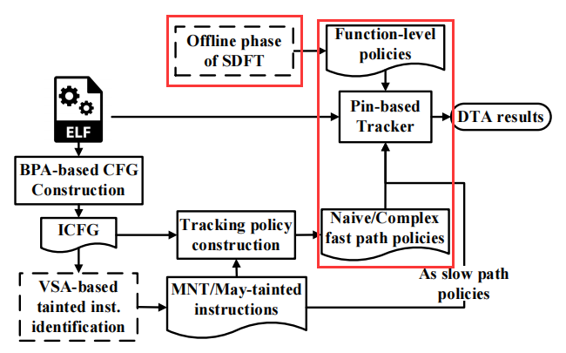
Example demonstration
PDG-based function abstract
Function fast path →printf etc..
Pin-based Tracker
Input:
Function-level policies
Naive/Complex fast path policies
Slow path policies
output:
DTA results
Next ——podft’s efficiency and effectiveness.
Notes:
For the basic blocks of external library functions, we enforce the function fast path policy. This basic blocks ignore instrumenting tag operations, and we will perform function-level instrumenting tag operations based on the results of the function abstraction. For the function summary, we use the offline phase of SDFT to generate the taint rules from the library functions’ program dependency graph (PDG). The taint rules serve as the function-level policies that abstract the taint computation of popular library functions.
Then, the Pin-based tracker of podft conducts the DBI-based dynamic taint analysis. We develop podft’s dynamic analysis by extending the DTA tool libdft. podft’s tracker instruments the binary program with proper analysis routines based on the tracking policies.
（摁下空格） Next, We will show our experimental results to demonstrate podft’s efficiency and effectiveness.
Info:
The function-level policy guides the tracker to flip to a function-level taint computation during the execution of library functions. The basic block-level policies are enabled on the traces of user code to take the naive fast path on MNT basic blocks and the complex fast path when the hot potentially-tainted basic blocks are decided untainted with a check of the tag memory state at the block entry. For the basic blocks decided to be tainted at runtime or potentially tainted but not frequently used, the addresses of taint-involved instructions are used to guide the tag operations along the slow paths.

Slide 12
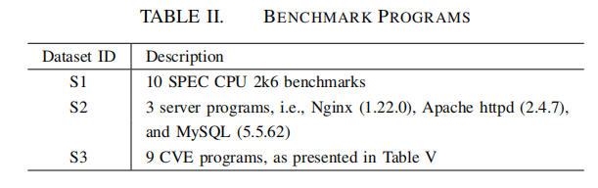
Evaluations
Experimental Settings
Desktop with a 2.8GHz×4 Intel Core(TM) i7-7700HQ CPU, 8GB RAM,
and Linux 3.16.0 kernel (Ubuntu 14.04 32-bit).
The DBI framework is Pin v2.14, and libdft.
Benchmark Programs
Notes:
We use real-world benchmarks to evaluate podft. We compile the binaries of these benchmarks on their default compiler optimization level.
For the performance evaluation, we use the standard working task in the DBI execution of each benchmark program of datasets S1 and S2.
Specifically, for the SPEC2k6 benchmarks of dataset S1, we use the standard SPEC2k6 workload test in the instrumented execution.
For httpd and Nginx in dataset S2, we use the benchmarking tool ab to randomly select and deliver 10,000 and 100,000 requests to the servers.
For MySQL, we use the load emulation tool mysqlslap to connect the MyISAM and InnoDB storage engines of MySQL, automatically generate a complicated table, and issue 1,000 related SQL queries with 10 parallel clients.

Slide 13
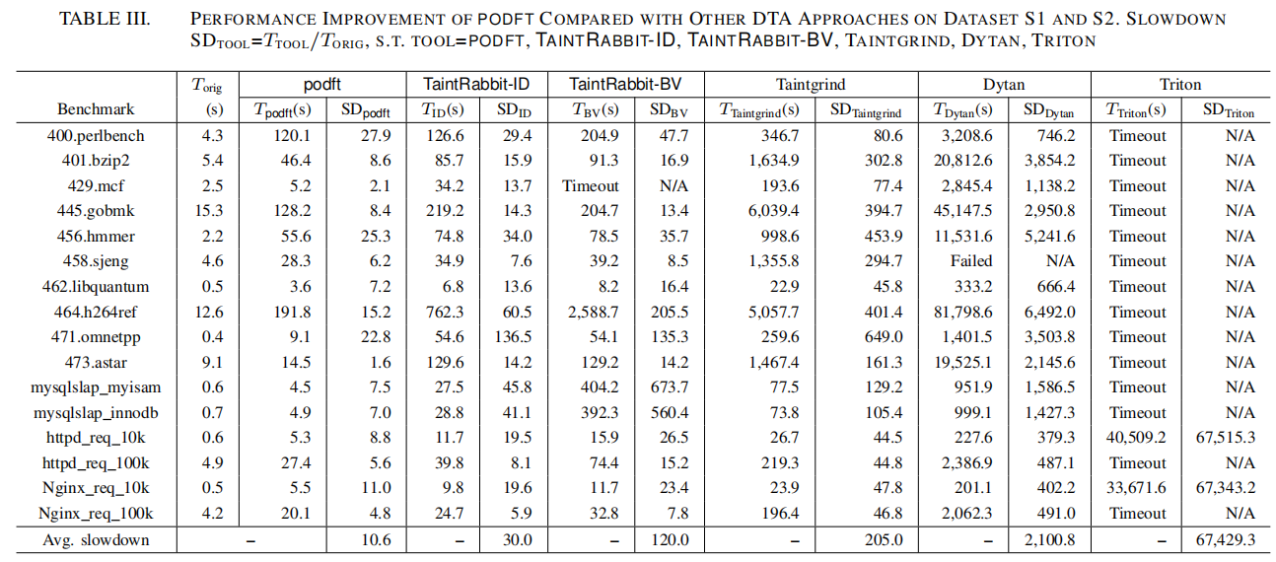
Evaluations
Efficiency of podft
Compare podft’s efficiency with Taint Rabbit , Dytan, Triton , and Taintgrind.
podft achieves slowdowns of 1.6x to 27.9x with an average slowdown of 10.6x.
podft is more efficient than the other DTA tools.
Notes:
We first compare podft’s efficiency with other dynamic taint analysis approaches, including TaintRabbit, Dytan, Triton, and Taintgrind.（摁下空格）
Besides the execution time of the instrumented benchmark programs tracked by different tools, the slowdown metric of each tool (SD in Table III) measures the magnification of each tool’s instrumentation cost compared with the original execution. For the datasets S1 and S2, podft achieves slowdowns of 1.6x to 27.9x with an average slowdown of 10.6x.
We can see that on each benchmark in Table III, podft outperforms other DTA tools. The average slowdowns show that podft is more efficient than the other DTA tools. TaintRabbit-BV and Dytan cannot finish the instrumented execution of some benchmarks properly, while Triton is relatively inefficient, reaching timeouts on most of the benchmarks.

Slide 14
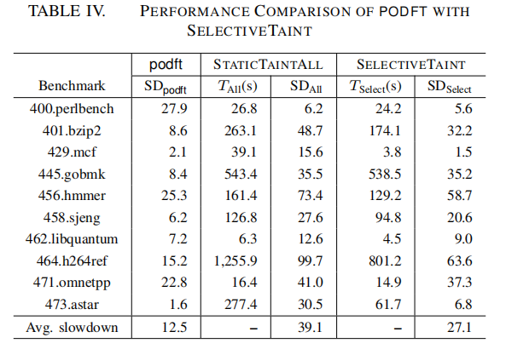
Evaluations
Efficiency of podft
Compare podft’s efficiency with SELECTIVETAINT.
podft achieves slowdowns of 1.6x to 27.9x with an average slowdown of 12.5x.
and is generally more efficient than SELECTIVETAINT.
Notes:
Then, because podft uses the VSA-based static analysis of SELECTIVETAINT, we compare the efficiency of podft with this static binary rewriting approach. （摁下空格）
The results are presented in Table IV.
On dataset S1, podft has an average slowdown of 12.5x, while STATICTAINTALL and SELECTIVETAINT report average slowdowns of 39.1x and 27.1x, respectively.
SELECTIVETAINT reduces the slowdowns of STATICTAINTALL in all the S1 benchmarks.
Although podft is generally more efficient than SELECTIVETAINT on S1, we observe several cases, e.g., perlbench and mcf, where SELECTIVETAINT can outperform podft.

Slide 15
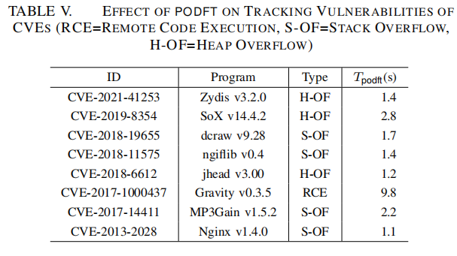
Evaluations
Effectiveness of podft’s Dynamic Taint Analysis
Real exploits detection by podft
Develop Pintool over podft to track vulnerability of CVEs
Notes:
We validate the effectiveness of podft by tracking the real-world vulnerabilities of CVEs triggered by public exploits.
The CVEs and the tracking time of podft are presented in Table V. （摁下空格）
podft’s taint tracking can successfully detect the sensitive-flow-related exploits of all these CVEs. For each CVE, We develop a specific Pintool over podft to track the vulnerability.
To retrieve the taint sources, we identify the target binary’s specific syscalls, functions, or program arguments.
We also treat the user input as taint sources in the cases where the taint source is unspecified by the CVE.
We identify the taint sink by manually analyzing the assembly code and investigating the vulnerable functions reported by the CVEs.
We analyze the suspicious variables and the instructions that operate on these variables in these functions.
Consequently, the instrumented check decides if such a variable holds a taint tag at these instructions’ locations.

Slide 16
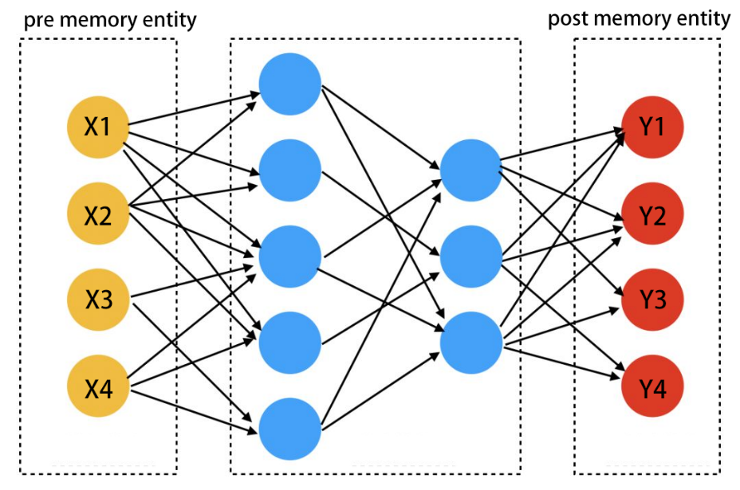
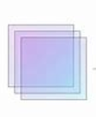
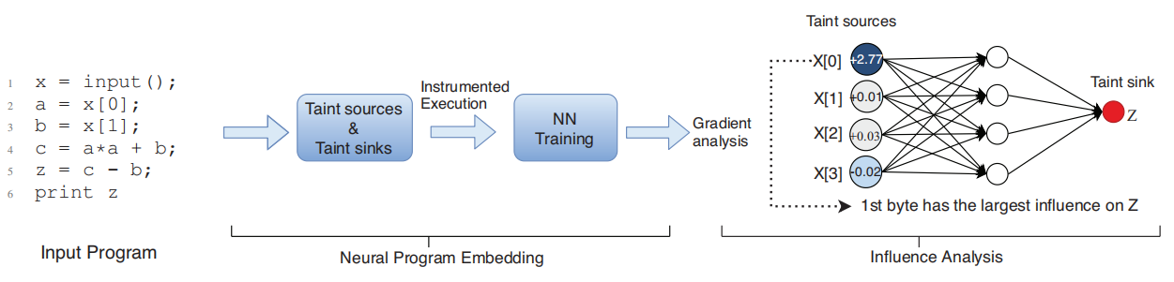
Work in progress
Work in progress
more scalable and more flexible to be used in traditional DTA
Hot BBl feature extraction
Hot BBL
NN Training
Hot BBl memory abstraction
neural hot basic block embedding
Fig.1. the workflow of hot BBL embedding
Fig.2. the workflow of NeuTaint(SP2020)
Notes:
Now, let me conclude with our work in progress.
We believe Podft can be even more efficient, because we see a chance to develop a more scalable complex fast path policy enforcement approach. Our idea is to use deep neural networks to track basic block-level taints. Since hot potentially tainted basic blocks are frequently executed and could have various inputs and outputs, we propose to use fuzzing techniques to profile the runtime tag memory relations between the inputs and outputs. Also, we believe such relations can be properly abstracted and shall not be too complicated, because these hot basic blocks only use a limited number of memory and registers,.
Previous work, Neutaint, has used neural networks to estimate information flow. For a given program and a set of inputs, it marks these inputs and uses lightweight instrumentation to collect values of sink variables. NeuTaint trains a neural network model to learn this dynamic behavior. Its neural network approximates a function that maps sources to sinks. Then, NeuTaint constructs two saliency maps to infer the information flow from the taint source to the sink. Saliency maps analyze the sensitivity of input features for NeuTaint.
Motivated by the principle of Neutaint, we are trying to train neural hot basic block embeddings using these tag memory relations. Our neural hot basic block embedding will consider several instruction-level static features to merge the taint-tracking prediction of different hot basic blocks into one deep model for each binary program. Specifically, we use an NN model similar to the multi-fully connected layers NN model. In most cases, it’s not trivial to abstract the features of all memory spaces. Still, since the memory space that a single basic block can operate is limited, it is feasible to abstract the partial memory space that the basic block can operate. Integrating such a design into podft can avoid the efforts of differentiating complex fast paths from slow paths on hot basic blocks, thus avoiding the static data-dependency analysis.
Moreover, our basic block-level embeddings are more flexible to be used in traditional DTA infrastructures.

Slide 17
THANKS
Thanks for listening

