Slide 1

PISE Protocol Inference using symbolic execution and automata learning
Ron Marcovich, Orna Grumberg, Gabi Nakibly
Technion – Israel Institute of Technology
{ron.mar, orna, gnakibly}@cs.technion.ac.il
Notes:
Hello everybody, my name is Ron Marcovich and today I’m going to present our work PISE. We introduce a novel method for automatic protocol inference. Our method uses symbolic execution and automata learning to uncover the state machine of the protocol that a given binary code impliements.

Slide 2
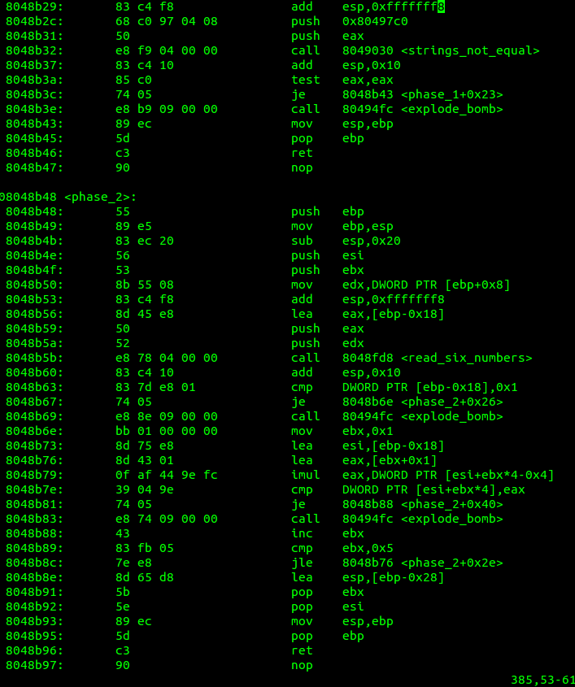
What is protocol inference?
What is protocol reverse engineering?
R:
HELO
S:
250 OK
Mail Server
R:
MAIL FROM
start
R:
RSET
RCPT TO: ??????
S:
250 OK
R:
RCPT TO
R:
DATA
R:
RCPT TO
S:
250 OK
“R:” – Receive
“S:” - Send
S:
550
Notes:
Explain transitions. S is sent and R receive. What is a state machine at all.

Slide 3



Motivations:
Finding Bugs
Finding Backdoors
Analyzing Malware

Slide 4
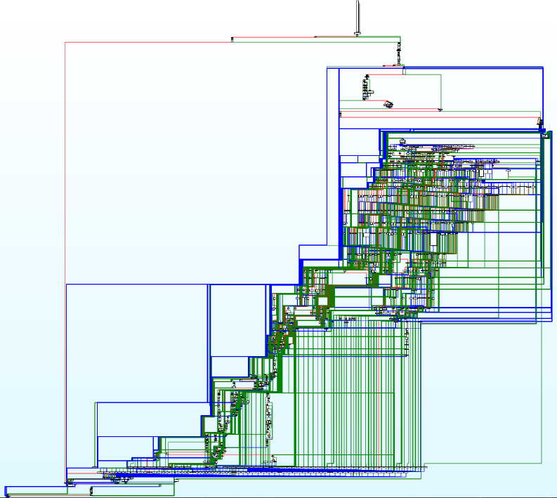

Manual Protocol Inference is Hard!
It can take days or even weeks!

Slide 5

Research Goal
Automatically infer the protocol
Our input:
Binary code of a program
Our output:
State machine of the protocol
Messages formats
R: HELO
S: 250 OK
R: MAIL FROM
start
R: RSET
RCPT TO: ????
S: 250 OK
R: RCPT TO
R: DATA
R: RCPT TO
S: 250 OK
S: 550

Slide 6
Assumptions
We assume:
We do not assume:
Protocol Regularity
Past traffic captures
Active protocol peer
Source code
Messages’ formats
Notes:
While previous works assumed network captures or online peer to interact with, we assume neither of them.

Slide 7

Under the Hood
Notes:
~3:15

Slide 8
Overview
Learner
Queries
Teacher
Answers
State Machine
L* Algorithm
Alphabet = Message Types
Notes:
So in an overview our method is composed of two components: The learner that builds the protocol’s state machine by sending queries to a Teacher, while the Teacher analyzes the binary code in order to answer the learner’s queries.
The learner uses a slightly modified version of L* algorithm, where as the Teacher uses symbolic execution in order to answer the learner’s queries.

Slide 9

L* Algorithm for protocols
Client
Server
{R:init, S:start}
{R:init, R:init}
init
start
R:data
data
R:init
S:start
finish
R:finish

Slide 10
Answering Membership queries
Let’s assume for now that we know the message types
Is this sequence of message types valid for the protocol?
?
Learner
Teacher
Yes/No
L* Algorithm
Symbolic Execution
Notes:
How to answer queries assuming we already know the message types.

Slide 11
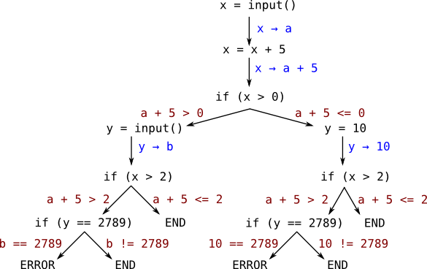
Symbolic Execution
a > 3
,b = 2789
Notes:
Constraints on inputs => matching execution paths
Symbolic execution is a static method that allows to trace all possible execution paths of a program given an input.
The input in our case are received messages.

Slide 12
Answering Membership queries
Is {R: Init, S: Start, R: Data} valid for the protocol?
R: Init
msg ← Receive()
if (msg is Init)
false
true
S: Start
Client
Server
Error()
Send(Start)
Msg ← Receive()
If (msg is Data)
R: Data
init
start
data
false
true
finish
Send(Error)
.
.
.
.
.
.

Slide 13
Answering Membership queries
Is {R: Data} valid for the protocol?
R: Data
msg ← Receive()
if (msg is Init)
false
true
Error()
Send(Start)
Msg ← Receive()
If (msg is Data)
Client
Server
init
start
false
true
data
finish
Send(Error)
.
.
.
.
.
.
Notes:
So now let’s see an example for when the sequence is invalid.

Slide 14
Discovering message types
As said, we do not know in advance the protocol’s message types.
We update membership queries to discover it little by little.
Is this sequence of message types valid for the protocol?
Extend L* to handle new message types
L* algorithm
Symbolic Execution
Yes/No
If yes, here are message types that can follow the sequence.
Notes:
But, we don’t know the message types in advance. To solve this problem, we ask the symbolic execution that whenever a sequence is valid, the message types that can follow the sequence are returned as well.

Slide 15
Probing for following message types
What message types can follow {R: Init}?
R: Init
msg ← Receive()
if (msg is Init)
Client
Server
false
true
Get examples
init
Error()
Send(Start)
Msg ← Receive()
If (msg is Data)
.
.
.
start
data
finish
Notes:
Lucky for us, symbolic execution allows to get examples for symbolic inputs that satisfy the constraints of the execution path. We exploit this feature to get examples for messages.

Slide 16
Probing for following message types
What message types can follow {R: Init, S: Start}?
R: Init
msg ← Receive()
if (msg is Init)
false
true
Unknown symbolic value ???
S: Start
Error()
Send(Start)
Msg ← Receive()
If (msg is Data)
Client
Server
init
start
false
true
data
finish
Send(Error)
.
.
.
.
.
.

Slide 17
Probing for following message types
Resume Execution: Wait for message to be parsed
Constraints are developed according to the parsing logic
Get concrete messages that match constraints
msg ← receive()
if (msg begins with ‘data’) {
// Constraint: msg begins with ‘Data’
} else {
// I can’t parse this message, error
}
Notes:
To probe received messages, we use a new approach we developed. We resume the symbolic execution from the point that the sequence was validated. We then let the unknown, symbolic received message to be parsed. The parsing generates constraints on the received message, according to the protocol’s logic. Finally, we generate examples for concrete messages that follow the query.

Slide 18
Concrete messages -> Message type
Example Messages
Find features of message type
RCPT TO: email1@blabla.com
RCPT TO: user2@lalala.bbb
RCPT TO: ?????
RCPT TO: person3@nana.ccc
Notes:
The symbolic execution returns concrete examples of a message type.
We need a way to generalize these examples to a message type.
Find a common features to all the example messages.
It can be done it many ways, we used a naïve approach that worked well enough for us. In some use cases different features can be used.

Slide 19
Tying it all together
Is this sequence of message types valid for the protocol?
L* algorithm
Symbolic Execution
Yes/No
If yes, here are message types that can follow the sequence.

Slide 20
An illustrative example
Message Types
S:start
R:init
S:start
R: data
R: finish
R:data
R:init
M={}
M={R:init,S:start}
M={R:init,R:data,R:finish}
M={R:init,R:data}
M={R:init}
M={R:data}
valid ?
L* algorithm
Symbolic Execution
R:finish
Yes ☺
No ☹
m_{next}=
{R:init}
{S:start,R:data,R:finish}
{}

Slide 21
Equivalence Query
Approximated as in the original L* work, with a test suite
Probing is also in use for the test suite
To discover missing message types
Notes:
Approximation,we have nothing to compare to

Slide 22
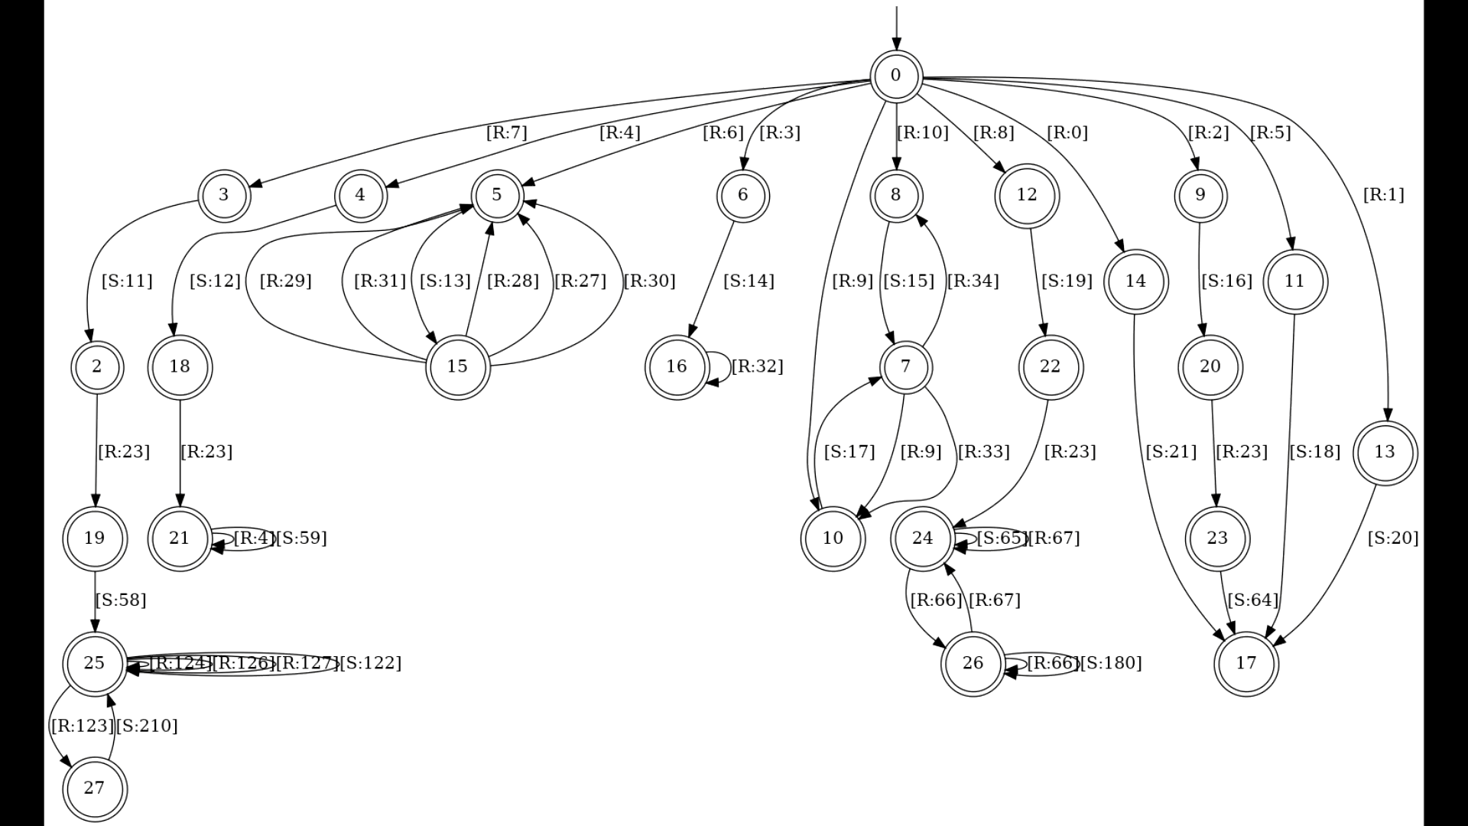
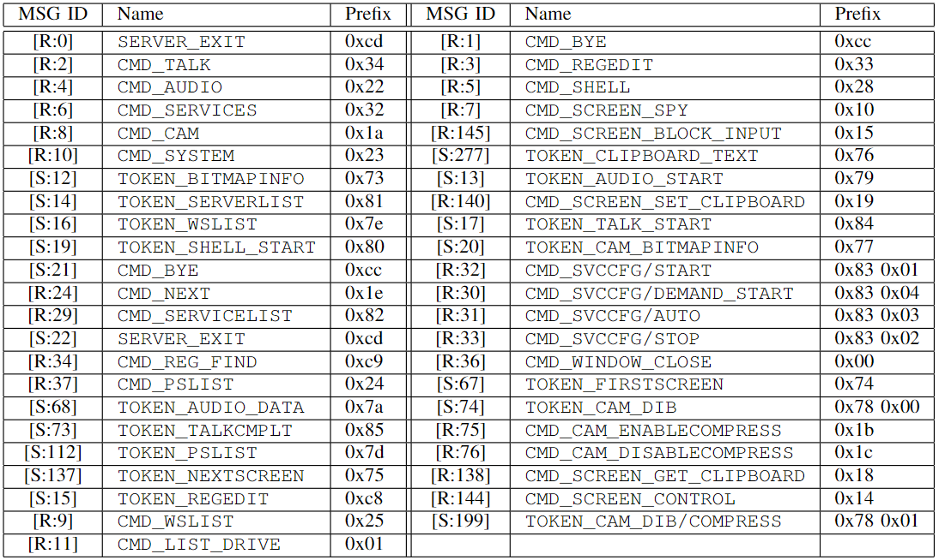
Example - method’s output

Slide 23

Caveats
PISE is as good or as bad as the symbolic tool it uses.
Currently, PISE uses angr.
- Trouble supporting multiple threads.
- Does not fully support windows API
L* algorithm
Symbolic Execution

Slide 24


Summary
R: HELO
S: 250 OK
R: MAIL FROM
start
R: RSET
S: 250 OK
R: RCPT TO
R: DATA
R: RCPT TO
S: 250 OK
S: 550
Notes:
PISE is the first of its kind!
It is based on symbolic execution and advanced algorithms for automata learning

Slide 25

Questions

Slide 26





We do not assume
No past traffic captures
No active protocol peer
No source code
Notes:
While previous works assumed network captures or online peer to interact with, we assume neither of them.

Slide 27


Agenda
What is protocol inference?
What is PISE all about?
How PISE does it
R: HELO
S: 250 OK
R: MAIL FROM
start
R: RSET
S: 250 OK
R: RCPT TO
R: DATA
R: RCPT TO
S: 250 OK
S: 550

Slide 28
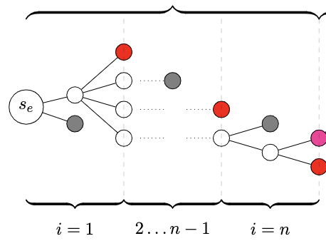
Answering Membership queries
Let M = {M1, .., Mn}
Send/receive a message
(i-th time)
Constraint to Mi
Gray: valid state
Red: invalid for the sequence
Magenta: valid for the sequence
Notes:
Lets formalize it. To check if a sequence of message types is valid in the protocol, we intervene the symbolic execution on sites of send and receive.
We constraint symbolic execution to executions that match the sequence we are given.
By inserting constraints we guide symbolic execution to find executions that match the sequence.
If after constraining the entire sequence there are feasible executions – the sequence Is valid.

Slide 29
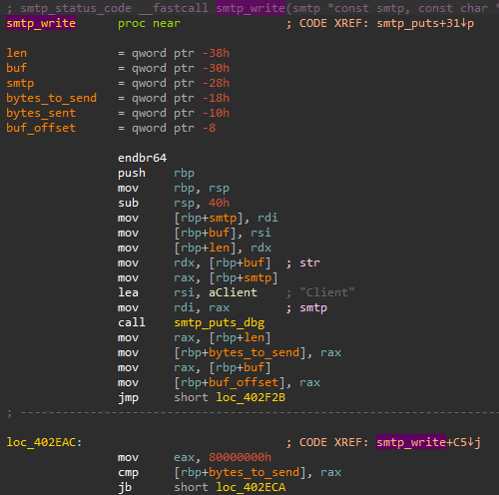
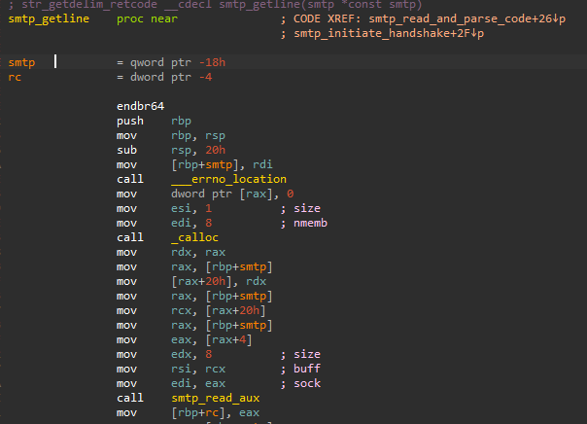
How to identify a send or receive?
Intercept calls to send and receive procedures
Notes:
To tell when a message is being sent or received, we need the user of our method to provide information on sites of send and receive. This part has to be done manually, using IDA for example. Our method can also intercept the standard send and receive functions, but also higher level and program specific methods.

Slide 30
Questions
ron.mar@campus.technion.ac.il
gabin@radware.com
https://github.com/ron4548/PISE

