Slide 1

RCABench: Open Benchmarking Platform for Root Cause Analysis
Keisuke Nishimura, Yuichi Sugiyama, Yuki Koike, Masaya Motoda, Tomoya Kitagawa, Toshiki Takatera, Yuma Kurogome
{keisuken, yuichis, yukik, masayam, tomoyak, toshikit, yumak}
@ricsec.co.jp
Ricerca Security, Inc., Tokyo, Japan
Notes:
Thank you for your introduction. I am keisuke Nishimura from ricerca security.
Today, I would like to talk about our project, RCABench Open Benchmarking Platform for Root Cause Analysis.

Slide 2
Fuzzers find a lot of bugs automatically
OSS-Fuzz: 8,900+ vulnerabilities and 28,000+ bugs
ClusterFuzz: ~27,000 bugs in Google
“We got inputs that cause crashes automatically.” “How do we process them? Manual analysis?”
Notes:
(0:25-1:10)
To ensure softwares’ security, finding vulnerabilities is important. Recently fuzzing has successfully contributed to automatically bug finding.
For example, OSS-Fuzz, a popular fuzzing infrastructure, has found more than 8,900 vulnerabilities and 28,000 bugs.
Here, when we use fuzzing, sometime we get a lot of inputs that cause crashes
In that case, next, how do we have to process them? Is manual analysis practical?

Slide 3


RCA (Root Cause Analysis) a.k.a Fault Localization
Automatic crash analysis
Candidates of Root Cause
Lines
Basic Blocks
…
Program
(Souce Code)
RCA tool
Crashing Input
Notes:
(1:10-2:00)
One possible solution to process a lot of crashing inputs is the automatic analysis of the bugs or faults.
This is called root cause analysis RCA a.k.a. Fault Localization, which tries to reduce the cost of analyzing crashing inputs by automatically finding the root cause of crashes.
Generally speaking, RCA tools take a targeted program and a crash input, and shows the candidates of root causes, such as buggy lines, basic blocks, or buggy conditions related to one crash input.
How do they work?

Slide 4
Internal components of RCA tools
Crashing input
Generating more inputs by fuzzing / from testcases
Non-Crashing input
Crashing Input
Data Augmentation
Feature
Extraction
RC
Candidates
User
Input datasets
Statistically inferring
root causes
Program
(Souce Code)
Notes:
(2:00-2:50)
Based on our observation, Typical recent RCA tools consist of the two major components, Data Augmentation and Feature Extraction.
The former, data augmentation, generates more program inputs from one given crash input typically using fuzzing.
The latter, feature extraction component, takes the result of data augmentation as inputs, and statistically infers root causes using some heuristics or their own algorithms.
Our research aims at evaluating those RCA tools precisely to provide benchmarking platform.

Slide 5
Evaluation of RCA techniques is challenging…
#1: Non-uniqueness of root cause definition
#2: Tightly coupled RCA steps
#3: Variance of Data Augmenatation
Notes:
(2:50-3:00)
However, based on our observations, we would say the evaluation of RCA techniques is challenging due to the following three reasons.

Slide 6
Challenge #1: Non-uniqueness of root cause location
Multiple possible patches for CVE-2017-15232
for (row = 0; row < num_rows; row++) {
jzero_far((void *) output_buf[row],
(size_t) (width * sizeof(JSAMPLE)));
NULL-able
Original souce code
Notes:
(3:00-3:15)
The first challenge of the evaluation is the non-uniqueness of root cause location.
Let me show you an example, the actual vulnerabilty CVE-2017-15232
In the original source code, the output_buf can be null, so this code may cause a crash.

Slide 7
Challenge #1: Non-uniqueness of root cause location
Multiple possible patches for CVE-2017-15232
for (row = 0; row < num_rows; row++) {
jzero_far((void *) output_buf[row],
(size_t) (width * sizeof(JSAMPLE)));
NULL-able
Where is/are the RC location(s)?
Original souce code
Notes:
(3:15-3:30)
Now, Let’s assume you are a user of two RCA tools. and where do you think RCA tools indicate as root cause locations?

Slide 8
Challenge #1: Non-uniqueness of root cause location
Multiple possible patches for CVE-2017-15232
for (row = 0; row < num_rows; row++) {
jzero_far((void *) output_buf[row],
(size_t) (width * sizeof(JSAMPLE)));
RC location is…
HERE
RCA Tool #1
Original souce code
Notes:
(3:30-3:45)
Your first RCA tool may say that the location of root causes is here, just before the loop.

Slide 9
Challenge #1: Non-uniqueness of root cause location
Multiple possible patches for CVE-2017-15232
+ if (output_buf == NULL) {
+ ERREXIT();
+ }
for (row = 0; row < num_rows; row++) {
jzero_far((void *) output_buf[row],
(size_t) (width * sizeof(JSAMPLE)));
Possible Patch #1
Notes:
(3:45-4:10)
Based on this suggestion,the developer’s patch can be like this. Before the loop, we can check if the output_buf is not null. As you can see, the patch works well.

Slide 10
Challenge #1: Non-uniqueness of root cause location
Multiple possible patches for CVE-2017-15232
for (row = 0; row < num_rows; row++) {
jzero_far((void *) output_buf[row],
(size_t) (width * sizeof(JSAMPLE)));
RC location is…
HERE
RCA Tool #2
Original souce code
Notes:
(4:10-4:20)
But, how about this locations? If the second RCA tool indicates this location, just after the loop and before tthe dereferencing.

Slide 11
Challenge #1: Non-uniqueness of root cause location
Multiple possible patches for CVE-2017-15232
for (row = 0; row < num_rows; row++) {
+ if (output_buf == NULL) {
+ ERREXIT();
+ }
jzero_far((void *) output_buf[row],
(size_t) (width * sizeof(JSAMPLE)));
Possible Patch #2
Notes:
(4:20-4:50)
The patch will be like this.
When we try to fix the issue by adding checks, this patch also should be acceptable because it checks output_buf before dereferencing it.
Of course, the previous patch would be better when we consider performance or code quality,
But for just fixing this issue, we can say the two patches are acceptable.

Slide 12

Challenge #1: Non-uniqueness of root cause location
Many possible candidates for root cause locations
The ground truth is …
Line 80 in function A
Line 50 in function A
Line 10 in function B
Line 50 in function A
Line 10 in function B
Line 10 in function A
Evaluator 1
Evaluator 2
Evaluator 3
Notes:
(4:50-5:45)
To sum up, if we define the root cause location as the source code lines that should be fixed, there can be multiple candidates for root cause locations. This means that, in the evaluations of RCA tools, different sets of root cause locations may be used as the ground truth .
Such possibilities make fair evaluations difficult.

Slide 13
Challenge #2: Tightly coupled RCA steps
Aurora
[Security ‘20]
AFLcem
AuroraFE
Crashing input
VulnLoc
[AsiaCCS ‘21]
ConcFuzz
VulnLocFE
Data Augmentation
Feature
Extraction
Crasing input
Collecting inputs
Inferring root causes
Non-Crasing input
Notes:
(5:45-6:30)
The next challenge is about the modularization in RCA techniques
As I mentioned before, existing methods consist of two separable and orthogonal steps: data augmentation and feature extraction.
Data augmentation generates and collects new crashing and non-crashing inputs from one given input.
For example, Aurora uses AFL crash exploration mode, and VulnLoc utilizes Concfuzz, concentrated fuzzing.
And they also design and implement their own algorithms to find candidates of root causes as feature extraction.
We call them AuroraFE and VulnLocFE respectively.

Slide 14
Challenge #2: Tightly coupled RCA steps
Aurora
[Security ‘20]
AFLcem
AuroraFE
Not Fully Modularized
Crashing input
VulnLoc
[AsiaCCS ‘21]
ConcFuzz
VulnLocFE
Data Augmentation
Feature
Extraction
Crasing input
Collecting inputs
Inferring root causes
Non-Crasing input
Notes:
(6:30-7:30)
However, in the evaluations of the existing studies, data augmentation and feature extraction methods were not fully modularized, which means, for example, VulnLocFE cannot use the results of AFL crash exploration mode directly.
Data augmentation and Feature extraction methods are designed in a orthogonal manner.
So, we suggest that the two components should be decoupled so that each method can be used interchangeably.

Slide 15
Challenge #3: Variance of Data Augmentation
Data Augmentation (internal fuzzing) Time
Longer time = More inputs = More accurate ??
Initial seeds (crashing inputs) of Data Augmentation
Do seeds affect accuracy, like fuzzing *?
Randomness of Data Augmentation
Quality of generated dataset may change?
* A. Herrera, et al. “Seed selection for successful fuzzing,” ISSTA ’21
Notes:
(7:30-9:00)
The third challenge is the variance of data augmentation.
In some existing studies, evaluations of RCA techniques did not consider the variable characteristics of data augmentation.
As explained before, some data augmentation uses fuzzing, which is a highly random process.
Therefore, in order to precisely evaluate the data augmentation, at least these three factors need to be taken into account.
The first factor of variance is the time spent in data augmentation.
We can generate larger number of inputs by spending more and more time in fuzzing;
this may increase the diversity of the dataset. But how the larger datasets affect the accuracy of feature extraction is still unclear.
The next factor of variance is initial seeds or initial crashinpt.
The existing studies sometimes prepared only one specific crashing input as an initial seed for fuzzing in data augmentation.
However, in the field of fuzzing, the difference in the initial seeds is known to affect performance..
This fact suggests that initial inputs may affect the accuracy of RCA techniques.
The third factor of variance is the randomness of fuzzing itself.
Fuzzing is a highly stochastic process, so the generated dataset changes with each fuzzing run. It can affect the results of RCA.
We would say the evaluation of existing studies was not enough to care about the randomness. for example.,
they sometimes use only one dataset from a single fuzzing run.

Slide 16
RCABench: Open Benchmarking Platform for RCA
Existing challenges
Non-uniqueness RC
Tightly coupled RCA steps
Variance of D.A.
RCABench supports:
Predefined public RC locations
Decoupled RCA steps
Variance-aware evaluation
Notes:
(9:00-9:30)
To tackle the aforementioned three challenges,
we present, an end-to-end benchmarking platform for RCA, RCABench.
RCABench has novel three feature.

Slide 17
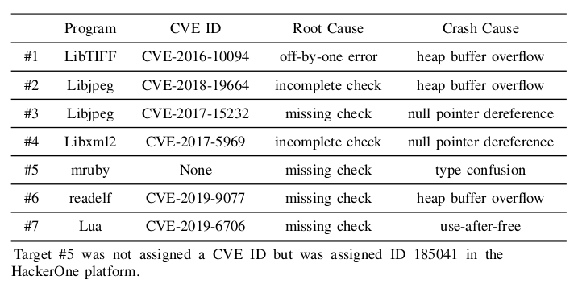
RCABench: Open Benchmarking Platform for RCA
7 real-world bugs/vulnerabilities with predefined public RC
from VulnLoc/Aurora’s
evaluations
But no public RC…
We plan to add more targets….
Notes:
(9:30-11:30)
The current version of RCABench provides 7 real-world bugs and vulnerabilities for the evaluation.
We selected them carefully to include diverse root causes and crash causes, such as heap overflow and use after free.
In addition to this selection, we also pre-defined the locations of root causes based on the actual developer’ patches and their fixes and made them public.
This is the temporary countermeasure to the non-uniqueness of root cause.
Perhaps, the best way to tackle this non-uniqueness of root causes problem is to newly propose the reasonable definition of root causes.
It is difficult to propose an appropriate representation of root causes that can uniquely express any root cause. and,
to the best our knowledge such expression is still unknown.
So we adopted this temporary, but effective ways, just making them public, for the easy reproduction of evaluations,

Slide 18
RCABench: Open Benchmarking Platform for RCA
Decoupling and modularization of D.A and F.E.
Abstraction Layer
Aurora
AFLcem ✕ AuroraFE
AFLcem
AuroraFE
ConcFuzz ✕ AuroraFE
VulnLoc
Crash Input
AFLcem ✕ VulnLocFE
ConcFuzz
VulnLocFE
ConcFuzz ✕ VulnLocFE
Crasing input
Non-Crasing input
Notes:
(11:30-13:00)
The next feature of RCABench is the modularization, decoupling of Data augmentation and feature extraction.
The current version of RCABench supports two data augmentation methods and two feature extraction methods that came from Aurora and VulnLoc.
And we implemented the abstraction layer between the data augmentation and feature extraction, which allows VulnLocFE to use the output of AFLcem and also allows AuroraFE to use the result of ConcFuzz.
This design enables to test new combinations and provides more precise evaluations of two orthogonal steps .

Slide 19
RCABench: Open Benchmarking Platform for RCA
Supporting variance-aware evaluation
Multiple initial crashing inputs for some targets
Multiple Data Augmentation times
Configuration based easy multiple benchmarking
Notes:
(13:00-14:00)
The last feature of RCABench is the support of variance-aware evaluation.
For some targets, we prepare multiple initial crash inputs to see the differences of initial inputs.
Also, this platform is designed to evaluate RCA techniques in different data augmentation times.
In addition, our configuration-based experiment platform allows to easily take multiple benchmarks.

Slide 20
Results of RCABench
RQ1: Which RCA technique is most accurate?
RQ2: Does D.A. time length affect accuracy?
RQ3: Do initial seeds affect accuracy?
RQ4: Does the randomness of D.A. affect accuracy?
Please see the paper for the detail 😀
Notes:
(14:00-14:15)
Thanks to these features of RCABench, we could set and answer the following questions.

Slide 21
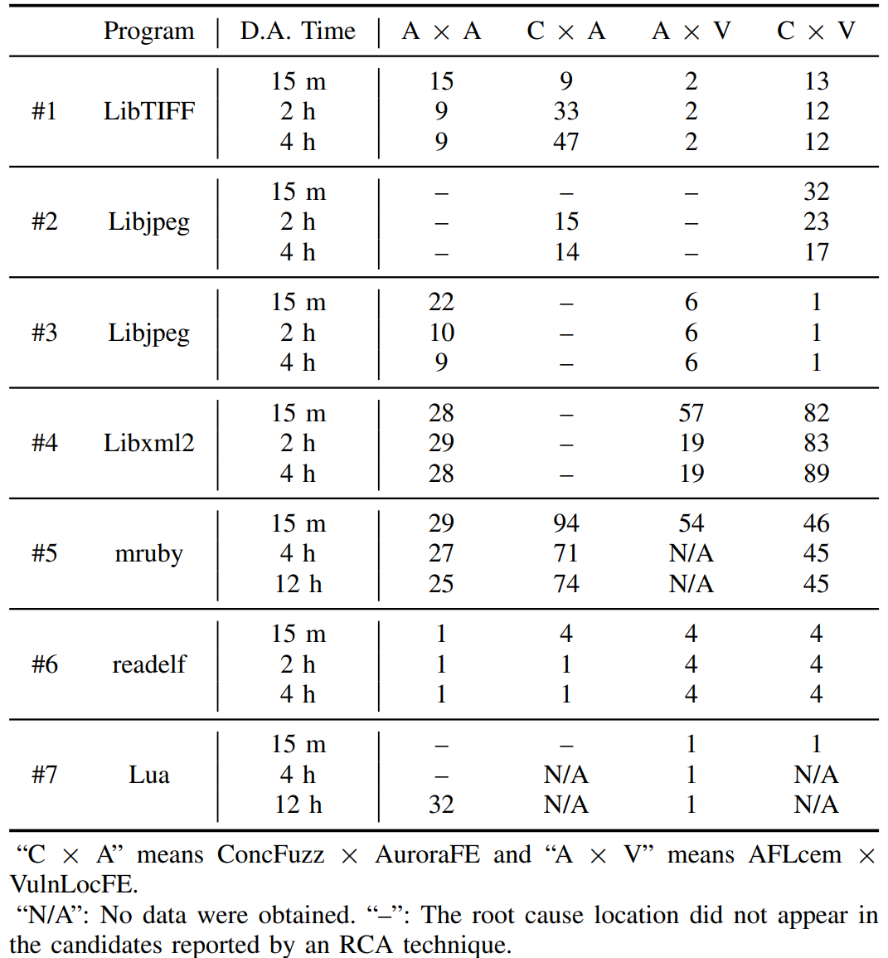
RQ1: Which RCA technique is most accurate?
RCA techniques:
AFLcem x AuroraFE = Aurora[Security ‘20]
ConcFuzz x VulnLocFE = VulnLoc[AsiaCCS ‘21]
AFLcem x VulnLocFE
ConcFuzz x AuroraFE
Answer: There was no obviously universal technique that was most accurate for all targets.
Newly tested
Notes:
(14:15-15:15)
First, we conducted end-to-end evaluations of four RCA techniques, which are, two existing techniques, Aurora and VulnLoc and the newly tested combinations, AFLcem times VulnLocFE and ConcFuzz timesAuroraFE.
And it was found that there was no obviously universal technique that was most accurate for all targets.

Slide 22
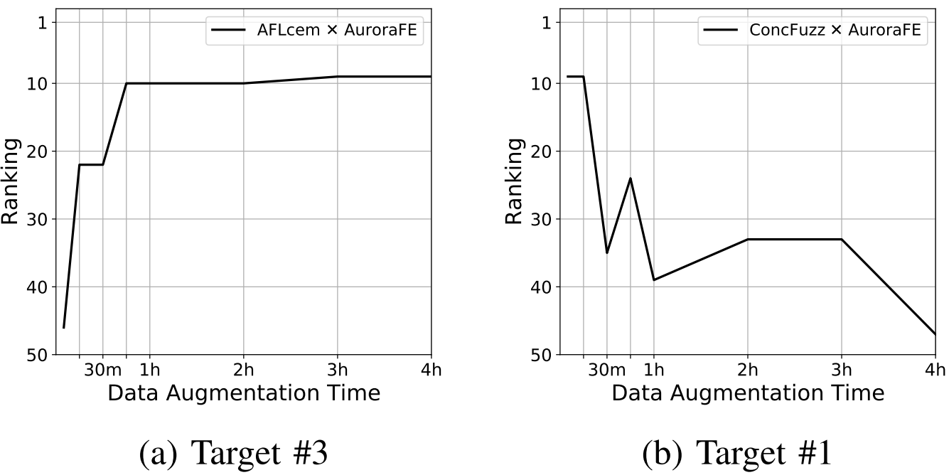
RQ2: Does D.A. time length affect accuracy?
Answer:
Accuracy improved or did not change over time in many cases.
There were a few cases in which the accuracy was degraded.
More accurate
worsen
improve
Notes:
(15:15-16:30)
The next experiment shows the relationship between Data Augmentation times and the accuracy.
For many targets we found that increasing Data Augmentation time improved or did not change the accuracy as shown in the left figure,
However, we found some exceptional cases where increase of Data Augmentation time worsened accuracy, which means the longer Data Augmentation time has a negative impact on accuracy.
Thus, data augmentation time affects the accuracy in various ways depending on target programs and RCA techniques.
More precise analysis and mitigation of the degradations are left for future works.
This suggests that it is important to evaluate techniques using a variety of Data Augmentation times.

Slide 23
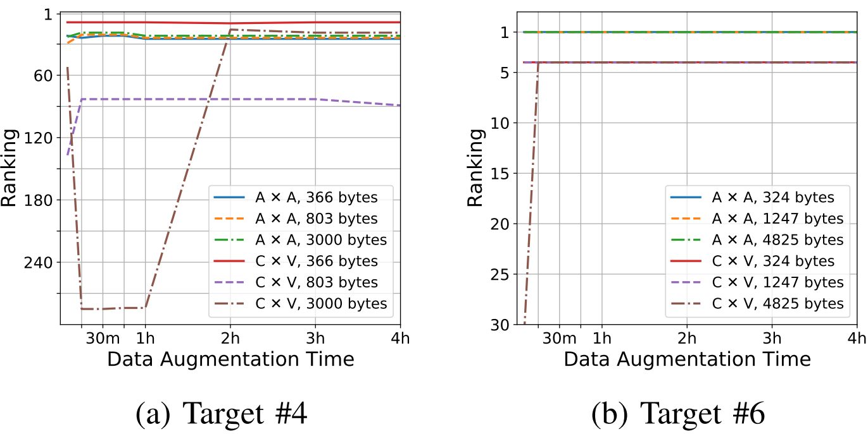
RQ3: Do initial seeds affect accuracy?
Answer: Initial seeds sometimes affect accuracy.
Notes:
(16:30-17:00)
RCABench could also showed the initial seeds affected the results of RCA.
The left-hand figure shows, the results are very different depending on initial seeds.
So we can conclude that differences in initial seed may lead to significant performance differences.
Evaluators should make the initial seeds public for reproducibility.
Further work is required to precisely analyze the mechanism of this effectt.

Slide 24
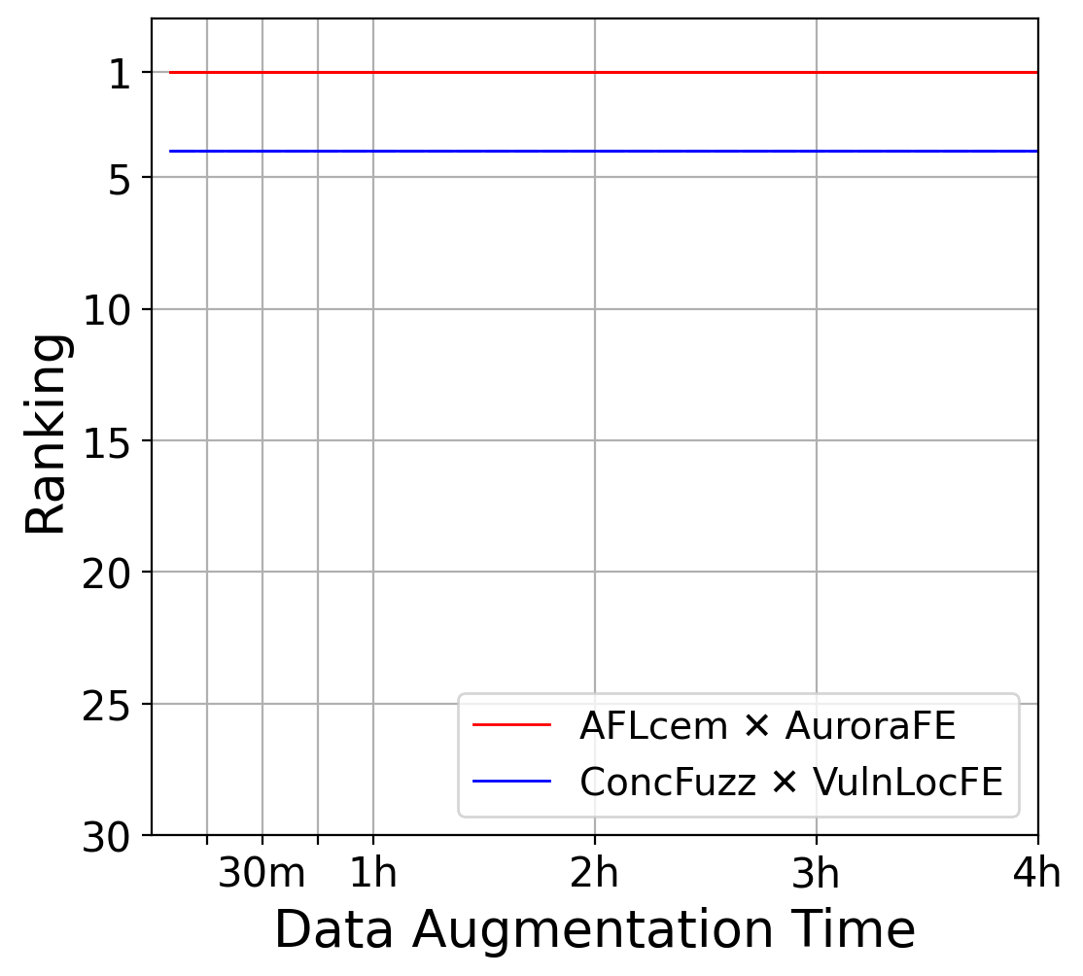
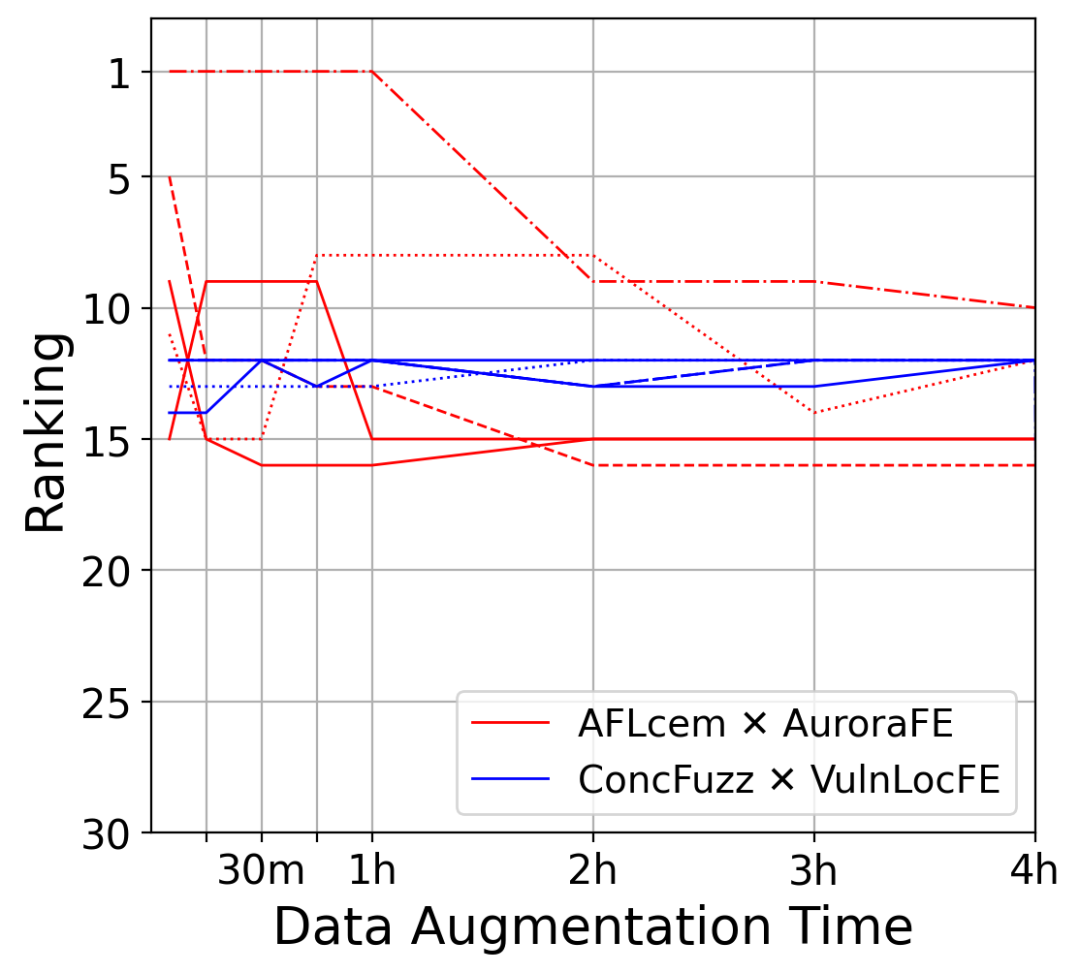
RQ4: Does the randomness of D.A. affect accuracy?
Answer: Randomness in DA can lead to non-negligible variances in accuracy.
Target #6
Target #1
Notes:
(17:00-18:00)
The final investigation is the impact of randomness in Data Augmentation.
We conducted the same experiments five times.
While the results in the left figure was constant, the results in the right differ significantly due to the randomness of the Data Augmenataion.
Such result suggests that experiments should be conducted multiple times to reduce the effect of randomness as much as possible.

Slide 25
Limitations and future work
Mores statistical evaluation considering randomness
D.A. randomness affected the RCA results (RQ4).
This threatens the validity of previous RCA evaluations.
More abundant targets with diverse root causes
We plan to add more diverse targets
Fuzzing benchmark (Magma, FuzzBench…)
Real-world vulnerabilities
Notes:
(18:00-19:00)
Finally, we have to talk about the limitations and future works of this project.
First of all, as we show in the previous page, the randomness of DA affects our results, which threatens the validity of even our evaluations.
We have to do more robust statistical analysis in the future.
We also have to admit that the seven targets is not enough to fully evaluate the performance of RCA techniques.
We plan to add more diverse targets. And any contributions are welcome.

Slide 26
Conclusion
Motivation: Evaluation of RCA techniques are challenging
RCABench (end-to-end benchmarking platform)
Predefined and public root cause locations for seven targets
Decoupling RCA steps (D.A. and F.E)
Variance-aware evaluation for Data Augmentation (DA time/initial seed/fuzzing randomness)
https://github.com/RICSecLab/RCABench
Notes:
(19:00-20:00)
Let me summarize our study.
Our work aims at evaluating the existing and future RCA techniques in a fair and precise manner.
So we present RCABench, end-to-end benchmarking platform.
RCABench has the three features:
first, we selected 7 real world bugs and vulnerabilities and made their root cause locations public.
Then, RCABench decouples the steps of RCA techniques, data augmentation and feature extraction.
We suggest that RCA techniques should be more modularized to fairly evaluate their two orthogonal methods.
Finally, RCABench supports the variance-aware evaluations for data augmentation which we demonstrated the need for.
My presentation is finished here. Thank you for listening. I will take any questions.

Slide 28
Limitations and future work
Modular framework for fair and objective RCA evaluation
Implementation differences can spoil fair comparisons.
Tracing: Intel PIN, DynamoRIO…
Language: Python, C++
Misc: parallelization, file I/O, log…
Basic Blocks for implementation is needed. c.f. modular framework for fuzzing [LibAFL, fuzzuf]
LibAFL: https://github.com/AFLplusplus/LibAFL fuzzuf: https://github.com/fuzzuf/fuzzuf
Notes:
As future work, more modular framework or basic blocks to implement RCA techniques.
For example, the way to collect traces or languages to be written, will affect the performance of data augmentation, which sometimes hurts the fair comparisons of algorithms. To mitigate such situation, in the fuzzing field, some basic blocks, such as LibAFL and fuzzuf are provided.
We believe those kinds of frameworks for RCA will help more fair and effective implementations and comparisons.

Slide 29
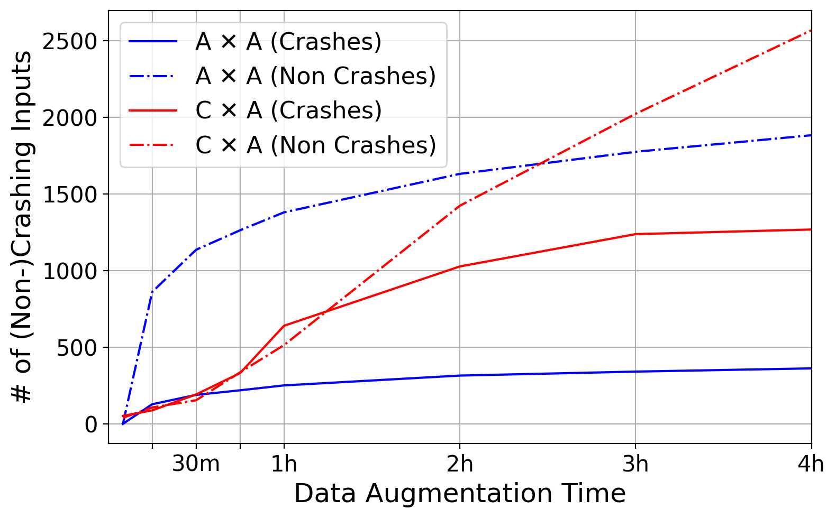
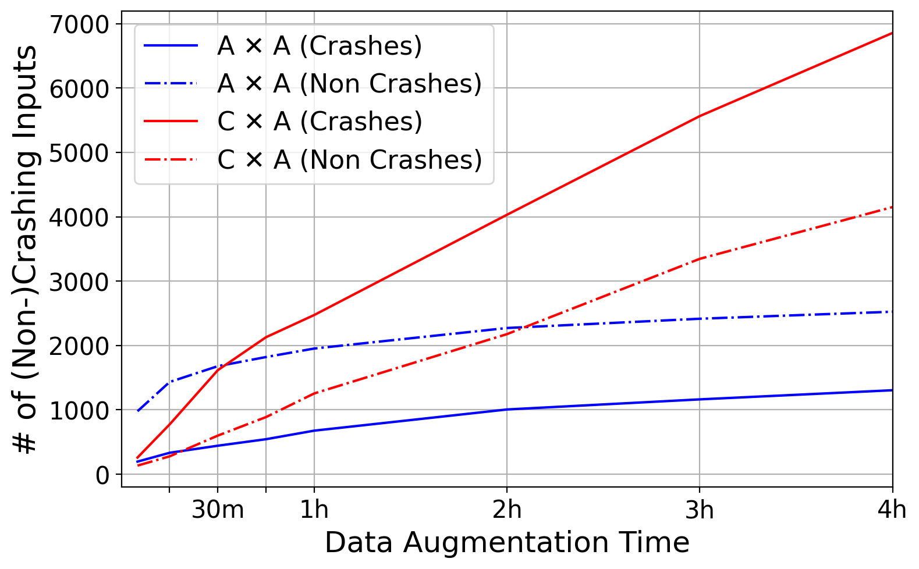
What affects the quality of the DA’s results?
Number of inputs
Ratio of crashing/non-crashing inputs
depends on combinations of targets and methods.
Target #1
Target #6
Notes:
When increasing the DA time, what happened?
We briefly observed the results of data augmentation.
Here is the two targets of crashing and non-crashing inputs that each data augmentation found.
One possible factors that affects the accuracy is absolute number of samples.
As you can see, the numbers of inputs varies in the combination of targets and DA methods,
Another factor is the ratio of crashing and non-crashing inputs.
The ratio actually varies in the different data augmentation time.
the numbers of inputs varies in the combination of targets and DA methods
This point may determine the quality of the data set.

Slide 30
Target selection
Diverse Root Cause (Missing check, Incomplete check)
Diverse crash causes (heap overflow, UAF …)
Real-world software
Any contributions are welcome.

Slide 31
Question: What about targets with poor accuracy?
if statement at the patch point is executed regardless of the value of count.
if(TIFFGetField(input, TIFFTAG_JPEGTABLES, &count, &jpt) != 0) {
- if (count >= 4) {
+ if (count > 4) {
int retTIFFReadRawTile;
_TIFFmemcpy(buffer, jpt, count - 2);
Target #1: CVE-2016-10094
Notes:
Some existing techniques focus on just the control flow, not the value of memory.
But like this example, sometimes those techniques cannot detect the incomplete check about certain values.
This suggests the possibility of further improvement of RCA techniques by considering features other than the control flow.
But of course, considering a lot of information is a trade-off with false positives.

Slide 32
More precise evaluation for randomness
Average of rankings
User’s perspective
Is 1000 candidates of RC practical
Internal thresholds to reduce the output cadidates
More fundamental solution such as formalization is needed.

Slide 33
Question: Number of figures
RCA techniques shows the candidates of root causes ordered by the level of confidence.
The number means the ranks of the actual root cause we defined.
Candidate
a.c:100
b.c:200
a.c:105
Root cause
b.c:200 a.c:500
Rank 2

Slide 34
Non-uniqueness of root cause location
Multiple possibilities of root causes locations
Patch 1 in function buggy()
function buggy(size) {
data = malloc(size);
return data;
}
function crashable(idx) {
data = buggy(size);
data[idx] = 1;
}
if (data == NULL) {
exception();
}
Missing check of malloc()’s return value
Patch 2 in function crashable()
if (data == NULL) {
exception();
}
Missing check of buggy()’s return value
Notes:
The source code in the left hand side contains a bug because the return value of malloc() is used in the function crashable() without null-checking.
If the value is Null, the assignment in function crashable() may cause a crash.
So where is the root cause locatoin? or where are the root cause locations?
One possible fix is to check the return value of malloc() in the function buggy() directly, in other words, patch 1.
Here, we can say that the root cause location is here, just after the call of malloc().
However, another developer may say the fix of Patch 1 should not be applied because it is ok that function buggy() can return Null. and the caller of buggy() should check the return value.
So, from this perspective, the fix should be like patch 2, the return value of buggy() should be checked in the function crashable().
and someone can say that the root cause location is in function crashable().
Or another developer may say that RCA techniques should show the both locations.
This toy example shows the difficulty of determining where is or are exactly buggy root cause locations.
They can be highly dependent on the situation and evaluators. So at least, making them public is important for fair and reproducible evaluation.

