Slide 1
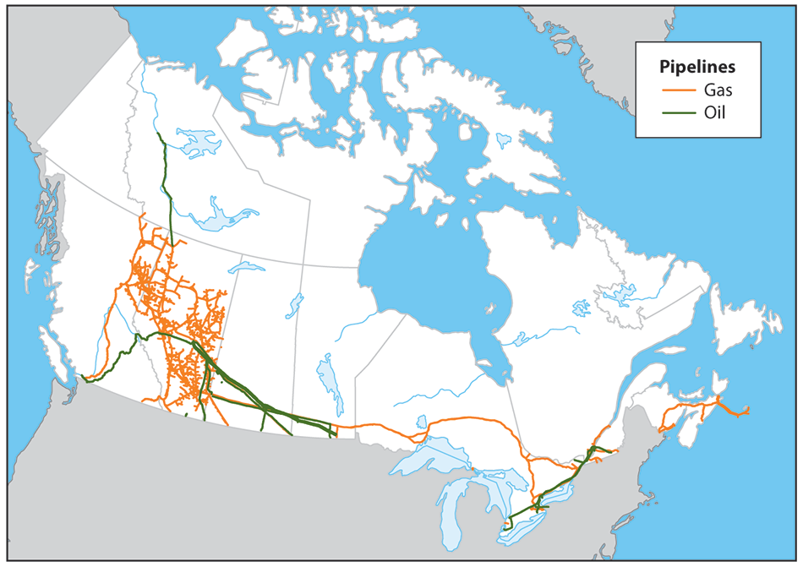
Visualizing and Classifying Pipeline Incidents in Canada (2008 – 2024)

Slide 2
Introduction
Pipeline incidents present significant risks to both the environment and public safety. Understanding the root causes and classifying these incidents will aid in predicting potential future incidents, contributing to improved safety standards and damage prevention. Leveraging machine learning and data visualization techniques can provide actionable insights into incident causes, types, and trends.

Slide 3
Dataset Overview
The dataset contains detailed information on pipeline incidents from 2008 to the present, with over 1,800 rows and 102 columns. The data includes key features such as location, incident type, and cause.
Dataset Source: Canada Energy Regulator

Slide 4
Project Objectives
1. Develop a comprehensive data analysis and machine learning pipeline to classify pipeline incidents Emergency Level.
2. Visualize incident causes, types, and trends to identify patterns and high-risk factors.
3. Aid in predicting future incidents to improve safety standards and damage prevention efforts.

Slide 5
ETL
1. Dropped columns with more than 60% nulls
2. Rename columns to have shorter names
3. Columns with multiple options where made ATOMIC using precedence order derived from frequency (likely introduced bias)
4. Exported the pd data frame into a csv file that was used in machine learning and predictive model.

Slide 6
Key Insights
Initial analysis reveals several key insights regarding the nature and frequency of incidents:
- The majority of incidents are concentrated in the western provinces specifically Alberta.
- Equipment failure and human error are significant contributing factors.
- Machine learning techniques can classify incidents with a high degree of accuracy.

Slide 7
Conclusion
The project highlights the importance of data-driven approaches to pipeline safety. Future work will focus on refining the model and incorporating additional data for improved predictive capabilities.

