Slide 1
ReadInEveryWeather Aggregator
One endpoint for weather, news and books
Usage guide with screenshots and live examples
.NET 8 · ASP.NET Core · November 2026
Notes:
ReadInEveryWeather Aggregator calls three public APIs in parallel and returns one merged, filterable result.

Slide 2
One request, three sources, one answer
Weather
Open-Meteo · 7-day forecast
category: weather
Unified JSON
GET
/api/aggregation
Merged items in one format
Filter by source, category, date
Sort by date, title or source
Status per source
News
Hacker News search (Algolia)
category: news
Books
Open Library book search
category: books
Notes:
All three providers are called at the same time. Their items are normalised into one shape, then filtered and sorted.

Slide 3
Getting started in two minutes
1
Run the API
Test login
Username
demo
Password
demo123
dotnet run --project src/ReadInEveryWeatherAggregator.Api
2
Open Swagger in a browser
http://localhost:5053/swagger
3
Run the 56 tests
Set in appsettings.Development.json. Works in the Development environment only.
dotnet test
Notes:
Requires the .NET 8 SDK. The demo login is configured only for the Development environment.

Slide 4
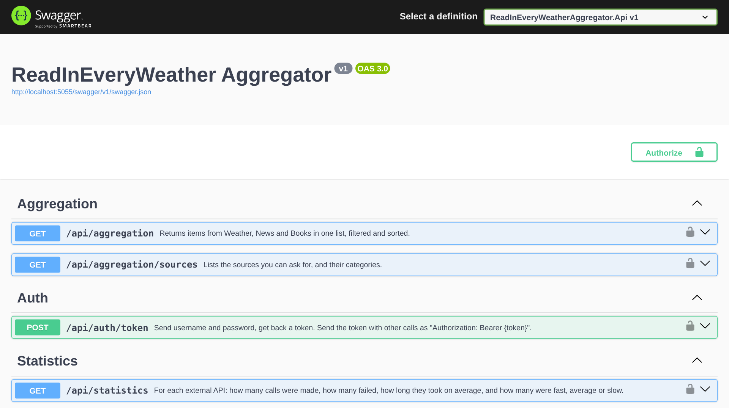
Swagger lists every endpoint
POST
/api/auth/token
Log in, get a JWT (open to all)
GET
/api/aggregation
Merged, filtered, sorted data
GET
/api/aggregation/sources
List of providers
GET
/api/statistics
Request statistics per API
Lock icon
Every endpoint except /api/auth/token needs the token.
Notes:
Swagger UI is available at /swagger in the Development environment.

Slide 5
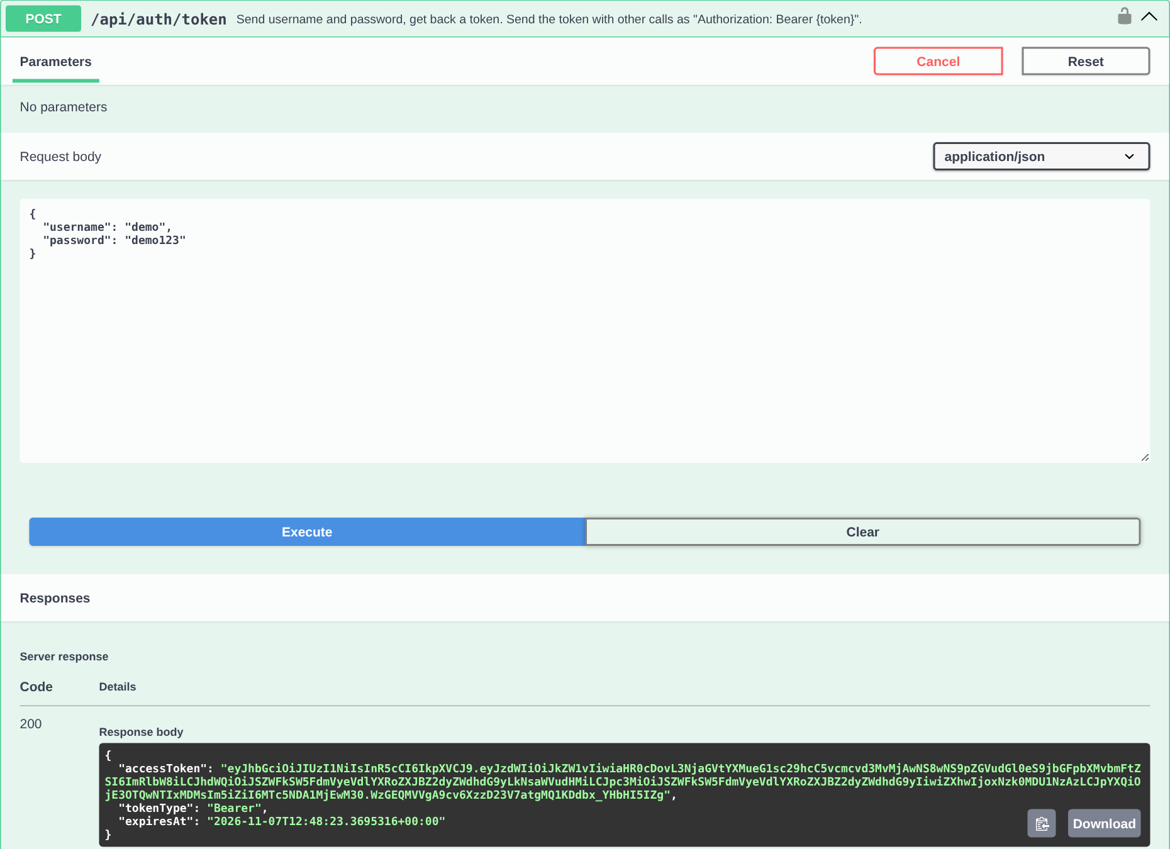
Step 1 · Log in to get a token
1
Open POST /api/auth/token
Click it, then Try it out.
2
Enter the test login
{
"username": "demo",
"password": "demo123"
}
3
Execute and copy accessToken
The token is valid for 60 minutes.
A wrong username or password returns 401 Unauthorized.
Notes:
The login only accepts the demo user from configuration. The response contains accessToken, tokenType and expiresAt.

Slide 6
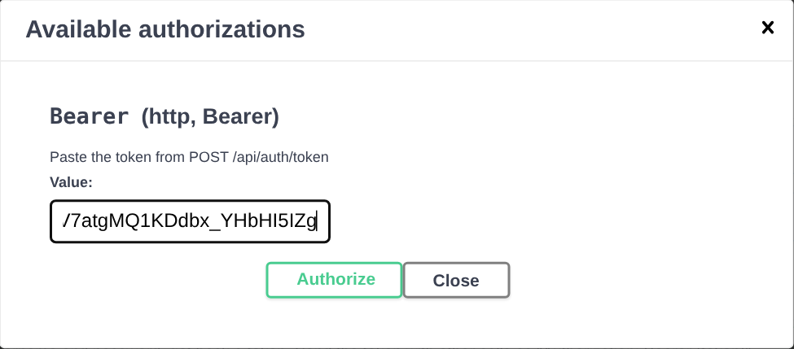
Step 2 · Authorize Swagger with the token
In Swagger
Click Authorize (top right)
Paste the accessToken value
Click Authorize, then Close
Swagger now sends Authorization: Bearer <token>
Same thing with curl
TOKEN=$(curl -s -X POST http://localhost:5053/api/auth/token \
-H "Content-Type: application/json" \
-d '{"username":"demo","password":"demo123"}' | jq -r .accessToken)
curl -H "Authorization: Bearer $TOKEN" http://localhost:5053/api/statistics
Notes:
Without the header, protected endpoints return 401.

Slide 7
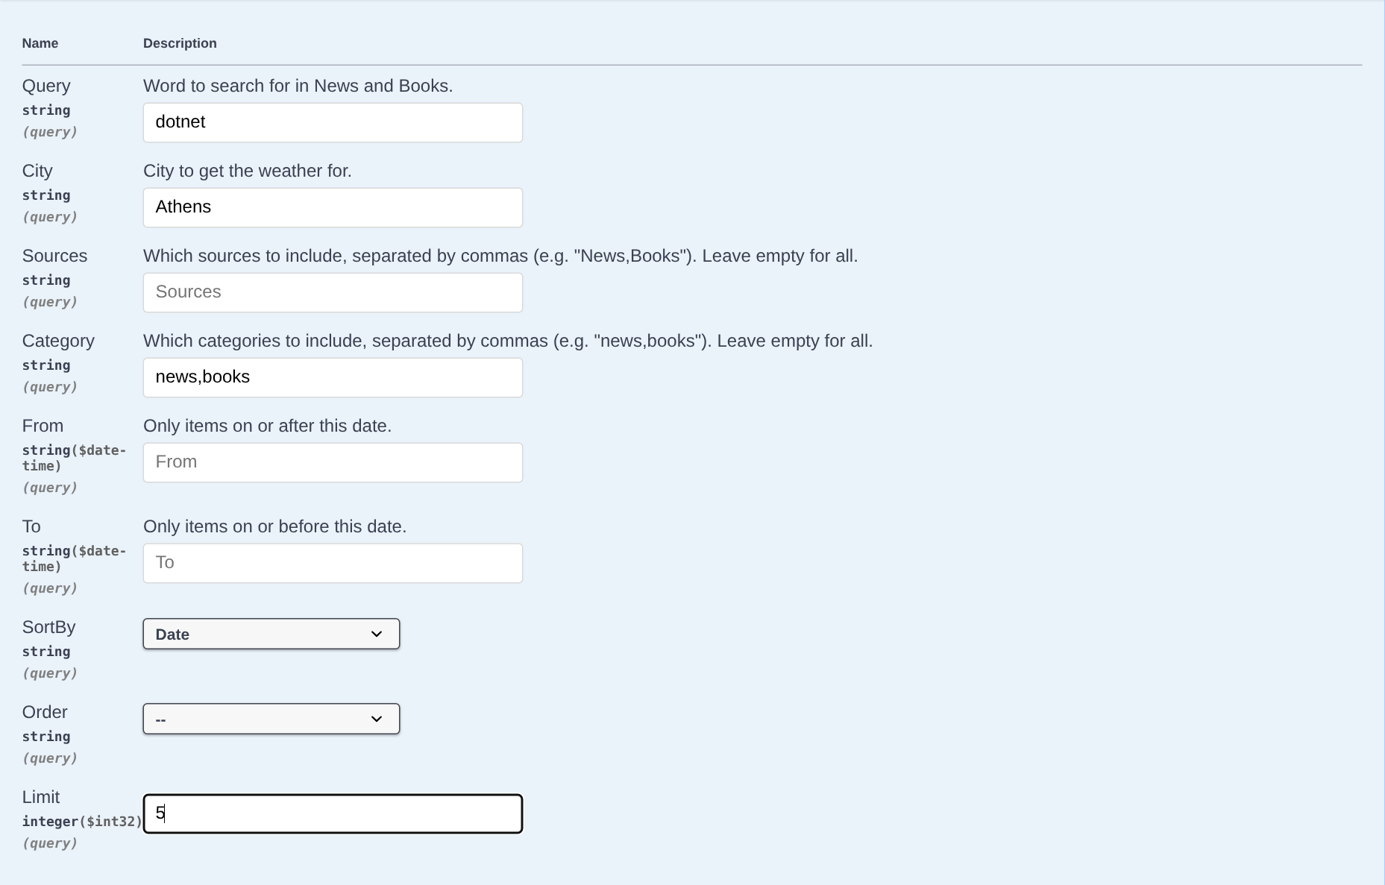
Step 3 · Choose what to fetch
Parameter | What it does
query | Keyword for News and Books
city | City for the weather forecast
sources | Only these providers
category | weather, news, books
from / to | Date range
sortBy | date, title, source
order | desc (default) or asc
limit | 1 to 200 items (default 50)
Example shown: dotnet · Athens · news,books · Date · 5
Notes:
Providers excluded by sources or category are not called at all.

Slide 8
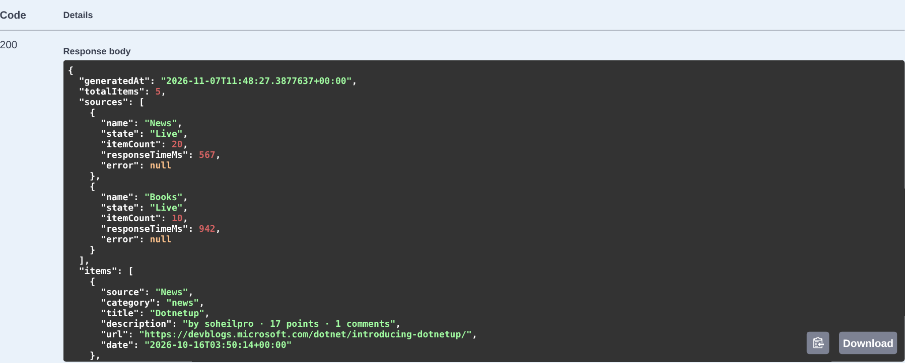
Step 4 · Read the response
sources[].state
Live
Fetched from the API now
Cached
From cache, no external call
Fallback
API failed, last good data
Failed
API failed, no saved data
sources
One entry per provider: state, item count, response time, error.
items
Merged list: source, category, title, description, url, date.
date
Forecast day, publish date, or 1 January of a book's first publish year.
Notes:
The response always returns HTTP 200 when at least the request was valid; failed sources are reported in sources[].

Slide 9
Parallel calls: 1.02 s instead of 2.08 s
1.02 s
whole request, all three APIs
2.08 s
if they were called one after another
Task.WhenAll starts every provider together, so a request takes about as long as the slowest API.
Measured 6 Nov 2026: query=climate, city=Thessaloniki, first (uncached) call
Notes:
Real measurement from a local run. Weather 1,009 ms, News 580 ms, Books 487 ms; total request 1,023 ms (curl time).

Slide 10
Cache: the same request again took 7.1 ms
First call
Same call again
How the cache works
1,023 ms
7.1 ms
Key = provider + query + city
Fresh for 120 s: no external call
Kept 60 min as fallback data
Filters and sorting run after the cache, so they reuse it
Cache hits are not counted in statistics
all sources Live
all sources Cached
"sources": [
{ "name": "Weather", "state": "Cached", "itemCount": 7 },
{ "name": "News", "state": "Cached", "itemCount": 20 },
{ "name": "Books", "state": "Cached", "itemCount": 20 }
]
Notes:
Lifetimes are set in the Caching section of appsettings.json.

Slide 11
When one API fails, the others still answer
Demo: Books pointed at a dead address (localhost:1)
1
Retry
"totalItems": 2,
"sources": [
{ "name": "News", "state": "Live",
"itemCount": 20, "responseTimeMs": 995 },
{ "name": "Books", "state": "Failed",
"itemCount": 0, "responseTimeMs": 353,
"error": "Connection refused (localhost:1)" }
]
2 retries with exponential backoff
2
Circuit breaker
Stops calling an API that keeps failing
3
Fallback
Returns the last good data, marked Fallback
Response is still 200 OK with the News items.
4
Failed
No saved data: 0 items, error message shown
Notes:
Real output from a second instance started with ExternalApis__Books__BaseUrl=http://localhost:1/. The log showed the retry attempts.

Slide 12
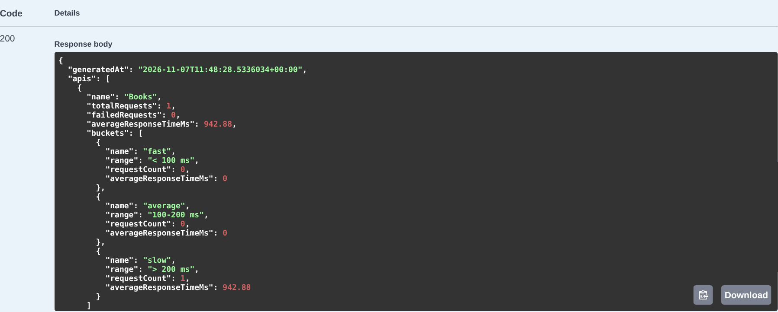
Statistics group requests by speed
Buckets per API
fast
< 100 ms
average
100–200 ms
slow
> 200 ms
Each API also shows total requests, failures and the average time.
Background anomaly check (every 60 s)
Warns in the log when an API's average over the last 5 minutes is more than 50% above its overall average. Log format:
warn: Performance anomaly: Books averaged 900 ms over the last 5 min vs 350 ms overall (+157.1%)
Notes:
Statistics are kept in memory and are thread-safe. The anomaly line is an illustration of the log format; the numbers are an example.

Slide 13
Bad requests get clear error messages
401
No token
400
Unknown source
400
Dates reversed
GET /api/statistics
→ 401 Unauthorized
GET /api/aggregation?sources=twitter
→ "Unknown source(s): twitter.
Valid: Weather, News, Books."
GET /api/aggregation
?from=2026-02-01&to=2026-01-01
→ "'From' must be earlier
than 'To'."
Format
Errors follow the ProblemDetails standard (RFC 7807): type, title, status, errors per field, traceId. Unexpected server errors return 500 without internal details.
Notes:
Real responses from the running API.

Slide 14
56 automated tests, all passing
56
Test class | Tests | What it checks
ApiEndpointsTests (integration) | 11 | 401, login, binding, 400s, statistics
ProviderTests | 10 | Request URLs, JSON mapping, errors
AggregationServiceTests | 9 | Parallel calls, cache, fallback, cancellation
StatisticsServiceTests | 9 | Buckets, averages, 40,000 parallel writes
ItemFilterTests | 7 | Every filter and sort option
PerformanceAnomalyDetectorTests | 4 | Slow API detected, stable API ignored
TokenServiceTests | 4 | Valid token signed, bad login rejected
ProviderRegistrationTests | 2 | Each provider by its interface, all as one list
tests passed, 0 failed
No network needed: external APIs are replaced by fakes. Time-based logic uses a fake clock, so tests never wait.
$ dotnet test
Passed! - Failed: 0,
Passed: 56, Total: 56
Notes:
Run with dotnet test from the solution folder.

Slide 15
Quick reference
Test login
Addresses
Commands
Username
demo
Password
demo123
Swagger UI
localhost:5053/swagger
Login
POST /api/auth/token
Data
GET /api/aggregation
Statistics
GET /api/statistics
Run
dotnet run --project
src/ReadInEveryWeatherAggregator.Api
Test
dotnet test
Docs
README.md
Notes:
Everything needed to run and try the API.

