Slide 1
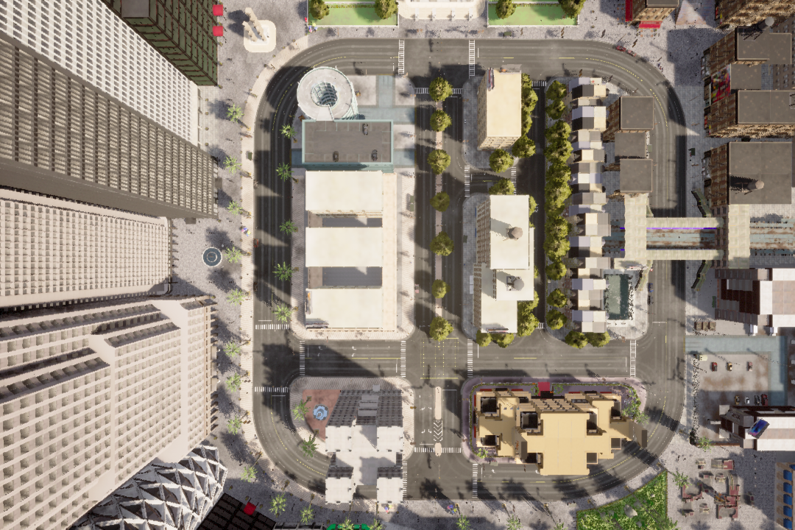
Train
Test 1
Test 2

