Slide 1
Constructive Computer Architecture
Introduction to (simultaneous) multithreading

Slide 2
How to go faster?
Lost opportunities, sometimes the processor is mostly dead:
On load miss
When stalling for dependencies
On branch misprediction

Slide 3
Previously in 6.1920
Processor does 2 insts per cycle
Cost ☹:
Increased complexity in control logic (hard to debug/verify)
Increased area/energy if unused:
More ports in RF …
Noncost ☺:
No changes to the programs!
Size of cache/size of Rf

Slide 4
Yet another idea
So far, processor runs 1 program
Why not making it run 2 (or k) programs?
pc_x, rf_x[_]
pc_y, rf_y[_]
Run one instruction of each program each cycle?
Not necessarily, almost never in the rest of this lecture
Multithreading

Slide 5
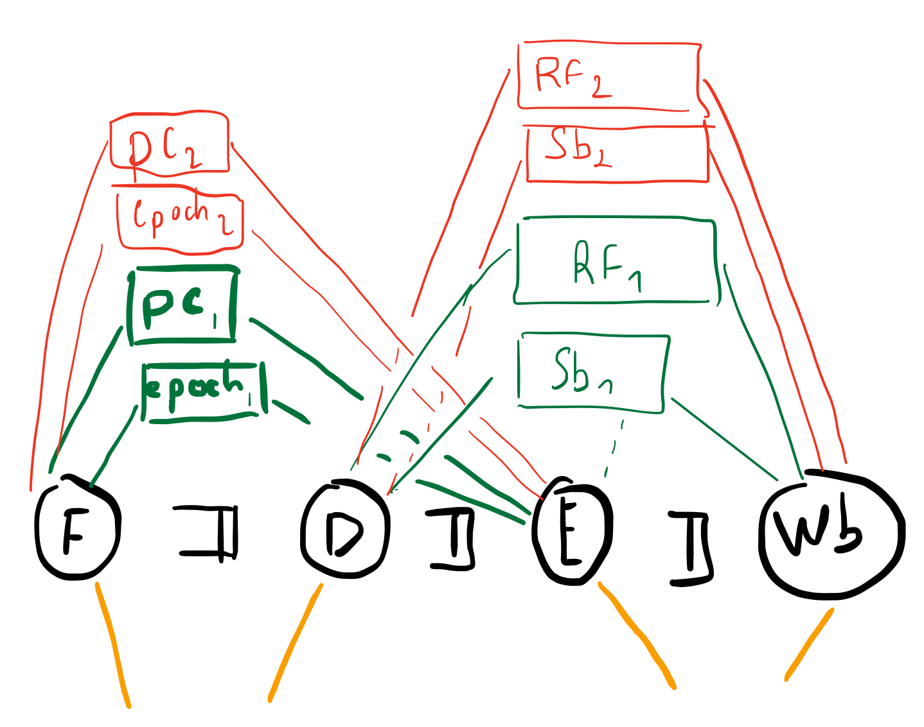
Preliminary diagram

Slide 6
Multithreading (MT)
Noncost ☺:
Lower complexity in control logic
Cost ☹:
Changes to the programs!
Increases number of Rf
Potentially requires bigger caches

Slide 7
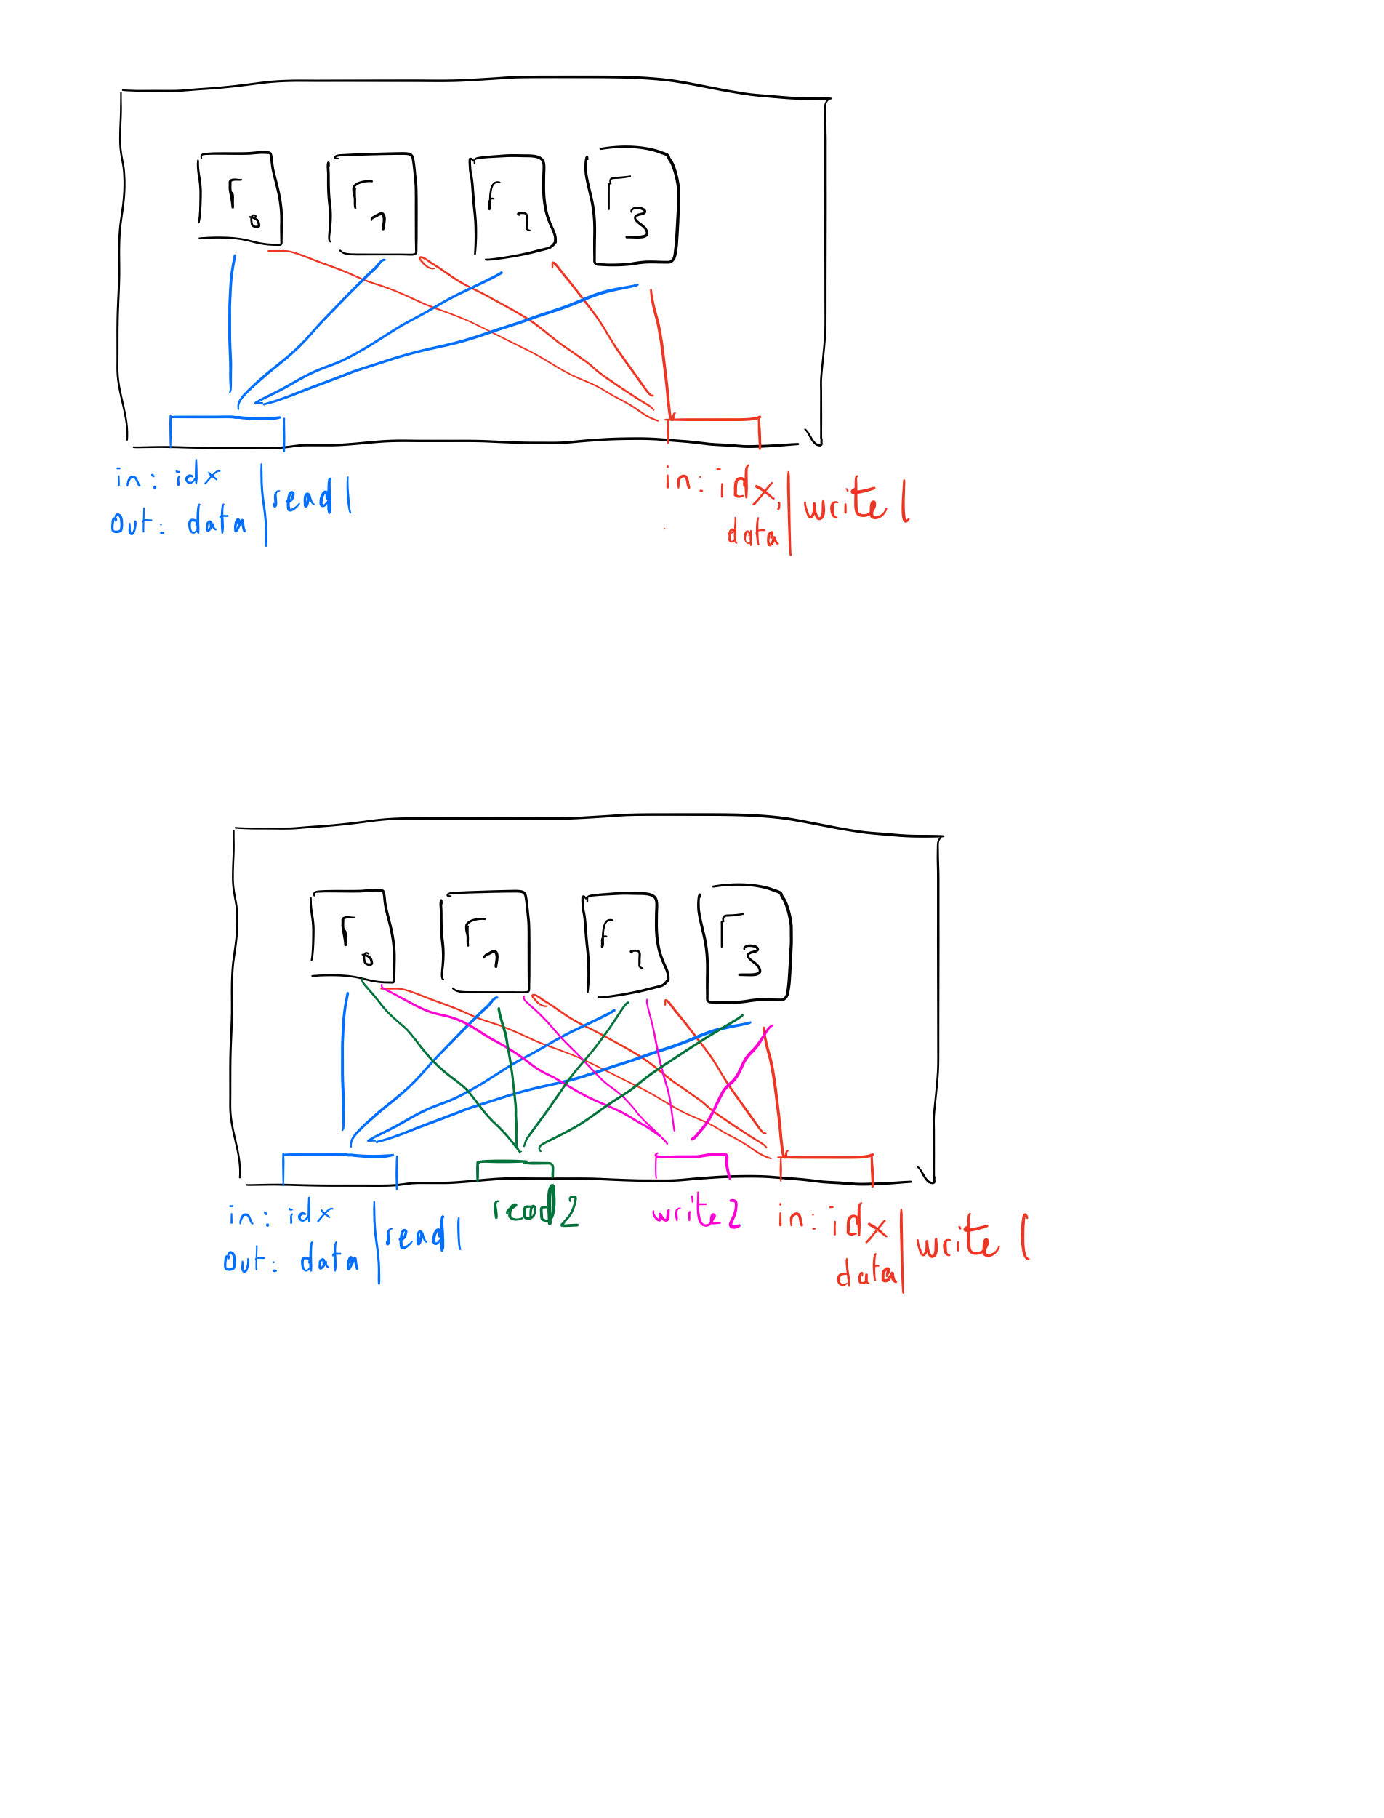
Tradeoffs in the RF
RF is on the cost side for different reasons.
RF for multithreading
Tuesday’s RF for superscalar

Slide 8
Tradeoffs in the RF
Relative costs of
N registers of size B, R read ports, W write ports, rfcost(N,B,R,W)?
rfcost is (critical path, area, energy)
Increasing the number of ports is typically quite expensive

Slide 9
Wait – Back to superscalar’s lecture

Slide 10
Side-notes – Superscalar throwback
Split the 32 registers in 2 subRF of 16 registers
Each subRF has 2 read ports, 1 write port
Take 1 cycle if the two instructions don’t collide
Take 2 cycles if collision
Ask the compiler to be nice and generate collision-free instructions

Slide 11
Return to today’s lecture

Slide 12
Refining the idea
Running 2 programs? Ok, but how?
“Fine-grain multithreading”
“Coarse-grain multithreading”
“Simultaneous multithreading”
Let’s discuss at a high-level first, then details

Slide 13
1.Fine-grained MT
Cycle 0: Fetch from pc1
Cycle 1: Fetch from pc2
Cycle 2: Fetch from pc1
“Barrel processor”
Reduce stalling due to
dependencies between registers!

Slide 14
2.Coarse-grained MT
Cycle 0: Fetch from pc1
Cycle 1: Fetch from pc1
… (cycle i-1) ins from pc1 is Load miss
Cycle i: Fetch from pc2
Does not help with
dependencies between registers.
Only target load misses!

Slide 15
3. SMT (Simultaneous)
Fetch instructions from both threads simultaneously (“combined with superscalar”)

Slide 16
Great, does it work?

Slide 17
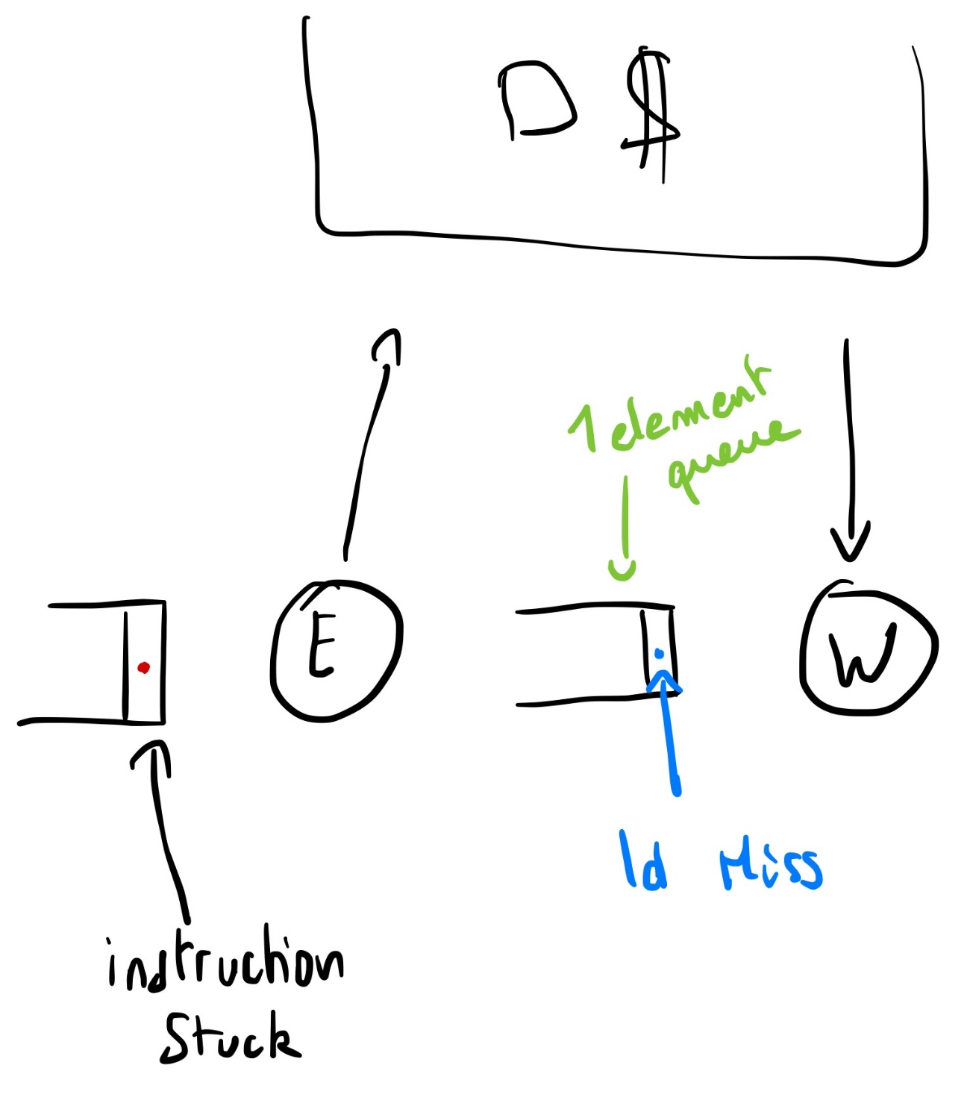
Yes (part one of lab) but No (part two of lab)
Functionally yes.
It does not work because of backpressure!

Slide 18
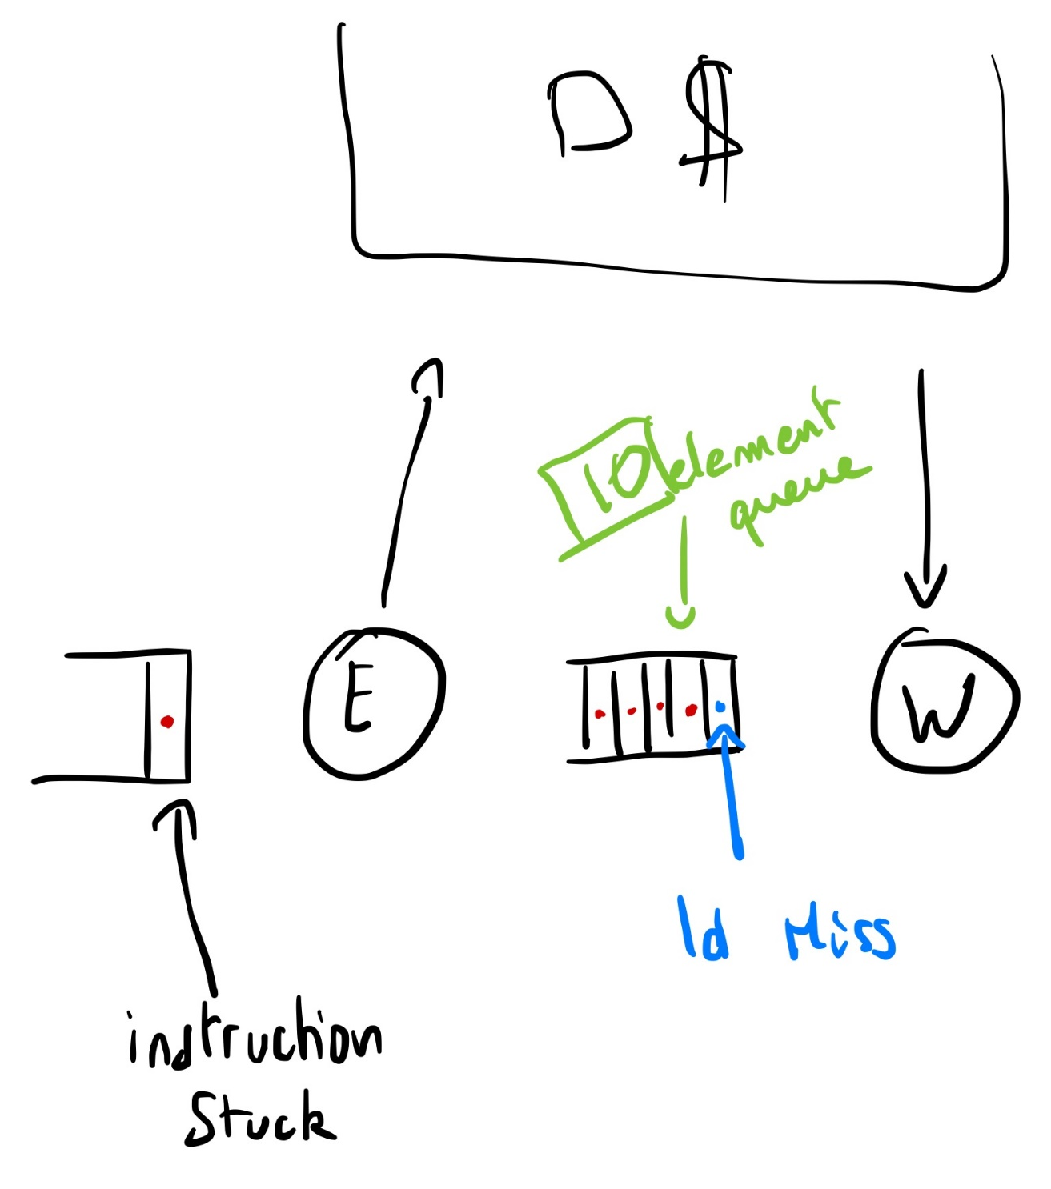
Not a solution
We are stuck behind the blue truck
Latency Load miss ~40/60 cycles – gigantic structure

Slide 19
Solution
Use two 1-element queues for e2w, one for each thread
Is it “necessary” to also use two queues for f2d and d2e?
In any case, this is only about performance
For perf, it depends: no for Coarse-grain, yes for the others.

Slide 20
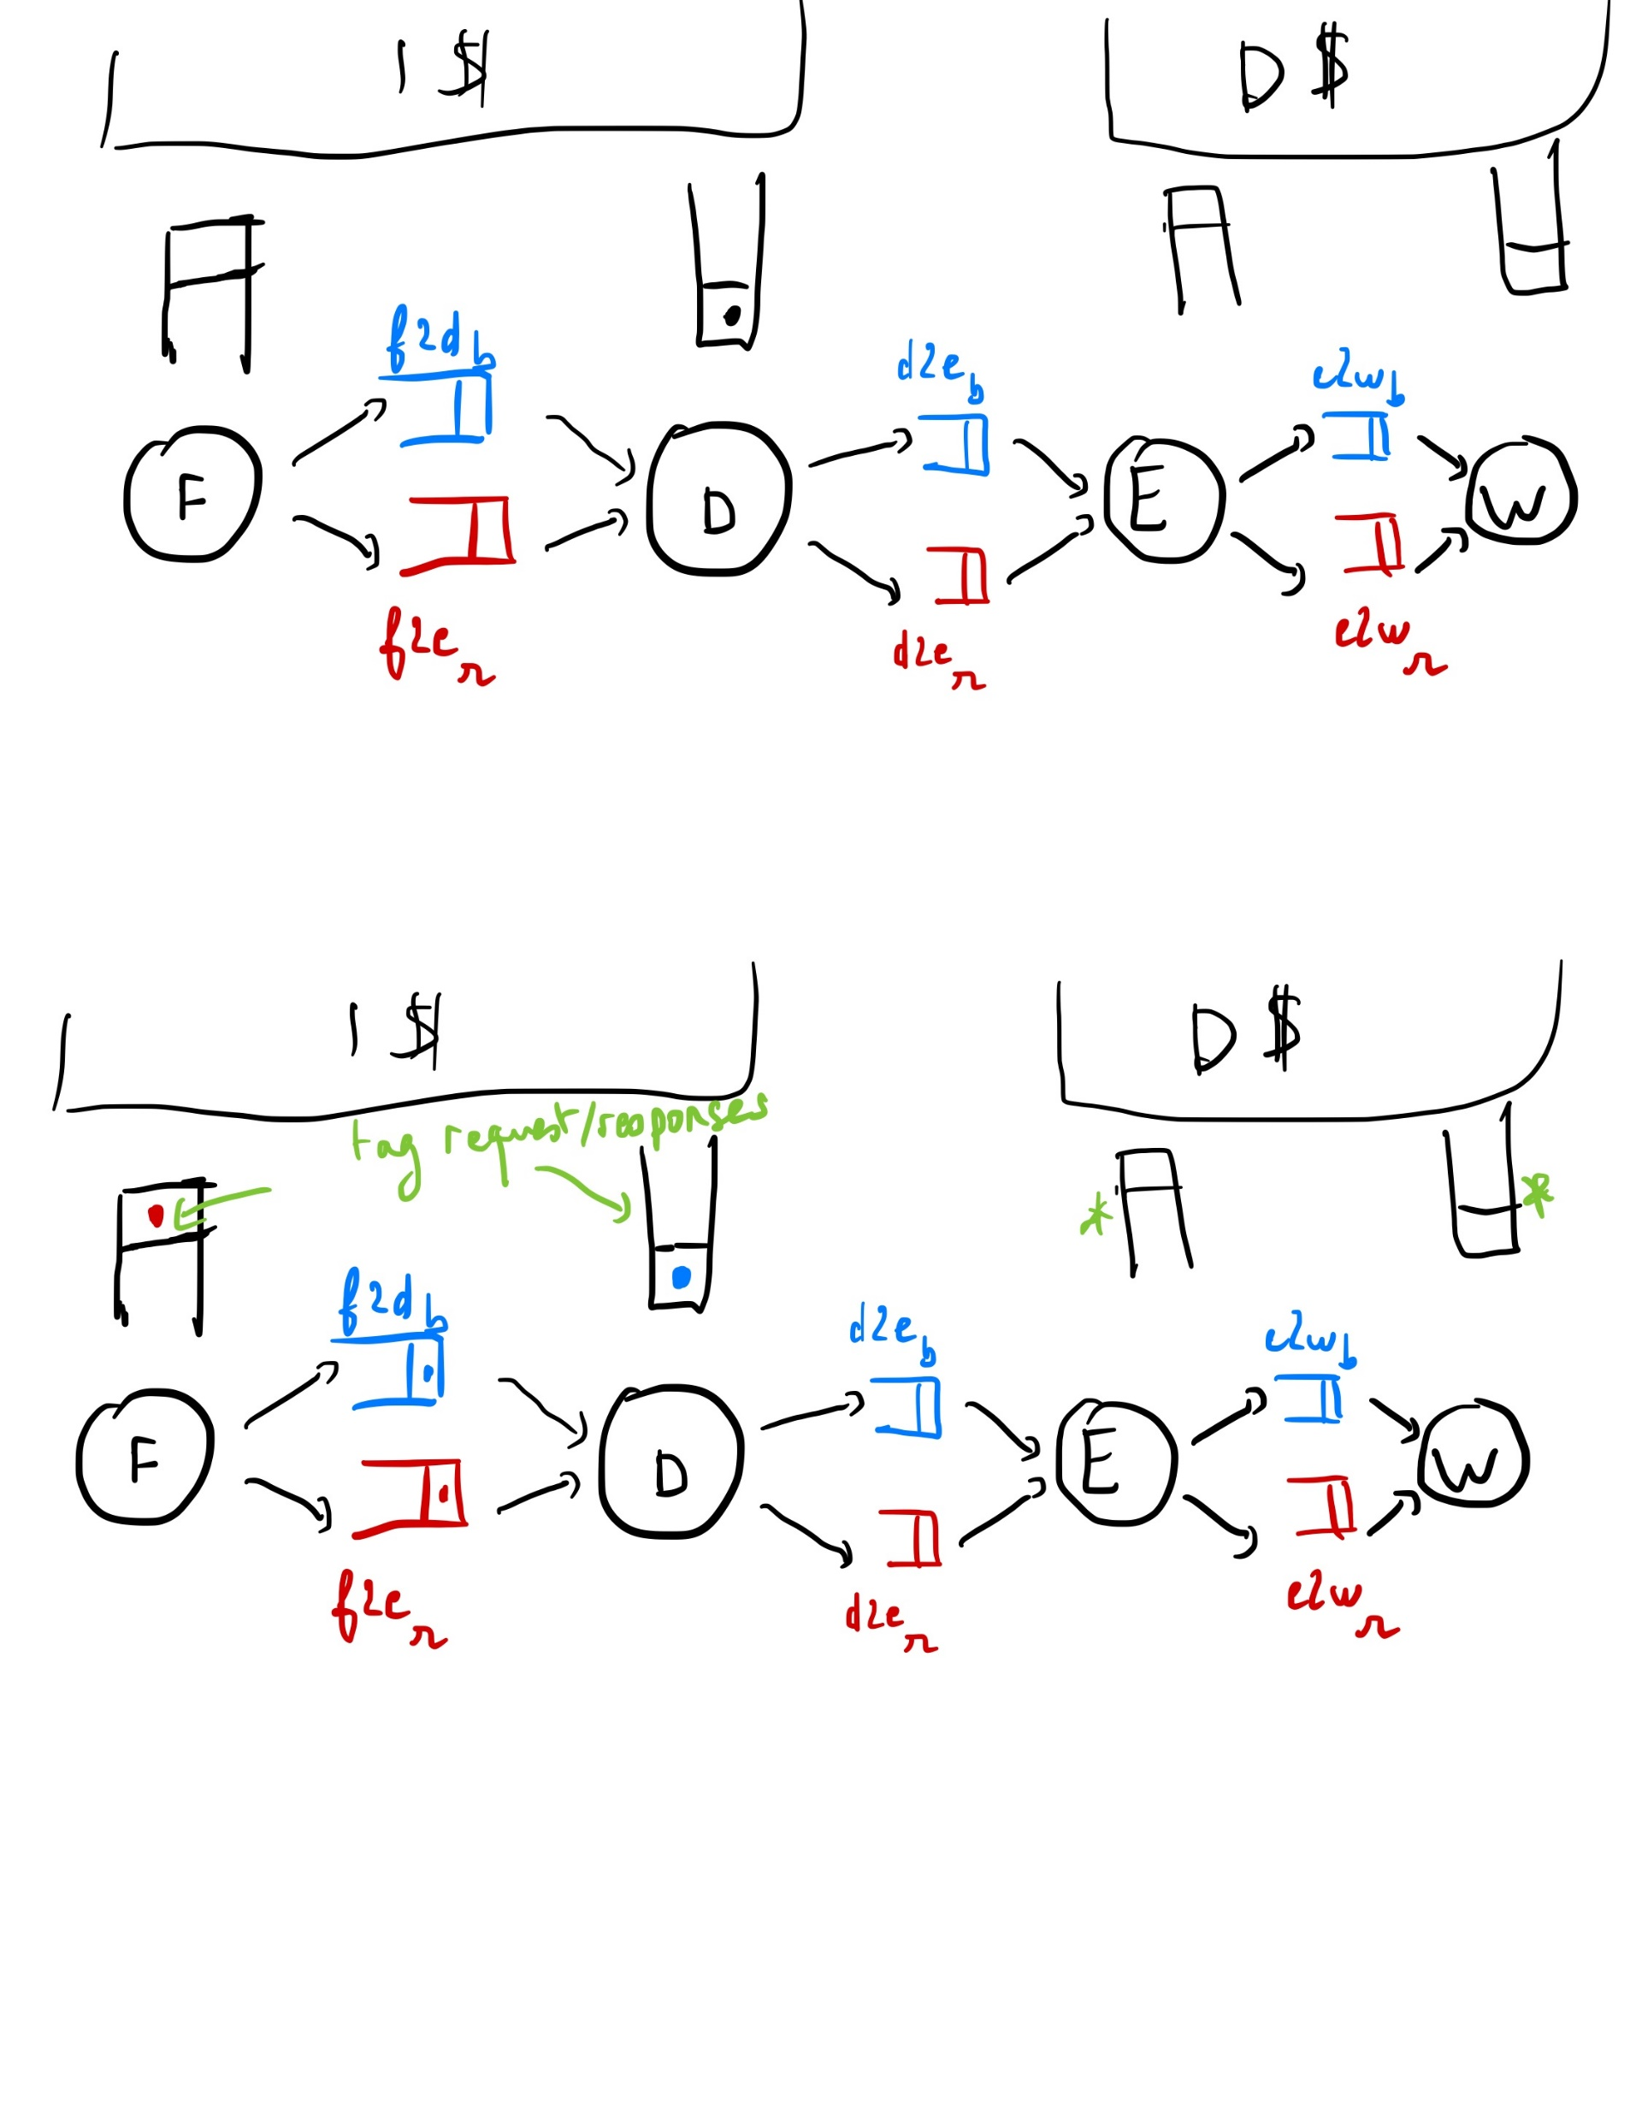
More accurate diagram

Slide 21
Morer accurate diagram

Slide 22
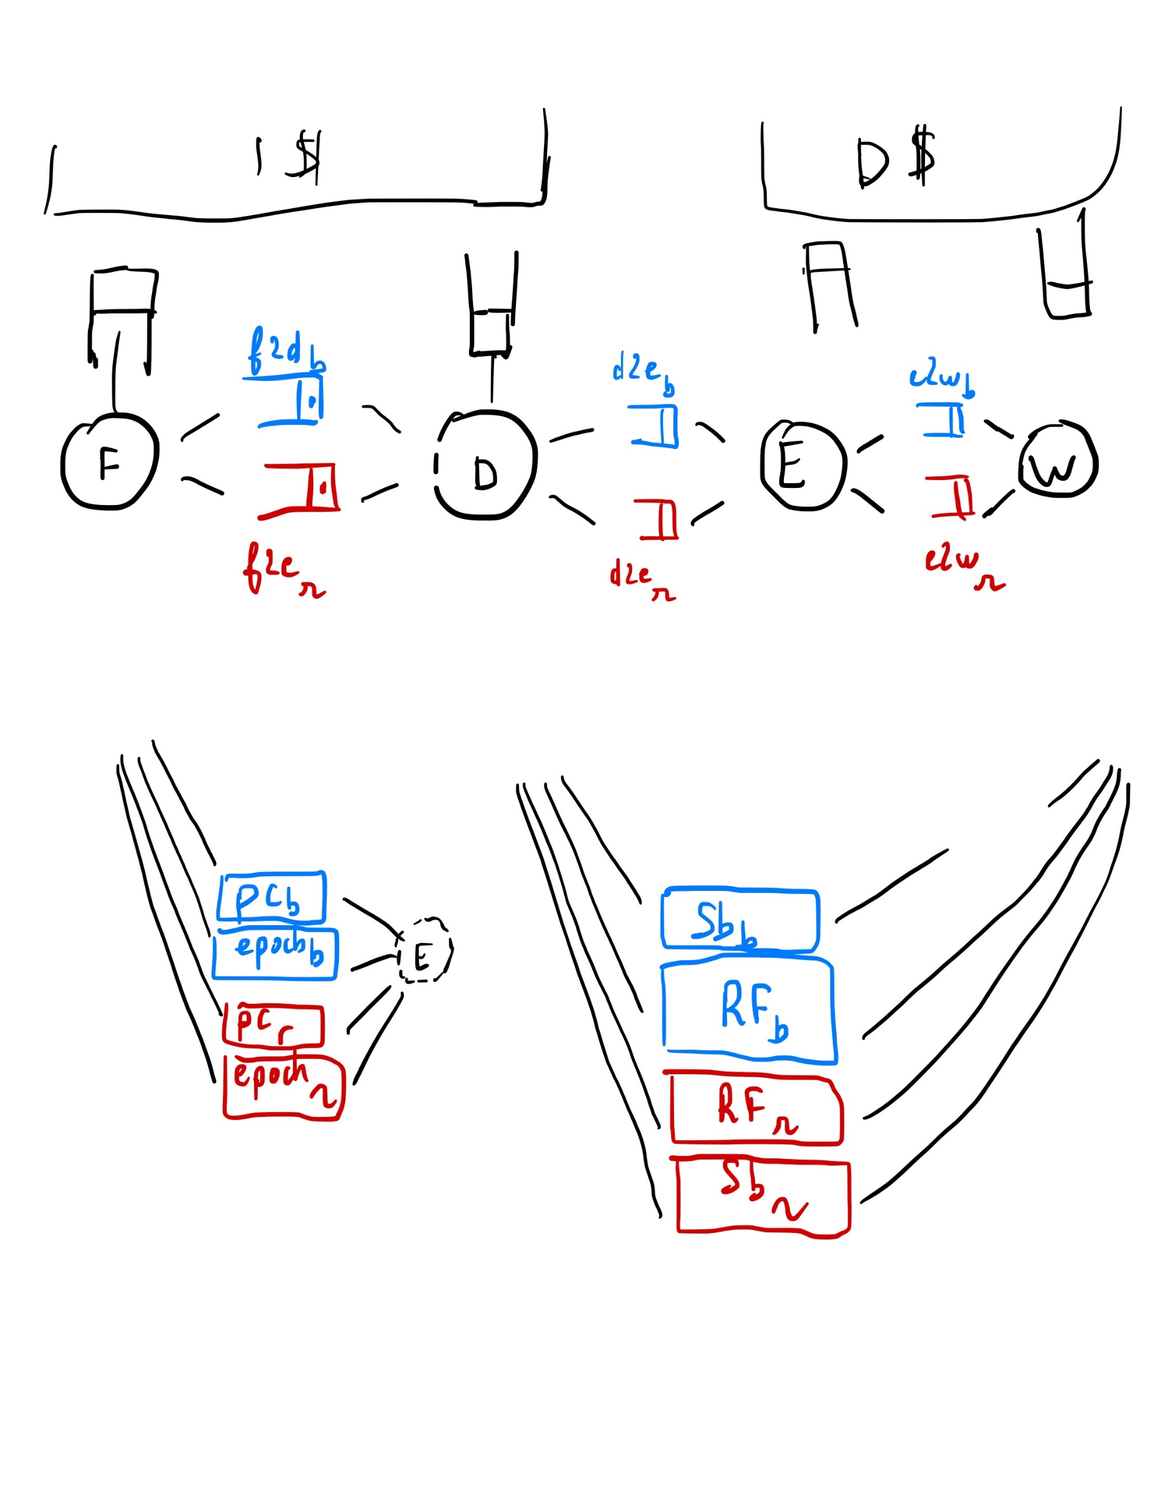
Drawing more
1. Are there potential
choices for scheduling?
2. Wait, did we just
duplicate everything?

Slide 23
Round-robin scheduling
High-level:
Try to be fair and run both threads
It is good to avoid dependencies!
“Don't put all your eggs in one basket”
If one thread is stuck, make progress on the other one

Slide 24
Round-robin in Execute
// Original code:
rule execute if (!starting);
d2e.deq();
let current_inst = d2e.first();
if (current_inst.epoch == epoch[0]) begin
do the current_inst
if ppc != nextpc(current_inst), redirect and toggle epoch
end else begin
squash current_inst
end
endrule

Slide 25
Round-robin in Execute
rule execute if (!starting);
let current_instb = d2e_b.first();
let current_instr = d2e_r.first();
// choose which one to run, dequeue from that queue
…
endrule
Does not work, execute gets stuck
if I don’t have both red and blue insts available

Slide 26
Round-robin in Execute
Reg#(Bool) priority <- mkReg(True);
rule execute if (!starting);
if (priority) begin
if (d2e_b.notEmpty) begin
d2e_b.deq();
let current_inst = d2e_b.first();
Execute current_ins and push in e2w_b
end else begin
d2e_r.deq();
let current_inst = d2e_r.first();
Execute current_ins and push in e2w_r
end
end else begin
// […]
end
priority <= !priority;
endrule

Slide 27
Round-robin in Execute
// The ellipsis: […]
else begin
if (d2e_r.notEmpty) begin
d2e_r.deq();
let current_inst = d2e_r.first();
Execute current_ins and push in e2w_r
end else begin
d2e_b.deq();
let current_inst = d2e_b.first();
Execute current_ins and push in e2w_b
end
end
priority <= !priority;
endrule

Slide 28
Handle control instructions
If instruction comes from
How to correct from misprediction?
Two epochs: one per thread
Execute rule use the appropriate epoch (depending on the source d2e_b or d2e_r ) to filter out the instruction
Modify the appropriate pc

Slide 29
Exploiting choices https://dl.acm.org/doi/pdf/10.1145/232973.232993
Every cycle, which thread should we fetch from? Execute from? Etc...
There is a scheduling choice:
Greedy (1 except if one stuck, then 2)
Alternate?
Random?
Anything smarter?

Slide 30
More choices
Interesting policies:
#in-flight branches on each thread. Pick thread with minimal number of branches (if possible) Why is it good?
#in-flight misses on each thread
#in-flight instructions (priority to minimal in-flight instructions)
Those ideas even more important when we have a superscalar machine

Slide 31
Extra difficulties with SMT
Fetching two different lines from the I$ the same cycle?
Requires a 2-ported BRAM/SRAM
What if we don’t have those for our I$? ☹
We can play a little trick!

Slide 32
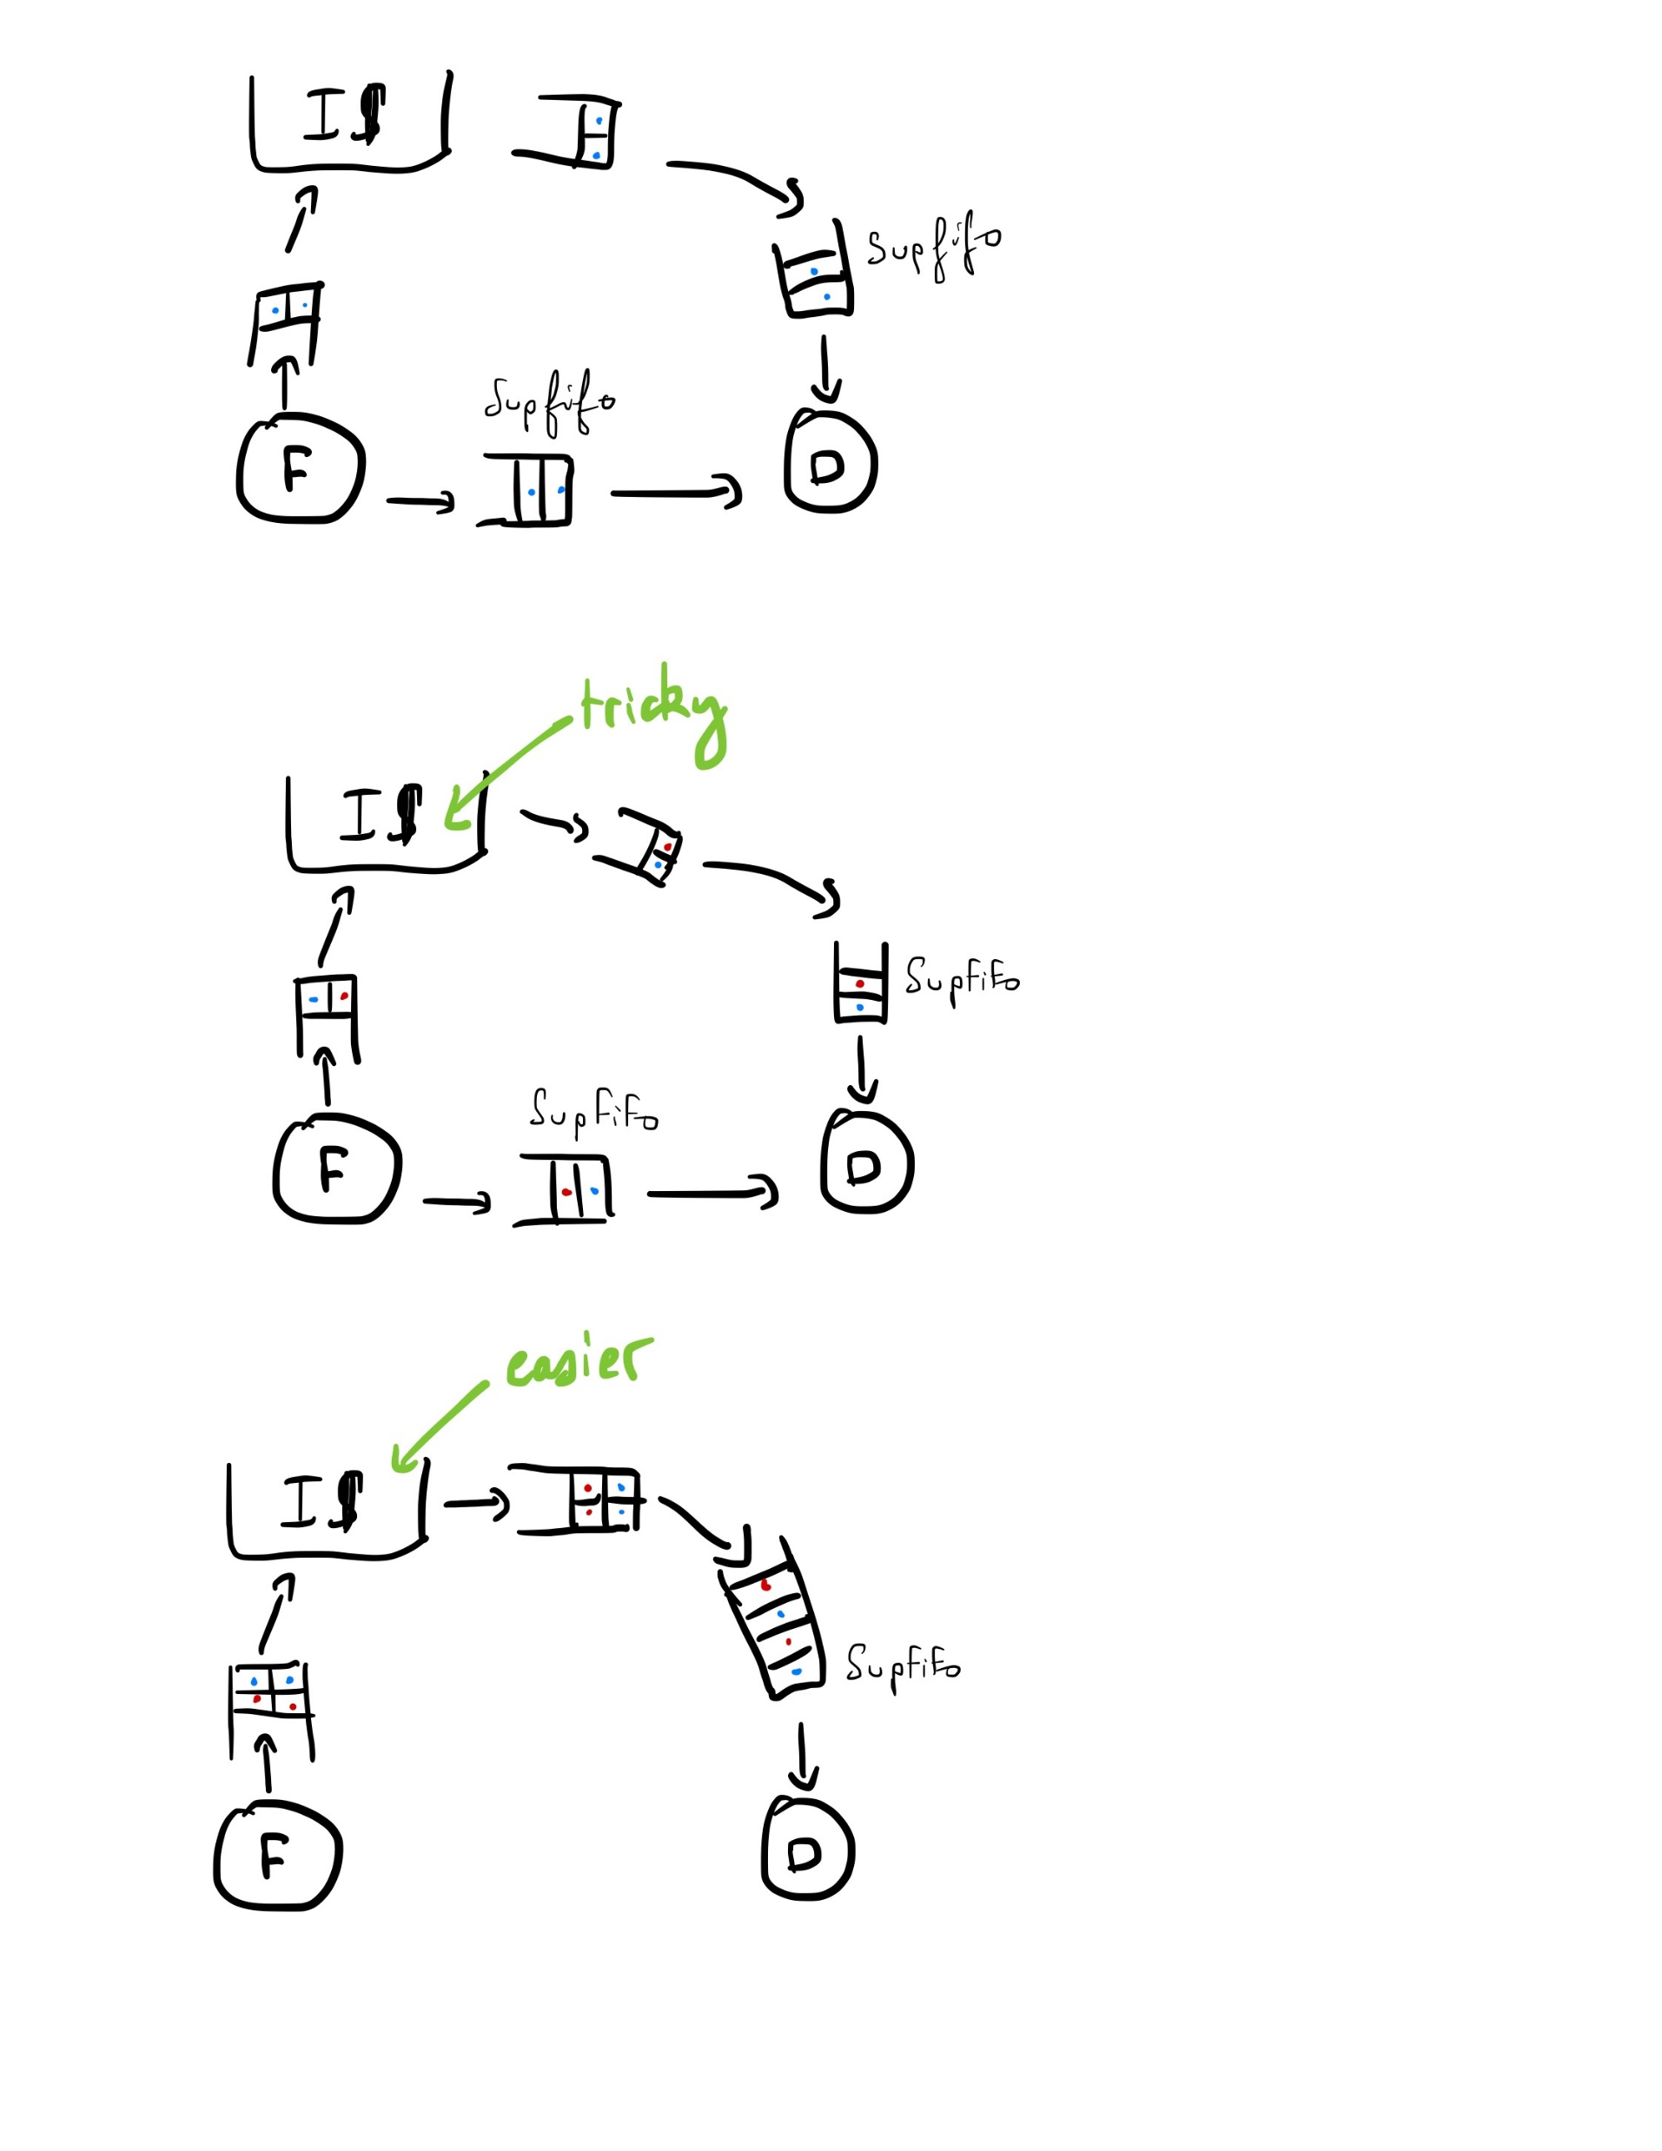
L1 superscalar

Slide 33
L1 for SMT - 2-port I$

Slide 34
L1 for SMT – 1-port I$

Slide 35
Scope, gains, losses?
We showed 2-way multithreading, does it works for k-way (k=3,4…)?
Modern intel: k=2
Alpha Ev8 (Araña): k=4
GPU ?
How much performance is there to win?
Let’s read Wikipedia together!

Slide 36
The elephant in the room:
What is a thread?

Slide 37
HW thread vs SW thread
Scenario, two programs, one pc register:
swth0 runs for 1ms
Timer interrupt – current pc get shelved
OS code runs, decide if it wants to return to current pc, or to another pc, maybe pc of swth1
swth1 runs for 1ms
Multiple SW thread can be run with one HW thread
Only a few extra registers
are necessary to run multiple threads
on a single hardware thread

Slide 38
What we did not talk about
With current setup:
The two programs share the same memory
They can mess with each other memory
BAD the 2 programs run by our HW threads are conceptually completely different
Could we provide an abstraction?

Slide 39
Virtual memory idea
Addresses of the program are “virtual”
The hardware add one level of indirection to actually find the real address
The translation depends on the thread
SW Thread VS Process:
Two threads of the same process, have the same translation

