Slide 1
Constructive Computer Architecture
SIMD/Vector processors
Sanjay & Arvind
Electrical Engineering and Computer Science
Massachusetts Institute of Technology

Slide 2
1990s: Multimedia applications
Audio uncompressed:
  16-bit values sampled at 44100 Hz
  ~10MB per minute (stereo)
  (CD-DA: 74 minutes)
Video uncompressed:
  3*8-bit, 480p @ 30 fps ~ 221 Mbit/s.
  The Lion King ~ 144GBytes
Hard drives in 97/98: ~5GB

Slide 3


Multimedia in computers: compression
Using MPEG-2 compression:
The Lion King - ~650MB
Typical image compression scheme:
Tile the images in blocks of 8x8
For each tile:
  Go to frequency domain (DCT)
  Quantize in the frequency domain
    (more quantization for higher frequency)
  Huffman the result
Decompression:
Inverse DCT, go back from frequency domain
to original domain

Slide 4
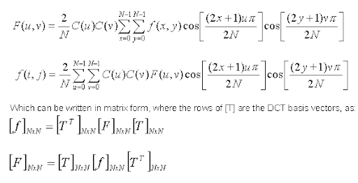
A few encoding techniques
Discrete Fourier Transform
  Fast Fourier Transform
Discrete Cosine Transform
  Commonly used in MPEG, JPEG, etc
General idea is to move to frequency domain to compress, and invert back to x,y domain to view
Take 6.003 for an in depth analysis on these algorithms

Slide 5
A case study: iDCT (inverse discrete cosine transform):
taking a look at the code
knusperli/idct.cc at master · google/knusperli (github.com)
libjpeg-turbo/jidctint.c at main · libjpeg-turbo/libjpeg-turbo (github.com)

Slide 6
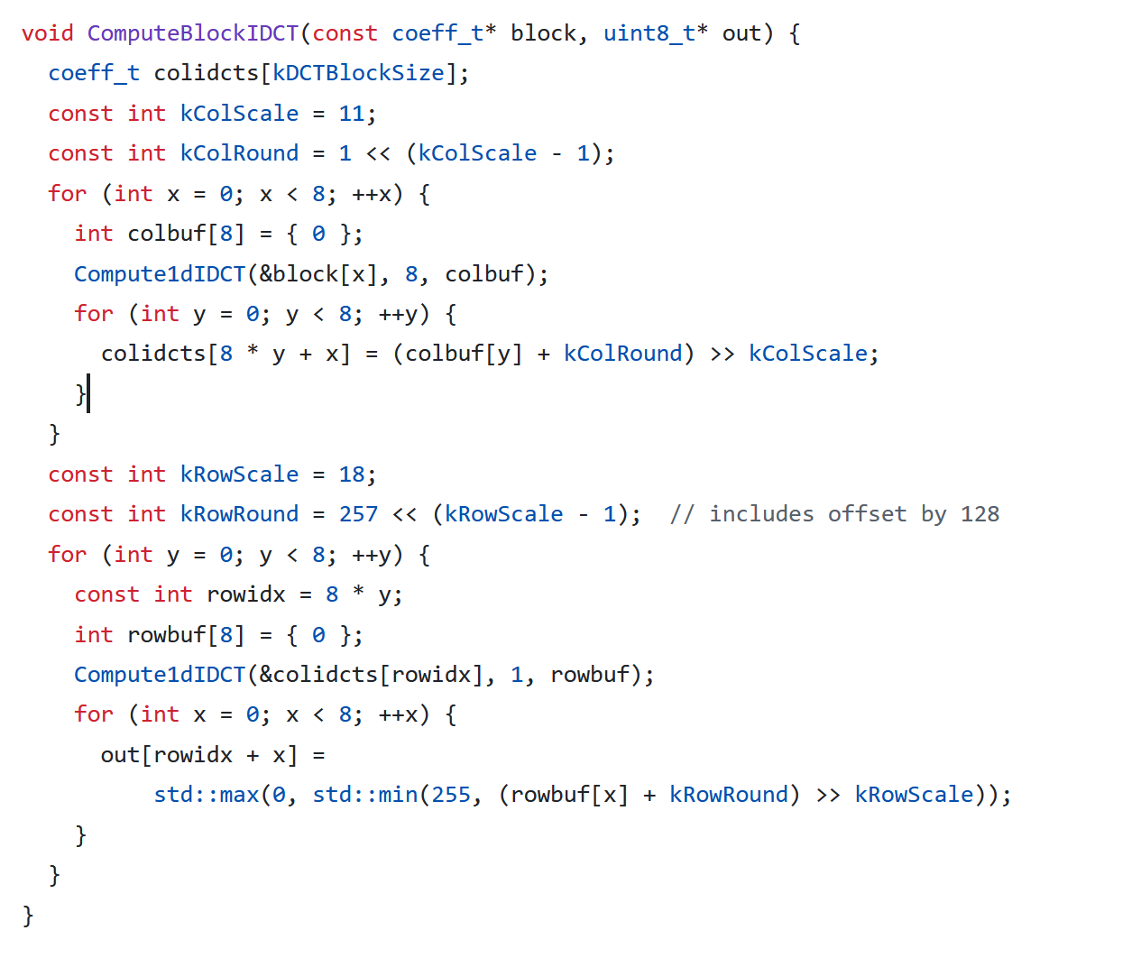
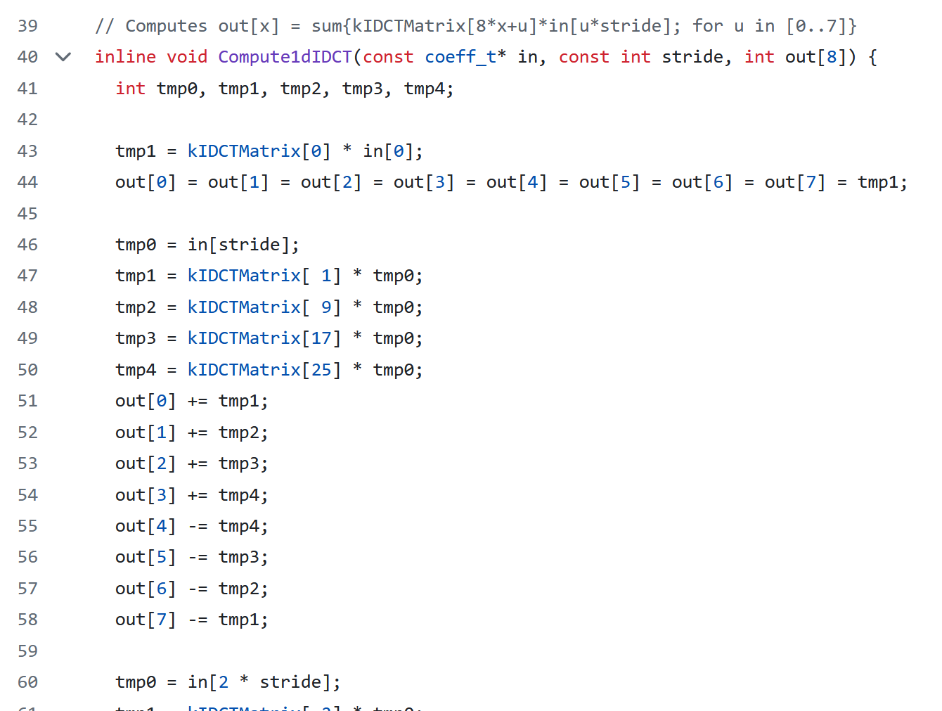
Some samples from the code

Slide 7
Observations:
Almost branch-free program
  Straight-line code
Applied to all the tiles
The only branches are for static loop (could be unrolled)

Slide 8
In the previous episodes of 6.1920
Do the following techniques apply well?
  Multicore
    what would be the threads?
  Superscalar
  Multithreading
So far different threads execute different code (a priori)
  What can we do instead?

Slide 9
Single Instruction
Multiple Data - SIMD
Basic idea:
  apply the same program simultaneously to multiply different data
Very rich idea, but let’s start easy
32b
…
8b | 8b | …
Standard registers
Vector registers

Slide 10
Simple example – v1
We have 4 column arrays of 16 elements (each 1 byte), we want to compute the 4 sums of their elements:
Sum over each element…..
  For i in [0 ..3]:
  For j in [0 .. 16]:
  sum[i] = sum[i] + v[j][i];

Slide 11
Simple example with vectors
Vr1: “sum[*]”
Vr2: “v[*][j]”
  // Start with vr1 == 0
  // r1 == address of v
  // r3 == end of v
  Onemore:
    Vector-ld vr2 0(r1)
    Vector-add vr1 vr1 vr2
    addi r1 r1 <elt size>
    sub r4 r1 r3
    bnez r4 onemore
  For i in [0 ..3]:
  For j in [0 .. 16]:
  sum[i] = sum[i] + v[j][i]
How can we do better?
Can we optimize for vector operations?
Can we add instructions?

Slide 12
Building our rudimentary “strawman” vector machine
Reuse the standard register file (mix vectors and nonvectors registers)
Add new element-wise ALU instructions
  changes in Decode/Execute
Done

Slide 13
Sharing trick
What extra-logic do I need to do:
  Four 8-bits addition
  Two 16-bits addition
What do I add? Nothing! If I used 32-bits CSA or RCA!
  In bluespec we can make a 32-bit register an arbitrary sized vector using pack and unpack

Slide 14
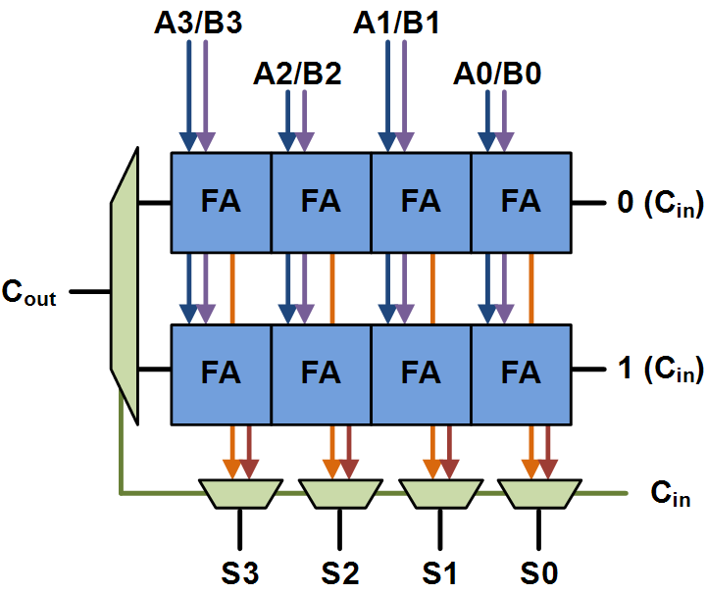
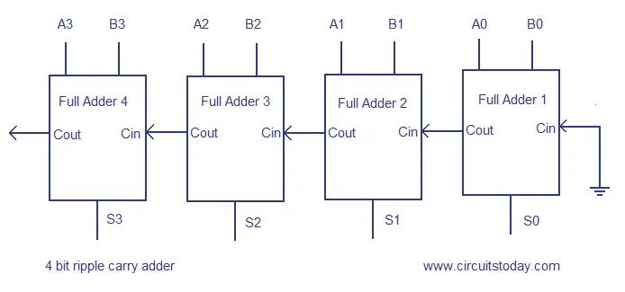
CSA and RCA
Carry select adder and Ripple carry adder
How can we repurpose a 32bit adder to add vector components? (think about the carry)

Slide 15
Intel MMX
Originally for 16-bits machines
Create a new vector register file:
  New register file with 64 bits wide registers!
  Add instructions to embed standard registers into vector registers
  Each vector register can be:
    64 = 32b * 2 or 16b * 4 or 8b*8
https://docs.oracle.com/cd/E18752_01/html/817-5477/eojdc.html

Slide 16
General “MMX” Design Overview
Vector RF Scoreboard
epoch
Vector Register file
pc
Register file
scoreboard
F
D
E
W
Imem/Dmem

Slide 17
Implementation remark
How do we do K multiplications/shifts per cycle?
  Put K multipliers/shifts?
  We could also time-share a fixed number of multipliers/shifts
Important decoupling idea:
  The instructions describe typically element-wise computations
  The implementation might run this computation across many cycles
    This requires more stalling and/or pipelines

Slide 18
Problem
What if we consider adding special vector instructions to load, shift, and add
Ld vr1 0x1000
vshl vr3 vr1 3
vadd vr1 vr3 vr4
If we do the strawman: we cannot start processing vadd until all the elements of vr1 have been shifted and written to vr3
How can we improve this?

Slide 19
Better diagram
What if we create a dedicated vector processing unit?
Vector Unit
Vector Register file
epoch
pc
Register file
scoreboard
F
D
E
W
Imem/Dmem

Slide 20
2-lanes vector-unit in BSV
interface VectorUnit;
method Action enq(Bit#(32) rs1, DInst dinst);
method ActionValue#(Tuple2#(Bit#(32), DInst)) deq();
method ActionValue#(MemReq) memreq();
method Action memresp(MemResp resp);
endinterface
typedef struct
{ DInst dinst; Bit#(3) fragId } PartialVInst …

Slide 21
Lanes
Let’s assume we can afford only 2 barrel shifter/multipliers.
Process the vector on 2 lanes:
  Lane 0 will handle elements [0,2,4,6]
  Lane 1 will handle elements [1,3,5,7]
vr1
vr2
vr3
vr4
…

Slide 22
Summary diagram (distributed) VectorUnit – vALU only
Note: arrows indicate appropriate FIFOs and pipelines
Vec Reg Read
Vec Exec
Vec wb
Vr_n: idx 0, 2, 4, …
Vec rf + sb
vecUnit2proc rf
Decode2vecUnit
Vr_n: idx 1, 3, 5, …
Vec rf + sb
Vec Reg Read
Vec Exec
Vec wb

Slide 23
2-lane vector unit – vInsts
Vector#(16, Bit#(32)) vrf1 <- mkReg(0); //32 could be 64,128,256 …!
Vector#(16, Bit#(32)) vrf2 <- mkReg(0);
SupFifo#(PartialVInst) lane0 <- mkSupFifo;
SupFifo#(PartialVInst) lane1 <- mkSupFifo;
method enq(Bit#(32) val, Dinst dinst);
if (isByteInst(dinst)) begin
lane0.enq1(p(dinst,0)); lane0.enq2(p(dinst,2));
lane1.enq1(p(dinst,1)); lane1.enq2(p(dinst,3));
end
if (is16bitsInst(dinst)) begin
lane0.enq1(p(dinst,0));
lane1.enq1(p(dinst,1));
end
…

Slide 24
2-lane vector unit
rule lane_0_reg_read if (isVArith(lane0.first1().dinst));
// Similar to Old decode, except that no more decoding to do!
// Only reading register
// sb private to lane 0, 1 bit per element
// The part of the vregister owned by the lane does not need
// to be fully written to read a part of it
end
rule lane_0_exec;
// Similar to Old exec, but much simpler (careful with sizes)
// no PC/branch/misprediction/epoch/business!
// no memory stuff neither. \o/ Fishy?
end
rule lane_0_wb;
// as old wb except! Except no business with memory
end

Slide 25
2-lane vector unit
rule lane_1_reg_read if (isVArith(lane1.first1().dinst));
// Similar to Old decode, except that no more decoding to do!
// sb private to lane 1, 1 bit per element
// The part of the register owned by the lane does not need
// to be fully ready for a next element to read
end
rule lane_1_exec;
// Similar to Old exec, but much simpler
// no PC/branch/epoch business
// no memory stuff \o/
end
rule lane_1_wb;
// as wb exec! Except no business with memory
end

Slide 26
Load instruction – 2-lane
method enq(Bit#(32) val, Dinst dinst);
if (isByteInst(dinst)) begin
lane0.enq1(p(dinst,0)); lane0.enq2(p(dinst,2));
lane1.enq1(p(dinst,1)); lane1.enq2(p(dinst,3));
end
if (is16bitsInst(dinst)) begin
lane0.enq1(p(dinst,0));
lane1.enq1(p(dinst,1));
end
if (isLoad(dinst)) begin
register scoreboard dependency for all the elements of the vreg
send load for address val;
end
…

Slide 27
Receive load value
method Action memresp(MemResp resp);
vrf1[getVRd(dinst)] <= subpart1(resp);
vrf2[getVRd(dinst)] <= subpart2(resp);
clear SBs dependency on getVRd(dinst)
let dinst = lane0.first1().dinst;
if (isByteInst(dinst)) begin
lane0.deq1(); lane0.deq2();
lane1.deq1(); lane1.deq2();
end
if (is16bitsInst(dinst)) begin
lane0.deq1();
lane1.deq1();
end
…

Slide 28


An ignored danger on this picture
We need to avoid accidentally overwriting a vector register on a branch
epoch
pc
Register file
scoreboard
F
D
E
W
branch
load
Vector Unit
Vector Register file
vadd

Slide 29
An ignored danger on this picture
Cheap solution: do not emit vector if there is a branch ahead
epoch
pc
Register file
scoreboard
F
D
E
W
branch
load
Vector Unit
Vector Register file
vadd
misprediction!

Slide 30
One last “detail”
How do we move values between vrf and rf:
  Standard register -> Vector register
  Vector -> Standard register

Slide 31
The RISCV world
RISCV vector instruction might sound quite different from MMX
  Vector registers don’t have ISA-fixed length
  vadd does not carry the size of the elements
All this is configurations with CSRs
Collection of RISC-V extensions listed in the ISA specs
https://riscv.org/technical/specifications/
https://github.com/riscv/riscv-v-spec/blob/master/v-spec.adoc

Slide 32
MMX is too limited
Modern and old vectors

Slide 33
Simple example - v2
We have one matrix of 4x16 elements (each 1 byte), we want to compute the sum of the elements
1. Compute the 4 sums of the columns using previous code
2. Finish by summing the 4 elements of the resulting vector
How to do step 2?

Slide 34
Back to lab1a
a | b | c | d
b | c | d | a
shufflel vra vrb i :=
“vra = vrb << i”
Shifting/Shuffling is tremendously useful
to perform operation across vectors!
// Want to reduce vr1 [a,b,c,d]
shufflel vr2 vr1 1
vadd vr1 vr1 vr2
// vr1 = [a+b, b+c, c+d, d+a]
shufflel vr2 vr1 2
vadd vr1 vr1 vr2
// vr1 = [a + b + c + d, b +c + d + a, … ]

Slide 35
Simple example – v3
We have 4 rows arrays of 16 elements (each 1 byte), we want to compute the 4 sums of their elements:
  For i in [0 ..3]:
  For j in [0 .. 16]:
  sum[i] = sum[i] + v[i][j];

Slide 36
Vectors in memory: Layout issues
“Rows”
v[0][0]
v[0][1]
v[0][2]
v[0][3]
v[1][0]
v[1][1]
…
v[16][3]
“Column”
v[0][0]
v[0][1]
v[0][2]
v[0][15]
v[1][0]
…
V[3][15]
addr 0
addr 0
addr 1
addr 1
addr 2
addr 2
addr 3
..
addr 15
First element of all the arrays, then
Second element fo all the arrays …
One array entirely
Before the next array
Big problem: one 64 bits (i.e. 1 line) load on the right does not bring
one element of each of the 4 vectors! Inefficient!

Slide 37
Strided loads
Populating the vector from memory might require noncontiguous data!
For array processing a common pattern is:
  vr[i] wants to get:
  base + i * offset
Slow/Multicycle operation, or requires changes to the cache!

Slide 38
More generally – Scatter gather
Populating the vector from memory might require noncontiguous data!
In general
  vr1[i] wants to get:
  mem[vr2[i]]
Slow/Multicycle operation, or requires changes to the cache!

Slide 39
Simple example – v4
We have 4 column arrays of 16 elements (each 1 byte), we want to compute the 4 sums of the elements greater than 42:
  For i in [0 .. 3]:
  For j in [0 .. 16]:
  if (v[j][i] > 42)
  sum[i] = sum[i] + v[j][i];

Slide 40
Not a problem!
  For i in [0 .. 3]:
  For j in [0 .. 16]:
  if (v[j][i] > 42)
  sum[i] = sum[i] + v[j][i];
  For i in [0 .. 3]:
  For j in [0 .. 16]:
  mask[i] = ~(v[j][i] > 42) + 1;
  sum[i] = sum[i] + (mask[i] & v[j][i]);

Slide 41
HW predication
SW predication is a fun game, consider:
  sum[i] = sum[i] * v[j][i];
Instead of having ad-hoc bit-tricks:
  One special vector register: predication register
The predication register tells which vector entries are active

Slide 42
Finally: Vectors vs threads
MMX: no, they all run the same program, with very limited way to touch the memory, all in sync.
With hw predication + shuffle + scatter/gather, we can start “emulating” threads.
How could we do jumps?

