Slide 1
Constructive Computer Architecture
Connecting devices and accelerators
Martin Chan
Adapted from Thomas Bourgeat

Slide 2
Errata – Lecture on vector
MMX actually reused existing registers (the x87 floating point registers)
It was SSE (the successor) that defined new registers (the xmm registers)

Slide 3
Outline
Motivator for accelerators
Discussing multiple hardware accelerators in the wild – 3 cases
  Some implementation details if using for project
Performance considerations
Software integration and usability

Slide 4
Motivator for accelerators

Slide 5
When do accelerators make sense?
Accelerators are tools to help your processor do some computations.
Hardware vs software
  Think of matrix multiply (100s vs 100ks of cycles)
High arithmetic intensity
Cost
What’s an application that might not
make much sense to accelerate?
Notes:
Little guy example
Not much sense: infrequent (machine-wise or per-machine), inexpensive, or likely to change

Slide 6
Devices and accelerators in the wild

Slide 7
Examples
Network Interface Cards (NIC)
  TCP/IP stack runs on some NIC
Crypto (AESENC and its siblings)
Matrix/ML accelerators
  Gemmini, TPU, etc.
GPU, GPGPU
  Fixed function/Fully programmable
FPGA accelerators
Signal processing
Many more

Slide 8
Basic observations
Wide range of programmability
  Programmable: GPU
  Not so programmable: NIC
  Not programmable: AES accelerator
Some requires new CPU instructions (AES), but not necessarily (NIC)
Let’s look at AESENC, NIC, DL

Slide 9
Case study 1: AESENC
Register-to-register accelerator

Slide 10
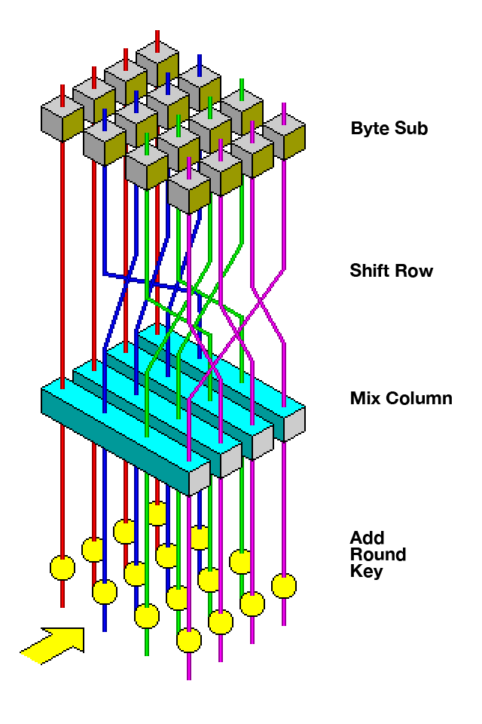
AES encryption
m and key are 128 bits
AES_encrypt(m, key)

Slide 11
AESENC
AESENC xmm1, xmm2
“Perform one round of an AES encryption flow, using one 128-bit data (state) from xmm1 with one 128-bit round key from xmm2”

Slide 12
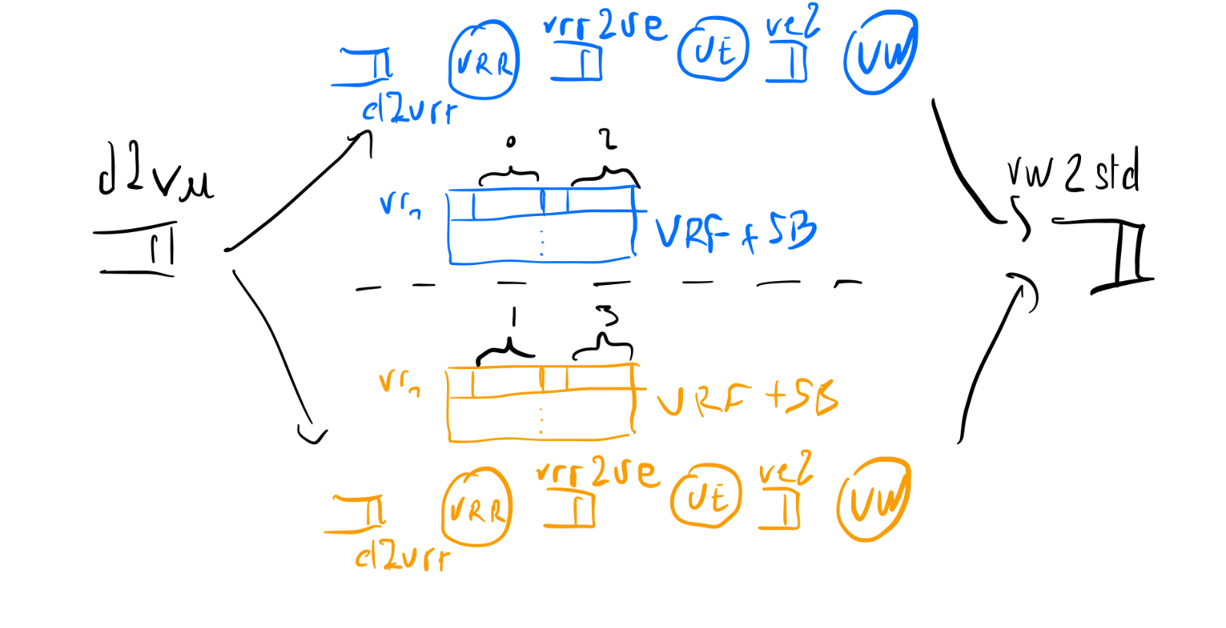
Can fit in vector unit!
Use vector registers to hold 128 bits
Add the new instruction: decode and execute
*
*

Slide 13
TODO
Potentially add slides to show the code?

Slide 14
Performance gain
~4-8 cycles of latency for the instruction
  Accelerator can be pipelined
Some nonresearch evaluation shows a 10x speedup on a pure AES benchmark
Sources:
https://eprint.iacr.org/2016/299.pdf
https://www.tomshardware.com/reviews/clarkdale-aes-ni-encryption,2538-7.html

Slide 15
Case study 2: a pseudo-NIC
A typical device – memory-to-memory
Notes:
Sometimes the input and outputs don’t fit in registers. E.g., think of network packets.

Slide 16
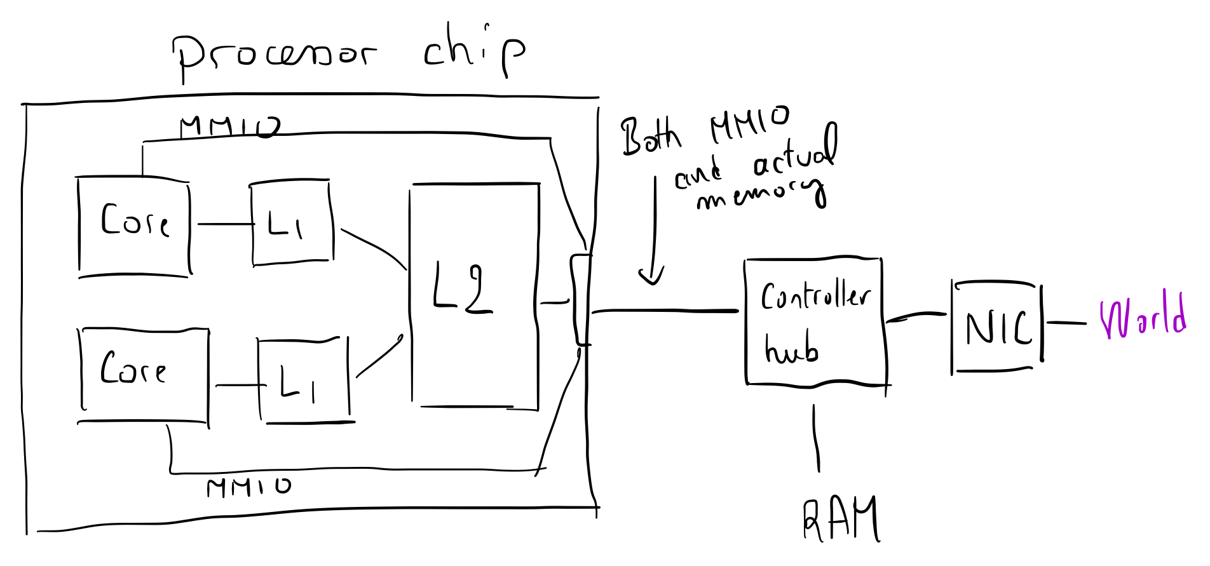
Slightly unfamiliar view
High-level picture – NIC
MMIO
Uncached
Uncached
Std Memory
operations

Slide 17
Simplified journey of a packet in a fancy NIC
Processor tells NIC:
  Address in RAM for SEND packets
  Address where NIC should put the RECEIVED packets
Application generate data to send:
  “GET / HTTP/1.1
  Host: www.example.com
  User-Agent: Mozilla/5.0
  …”
Wrap the string in an envelope with an address
Put the envelope in the SEND location

Slide 18
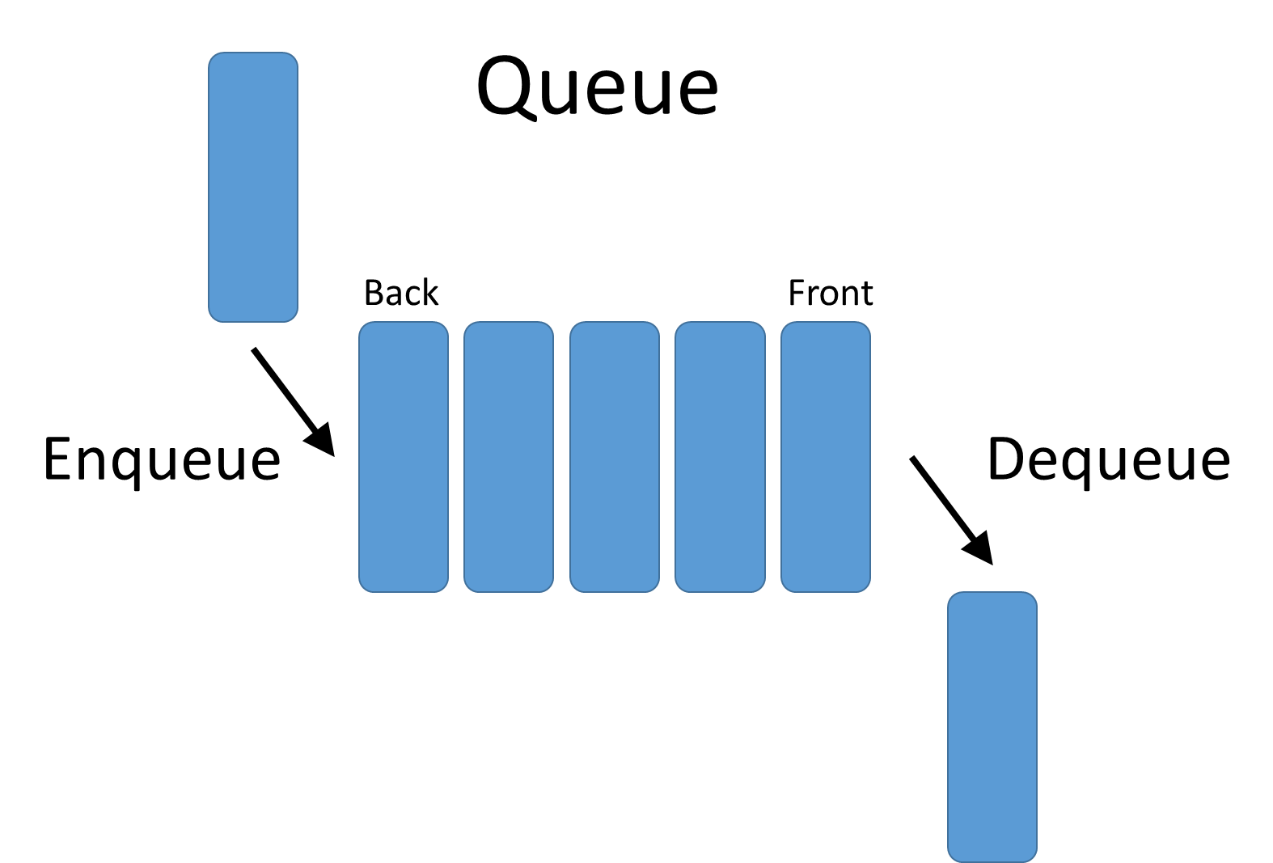
Agreeing on send locations
ToSend:?
Received:?
0x1000
uncachedstore
0xF000_0000
0x1000
0x1000
ToSend
Notes:
Interesting thing: software queue. Needs to be in a stable location (don’t want the NIC looking when the processor moved it around)

Slide 19
Agreeing on receive location
ToSend:0x1000
Received:?
uncachedstore
0xF000_0004
0x5000
0x5000
0x1000
ToSend
0x5000
Received

Slide 20

Simplified journey of a received packet
ToSend:0x1000
Received:0x5000
0x1000
ToSend
0x5000
Received

Slide 21
The NIC-CPU system
ToSend and Receive are in-mem circular buffers:
  CPU push into ToSend and pull from Received
  NIC push into Received and pull from ToSend
The NIC, once configured, operate independently of the core
The NIC performs computations – network cost little CPU compute

Slide 22
Arrivals and departures
How does NIC know when something should be sent
How does CPU know when something arrived
Two solutions:
  Active polling – check every 1ms
  Doorbell mechanism:
    CPU -> NIC: store to special location
    NIC -> CPU: Interrupts
    Note the apparent asymmetry

Slide 23
MMIO vs Shared memory
Through MMIO the processor sends commands and pointers
The data is not sent directly through MMIO, but through shared memory
Why MMIO to NIC must be uncached?
Why stores to ToSend must be uncached?

Slide 24
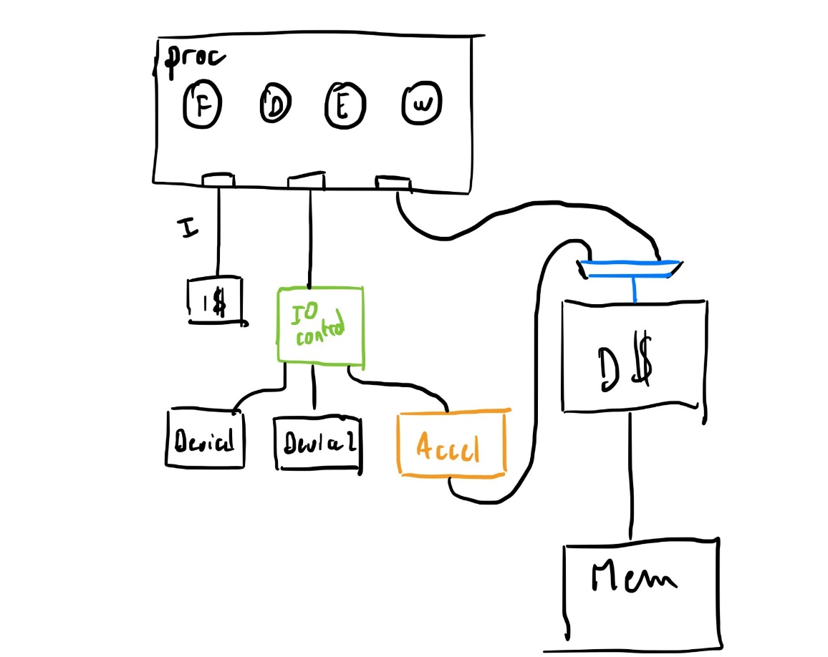
Simplified picture for our world
So far: single bus for MMIO/mem
Our world is simpler thanks to a different architecture:
Notes:
Or hook it up to the L2 or CacheInterface. As long as we don’t bump into coherency issues (reason for the uncached stuff before)

Slide 25
Simplest “IO controller”?
let req <- rv_core.getMMIOReq;
if (req.byte_en == 'hf) begin
if (req.addr == 'hf000_fff4) begin
$fwrite(stderr, "%0d", req.data); $fflush(stderr);
end
if (req.addr == 'hf000_fff0) begin
$fwrite(stderr, "%c", req.data[7:0]); $fflush(stderr);
end
if (req.addr == 'hf000_fff8) begin
if (req.data == 0) $fdisplay(stderr, " PASS");
else $fdisplay(stderr, " FAIL (%0d)", req.data);
$fflush(stderr); $finish;
end
end
This code can be extended to push req
in the queue corresponding to the NIC
or your favorite accelerator!

Slide 26
Case study 3 - Matrix multiply (pseudo-gemmini)
(another) memory-to-memory accelerator

Slide 27
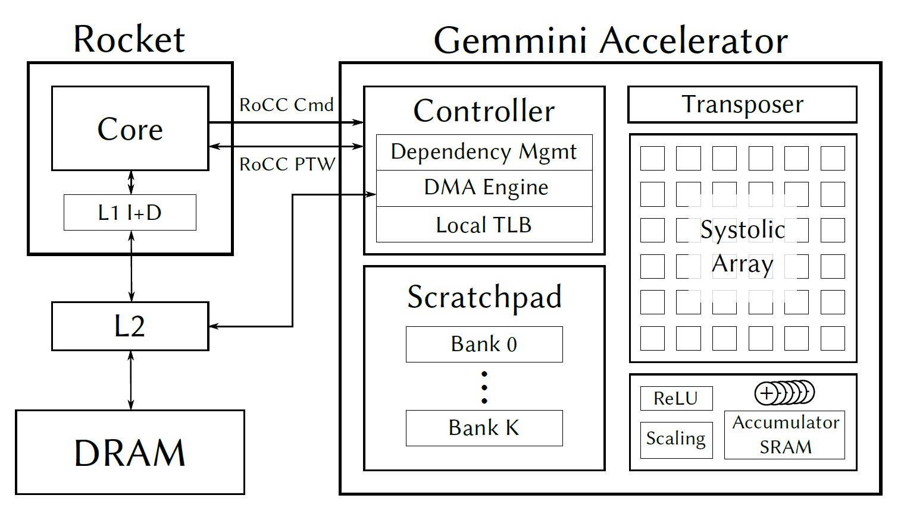
General Matrix Multiply– The Gemmini accelerators
Source:
GitHub - ucb-bar/gemmini: Berkeley's Spatial Array Generator
Notes:
Accelerator has its own memory. A scratchpad to help it do its work.
Dependency management for internal logic.
DMA: Direct memory access
TLB: Virtual memory thing

Slide 28
Simplified commands for Gemmini-like
Let’s define accelerator instructions (not processor instructions!)
  “mvin a sbase length”
    for (0 <= i < length)
      scratchpad[sbase+i] <= mem[a+i]
  “mvout a sbase length”
  “matmul.compute A B C D“
    C = A * B + D
We liberally simplified:
1. Mv are fancier because matrix are 2 dimensional
2. Compute is decomposed into multiple instructions for flexibility
Notes:
Kind of like instructions for your accelerator. Good for project.
Can but not necessarily corresponds to the RISC-V instructions that your processor consumes. We’re looking from the accelerator.

Slide 29
General Matrix Multiply– The Gemmini accelerators
Send gemmini instructions
Data access
Source:
GitHub - ucb-bar/gemmini: Berkeley's Spatial Array Generator

Slide 30
Gemmini accelerator instructions
Why decouple instruction between data movement and compute?
What are the key differences between:
  Instructions for Gemmini
    ex: mvin a sbase length
  Instructions for a RISC-V core
    ex: add r1 r2 r3
Notes:
Decouple; might want to use the same operand multiple times (e.g., A x B, A x C, A x D).
Differences: 1. Gemmini takes orders, RISC-V fetches its own instructions. 2. Gemmini doesn’t receive with registers, core does. Gemmini receives values.

Slide 31
How to send a command from SW?
Proposition 1: map accelerator into MMIO space (multiple addresses)
  sw queue_arg1 r1
  sw queue_arg2 r2
  sw queue_opcode r3
Proposition 2:Add new instructions that does all of this!
    Read the 2 registers, push the values of those registers and the appropriate opcode directly to the accelerator queue
https://github.com/IBM/rocc-software/blob/954057f216a1900c4a0906021145737385876f7f/src/xcustom.h#L147
Notes:
Depends on flexibility of your ISA and the extensibility.
This is pretty much the slide you want to pay attention to for connecting your accelerator and have it be usable.

Slide 32
Dangerously confusing
The new accelerator instructions:
  Starts their life as new processor instruction with opcode OP:
  At decode time, read rs1, rs2: (rv1,rv2)
  At execute time, push the “Gemmini” instruction:
      “OP a sbase length”
      a = rv1, sbase = rv2[0:15], length=rv2[16:31]
  Directly writeback (no destination register)

Slide 33

Sketch in BSV

Slide 34
MMIO-style integration
A pseudo-snippet (in future top_pipelined.bsv)
Bit#(32) addr_accelerator = 0xF000C0FFE;
Cache cache <- mkCache;
Memory mem <- mkMem;
RVIfc rv_core <- mkpipelined;
Accelerator accel <- mkAcccelerator;
…
rule requestMMIO;
let req <- rv_core.getMMIOReq;
if (req.byte_en == 'hf) begin
if (req.addr == addr_accelerator) begin
accel.put(req.data)
end
…
Notes:
Some slight differences. I think the Memory lives in CacheInterface, so you’ll need additional methods that accommodate the accelerator stuff.

Slide 35
MMIO-style integration
A pseudo-snippet (top_pipelined.bsv)
…
FIFO#(CoreOrAccel) who_uses_cache <- mkFIFO;
…
rule requestD;
let req <- rv_core.getDReq;
cache.put(…)
who_uses_cache.enq(Core);
…
endrule
rule requestAcc;
let req <- acc.memreq;
cache.put(…)
who_uses_cache.enq(Accel);
…
endrule
Notes:
Similar problem to getting L2 to service both iCache and dCache. We need to have some way for the cache to know whether to talk to the core or the accelerator.

Slide 36
MMIO-style integration
A pseudo-snippet (top_pipelined.bsv)
…
rule responseCache;
let x <- cache.get();
let origin = who_uses_cache.first();
who_uses_cache.deq();
if (origin == Core)
rv_core.getDResp(req);
else accel.getDResp(req);
endrule

Slide 37

Remark
Wherever else did you use a similar multiplexer in your project?

Slide 38
Summary so far
(Some types of accelerators)

Slide 39
Architectural observations
AES - within the core
NIC - off-chip
  Direct access to memory
  Internal memory, ~10MB – 80GB
  Simple configuration through “MMIO”
Gemmini-like – out-of-core, on-chip:
  Access to the coherent memory
  Uses scratchpad
  Commands sent through MMIO or directly through new processor instructions

Slide 40
Performance considerations
Or when accelerator can’t do miracles

Slide 41
Latency numbers
On-chip latency:
  1 cycle (registers memory) -~10 clock cycles (last level cache)
Off-chip (e.g. PCIe) latency:
  1us (~4000 cycles)
  A whole lot of CPU work!
Why not have everything on chip?
Notes:
Why not have everything on chip? (circuit-level, or amount of data input/output)
Can help off-chip if we pipeline, e.g. AESENC.

Slide 42
Throughput considerations
PCIE throughput (gen 2):
  500MB/s per lane (up to 16 lanes)
  Reality: a few GB/s
  CPU/DRAM bandwidth ~5-10x more (60-150GB/s)
  Internal GPU bandwidth: ~1TB/s
More modern PCIE: 1GB/s (resp. 2GB/s) per lane for Gen3 (resp. Gen4)

Slide 43
Throughput takeaway
FPGA being disappointing
If a CPU already manages to saturate memory bandwidth, an accelerator won’t go faster!
FPGA will typically go slower when because PCIe bandwidth < DRAM bandwidth
Accelerator best leverage “high arithmetic intensity” code, those applications are not so common
Notes:
Check where your bottleneck is.

Slide 44
Software integration
We have accelerators, now how do we run
software using them (or test them)?

Slide 45
Using MMIO from SW
Write a program to manage the shared buffers with the device:
  Allocate buffers
  Recycle buffers
  Send address of buffers to device
  Doorbell code, etc…
Such a program is named a device driver!
Notes:
Remember the management with the NIC. Where the buffer is, etc.

Slide 46
Adding instructions from SW – AES-like
Add new instructions
Generate programs that use the new instructions
  Necessary both for Gemmini-style and for AESENC-style

Slide 47
Adding a new instruction in assembly
In assembly, if the new instruction matches the structure of standard riscv instruction: we can use the “.insn” directive:
  Redefine “add a0, a1, a2”:
    “.insn r 0x33, 0, 0, a0, a1, a2”
See the following for some useful documentation:
https://www.rowleydownload.co.uk/arm/documentation/gnu/as/RISC_002dV_002dDirectives.html
https://sourceware.org/binutils/docs/as/RISC_002dV_002dFormats.html

Slide 48
Incantations to inject assembly directly in C
asm volatile(".insn r " opcode ", " fn2 ",
" fn7 ", x0, %0, %1" : : "r"(rs1), "r"(rs2));
// Read the manual
// https://gcc.gnu.org/onlinedocs/gcc/Extended-Asm.html
Sufficient and expected for project using accelerator
(hand-write assembly in C or RISC-V to test)

Slide 49
Software Integration
The elephants are in the room
Having defined new instructions is not the end of the story:
  If I add AESENC, my libssl library won’t suddenly start using it
  Have to worry about cross-platform
If I have matmul 16x16, or matmul (nxm forall n,m<64),
  512x512 matmul?
  convolution?
  Arbitrary linear/tensor algebra operator
Notes:
It would benefit from compiler help.

Slide 50
Something more automatic?
We want compiler help to make good use of the accelerator.
Ordinary software calls specialized software libraries (e.g., PyTorch, libssl)
  Useful for when the use doesn’t exactly match the instructions.
  Useful to hide instructions.
Writing in a special language (e.g., CUDA)
Notes:
e.g., the matrix multiplications.

Slide 51
Compilation challenges
The elephants are in the room
All things considered standard compilation is easy:
  Usually not too many different ways to compile
With Domain Specific, program space is typically very complicated
  A*(B*C)*A or (A*B) * (C * A) …
  Compiler must find best sequence of instructions modulo rewrites

Slide 52
Compilation – Sync issues
The elephant are in the room
Sync issues:
  Need to add explicit data movement instructions if I want to use the data computed on CPU
Hot research ideas:
  Decoupling functionality and scheduling (e.g., Halide, TACO for tensor code)
  Maybe not a fully push-button compilation, more an “assistant-compiler”, where the user is the actual compiler (e.g., Exo)
Notes:
One program about describing the computation itself, then separate guide about data orchestration.
For project, would write the assembly program yourself. Or if brave then use the other tools we talked about.

Slide 53
Fixed-function GPU
Extra-slides

Slide 54
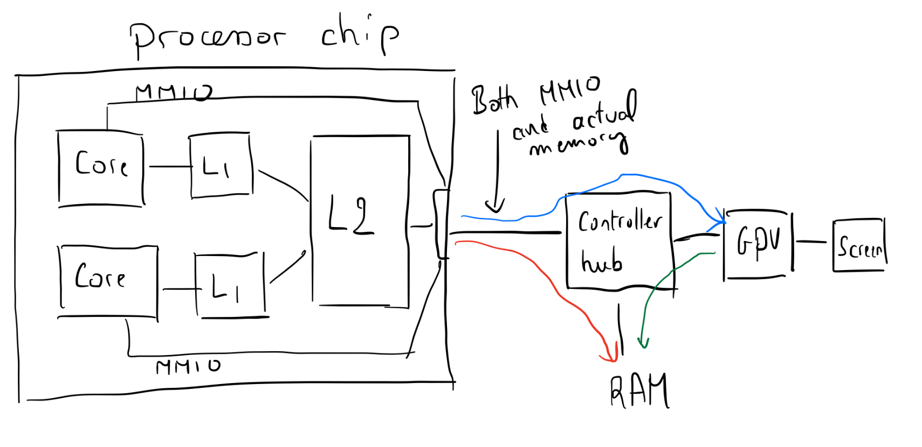
High-level pictures - GPU
Dedicated RAM

Slide 55
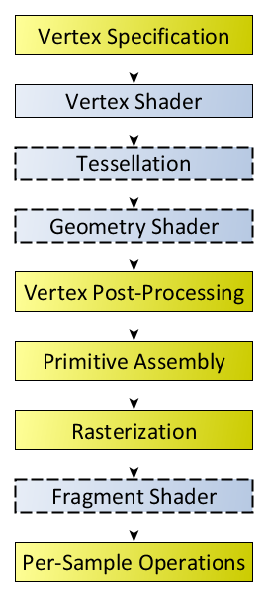
Graphics pipeline (openGL-like)
Input data:
objects (set of polygones)
scene (objects position)
camera
textures and texture mapping
source of light …

