Slide 1
The Hemlock and Murray Chambers
A Comparison

Slide 2
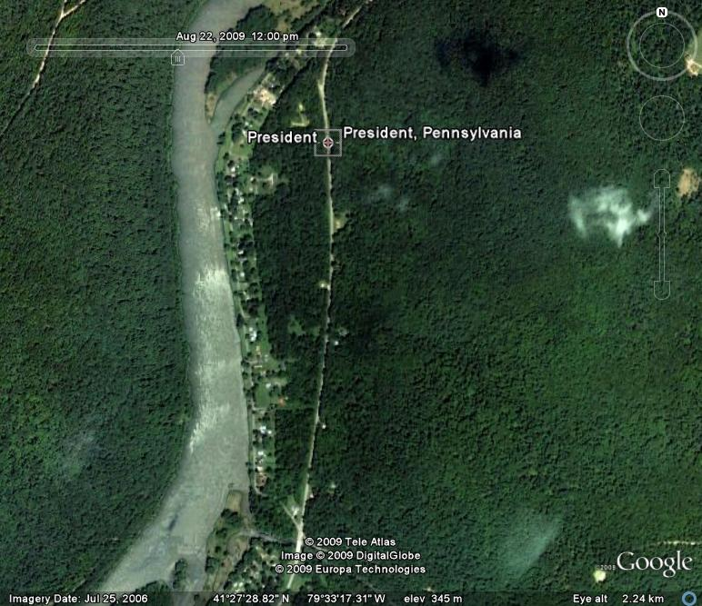
The Hemlock Chamber
President, PA

Slide 3
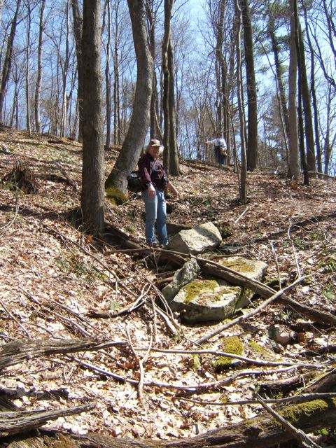
Tom Anderton at the entrance to the chamber, among the fallen roof slabs

Slide 4
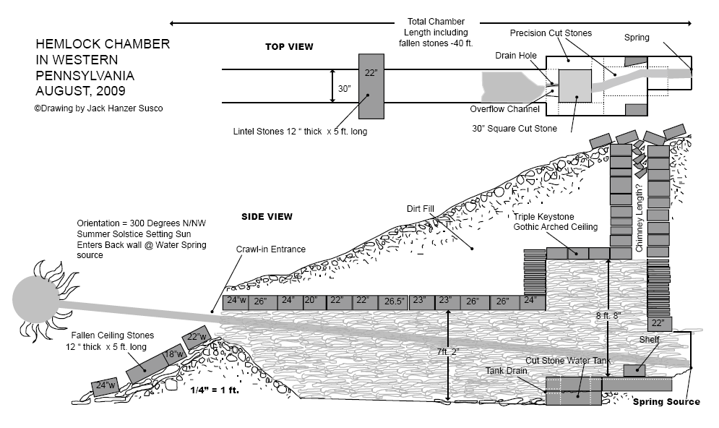

Slide 5
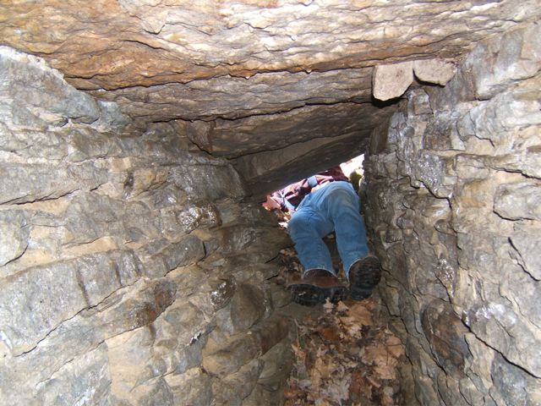
Entering chamber

Slide 6
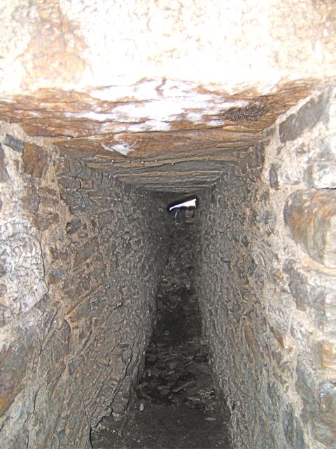
View from “vault” section
Note in “tunnel” section
  Slab roof
  Mortared joints
  Dirt floor

Slide 7
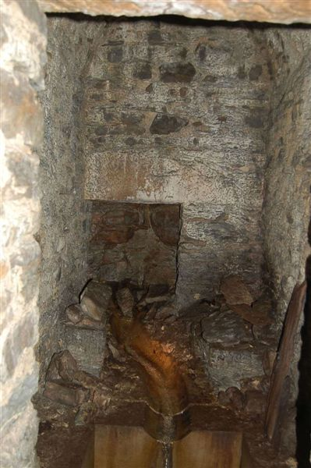
View of “vault” section
Note
  Recessed spring entrance
  Ledges in both corners
  Channel into square basin

Slide 8
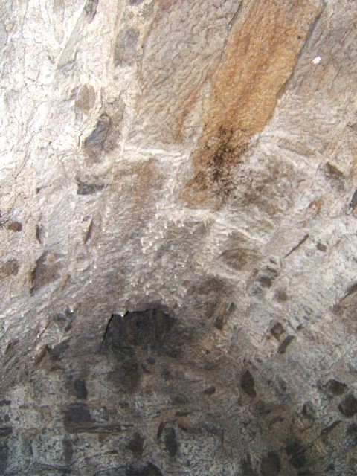
Barrel arched ceiling
Chimney visible which vents to surface
Visible on surface

Slide 9
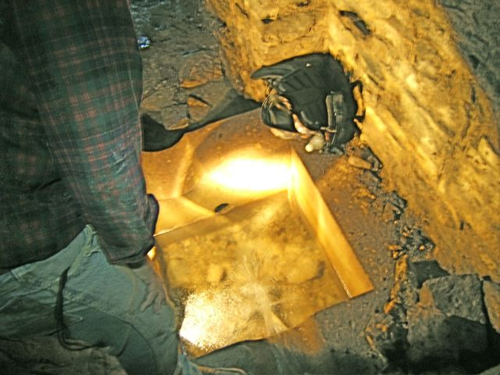
Floor Basin
Drain hole drilled 19 inches through stone

Slide 10
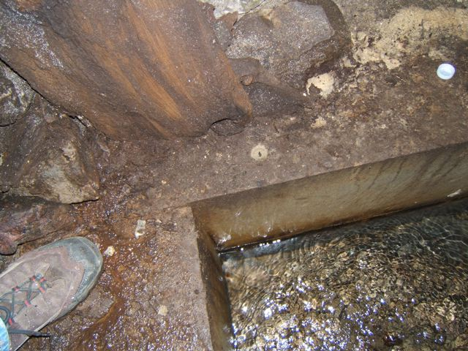
Basin created by four stone slabs adjoining
  Note seam
Wall using stone basin as foundation

Slide 11
Chamber orients East-West
Summer solstice sunset enters chamber, lights basin through hole in stone

Slide 12
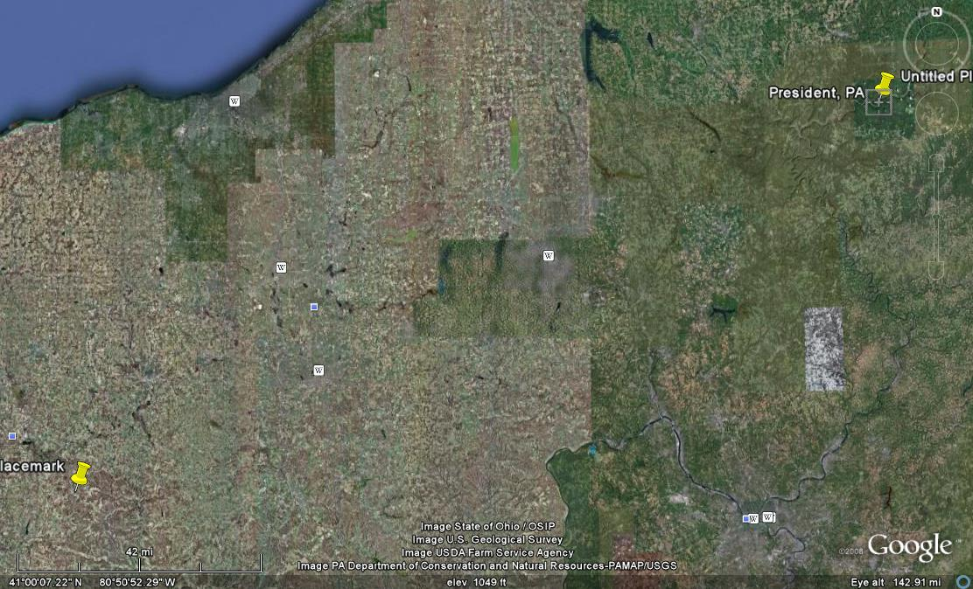
Murray Chamber
Greer, Ohio
Located 180 miles WSW of President, Pennsylvania

Slide 13
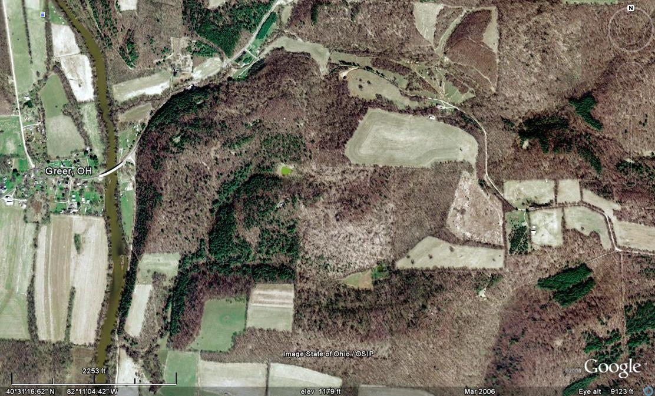
Murray Chamber
Greer, Ohio

Slide 14
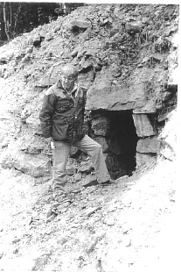
Current entrance
Portion of chamber removed by excavation in 1982, which discovered the chamber

Slide 15
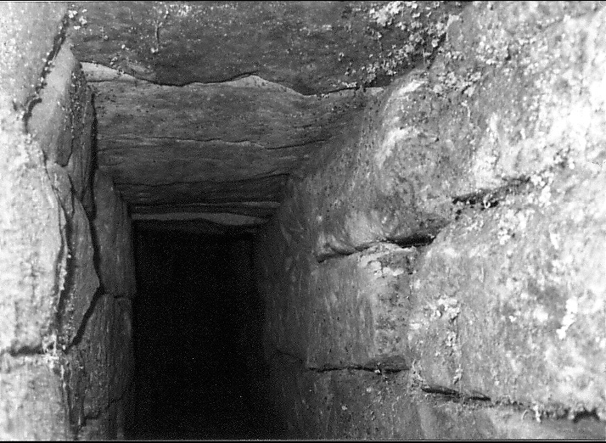
“Tunnel” portion of Murray Chamber

Slide 16
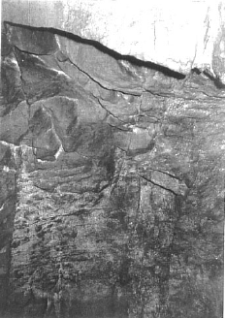
Close up of barrel arched ceiling of the Murray Chamber

Slide 17
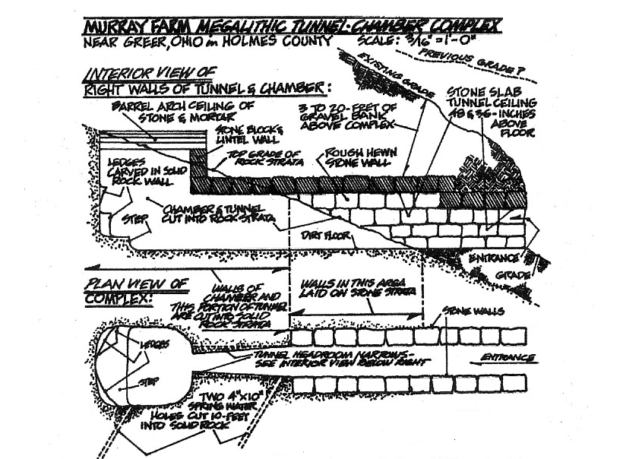
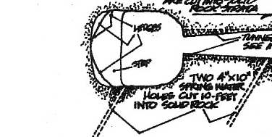
Note two spring water “holes”
Chamber oriented North-South, opens to North

Slide 18
Comparing the Chambers
 | Murray |  | Hemlock
Length (Approx.) | 31' (+?) |  | 40'
 | Tunnel | Vault | Tunnel | Vault
Width | 18"-24" | 50"-53" | 30" | 60"
Height | 3'-4' | 8'2" | 7'2" | 8'8"

Slide 19
Comparing the Chambers
 | Murray |  | Hemlock
 | Tunnel | Vault | Tunnel | Vault
Ceilings | Slab | Barrel Arch | Slab | Barrel Arch
Walls | Dry Stone |  | Mortared
Slabs (Approx.) | 40"L x 15"-22"W x 14"H |  | 60"L x 18"-26"W x 12"H
Spring Water/ Containment | 2-10'L x 4"W x 10"H "holes" |  | 30" square basin/channels

Slide 20
Comparing the Chambers
 | Murray | Hemlock
Ledges Against Rear Wall | 3 | 2
Proximity to River | 0.6 miles to Mohican River | <½ mile to Alleghany River
Orientation | North | West
Iron Ore In Area | Yes | Yes

