Slide 1



2025 2nd Asia Pacific Conference on Innovation in Technology (APCIT)
Decoding Dementia: A Deep Learning Framework for Multi-Class Alzheimer’s Classification Using VGG16 and MRI Scans
Paper ID: 2111
Garikapati Revanth Sai Department of Computer Science and Engineering,
Narasaraopeta Engineering College (Autonomous), Narasaraopet.

Slide 2

Index-
Introduction
Objectives
Literature Survey
Proposed Framework
VGG16 Feature Extraction
Grey Wolf Optimizer (GWO)
Implementation
Results & Analysis
Conclusion
Future Scope

Slide 3
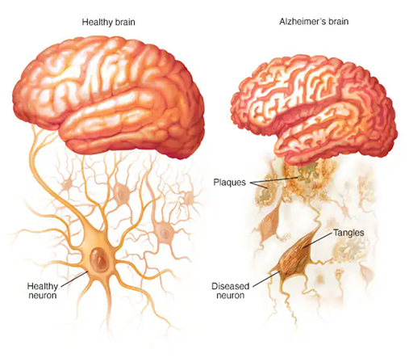
Introduction-
Alzheimer’s Disease → most common cause of dementia (>60% cases).
Early detection is critical for treatment and care.
Traditional diagnosis (memory tests, MRI observation) → limited accuracy.
Challenges:
Class imbalance in datasets
High-dimensional MRI features
Need: AI-based framework for accurate, stage-wise classification.

Slide 4
Objectives-
Our Research work aims to:
Develop a VGG16-based CNN for multi-class Alzheimer’s classification.
Apply Grey Wolf Optimizer (GWO) for feature selection.
Use SMOTE-Tomek to handle dataset imbalance.
Achieve high accuracy and robustness across all disease stages.
Ensure the model is interpretable and clinically relevant.

Slide 5
Literature Survey-
Existing Research:
VGG-based CNNs + Resampling (SMOTE-Tomek): Helped with imbalance but lacked interpretability.
Graph Neural Networks (GNNs): Captured brain connectivity but unstable with noisy data.
Dual-stream CNNs: Improved early AD classification but sensitive to imaging variations.
Reviews & Hybrid Models: Good progress, but still issues with scalability and transparency.
Gap Identified:
Need for a robust, optimized, and interpretable framework for MRI-based AD stage classification.

Slide 6
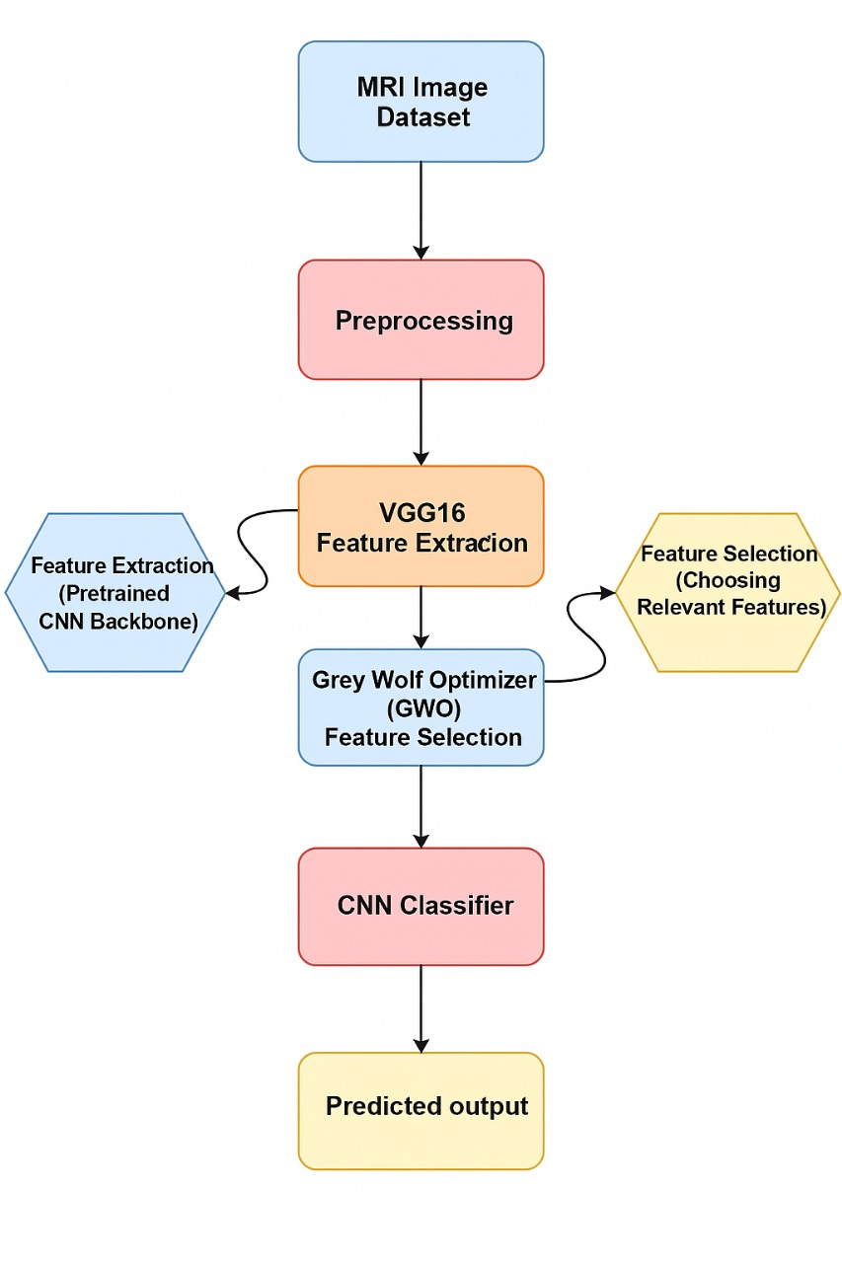
Proposed Framework-
Pipeline Overview:
Input: Brain MRI scans (4 classes – Non-Demented, Very Mild, Mild, Moderate).
Preprocessing: Resize, normalization, label encoding.
Feature Extraction: VGG16 model captures structural + textural patterns.
Feature Selection: Grey Wolf Optimizer (GWO) selects most important features.
Classification: Custom CNN classifies into Alzheimer’s stages.
Evaluation: Accuracy, Precision, Recall, F1-score, ROC-AUC.

Slide 7
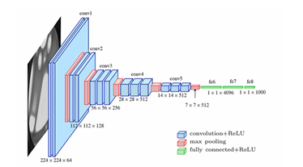
VGG16 Feature Extraction-
Key Points:
Pre-trained deep CNN used for extracting hierarchical features.
Handles spatial patterns & textural details in MRI scans.
Transfer learning → efficient even with smaller datasets.
Architecture highlights:
13 convolutional layers + ReLU
Max-pooling for dimensionality reduction
Fully connected layers → modified for 4-class output

Slide 8
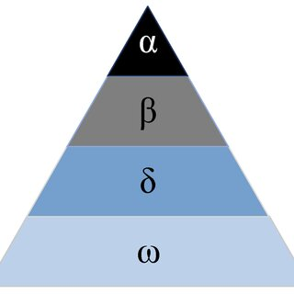
Grey Wolf Optimizer (GWO)-
Key Points:
Nature-inspired algorithm → mimics hunting behavior of grey wolves.
Roles in hierarchy: Alpha (α), Beta (β), Delta (δ), Omega (ω).
Used for feature selection:
Removes redundant features.
Keeps only most discriminative ones.
Improves efficiency & reduces overfitting.
Balances exploration (searching broadly) and exploitation (refining solutions).

Slide 9
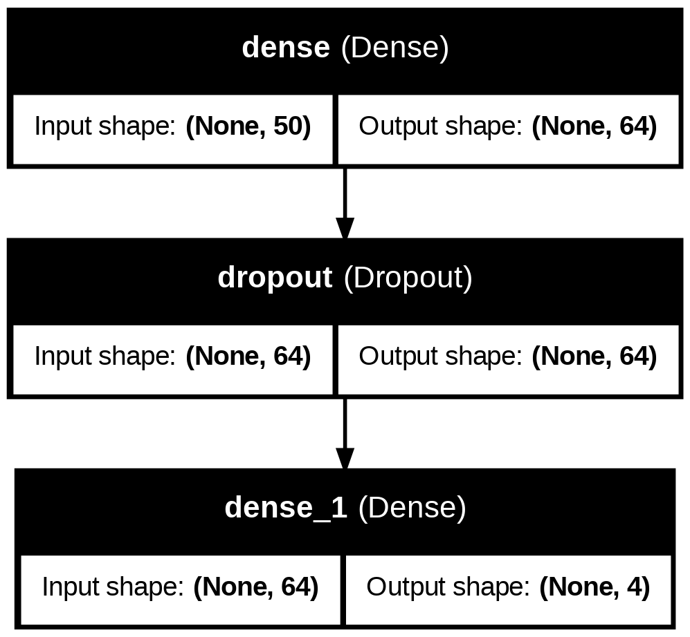
Implementation-
Dataset:
Public Alzheimer’s MRI dataset.
4 classes: Non-Demented, Very Mild, Mild, Moderate.
Balanced subset → 200 images per class (800 total).
Train-test split: 80:20.
Preprocessing:
Resized images → 224×224 pixels.
Normalization using Keras preprocess_input().
One-hot label encoding.
Training Setup:
CNN trained on GWO-selected features.
30 epochs, Adam optimizer, categorical cross-entropy loss.
Layers: Conv2D + ReLU → MaxPooling → Dropout → Dense → Softmax.

Slide 10
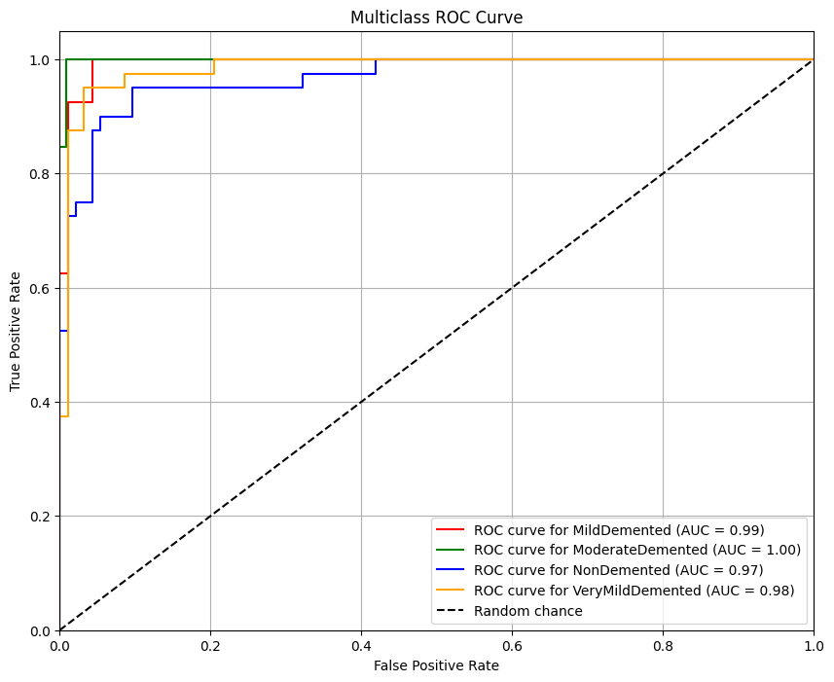
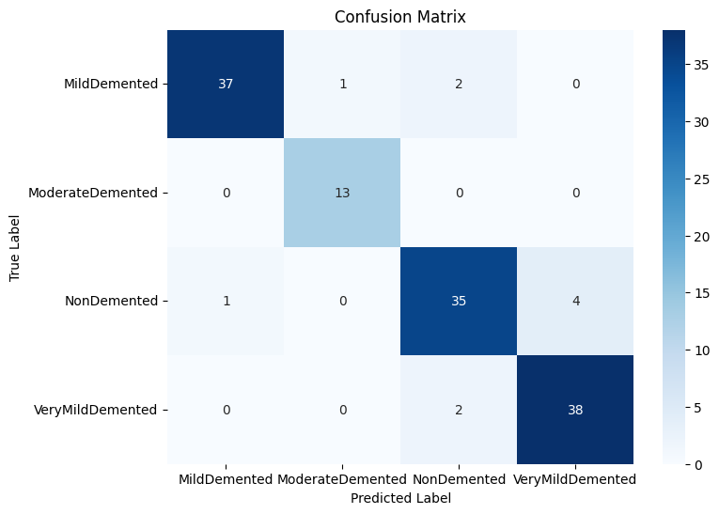
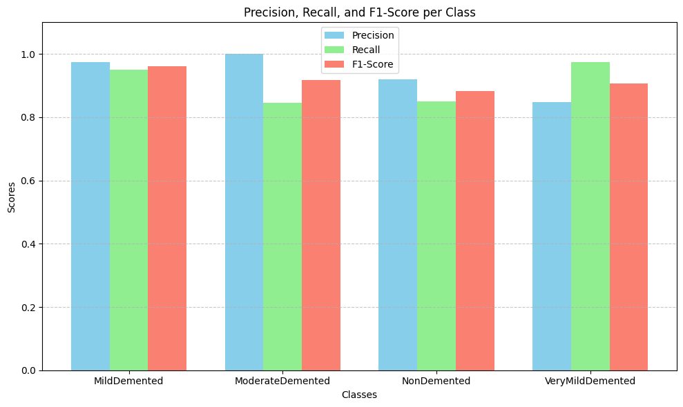
Results & Analysis-
Model Performance:
Validation Accuracy: > 99.3% across 30 epochs.
Loss Curves: Smooth convergence → no overfitting.
Confusion Matrix: High accuracy in all 4 classes; minor misclassifications between Mild & Very Mild.
Class-Specific Metrics:
Precision, Recall, F1-score: > 0.90 for all classes.
AUC Values:
Mild Demented → 0.99
Moderate Demented → 1.00
Non-Demented → 0.97
Very Mild Demented → 0.98
Macro-average AUC → 0.9958
Comparisons:
Outperformed baseline models:
VGG19 → 82.6%
DenseNet169 → 80%
Proposed VGG16 + GWO → 99.36% Accuracy, 99% F1-Score

Slide 11
Conclusion-
Key Takeaways:
Proposed VGG16 + Grey Wolf Optimizer (GWO) framework for Alzheimer’s MRI classification.
Achieved 99.36% accuracy and 99% F1-score → surpassing state-of-the-art models.
GWO-based feature selection improved efficiency and reduced overfitting.
Framework provides reliable, stage-wise classification → supports early diagnosis.

Slide 12
Future Scope-
Next Steps:
Integrate explainability tools (e.g., Grad-CAM++) for clinical interpretation.
Extend framework to other modalities (PET, CT scans, multimodal data).
Validate on larger and more diverse populations.
Optimize further for real-time clinical applications.
THANK YOU

