Slide 1
Decoding Dementia: A Deep Learning Framework for Multi-Class Alzheimer’s Classification Using VGG16 and MRI Scans

Slide 2

Department of Computer Science and Engineering Decoding Dementia: A Deep Learning Framework for Multi-Class Alzheimer’s Classification Using VGG16 and MRI Scans
PRESENTED BY
G Revanth Sai
M Karthik
K Aditya
Ch Jaswanth Reddy
(22471A0521.)
(22471A0528.)
(22471A0527.)
(22471A0506.)
Under the Guidance of,
Rama Krishna Eluri _{Mtech,phd},
Associate Professor,
Department of Computer Science and Engineering,
Narasaraopeta Engineering College (Autonomous), Narasaraopet- 522 601.
Review No. 1
Department of CSE

Slide 3
OUTLINE
Abstract
Introduction
Literature Survey
Research Gaps
Problem Statement
Objectives
Block Diagram / Flow Diagram
Methodology
Implementation
Results and Analysis
Conclusion & Future Scope
References
Question and Answers
Acknowledgements
Review No. 1
Department of CSE

Slide 4
ABSTRACT
Alzheimer’s Disease (AD) diagnosis is challenging due to imbalanced data and high-dimensional MRI features
Proposed framework combines VGG16 deep learning and Grey Wolf Optimizer (GWO) for feature selection
Classifies AD into four stages: Non-Demented, Very Mild, Mild & Moderate Demented
Achieved 99.36% accuracy and strong F1-score in experimental study
Demonstrates potential for accurate early-stage detection and clinical assistance
Review No. 1
Department of CSE

Slide 5
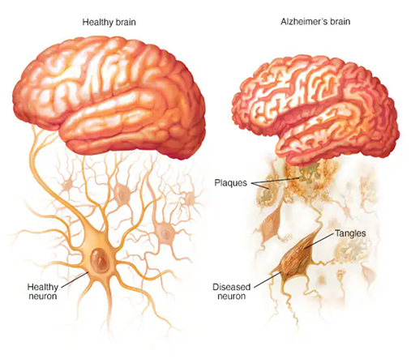
Feature | Healthy Brain | Alzheimer’s Brain
Brain size | Normal | Shrunk / atrophied
Neuron health | Strong, intact | Damaged, dying
Amyloid plaques | Absent | Present
Tangles | Absent | Present
Brain clarity | Clean & organized | Cloudy, disrupted
Connectivity | Strong | Weak or broken

Slide 6
INTRODUCTION
Alzheimer’s Disease (AD) is a progressive neurodegenerative disorder
Affects memory, cognitive functions, and daily life activities
Most common cause of dementia, affecting 60–70% of cases globally
Brain damage caused by amyloid-beta plaques & tau tangles
Early diagnosis helps slow progression and supports better treatment
MRI scans provide crucial structural information for AD detection
Deep learning techniques improve accuracy in identifying AD stages
Review No. 1
Department of CSE

Slide 7
LITERATURE SURVEY
No | Title | Author | Journal Name & Year | Methodology Adapted | Key Findings | Gaps
1 | STCNN: Combining SMOTE-TOMEK With CNN for Imbalanced Classification of Alzheimer’s Disease | Anjali et al., | URL of the paper | SMOTE-TOMEK resampling, train-validation-test split, CNN (VGG-style), Adam optimizer, Softmax output | Achieved 99.36% accuracy and 99% F1-score; effectively handled class imbalance using SMOTETOMEK. | Limited interpretability; does not address real-time clinical scalability.
2 | A Lightweight Deep CNN Extracting Contextual Features for AD Using Structural MRI | Emimal Jabason et al., |  | Skull stripping, registration, bias correction, entropy-based 2D slice selection, LHAttNet, dual-context attention-augmented CNN | High accuracy (>97%) in binary and multi-class tasks with fewer parameters and strong generalization | Lacks full 3D context modeling; limited multimodal input
3 | A Cross-Modal Mutual Knowledge Distillation Framework for Alzheimer’s Diagnosis | Min Gu Kwak et al., |  | Spatial normalization, 3D resizing, data augmentation, IC-MKD, MDT-Student bidirectional distillation | Robust performance on incomplete data using MRI alone via knowledge from PET+MRI teacher. | Scalability to more modalities and interpretability remains limited.
4 | Improving Alzheimer’s Diagnosis With MultiModal PET Features by 3D MLP-Mixer | Zi-Chao Zhang et al., |  | SPM12, sMRI processing, gray matter extraction, 3D-Mixer with regression and classification modules | AUC of 0.968 and generalizes well across 5 datasets using sMRI-only to emulate PET. | Simple fusion technique; lacks tau PET/functional data.
5 | Biceph-Net: Lightweight Framework for Alzheimer’s Using 2DMRI and Deep Similarity | Ashraf Haroon Rashid et al. |  | CAT-12 gray matter segmentation, 2D slice extraction, Biceph-Net with VGG-16 and triplet + cross-entropy loss | 100% accuracy in AD vs CN; interpretable embeddings and efficient computation | Only single-slice input; no multimodal integration.
Review No. 1
Department of CSE

Slide 8
LITERATURE SURVEY
Key Findings from Existing Research:
Deep learning models such as CNN, VGG-based architectures are widely used for AD classification
SMOTE-Tomek and other data balancing techniques improve performance on imbalanced datasets
Knowledge distillation and ensemble techniques enhance model generalization
Most studies focus on limited imaging modalities and struggle with interpretability
Limitations Identified:
Insufficient handling of high-dimensional MRI features
Early-stage AD diagnosis remains challenging due to very subtle brain changes
Lack of explainability for clinical adoption
Many models fail to scale to real-world medical data
Review No. 1
Department of CSE

Slide 9
RESEARCH GAPS
• Existing models struggle with early-stage AD detection due to subtle MRI variations • High-dimensional MRI data leads to overfitting and reduced model efficiency • Class imbalance between different AD stages affects classification performance • Limited interpretability reduces trust and adoption in clinical settings • Most approaches require high computational resources and lack real-time applicability • Lack of robust feature selection causes redundant or irrelevant features to influence predictions
Review No. 1
Department of CSE

Slide 10
PROBLEM STATEMENT
• Alzheimer’s Disease diagnosis is often delayed due to difficulty in identifying early brain changes • MRI data is high-dimensional and imbalanced, reducing model accuracy and reliability • Existing deep learning models lack efficient feature selection → leads to computational cost & overfitting • A robust framework is needed to accurately classify multiple AD stages using MRI scans • The system must support early detection and be suitable for clinical decision-making
Review No. 1
Department of CSE

Slide 11
OBJECTIVES
Primary Objectives:
To develop a deep learning-based framework for accurate multi-class Alzheimer’s Disease classification
To extract meaningful features from MRI data using the VGG16 architecture
Specific Objectives:
Apply Grey Wolf Optimizer (GWO) to select the most relevant features
Reduce the impact of class imbalance and improve prediction performance
Enhance classification accuracy for all four AD stages
Evaluate the model using performance metrics like Accuracy, Precision, Recall & F1-Score
Provide a reliable system that supports early diagnosis in clinical environments
Review No. 1
Department of CSE

Slide 12
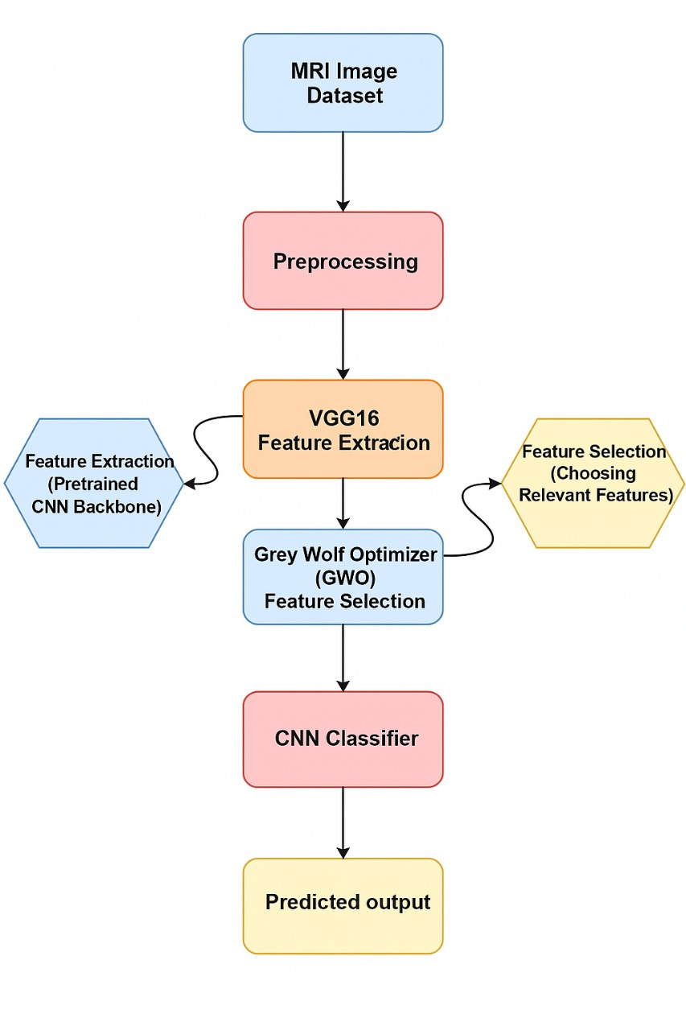
BLOCK DIAGRAM OR FLOW DIAGRAM
Review No. 1
Department of CSE

Slide 13
METHODOLOGY
Pipeline Overview:
Input: Brain MRI scans (4 classes – Non-Demented, Very Mild, Mild, Moderate).
Preprocessing: Resize, normalization, label encoding.
Feature Extraction: VGG16 model captures structural + textural patterns.
Feature Selection: Grey Wolf Optimizer (GWO) selects most important features.
Classification: Custom CNN classifies into Alzheimer’s stages.
Evaluation: Accuracy, Precision, Recall, F1-score, ROC-AUC.
Review No. 1
Department of CSE

Slide 14
1.Dataset Description-
Alzheimer_MRI_4_classes_dataset –
The Alzheimer MRI 4 Classes Dataset is a publicly available collection of MRI brain scan images used to classify Alzheimer's disease at different stages. It is widely used for deep learning, CNN-based classification, and medical image analysis research.
Contains 4 Classes:
Mild Demented – Early-stage Alzheimer's, subtle changes.
Moderate Demented – Middle-stage, visible tissue loss.
Very Mild Demented – Initial changes with minimal symptoms.
Non Demented – Healthy MRI scans.
Total Images: ~6,400+ MRI images
(Slight variations depending on dataset version)
Image Type:
Grayscale MRI slices (usually size 128×128 or 176×176).
Already labeled into folders by class.

Slide 15
Purpose:
Alzheimer’s classification models
CNN, VGG16, EfficientNet, ResNet, GWO feature optimization, etc.
Research on early diagnosis from MRI images
Image preprocessing, augmentation, and transfer learning experiments
Advantages:
Cleanly labeled dataset (no need for manual separation)
Balanced structure across classes
Good for building 4-class Alzheimer detection models
Widely cited in academic research and final-year projects
Kaggle Dataset Link
Here is the official link:
https://www.kaggle.com/datasets/tourist55/alzheimers-dataset-4-class-of-images

Slide 16
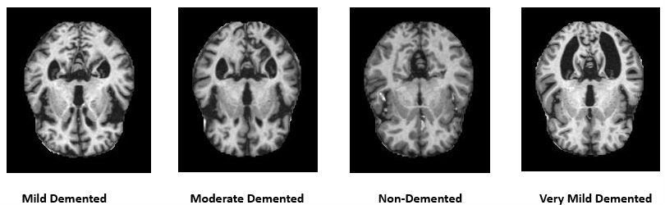
Fig- Sample Dataset Visualization from Dataset
Review No. 1
Department of CSE

Slide 17
2.Preprocessing used-
The following preprocessing steps were applied to the MRI images before model training:
i. Image Resizing
All MRI images were resized to 224 × 224 pixels → This ensures compatibility with the VGG16 input layer and keeps image dimensions uniform.
ii. Pixel Normalization
The preprocess_input() function from Keras was used → This scales pixel intensities to a standard range, improves training stability, and speeds up convergence.
iii. Label Encoding (One-Hot Encoding)
Class labels such as Non-Demented, Very Mild, Mild, Moderate were converted into a one-hot encoded format → Required for multi-class softmax classification.
iv. Dataset Splitting (80:20)
The dataset was divided into 80% training and 20% testing → Ensures fair evaluation while providing enough data for training the deep learning model.

Slide 18
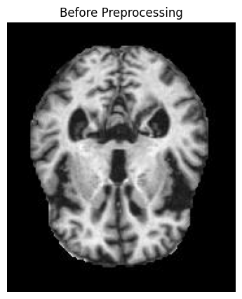
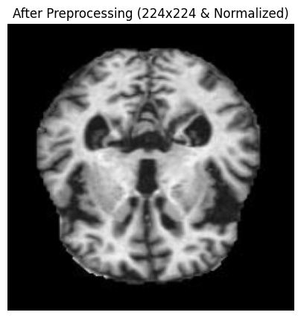
Fig- Before Preprocessing vs After Preprocessing
Review No. 1
Department of CSE

Slide 19
3.Feature Extraction-
The VGG16, a deep convolutional neural network, to extract high-level and discriminative features from the MRI images. VGG16 is chosen because of its strong ability to capture spatial patterns, textures, and structural characteristics that are important for identifying Alzheimer’s stages.
i. Input Setup
MRI images are resized to 224 × 224 × 3, which is the required input size for VGG16. Grayscale MRI images are mapped into 3-channel format to match this input requirement.
ii. Convolution + ReLU Layers (Feature Learning)
VGG16 uses 13 convolutional layers, grouped into five blocks. Each convolution layer extracts increasingly complex patterns:
Early layers → edges, gradients, basic textures
Middle layers → anatomical shapes, brain tissue boundaries
Deep layers → disease-specific structural differences, cortical thinning, abnormalities
Each convolution layer uses ReLU activation, which introduces non-linearity and improves feature learning.

Slide 20
iii. Max Pooling (Spatial Reduction)
After each block, max-pooling is applied to:
Reduce spatial dimensions
Retain the strongest/most important feature responses
Improve computational efficiency
This also helps the model focus on dominant Alzheimer-related features.
iv. Extraction of Deep Features
The paper specifically extracts features from the Block5 Pool layer, which contains deep, abstract representations useful for classification.
These feature maps represent:
Tissue texture patterns
Variations linked to different dementia stages
Brain morphology changes
v. Output Feature Vector
The extracted feature maps are flattened into a feature vector, which becomes the input for the next stage:
GreyWolfOptimizer(GWO) for feature selection
Followed by a CNN classifier
This helps reduce dimensionality and improves classification accuracy.

Slide 21
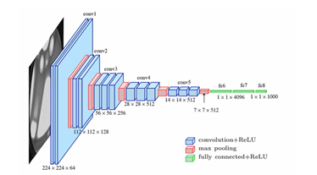
Fig- Blockdiagram of VGG16 (Feature extraction)
Review No. 1
Department of CSE

Slide 22
4. Feature Selection-
After extracting high-dimensional deep features from VGG16, the paper applies a Grey Wolf Optimizer (GWO) to select only the most important and informative features. This step reduces dimensionality, removes irrelevant features, and improves the final classification accuracy.
i. Why Feature Selection Is Needed
VGG16 produces a very large feature vector. Not all extracted features contribute equally to Alzheimer’s stage classification.
To avoid:
Overfitting
Slow training
Redundant or noisy features
a feature selection method is applied.
ii. Why GWO Is Used
Grey Wolf Optimizer (GWO) is chosen because:
It balances exploration and exploitation
It searches globally for the best feature subsets
It is simple, fast, and effective for high-dimensional data

Slide 23
GWO mimics the hunting behavior of real grey wolves: leadership hierarchy and coordinated hunting strategy.
iii. How GWO Selects Features
The algorithm represents each wolf as a binary feature mask, where:
1 = selected feature
0 = discarded feature
During optimization:
The best three wolves (alpha, beta, delta) guide the rest
Each wolf updates its feature selection based on the leaders
A sigmoid transfer function converts continuous values into 0/1 decisions
iv. Objective of GWO
The goal is to:
Maximize classification accuracy
Minimize the total number of selected features
Thus, the output is a refined set of highly discriminative features that improves model performance.

Slide 24
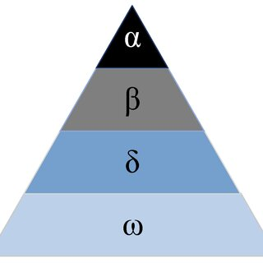
v. Final Output of Feature Selection The result is a reduced, optimized feature vector, which is then fed into the final CNN classifier. This: Speeds up training, Increases accuracy, Reduces overfitting,& Improves interpretability. Fig- Grey Wolf Optimizer (GWO)
Review No. 1
Department of CSE

Slide 25
6.CNN Classifier-
After feature extraction (VGG16) and feature selection (GWO), the optimized feature vectors are fed into a custom-designed Convolutional Neural Network (CNN) for final classification of Alzheimer's stages.This CNN is specifically built to learn refined patterns from the selected features and map them to the four output classes.
i. Input to the CNN
The selected features from GWO are reshaped into a format compatible with Conv2D layers so that the network can learn spatial representations.
ii. Convolution Layers (Pattern Extraction)
The CNN includes one or more Conv2D layers with ReLU activation, which help in:
Learning local spatial features
Enhancing informative patterns
Preserving Alzheimer-related structural cues
ReLU is used for fast learning and non-linearity.
iii. Max Pooling (Dimensionality Reduction)
MaxPooling layers are applied to:

Slide 26
Reduce spatial dimensions
Prevent overfitting
Retain dominant features
This speeds up training and focuses the model on the most important patterns.
iv. Dropout (Regularization)
A dropout layer is used to randomly deactivate some neurons during training. This:
Prevents overfitting
Improves generalization
Makes the classifier more robust
v. Fully Connected (Dense) Layers
Flattened and pooled features are fed into Dense layers to learn high-level combinations of features.The final Dense layer uses Softmax activation to output probabilities for the four Alzheimer’s classes:
Non-Demented
Very Mild Demented
Mild Demented
Moderate Demented

Slide 27
vi. Training Details
Loss function: Categorical cross-entropy
Optimizer: Adam
Epochs: 30 → This setup ensures fast convergence and high classification accuracy.

Slide 28
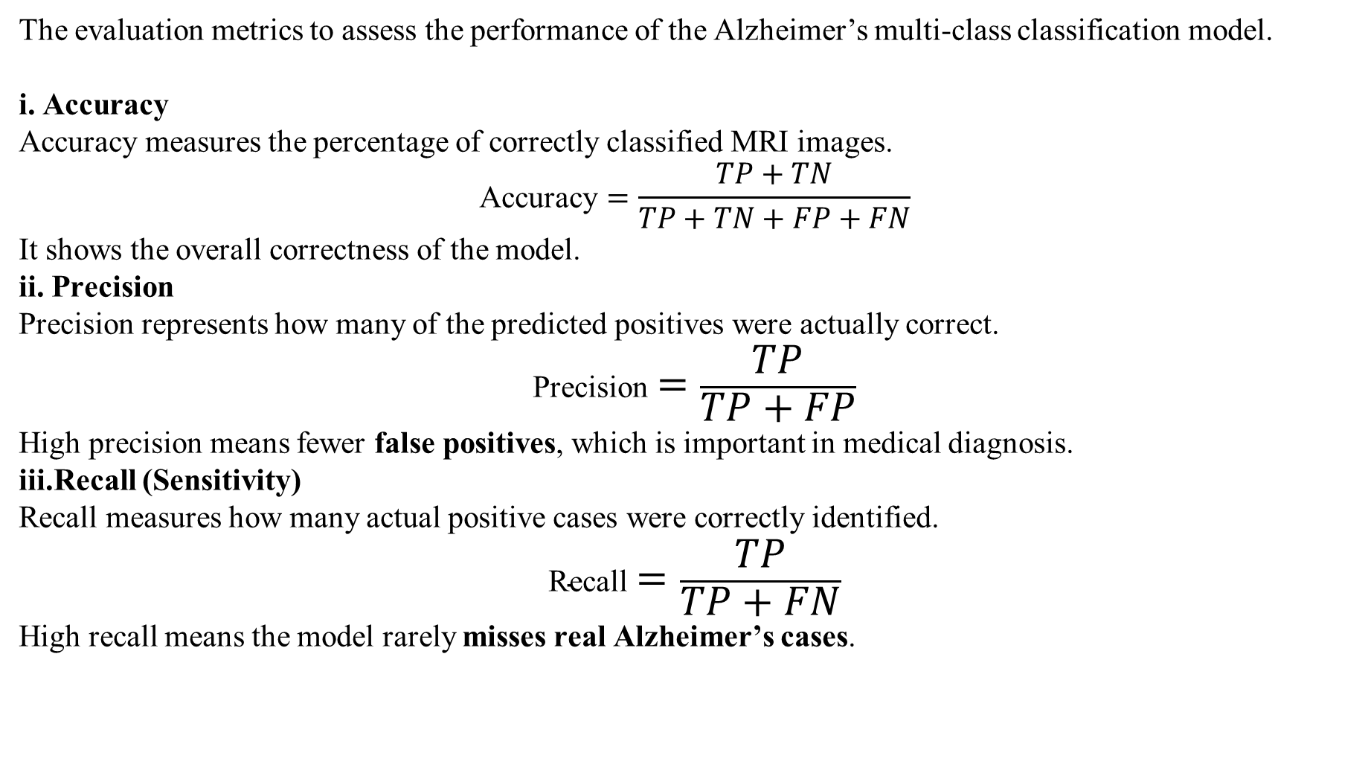
6. Evaluation-
The evaluation metrics to assess the performance of the Alzheimer’s multi-class classification model.
i. Accuracy
Accuracy measures the percentage of correctly classified MRI images.
$$\text{Accuracy}=\frac{TP+TN}{TP+TN+FP+FN}$$
It shows the overall correctness of the model.
ii. Precision
Precision represents how many of the predicted positives were actually correct.
$$\text{Precision}=\frac{TP}{TP+FP}$$
High precision means fewer false positives, which is important in medical diagnosis.
iii.Recall (Sensitivity)
Recall measures how many actual positive cases were correctly identified.
$$\text{Recall}=\frac{TP}{TP+FN}$$
High recall means the model rarely misses real Alzheimer’s cases.

Slide 29
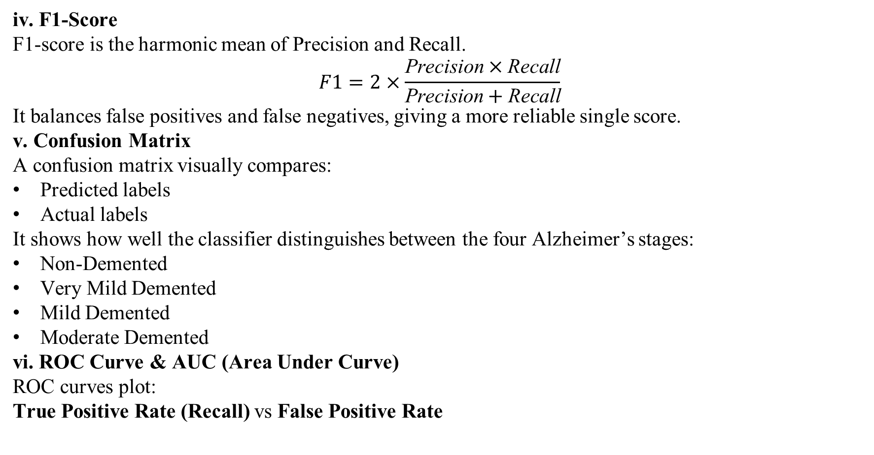
iv. F1-Score
F1-score is the harmonic mean of Precision and Recall.
$$F1=2×\frac{\text{Precision}×\text{Recall}}{\text{Precision}+\text{Recall}}$$
It balances false positives and false negatives, giving a more reliable single score.
v. Confusion Matrix
A confusion matrix visually compares:
Predicted labels
Actual labels
It shows how well the classifier distinguishes between the four Alzheimer’s stages:
Non-Demented
Very Mild Demented
Mild Demented
Moderate Demented
vi. ROC Curve & AUC (Area Under Curve)
ROC curves plot:
True Positive Rate (Recall) vs False Positive Rate

Slide 30
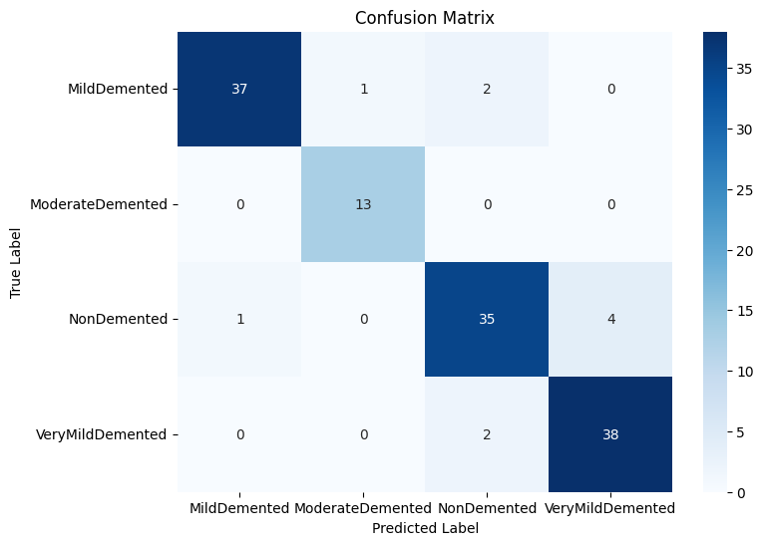
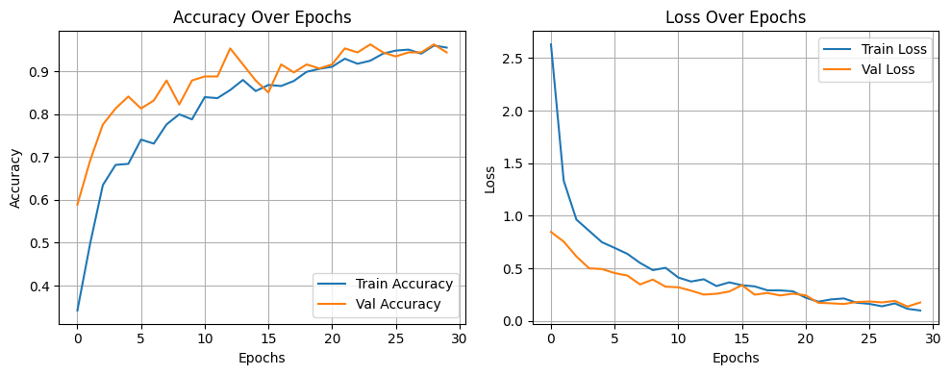
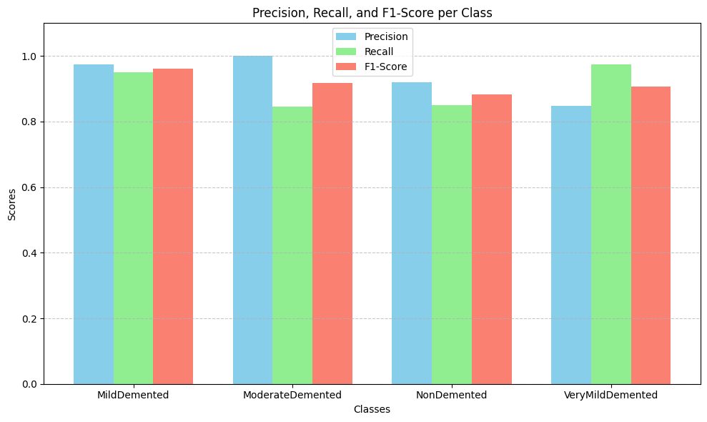
AUC ranges from 0.5 to 1.0, where values close to 1.0 indicate excellent model performance.
Each Alzheimer’s stage in your study achieved very high AUC values (0.97–1.00).
(a) (b)
Fig-
a. Confusion Matrix
b. Acc Vs Loss
c. Precision,Recall,F1-Score
(c)

Slide 31
IMPLEMENTATION
Software & Tools Used
Programming Language: Python
Deep Learning Framework: TensorFlow / Keras
Preprocessing & Computation: NumPy, OpenCV
Training Environment: GPU-enabled system
Evaluation Metrics: Scikit-learn
Model Implementation Steps
Loaded MRI dataset and applied preprocessing pipeline
Used VGG16 as feature extractor (transfer learning)
Extracted deep features from Block 5 layer
Applied Grey Wolf Optimizer (GWO) for optimal feature selection
Constructed and trained custom CNN model on selected features
Validated model performance using test dataset
Review No. 1
Department of CSE

Slide 32
RESULTS & ANALYSIS
Model Performance
Achieved 99.36% accuracy in classifying AD stages
High F1-Score (99%) indicating balanced precision & recall
Training and validation curves show strong convergence without overfitting
Key Observations
Very Mild vs Mild Demented cases show small misclassifications (subtle structural differences)
GWO feature selection improved model efficiency & reduced computational load
Better results than baseline models like VGG19 & DenseNet169
Performance Metrics Used
Accuracy
Precision & Recall
F1-Score
Confusion Matrix
ROC Curve & AUC Score
Review No. 1
Department of CSE

Slide 33
CONCLUSION and FUTURE SCOPE
Conclusion
A hybrid VGG16 + GWO deep learning model was developed for Alzheimer’s stage classification
It efficiently handled class imbalance and high-dimensional MRI data
Achieved excellent performance (99.36% accuracy and 99% F1-score)
Demonstrated strong potential for early and reliable AD diagnosis
Future Scope
Integrate Explainable AI methods (e.g., Grad-CAM++) for better clinical interpretation
Extend framework to include multimodal data (PET, cognitive scores, genetics)
Test on larger and more diverse datasets for clinical deployment
Review No. 1
Department of CSE

Slide 34
REFERENCES
[1] Anjali et al., "STCNN model integrating SMOTE-TOMEK with CNN for Alzheimer’s classification," IEEE Sensors Letters, 2024.
[2] E. Jabason et al., "A Lightweight Deep CNN Extracting Contextual Features for AD Using Structural MRI," IEEE Journal of Biomedical and Health Informatics, 2025.
[3] M. G. Kwak et al., "A Cross-Modal Mutual Knowledge Distillation Framework for Alzheimer’s Diagnosis," IEEE Transactions on Automation Science and Engineering, 2025.
[4] Z. Qiu et al., "3D Multimodal Fusion Network With Disease-Induced Joint Learning for Alzheimer’s Diagnosis," IEEE Transactions on Medical Imaging, 2024.
[5] A. H. Rashid et al., "Biceph-Net: Lightweight Framework for Alzheimer’s Using 2D-MRI and Deep Similarity," IEEE Journal of Biomedical and Health Informatics, 2023.
Review No. 1
Department of CSE

Slide 35
QUESTIONS and ANSWERS
Any Questions? We are happy to clarify!
Review No. 1
Department of CSE

Slide 36
ACKNOWLEGEMENTS
THANK YOU
Review No. 1
Department of CSE

