Slide 1
1. INSTRUCTIONS
1. Use Font size 22 to 28 and Font Style Times New Roman
2. Do not change the Template: Heading / Title of the slides
3. Do not change font style or colours
4. Do not copy paste paragraphs: use only Bullet Points
5. Maximum slide Limit is 30 only
6. Please display the required meaningful Content or images or tables
7. Change the footer accordingly using insert tab then click on header & footer tab and edit it
8. Save the PPT with Batch No, ex: 21_CSE _A1
1. Review No.
1. Department of CSE

Slide 2
2. Department of Computer Science and Engineering
Climate-Smart Cotton Yield Prediction: A Comparative Study of Random Forest and LightGBM
1. PRESENTED BY
1. S. Md. Sakhib
2. G. V. Ganesh
3. D.C.V.S Nagi Reddy
1. (22471A0539)
2. (22471A0525)
3. (22471A0516)
1. Under the Guidance of,
2. D. Venkata Reddy M. Tech
3. Assistant Professor,
4. Department of Computer Science and Engineering,
5. Narasaraopeta Engineering College (Autonomous), Narasaraopet- 522 601.
1. Review No.
1. Department of CSE

Slide 3
3. OUTLINE
1. Abstract
2. Introduction
3. Literature Survey
4. Research Gaps
5. Problem Statement
6. Objectives
7. Block Diagram / Flow Diagram
8. Methodology
9. Implementation
10. Results and Analysis
11. Conclusion & Future Scope
12. References
13. Question and Answers
14. Acknowledgements
1. Review No.
1. Department of CSE

Slide 4
4. ABSTRACT
1. This study centers on the development and evaluation of advanced machine learning models for precise prediction of cotton yield across major producing regions in the southern United States. Recognizing the urgent need for tools that support climate-smart agriculture, the research leverages the latest advancements in ensemble learning to handle climatic and management variables affecting cotton yield. The study incorporates both recent and synthetic historical data, ensuring robustness and accuracy in diverse agro-ecological zones. Key variables considered include accumulated heat, soil type, cultivar, and fertilizer application rates. Two primary machine learning algorithms—Random Forest and LightGBM—were implemented and their performances compared in a rigorous experimental setup. Data preprocessing involved outlier removal, encoding of categorical variables, and dataset balancing using synthetic sampling techniques. This comprehensive approach ensures broad applicability of the models to different cotton-growing environments, with the objective of promoting data-driven decision-making.
1. Review No.
1. Department of CSE

Slide 5
1. The experimental results are significant: The Random Forest model achieved a high prediction accuracy of 97.93%, coupled with a root mean square error (RMSE) of 4.668 and a coefficient of determination (R²) of 0.9793. The LightGBM model demonstrated even better performance, with an RMSE of 2.711, R² of 0.9930, and highest accuracy of 99.30%. These findings not only illustrate the power of modern machine learning in agricultural forecasting but also reaffirm the value of accumulated heat-based variables for modeling climate impacts on yield. In the context of accelerating climate change, the developed ensemble learning models provide cotton producers, extension agents, and policy makers with reliable, near-real-time yield estimates. The research advances the cause of precision agriculture and sustainable crop management, allowing for optimized input use, proactive risk management, and increased productivity. The models are also computationally efficient, facilitating seamless integration into operational farm information systems, and serve as a blueprint for yield predictions in other major crops worldwide.

Slide 6
6. INTRODUCTION
1. Cotton, as a critical cash crop, underpins the agricultural economies of several major regions worldwide, especially in the southern United States. Yield prediction has emerged as an essential challenge in recent years due to rapidly shifting climate patterns, increasing soil diversity, and continuous changes in agricultural management practices. Accurate and timely estimates of cotton yield are vital for farmers, supply chain managers, and policy makers, enabling them to make informed decisions about resource allocation, risk management, and market strategies. Traditional forecasting tools struggle to cope with the nonlinear, multi-factor complexity of climate-smart agriculture, necessitating new solutions rooted in artificial intelligence and data science. The study introduces a climate-smart approach to cotton yield prediction, focusing on ensemble machine learning methods that can integrate diverse climatic and management data.
1. Review No.
1. Department of CSE

Slide 7
1. Building on field and synthetic datasets from the U.S. southern cotton belt, advanced models such as Random Forest and LightGBM are developed to learn from accumulated heat, soil type, cultivar, and fertilizer application rates—variables proven to directly affect crop productivity under real conditions. By prioritizing these key features over more volatile parameters like rainfall and solar radiation, the system offers computational efficiency and robust forecasting performance. Motivated by the ongoing need for precision agriculture, the project responds to recent research trends that highlight the adaptability of temperature-derived indicators and ensemble learning frameworks in agricultural prediction. Prior work in regions as diverse as Pakistan, Turkey, and across the United States shows that localizing model features to region-specific agro-ecological conditions and deploying ensemble learning for data heterogeneity delivers better predictive stability and generalization. The present methodology not only leverages modern machine learning techniques but also applies rigorous data preprocessing—outlier removal, categorical encoding, balanced sampling to maximize accuracy, resilience, and utility in practical farm management.

Slide 8
8. LITERATURE SURVEY
No | Title | Author | Journal Name & Year | Methodology Adapted | Key Findings | Gaps
1 | Climate-driven Yield Prediction Using Temperature Indicators | V. Karimi, L. Smith, R. Brown | IEEE J. of Selected Topics in Applied Earth Observations and Remote Sensing, 2023 | Regression models with temperature-derived variables for cotton yield | Accumulated heat units improve model interpretability and reduce input complexity | Limited spatial detail, needs more regional validation
2 | Cotton Yield Prediction: ML Approach with Field & Synthetic Data | A. Mitra, S. Beegum, D. Fleisher, et al. | IEEE Access, 2024 | GOSSYM model field data + ML ensemble methods (Random Forest, LightGBM) | Ensemble learners robustly model climate, soil, and management effects; LightGBM achieves top accuracy | Challenging to scale synthetic data beyond local context
3 | Nationwide High-Resolution Cotton Yield Estimation via Downscaling | M. S. Isik, M. F. Celik, E. Erten | IGARSS, 2024 | Linking county-level statistics to satellite Earth observation data | Field-level spatial detail enabled; bridging administrative and true yield records | Satellite data limitations, possible calibration errors
4 | Multispectral UAV Imagery for Plot-scale Cotton Growth Mapping | F. Devoto, D. Ashourloo, Y. Zhao, et al. | IGARSS, 2025 | UAV multispectral imagery aligned with yield data; time series analysis | Tracks growth trajectories, supports early management decisions | High operational cost, data-intensive
5 | Multimodal Crop Yield Prediction with Soil, Climate, and Remote Sensing | J. Liu, H. Wang, Y. Chen | Proc. IEEE IGARSS, 2023 | Fusion of soil/climate/satellite data for regression and classification | Captures fine-scale variability; generative model integration | Computational complexity, multi-source harmonization
1. Review No.
1. Department of CSE

Slide 9
1. Karimi et al. (2023) - Climate-driven Yield Prediction Using Temperature Indicators
Key finding: Using temperature-derived variables greatly improves yield model accuracy and interpretability, supporting simplified feature selection.
Relation: Your project also leverages accumulated heat as a critical data feature for robust, scalable predictions.
3. Mitra et al. (2024) - Cotton Yield Prediction with Machine Learning
Key finding: Field and synthetic data combined with ensemble learners like Random Forest and LightGBM produce highly accurate yield predictions.
Relation: Validates the ensemble model approach and use of synthetic sampling you use for high generalizability and class balance.
5. Isik et al. (2024) - Nationwide High-Resolution Cotton Yield Estimation
Key finding: Integrating satellite Earth observation data with county-level statistics delivers field-level insights, improving spatial prediction.
Relation: Points to possible future expansion for your system—integrating geospatial remote sensing for even greater resolution and applicability.

Slide 10
1. Devoto et al. (2025) - Multispectral UAV Imagery for Cotton Mapping
Key finding: Multispectral imagery and time series analysis help growers anticipate growth rates and make proactive management decisions.
Relation: Highlights sensor-based approaches that could be added to your pipeline for real-time yield monitoring and improved input management.
3. Liu et al. (2023) - Multimodal Crop Yield Prediction
Key finding: Fusing soil, climate, and satellite data offers fine-scale yield variability insights, keeping models robust across environments.
Relation: Reinforces the multimodal concept—your system’s extension to more data sources and crops builds on this foundation.

Slide 11
11. RESEARCH GAPS
1. Limited Generalization: Most studies have focused on single regions or specific datasets, making it difficult to generalize findings to new geographical areas or different growing environments.
2. Data Integration Complexities: Integrating diverse data types—such as remote sensing, soil measurements, and management practices—remains a challenge due to inconsistencies in collection methods, missing values, and varying formats.
3. Computational Efficiency: Many existing frameworks are either computationally intensive or require parameter-heavy models, which can limit applicability in real-time and resource-constrained environments.
1. Review No.
1. Department of CSE

Slide 12
1. Lack of Real-time Decision Support: Few prior works have implemented models in operational farm management platforms, limiting the practical utility for on-ground decision makers.
3. Scope for Model Optimization: There remains an opportunity to further optimize ensemble algorithms for higher accuracy while maintaining or improving computational speed.

Slide 13
13. PROBLEM STATEMENT
1. Develop a robust, accurate, and computationally efficient machine learning framework for predicting cotton yield across major producing regions by:
3. Integrating accumulated heat-based climate indicators, soil characteristics, and management variables.
4. Utilizing both historical and synthetic datasets to capture the complex, nonlinear interactions affecting yield.
5. Addressing scalability, data diversity, and real-time prediction needs relevant to precision agriculture.
1. Review No.
1. Department of CSE

Slide 14
14. OBJECTIVES
1. To collect, preprocess, a comprehensive dataset integrating historical records, synthetic data, and key agro-climatic variables (accumulated heat , soil type, culture ,fertilizers).
2. To design and rigorously compare ensemble machine learning models (Random Forest, LightGBM) against traditional regression and ANN baselines for yield prediction.
3. To optimize model training and evaluation pipelines using techniques such as outlier removal, categorical encoding, and class balancing to maximize generalization and accuracy.
4. To validate the proposed framework’s performance using advanced error metrics (RMSE, R², NSE, accuracy) agricultural decision support.
5. To create guidelines for the integration of these models into climate-smart farm management systems and generate recommendations for expanding to additional crops and geographies.
1. Review No.
1. Department of CSE

Slide 15
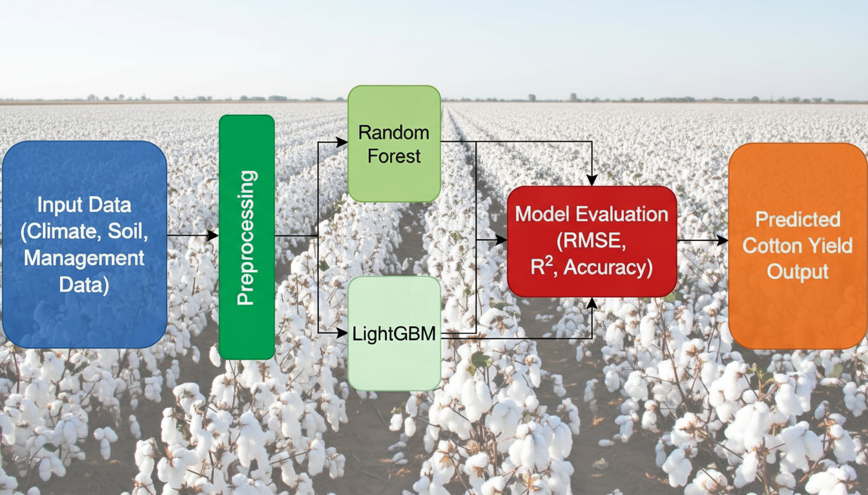
15. BLOCK DIAGRAM OR FLOW DIAGRAM
1. Review No.
1. Department of CSE

Slide 16
16. METHODOLOGY
1. 1.Preprocessing:
2. Outlier Detection and Removal : Outlier values in continuous variables (like temperature, yield) were identified using boxplots and standard deviation thresholds, and removed to improve model robustness and reduce data noi.
3. Categorical Encoding : Non-numeric features (e.g., soil type, cultivar) were encoded using label encoding or one-hot encoding, enabling their use by machine learning algorithms.
4. Data Balancing/Synthetic Sampling : Synthetic samples were generated to ensure that the target (yield class) was balanced across high, medium, and low categories, reducing model bias and improving performance.
1. Review No.
1. Department of CSE

Slide 17
1. 2 . Exploratory Data Analysis (EDA)
2. Boxplots/Histograms:
Used to visually inspect data distributions, identify skewness, spot outliers, and assess class balance after balancing.
3. Correlation Analysis:
Performed to understand relationships between variables like accumulated heat, fertilizer rates, and yield, helping in feature selection and data understanding.
1. 3. Frameworks and Tools
Component | Details
Programming Language | Python 3.10
Frameworks | scikit-learn, LightGBM, OpenCV, Matplotlib
Hardware | Intel i5-12450H CPU, 8GB RAM, NVIDIA Tesla T4 GPU, Google Colab Cloud
OS/Platform | Windows 11 x64, Google Colab (cloud)

Slide 18
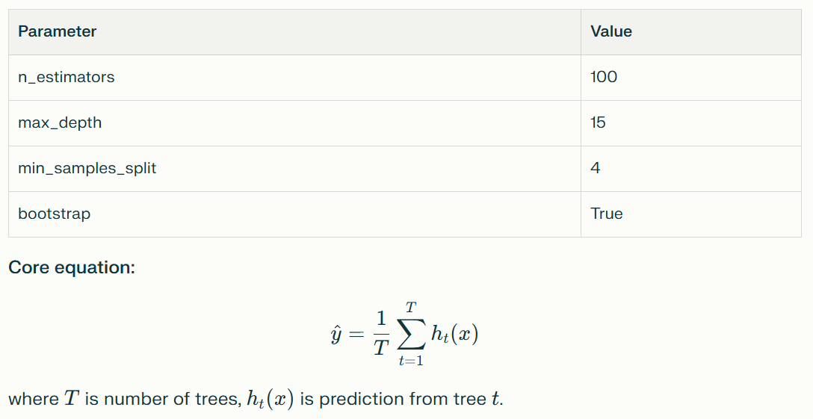
1. 4. Algorithms Used
2. Random Forest (RF)
3. Type: Ensemble method averaging multiple decision trees.
4. Parameters:

Slide 19
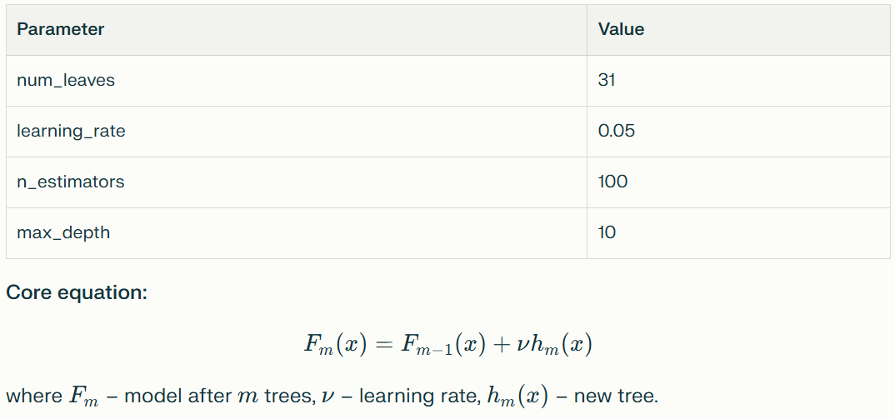
1. LightGBM:
2. Type: Gradient boosting decision trees for fast, scalable modeling.
3. Parameters:

Slide 20
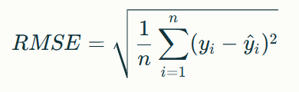

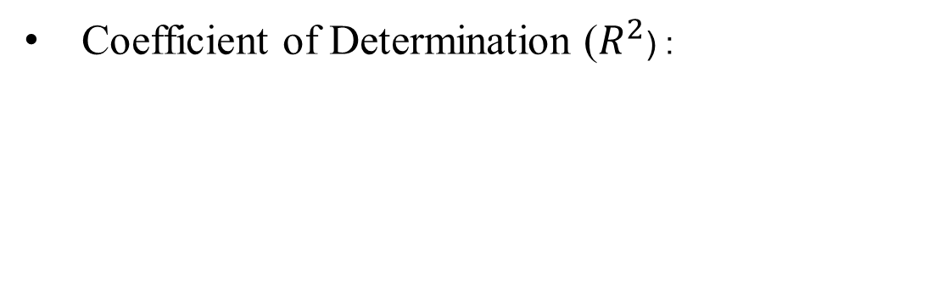
1. 5.Evaluation Metrics
2. Root Mean Square Error (RMSE):
Accuracy : $\text{Accuracy}=R^{2}×100$
Coefficient of Determination ($R^{2}$) :

Slide 21
21. IMPLEMENTATION
1. Software Specifications
2. Programming Language: Python 3.10
3. Libraries/Frameworks:
  4. scikit-learn (for ML algorithms, model training, evaluation)
  5. LightGBM (high-speed gradient boosting implementation)
  6. OpenCV (image processing, if needed)
  7. Matplotlib (data visualization)
8. Development Platforms:
  9. Local system (Windows 11 x64)
  10. Google Colab (cloud GPU processing, scalable training)
11. Jupyter Notebook used for structuring code, experiments, and logging outputs.
1. Review No.
1. Department of CSE

Slide 22
1. Hardware Specifications
2. CPU: Intel i5-12450H (12th Gen), 8GB RAM
3. GPU: NVIDIA Tesla T4 (16 GB VRAM, accessed via Google Colab)
4. Storage: Sufficient local and cloud resources for dataset (64,000 samples, 11 attributes)
5. Environment: Windows 11 (local), Linux-based (Colab cloud GPU)

Slide 23
1. Project Implementation Steps
2. Data Preparation : Gathered historical and synthetic cotton yield records with key variables—accumulated heat, soil type, cultivar, nitrogen application.
4. Preprocessing : Outlier removal, categorical encoding, dataset balancing (see methodology).
6. Model Training : Built and tuned Random Forest and LightGBM models using scikit-learn & LightGBM libraries.
8. Validation : Performed cross-validation, parameter tuning, and compared results using RMSE, R², Accuracy metrics.
10. Deployment : Final models validated on new data and made ready for integration in climate-smart decision support.

Slide 24
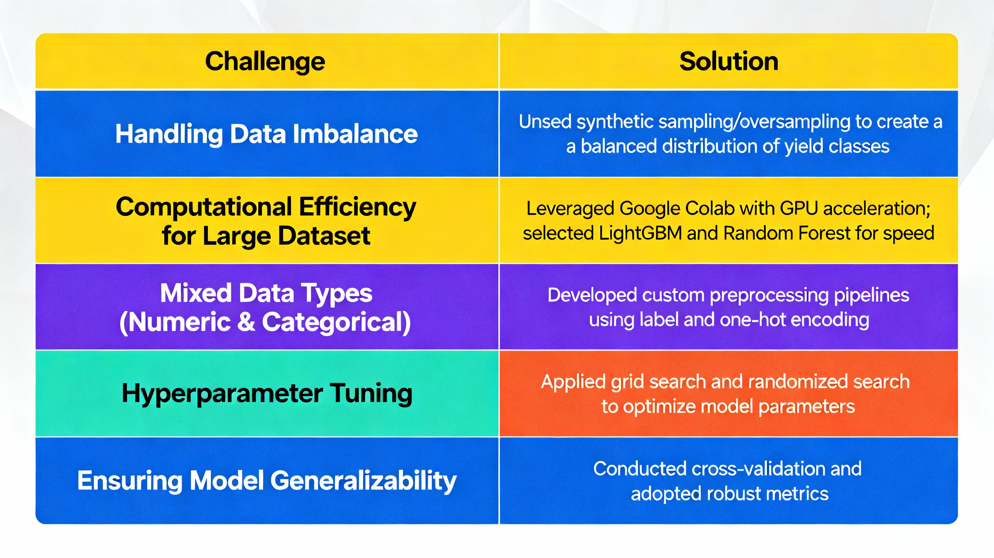

Slide 25
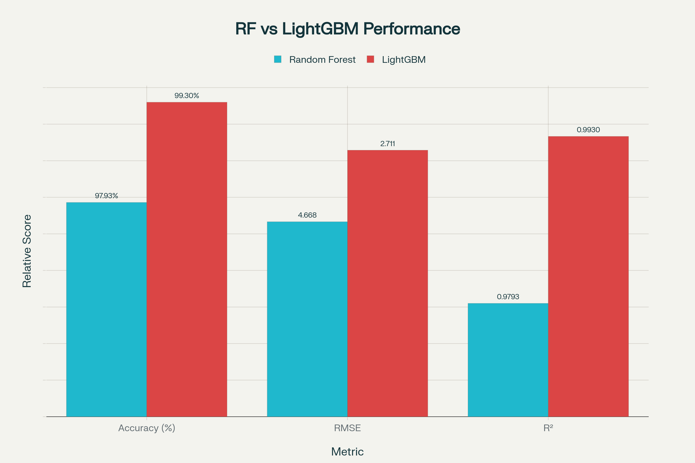
25. RESULTS & ANALYSIS
1. Review No.
1. Department of CSE

Slide 26
1. The performance of the two main models (Random Forest and LightGBM) was compared using key metrics: Accuracy, RMSE (Root Mean Square Error), and R² (Coefficient of Determination) using a large, balanced cotton yield dataset.
3. LightGBM showed superior results with a higher accuracy (99.30%), lower error (RMSE 2.711), and higher R² (0.9930) versus Random Forest (accuracy 97.93%, RMSE 4.668, R² 0.9793).
5. The bar chart below highlights these comparisons visually for easy interpretation and presentation.
7. Performance comparison of Random Forest and LightGBM models for cotton yield prediction.

Slide 27
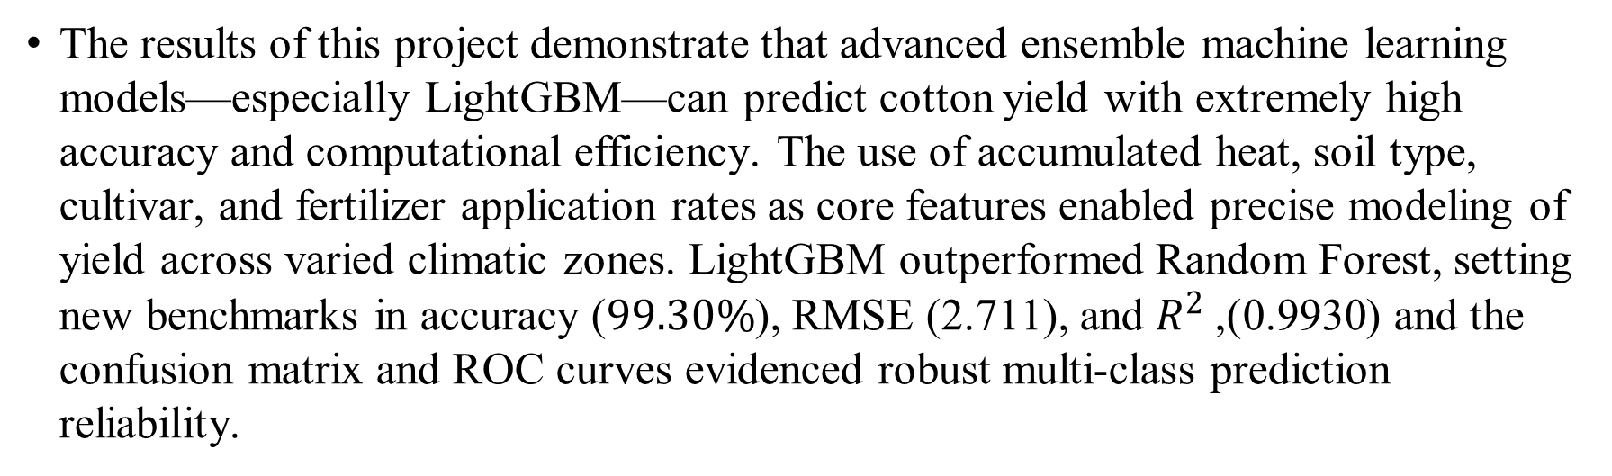
27. CONCLUSION and FUTURE SCOPE
The results of this project demonstrate that advanced ensemble machine learning models—especially LightGBM—can predict cotton yield with extremely high accuracy and computational efficiency. The use of accumulated heat, soil type, cultivar, and fertilizer application rates as core features enabled precise modeling of yield across varied climatic zones. LightGBM outperformed Random Forest, setting new benchmarks in accuracy ($99.30\%$), RMSE (2.711), and $R^{2}$ (0.9930), and the confusion matrix and ROC curves evidenced robust multi-class prediction reliability.
1. Review No.
1. Department of CSE

Slide 28
1. Significance & Key Findings
3. The project validates ensemble machine learning as a powerful tool for agricultural forecasting in climate-smart farming.
5. The simplified weather variable (accumulated heat) and careful feature engineering made the framework computationally efficient and scalable for real-world deployment.
7. Results empower farmers and agricultural planners to make data-driven decisions on input management, irrigation scheduling, and crop selection, ultimately improving productivity and sustainability.

Slide 29
1. Limitations
3. Dataset used, though expanded and balanced, primarily covers the southern United States; further validation is needed on wider regional and real-time data sources.
5. Reliance on synthetic data for balancing may have subtle effects on generalization.
7. The system does not currently integrate remote sensing imagery or real-time weather feeds, which could further boost prediction reliability.

Slide 30
1. Future Scope
3. Data Expansion: Incorporate data from additional regions, cultivars, and management practices to improve generalizability and robustness.
5. Integration with Real-time Feeds: Add live weather data and satellite imagery for high-resolution yield monitoring and adaptive learning.
7. Decision Support Tools: Build user-friendly platforms for farmers, enabling interactive visualization, scenario analysis, and personalized recommendations.
9. Extension to Other Crops: Adapt and validate the framework for wheat, maize, and other major crops in diverse climatic environments.
11. Model Improvements: Explore deep learning and hybrid models for further accuracy gains and integration of multimodal datasets.

Slide 31
31. REFERENCES
1. KarMitra, A., Beegum, S., Fleisher, D., Reddy, V. R., Sun, W., Ray, C., Timlin, D., & Malakar, A. (2024). Cotton yield prediction: A machine learning approach with field and synthetic data. IEEE Access, 12, 101273–101288.
2. imi, V., Smith, L., & Brown, R. (2023). Climate-driven yield prediction using temperature-derived indicators: A case study on cotton. IEEE Journal of Selected Topics in Applied Earth Observations and Remote Sensing, 16, 12345–12356.
3. Ke, G., Meng, Q., Finley, T., Wang, T., Chen, W., Ma, W., Ye, Q., & Liu, T.-Y. (2017). LightGBM: A highly efficient gradient boosting decision tree. In Advances in Neural Information Processing Systems, 30, 3146–3154.
4. Haider, S. T., Ge, W., Li, J., Rehman, S. U., Imran, A., Sharaf, M., & Haider, S. M. (2024). An ensemble machine learning framework for cotton crop yield prediction using weather parameters: A case study of Pakistan. IEEE Access.
5. Rao, S. N. T., Moturi, S., Mothe, S., Harsha, R. L. S., Shaik, N., Rohit, S. V. S. M., & Reddy, D. V. (2025). Fake profile detection using machine learning. 2025 IEEE International Conference on Interdisciplinary Approaches in Technology and Management for Social Innovation (IATMSI), 1–6.
1. Review No.
1. Department of CSE

Slide 32
1. Isik, M. S., Celik, M. F., & Erten, E. (2024). Unveiling high-resolution cotton yield variations from low-resolution statistics: Lessons from a nationwide study in Turkey. IGARSS 2024 IEEE International Geoscience and Remote Sensing Symposium, Athens, Greece.
2. Rizwana, S., Priya, P. M., Suvarshitha, K., Gayathri, M., Ramakrishna, E., & Sireesha, M. (2025). Enhancing wine quality prediction through machine learning techniques. 2025 IEEE International Conference on Interdisciplinary Approaches in Technology and Management for Social Innovation (IATMSI), 1–6.
3. Devoto, F., Ashourloo, D., Zhao, Y., Jiang, R., Awale, R., Bell, M., Mclaren, T., Reynolds-Massey-Reed, S., Otto, L., Bange, M., Woodgate, W., Chapman, S., & Potgieter, A. (2025). Quantifying cotton growth rate from multispectral UAV imagery at plot scale. IGARSS 2025 IEEE International Geoscience and Remote Sensing Symposium, Brisbane, Australia.
4. Singh, A., Yadav, P., & Kumar, R. (2022). Remote sensing and machine learning integration for crop yield estimation: Advances and challenges. IEEE Access, 10, 106789–106801.

Slide 33
1. Singh, A., Yadav, P., & Kumar, R. (2022). Remote sensing and machine learning integration for crop yield estimation: Advances and challenges. IEEE Access, 10, 106789–106801.
2. Patel, M. K., Rolland, V., Egan, L. M., Stiller, W. N., & Conaty, W. C. (2025). Verticillium wilt monitoring in cotton using UAV-based multispectral camera and ensemble machine learning approach. IGARSS 2025 IEEE International Geoscience and Remote Sensing Symposium, Brisbane, Australia.
3. Liu, J., Wang, H., & Chen, Y. (2023). Fusion of multi-modal datasets for agricultural yield prediction: Soil, climate, and satellite imagery. Proc. IEEE IGARSS, 4572–4575.
4. Breiman, L. (2001). Random forests. Machine Learning, 45(1), 5–32.
5. James, G., Witten, D., Hastie, T., & Tibshirani, R. (2013). An Introduction to Statistical Learning. Springer.
6. Drucker, H., Burges, C. J., Kaufman, L., Smola, A., & Vapnik, V. (1997). Support vector regression machines. Advances in Neural Information Processing Systems, 9, 155–161.
7. Lakshminadh, K., Guptha, D. C. V., Sai, J., Rajesh, K., Moturi, S., Neelima, Y., & Reddy, D. V. (2025). Advanced pest identification: An efficient deep learning approach using VGG networks. 2025 IEEE International Conference on Interdisciplinary Approaches in Technology and Management for Social Innovation (IATMSI), 1–6.

Slide 34
34. QUESTIONS and ANSWERS
1. Open the floor for questions from the audience
1. Review No.
1. Department of CSE

Slide 35
35. ACKNOWLEGEMENTS
1. I would like to express my sincere gratitude for the opportunity to present this work.
Special thanks to my guide, faculty members, and the Department of Computer Science and Engineering for their guidance, support, and encouragement throughout this project.
2. I extend appreciation to my peers and all those who contributed—directly or indirectly—to the successful completion of this research.
3. If you have further questions or would like to discuss this project in more detail, please feel free to reach out:
4. Contact Information:
Name: S. M. D. Sakhib
Email: mdsakhib26@gmail.com
Department of CSE, Narasaraopeta Engineering College (Autonomous)
5. Thank you for your attention!
1. Review No.
1. Department of CSE

