Slide 1

{Climate-Smart Cotton Yield Prediction: A Comparative Study of Random Forest and LightGBM}
{Paper Id:894}
Authors :D.Venkata Reddy, S.MD.Sakhib, G.V.Ganesh, D.C.V.S.Nagi Reddy, N.S.Gunapriya, N.Ravi Kumar, M.Sireesha
Affiliation:
Department of Computer Science and Engineering,
Narasaraopeta Engineering College (Autonomous), Narasaraopeta, India

Slide 2

Paper_id :894
Problem to Solve:
To accurately predict cotton yield despite climate variability, soil differences, and
limited historical data.
Motivation:
To help farmers make data-driven decisions and improve productivity under changing climate conditions.
Research Scope / Goal:
To develop and compare RF and LightGBM models for highly accurate cotton yield prediction using enhanced datasets.
Expected Outcomes:
A highly accurate, stable, and scalable cotton yield prediction model suitable for
real-world agricultural use.

Slide 3

Paper_id :894
Background Context:
Climate change and rising temperatures significantly impact cotton growth, creating a need for reliable yield prediction.
Importance of the Problem:
Accurate yield prediction helps farmers optimize resources, reduce risks, and improve overall agricultural productivity.
Technology Involved:
Random Forest for ensemble-based yield modeling
LightGBM for fast and high-accuracy gradient boosting
Synthetic data generation for balanced and robust training
key Challenges:
Limited historical data, heterogeneous soil–climate conditions, and nonlinear
crop behavior make prediction difficult.

Slide 4

Paper_id :894
Existing Solutions:
Crop simulation models (e.g., GOSSYM)
Traditional ML methods (RF, SVR, MLR, ANN)
Remote-sensing–based prediction frameworks (UAV and satellite models)
Limitations:
High dependency on detailed weather or remote-sensing data, limited
generalization, and higher computational cost.
Novelty of Proposed Approach:
Using simplified climate indicators with synthetic data and optimized
LightGBM for highly accurate and efficient yield prediction.

Slide 5
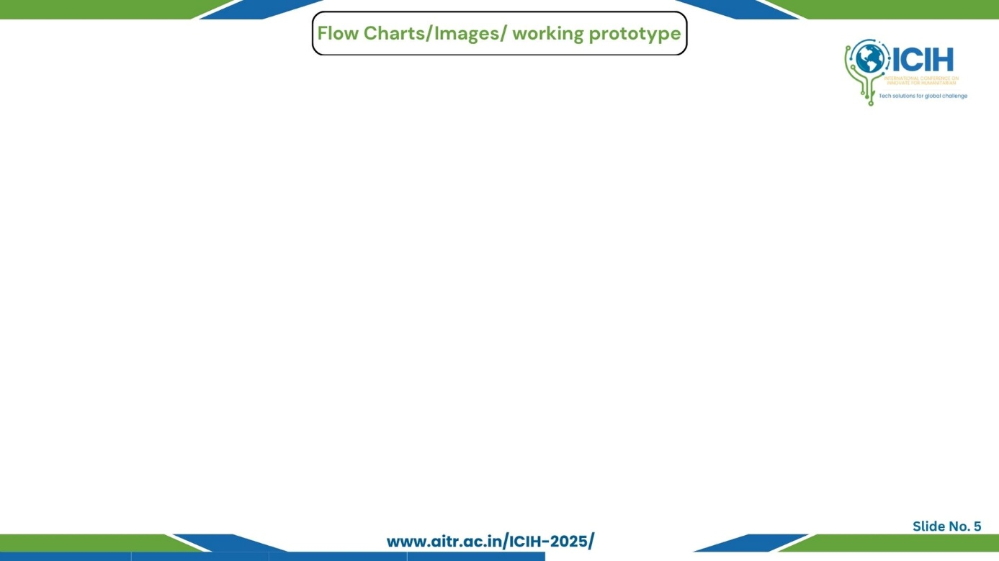
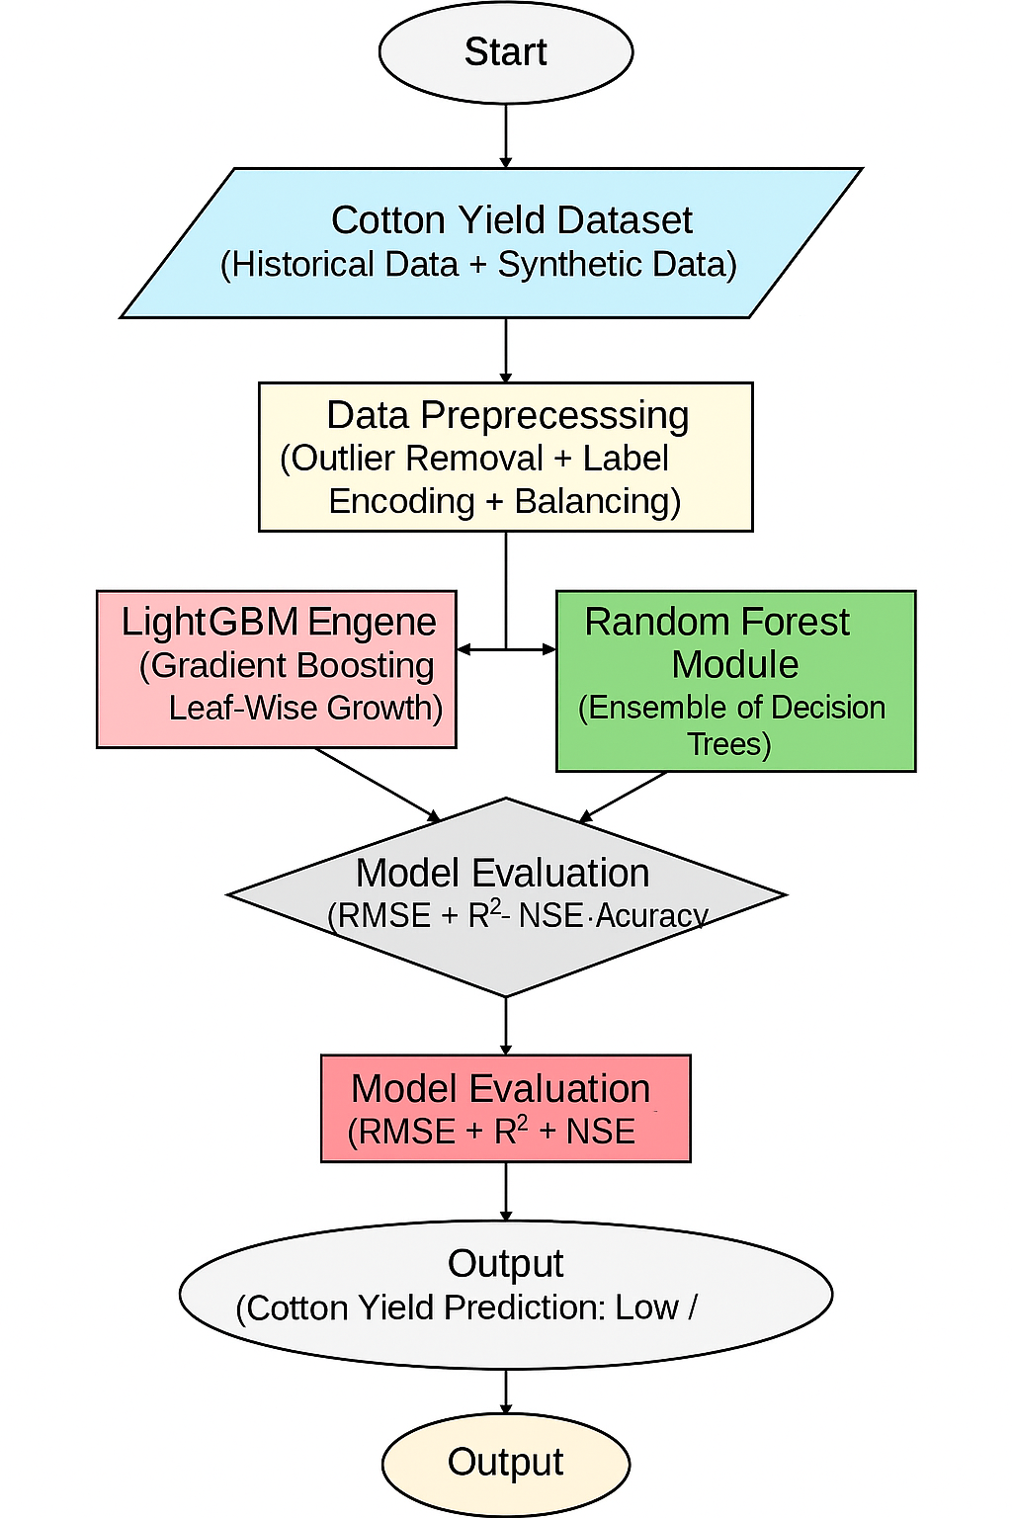
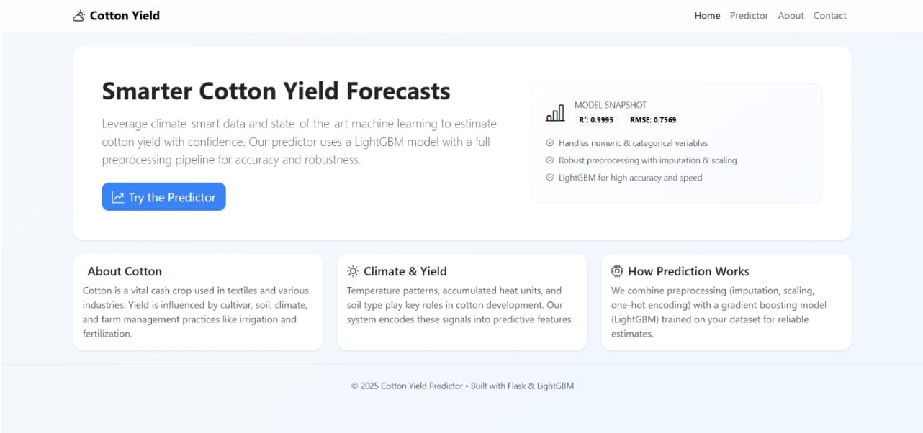
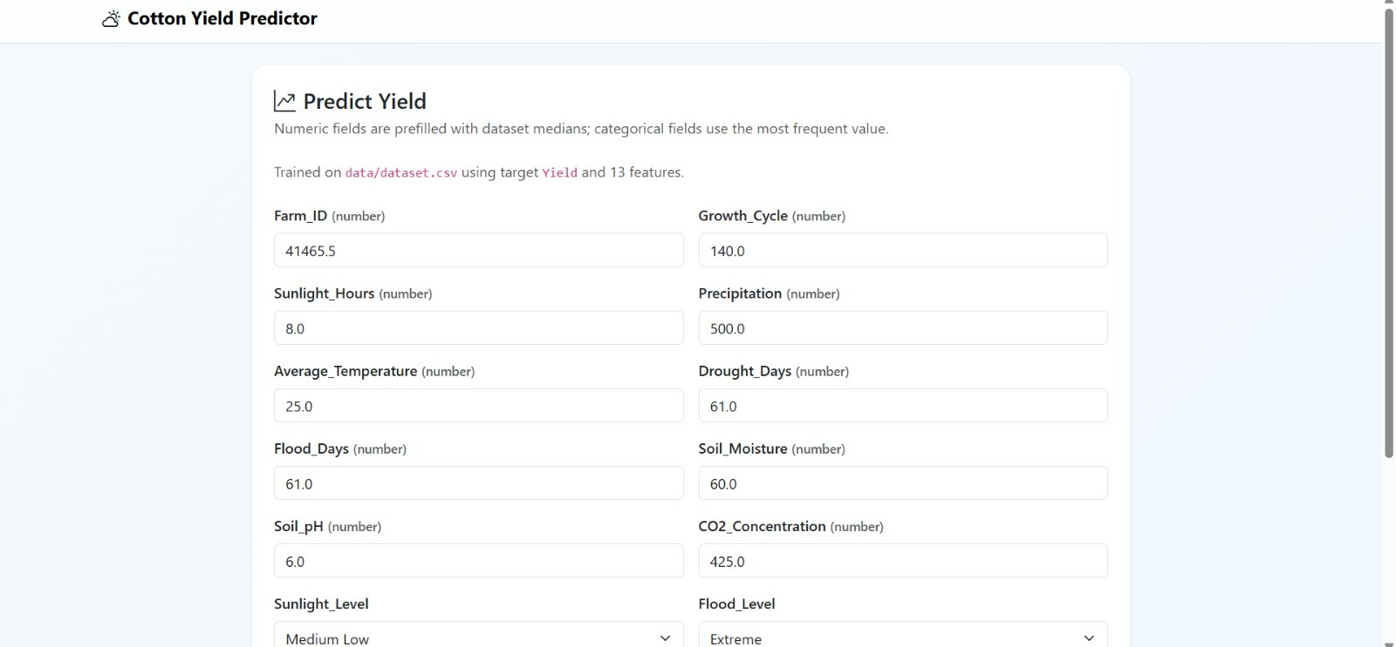
Paper_id :894
Workflow Overview:
Data Preprocessing – removes outliers, encodes categories, and balances data
Feature Engineering – generates accumulated heat units and synthetic samples
Model Training – RF, LightGBM, and baseline models are trained and tuned
Evaluation Module – computes RMSE, R², NSE, and accuracy
Prediction System – outputs final cotton yield estimation (High/Medium/Low)
Architecture Highlights:
Accumulated Heat + Soil + Cultivar + Nitrogen → Combined Feature Vector.
LightGBM Leaf-Wise Tree Growth for fine-grained splitting.
Synthetic Data Augmentation to handle imbalance and improve stability
PROTOTYPE OF MODEL
MODEL ARCHITECTURE
USER PREDICTING INTERFACE

Slide 6
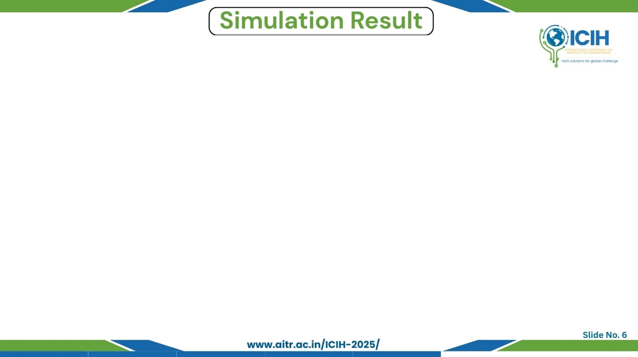
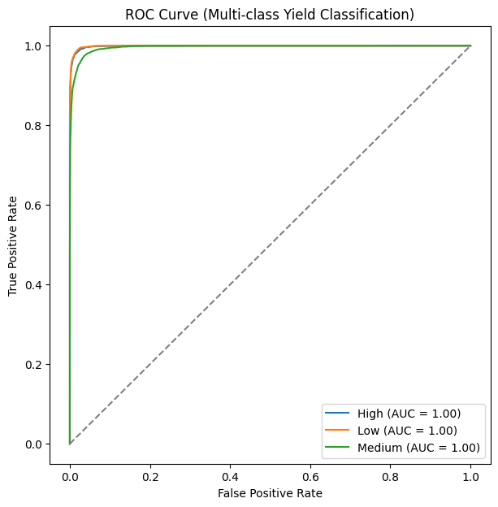
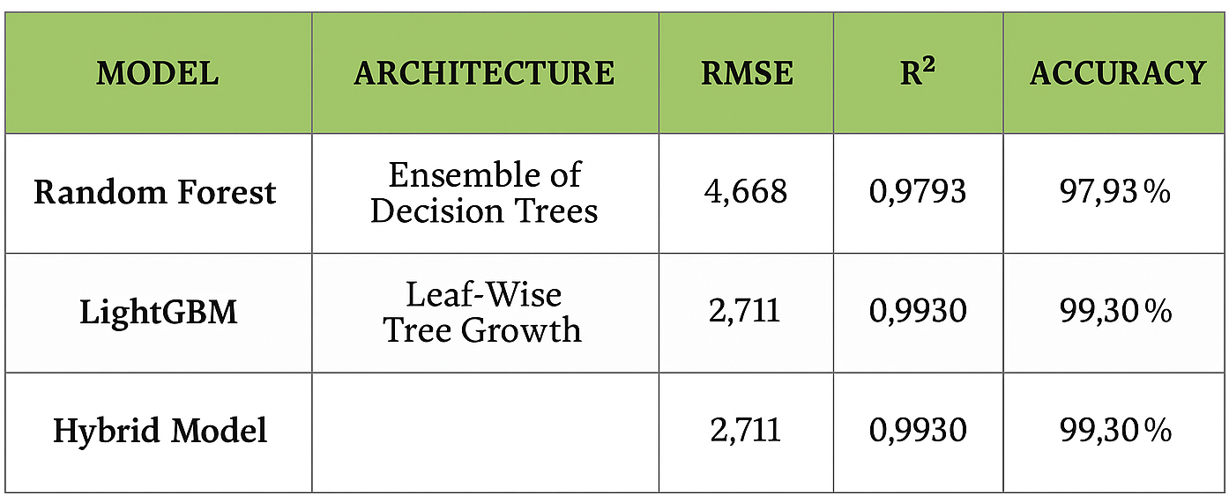
Paper_id :894
Training Setup:
Model trained on the cotton yield dataset combining historical records and synthetic samples.
Optimizer:
Used LightGBM’s built-in gradient boosting optimizer for stable and efficient tree
growth.
Learning Rate:
Applied learning-rate tuning with early stopping for smooth and controlled model
convergence.
Batch Size & Epochs:
Training performed using an 80/20 split, with multiple boosting rounds ensuring
balanced learning.
Metrics Used:
Evaluated using RMSE, R², NSE, Accuracy, Confusion Matrix, and ROC-AUC.
Results:
Achieved 0.9930 R², 2.711 RMSE, and AUC ≈ 1.00, outperforming all baseline models.
Training Dynamics & ROC Curve Summary:
Training Loss: Steadily decreases → LightGBM and RF models learn effectively.
Validation Metrics: R², NSE remain stable → strong generalization with no overfitting.
Optimizer & Boosting Strategy: Leaf-wise boosting + tuned learning rate → smooth and fast convergence.
ROC Curve: Curves stay near the top-left → excellent class separation.
AUC ≈ 1.00: Indicates near-perfect classification performance across yield classes.
Leaf-Wise Gradient Boosting

Slide 7

Paper_id :894
    Main Findings:
    The LightGBM model achieved 99.30% accuracy, R² = 0.9930, and RMSE = 2.711, outperforming all other models.
    Synthetic data + accumulated heat units significantly improved prediction stability.
    The model generalizes well across yield classes with AUC ≈ 1.00 and stable validation metrics.
    Advantages of the Solution
    Uses simplified climate indicators for faster and more scalable prediction.
    Handles data imbalance through synthetic augmentation.
    Delivers highly accurate results with low error compared to traditional models.
    Key Contributions
    Introduced an enhanced preprocessing pipeline with outlier removal and synthetic data generation.
    Optimized LightGBM using leaf-wise boosting for superior accuracy.
    Provided a climate-smart, efficient, and deployable cotton-yield prediction framework.
Limitations
Relies mainly on numerical agronomic inputs without satellite or UAV imagery.
Performance may vary across regions with unseen soil or climate conditions.
Synthetic data may not capture extremely rare real-world scenarios.
Future Scope
Integrate high-resolution remote sensing (UAV + satellite) for richer features.
Expand dataset to additional regions and cultivars for broader generalization.
Develop a real-time farmer decision-support system with mobile/app deployment

Slide 8

Paper_id :894
[1] A. Mitra, S. Beegum, D. Fleisher, V. R. Reddy, W. Sun, C. Ray, D. Timlin, and A. Malakar, “Cotton yield prediction: A machine learning approach with field and synthetic data,” IEEE Access, vol. 12, pp. 101 273–101 288, 2024.
[2] V. Karimi, L. Smith, and R. Brown, “Climate-driven yield prediction using temperature-derived indicators: A case study on cotton,” IEEE Journal of Selected Topics in Applied Earth Observations and Remote Sensing, vol. 16, pp. 12 345–12 356, 2023.
[3] G. Ke, Q. Meng, T. Finley, T. Wang, W. Chen, W. Ma, Q. Ye, and T.-Y. Liu, “Lightgbm: A highly efficient gradient boosting decision tree,” in Advances in Neural Information Processing Systems, vol. 30, 2017, pp. 3146–3154.
[4] S. T. Haider, W. Ge, J. Li, S. U. Rehman, A. Imran, M. Sharaf, and S. M. Haider, “An ensemble machine learning framework for cotton crop yield prediction using weather parameters: A case study of pakistan,” IEEE Access, 2024.
[5] S. N. T. Rao, S. Moturi, S. Mothe, R. L. S. Harsha, N. Shaik, S. V. S. M. Rohit, and D. V. Reddy, “Fake profile detection using machine learning,” in 2025 IEEE International Conference on Interdisciplinary Approaches in Technology and Management for Social Innovation (IATMSI), 2025, pp. 1–6.
[6] M. S. Isik, M. F. Celik, and E. Erten, “Unveiling the highresolution cotton yield variations from low-resolution statistics: Lessons from a nationwide study in turkey,” in IGARSS 2024 – 2024 IEEE International Geoscience and Remote Sensing Symposium. Athens, Greece: IEEE, 2024.
[7] S. Rizwana, P. M. Priya, K. Suvarshitha, M. Gayathri, E. Ramakrishna, and M. Sireesha, “Enhancing wine quality prediction through machine learning techniques,” in 2025 IEEE International Conference on Interdisciplinary Approaches in Technology and Management for Social Innovation (IATMSI), 2025, pp. 1–6.
[8] F. Devoto, D. Ashourloo, Y. Zhao, R. Jiang, R. Awale, M. Bell, T. Mclaren, S. Reynolds-Massey-Reed, L. Otto, M. Bange, W. Woodgate, S. Chapman, and A. Potgieter, “Quantifying cotton growth rate from multispectral uav imagery at plot scale,” in IGARSS 2025 – 2025 IEEE International Geoscience and Remote Sensing Symposium. Brisbane, Australia: IEEE, 2025.
[9] A. Singh, P. Yadav, and R. Kumar, “Remote sensing and machine learning integration for crop yield estimation: Advances and challenges,” IEEE Access, vol. 10, pp. 106 789–106 801, 2022.
[10] M. K. Patel, V. Rolland, L. M. Egan, W. N. Stiller, and W. C. Conaty, “Verticillium wilt monitoring in cotton using uav-based multispectral camera and ensemble machine learning approach,” in IGARSS 2025 – 2025 IEEE International Geoscience and Remote Sensing Symposium. Brisbane, Australia: IEEE, 2025.
[11] J. Liu, H. Wang, and Y. Chen, “Fusion of multi-modal datasets for agricultural yield prediction: Soil, climate, and satellite imagery,” in Proc. IEEE IGARSS, 2023, pp. 4572–4575. [12] Vahid and C. Smith, “Climate-driven yield prediction using temperature-derived indicators: A case study on cotton,” IEEE Journal of Selected Topics in Applied Earth Observations and Remote Sensing, vol. 16, pp. 12 345–12 356, 2023.
[13] S. Rafi, M. S. Reddy, M. Sireesha, A. L. Niharika, S. Neelima, and K. Nikhitha, “Detecting sarcasm across headlines and text,” in 2025 IEEE International Conference on Interdisciplinary Approaches in Technology and Management for Social Innovation (IATMSI), 2025, pp. 1–6.
[14] S. N. T. Rao, T. C. Dulla, V. K. Kolla, G. S. Kurakula, M. Suneetha, S. Moturi, and D. V. Reddy, “Deep learning-based tomato leaf disease identification: Enhancing classification with alexnet,” in 2025 IEEE International Conference on Interdisciplinary Approaches in Technology and Management for Social Innovation (IATMSI), 2025, pp. 1–6.
[15] K. V. N. Reddy, Y. Narendra, M. A. N. Reddy, A. Ramu, D. V. Reddy, and S. Moturi, “Automated traffic sign recognition via cnn deep learning,” in 2025 IEEE International Conference on Interdisciplinary Approaches in Technology and Management for Social Innovation (IATMSI), 2025, pp. 1–6.
[16] S. S. N. Rao, C. Sunitha, S. Najma, N. Nagalakshmi, T. G. R. Babu, and S. Moturi, “Advanced water quality prediction: Leveraging genetic optimization and machine learning,” in 2025 IEEE International Conference on Interdisciplinary Approaches in Technology and Management for Social Innovation (IATMSI), 2025, pp. 1–6.
[17] L. Breiman, “Random forests,” Machine Learning, vol. 45, no. 1, pp. 5–32, 2001.
[18] K. Lakshminadh, D. C. V. Guptha, J. Sai, K. Rajesh, S. Moturi, Y. Neelima, and D. V. Reddy, “Advanced pest identification: An efficient deep learning approach using vgg networks,” in 2025 IEEE International Conference on Interdisciplinary Approaches in Technology and Management for Social Innovation (IATMSI), 2025, pp. 1–6.
[19] G. James, D. Witten, T. Hastie, and R. Tibshirani, An Introduction to Statistical Learning. Springer, 2013.

