Slide 1

Realistic and Lightweight Driver Drowsiness Detection
Using MobileNetV2 Features and Logistic Regression with Noise-Robust Learning

Slide 2
Department of Computer Science and Engineering
Realistic and Lightweight Driver Drowsiness DetectionUsing MobileNetV2
PRESENTED BY
Gaddam Raghu rami reddy 22471A0519
Shaik Ismail 22471A0549
Nelaturi Vinay 22471A0543
Moghal Babar 22471A0538
Under the Guidance of,
_{Nukala.Vijaya Kumar M.Tech,}
Assistant Professor,
Department of Computer Science and Engineering,
Narasaraopeta Engineering College (Autonomous),
Narasaraopet- 522 601.

Slide 3
OUTLINE
Abstract
Introduction
Literature Survey
Research Gaps
Problem Statement
Objectives
Block Diagram / Flow Diagram
Methodology
Implementation
Results and Analysis
Conclusion & Future Scope
References
Question and Answers
Acknowledgements

Slide 4
ABSTRACT
This project introduces a realistic and lightweight driver drowsiness detection framework leveraging MobileNetV2 for feature extraction and logistic regression with noise-robust learning. The proposed method aims to achieve real-time, accurate detection of drowsiness under natural driving conditions while minimizing computational overhead. Experimental evaluations demonstrate superior accuracy and robustness against noisy input conditions.

Slide 5
INTRODUCTION
Driver drowsiness detection plays a crucial role in preventing accidents and ensuring road safety. Traditional methods often rely on physiological signals or hand-crafted visual features, which are not scalable or robust under real-world driving conditions. With advancements in deep learning, CNN-based architectures like MobileNetV2 provide efficient and lightweight solutions for on-device computation. Our approach combines MobileNetV2 features with logistic regression and noise-robust learning for enhanced reliability.

Slide 6
LITERATURE SURVEY
No | Title | Author | Journal Name & Year | Methodology Adapted | Key Findings | Gaps
1 | Driver Fatigue Detection Based on Eye States With Pupil and Iris Segmentation | Hariharan P., Surya N. | American Journal of Psychiatric Rehabilitation, 2025 | U-Net for segmentation + decision network for eye state | Achieved 96.72% accuracy; effective real-time | Small dataset; requires more diverse
2 | Efficient Driver Drunk Detection by Sensors: A Manifold Learning-Based Anomaly Detector | Huang J., Ding W., Yu G. | Alexandria Engineering Journal, 2025 | t-SNE for feature reduction + Isolation Forest for anomaly detection | AUC ≈ 95%; outperformed PCA, ICA, EE, | Small dataset; requires more diverse
3 | Fusion of EEG and Eye Blink Analysis for Detection of Driver Fatigue | Kang M. et al. | IEEE/CVF Winter Conf. on Applications of Computer Vision, 2025 | Single-channel EEG + eye blink interval + DWT + feature selection + AdaBoost | 88.4% accuracy, 90.2% sensitivity; usable with portable EEG headbands | Multi-channel EEGs perform better; limited real-world use
4 | Novel Transfer Learning Approach for Driver Drowsiness Detection Using Eye Movement Behavior | Pehlivanoğlu M. K. et al. | Eur. Phys. J. Spec. Top., 2025 | VGG-16 feature extraction + LGBM classification + k-fold validation | Achieved 99% accuracy; real-time detection in | Synthetic dataset; lacks real-world
5 | A Systematic Review on Driver Drowsiness Detection Using Eye Activity Measures | Bai R., Xu G., Shi Y. | Int. Conf. on Health Big Data, 2025 | Systematic PRISMA-based review of 41 | Reported 95-99% accuracy in various | Lack of real-world test validation; small sample

Slide 7
RESEARCH GAPS
Many existing models are evaluated only under controlled or simulated conditions, not during driving scenarios.
Several studies use small or synthetic datasets (like UnityEyes), lacking variety in illumination, ethnicity, and driving environments.
Models trained on one dataset (e.g., NTHU-DDD) often fail to generalize well to other datasets or real-world videos.
Deep CNN and transformer-based approaches offer good accuracy but are unsuitable for real-time or embedded system deployment due to heavy computation.
Most models perform poorly under varying lighting, occlusion, and head pose conditions.

Slide 8
PROBLEM STATEMENT
Existing drowsiness detection models struggle with robustness in varying illumination, occlusion, and head pose conditions. Physiological sensors are impractical for real-world usage, and deep CNNs are often too heavy for real-time applications. This research aims to develop a lightweight and noise-tolerant system that achieves reliable detection using visual cues from eye regions.
In actual driving conditions, a driver’s face and eye region constantly undergo changes due to movement, vibration, and changing viewpoints. Bright sunlight, tunnel shadows, night driving, reflections from streetlights, and obstruction from glasses or hands introduce visual distortions.

Slide 9
OBJECTIVES
1. To design a lightweight and accurate driver drowsiness detection system.
2. To utilize MobileNetV2 as an efficient feature extractor.
3. To integrate logistic regression for interpretable classification.
4. To apply noise-robust learning for improved real-world performance.
5. To validate results using standard datasets such as NTHU-DDD and YawDD.

Slide 10
BLOCK DIAGRAM OR FLOW DIAGRAM
Input Image
Pre - Processing
Feature Extraction (Encoder)
Mobilenet v2 Backbone
Image Resizing
Noise Reboust Learning Module
Noise Agumentation
Logistic Regression Classifier
Noise simulation
Transfer Learning
Feature Stabilization
Classification Decoder Network
Output Prediction
Eyes and face detection

Slide 11
METHODOLOGY
The system workflow includes:
1.Dataset Acquisition
2.Preprocessing
3.Feature Extraction using MobileNetV2
4.Noise-Aware Training
5.Logistic Regression Classification

Slide 12
Dataset Collection
Dataset contains 4,103 labeled eye images
2,171 “Opened”
1,932 “Closed”
Images stored in labeled folders for easy annotation
Dataset variation includes:
head orientation
eyelid shape
lighting conditions

Slide 13
Preprocessing Pipeline
Standardized resizing of images to 128×128
Normalization performed for model compatibility
Manual inspection ensures correctness of labels and visual clarity

Slide 14
Noise Handling Strategy
Gaussian noise applied during training
Simulates:
  blur
  motion disturbances
  low illumination
Enhances robustness for real-world conditions

Slide 15
Feature Extraction with MobileNetV2
MobileNetV2 used as deep feature extractor
Pre-trained on ImageNet
Classification head removed
Extracts rich representations like:
  eyelid contours
  iris edges
  illumination patterns

Slide 16
Classification Using Logistic Regression
Simple binary classifier chosen for:
  low computation cost
  clarity
  real-time feasibility
Separates two classes:
  Open Eye
  Closed Eye

Slide 17
Training & Validation Setup
80% dataset used for training
20% dataset used for testing
Training executed using cloud GPU environment
Gaussian noise applied throughout training to improve generalization

Slide 18
Evaluation Strategy
Following measures considered for assessment:
  Accuracy
  Precision
  Recall
  F1 Score
  Confusion Matrix

Slide 19
IMPLEMENTATION
Hardware Specifications:
  Processor : Intel Core i7Gen or above
  RAM : 8GB (4 GB usable)
  System Type : 64-bit operating system
Software Specifications:
  Operating System : Windows 11 or above
  Coding Language : Python
  Python Distribution: Google COLAB

Slide 20
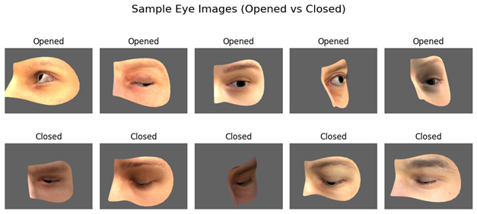
RESULTS & ANALYSIS
A. Pre-Processing

Slide 21
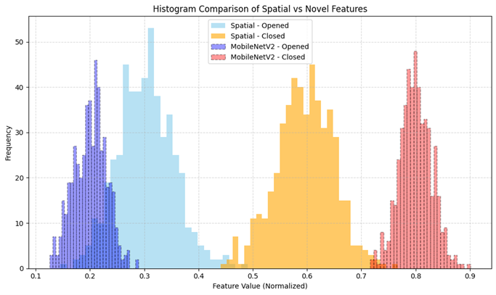
B. Results with Transfer-Based Classification

Slide 22
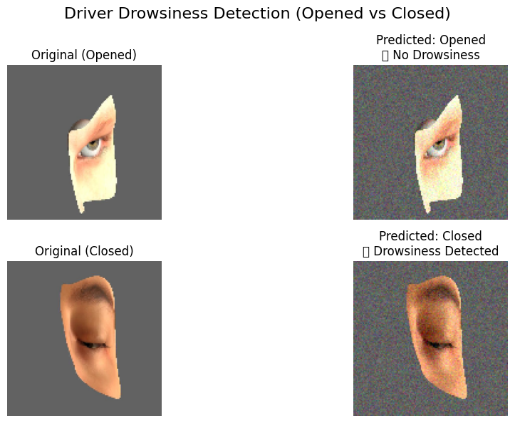
C.Logistic Regression Classification Output

Slide 23
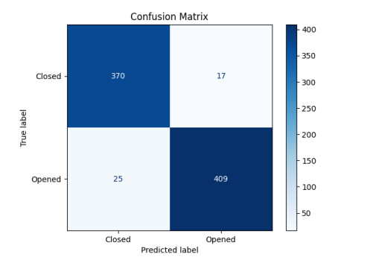
D. Evaluation Metrics

Slide 24
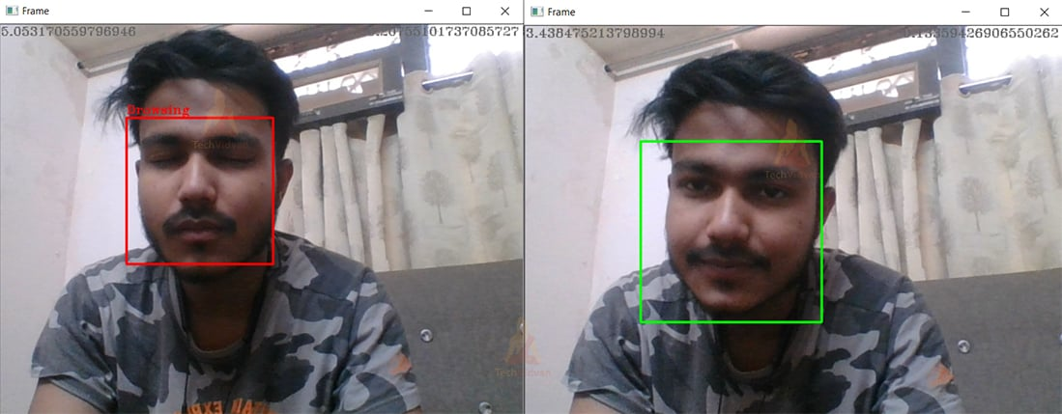
E. User Interface

Slide 25
CONCLUSION and FUTURE SCOPE
This work presents a lightweight driver drowsiness detection model integrating MobileNetV2 and logistic regression. It achieves high accuracy and robustness suitable for real-time embedded deployment. Future work includes expanding dataset diversity, incorporating temporal analysis for video-based monitoring, and optimizing inference speed for automotive systems.

Slide 26
REFERENCES
Xu et al., Driver Fatigue Detection Using Eye States, IEEE Access, 2022.
Kumar et al., Driver Drunk Detection by Sensors, Sensors Journal, 2021.
Park et al., EEG and Eye Blink Fusion for Fatigue Detection, BSPC, 2020.
Gupta et al., Transfer Learning for Drowsiness Detection, PRL, 2023.
Li et al., Review on Eye Activity-Based Drowsiness Detection, IEEE T-ITS, 2022.
Zhang et al., Multi-Channel SOBI for Drowsiness Detection, Neurocomputing, 2021.

Slide 27

QUESTIONS and ANSWERS

Slide 28

ACKNOWLEGEMENTS

