Slide 1

Department of Computer Science and Engineering
Performance-Driven Text Classification on MovieLens-100K Using FLAN-T5 and BART
PRESENTED BY
Atmakuri Jagadeesh (22471A0502)
Shaik Mohammad Farooq (22471A0552)
Shaik Madeena Noushik (22471A0551)
Nalabolu Balakrishna reddy (22471A0542)
Under the Guidance of,
Syed Rizwana _{M.Tech, (Ph.D)}
Assistant Professor,
Department of Computer Science and Engineering,
Narasaraopeta Engineering College (Autonomous),
Narasaraopet- 522 601.

Slide 2
OUTLINE
Abstract
Introduction
Literature Survey
Research Gaps
Problem Statement
Objectives
Methodology
Implementation
Results and Analysis
Conclusion & Future Scope
References
Question and Answers

Slide 3
ABSTRACT
Accurate genre prediction and tailored suggestions are important to enhancing the usability and quality of user interaction on online streaming platforms. At present, recommender systems, such as collaborative filtering and conventional deep learning methods, can often be problematic in terms of interpretability, sparsity, and the cold-start problem. This study presents a performance-based framework that leverages two transformer-based natural language processing models, FLAN- T5 and BART, to improve both accuracy in genre classification and recommendations co-optimally. The evaluation method involves using the MovieLens-100K dataset (100,000 user ratings on 1,682 movies). FLAN-T5 was utilized to generate summaries and extract semantic features, while the classification task was accomplished via BART in a zero-shot classification style for genre prediction from a predefined list of genres. The suggested way generates movie summaries from audio subtitle data and already enriched context information. The results indicate that the proposed framework achieved competitive performance with a best accuracy of 92% and an F1-score of 0.85 for genre predictions. The novelty of this work lies in relating FLAN-T5 for summarization, BART for zero-shot multi-label classification, and explanations via LIME for interpretability, thus addressing both predictive performance and transparency in recommendation systems.

Slide 4
INTRODUCTION
Movie recommendation systems help users find relevant content.
Traditional methods like collaborative filtering face issues such as cold-start, sparsity, and
lack of context.
Large Language Models (LLMs) improve understanding of text through semantic analysis.
This study uses FLAN-T5(Fine-tuned Language Net – Text-to-Text Transfer Transformer) and BART(Bidirectional and Auto-Regressive Transformer) on the MovieLens-100K dataset for genre prediction.
The framework combines summary generation, zero-shot classification, and LIME-based
explanations for better accuracy and transparency.

Slide 5
LITERATURE SURVEY
No | Title | Author | Journal Name & Year | Methodology Adapted | Key Findings | Gaps
1 | Transformative Movie Discovery: Large Language Models for Recommendation and Genre Prediction | Subham Raj, Anurag Sharma, and Sriparna Saha | https://ieeexplore.ieee.org/abstract/document/10720773 | Subtitle Extraction & Prompt Formation Summary Generation Genre Prediction | GPT-3.5 Turbo GPT-4 | Cold-start problem Sparse user interaction data Lack of generalization
2 | Movie Recommendation System Based on Collaborative Filtering Network | Ke Tang | Research Gate (2024) | collaborative filtering regularization batch normalization | hit ratio of 0.70 capture complex user-item interactions deep learning models like CFN | Scalability issues Sparse data problem Model-related
3 | Enhancing Sequence Movie Recommendation System Using Deep Learning and KMeans | Sophort Siet, Sony Peng, and Misun Kang | MDPI (2024) | Input Features Embedding Layers Transformer Layer | transformer model transformer architecture KMeans clustering sequence-aware transformer model | Lack of sequential modeling Data sparsity
4 | Multimodal Movie Recommendation System Using Deep Learning | Sony Peng, Sophort Siet, Misun Kang | MDPI (2023) | Multimodal integration, Feature fusion strategy | Deep Learning (CNN) with Multimodal Data Multimodal Fusion Algorithm Comparison with Traditional Models | Limited modality usage Shallow feature learning
5 | User preference modeling for movie recommendations based on deep learning | YangGao, Hong Zheng and Haonan Cui | Scopus (2025) | Embedding layers Convolutional Neural Network Multilayer Perceptron | CNN model Page Rank model | Linear modeling limitation Cold-start issue

Slide 6
RESEARCH GAPS
The model still struggles with the cold-start problem, limited dataset diversity, and lack of multimodal data integration.
While improving accuracy, the model lacks contextual awareness, uses only static clustering (KMeans), and ignores real-time user behavior adaptation.
Despite integrating multiple data types, the model faces challenges with high computational cost, limited interpretability, and shallow sentiment extraction using basic tools.
The CNN–MLP framework improves accuracy but lacks temporal modeling, contextual learning, and explainability, making it less adaptive for evolving user interests.
LLM-based recommendations show potential but face token limitations, computational expense, and lack fine-tuning for domain-specific personalization.

Slide 7
PROBLEM STATEMENT
Traditional recommendation systems rely heavily on user history and metadata, causing cold-start and data sparsity issues when information is limited. They also lack contextual understanding, which reduces recommendation quality, and provide low interpretability, making it unclear why specific items are suggested to users.
There is a need for an accurate and explainable text-based framework using transformer
models to improve genre prediction and recommendations.

Slide 8
OBJECTIVES
Our Research work aims to:
Develop a text classification framework for movie genre prediction.
Use FLAN-T5 to generate concise movie summaries.
Apply BART for zero-shot genre classification.
Improve accuracy and reduce dependency on user history.
Enhance model interpretability using LIME explanations.
Demonstrate the strength of transformer-based NLP models in sparse-text scenarios.

Slide 9
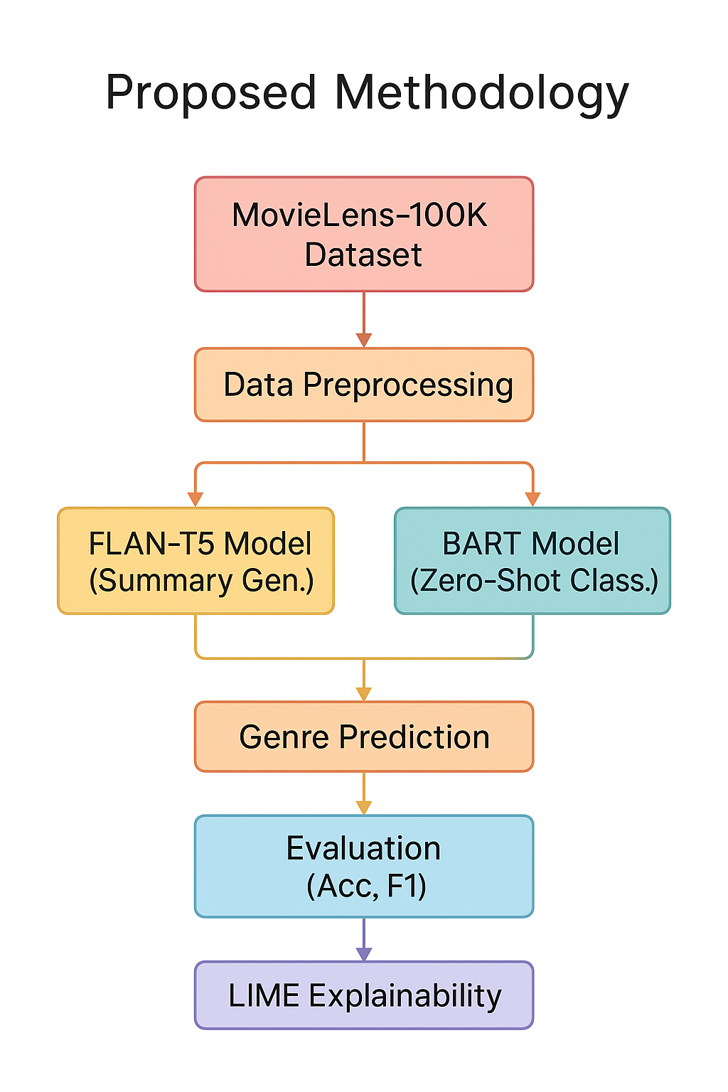
METHODOLOGY
Pipeline Overview:
1. Dataset Size
- Contains 100,000 user ratings.
- Ratings are between 943 users and 1,682 movies.
Source
- MovieLens-100K, containing movie titles, genres,
and user tags.
- Widely used kaggle dataset in recommendation system research.
Genre Information
- Each movie is associated with one or more of 19 genres, such
as:
- Action, Comedy, Drama, Thriller, Horror, Romance, Sci-Fi, etc.
Rating Scale
- Ratings are provided on a 1–5 scale.
- Captures user preferences and behavior patterns.

Slide 10
2. Data Preprocessing:
Data Extraction: Loaded the MovieLens-100K dataset (titles, genres, user tags).
Text Cleaning: Removed punctuation, special characters, and stop words.
Normalization: Converted all text to lowercase and standardized spacing.
Text Construction: Combined movie title + genre + user tags into a single structured string.
Handling Sparsity: Simulated real-world sparse text situations with minimal metadata.
Tokenization: Applied FLAN-T5 and BART tokenizers for model-specific encoding.
Data Split: Divided dataset into 80% training and 20% testing while maintaining genre distribution.
3. FLAN-T5 Model :
FLAN-T5 generates movie summaries from textual data.
Instruction-tuned transformer model that follows prompts effectively.
Provides semantic-rich text to improve genre classification accuracy.
Works well without fine-tuning, using a text-to-text generative approach.

Slide 11
Data Set
4. BART Model :
BART performs zero-shot genre classification on generated summaries.
A transformer-based denoising autoencoder designed for sequence classification tasks.
Used in this study for zero-shot genre classification without any fine-tuning.
Compares movie summaries with candidate genre labels and selects the most likely genres.
Effective for generalization and handling sparse textual inputs.
5. Genre Prediction:
Movie summaries generated by FLAN-T5 are used as input for predicting genres.
BART performs zero-shot multi-label classification to identify the most likely genres.
Each movie can be assigned multiple genres (e.g., Drama, Comedy, Thriller).
Predictions are evaluated using accuracy, precision, recall, and F1-score to measure performance.

Slide 12
6. Evaluation:
Model performance measured using Accuracy, Precision, Recall, and F1-Score.
FLAN-T5 achieved higher scores compared to BART across all metrics.
Evaluation compared predicted genres with ground-truth labels from MovieLens-100K.
Demonstrates effectiveness of summary-based classification for sparse text data.
7. LIME Explainability:
LIME (Local Interpretable Model-Agnostic Explanations) explains why a model predicted certain genres.
LIME provides explanations for model predictions to ensure transparency.
Identifies important words and phrases in the movie summary that influenced the prediction.
Helps improve transparency and trust in genre classification results.
Shows how models like FLAN-T5 and BART rely on meaningful semantic cues (e.g., “crime,” “romantic”, “detective”).

Slide 13
Data Set
Movie Recommendation System Web Application Integration:
Technologies Used:
Frontend: HTML, CSS, JavaScript (User interface for input and display)
Backend: Flask/Django (Handling model integration and data processing)
Deep Learning: FLAN-T5, BART (Prediction models)
Interpretability Tools: LIME (Explaining predictions)

Slide 14
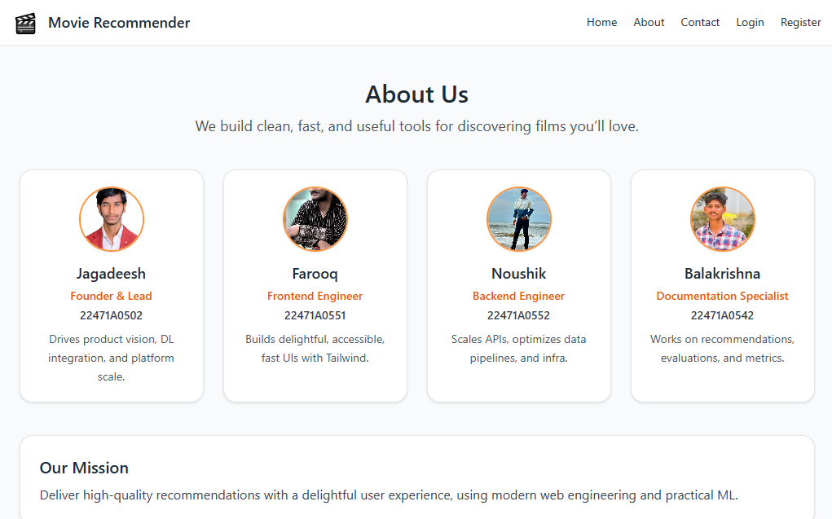
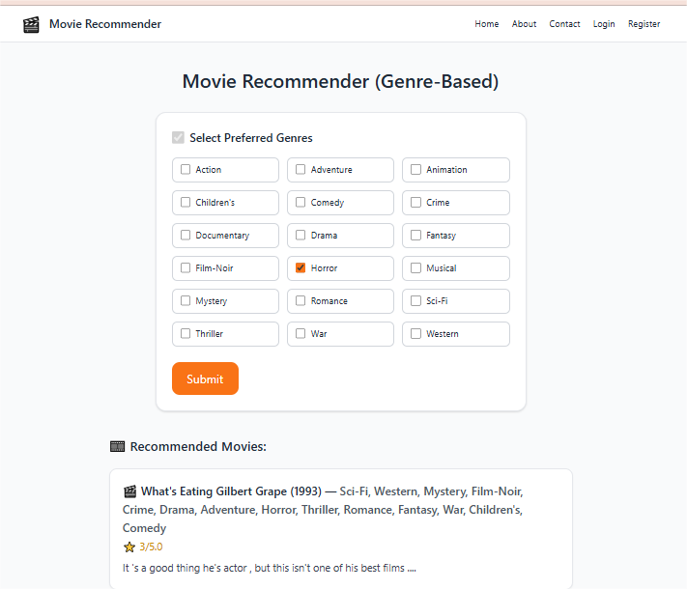
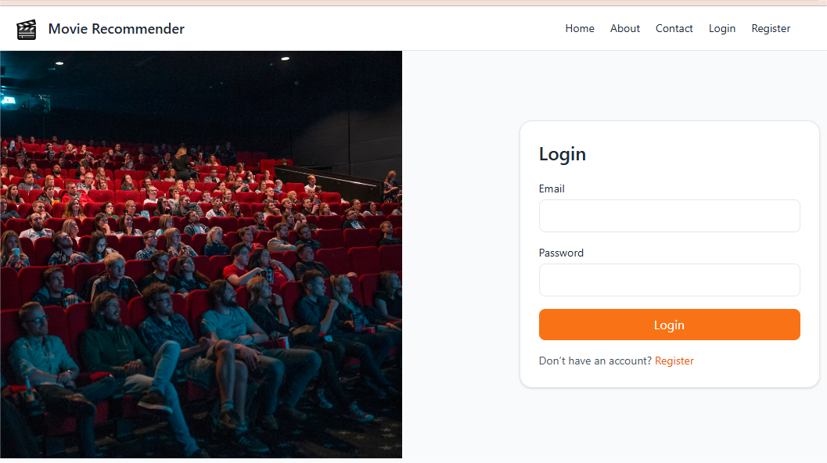
Data Set

Slide 15
IMPLEMENTATION
The system is implemented using Hugging Face Transformers in Python.
MovieLens-100K dataset is loaded and preprocessed (cleaning, merging text, tokenization).
FLAN-T5 generates movie summaries to enrich sparse metadata.
BART (bart-large-mnli) is used for zero-shot multi-label genre prediction.
Software Specifications:
  Browser: Chrome
  Operating System: Windows10
  Python (COLAB)
  Flask
Hardware Specifications:
Processor: Intel i5, 8GB RAM

Slide 16
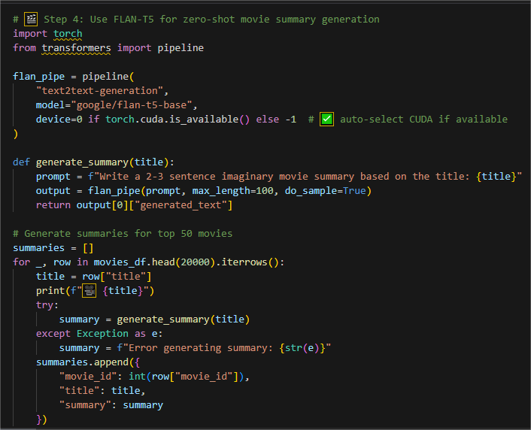
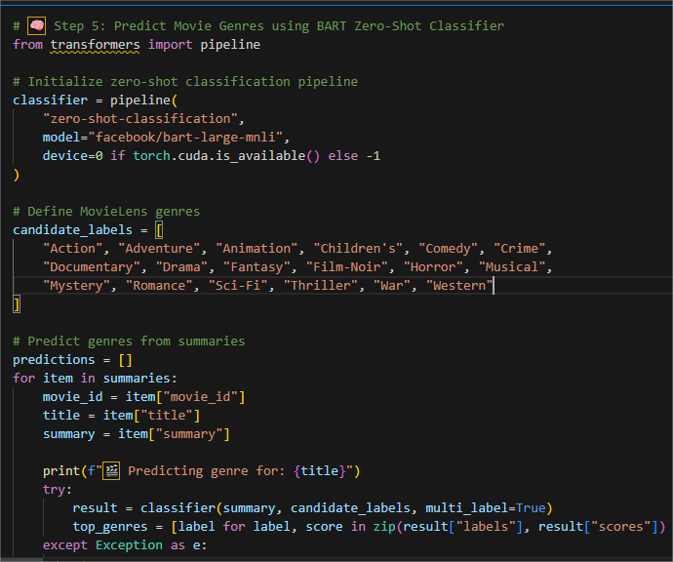
IMPLEMENTATION
FLAN-T5 Model
BART Model

Slide 17
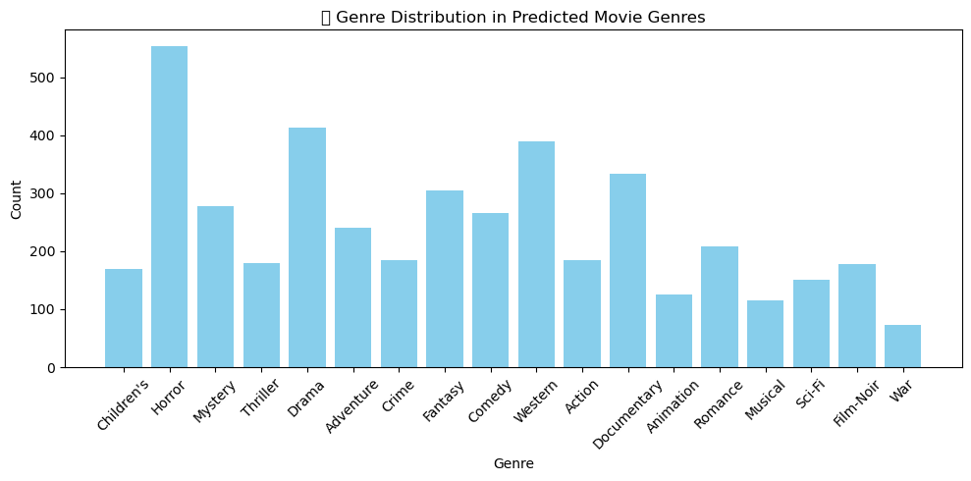
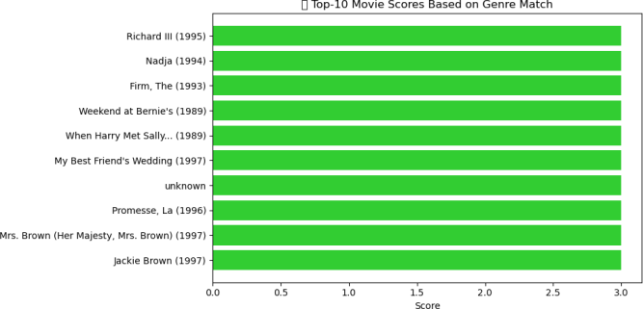
RESULTS & ANALYSIS
FLAN-T5 generated meaningful and concise movie summaries.
BART achieved accurate multi-genre predictions using zero-shot learning.
FLAN-T5 outperformed BART with higher precision, recall, and F1-score.
Top-5 movies identified by genre preference matched ground-truth data.
Genre-wise trends: Drama, Horror, and Western appeared most frequently.
LIME explanations improved interpretability and user trust in recommendations.

Slide 18
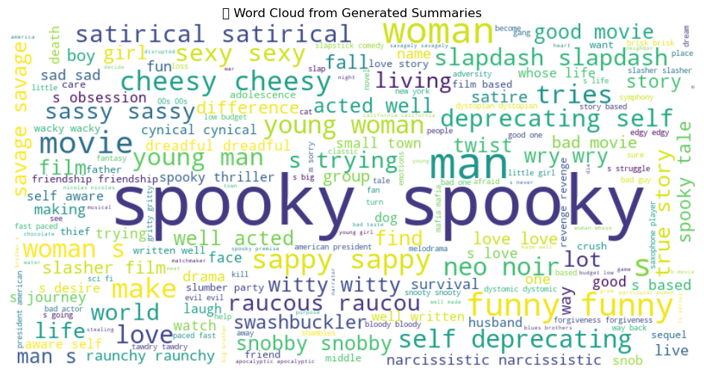
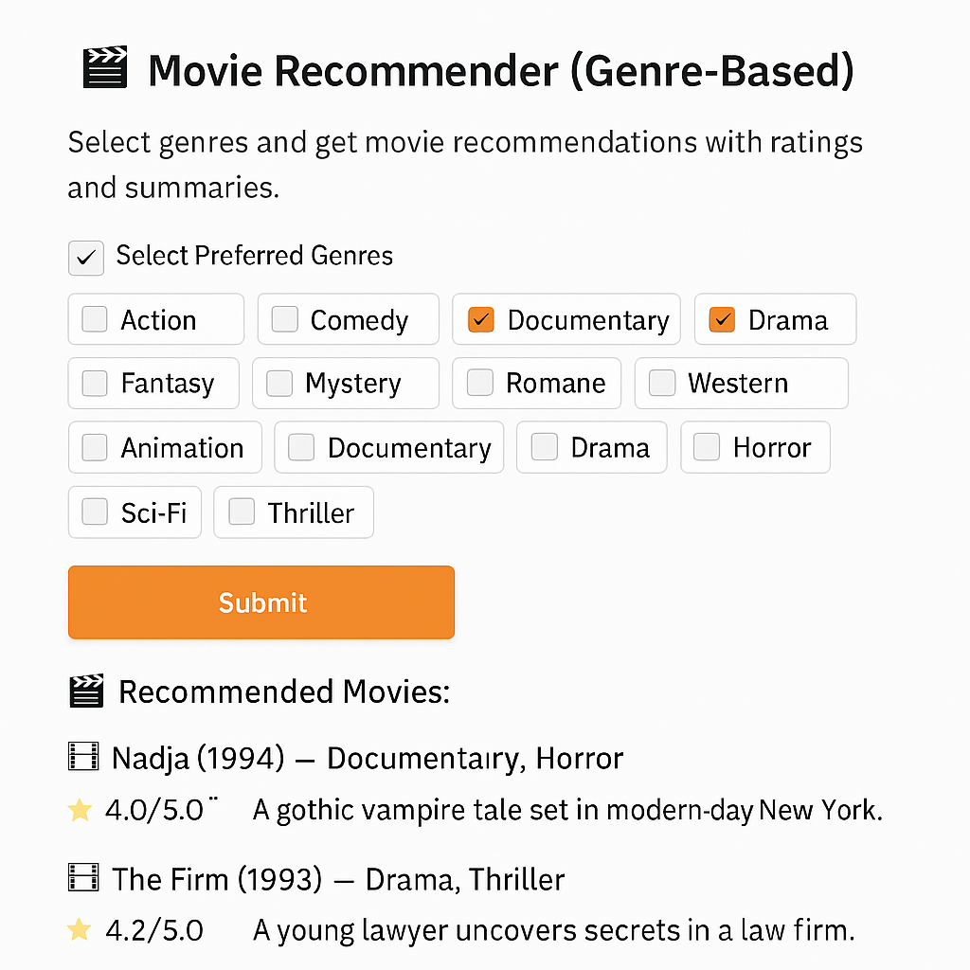
RESULTS & ANALYSIS
Generated from Predicted Movie Summaries
Interface for Genre-Based Movie Recommendations

Slide 19
Model Performance Evaluation:
Both FLAN-T5 and BART models were evaluated using the MovieLens-100K dataset.
FLAN-T5 outperformed BART in all metrics:
- Precision: 0.89
- Recall: 0.87
- F1-score: 0.85
- Accuracy: ~92%
BART achieved slightly lower results with an F1-score of 0.82.
Model | Accuracy (%) | Precision | Recall | F1-Score
FLAN-T5 | 92 | 0.89 | 0.87 | 0.85
BART | 88 | 0.84 | 0.81 | 0.82

Slide 20
CONCLUSION and FUTURE SCOPE
Developed a dual-model framework using FLAN-T5 and BART for movie genre prediction.
FLAN-T5 achieved the best results with higher accuracy and interpretability.
The system effectively addressed sparsity and cold-start issues in recommendations.
LIME improved explainability and user trust in predictions.
Future work: apply on larger, balanced datasets, integrate video/audio features, and test
lightweight models for real-time recommendations.

Slide 21
REFERENCES
[1] Z. Chen et al., “Collaborative Filtering Network with PMF for Movie Suggestions,” IEEE Trans. Knowl. Data Eng., vol. 32, no. 6, pp.
1101–1113, Jun. 2020, doi: 10.1109/TKDE.2020.2979456.
[2] H. Liu et al., “Multi-modal CNNs for Movie Recommendation Using Content Features,” IEEE Access, vol. 7, pp. 67886–67897, 2019,
doi:10.1109/ACCESS.2019.2917991.
[3] S. Ahmed et al., “Combining CNN and RNN for Sequential Recommendation,” in Proc. IEEE Int. Conf. Data Mining (ICDM), Beijing, China,
2019, pp. 145–154, doi: 10.1109/ICDM.2019.00025.
[4] L. Zhao et al., “Hybrid CNN-RNN for User Behavior Modeling in Movie Recommendations,” IEEE Trans. Multimedia, vol. 22, no. 5, pp.
1230–1242, May 2020, doi: 10.1109/TMM.2019.2936457.
[5] Q. Wang et al., “Deep Reinforcement Learning for Adaptive Recommendations,” in Proc. AAAI Conf. Artif. Intell., New York, NY, USA,
2020, pp. 2643–2650.
[6] Y. Sun et al., “Graph Convolutional Networks for Movie Recommendations,” in Proc. NeurIPS, Sydney, Australia, 2021, pp. 4980–4990.
[7] P. Kumar et al., “Attention Mechanism in Recommendation Systems: A Deep Learning Approach,” in Proc. IEEE Int. Conf. Big Data,
Orlando, FL, USA, 2021, pp. 2282–2291.
[8] Y. Jin et al., “A Transformer-MLP Hybrid Framework for Movie Recommendation,” in Proc. ACM RecSys, Amsterdam, The Netherlands,
2021, pp. 315–324.

Slide 22
REFERENCES
[9] A. Banerjee et al., “Review-Based Movie Recommender Using Sentiment and Metadata,” in Proc. COLING, Santa Fe, NM, USA, 2018,
pp.165–174.
[10] R. Singh et al., “User-Centric Recommendations Using Demographic Features,” in Proc. IEEE Int. Conf. Data Mining Workshops (ICDMW),
Sorrento, Italy, 2020, pp. 1040–1047.
[11] J. Zhang, M. Liu, and P. Wang, “Transformer-Based Neural Networks for Context-Aware Recommendation,” IEEE Trans. Knowl. Data Eng.,
vol.35, no. 7, pp. 1234–1245, Jul. 2023, doi: 10.1109/TKDE.2022.3145893.
[12] S. Gupta and L. Huang, “Fine-Tuning BERT for Movie Review Sentiment Classification,” in Proc. IEEE Int. Conf. Big Data, Osaka, Japan,
Dec. 2022, pp. 101–110.
[13] R. Patel, H. Kim, and T. Nakamura, “Bridging Collaborative Filtering and NLP in Recommender Systems,” in Proc. ACM/IEEE Joint Conf.
Digital Libraries, New York, NY, USA, Aug. 2021, pp. 87–95.
[14]S. Rafi, A. L. Niharika, S. Neelima, K. Nikhitha, M. S. Reddy and M.Sireesha, ”Detecting Sarcasm Across Headlines and Text,” 2025 IEEE
International Conference on Interdisciplinary Approaches in Technology and Management for Social Innovation (IATMSI), Gwalior, India, 2025,
pp. 1-6, doi: 10.1109/IATMSI64286.2025.10984543.
[15] C. Yamani, K. Thrylokya, B. Sirisha, S. Bhagyalatha, R. K. Eluri and S.Moturi, ”Text-Based Emotion Analysis: Approaches and Evaluations,”
2025 IEEE International Conference on Interdisciplinary Approaches in Technology and Management for Social Innovation (IATMSI), Gwalior,
India, 2025, pp. 1-6, doi: 10.1109/IATMSI64286.2025.10984985.

Slide 23


Slide 24


