Slide 1


2025 6th GLOBAL CONFERENCE FOR ADVANCEMENT IN TECHNOLOGY
(GCAT 2025)
EfficientSINet-B4: Enhancing Crowd Counting with EfficientNet and Shunting Inhibition Mechanism
Paper ID: 2375
Yerragunta Mahesh Kumar Reddy
Narasaraopeta Engineering College (Autonomous),
Narasaraopet

Slide 2
Index-
Introduction
Objectives
Literature Survey
Proposed Framework
Model Architecture-
Dataset & Preprocessing
Training Setup
Evaluation Metrics
Results & Analysis
Comparative Analysis
Conclusion & Future Scope

Slide 3
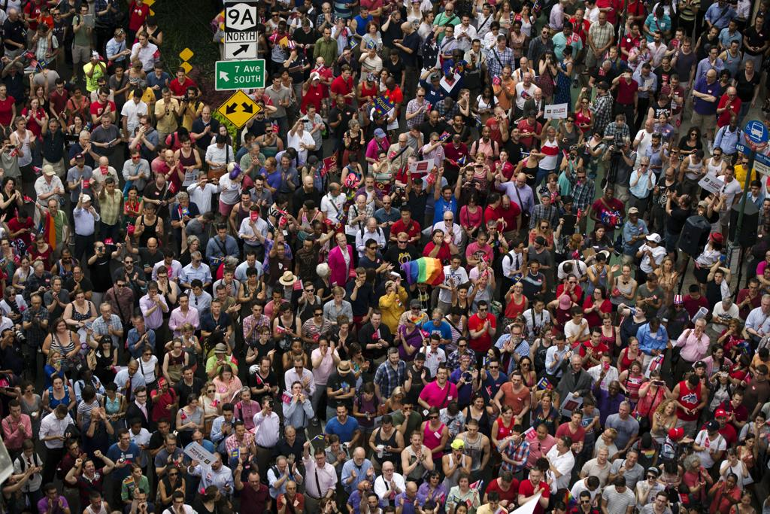
Introduction-
Crowd Counting Importance:
Crucial for public safety, crowd control, and smart surveillance systems.
Helps in avoiding overcrowding incidents, optimizing urban planning, and ensuring safe evacuation.
Challenges in Traditional Methods:
Occlusion and scale variations make counting difficult.
Shallow models (like classic SINet) fail in dense and complex scenes.
Motivation:
Need for a lightweight, accurate, and biologically inspired model that can effectively handle dense crowds.
Integrate EfficientNet-B4 to extract deeper features and enhance robustness.
Goal: Improve counting accuracy while keeping the model efficient and scalable for real-world use.

Slide 4
Objectives-
Main Aim:
To develop a lightweight and accurate crowd counting model by integrating EfficientNet-B4 with the Shunting Inhibition mechanism.
Specific Objectives:
Replace the shallow SINet encoder with EfficientNet-B4 for richer feature extraction.
Incorporate biologically inspired Shunting Inhibition layers to improve density estimation.
Enhance robustness and accuracy in dense and complex crowd scenes.
Maintain computational efficiency for real-time deployment.
Evaluate model performance using MAE and RMSE on benchmark datasets (ShanghaiTech Part-A).

Slide 5
Literature Survey-
Existing Research:
MCNN (Zhang et al.) → Multi-column CNN to handle scale variation but limited contextual learning.
CSRNet (Li et al.) → Used dilated convolutions for broader receptive fields but computationally heavy.
DM-Count (Wang et al.) → Treated counting as density map matching, improved accuracy but complex training.
Radar-Transformer (Nguyen et al.) → Used radar signals + transformers for privacy-preserving counting.
SDA-Net (Bai et al.) → Introduced scale-aware attention, effective but lacks generalization in dense crowds.
Gap Identified:
Need for a deep yet lightweight model that:
Captures multi-scale contextual features,
Is efficient for real-time applications, and
Improves performance on dense and occluded crowd scenes.

Slide 6
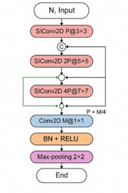
Proposed Framework-
Model Name:
EfficientSINet-B4 -A hybrid of EfficientNet-B4 encoder + Shunting Inhibition mechanism
Pipeline Overview:
Input: Crowd images from ShanghaiTech Part-A dataset
Preprocessing:
  Resize images → 256×256
  Normalize using ImageNet statistics
  Generate density maps from head annotations (Gaussian kernel σ = 15)
Feature Extraction:
  Deep hierarchical features via EfficientNet-B4 backbone
Density Map Generation:
  Lightweight CNN decoder with SI-Conv2D layers
  Combines local + global contextual features
Output:
  Predicted density map
  Crowd count obtained by summing pixel intensities

Slide 7
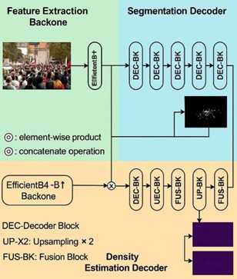
Model Architecture-
Architecture Overview:
Encoder:
  Based on EfficientNet-B4, pretrained on ImageNet.
  Extracts multi-scale, high-level visual features efficiently.
  Balances accuracy vs. parameter size (only 25M parameters).
Decoder:
  Lightweight CNN with successive layers:
    Conv2D(1792→512, 3×3)
    Conv2D(512→256, 3×3)
    Conv2D(256→128, 3×3)
    Conv2D(128→1, 1×1)
  Final layer outputs the density map (no ReLU to preserve real values).
Shunting Inhibition (SI-Conv2D):
  Inspired by biological neural processes.
  Uses multiple kernel sizes (3×3, 5×5, 7×7).
  Fuses local & global context through concatenation and summation.
  Enhances model’s ability to suppress irrelevant noise and highlight crowd regions.

Slide 8
Dataset & Preprocessing-
Dataset Used:
ShanghaiTech Part-A (Benchmark dataset for dense crowds)
482 high-resolution crowd images
  300 for training, 182 for testing
Each image annotated with head locations (.mat files)
Preprocessing Steps:
Resize all images → 256 × 256 pixels
Normalize using ImageNet mean & standard deviation
Convert to PyTorch tensors for GPU training
Generate density maps using Gaussian kernel (σ = 15)
Maintain total crowd count consistency after resizing

Slide 9
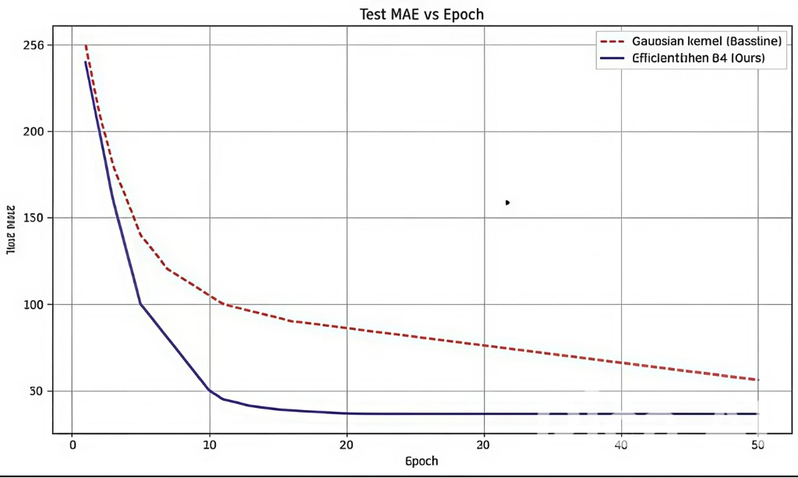
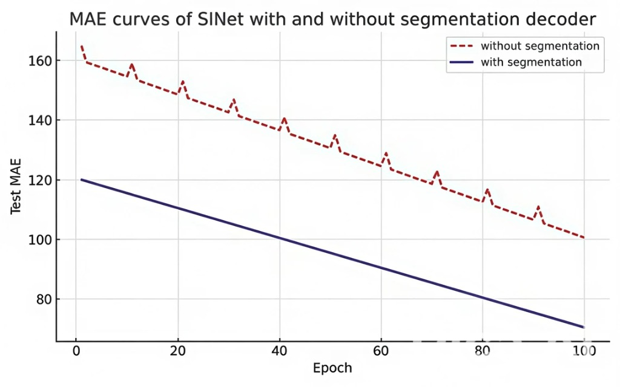
Training Setup-
Training Details:
Framework: PyTorch
Optimizer: Adam
Loss Function: Mean Squared Error (MSE)
Learning Rate: 0.0001 (with ReduceLROnPlateau scheduler)
Epochs: 50–100 (until convergence)
Batch Size: 4
Hardware: GPU-accelerated training
Key Observations:
Stable convergence with smooth loss reduction
Fast learning rate adaptation avoids overfitting
Segmentation decoder improves MAE stability

Slide 10
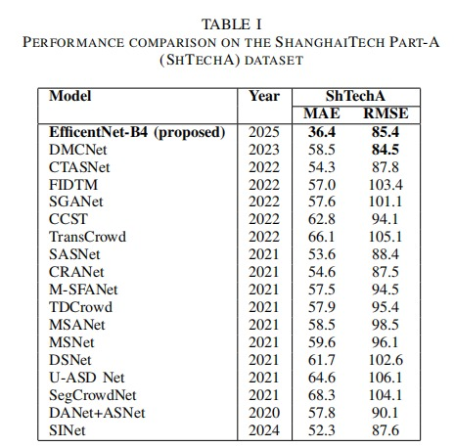
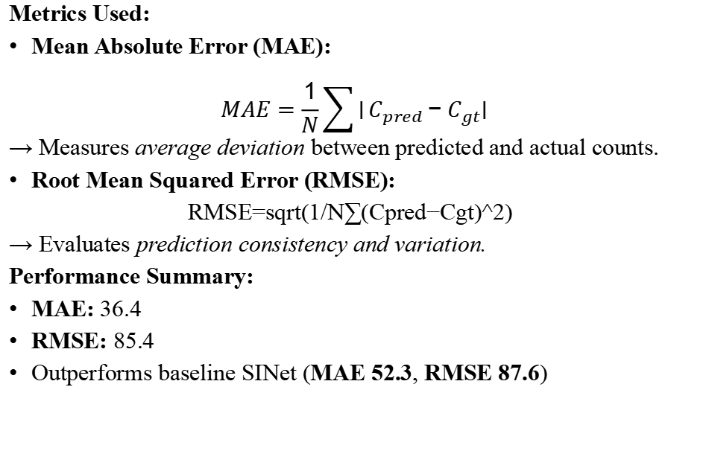
Evaluation Metrics-
Metrics Used:
Mean Absolute Error (MAE):
$$MAE=\frac{1}{N}\sum{∣}C_{pred}−C_{gt}∣$$
→ Measures average deviation between predicted and actual counts.
Root Mean Squared Error (RMSE):
RMSE=sqrt(1/N​∑(Cpred​−Cgt​)^2)
→ Evaluates prediction consistency and variation.
Performance Summary:
MAE: 36.4
RMSE: 85.4
Outperforms baseline SINet (MAE 52.3, RMSE 87.6)

Slide 11
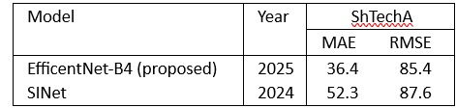
Results & Analysis-
Performance Highlights:
Faster convergence and lower error than baseline.
Stable training with segmentation branch integration.
Model learns effective density estimation early (Epoch 5–10).
Quantitative Results:
Qualitative Results:
Predicted density maps closely match real crowd distributions.
Effective even under occlusion and high-density conditions

Slide 12
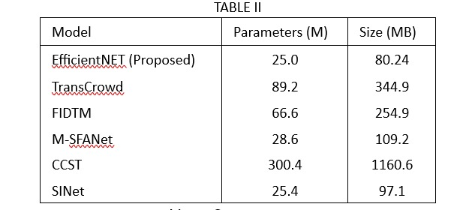
Comparative Analysis-
Model Efficiency:
Lightweight & faster — ideal for real-time deployment in surveillance systems.

Slide 13
Conclusion & Future Scope-
Conclusion:
Introduced EfficientSINet-B4, combining EfficientNet-B4 encoder and Shunting Inhibition for enhanced feature extraction.
Achieved MAE = 36.4, RMSE = 85.4, outperforming SINet and other models.
Lightweight, accurate, and suitable for real-time crowd monitoring.
Future Scope:
Test on larger and diverse datasets (e.g., UCF-QNRF, JHU-CROWD++).
Integrate adaptive kernels and attention mechanisms for dynamic density mapping.
Extend to anomaly detection and crowd behavior prediction.
Optimize further for edge device deployment.
THANK YOU

