Slide 1

Neuro-Diagnosis: A YOLO-Inspired Pipeline for Automated Tumor Boundary Extraction and MRI-Based Classification and Segmentation. Paper Id: 163
Authors: K.V. Narasimha Reddy, Shaik Mohammad Khaleel, Bontha John Babu, Yannakula Shiva Sai,
Chowdari Rama Krishna, Dodda Venkata Reddy,
Akila Venkatraman, Dr. Sireesha Moturi.

Slide 2
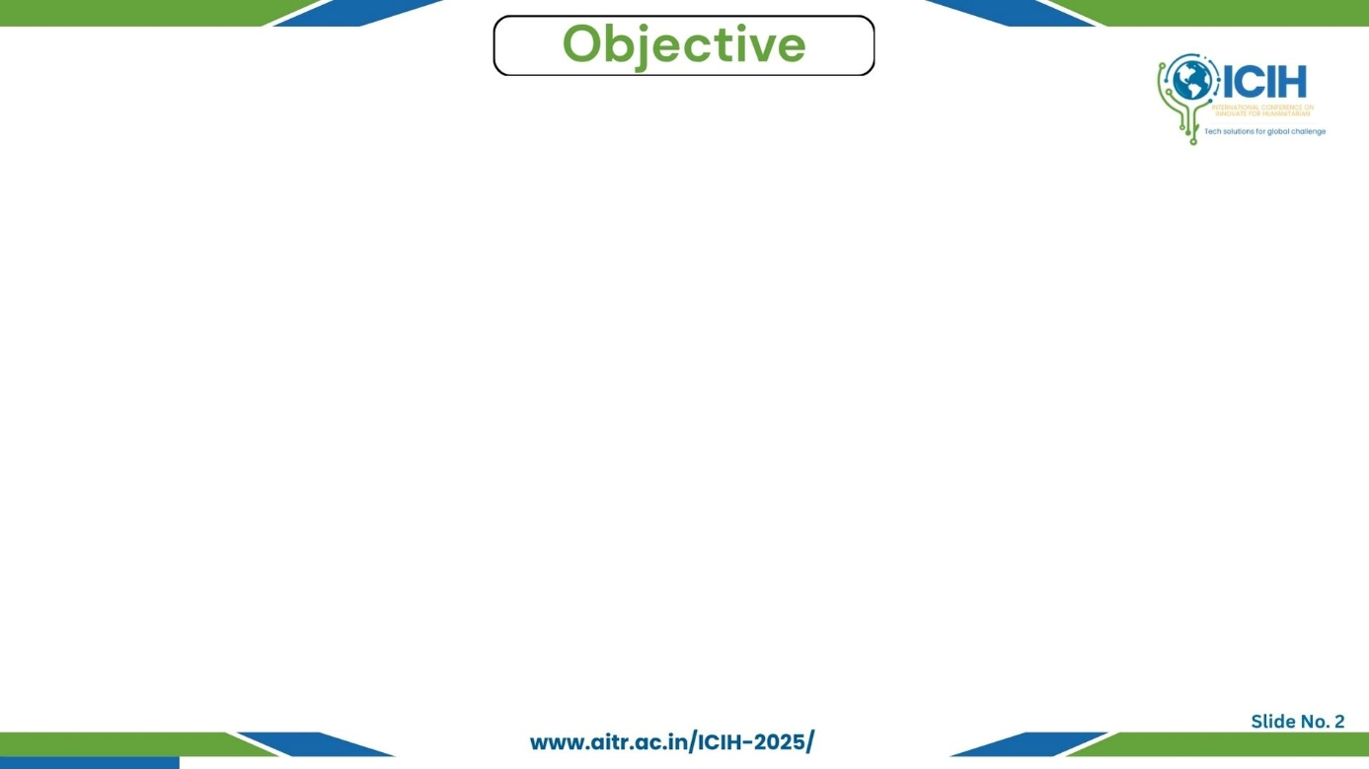
Paper_id :163
Manual MRI analysis is slow and prone to human error.
Need for fast, accurate and real-time tumor detection.
Goal→ To build a YOLO-based pipeline for tumor segmentation and classification.
Expected Outcomes→ Improved accuracy, reduced diagnostic time, and real-time capability.

Slide 3
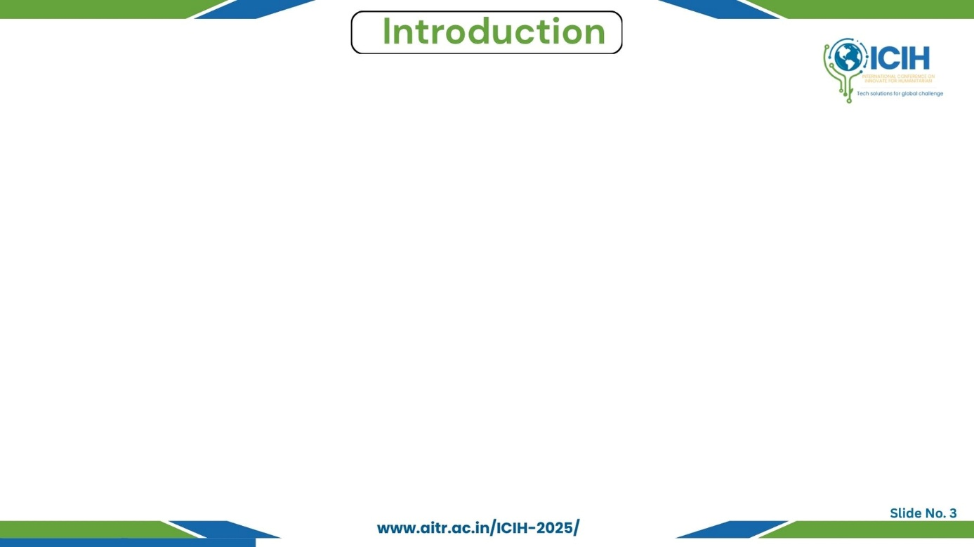
Paper_id :163
Brain tumors are life-threatening due to uncontrolled cell growth.
MRI is the most reliable method for detecting brain tumors without surgery.
Deep learning models (CNN, YOLO) improve diagnostic accuracy but face challenges.
Key Challenges→ Variability in MRI quality, complex tumor boundaries, limited annotated datasets.

Slide 4
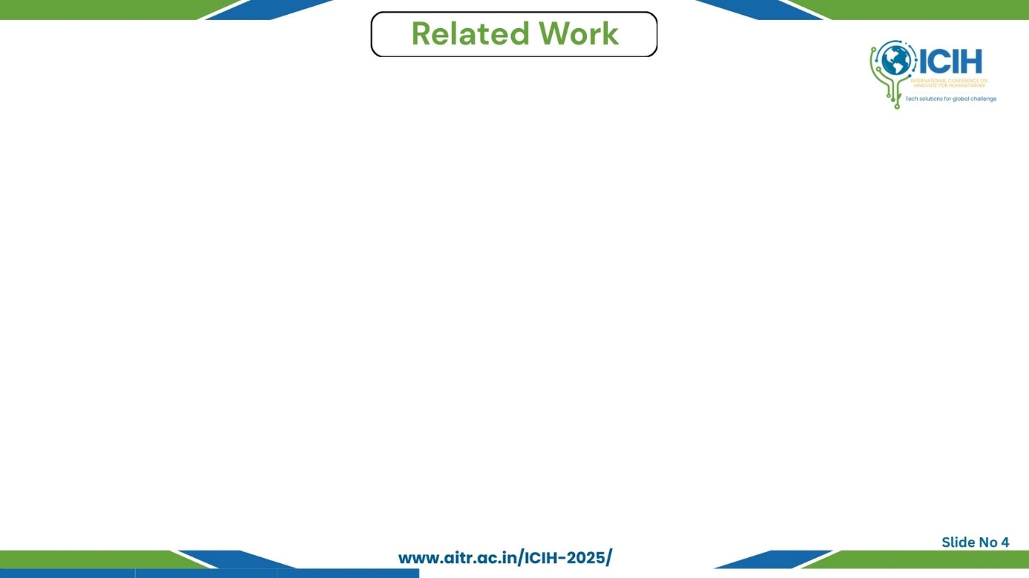
Paper_id :163
Existing methods→ CNN-based segmentation and hybrid U-Net.
Limitations→ High computation time, limited real-time use.
Novelty→ Proposed a YOLO-based ensemble (YOLOv5, YOLOv7, YOLOv8) for simultaneous segmentation and classification.
Introduced a real-time GUI for visual diagnostic support.
Optimized for faster inference and clinical usability.

Slide 5
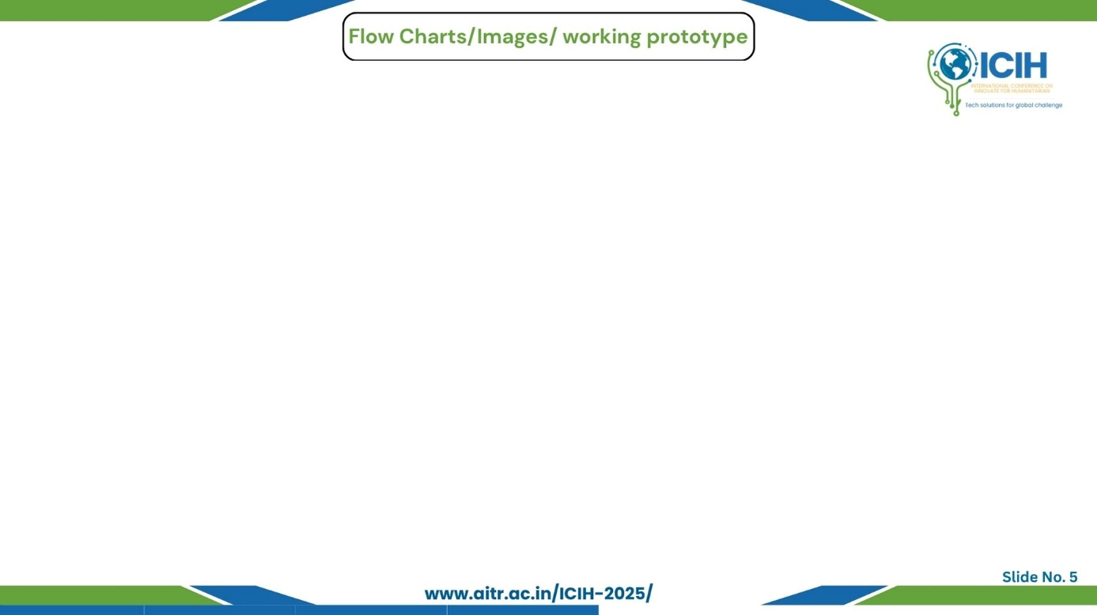
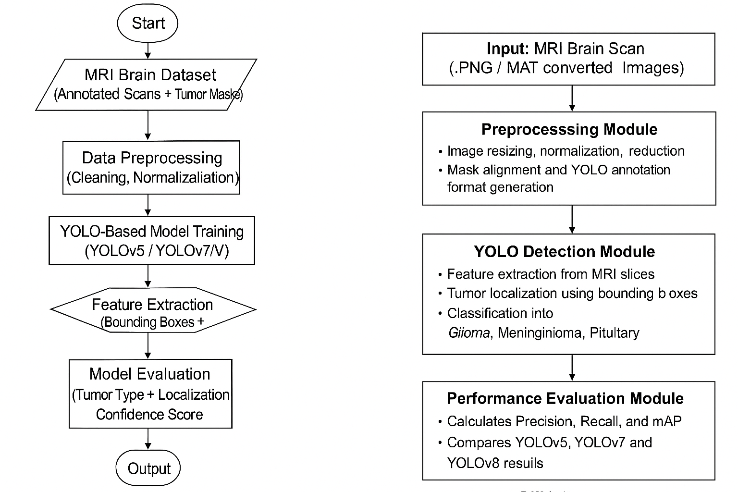
Paper_id :163
Workflow Overview
The system automates brain tumor detection from MRI scans using YOLO-based models.
Preprocessed images are trained through YOLOv5, YOLOv7, and YOLOv8 to extract tumor features and classify them as Glioma, Meningioma, or Pituitary.
Performance is evaluated using Precision, Recall, and mAP, with a GUI interface displaying real-time results.

Slide 6
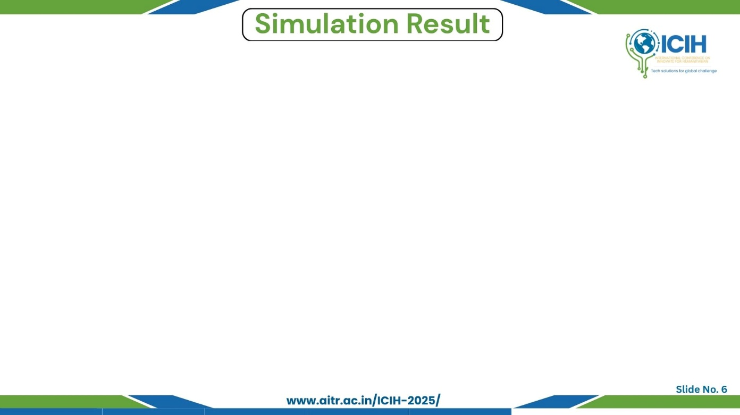
Paper_id :163
YOLOv8 outperforms YOLOv5 and YOLOv7 in all key metrics.
Demonstrates reliable, real-time performance suitable for clinical use.
DL Model | Precision | Recall | mAP
Yolo v5 | 0.903 | 0.876 | 0.914
Yolo v7 | 0.805 | 0.764 | 0.821
Yolo v8 | 0.914 | 0.886 | 0.934
mAP → Mean Average Precision

Slide 7
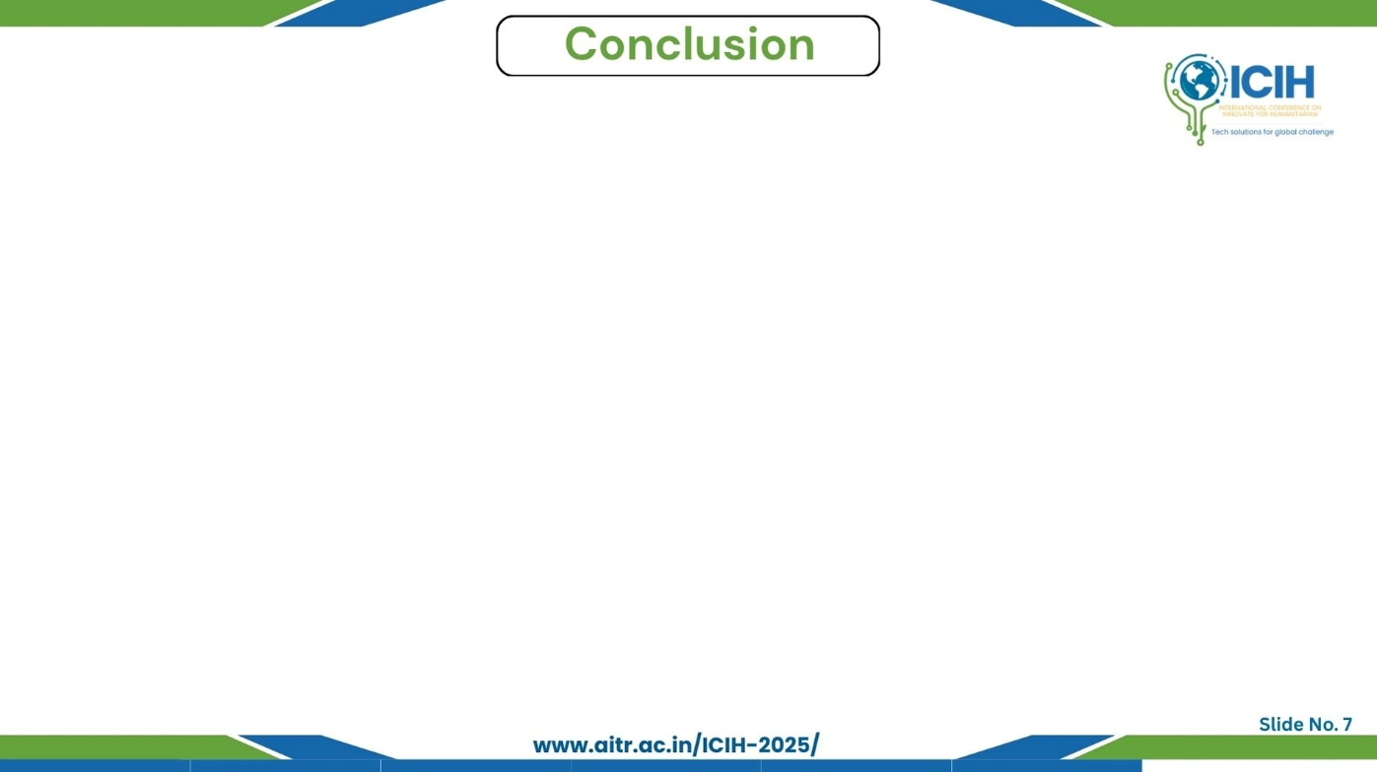
Paper_id :163
Main Findings→ YOLOv8 achieves Precision 0.914, Recall 0.886, mAP 0.934.
Advantages→ Automation, Real-time processing, Reliable diagnosis.
Key contributions→ YOLOv8-based automated brain tumor detection with high accuracy.
Limitations→ Limited by 2D MRI data, class imbalance, and lacks explainability for clinical use.
Future Scope→ 3D MRI, Explainable AI (XAI), Clinical deployment.

Slide 8
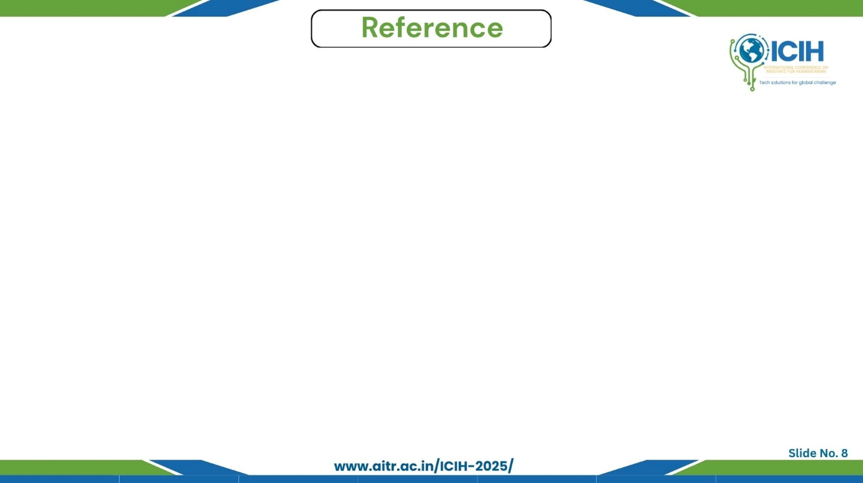
Paper_id :163
[1] P. Hariharan and N. Surya, “Automated brain tumor detection and localization using YOLO-based deep learning algorithm,” Am. J. Psychiatr. Rehabil., vol. 28, no. 5,
pp. 198–203, 2025.
[2] M. K. Pehlivanoğlu, İ. İnce, B. A. Kından, A. G. Eker, and İ. Doğan, “Towards advanced brain tumor segmentation: A novel hybrid architecture integrating UNet, FCN, and YOLO models on the newly introduced BTS-DS 2024 dataset,” Eur. Phys. J. Spec. Top., pp. 1–15, 2025.
[3] M. Xiong, A. Wu, Y. Yang, and Q. Fu, “Efficient brain tumor segmentation for MRI images using YOLO-BT,” Sensors, vol. 25, no. 12, p. 3645, 2025.
[4] D. Alamiri et al., “Applying deep learning to MRI image analysis for brain tumor classification,” in Proc. 6th Int. Conf. Bio-eng. Smart Technol. (BioSMART), 2025,
pp. 1–5.
[5] M. K. Thakur and S. Chauhan, “Brain tumor detection and classification using YOLO algorithms,” in Proc. Int. Conf. Inventive Comput. Technol. (ICICT), 2025, pp. 116–123.
[6] M. H. O. Alnageeb and M. H. Supriya, “Real-time brain tumour diagnoses using a novel lightweight deep learning model,” Comput. Biol. Med., vol. 192, p. 110242, 2025.
[7] K. V. N. Reddy, V. R. Dodda, R. R. Mule, P. R. Babu, and M. Aparna, “Brain tumor detection using deep learning techniques,” AIP Conf. Proc., vol. 3162, p. 020072, 2025.
[8] J. Huang, W. Ding, T. Zhong, and G. Yu, “YOLO-TumorNet: An innovative model for enhancing brain tumor detection performance,” Alexandria Eng. J., vol. 119,
pp. 211–221, 2025.
[9] M. Kang, F. F. Ting, R. C. W. Phan, and C. M. Ting, “PK-YOLO: Pretrained knowledge guided YOLO for brain tumor detection in multiplanar MRI slices,” in Proc. IEEE/CVF Winter Conf. Appl. Comput. Vis. (WACV), 2025, pp. 3732–3741.
[10] S. L. Jagannadham, K. L. Nadh, and M. Sireesha, “Brain tumour detection using CNN,”
in Proc. 5th Int. Conf. I-SMAC (IoT in Social, Mobile, Analytics and Cloud), Palladam, India, 2021, pp. 734–739, doi: 10.1109/I-SMAC52330.2021.9640875.
[11] S. Khalighiyan, “Brain tumour identification through advanced machine learning techniques,” M.S. thesis, Univ. Windsor, Canada, 2025.
[12] N. B. Bahadure, S. Routray, J. C. Patni, N. Raju, and P. D. Patil, “Berkeley wavelet transform and improved YOLOv7-based classification technique for brain tumor severity prediction,” Int. J. Electr. Comput. Eng., vol. 15, no. 1, 2025.
[13] R. Bai, G. Xu, and Y. Shi, “SCC-YOLO: An improved object detector for assisting in brain tumor diagnosis,” in Proc. Int. Conf. Health Big Data, 2025, pp. 114–120.
[14] S. Uzun and M. Okuyar, “A new deep learning-based GUI design and implementation for automatic detection of brain strokes with CT images,” Eur. Phys. J. Spec. Top., vol. 234, no. 1, pp. 141–164, 2025.
[15] S. Muksimova, S. Umirzakova, S. Mardieva, N. Iskhakova, M. Sultanov, and Y. I. Cho,
“A lightweight attention-driven YOLOv5m model for improved brain tumor detection,” in Proc. IEEE Conf. Computers in Biology and Medicine, vol. 188, p. 109893, 2025.

