Slide 1

XSFN-Net: A Hybrid Deep Spiking Fractional Neural Network for OSCC Classification in Histopathological Images
Paper ID : 173
Authors : Dr. S. N. Tirumala Rao, Pavitra Utalapalli, Vijaya Chilamkuri, Mounika Chevula, Arthi Achaibhar, S. Govinda Rao, Dr. Sireesha Moturi.

Slide 2
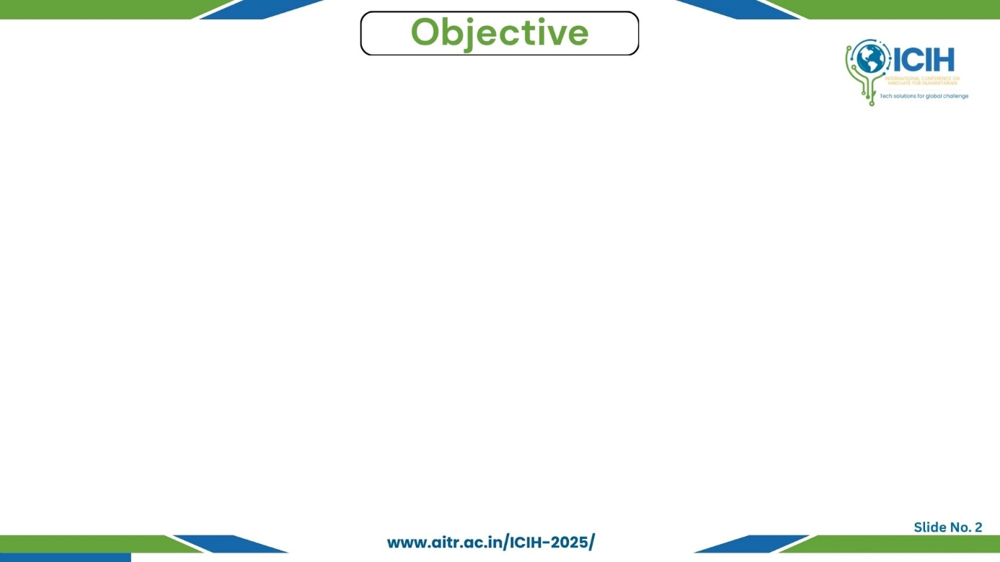
Paper_id :173
Problem to solve / motivation:
Oral Squamous Cell Carcinoma (OSCC) accounts for nearly 90% of oralmalignancies and remains difficult to diagnose early due to subtle histopathological differences.
Manual diagnosis through microscopy is subjective, time-consuming, and highly dependent on pathologist expertise.
Research scope/goal:
To design a hybrid deep learning model (XSFN-Net) integrating Xception, Fractional Calculus Fusion, and Deep Spiking Neural Network (DSNN) for accurate OSCC classification from histopathological images.
Expected outcomes:
Achieve improved accuracy (>90%), precision, and recall compared to existing CNN-based models.
Provide a reliable, biologically inspired, and computationally efficient diagnostic tool for early oral cancer detection.

Slide 3

Paper_id :173
Background context:
Oral Squamous Cell Carcinoma (OSCC) is the most common oral malignancy, responsible for 84–97% of oral cancers.
Early detection is critical — 5-year survival rate drops from 85% to below 40%
Importance of the problem:
Manual histopathological analysis is subjective and prone to human error.
Requires an automated, objective, and high-accuracy AI system for reliable OSCC diagnosis.
Basic overview of technology involved:
Xception model for deep spatial feature extraction.
Fractional Calculus for flexible feature fusion.
Deep Spiking Neural Network (DSNN) for biologically inspired classification.
Key challenges:
Variations in staining, magnification, and tissue morphology.
Limited annotated datasets for OSCC.
Balancing handcrafted and deep features for robust classification.

Slide 4
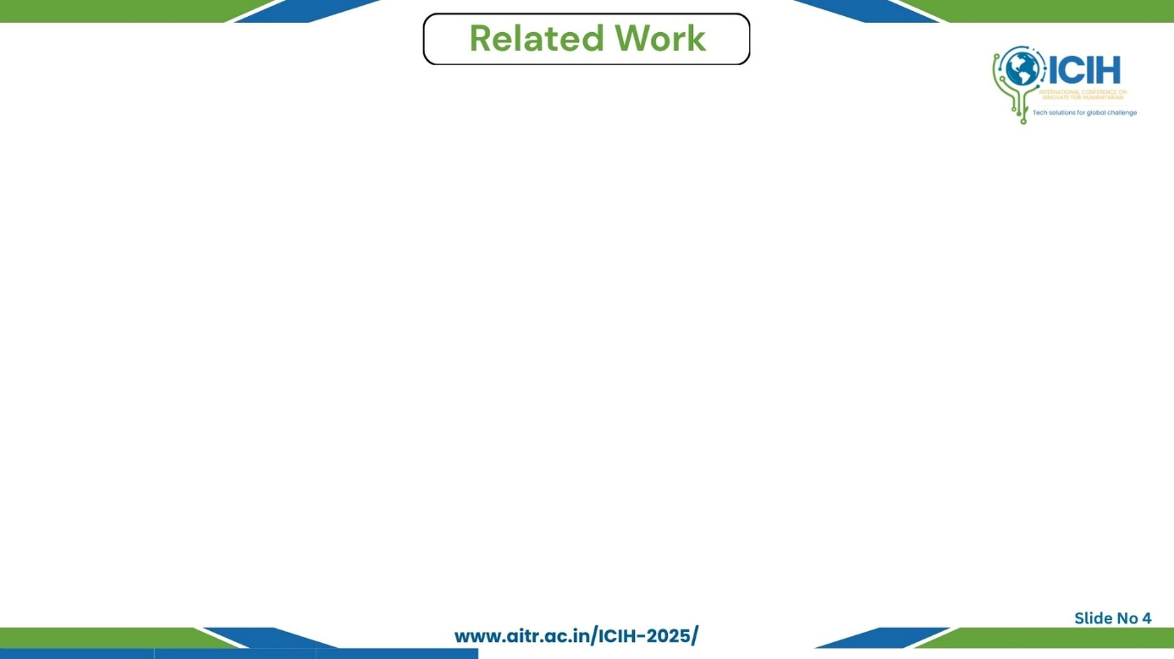
Paper_id :173
Short review of similar technologies/research:
Ramya et al. – Combined handcrafted and deep features for OSCC classification.
Devindi et al. – Multimodal CNN using clinical and image data.
Madhusmita Das et al. – Ensemble model (InceptionResNetV2 + Xception).
Vasuki et al. – Modified VGG with XGBoost for improved OSCC detection.
Existing solutions & approaches:
Pure CNN or ensemble models relying on deep features.
Some models incorporate handcrafted features or simple preprocessing.
Limitations of current works:
Lack of integration between handcrafted and deep features.
Limited interpretability and biological plausibility.
Insufficient noise handling and segmentation accuracy.
Novelty of our approach:
Hybrid model combining Xception + Fractional Calculus Fusion + DSNN.
Integrates handcrafted (LVP, DWT, GLRM) and deep spatial features.
Achieves 91% accuracy with biologically inspired, energy-efficient computation.

Slide 5
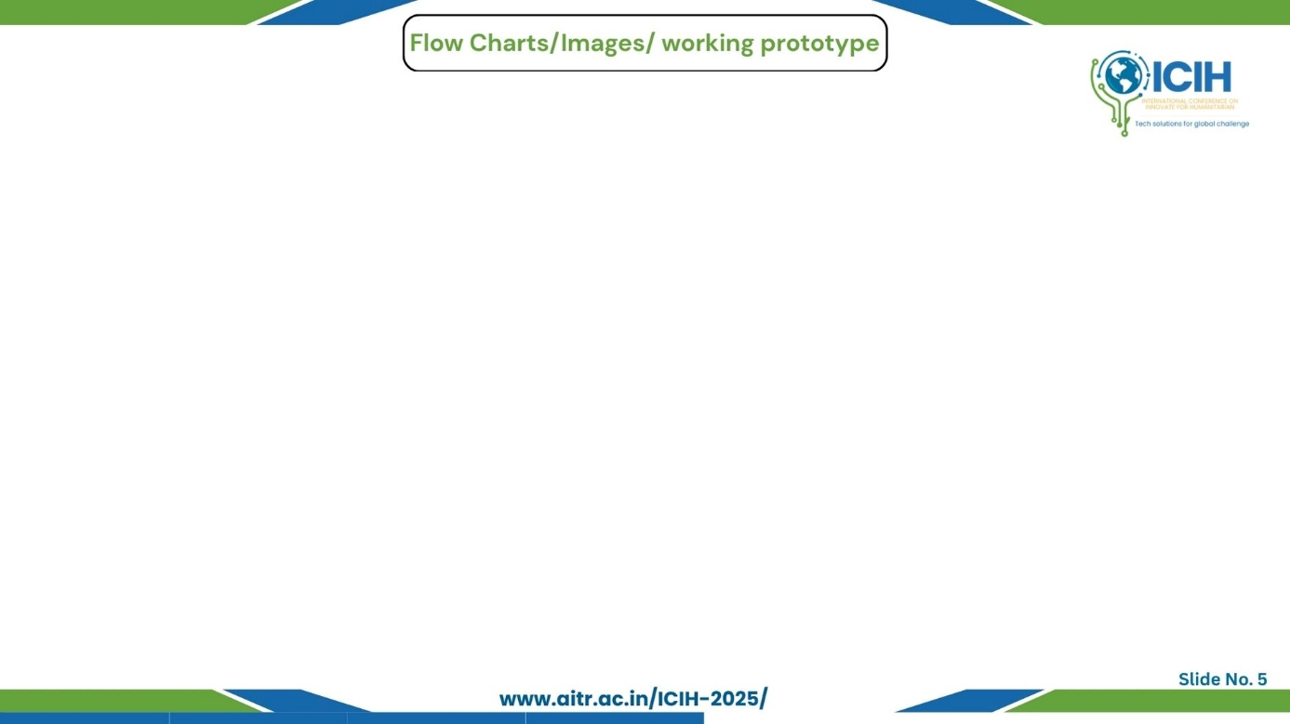
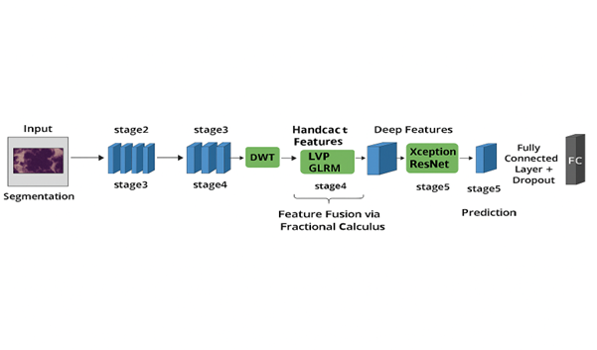
Paper_id :173
Architecture diagram:
Figure : Architecture of the OSCC with Fractional Calculus Feature Fusion
Brief bullet captions describing each element:
Xception: Extracts high-level semantic features.
Fractional Calculus: Enables adaptive integration of multi-domain features.
DSNN Layer: Simulates biological neuron firing for efficient, interpretable classification.

Slide 6
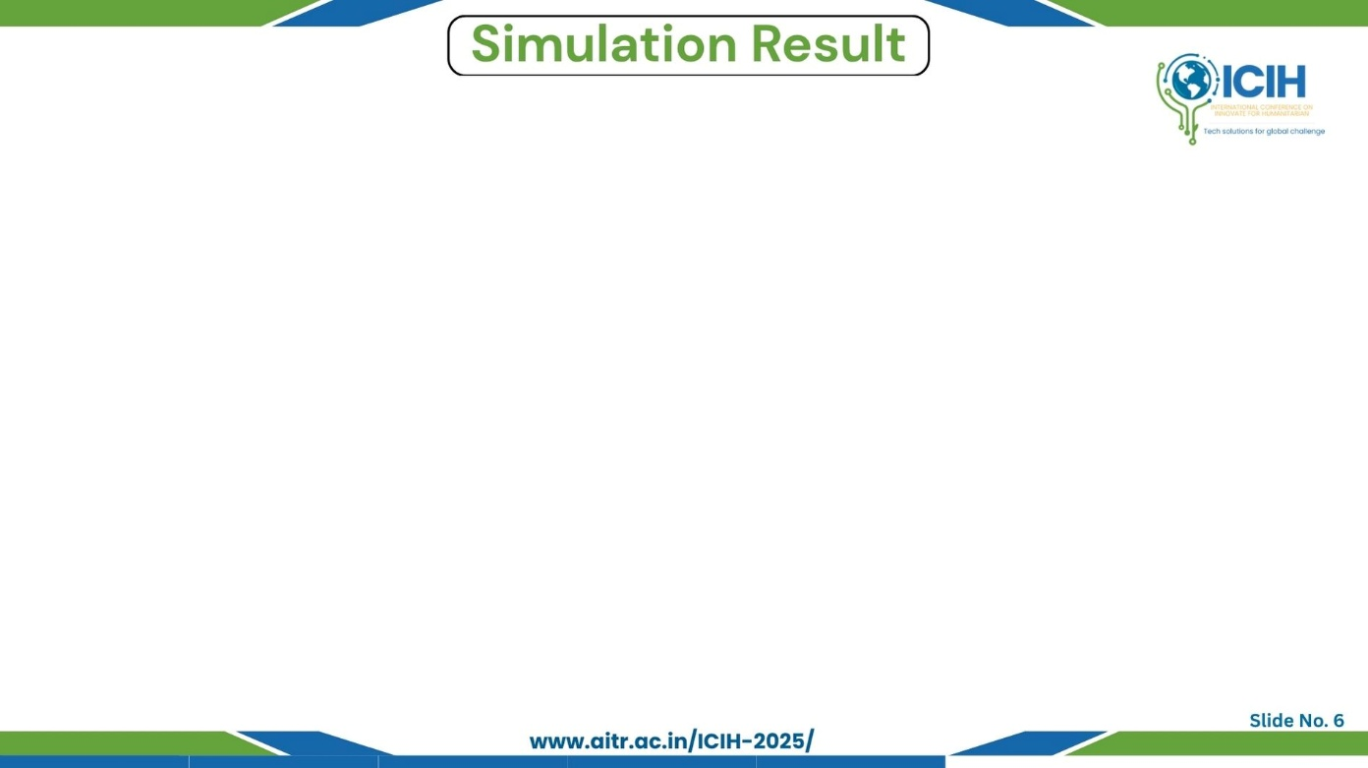
Paper_id :173
Table:
Performance comparisons:
XSFN-Net consistently outperformed CNN and OralNet across all five folds.
Accuracy improved from ~76% (traditional CNN) to 91% (proposed XSFN-Net).
Brief observations & insights:
Fractional Calculus fusion increased discriminative power and reduced feature redundancy.
DSNN enhanced interpretability and computational efficiency, showing potential for clinical deployment.
Model | Accuracy | Precision | Recall | F1-Score
CNN | 76% | 74.5% | 75.2% | 74.8%
OralNet | 76.31% | 75.1% | 76.0% | 75.5%
XSFN-NET | 91% | 93.51% | 93.01% | 93.64%

Slide 7
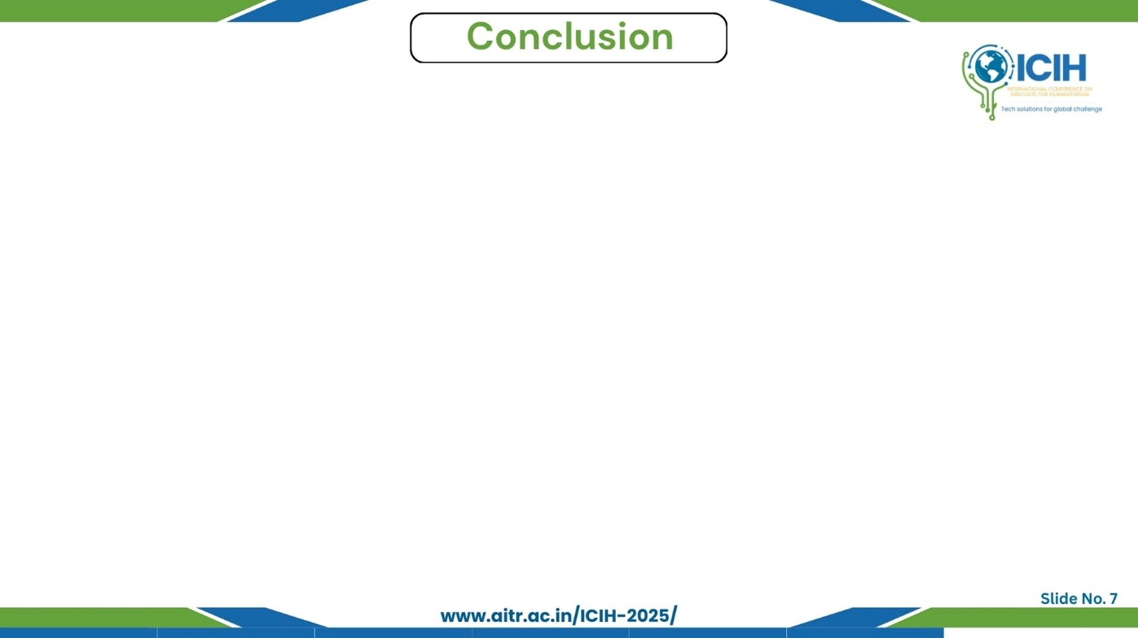
Paper_id :173
Main findings:
The proposed XSFN-Net achieved 91% accuracy, 93.51% precision, 93.01% recall.
Effectively classified OSCC and normal tissues from histopathological images.
Advantages of our solution:
Combines handcrafted + deep features for robust representation.
Fractional Calculus Fusion enhances adaptability and feature balance.
Key contributions:
Introduced a hybrid deep spiking fractional neural network for OSCC classification.
Integrated novel Medav filtering and PraNet segmentation for precise preprocessing.
Limitations and future scope:
Dataset size (1,224 images) limits large-scale generalization
Incorporate Explainable AI (XAI) for clinical trust.

Slide 8
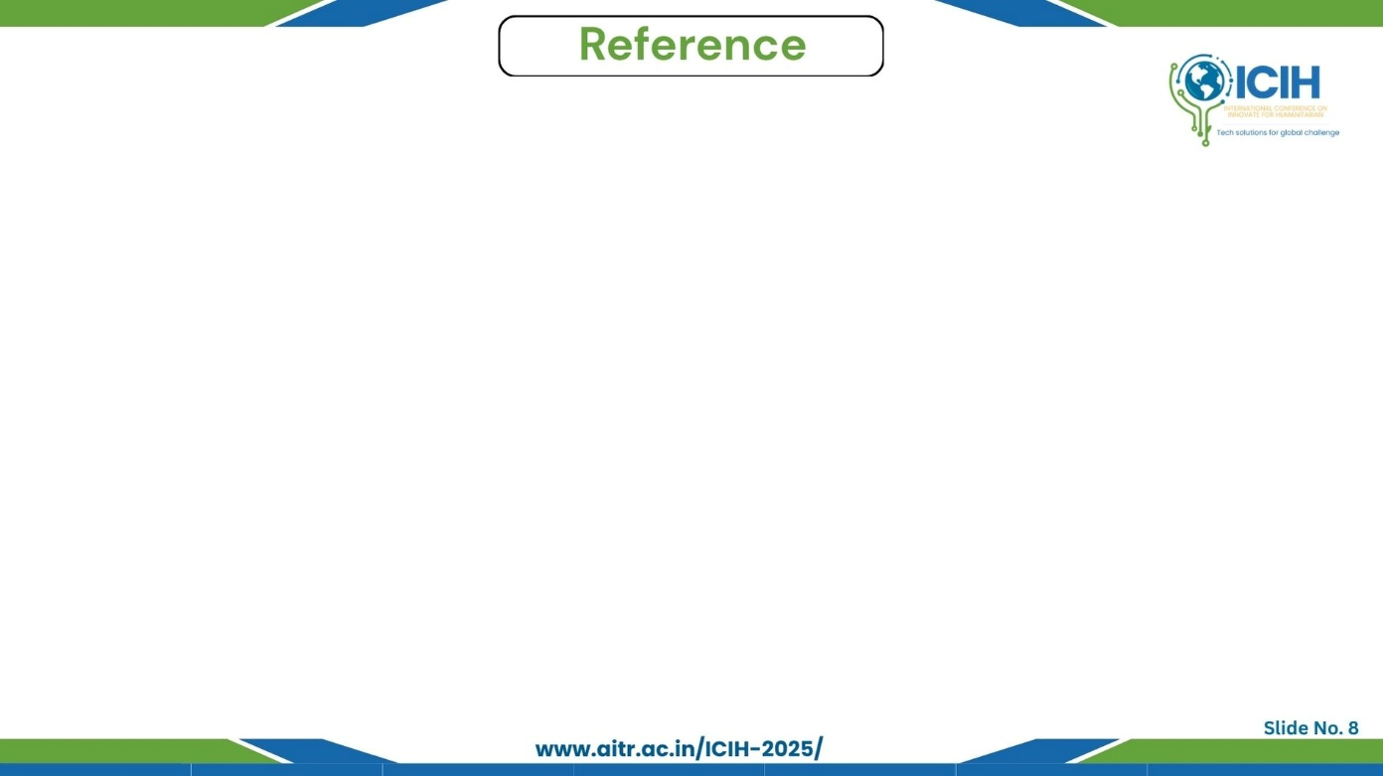
Paper_id :173
Reference
S. Ramya et al., “Xception Spiking Fractional Neural Network for OSCC Classification Based on Histopathological Images,” IEEE Access, 2025.
G. A. I. Devindi et al., “Multimodal Deep Convolutional Neural Network Pipeline for AI-Assisted Early Detection of Oral Cancer,” IEEE Access, 2024,
M. Das et al., “An Ensemble Deep Learning Model for Oral Squamous Cell Carcinoma Detection Using Histopathological Image Analysis,” IEEE Access, 2024,
S. Vasuki et al., “Ensemble Deep Learning Framework for OSCC Classification Using Modified VGG and CNN Features with XGBoost,” in Proc. IEEE ICTEST, 2025,
Karishma Madhusudan Desai et al., “Screening of Oral Potentially Malignant Disorders and Oral Cancer Using Deep Learning Models,”

