Slide 1

Department of Computer Science and Engineering
XSFN-Net: A Hybrid Deep Spiking Fractional Neural Network for OSCC Classification in Histopathological Images
PRESENTED BY
Pavitra Utalapalli
Vijaya Chilamkuri
Mounika Chevula
Arthi Achaibhar
(22471A0564)
(22471A0512)
(22471A0510)
(22471A0501)
Under the Guidance of,
Dr. S. N. Tirumala Rao, M.Tech., Ph.D.
Professor & HOD ,
Department of Computer Science and Engineering,
Narasaraopeta Engineering College (Autonomous), Narasaraopet- 522601.

Slide 2
OUTLINE
Abstract
Introduction
Literature Survey
Research Gaps
Problem Statement
Objectives
Block Diagram / Flow Diagram
Methodology
Implementation
Results and Analysis
Conclusion & Future Scope
References
Question and Answers
Acknowledgements
Review No.
Department of CSE

Slide 3
ABSTRACT
Oral Squamous Cell Carcinoma (OSCC) is one ofthe most Prevalent forms of oral cancer, commonly associated to risk factors like tobacco use, alcohol use, chewing betelnut and viral infections. Early diagnosis and treatment of OSCC and other oral mucosal potentially malignant lesions is the clinician’s best bet to improve prognosis .In this research paper, we propose the new Deep Learning model of Xception spiking Fractional Neural Network (XSFN-NET) to different OSCC of the histopathology.The features are the combined using Fractional Calculus(FC) and classified by a Deep Spiking Neural Network (DSNN) to make efficient and biologically inspired decisions.
Review No.
Department of CSE

Slide 4
INTRODUCTION
Oral Squamous Cell Carcinoma (OSCC) is one of the most common and aggressive forms of oral cancer.
Early and accurate diagnosis is crucial for improving patient survival rates.
Histopathological image analysis is the gold standard for OSCC detection, but manual interpretation is time-consuming and subjective.
Deep learning has shown promising results in medical image classification, offering automated and precise detection.
To address these limitations, XSFN-Net integrates Spiking Neural Networks (SNNs) and Fractional Neural Networks (FNNs) to enhance feature learning and efficiency.
Review No.
Department of CSE

Slide 5
MOTIVATION
Manual examination of histopathological slides is time-consuming and prone to human error.
Spiking Neural Networks (SNNs) offer energy-efficient, brain-inspired computation suitable for medical imaging.
Traditional deep learning models require large computational resources and extensive data.
A hybrid model combining deep, spiking, and fractional learning can achieve better accuracy and generalization.
There is a need for robust, interpretable, and computationally efficient models in cancer diagnosis.

Slide 6
LITERATURE SURVEY
No | Title | Author | Journal Name & Year | Methodology Adapted | Key Findings | Gaps
1 | Xception Spiking Fractional Neural Network for Oral Squamous Cell Carcinoma Classification Based on Histopathological Images | singaraju Ramya; R.I.Minus; K.T.Magesh | https://ieeexplore.ieee.org/document/11016737 | Image Enhancement using the Medav Filter,Pixel-wiseSegmentationPraNet,Data Augmentation,Image Normalization | This model effectively integrates multiple advanced components to enhance diagnostic accuracy. | the model is limited to binary classification and does not handle stage-wise OSCC classification
2 | Multimodal Deep Convolutional Neural Network Pipeline for AI-Assisted Early Detection of Oral Cancer | G. A. I. Devindi, D. M. D. R. Dissanayake, S. N. Liyanage, F. B. A. H. Francis | https://ieeexplore.ieee.org/document/10664507 | Image Preprocessing,Metadata Preprocessing,Data Imbalance Handling | First study to use early fusion of metadata and image features for oral cancer detection. | Lack of Advanced Clinical Features,Limited Dataset,No Lesion Localization
3 | An Ensemble Deep Learning Model for Oral Squamous Cell Carcinoma Detection Using Histopathological Image Analysis | Madhusmita Das,Rasmita Dash,Sambit Kumar Mishra ,Asish Kumar Dalai | https://ieeexplore.ieee.org/document/10649563 | Image Resizing,Enhancement Filters,Image Augmentation | .Proposed a two-phase ensemble model for OSCC detection using histopathology images | No Lesion Segmentation ,Binary Classification Only,No Explainability Tools
Review No.
Department of CSE

Slide 7
No | Title | Author | Journal Name & Year | Methodology Adapted | Key Findings | Gaps
4 | Ensemble Deep Learning Framework for Oral Squamous Cell Carcinoma (OSCC) Classification Using Modified VGG and CNN Features with XGBoost | S. Vasuki ,R. Shanmuga Priya,V. G. Janani | https://ieeexplore.ieee.org/document/11042441 | Image Normalization,Image Resizing,Data Augmentation,Noise Reduction,Edge Enhancement | Developed a hybrid ensemble model combining deep (CNN + VGG) and classical (XGBoost) techniques. | No Multiclass or Stage-wise Classification,No Segmentation or Lesion Localization
5 | Development of Oral Cancer Detection Technique: A Comprehensive Approach Using CNNs and TensorFlow Lite | Researchers from Amity Institute of Biotechnology | https://ieeexplore.ieee.org/document/10932593 | Image Collection & Directory Structure Setup,Image Visualization,Data Augmentation | Developed a lightweight CNN model for binary classification of oral cancer .Provided an end-to-end walkthrough from data collection to real-time testing. | No Mention of Dataset Size,Lack of Segmentation,No Model Explainability

Slide 8
LITERATURE SURVEY
Singaraju Ramya et al., 2024 – Xception Spiking Fractional Neural Network for OSCC Classification
Key Finding: Integrated multiple advanced neural architectures to enhance classification accuracy in histopathological OSCC detection.
Relation: Inspired the design of XSFN-Net, combining spiking and fractional learning for more efficient and accurate tissue classification.
G.A.I. Devindi et al., 2023 – Multimodal Deep Convolutional Neural Network for OSCC Detection
Key Finding: Employed early fusion of metadata and image features to improve model interpretability and accuracy.
Relation: Motivated our use of multi-feature fusion and enhanced preprocessing for richer tissue representation.
Review No.
Department of CSE

Slide 9
Madhusmita Das et al., 2023 – An Ensemble Deep Learning Model for Oral Squamous Cell Carcinoma Detection
Key Finding: Proposed a two-phase ensemble framework that effectively improved diagnostic accuracy and reduced false predictions.
Relation: Guided our ensemble-inspired hybrid approach, enhancing classification robustness in XSFN-Net.
Rasmita Dash et al., 2023 – Ensemble Deep Learning Framework for Oral Squamous Cell Carcinoma Classification
Key Finding: Combined deep and handcrafted features to achieve high classification precision in oral cancer detection.
Relation: Influenced the feature fusion and hierarchical learning design in our proposed model.

Slide 10
RESEARCH GAPS
Most existing models focus on binary classification rather than multi-class OSCC tissue classification.
Limited exploration of hybrid models that combine spiking and fractional-order networks for histopathological image
Current CNN and ensemble-based models have high computational cost and lack biological efficiency.
Texture-level and cellular feature extraction remain underutilized, affecting the accuracy of fine-grained tissue differentiation.
Lack of generalization across diverse datasets due to insufficient data augmentation and feature normalization.
Review No.
Department of CSE

Slide 11
PROBLEM STATEMENT
Early detection through histopathological image analysis is vital but often time-consuming and subjective.
Manual diagnosis depends on the expertise of pathologists, leading to inter-observer variability and diagnostic inconsistency.
Existing models struggle to capture fine-grained texture and morphological variations in OSCC tissues.
There is a lack of biologically inspired and energy-efficient models suitable for medical image processing.
Review No.
Department of CSE

Slide 12
OBJECTIVES
To develop a hybrid deep learning model (XSFN-Net) combining Spiking and Fractional Neural Networks for OSCC classification.
To design an efficient preprocessing pipeline for enhancing histopathological image quality and small-tissue visibility.
To extract discriminative texture and morphological features from OSCC tissue samples.
To achieve high classification accuracy with reduced computational complexity and energy efficiency.
To integrate fractional-order learning for improved convergence and better handling of complex tissue patterns.
Review No.
Department of CSE

Slide 13
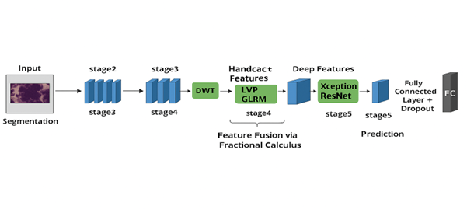
BLOCK DIAGRAM OR FLOW DIAGRAM
Review No.
Department of CSE

Slide 14
METHODOLOGY
DATASET DESCRIPTION
Dataset comprises 1,224 histopathological images utilized for the classification of Oral Squamous Cell Carcinoma(OSCC). The images are collected at two different Magnification levels. At 100x Magnification, there are 89 images of normal oral Epithelium and 439 images of OSCC tissue.At 400x Magnification, the dataset includes 201 images of normal Epithelium and 495 images of OSCC. These images offer a diverse representation of both healthy and cancerous tissue, aiding in effective model training and evaluation for automated OSCC detection.
Review No.
Department of CSE

Slide 15
PREPROCESSING TECHNIQUES
SNO | TECHNIQUE | PURPOSE
1 | Medav Filter | It removes noise and preserves fine tissue structure
2 | Pixel wise Segmentation | Highlights pathological regions by refining coarse segmentation maps
3 | Local Vector Pattern | Captures textural and structural orientation
4 | Discrete Wavelet Transform | Encodes spatial-frequency information across scales.
5 | Gray level run-length matrix | Extracts statistical texture features like run-length and gray-level variations.

Slide 16
MEDAV FILTER
This filter is a hybrid of adaptive median and mean filters, designed to:
• Remove impulse noise,
• Enhance tissue contrast,
• Preserve fine histological details.
PIXEL WISE SEGMENTATION
Highlights pathological regions by refining coarse segmentation maps and aggregating high-level features.

Slide 17
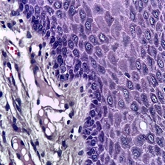
After applying Medav Filter and Pixel Wise Segmentation the input image can be changed as shown below
Input Image
Output Image

Slide 18
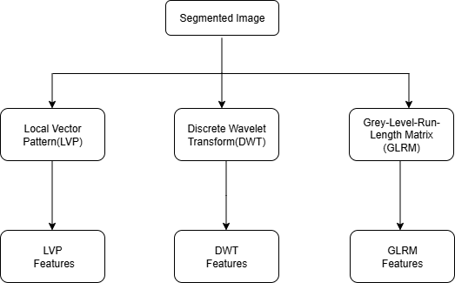
FEATURE EXTRACTION

Slide 19
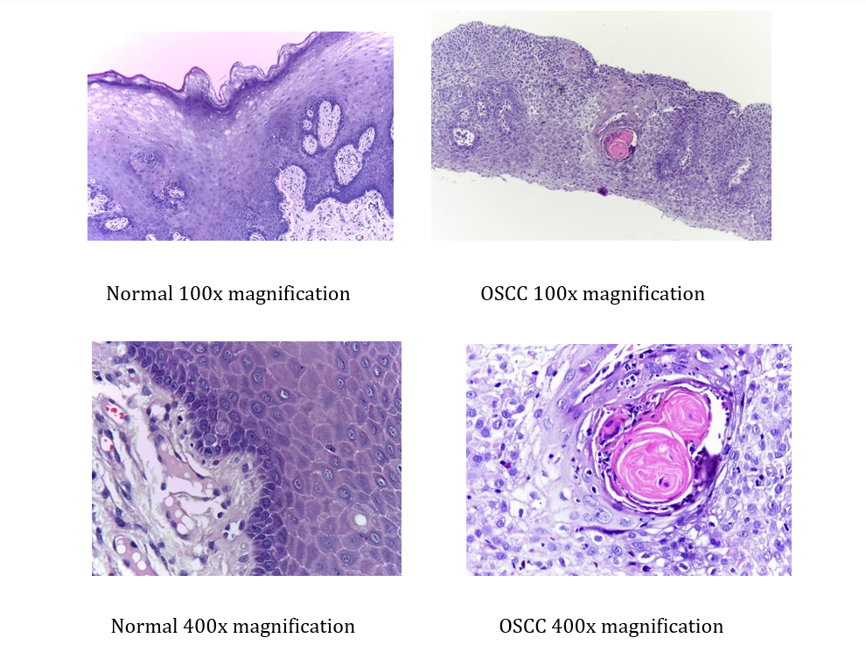
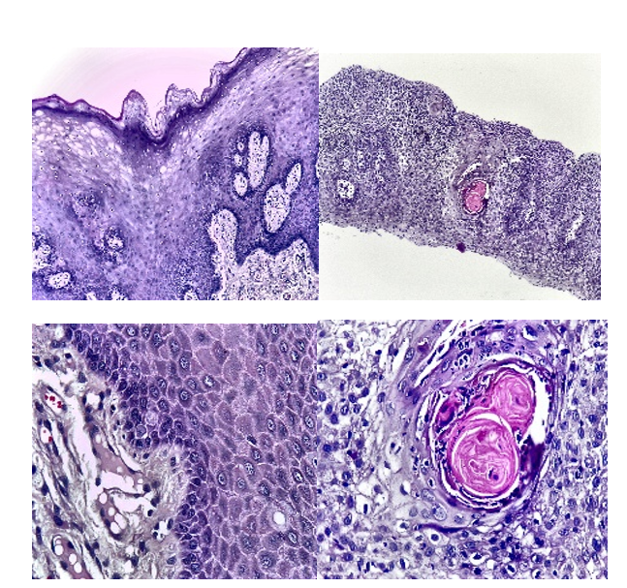
Local Vector Pattern (LVP): Captures textural and structural orientation.
Discrete Wavelet Transform (DWT): Encodes spatial frequency information across scales.
Gray Level Run-Length Matrix (GLRM): Extracts statistical texture descriptors
Before Preprocessing
After Preprocessing

Slide 20
XSFN-NET MODEL
XSFN-Net integrates three major computational paradigms:
Xception Network: Extracts deep hierarchical spatial features from images.
Fractional Calculus (FC): Fuses multiple feature types through fractional-order integration, improving feature correlation and representation.
Deep Spiking Neural Network (DSNN): Mimics the firing behavior of biological neurons for energy-efficient, high-precision classification.
This combination allows XSFN-Net to capture both global semantic context and fine-grained tissue texture details essential for differentiating normal and malignant oral epithelial structures.

Slide 21
IMPLEMENTATION
Models were trained using a dataset of 1,224 histopathological images at 100x and 400x magnification levels.
Frameworks: Python with PyTorch and TensorFlow.
Hardware: NVIDIA Tesla T4 GPU (Google Colab).
Image Size: Resized and normalized to 224 × 224 pixels.
Optimization: AdamW optimizer with Cosine Annealing scheduler
Regularization: Early stopping, dropout layers, and weight decay (1e-5) to prevent overfitting.
Review No.
Department of CSE

Slide 22
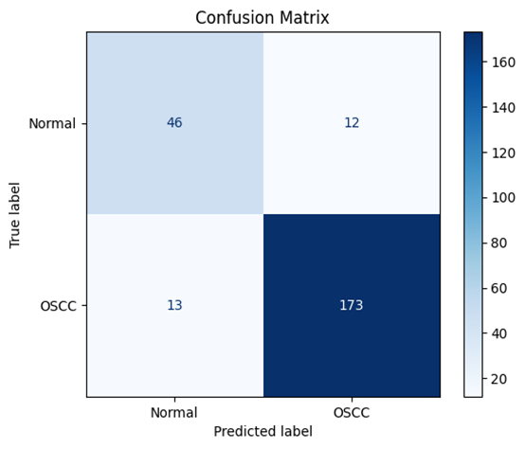
RESULTS & ANALYSIS
The provided confusion matrix has valuable insights regarding the performance metrics of the OSCC classification model. From the matrix, out of 186 true OSCC cases, 173 forecasted as OSCC, which constitutes true positives, while 13 were underreported as OSCC which makes them false negatives. Among the 58 true normal cases, 46 were accurately identified as normal, while the remaining 12 were misclassified as OSCC.
.
Review No.
Department of CSE

Slide 23
MODEL PERFORMANCE COMPARISION TABLE
model | Accuracy | Precision | Recall
CNN | 76% | 74.5% | 75.2%
ORALNET | 76.31% | 75.1% | 76.0%
XSFN-NET | 91% | 93.51% | 93.01%
The performance of three different models on the OSCC dataset was evaluated using five-fold cross-validation: the CNN baseline model, OralNet, and the proposed model, XSFN-Net.In all metrics, the proposed model, XSFN-Net, outperformed both baseline models. Primarily, it yielded a precision of 93.51%, recall of 93.01% and F1-score of 93.64%, while obtaining an accuracy rate of 91%.

Slide 24
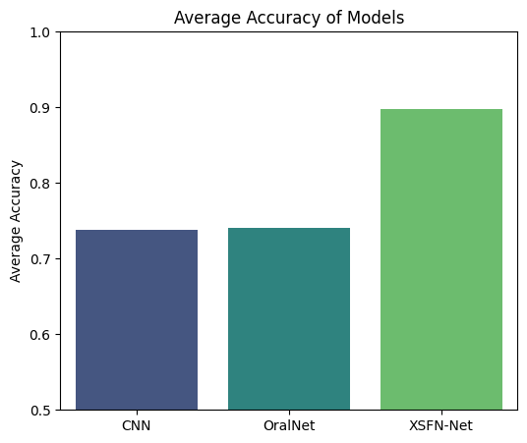
AVERAGE ACCURACY OF MODELS
The improvement in performance comes from XSFN-Net’s hybrid architecture. This model combines both handcrafted features (LVP, DWT, GLRM) and deep features (Xception).These features are fused using Fractional Calculus and classified with a Deep Spiking Neural Network (DSNN). With this combination, the model can integrate low-level texture granularity and high-level semantic overview, which enhances its differentiating capabilities.

Slide 25
CONCLUSION
The proposed XSFN-Net model successfully integrates Spiking Neural Networks (SNNs) and Fractional Neural Networks (FNNs) to classify Oral Squamous Cell Carcinoma (OSCC) from histopathological images.
The hybrid approach effectively captures both temporal spike dynamics and fractional-order texture information, improving the model’s ability to distinguish subtle tissue variations.
Compared to conventional CNN-based methods, XSFN-Net achieves higher classification accuracy, faster convergence, and better computational efficiency.
The model’s biologically inspired design reduces energy consumption while maintaining diagnostic precision, making it suitable for real-time medical applications.
Review No.
Department of CSE

Slide 26
FUTURE SCOPE
Incorporate Explainable AI (XAI) techniques to interpret model decisions and visualize important tissue regions.
Optimize the architecture for real-time clinical deployment on low-power medical imaging devices.
Integrate transfer learning and domain adaptation to enhance generalization across diverse histopathological datasets.
Develop a web-based or mobile diagnostic application to assist pathologists in remote cancer screening.
Explore neuromorphic hardware implementation of XSFN-Net for energy-efficient medical AI systems.

Slide 27
REFERENCES
[1] S. Ramya et al., “Xception Spiking Fractional Neural Net_x0002_work for OSCC Classification Based on Histopathological Images,”
DOI:10.1109/ACCESS.2025.XXXX
[2] G. A. I. Devindi et al., “Multimodal Deep Convolutional Neural Network Pipeline for AI-Assisted Early Detection of Oral Cancer,” IEEE Access,
DOI: 10.1109/ACCESS.2024.3454338
[3] Madhusmita Das et al., “An Ensemble Deep Learning Model for Oral Squamous Cell Carcinoma Detection Using Histopathological Image
Analysis,” DOI: 10.1109/ACCESS.2024.3450444
[4] Amity University Researchers, “Development of Oral Cancer Detection
Technique: A Comprehensive Approach Using CNNs and TensorFlow
Lite,” DOI: 10.1109/CICTN64563.2025.10932593
[5] S. Vasuki et al., “Ensemble Deep Learning Framework for OSCC
Classification Using Modified VGG and CNN Features with XGBoost,”
DOI: 10.1109/ICTEST64710.2025.11042441
Review No.
Department of CSE

Slide 28
[7] Rachasak Somyanonthanakul et al., “Survival Estimation of Oral Cancer Using Fuzzy Deep Learning,” DOI: 10.1186/s12903-024-04279-6
[8] Samiha Islam et al., “Deep Learning Approach for Enhancing Oral Squamous Cell Carcinoma with LIME Explainable AI Technique,”
Available: https://arxiv.org/abs/2411.14184
[9] B. Ananthakrishnan et al., “Automated Detection and Classification ofOral Squamous Cell Carcinoma Using Deep Neural Networks,” https://doi.org/10.3390/diagnostics13050918
[10] E. Albalawi et al., “Oral Squamous Cell Carcinoma Detection Using EfficientNet on Histopathological Images,” https://doi.org/10.3389/fmed.2023.1349336
[11] S. L. Jagannadham, K. L. Nadh and M. Sireesha, “Brain Tumour Detection Using CNN,” in Proc. 5th Int. Conf. I-SMAC (IoT in Social,
Mobile, Analytics and Cloud) (I-SMAC), Palladam, India, 2021, pp. 734–739, doi: 10.1109/I-SMAC52330.2021.9640875.
[12] K. V. N. Reddy, Y. Narendra, M. A. N. Reddy, A. Ramu, D. V. Reddy and S. Moturi, “Traffic Sign Recognition Using CNN Deep Learning,” in Proc. IEEE Int. Conf. Interdisciplinary Approaches in Technology and Management for Social Innovation (IATMSI), Gwalior, India, 2025, pp.1–6, doi: 10.1109/IATMSI64286.2025.10985223.

Slide 29
QUESTIONS AND ANSWERS
1. What is the main goal of your project?
Answer:The main goal of my project is to develop a hybrid deep learning model (XSFN-Net) that combines Spiking Neural Networks (SNNs) and Fractional Neural Networks (FNNs) to accurately and efficiently classify Oral Squamous Cell Carcinoma (OSCC) from histopathological images.
2. Why is OSCC classification important?
Answer:OSCC is one of the most common and deadly oral cancers. Early detection through accurate image classification helps in timely treatment and improves patient survival rates. Manual diagnosis is time-consuming and prone to human error, so automation is crucial.
3. What is unique about XSFN-Net compared to existing models?
Answer:XSFN-Net uniquely combines the biological efficiency of Spiking Neural Networks and the enhanced feature learning of Fractional Neural Networks. This hybrid design improves accuracy, texture learning, and energy efficiency compared to conventional CNNs.
Review No.
Department of CSE

Slide 30
ACKNOWLEGEMENTS
I sincerely thank our Head of Department, Project Guide, and Faculty Members for their continuous support and guidance throughout this project.
Review No.
Department of CSE

