Slide 1
An Explainable Deep Learning Framework for Predicting Traffic Accident Risk and Identifying Critical Factors Using CNN-BiLSTM-Attention and SHAP

Slide 2

Department of Computer Science and Engineering
An Explainable Deep Learning Framework for Predicting Traffic Accident Risk and Identifying Critical Factors Using CNN BiLSTM–Attention and SHAP
PRESENTED BY
Kallam Thirupatamma 22471A0526
Velangini Rani Biraka 22471A0504
Yenumala Mythri 21471A0569
Under the Guidance of,
Dr. S.V.N SREENIVASU _{MTech}
DEAN R&D and Professor,
Department of Computer Science and Engineering,
Narasaraopeta Engineering College (Autonomous),
Narasaraopet- 522 601.

Slide 3
OUTLINE
Abstract
Introduction
Literature Survey
Research Gaps
Problem Statement
Objectives
Block Diagram / Flow Diagram
Methodology
Implementation
Results and Analysis
Conclusion & Future Scope
References
Question and Answers
Acknowledgements

Slide 4
ABSTRACT
Road accidents cause major loss of life and property. To address this, we propose an explainable deep learning model that combines CNN, BiLSTM, and Attention to predict accident severity using spatial and temporal features. To make the predictions transparent, SHAP is used to identify the most important factors affecting severity, such as weather, lighting, and time. The model was tested on UK STATS19 and US Accident datasets, achieving high accuracy (86–87%) .This framework provides accurate and understandable accident risk predictions for better road safety planning.

Slide 5
INTRODUCTION
Road traffic accidents are a major global concern, causing severe injuries, deaths, and significant economic loss each year.
Accident severity is influenced by multiple factors such as weather conditions, lighting, road surface, traffic signals, and time of day, making prediction complex.
Traditional machine learning models usually focus on limited features and fail to capture the combined spatial and temporal patterns present in accident data.
Objective: This study proposes a hybrid deep learning approach that integrates CNN, BiLSTM, and Attention mechanisms to improve the accuracy of accident severity prediction.
Research Goal: To develop an explainable model that predicts accident severity and identifies key influencing factors using SHAP, helping traffic authorities enhance road safety and make informed decisions.

Slide 6
LITERATURE SURVEY
No | Title | Author | Journal Name & Year | Methodology Adapted | Key Findings | Gaps
1 | CNN-Based Deep Learning Model for Accident Severity Predictio | M. Zheng et al. | ResearchGate, 2019 | CNN for spatial feature extraction | Good accuracy in identifying crash severity using spatial patterns | No temporal learning; lacks explainability
2 | Predicting Accident Occurrence Using Spatial–Temporal Attention Networks | Y. Wang et al. | IEEE / arXiv, 2021 | Spatial-Temporal Attention Model | Effectively captures space + time patterns in accidents | No explanation of predictions; black-box model
3 | Traffic Accident Risk Evaluation Using Multi-Source Data | Y. Wang et al. | Electronics, 2024 | GRU + AdaBoost | Improved accuracy using multi-source features | Doesn’t provide model interpretability
4 | IoT-Based Vehicle Safety Alert System | Thakur & Verma | IJCA,2022 | IoT sensors + alert mechanism | Helps in real-time driver alert systems | Not AI-based; no predictive model
5 | Global Road Safety Report | WHO | WHO Report, 2022 | Statistical analysis | Highlights rapid rise in accidents worldwide | No machine learning or predictive framework.

Slide 7
LITERATURE SURVEY
Zheng et al. (2019) used a CNN-based model for accident severity prediction. It extracted spatial patterns effectively but failed to capture time-based information.
Wang et al. (2021) proposed a Spatial–Temporal Attention Network that learned both spatial and temporal features but lacked interpretability.
Omar (2024) combined a deep learning model with SHAP for explainable predictions, but the model did not include temporal learning components such as LSTM or BiLSTM.
Thakur & Verma (2022) developed an IoT-based vehicle safety alert system, which was useful for real-time alerts but did not include predictive deep learning.
WHO Report (2022) highlighted the increasing global rise in road accidents, showing the need for predictive and preventive systems.

Slide 8
PROBLEM STATEMENT
In today’s fast-growing transportation environment, the number of road traffic accidents continues to rise, leading to severe injuries, fatalities, and economic loss.
Accident severity depends on multiple complex factors such as weather, lighting, road conditions, traffic signals, and time of the day.
Existing models often analyze these factors independently, failing to capture the combined spatial and temporal relationships present in real-world accident data.
The complexity and non-linear nature of traffic data create challenges in accurately predicting accident severity and identifying the key factors influencing it.

Slide 9
RESEARCH GAPS
Limited Spatio-Temporal Focus: Many existing models analyze either spatial features (CNN) or temporal patterns (LSTM) separately, missing their combined impact on accident severity.
Dataset Limitations: Accident datasets are often imbalanced, contain missing values, or lack diversity across regions and conditions, affecting model reliability.
Real-Time Prediction Challenges: Few systems are designed for real-time accident severity prediction using live traffic, weather, and sensor data.
Lack of Explainability: Most deep learning models function as black boxes and do not clearly explain which factors contribute to severity predictions.

Slide 10
OBJECTIVES
Designed a deep learning–based system for accurate prediction of traffic accident severity.
Developed a unified model using CNN for spatial features and BiLSTM with Attention for temporal pattern learning.
Ensured robustness in predicting accident severity across diverse conditions such as weather, lighting, and road surface.
Built a complete pipeline for accident severity prediction, including preprocessing, data balancing (SMOTETomek), model training, and SHAP-based interpretation.

Slide 11
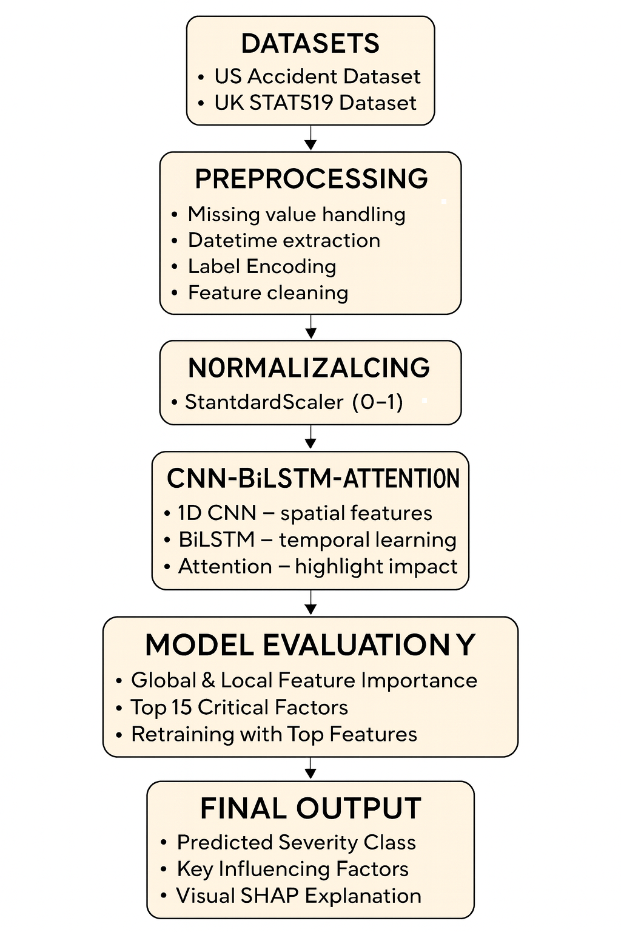
BLOCK DIAGRAM OR FLOW DIAGRAM

Slide 12
METHODOLOGY
The project uses two datasets: the UK Accident Dataset and the US Accident Dataset.
Both datasets were cleaned by removing missing values and duplicates to ensure data quality.
After preprocessing, the data was split into training and testing sets.
Each dataset underwent individual preprocessing based on its structure—categorical features were encoded, and numerical features were normalized.
Both datasets were then used to train the model, helping improve the reliability and generalization of accident severity prediction.

Slide 13
About Dataset
This work uses two datasets: the UK Accident Dataset and the US Accident Dataset, providing a broad and diverse set of real-world traffic accident records.
UK Dataset: Contains structured accident reports with details such as weather, road type, lighting conditions, vehicle information, and severity levels (Slight, Serious, Fatal). It offers clean and well-organized data from an official national source.
US Dataset: A large multi-state accident dataset collected from sensors, emergency reports, and traffic monitoring systems. It includes environmental factors like temperature, visibility, humidity, and traffic conditions, offering wider geographic and climatic variability.
Together, these datasets provide rich, complementary features that help build a more robust and generalizable accident prediction model.

Slide 14
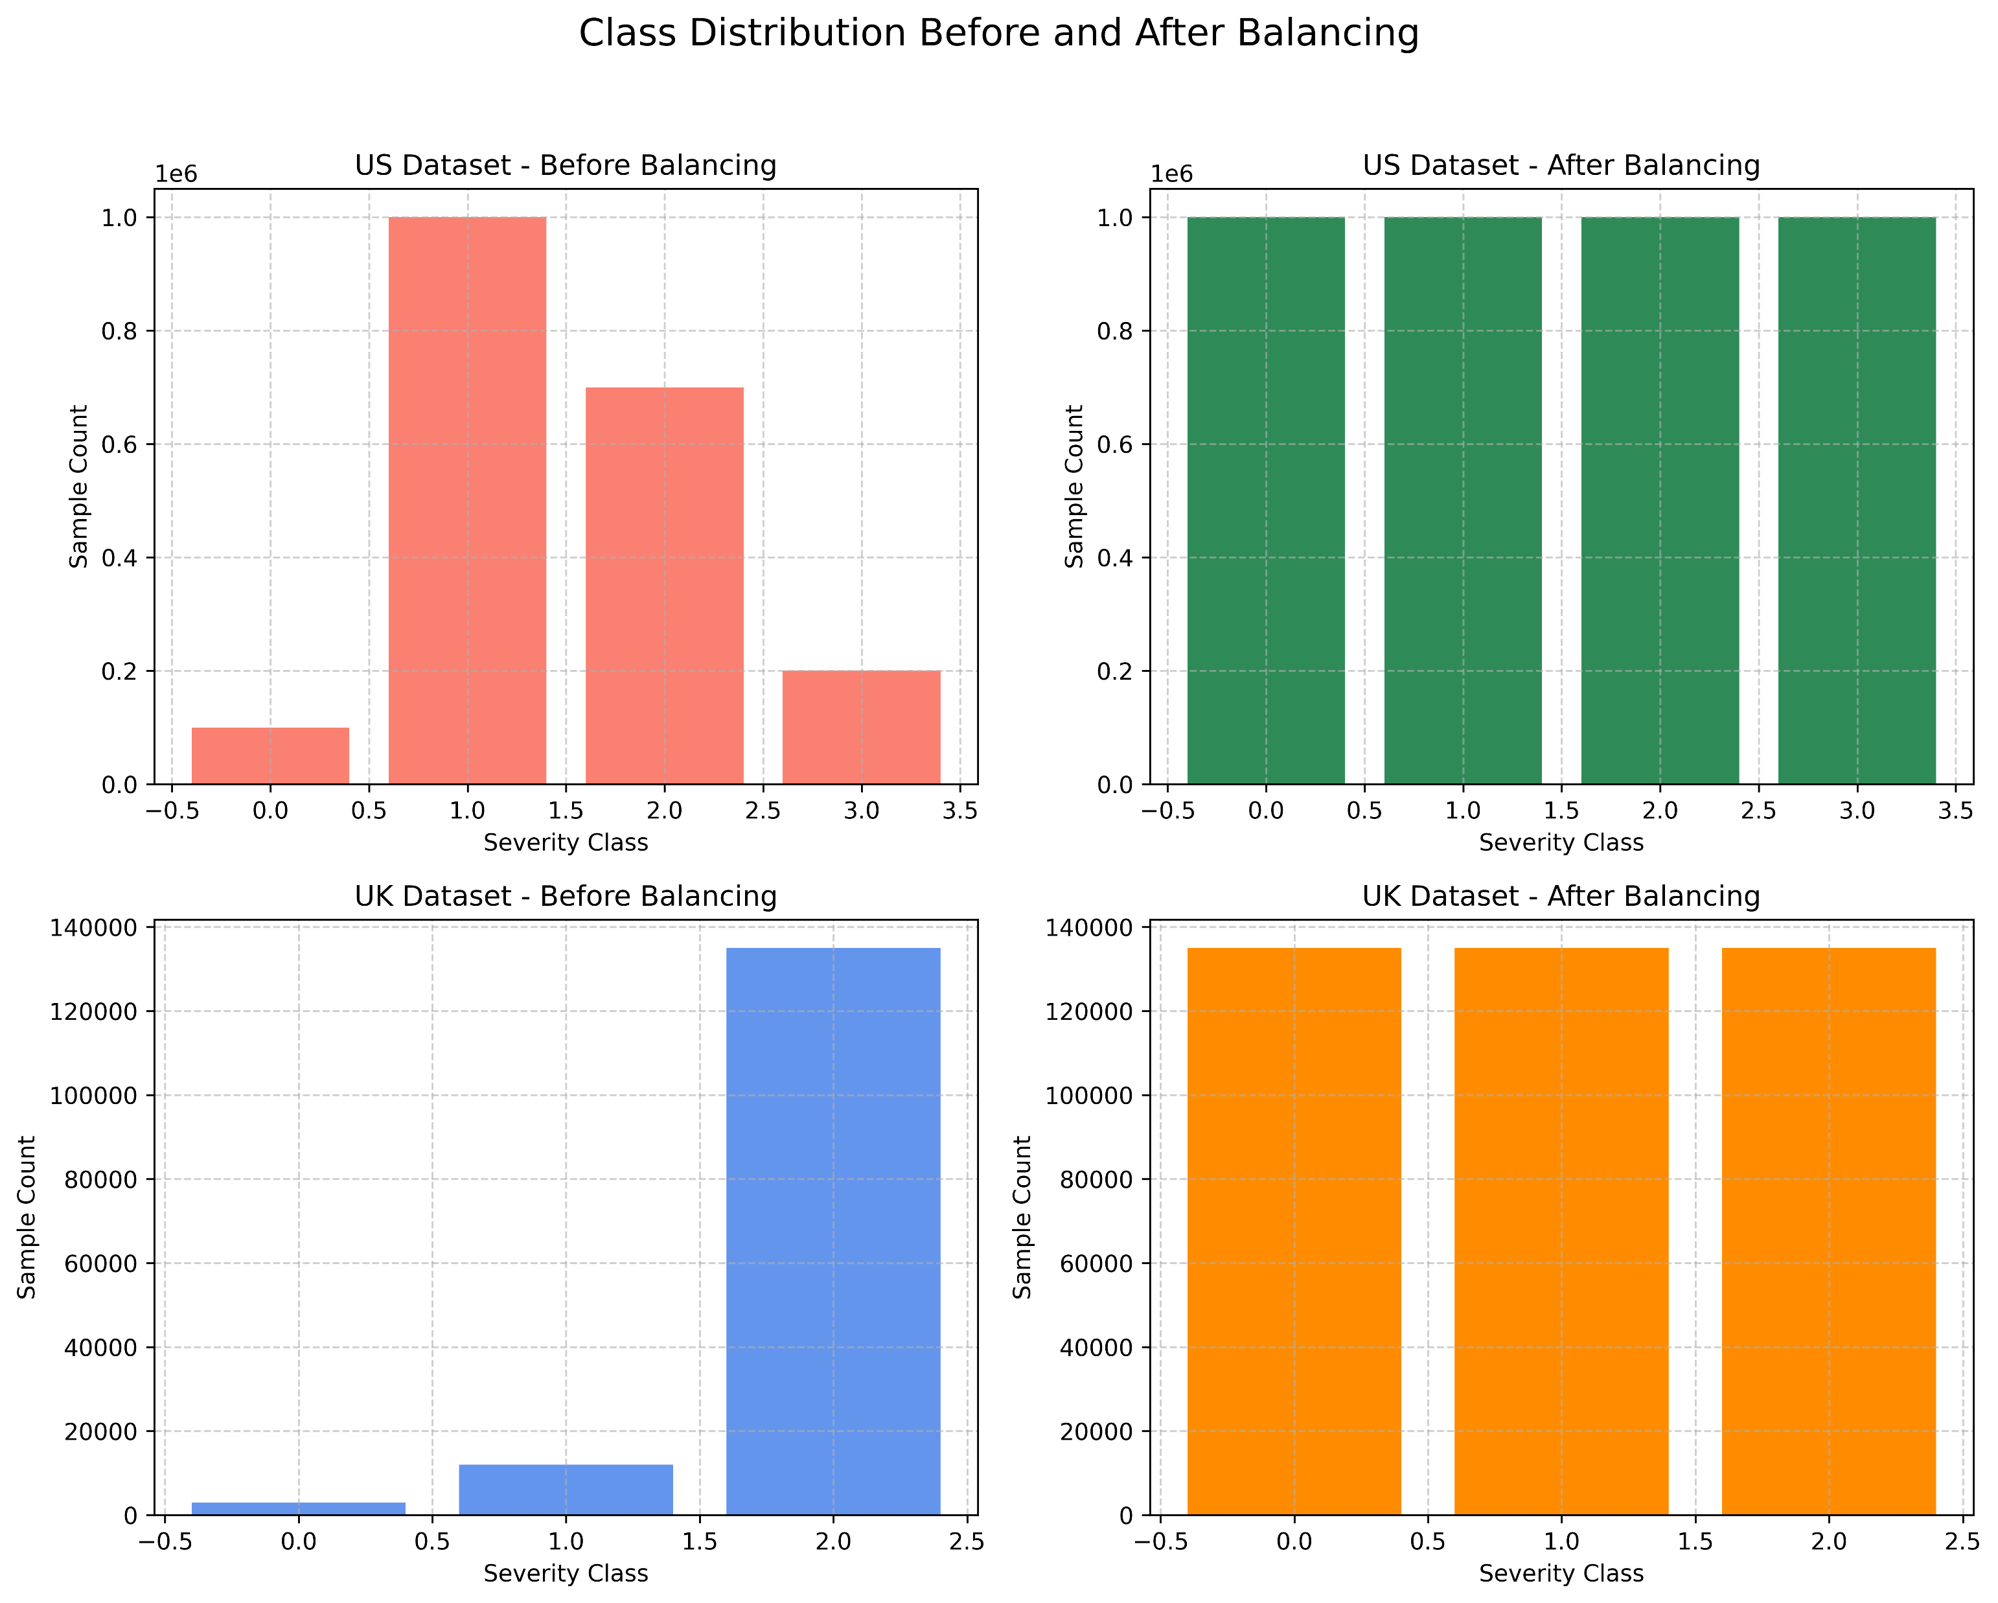
Data Preprocessing and Balancing
All missing values, duplicates, and irrelevant records were removed to ensure clean data.
Categorical features (like weather, road type, lighting) were converted into numerical form using encoding techniques.
Numerical features were normalized so the model can learn efficiently.
The dataset was divided into training and testing sets for model evaluation.
SMOTETomek was applied to balance the severity classes and improve prediction accuracy.

Slide 15
Feature Engineering
Converted all text-based and categorical values (like weather, road type, lighting) into numbers for model processing.
Removed unnecessary columns and repeated information to keep only useful data.
Standardized numerical features so they are in the same range for better learning.
Extracted time-based features such as hour, day, and month from the accident timestamp.
Identified the most important features using SHAP and selected them for training.

Slide 16
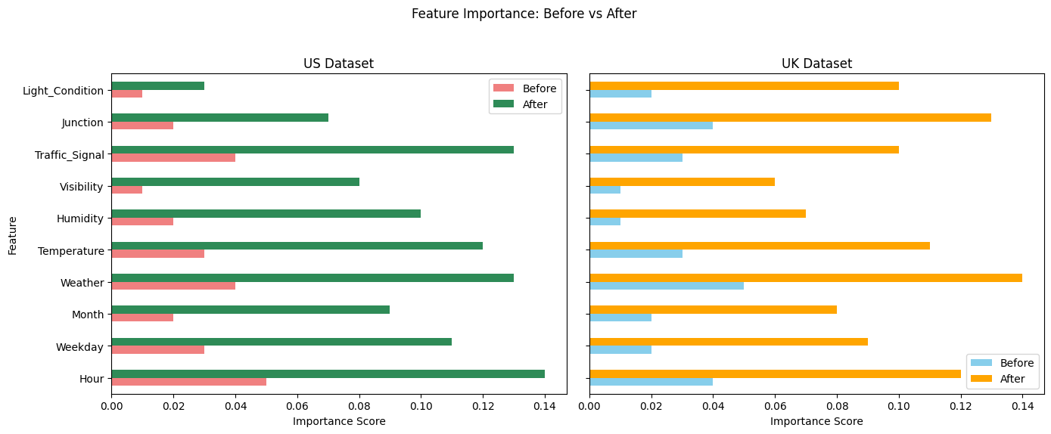

Slide 17
Model Architecture (CNN–BiLSTM–Attention):
Proposed CNN–BiLSTM–Attention Model
The proposed model integrates Convolutional Neural Network (CNN), Bidirectional Long Short-Term Memory (BiLSTM), and Attention Mechanism.
Each component plays a specific role in feature extraction and sequence learning:
1️⃣ CNN Layer – Spatial Feature Extraction
Learns spatial relationships among features such as weather, road type, and lighting.
Extracts local patterns and reduces noise through convolutional filters.
Outputs feature maps that represent spatial dependencies.
2️⃣ BiLSTM Layer – Temporal Dependency Learning
Processes sequential data (e.g., time, date, season) in both forward and backward directions.
Captures long-term temporal relationships and context in accident sequences.
Helps understand when and how accident risks vary with time.

Slide 18
3️⃣ Attention Mechanism – Focus on Key Features
Assigns weights to important features learned from BiLSTM outputs.
Allows the model to focus on critical information (like poor lighting or bad weather).
Improves both accuracy and interpretability.
4️⃣ Output Layer
Produces the accident severity prediction (e.g., minor, serious, fatal).
Uses a softmax activation for classification.

Slide 19
IMPLEMENTATION
Software Requirements :
Browser : Any latest browser like Chrome
Operating System : Windows 11
Python (Colab), Flask (Spyder)
Hardware Requirements :
System Type :AMD Ryzen 7 5800HS with integrated Radeon Graphics, 3.20 GHz
RAM : 12GB

Slide 20
Results:
Data Cleaning: All missing values, duplicate entries, and inconsistent records from both UK and US datasets were removed to ensure reliability.
Feature Encoding: Categorical attributes such as weather, road type, and lighting were converted into numerical values for model compatibility.
Normalization: Numerical features were scaled to maintain consistency, and time-based features were extracted for temporal learning.
Balancing: SMOTETomek was applied to correct class imbalance and improve prediction performance across severity levels.
Final Data Split: After preprocessing, 80% of the data was used for training and 20% for testing to ensure fair evaluation of the model.

Slide 21
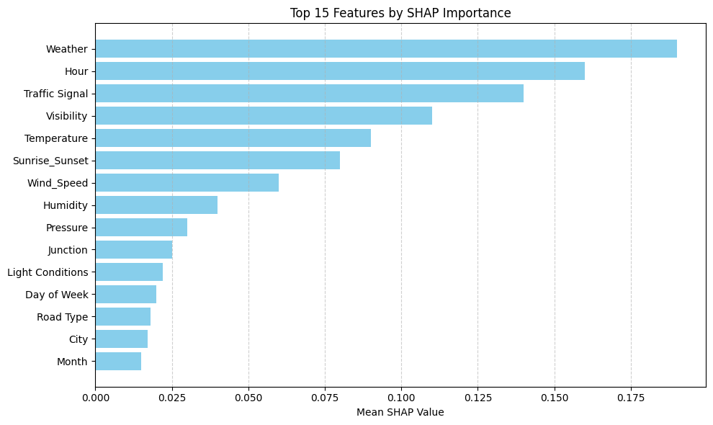
RESULTS & ANALYSIS
SHAP means Shapley Additive Explanations.
It helps to explain how the model makes decisions
Each feature’s importance is shown using bars.
Top important factors: Weather, Hour, Traffic Signal, Visibility, and Temperature.
These features affect how severe an accident can be.
SHAP makes the model clear, understandable, and trustworthy.

Slide 22
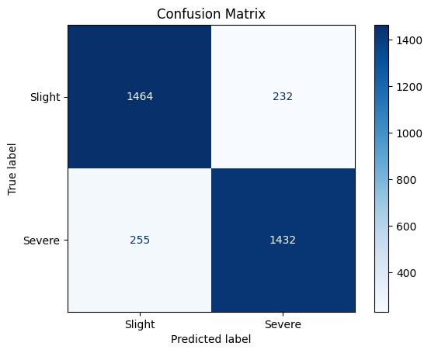
The confusion matrix shows that the model correctly predicted 1464 Slight accidents and 1432 Severe accidents. Only a small number of cases were misclassified, with 232 Slight cases predicted as Severe and 255 Severe cases predicted as Slight. Overall, the results indicate that the model accurately distinguishes between Slight and Severe accident categories with minimal errors.

Slide 23
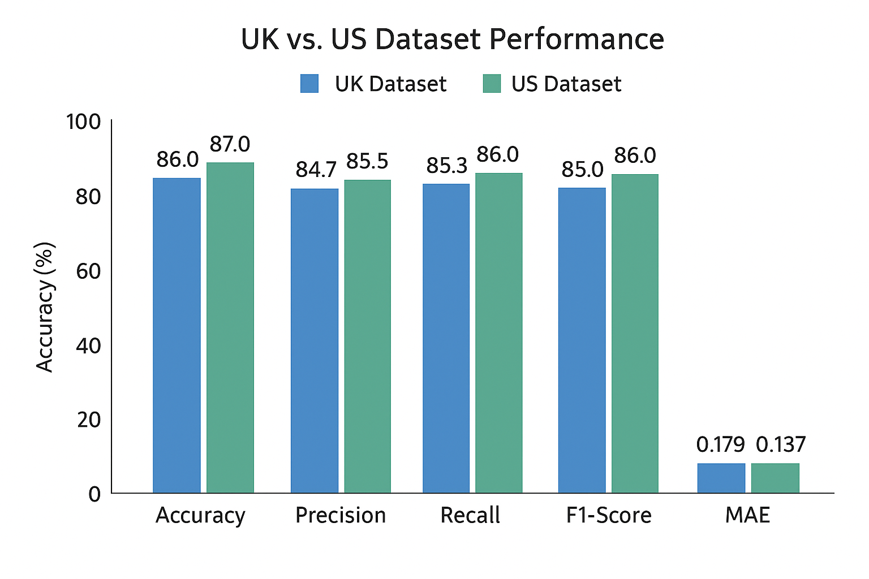
Performance Comparison of Proposed Model
The proposed CNN–BiLSTM–Attention model was tested on two datasets – UK and US traffic accident datasets.
Achieved accuracy of 87% (US) and 86% (UK), outperforming traditional models like Logistic Regression.
US dataset showed slightly better results due to higher data diversity and sample size.
MAE values (0.137 for US, 0.179 for UK) confirm
low prediction error and stable learning.
Precision, Recall, and F1-scores are balanced across both datasets, showing consistent performance.

Slide 24
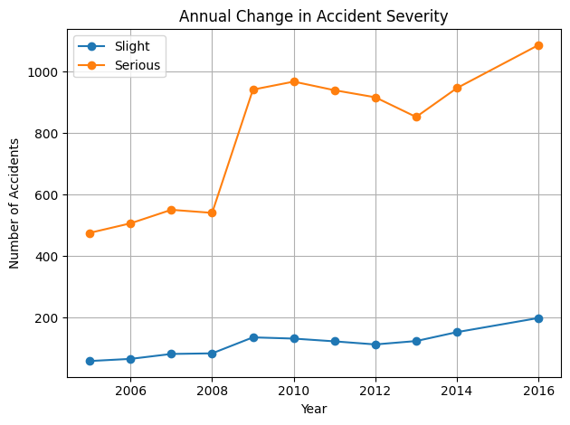
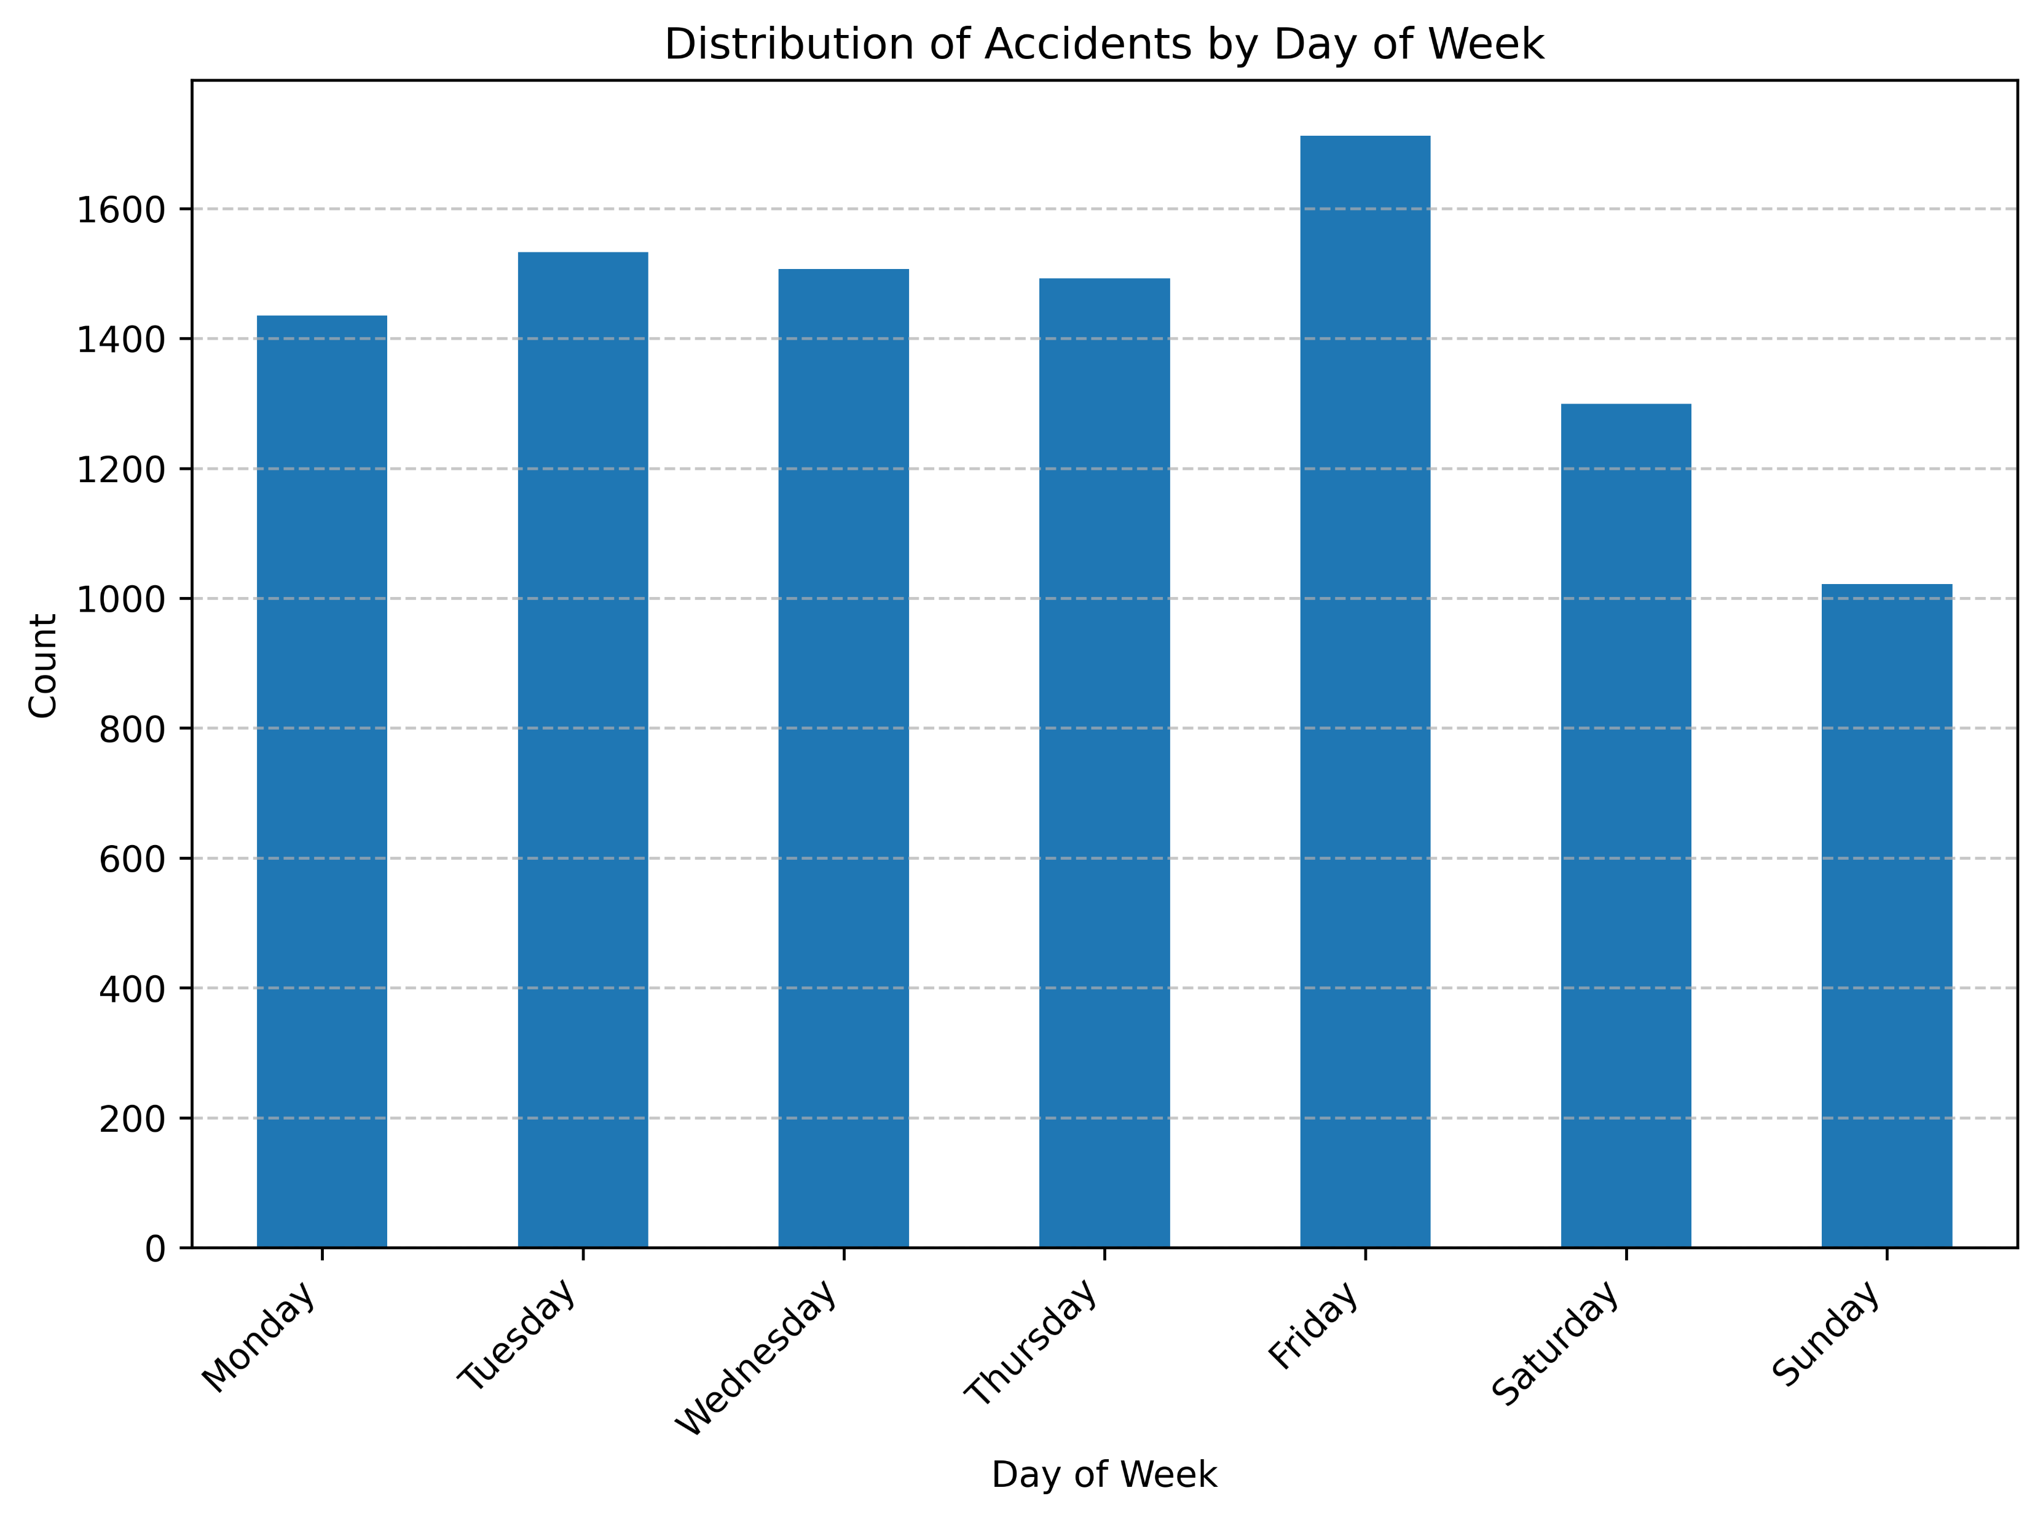

Slide 25
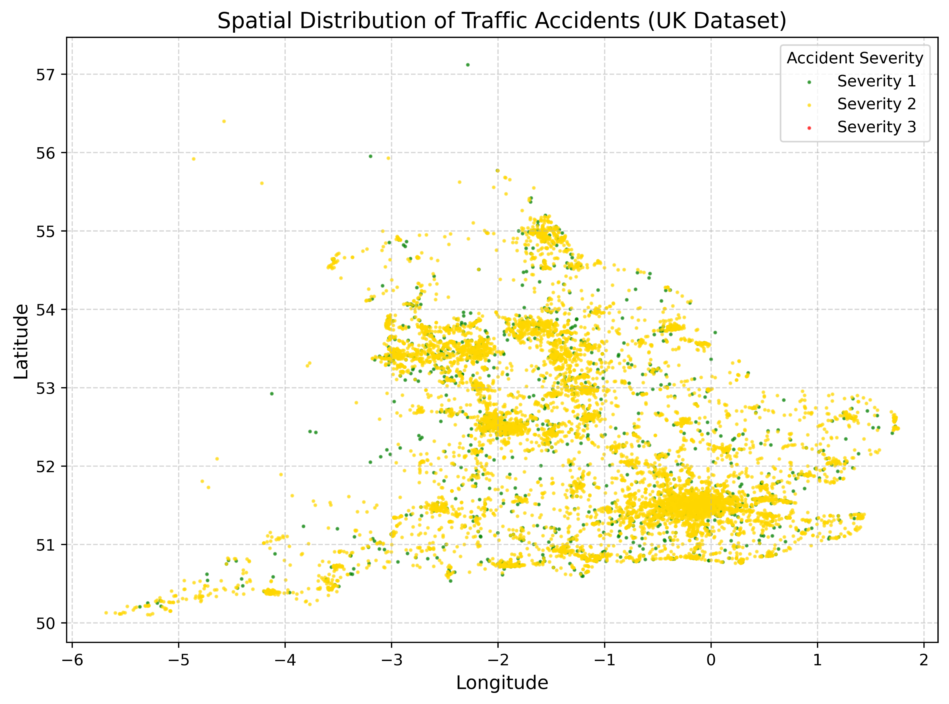
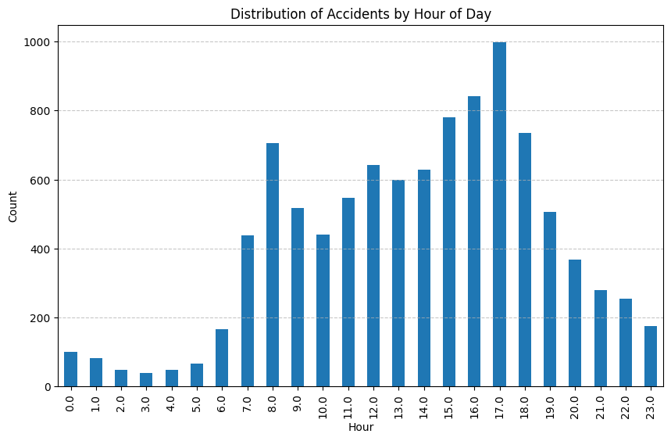

Slide 26
CONCLUSION and FUTURE SCOPE
Conclusion
Successfully developed an explainable deep learning framework for predicting road traffic accident severity using CNN–BiLSTM–Attention.
Demonstrated the importance of combining spatial and temporal features to improve prediction performance in real-world accident datasets.
Integrated SHAP to identify key factors influencing accident severity, ensuring transparency and trust in the model’s decisions.

Slide 27
CONCLUSION and FUTURE SCOPE
Future Scope
Extend the framework to support real-time accident risk prediction using live traffic and weather data.
Integrate IoT sensors, GPS inputs, and external APIs for continuous monitoring and early-warning systems.
Apply the model to datasets from multiple countries to improve generalization and global road safety planning.

Slide 28
REFERENCES
World Health Organization (WHO), “Global facts on traffic related injuries,” https://www.who.int/news-room/fact-sheets/ detail/road-traffic-injuries, 2022, fact Sheet.
M. Islam, K. N. Habib, and N. Eluru, “Application of machine learning techniques to assess traffic crash injury outcomes,” Transportation Research Part C, vol. 135, p. 103547, 2022.
M. Zheng et al., “Cnn-based deep learning framework for predicting traffic crash severity,” https://www.researchgate.net/ publication/331583833, 2019.
O. I. Omar, “Enhancing accident severity forecasting with mobilenet and shap explanations,” https://www.researchgate.net/ publication/379695758, 2024.
Y. Wang, Y. Song, and J. Wu, “Predicting accident occurrence using spatial-temporal attention networks,” https://arxiv.org/abs/ 2106.10197, 2021, arXiv:2106.10197.

Slide 29
S. M. Lundberg and S. I. Lee, “Interpreting predictions of complex models using shap,” in Advances in Neural Information Processing Systems (NeurIPS), vol. 30, 2017.
“Using interpretable ai for analyzing risks in road accidents,” https://www.nature.com/articles/s41598-025-00797-7, 2025.
Y. Wang, J. Zhao, and Y. Zhou, “Tunnel accident risk evaluation using multi-source data and fusion models,” Electronics, vol. 13, no. 7, 2024. [Online]. Available: https://www.mdpi.com/ 2673-2688/6/7/145
H. Tian, L. Zhang, and C. Xu, “Assessing intersection risk through multi-modal aerial imagery and deep learning,” in Pro ceedings of the IEEE International Conference on Computer Vision, 2021.
R. Zepf, D. Watzenig, and M. Stolz, “Modeling safety impacts of human error through traffic simulations,” in Proceedings of the IEEE Intelligent Transportation Systems Conference (ITSC), 2022.
V. Chandrasekhar, R. Suganya, and B. Narayanan, “Design of a real-time system for detecting anomalies in traffic flow,” Transportation Research Procedia, vol. 68, pp. 27–36, 2023.

Slide 30
H. Shim, M. Choi, and K. Kim, “Mapping risk for autonomous vehicles in complex terrains using probabilistic methods,” Sen sors, vol. 23, no. 1, 2023.
M. Thakur and A. Verma, “An iot-based alert mechanism for enhancing vehicular safety,” International Journal of Computer Applications, vol. 181, no. 3, 2022.
Y. Jeong, H. Kim, and S. Park, “Vision-based accident risk prediction using driver gaze divergence from in-vehicle cameras,” IEEE Transactions on Intelligent Transportation Systems, vol. 24, no. 5, pp. 4560–4572, 2024.
X. Liang, G. Ma, and S. Lin, “Estimating crash likelihood from satellite data using multi-scale convolutional networks,” in Proceedings of the AAAI Conference on Artificial Intelligence, 2023.
D. Venkatareddy, K. Reddy, and Y.Sowmya, “Explainable fetal ultrasound classification with cnn and mlp models,” in 2024 First International Conference on Innovations in Communications, Electrical and Computer Engineering (ICICEC). IEEE, 2024.
J. Gao, Y. Luo, and Z. Huang, “Kalman filtering-based approach for predicting vehicle collision probabilities,” IEEE Transactions on Intelligent Vehicles, vol. 8, no. 2, pp. 148–156, 2023.
S. Moturi, S. Tata, S. Katragadda, V. P. K. Laghumavarapu, B. Lingala, and D. V. Reddy, “Automated traffic sign recognition via cnn deep learning,” in Proc. 1st Int. Conf. for Women in Computing (InCoWoCo), 2024.

Slide 31
QUESTIONS and ANSWERS
Open the floor for questions from the audience

Slide 32
ACKNOWLEGEMENTS
Express gratitude for the opportunity to present
Provide contact information for further inquiries

