Slide 1


CMT Paper ID: 144
An Explainable Deep Learning Framework for Predicting Traffic Accident Risk and Identifying Critical Factors Using CNN-BiLSTM-Attention and SHAP
Authors Name
1. Dr. S.V.N Sreenivasu
2. Kallam Thirupatamma
3. Velangini Rani Biraka
4. yenumala mythri
5. Neelima G
6. Malathi Latha T
Affiliation
Dept. of CSE,
Narasaraopet Engineering College (1,2,3,4)
Dept. of CSE, GRIET (5)
Dept. of ETM, GNITS (6)
Presented by
Kallam Thirupatamma
Team members details
Velangini Rani Biraka
Yenumala Mythri
Notes:
1.7.2013
1.7.2013
1.7.2013
1.7.2013
‹#›
‹#›
‹#›
‹#›

Slide 2
Content
❖Introduction
❖Problem Statements
❖Objectives
❖Methodology
❖Result & Discussion
❖Conclusion & Future Scope
❖References
Notes:
1.7.2013
1.7.2013
1.7.2013
1.7.2013
‹#›
‹#›
‹#›
‹#›

Slide 3
Introduction:
Road traffic accidents are one of the major causes of death and injury worldwide.
Many factors such as weather, road condition, lighting, and driver behavior influence accident severity.
Predicting accident risk is complex due to the nonlinear and interrelated nature of these factors.
Traditional models like logistic regression and random forest give limited accuracy.
Deep learning can automatically learn spatial and temporal patterns from large accident datasets.
However, most deep learning models act as black boxes, providing little explanation of their predictions.
Deep learning with interpretability helps to accurately predict and explain road accident risks.
Hence, there is a need for an explainable model that is both accurate and interpretable.

Slide 4
Problem Statement:
Road accident prediction involves analyzing complex and interrelated factors such as weather, lighting, road type, and time.
Core Problem: Traditional machine learning models fail to effectively capture spatial and temporal dependencies in traffic data.
Deep learning models improve prediction accuracy but often behave as “black boxes”, offering no interpretability.
This lack of transparency limits their trust and adoption in real-world traffic management systems.
Hence, there is a strong need for an Explainable Deep Learning Framework that provides both accurate predictions and clear feature importance for accident risk analysis.

Slide 5
Objectives:
To design a hybrid deep learning framework combining CNN, BiLSTM, and Attention for accurate traffic accident risk prediction.
To handle imbalanced accident data using the SMOTETomek technique for better learning stability.
To apply SHAP (Shapley Additive Explanations) for interpreting the model’s predictions.
To identify key factors (e.g., weather, road type, lighting, time) influencing accident severity.
To ensure the proposed system is both accurate and explainable, improving trust and real-world usability.

Slide 6
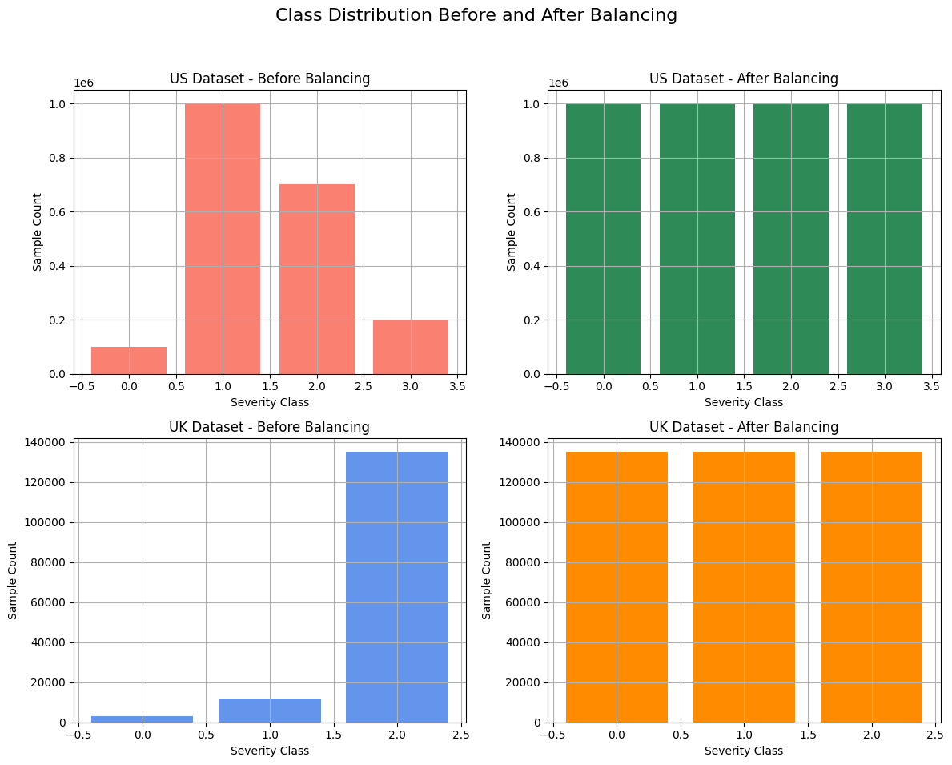
Methodology :
Proposed Explainable Deep Learning Framework
The proposed methodology consists of five major stages:
1️⃣ Data Collection:
Accident data obtained from UK STATS19 and US Accident datasets.
Includes factors like weather, lighting, road type, vehicle type, and time.
Provides a diverse, real-world dataset for training and testing.
2️⃣ Data Preprocessing:
Handle missing and noisy values using imputation techniques.
Perform label encoding for categorical features and normalization for numerical data.
Remove irrelevant or redundant attributes.

Slide 7
3️⃣ Data Balancing
Accident datasets are highly imbalanced — minor cases dominate over severe ones.
Apply SMOTETomek to oversample minority classes and clean overlapping samples.
Ensures balanced learning and prevents bias toward majority classes.
4️⃣ Model Development
CNN Layer: Extracts spatial features from the input data.
BiLSTM Layer: Learns temporal dependencies — how conditions evolve over time.
Attention Layer: Highlights key features that strongly influence outcomes.
Dense Layer: Generates the final accident severity prediction.
5️⃣ Explainability with SHAP
SHAP (Shapley Additive Explanations) interprets model outputs.
Shows how each feature contributes (positively or negatively) to the prediction.
Identifies critical factors influencing traffic accidents.

Slide 8
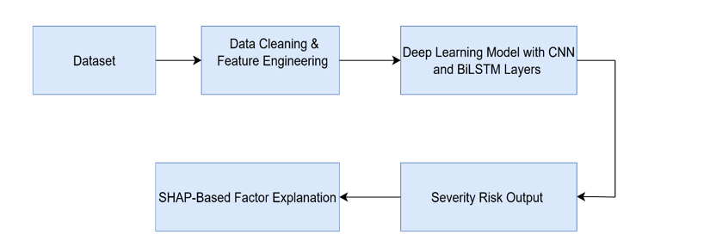
Model Architecture (CNN–BiLSTM–Attention):
Proposed CNN–BiLSTM–Attention Model
The proposed model integrates Convolutional Neural Network (CNN), Bidirectional Long Short-Term Memory (BiLSTM), and Attention Mechanism.
Each component plays a specific role in feature extraction and sequence learning:
1️⃣ CNN Layer – Spatial Feature Extraction
Learns spatial relationships among features such as weather, road type, and lighting.
Extracts local patterns and reduces noise through convolutional filters.
Outputs feature maps that represent spatial dependencies.
2️⃣ BiLSTM Layer – Temporal Dependency Learning
Processes sequential data (e.g., time, date, season) in both forward and backward directions.
Captures long-term temporal relationships and context in accident sequences.
Helps understand when and how accident risks vary with time.

Slide 9
3️⃣ Attention Mechanism – Focus on Key Features
Assigns weights to important features learned from BiLSTM outputs.
Allows the model to focus on critical information (like poor lighting or bad weather).
Improves both accuracy and interpretability.
4️⃣ Output Layer
Produces the accident severity prediction (e.g., minor, serious, fatal).
Uses a softmax activation for classification.

Slide 10
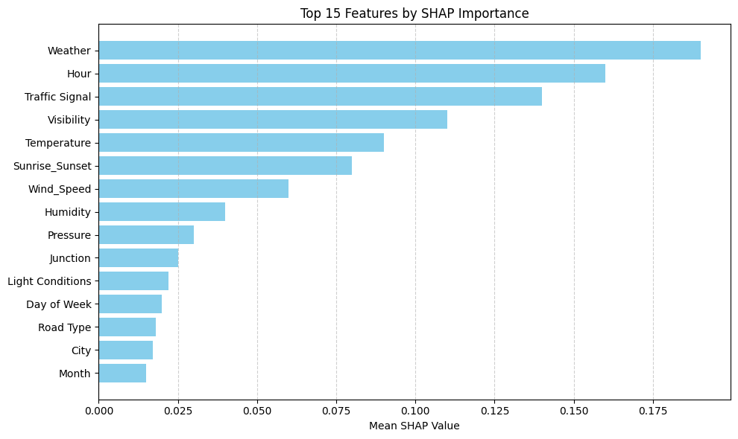
Results and Analysis
•SHAP means Shapley Additive Explanations.
•It helps to explain how the model makes decisions.
•Each feature’s importance is shown using bars.
•Top important factors: Weather, Hour, Traffic Signal, Visibility, and Temperature.
•These features affect how severe an accident can be.
•SHAP makes the model clear, understandable, and trustworthy.

Slide 11
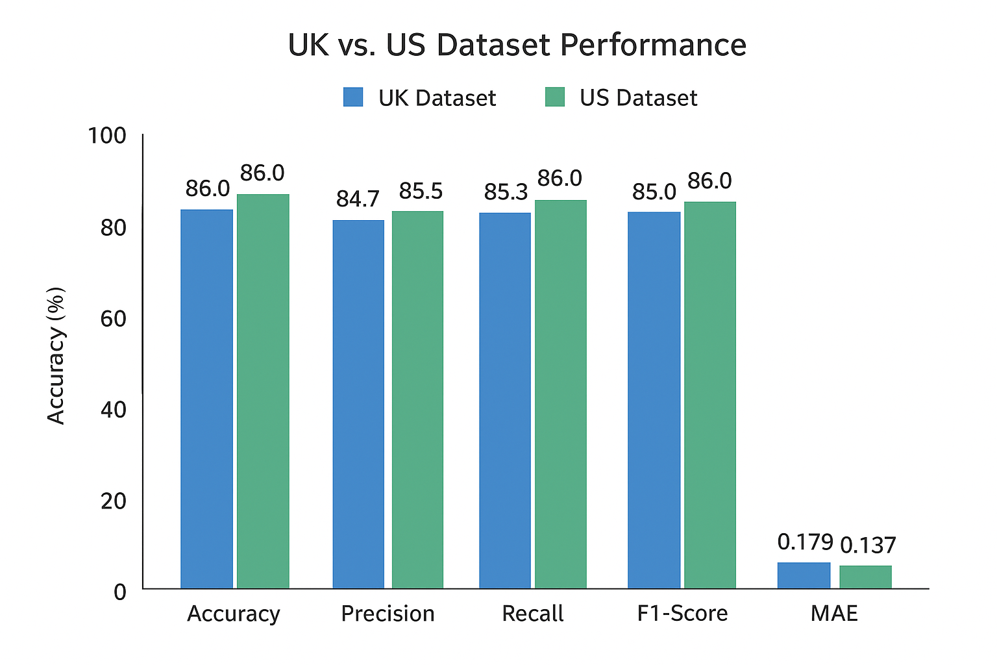
Performance Comparison of Proposed Model
The proposed CNN–BiLSTM–Attention model was tested on two datasets – UK and US traffic accident datasets.
Achieved accuracy of 87% (US) and 86% (UK), outperforming traditional models like Logistic Regression.
US dataset showed slightly better results due to higher data diversity and sample size.
MAE values (0.137 for US, 0.179 for UK) confirm low prediction error and stable learning.
Precision, Recall, and F1-scores are balanced across both datasets, showing consistent performance.

Slide 12
Conclusion
Developed an Explainable Deep Learning Framework combining CNN–BiLSTM–Attention and SHAP.
Achieved high accuracy (≈86–87%) and low MAE (≈0.13) in accident risk prediction.
Successfully handled imbalanced data using SMOTETomek for improved model stability.
SHAP provided feature-level interpretability, identifying top factors such as:
Weather, Lighting, Road Type, Hour, and Visibility.
Ensures both accuracy and explainability, making AI predictions transparent.
Supports data-driven road safety planning and decision-making by traffic authorities.
Future Scope
Integrate real-time accident prediction using IoT and GPS sensor data.
Develop a web or mobile dashboard for live monitoring and visualization of risk zones.
Expand the framework for multi-class and multi-region accident prediction.
Apply video-based accident detection using Deep Learning and computer vision.
Extend SHAP interpretability for dynamic and real-time explanations.
Collaborate with traffic departments to implement smart road safety systems.

Slide 13
References
Wang et al., “Traffic Accident Risk Prediction Using Spatial–Temporal Attention Networks,” IEEE Access, 2024.
Zheng et al., “CNN-Based Deep Learning Model for Accident Severity Prediction,” ResearchGate, 2019.
Lundberg & Lee, “A Unified Approach to Interpreting Model Predictions (SHAP),” NeurIPS, 2017.
Omar et al., “Explainable Deep Learning for Accident Forecasting,” ResearchGate, 2024.
WHO, Global Road Safety Report, 2022.
Thakur & Verma, “IoT-Based Vehicle Safety Alert System,” 2022.
Acknowledgements
We sincerely thank our guide, Dr. S. V. N. Sreenivasu, Professor & Head, Department of CSE, for his continuous guidance and encouragement.
We extend our gratitude to the Department of Computer Science and Engineering, Narasaraopeta Engineering College (Autonomous) for providing the necessary support and facilities.
We also thank our friends and family members for their motivation and help throughout the project.
Finally, we would like to thank the INCOWOCO 2025 Conference Committee for giving us the opportunity to present our research work on such a prestigious platform.

Slide 14
THANK YOU

