Slide 1





2025 IEEE iSSSC
2025 IEEE 3rd International Symposium on Sustainable Energy, Signal Processing & CyberSecurity
Paper Title:A Meta-Ensemble Deep Learning Approach Using EfficientFormerV2 and Swin Tiny Transformer for Skin Lesion Classification
Paper ID:711
Presenter Name:Hari Lakshmi Sai Manikanta
Authors:Dr. Sireesha Moturi, Yelchuri Siva Rama Krishna Vinay, Hari Lakshmi Sai Manikanta, Prajapathi Satyanarayana
Affiliation: Student, Department of CSE,Narasaraopeta Engineering College, Andhra Pradesh, India

Slide 2
Outline
Introduction (try to answer what it is, why it is, and what is (are) existing problems, why the problem is so important to discuss; may cite in the footer)
Motivation & Contributions
Proposed System Model
Results and Discussion
Conclusion
Reference

Slide 3
Introduction
Skin cancer is one of the most common and deadly cancers globally.
Early diagnosis is key to reducing mortality and improving treatment outcomes.
Manual diagnosis is subjective and depends heavily on expert experience.
Visual similarities among different lesion types cause frequent misclassification.
Deep learning have shown great promise in assisting dermatologists.
CNNs are efficient but sometimes miss global context.
Transformers capture long-range relations but are computationally heavy.
Hence, a balanced ensemble approach can combine the best of both worlds.

Slide 4
Motivation & Core Contribution
Motivation:
Single models (CNN or Transformer) struggle with imbalanced data and rare lesion types.
Lightweight yet accurate systems are needed for real-world deployment.
Core Contributions:
Introduced a dual-stream ensemble combining EfficientFormerV2 and Swin Tiny Transformer.
Designed a logistic regression meta-ensemble to balance class predictions.
Achieved strong macro F1-score (0.88) and ROC-AUC (0.9814) on HAM10000 dataset.
Highlighted EfficientFormerV2’s potential for low-resource clinical use.

Slide 5
Literature Review
Esteva et al. (2017): Achieved dermatologist-level accuracy using CNNs.
Liu et al. (2021): Introduced Swin Transformer with shifted-window attention.
Ayas (2023): Applied Swin Transformer for multiclass lesion classification.
Paraddy & Virupakshappa (2025): Proposed convolutional–Swin hybrid model.
Most previous works used either CNNs or Transformers alone.
Our work combines both for complementary strengths.

Slide 6
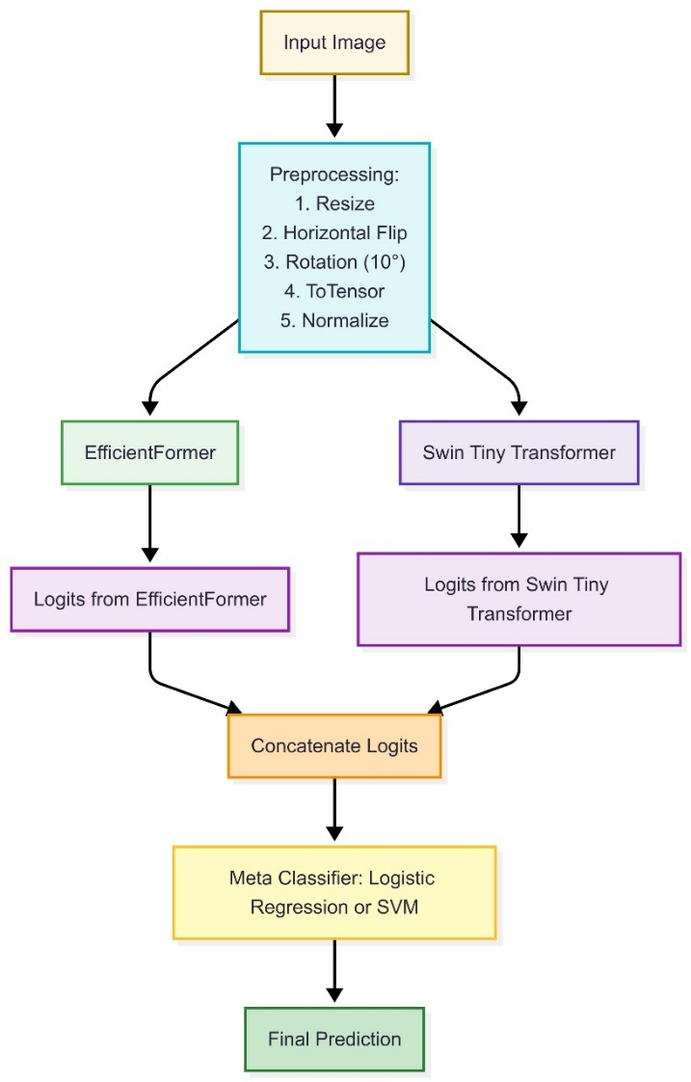
Proposed System Model
Input: Dermoscopic images from HAM10000 dataset.
Backbones:EfficientFormerV2 – lightweight CNN-transformer hybrid.
Swin Tiny Transformer – captures both local and global features.
Fusion Strategies:Soft Voting: Average of both models’ probabilities.
Meta-Ensemble: Logistic Regression learns from concatenated logits
Output: Final class label among seven lesion types

Slide 7
Simulation Setup
Dataset: HAM10000 (10,015 images, 7 classes)
Classes: NV, MEL, BKL, BCC, AKIEC, DF, VASC
Preprocessing: Resizing, rotation, flipping, normalization.
Training Details:
Optimizer: Adam, LR = 1e-4
Batch Size: 32, Epochs: 20
Early stopping and learning rate scheduling used.
Environment: Google Colab with NVIDIA Tesla T4 GPU.

Slide 8
Existing Work Comparison
Method | Accuracy (%) | Macro F1 | ROC-AUC | Remarks
Ayas (2023) – Swin Transformer | 94.30 | – | – | High accuracy, but lacks class balance metrics
Paraddy & Virupakshappa (2025) – CSwinformer | 98.72 | – | – | Focused on accuracy; no macro F1 or AUC reported
Proposed Meta-Ensemble (Ours) | 89.02 | 0.8800 | 0.9814 | Balanced prediction, strong rare-class performance
Key Observations
Earlier models report only accuracy; no F1 or AUC, hence less reliable for imbalanced datasets.
Our ensemble achieves better class balance, especially for rare lesion types (AKIEC, DF).
Macro F1 and ROC-AUC highlight true clinical reliability beyond accuracy alone.
Combines accuracy, balance, and efficiency, making it more practical for deployment.

Slide 9
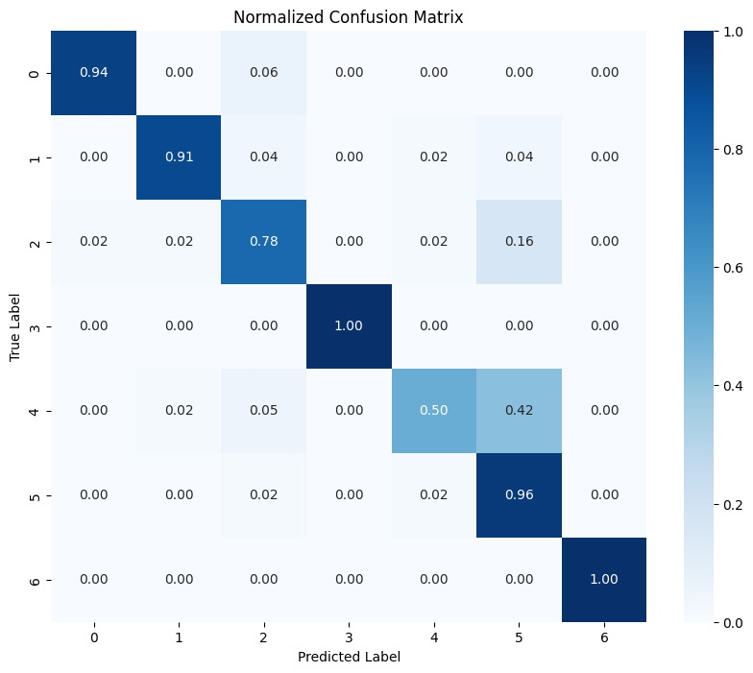
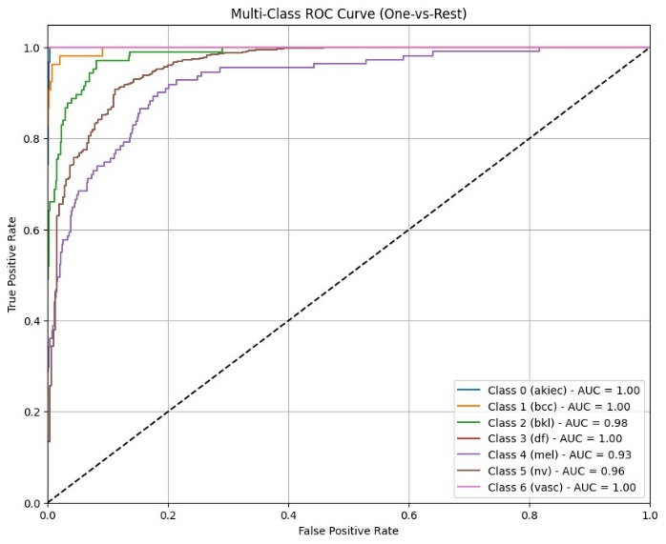
Result and Discussion
Performance Overview:
EfficientFormerV2: Accuracy – 89.77%, ROC-AUC – 0.964
Swin Tiny Transformer: Accuracy – 90.01%, ROC-AUC – 0.986
Meta-Ensemble (Logistic Regression):
  Macro F1 = 0.8800, ROC-AUC = 0.9814
  Provided the most balanced performance across all lesion classes.
Model Behavior:
Training vs Validation curves show steady improvement → indicates stable learning and no overfitting.
Confusion Matrix: Clear diagonal dominance → strong accuracy for all seven lesion types; slight confusion between BKL and MEL.
ROC Curve: All AUC values are ≥ 0.93, showing excellent discrimination between classes.
Ensemble reduces misclassification for rare lesions (AKIEC, DF, VASC).
EfficientFormerV2 ensures fast inference (18 ms/image), making the model suitable for real-time or resource-limited environments

Slide 10
Conclusion & Future Work
Proposed a dual-stream ensemble combining EfficientFormerV2 and Swin Tiny Transformer.
Achieved strong class-balanced metrics and efficiency.
Demonstrated practical potential for teledermatology and diagnostic tools.
Future Work:
Cross-dataset validation on ISIC datasets.
Integration of clinical metadata (age, site, etc.).
Implement explainability (Grad-CAM) for clinical trust.
Real-world pilot deployment with dermatologists.

Slide 11
References
Tschandl et al., Scientific Data, 2018 – HAM10000 Dataset
Esteva et al., Nature, 2017 – CNN-based Skin Cancer Classification
Liu et al., ICCV, 2021 – Swin Transformer
Li et al., arXiv, 2022 – EfficientFormerV2
Paraddy & Virupakshappa, J. Imaging Informatics in Medicine, 2025

Slide 12
Reviewer Comments Addressed
Key Improvements Based on Feedback
Highlighted novelty of meta-ensemble fusion.
Added benchmark comparison with latest models.
Discussed complexity & clinical feasibility.
Improved figures and English clarity.
Included cross-dataset validation in future work.
Added recent citations (2023–2025).
Clarified author’s details and contributions.

Slide 13
Thank You

